Slide 1
CEOS WGCV Working Group Calibration validation
WGCV for Newspace
Akihiko KUZE, Chair WGCV
Philippe Goryl, Vice Chair WGCV
And the WGCV Team
Agenda 2.3
SIT TW 2022, ESA/ESRIN
13th - 15th September 2022

Slide 2
Newspace
New Space Consideration
Earth observation data without proper calibration has little value for most applications, because if the data cannot be trusted, no reliable information can be derived from it.
SmallSat/NewSpace missions in general cannot guarantee the same quality and reliability as Agencies/Institutional missions creating user community scepticism about their data quality and leading to useless data (ref. Millan et al., 2019*). ForSmallSat to become valuable for space science, they must meet the quality requirements set by the science community.
*R.M. Millan et al, Small satellites for space science: a COSPAR scientific roadmap, Adv. Space Res. 64 (2019) 1466–1517, https://doi.org/10.1016/j.asr.2019.07.035.
SmallSat/NewSpace teams are interested in increasing the reliability of their data while ensuring a fast data delivery and return of investments. WGCV Cal/Val support helps to move forward and reach these goals. Providing such Cal/Val support will reduce their operating costs and add value to their end products. It will enhance their science/application/service capabilities and strengthen their competitiveness. It will shorten their start-up time and their time to market.

Slide 3
WGCV
The mission of the CEOS Working Group on Calibration & Validation (WGCV) is to ensure long-term confidence in the accuracy and quality of Earth Observation data and products and to provide a forum for the exchange of information about calibration and validation, including the coordination of cooperative activities.
https://ceos.org/ourwork/workinggroups/wgcv/
http://calvalportal.ceos.org/

Slide 4

WGCV
The mission of the CEOS Working Group on Calibration & Validation (WGCV) is to ensure long-term confidence in the accuracy and quality of Earth Observation data and products and to provide a forum for the exchange of information about calibration and validation, including the coordination of cooperative activities.
Provide Reference
Provide Methods and Protocols
Provides Tools
Provide Expertise
New Space
- Support Calibration
- Support validation
- Increase Confidence in the measurements/Mission
- Traceability
- Harmonisation
- Fitness for purpose

Slide 5
WGCV
All elements fit together to provide a coherent and comprehensive system for Cal/Val:
Facilitating Sensor to sensor interoperability by establishing a CEOS postlaunch Cal/Val reference
Increasing the reliability of data – including Newspace
SITSAT
SCR, CLARREO, LIBRA, TRUTHS
Vicarious Test Site
Vicarious Test Site characterisation
Picscar, picsand…
Tools and facilities
(ex: AIM….)
Instrumented Test Site
- radcalnet, sarcalnet, hypernet, LPV….
Expertise, communication
(JACIE, VH RODA, Workshop…etc…coordination WGISS and VC, ARD)
There are a growing number of public and commercial providers of high resolution space-borne Earth Observation data. Key to using data from these new sources is a good understanding of their characteristics, how they are calibrated, and their quality and technical capabilities. Interoperability between satellites/products will allow to extend dramatically the opportunities for global applications (agriculture, water use, forest and vegetation monitoring, pollution monitoring…etc…but also for climate applications).
The data can be used together only if we can trust its accuracy and characterisation. Therefore harmonisation in Calibration and Validation approaches are fundamental.
Global Earth Observation System of System can work if Quality Standard and Reference are put in place (otherwise it will be a cacophony generating more noise than information).
WGCV
Methods
(dcc, Rayleigh, pics…etc..)
Intercomparison exercise
Acix, cmix, demix, brix, srix4veg….
Reference Data
MTF, SOLAR IRRADIANCE…etc…
Fiducial Reference Measurement characterisation (FRM4STS, FRM4SOC, FRM4GHG…etc…
‹#›

Slide 6

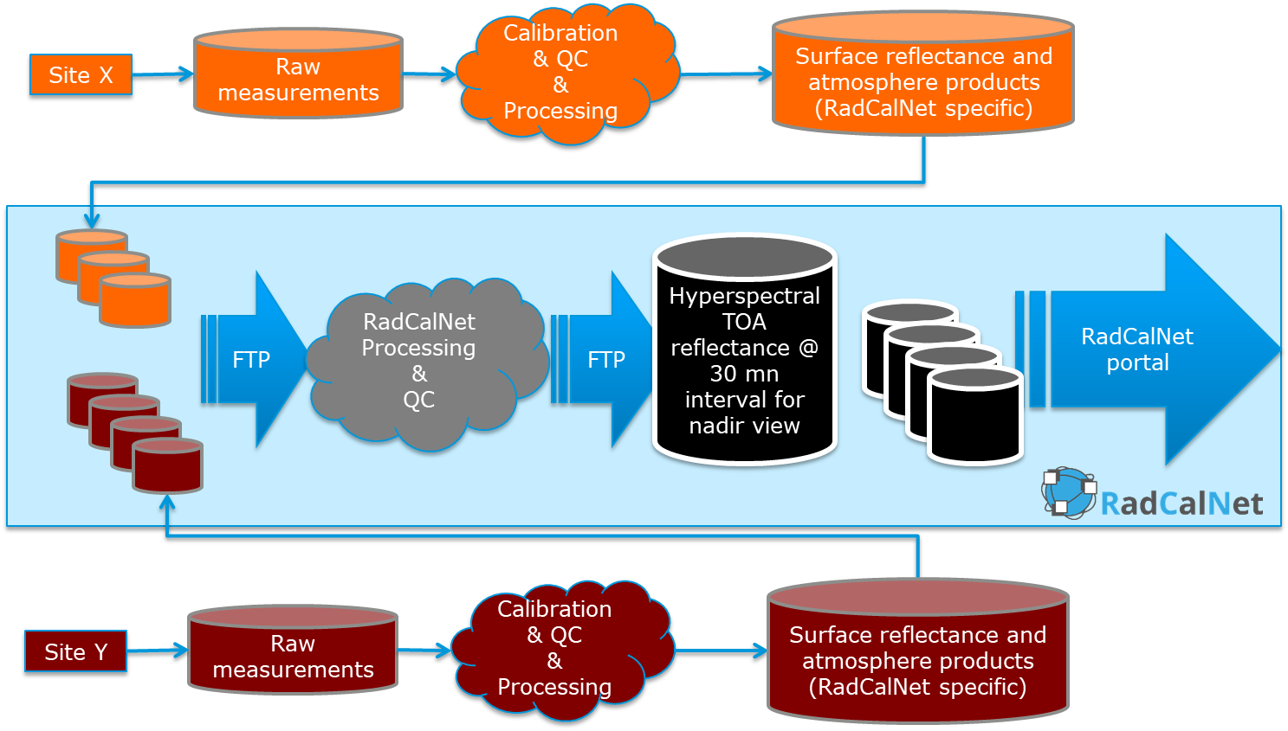
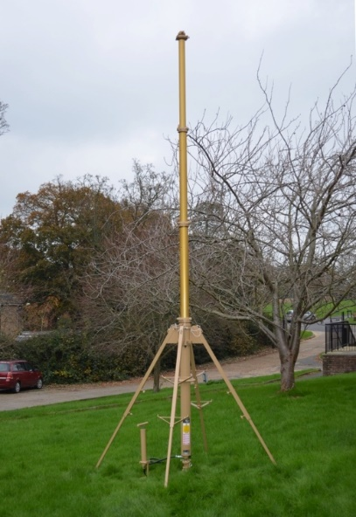
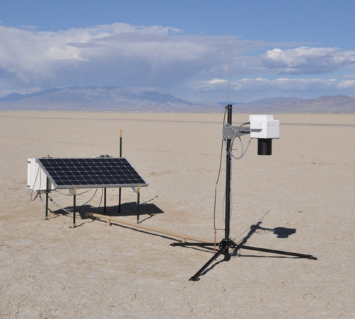
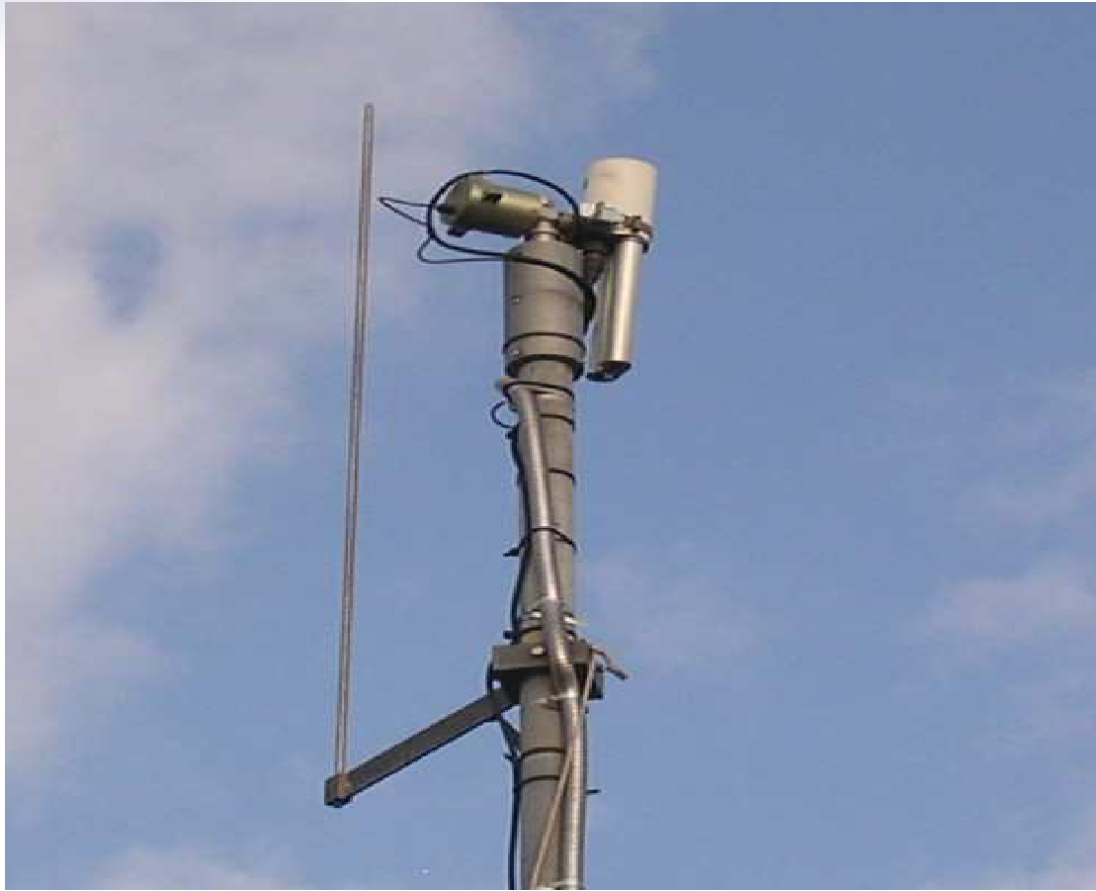
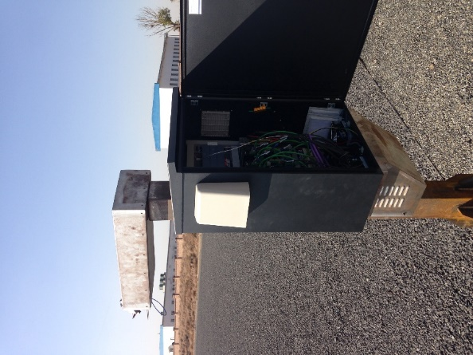
WGCV Reference
Radiometric Reference:
RadCalNet a CEOS WGCV Service
Network of test sites providing, via a common portal, Top Of Atmosphere @ Nadir Ref with uncertainties in range 400 - 2500nm (10 nm band) every 30 mins

Slide 7
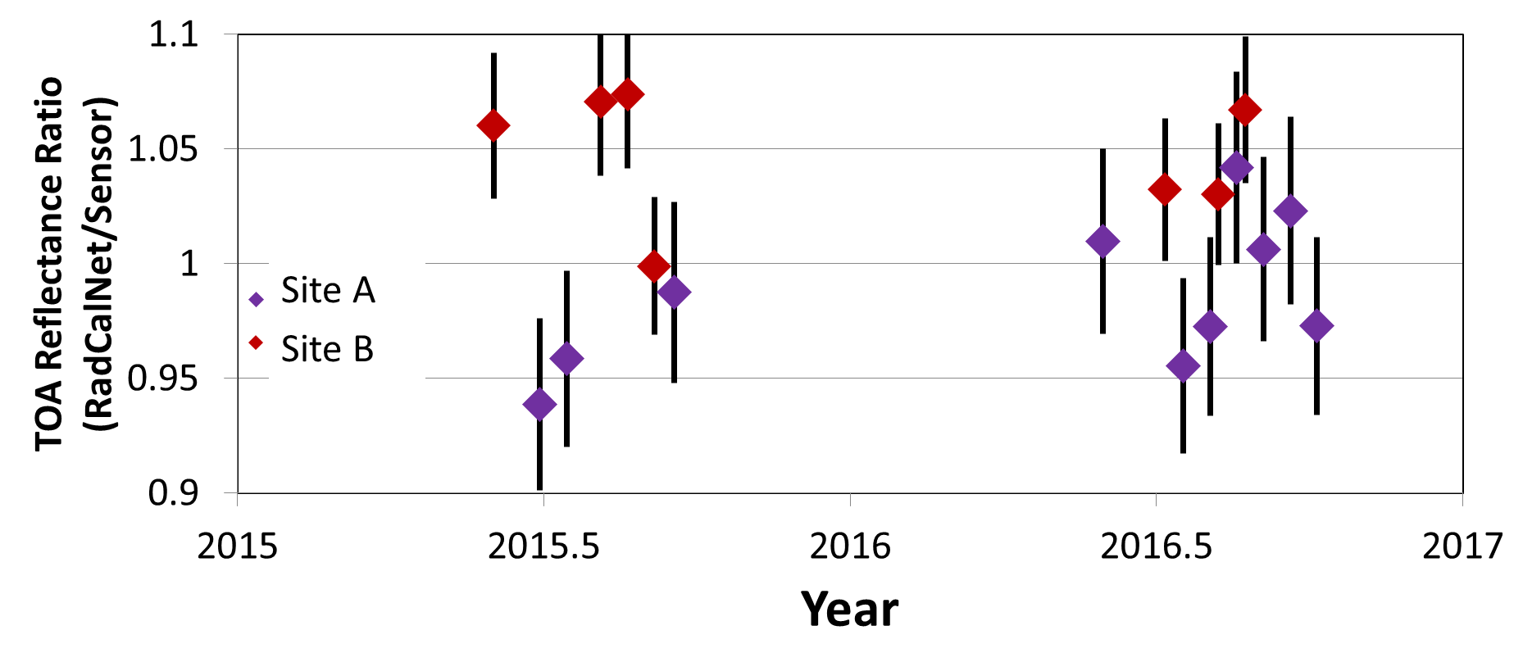
WGCV Reference
RadCalNet: SI-traceability with provided uncertainties is the key
Ensuring SI-traceability of automated data automatically provides comparable results
Test sites have to demonstrate their traceability and uncertainties
RadCalNet processing provides uncertainties for each data point
Several well understood sensors were used to evaluate RadCalNet sites
SI-traceability allows users to combine data from multiple sites with confidence
  Larger number of possible calibrations
  Evaluate temporal changes
RadCalNet provides fiducial reference measurements (incl. for New Space)
CEOS European Coordination meeting – SIT-35
‹#›

Slide 8
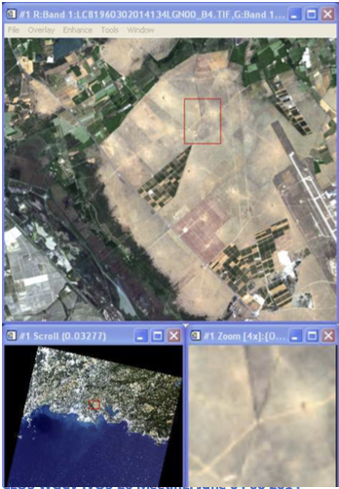
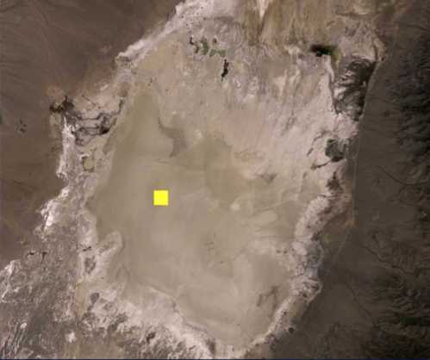
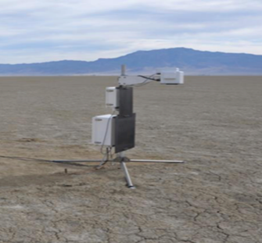
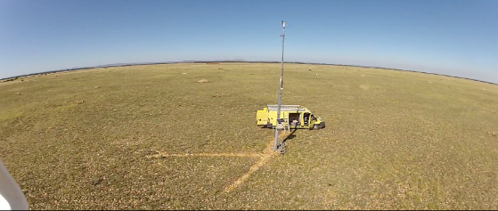
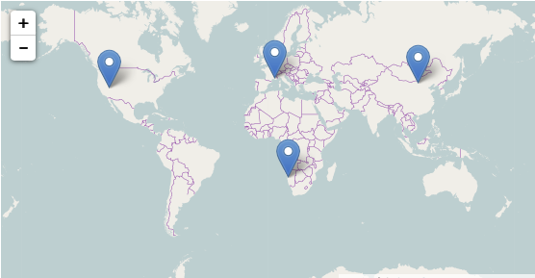
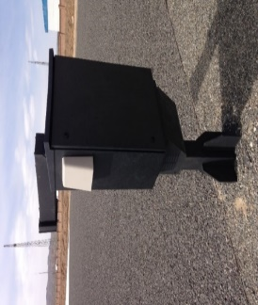
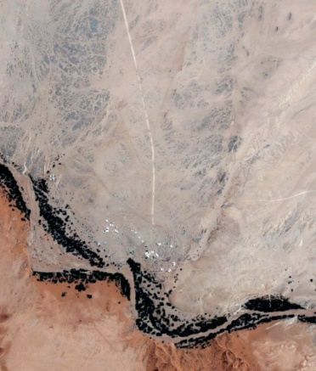
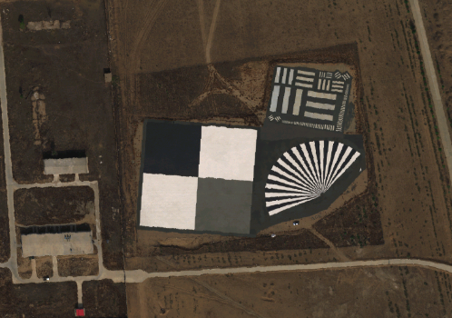
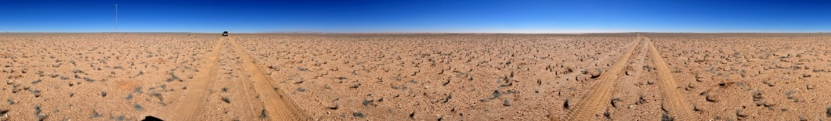
WGCV Reference
La Crau, France
CIMEL photometer (12 bands)
Pebbles and low vegetation
Site used since 1987 for calibration and instrumented since 1997
Railroad Valley Playa, USA
>20 years working experience on site
4 radiometers, sun photometer, met station
Dry lakebed
Gobabeb, Namibia
Sun photometer similar to La Crau) and met station
Sparse dry grass and gravel/sand
Baotou, China
Three automated spectrometers + sun photometer
Artificial target (white, black, and gray)
Operational since 2015
Baotou, China

Slide 9
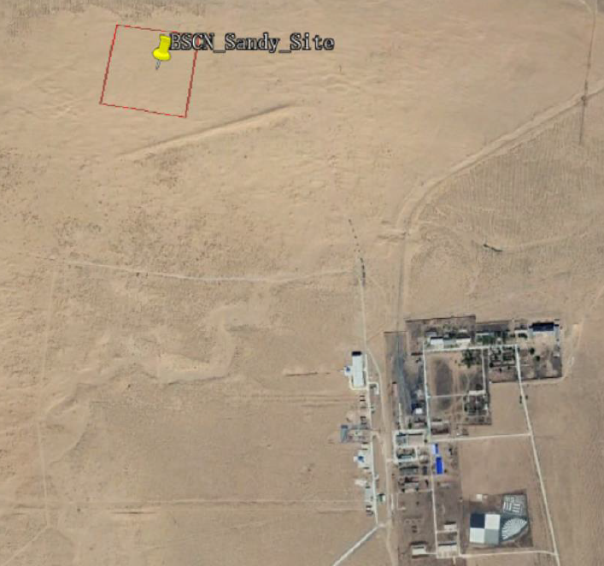
WGCV Reference
One new site added recently
Baotou Sandy Site
Baotou site is located in the Inner Mongolia, China, 50 km away from Baotou city. It covers a flat area of approximately 300 km2. The site is dominated by various land surfaces, including lake, sand, bare soil, maize, grass, sunflower, potato, pumpkin, etc. The BSCN sandy site is 300 x 300 m2 and located in a larger area of sandy desert. It is approximately 1.8 km north west of the BTCN artificial site.
Additional Sites under evaluation
Australia
India
‹#›

Slide 10
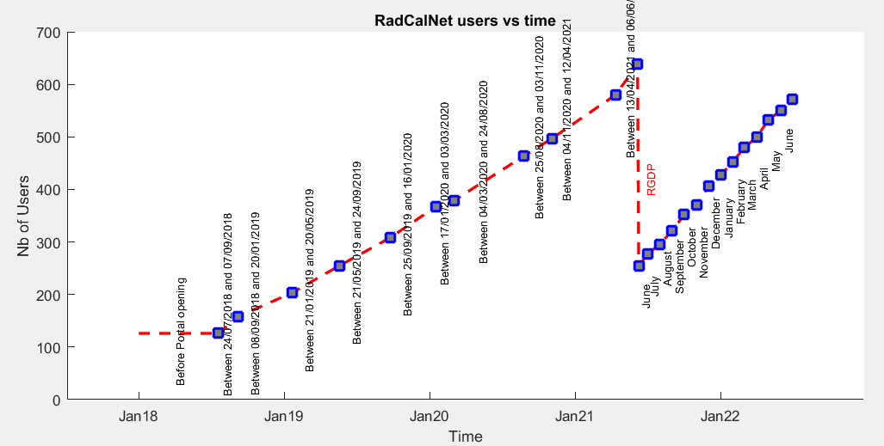
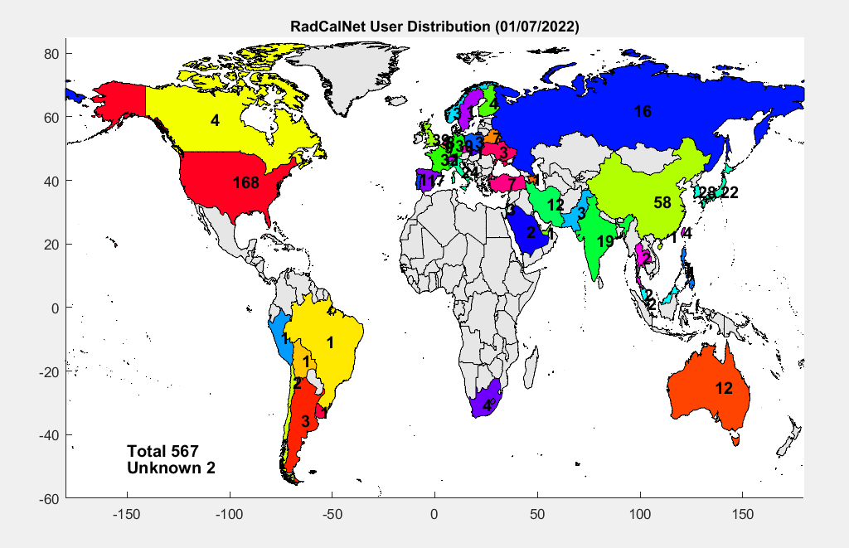
WGCV Reference
RadCalNet Users
First RadCalNet user workshop (9 – June 2021)
Exploited for validation/calibration of L1 products from:
  New space missions: e.g, Maxar (Worldview, GeoEye), Planet (Skysat constellation), etc..
  National space agencies missions: e.g., ARGANS (Sentinel-2, Landsat-8), JSC «Russian Space Systems» (Kanopus-V), ISRO (AWiFS), AIST (ASTER), NASA (OCO, GOSAT), DLR (DESIS), etc…
About 100 online participants
25 presenters
3 sessions:
  Multispectral instrument calibration/radiometric validation
  Hyperspectral instrument calibration/radiometric validation
  Exploitation of surface reflectance measurements
Presentations and programme available on https://www.radcalnet.org

Slide 11
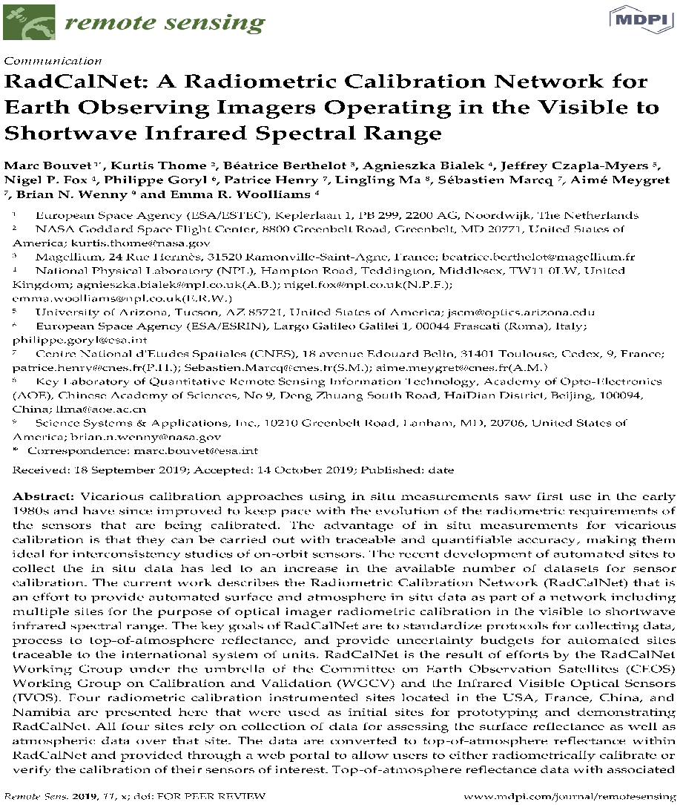
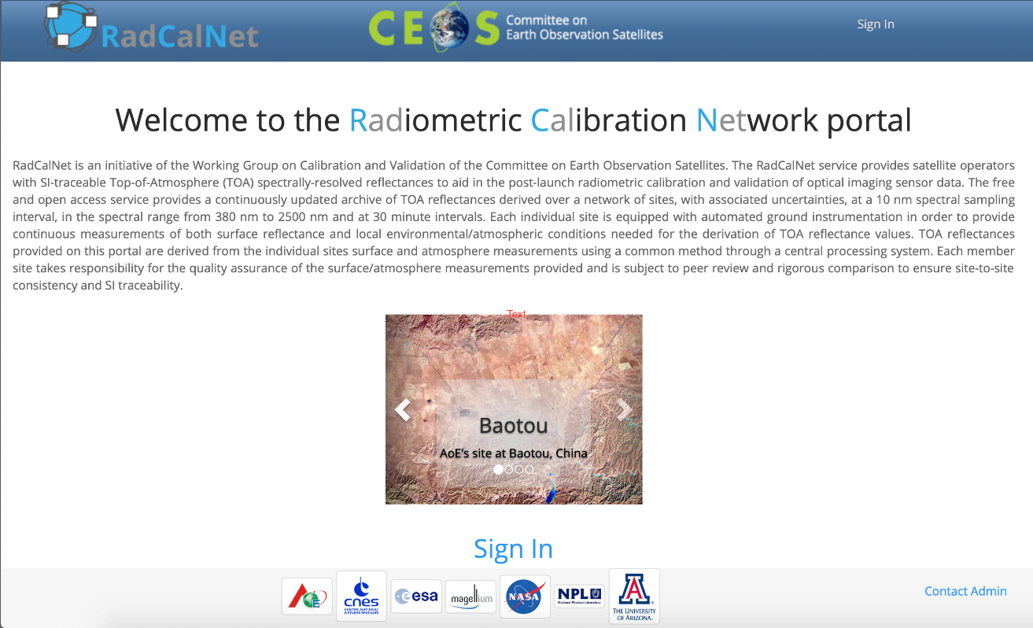
WGCV Reference
Remote Sens. 2019, 11(20), 2401;
https://doi.org/10.3390/rs11202401
and
https://www.radcalnet.org

Slide 12
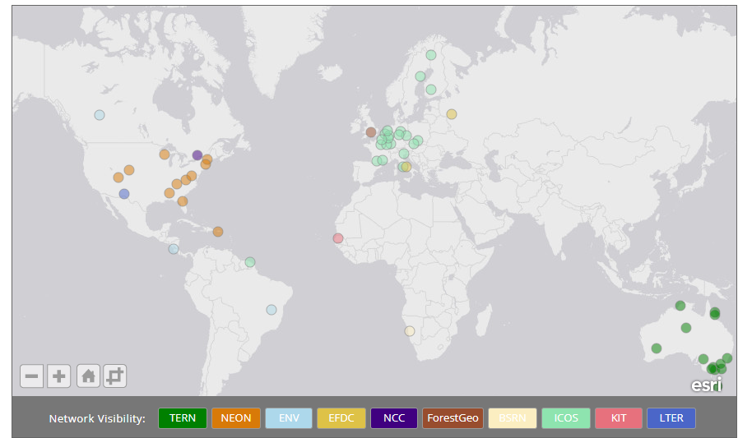
WGCV Reference
CEOS land validation sites: CEOS WGCV LPV have defined sites that we refer to as LPV Supersites as:
Super characterized (canopy structure and bio-geophysical variables) site following well- established protocols useful for the validation of satellite land products (at least 3) and for radiative transfer modeling approaches.
Active, long-term operations, supported by appropriate funding and infrastructural capacity.
Supported by airborne LiDAR and hyperspectral acquisitions (desirable).
The supersites were selected primarily from well known and established networks, and several were also nominated by each of the LPV focus areas, and then all sites were evaluated for their suitability by ranking them first based on the availability of data (active site) and their spatial representativeness. After this the variables were ranked based on how many key variables could be validated with a given site, whether structural information were available for the site, and if atmospheric and other properties were measured.
Joint CEOS WGCV IVOS/LPV on LST and Hyperspectral in preparations 🡪 relevant for Newspace as Hyperspectral and LST are two domains which are growing quickly
‹#›

Slide 13
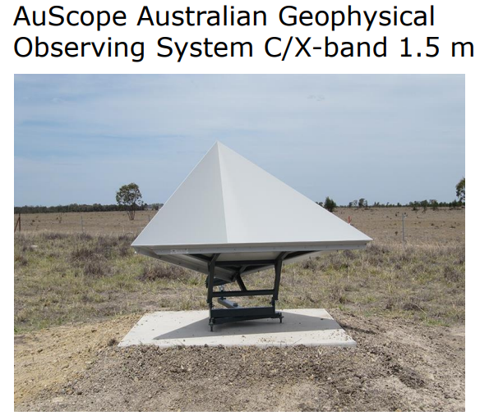
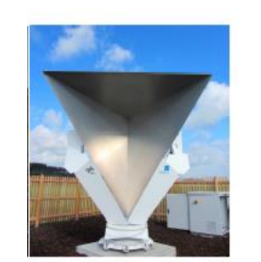
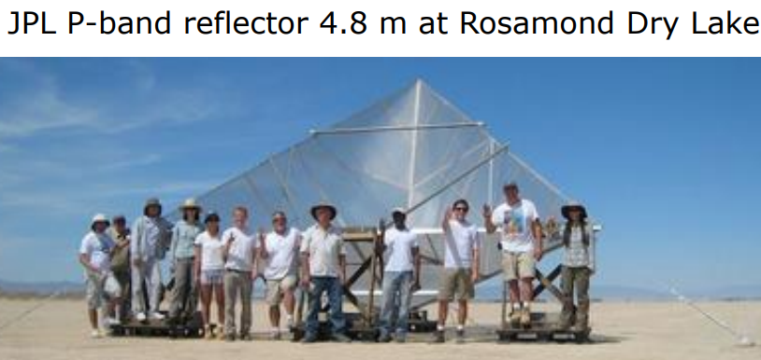
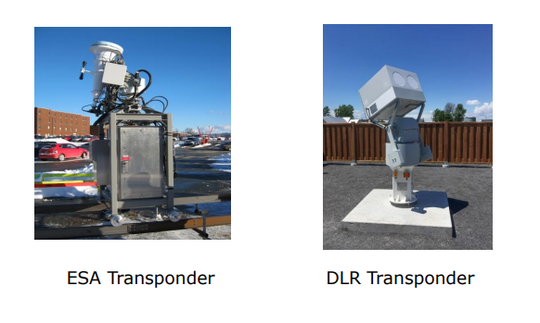
WGCV Reference
SARcalnet
There is a demand for well-defined calibration targets for SAR calibration
▪ Targets are used to calibrate the data from SAR missions
▪ Currently, in most cases these targets are defined differently for each SAR mission.
▪ There are three main category of targets
▪ Natural Targets
▪ Artificial Passive Targets
▪ Artificial Active Targets
▪ “SARcalnet” is in the early stages of formulation by the CEOS WGCV SAR subgroup.
▪ It would be an established network of calibration sites that would facilitate collaboration between sensors by using the same calibration references.
2.8 m DLR reflector in stowed position

Slide 14
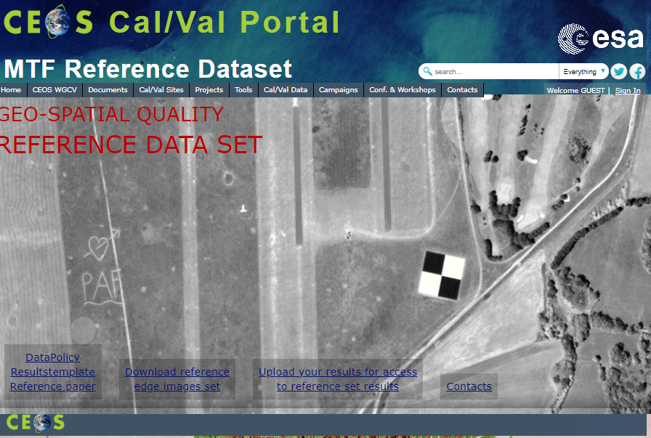
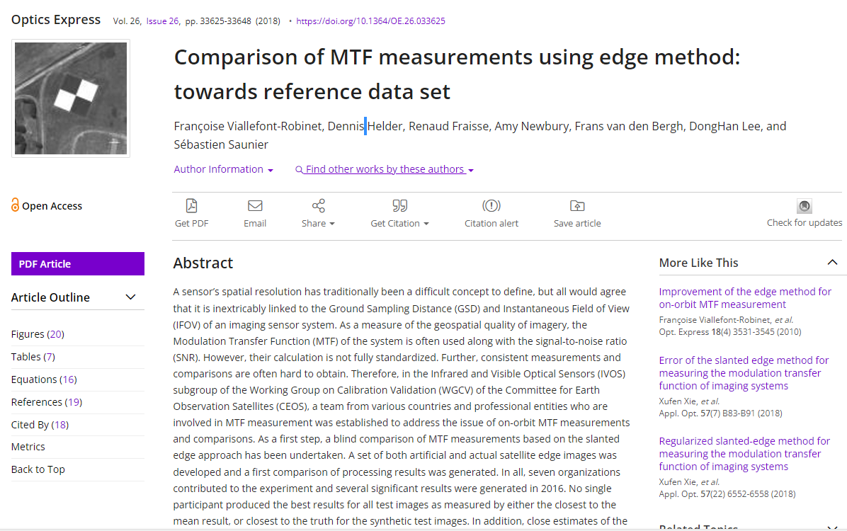
WGCV Reference
MTF
Modulation Transfer Function (MTF) Reference Dataset
Comparison of MTF measurements using edge method: towards reference data set
Françoise Viallefont-Robinet, Dennis Helder, Renaud Fraisse, Amy Newbury, Frans van den Bergh, DongHan Lee, and Sébastien Saunier
‹#›

Slide 15
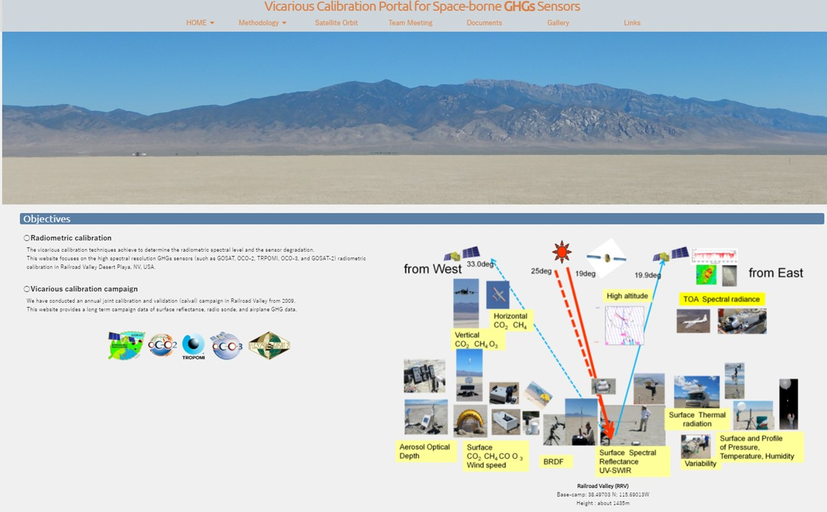
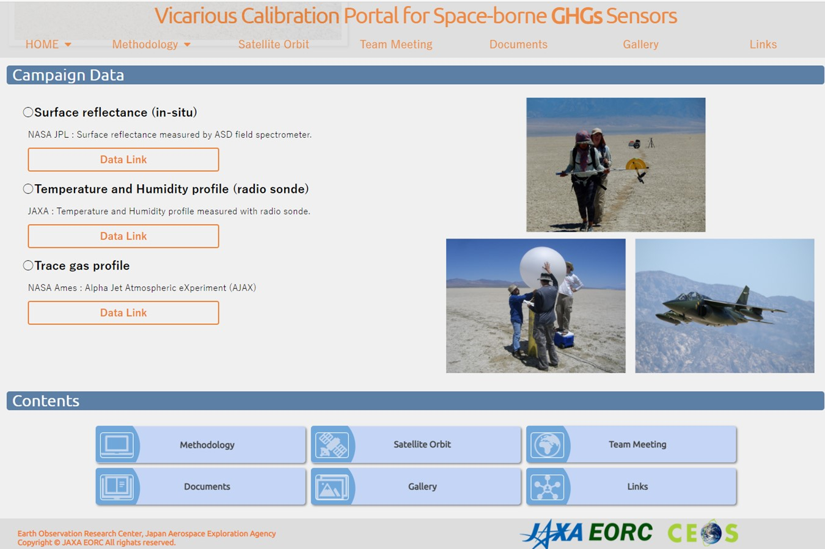
WGCV Reference
GHG sensors
https://www.eorc.jaxa.jp/GOSAT/GHGs_Vical/index.html
The VCAL Portal site provides
Methodology of vicarious calibration for various size footprint and off-nadir data.
14-year annual joint campaign data for CAL-VAL: surface albedo, radiosonde data, XCO2, CH4 by EM27-FTS, alpha jet vertical profile
Dataset for analysis: solar irradiance, molecule cross section
Analytical results from various type of spectrometers: GOSAT FTS, OCO, S5P TROPOMI……

Slide 16
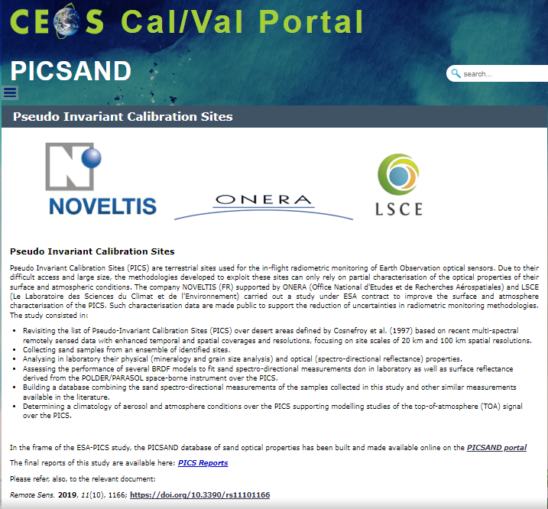
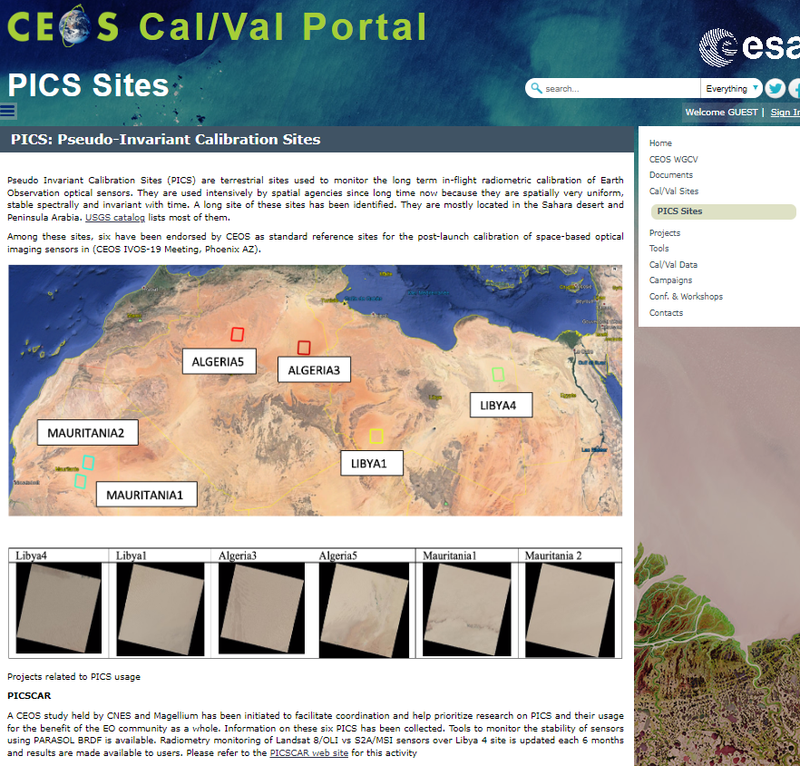
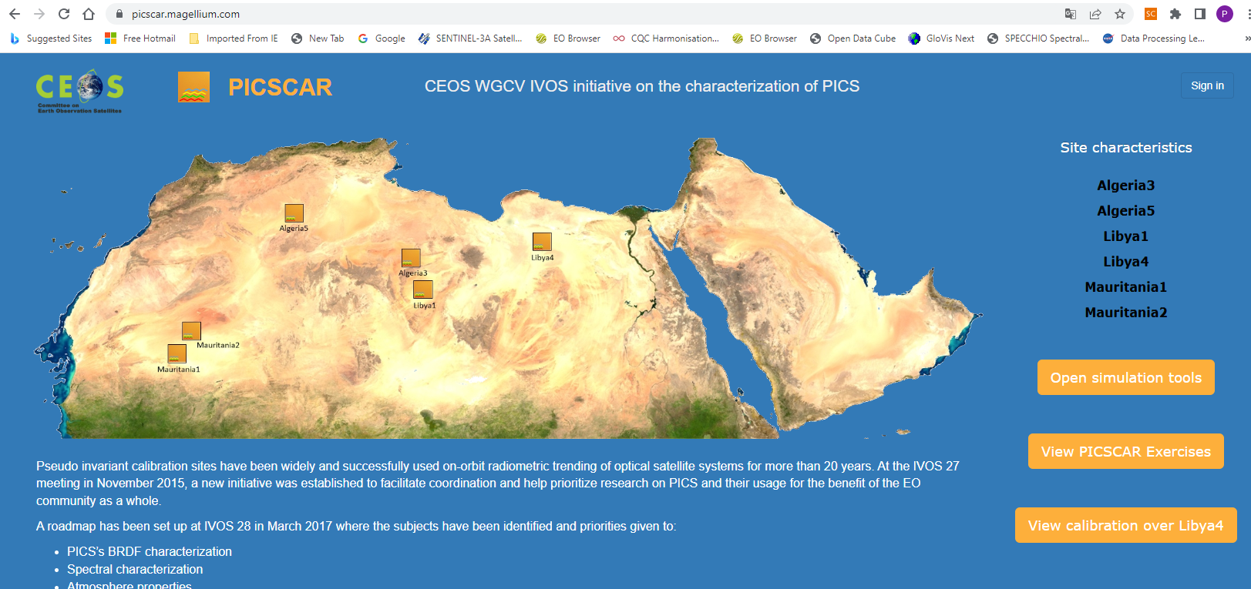
WGCV Reference / Methods
A CEOS study led by CNES and Magellium has been initiated to facilitate coordination and help prioritize research on PICS and their usage for the benefit of the EO community as a whole. Information on these six PICS has been collected. Tools to monitor the stability of sensors using PARASOL BRDF is available. Radiometry monitoring of Landsat 8/OLI vs S2A/MSI sensors over Libya 4 site is updated each 6 months and results are made available to users. Please refer to the PICSCAR web site for this activity
Vicarious Calibration Methods and sites
DCC ,
Rayleigh,
Glint
Pseudo-Invariant Calibration Site – PICS catalog
Database of sand optical properties has been built and made available online on the PICSAND portal

Slide 17
WGCV Reference / Methods
TSIS-1 HSRS solar irradiance reference spectrum
CEOS WGCV in coordination with GSICS recommends the Total and Spectral Solar Irradiance Sensor-1 (TSIS-1) Hybrid Solar Reference Spectrum (HSRS) as the new solar irradiance reference spectrum. This statement has been agreed during the latest WGCV#50 Plenary Meeting.
Details for TSIS-1 HSRS are available at:
https://lasp.colorado.edu/lisird/data/tsis1_hsrs

Slide 18
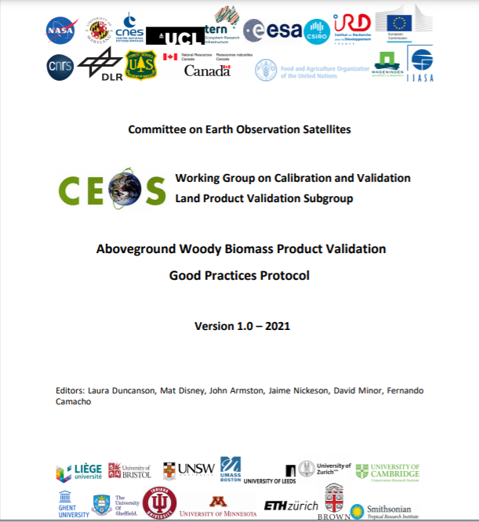



WGCV Methods / Protocols
WGCV provides Protocols
(list not exhaustive)
  Biomass Validation Protocols
  Soil Moisture
  LST
  Albedo
  LAI
  GHG
  SST
  Ocean Colour
  …..

Slide 19
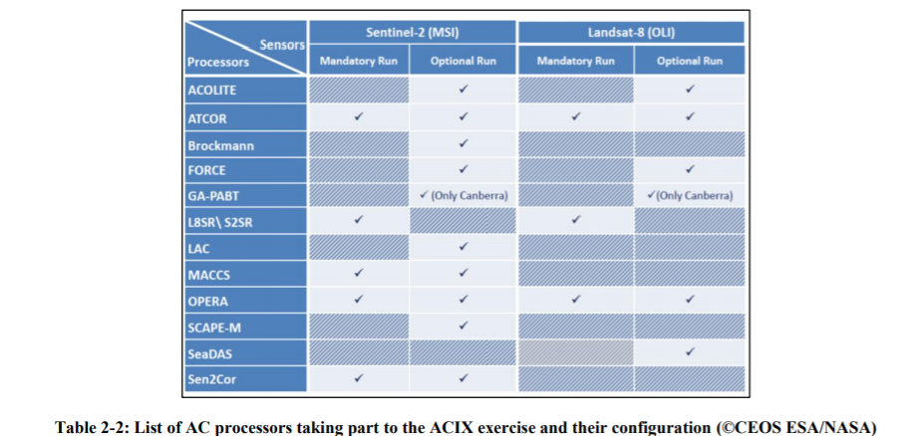
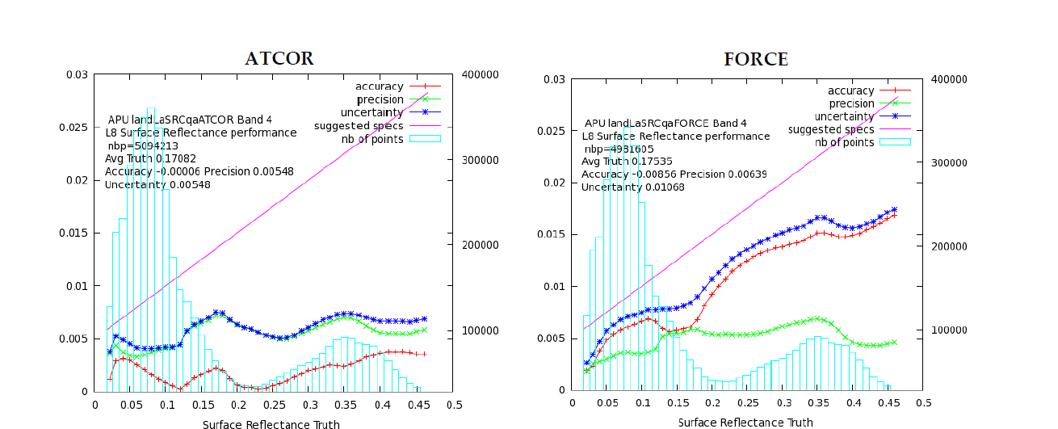
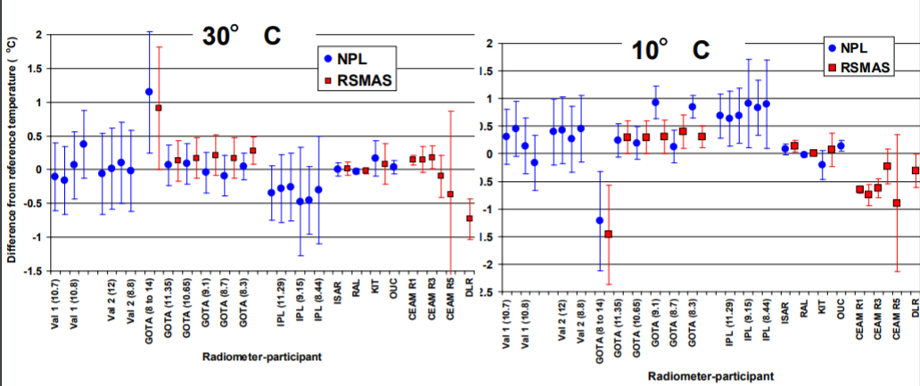
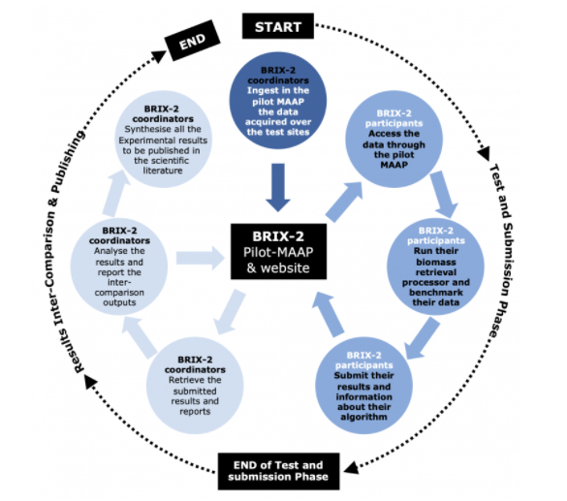
WGCV Methods / Intercomparison Exercises
WGCV provides intercomparison framework
ACIX
CMIX
DEMIX
BRIX
SRIX4VEG
FM4STS
FRM4OC
GHG
This relevant also for New Space 🡪 learn and improve the algorithm,
Ex: Planet did participate to ACIX
‹#›

Slide 20
WGCV Tools
WGCV is supporting a number of tools/facilities that support Cal/Val.
Example of a concept under assessment:
Earth Observation Assurance and Integrity Monitoring – AIM from Australia.
Concept Overview:
EO AIM aims to improve confidence and trust in more EO data sources and to thereby provide increased commercial opportunities for New Space companies and associated societal benefit for many applications
• EO AIM will provide access to legacy public cal-val ground sites and an automated open source toolkit to participating data providers to allow them to undertake routine checks on fundamental data quality measures
• Frequent characterisation and reporting of these measures is assumed to foster improved trust in the data and its fitness for new purposes
• Ideally we would integrate checks required by CEOS partners such that their qualification schemes (eg JACIE, EDAP) might be available as part of the process
• This process would open new commercial opportunities to providers and enable them to participate in agency data buys etc
• EO AIM seeks to mainstream application of regular cal-val to New Space missions and to provide free, open and transparent tools (as automated as possible) to incentivise uptake – Cal-Val as a service (CVAAS)

Slide 21
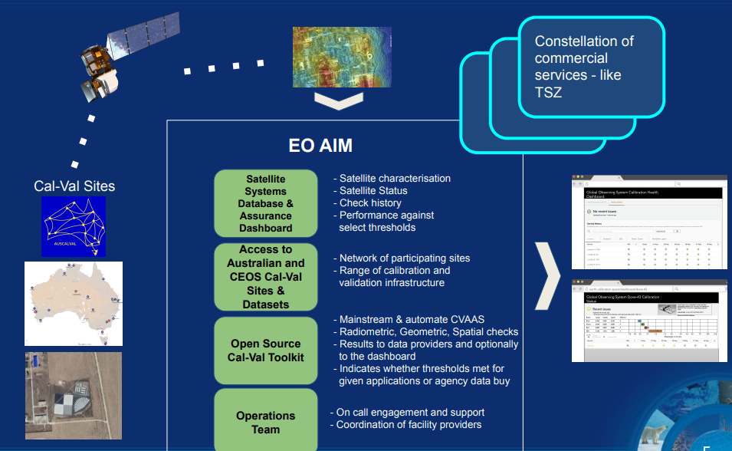
WGCV Tools – AIM example
AIM concept
IcEye, Planet, Satellogic, Maxar, AxelSpace, Capella..etc….
Based on CEOS WGCV best practises, reference test site, methods
Coordination CEOS WGCV, CEOS WGISS
Coordination JACIE,
VH RODA,
ESA project EOSure…etc….

Slide 22
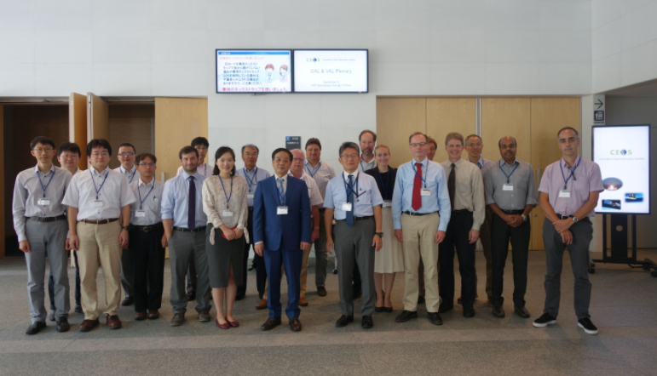
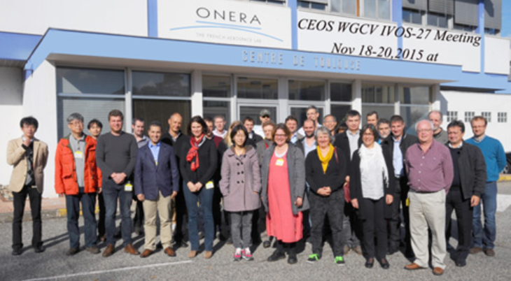
WGCV Expertise
Regular WGCV Meeting (open to CEOS members)
Coordination with GSICS
Subgroup Meeting and Workshop (IVOS, LPV, SAR, ACSG, MWV, TMSG)
Thematic Meeting (ACIX, RadCalNet…etc…)
Thematic Workshop (ex: Pre-flight calibration CEOS/GSICS workshop)
Japan, 2016
France, 2015, With IVOS and RadCalNet
‹#›

Slide 23
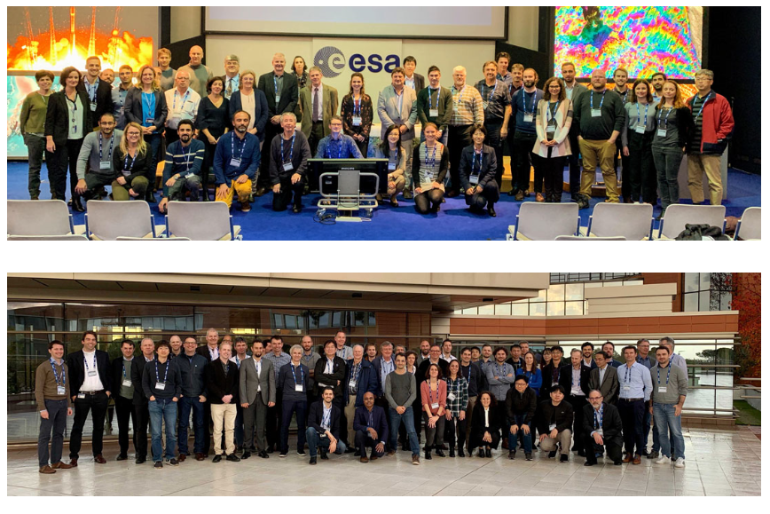
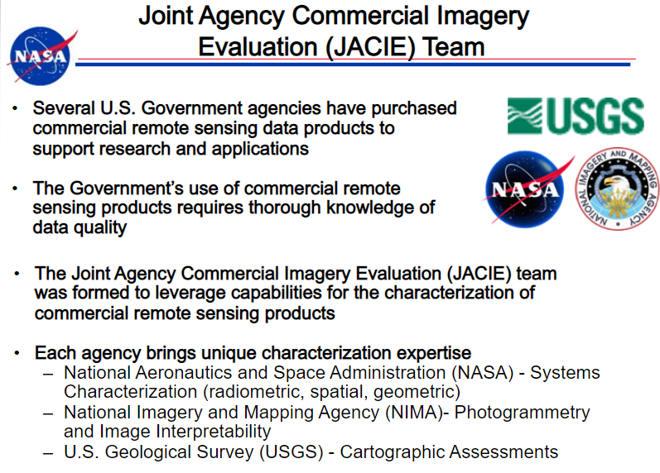
WGCV Expertise
WGCV is active in workshops relevant for Newspace
JACIE
Joint Agency Commercial Imagery Evaluation (JACIE) was formed to leverage resources from several USA Federal agencies for the characterization of remote sensing data and to share those results across the remote sensing community. Next JACIE: March 27 - 30, 2023 — USGS Headquarters, Reston, Virigina
https://www.usgs.gov/calval/jacie
VH-RODA
The Very High-resolution Radar & Optical Data Assessment (VH-RODA) 2022 Workshop will be held in Frascati, Italy, from 7 to 10 November 2022.
The 3rd Edition of the VH-RODA Workshop will provide an open forum (for the new space, commercial and institutional space sectors) for presenting and discussing about the current status and future developments related to Earth Observation (EO) data quality, calibration and validation of space-borne very high-resolution SAR and Optical sensors and data products, with a dedicated focus on commercial EO data providers and related Cal/Val activities, synergies between optical and SAR communities, presentation of standards and best practices for data quality.
https://earth.esa.int/eogateway/events/vh-roda
Coordination between JACIE and VH-RODA
‹#›

Slide 24
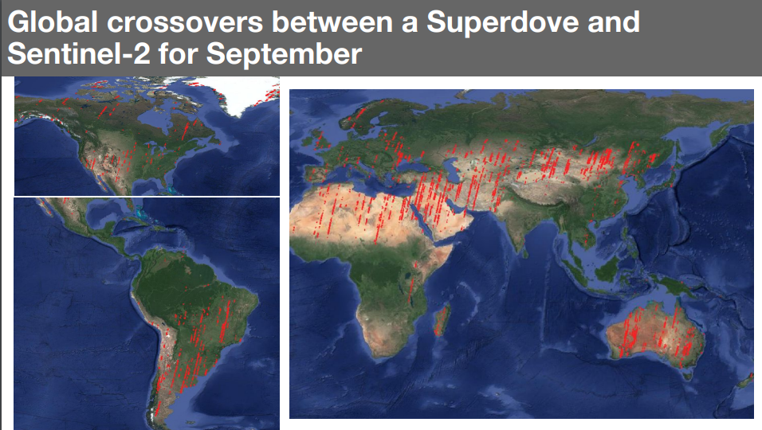
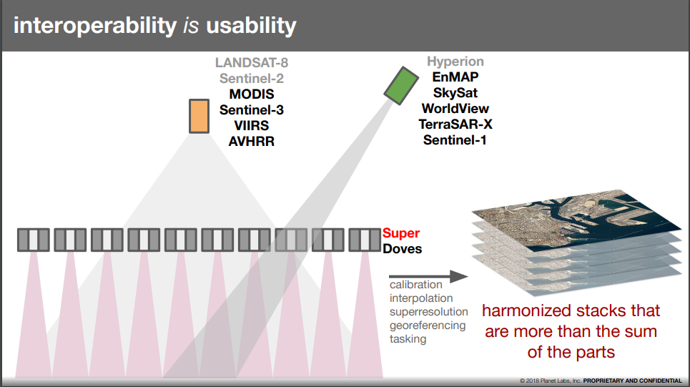
WGCV Expertise
WGCV is providing expertise on Analysis Ready Data 🡪 toward interoperability
WGCV supports CEOS (VC) is defining the specification for ARD
WGCV supports CEOS (VC) in assessing the ARD (CARD4L) compliancy
WGCV part of the CEOS ARD oversight group 🡪 evolution of ARD
WGCV and its subgroups (IVOS, SAR) instrumental in the dialog with Newspace on ARD evolution
Participation in ARD workshop
‹#›

Slide 25
WGCV Evolution
Reference from Space
Cal/Val role is fundamental
Development of Satellites to climate with advanced calibration system
Toward Fiducial Reference Measurement from Space
SITSAT
SI Traceable Satellite
SCR CLARREO LIBRA TRUTHS
Australia has announced its first National Satellite Mission for Earth Observation, the SCR series of Cal/Val satellites . SCR will support improved characterisation and calibration of other satellites - making them fit for more uses more of the time
Proposed by the UK, TRUTHS will establish an SI-traceable space-based climate and calibration observing system to improve confidence in climate-change forecasts – a kind of ‘standards laboratory in space’.
TRUTHS will also serve to calibrate other satellite sensors, such as those carried on the Copernicus missions and the emerging constellations of small satellites.
CLARREO Pathfinder (CPF) data will do this by taking highly accurate measurements of sunlight reflected by Earth and the Moon. These measurements, which will be anchored to international standards, will be five to ten times more accurate than those from existing sensors
Chinese Space-based Radiometric Benchmark (CSRB) 🡪 reference-type satellite LIBRA in around 2025. LIBRA will offer measurements with SI traceability for the outgoing radiation from the Earth and the incoming radiation from the Sun with high spectral resolution.
‹#›

Slide 26
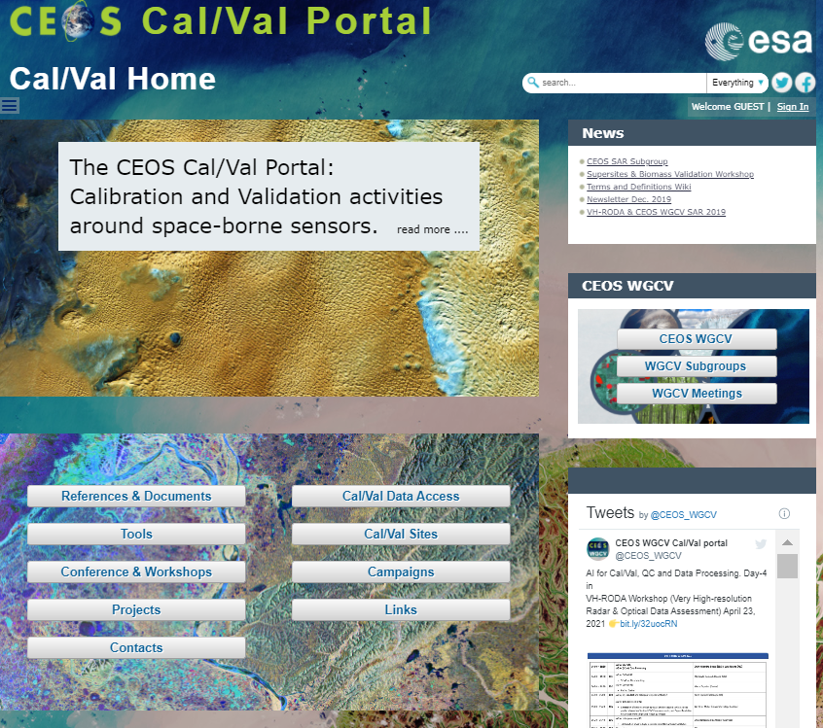
WGCV Communication
The CEOS Cal/Val portal serves as the main forum for exchange and information sharing for the CEOS Working Group on Calibration and Validation.
• It provides access to agreed upon good practices and Cal/Val protocols to the wider Earth Observation Community. It provides users with connections to reference data and networks and is a source for reliable, up- to-date and user-friendly information for Cal/Val tasks.
• The Portal facilitate data interoperability and performance assessment through an operational CEOS coordinated and internationally harmonized Cal/Val infrastructure consistent with QA4EO principles.

Slide 27

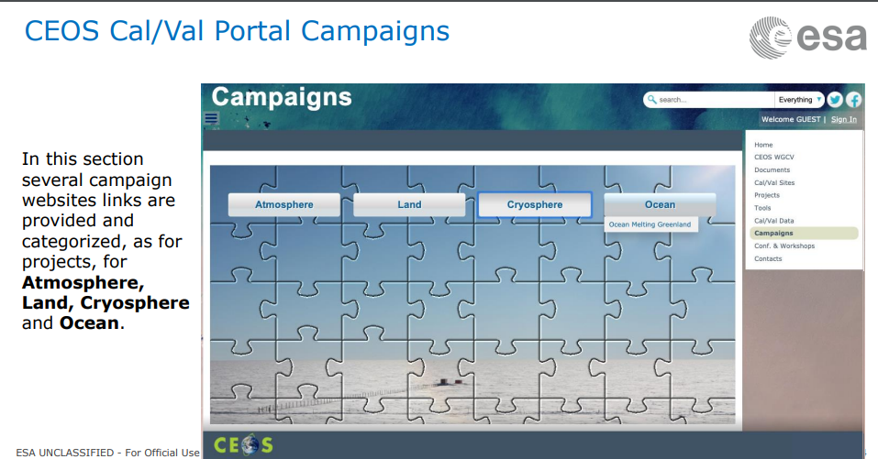
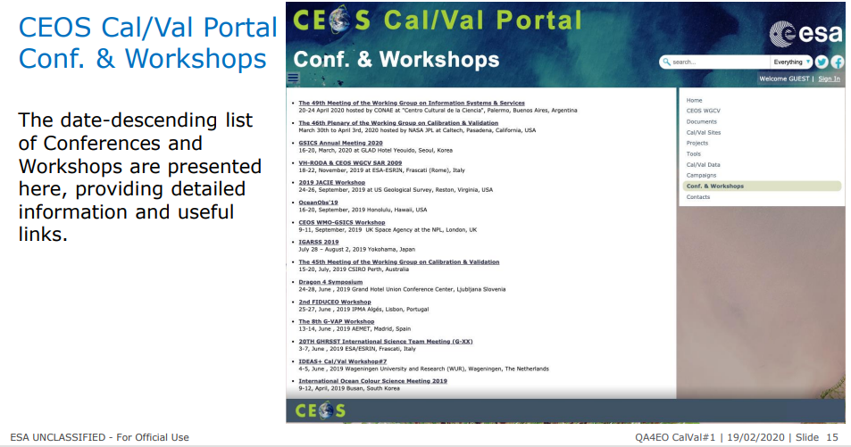
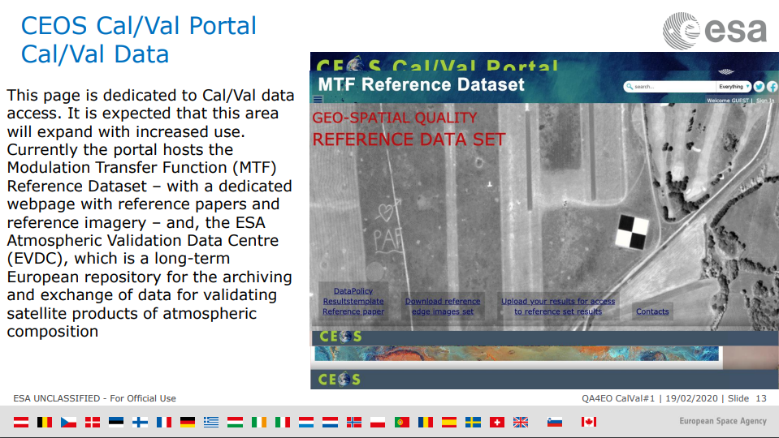
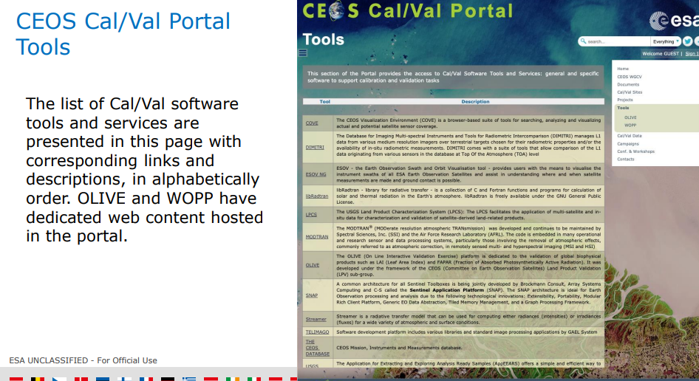
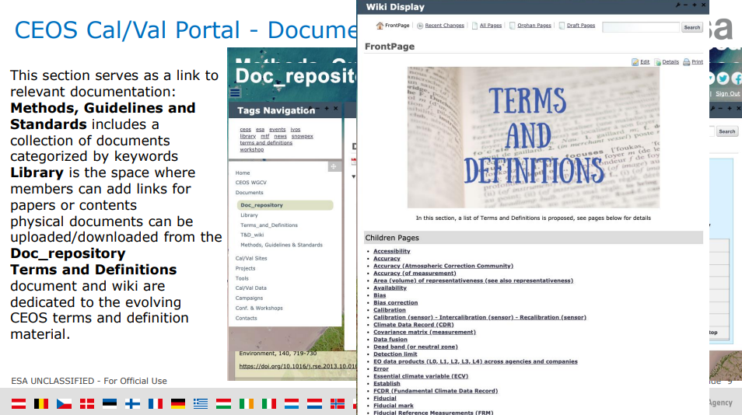



Slide 28


Conclusion
WGCV supports Newspace:
WGCV provides
    References
    Methods/Best practice
    Tools
    Expertise
WGCV instrumental to “implement” QA4EO following Metrology Principles
  🡪 Facilitate harmonization and interoperability
Communication/interaction/exchanges are fundamental
  within WGCV, within CEOS, with GSICS
  With Commercial sectors

Slide 29
Conclusion
All elements fit together to provide a coherent and comprehensive system for Cal/Val:
Facilitating Sensor to sensor interoperability by establishing a CEOS postlaunch Cal/Val reference
Increasing the reliability of data – including Newspace
SITSAT
SCR, CLARREO, LIBRA, TRUTHS
Vicarious Test Site
Vicarious Test Site characterisation
Picscar, picsand…
Tools and facilities
(ex: AIM….)
Instrumented Test Site
- radcalnet, sarcalnet, hypernet, LPV….
Expertise, communication
(JACIE, VH RODA, Workshop…etc…coordination WGISS and VC, ARD)
There are a growing number of public and commercial providers of high resolution space-borne Earth Observation data. Key to using data from these new sources is a good understanding of their characteristics, how they are calibrated, and their quality and technical capabilities. Interoperability between satellites/products will allow to extend dramatically the opportunities for global applications (agriculture, water use, forest and vegetation monitoring, pollution monitoring…etc…but also for climate applications).
The data can be used together only if we can trust its accuracy and characterisation. Therefore harmonisation in Calibration and Validation approaches are fundamental.
Global Earth Observation System of System can work if Quality Standard and Reference are put in place (otherwise it will be a cacophony generating more noise than information).
WGCV
Methods
(dcc, Rayleigh, pics…etc..)
Intercomparison exercise
Acix, cmix, demix, brix, srix4veg….
Reference Data
MTF, SOLAR IRRADIANCE…etc…
Fiducial Reference Measurement characterisation (FRM4STS, FRM4SOC, FRM4GHG…etc…
‹#›

Slide 30






Earthnet 🡪 ESA programme since 1975
International cooperation to share resources & foster their interoperability
Support free access to EO data from national and international Third Party Missions (TPM) for scientific, research and pre-operational applications
Data quality assessment and data harmonization activities (Earthnet Data Assessment Project - EDAP)
Quality benchmark data from commercial & NewSpace missions
Enable as first buyer or anchor customer, NewSpace EO data to be opened to broader European scientific community
Support the International Charter operations

Slide 31

Earthnet central element:
Third Party Missions
10,000 research projects used TPM data
In 2021, 1000 new science users
https://earth.esa.int/eogateway/missions/third-party-missions
Notes:
TPMs data combined with the data from ESA and Copernicus Sentinel missions, can exploit the synergy between all sources of data to meet the needs of user communities, from different sectors, for a growing range of applications.

Slide 32

Sentinel-2 L2A
03/08/2022
THANK YOU
FOR YOUR
ATTENTION

