Slide 1
WGCV-52
GHG CAL-VAL
Akihiko KUZE, JAXA
Agenda Item #2.8
WGCV-52, ESA/ESRIN, Italy
5th - 9th June 2023

Slide 2
WGCV for GHG sensors
Past meetings
(1) OCO-TROPOMI-GOSAT Calibration Team Meeting #7, April 12, WEBEX
RRV2023 Plan, Polarization Measurements
Vicarious calibration portal for space borne GHGs sensors
Collaboration with GSICS
Next meeting: Sep 15 (Friday) UTC 12:00
Upcoming meeting and event
International Coordination Workshop on Detection of Anthropogenic Methane Emissions from High-Resolution Satellites 7 – 8 June 2023 – Harvard University, the UNEP International Methane Emissions Observatory (IMEO), in collaboration CEOS and with support from the Global Methane Hub
CGMS plenary and GSICS June 29-30 in Tokyo hosted by JMA and JAXA
(3) 15th Joint vicarious calibration in Railroad Valley, NV between June 27 and July 2.
(4) 19th IWGGMS meeting July 4-6 in Paris hosted by CNES
(5) ACVC and WGCV joint meeting in Brussel Oct. 23-27
Slide 2

Slide 3

CEOS UN-IMEO CH4 detection works shops
International Coordination Workshop on Detection of Anthropogenic Methane Emissions from High-resolution Satellites 7 – 8 June 2023 – Harvard University, Cambridge MA – USA
Objective To produce a vision guiding the development of a system of systems that can rapidly deliver critically needed high-resolution methane emissions datasets and understanding of methane emissions and trends to diverse end users.
Presentation from CEOS WGCV
Joint Cal/Val Activities for Methane June 8.
Slide 3

Slide 4
CEOS CAL-VAL for GHG sensors
Current role in GHG (CO₂ and methane) remote sensing of CEOS WGCV
A. Intercomparison between GHG sensors
Radiance spectra (Level 1)
Retrieved parameters such as XCH₄, XCO₂, Psurf, SIF (Level 2)
Estimated emissions (flux)
B. Calibration
Radiometric (Degradation correction)
Spectroscopic
Polarization (Spectrometers, Earth’s surface, Atmospheric scattering)
CAL-VAL field and airplane campaigns and open CAL-VAL data base
Vicarious calibration portal
CEOS CAL-VAL portal (link to TCCON, COCCON, Contrail etc.)
Recommendation
Database (solar irradiance of TSIS-HSRS, molecular line parameters, lunar surface model etc.)
Algorithm
Slide 4

Slide 5
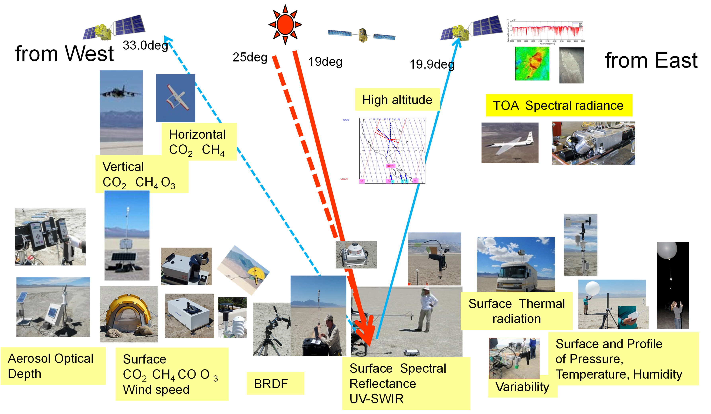
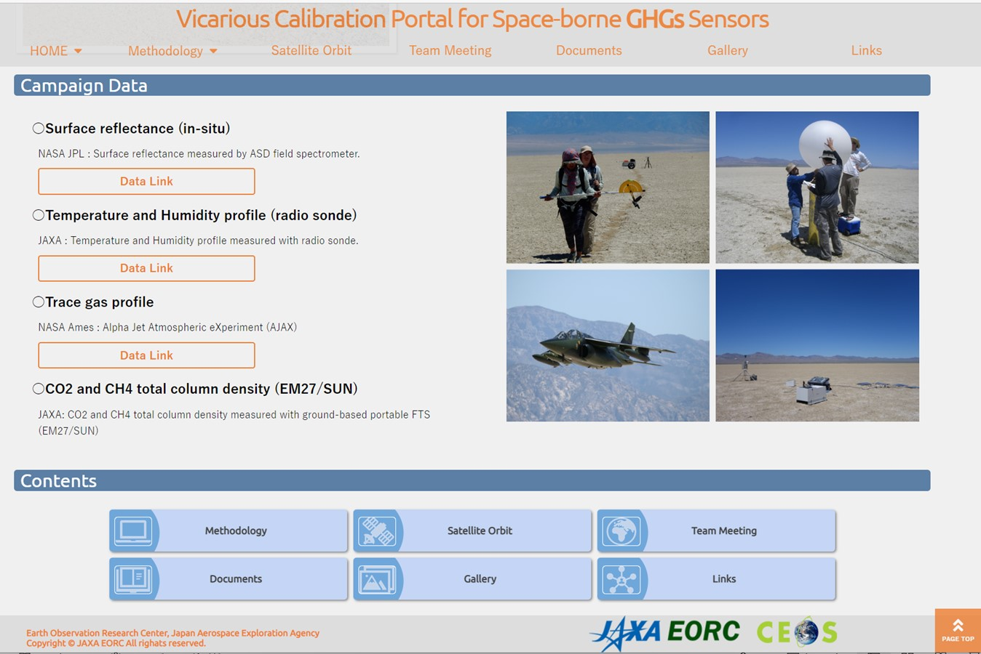

RRV joint CAL/VAL campaign
Joint CAL-VAL campaign for 5 instruments at Railroad Valley in Nevada, U.S.A. over 15 years
Coincident campaign observation of forward calculation parameters on the ground (XCH₄ etc.) and with sondes and AJAX spiral flights.
CAL-VAL data are open and free from the CEOS GHG VCAL portal.
https://www.eorc.jaxa.jp/GOSAT/GHGs_Vical/index.html

Slide 6
GOSAT for Multiple GHG sensor CAL-VAL
(1) Longest record in space since 2009
(2) Highest spectral resolution and simple spectral response with SINC function
Adjust to lower resolution sensors by truncating interferogram for intercomparison
(3) Wide spectral coverage of both solar reflected light and thermal emission
To provide vertical profile (LT, UT, Stratosphere)
(4) Two orthogonal linear polarization
Remove aerosol scattering, which is one of the largest retrieval errors.
(5) Customized observation pattern to target permanent CAL/VAL site and campaign with an agile 2-axis pointing system
(6) GOSAT-2 has similar function with better SNR and more flexible observation pattern
https://www.eorc.jaxa.jp/GOSAT/CO2_monitor/index_Ver.K.G2.html

Slide 7
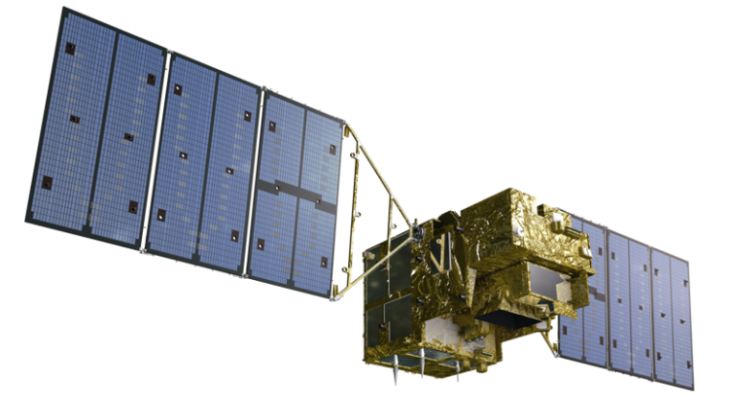


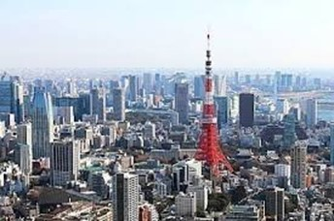
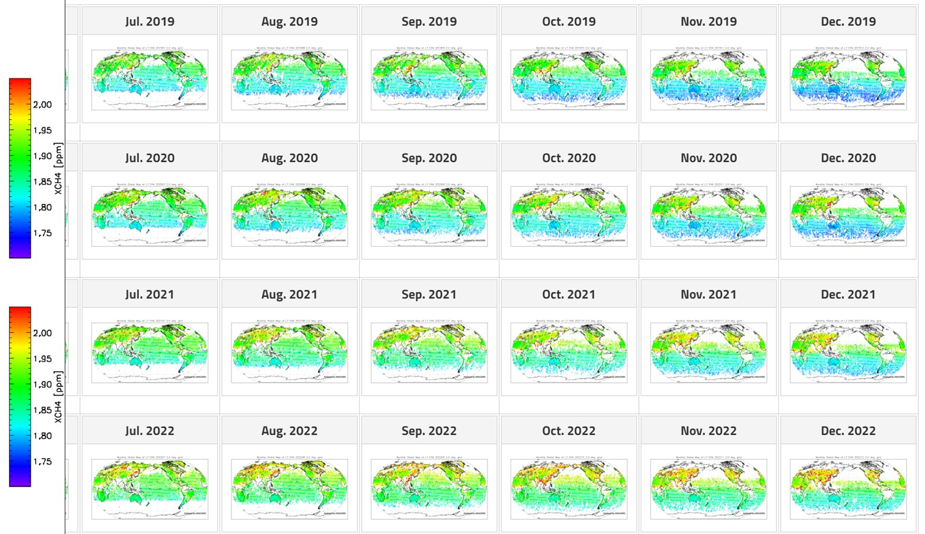
GOSAT Partial Column Density products (Ver. 3)
(1) SWIR constrains column density
(2) Two orthogonal linear polarization data remove aerosol contamination.
(3) TIR provides difference in partial column density between lower and upper troposphere.
Post screening of cloud contamination using onboard camera
(1) 14-year GOSAT and 4-year GOSAT-2 products
One file per month with clear sky data, CSV format and AK
(2) Contents XCO2, XCH4, XCO2 (LT, UT), XCH₄ (LT, UT), XCO (GOSAT-2 only), H2O (11 layers) aerosol optical thickness (AOT),
Retrieved surface pressure (P), solar-induced chlorophyll fluorescence (SIF)
time, geometry
(3) https://www.eorc.jaxa.jp/GOSAT/GPCG/download_v3/
ID：gosat、PW：***** (please contact us)
©MOE/JAXA/NIES
12km
4km
Delta CO₂ = XCO2 (LT) –CO2(UT)
GOSAT-2
XCH4 (LT)

Slide 8

GOSAT Unique design FTS Multiplex Advantages
7 bands (3 SWIR band by 2 orthogonal polarization + TIR) from 7 interferograms as input to JAXA EORC L2.
Scene flux from nadir
Deep space view
Diffused solar flux
Black body view
Monitor Camera
CMOS
1296 by 1040 pixels
Pointing and image motion compensation
Primary
Pointing Mechanism
CMOS camera for manual cloud screening
Fold mirror
Secondary
(Redundant )
Pick up mirror for the monitor camera
Thermal emission measurement
Common Field Stop
Beam Splitter
Aperture stop
(Cube Corner)
f = 68 mm
Collecting mirror
f = 250 mm
Aft Optics and Detectors
Field stop f = 3.95 mm
FTS Mechanism
Rotary Arm
DF1
DF2
DF3
Collimating mirror
f = 62.5 mm
BPF1
BPF2
BPF3
Camera Image,
22 May, 2022 Pasadena
Two linear polarization
MCT(B4) on the Dewar and the Pulse Tube Cooler
f = 0.777mm
InGaAs with the TE cooler
(B3) P,S f = 1.0 mm
Si (B1)P,S
f = 1.5 mm
InGaAs with the TE cooler
(B2) P,S f = 1.0 mm

Slide 9
GHG Task Team: Status of updating the Annex C in CAL-VAL
Quarterly GHG CAL VAL meeting with OCO-SP5-GOSAT and Future missions, GSICS, has been discussing the following items. (7th meeting on April 15) （Related to Annex C CV-6 and 7）
(1) Intercomparison of calibrated radiance spectra with a common forward model and data base such as TSIS (CV-4) We are planning to upload analytical results to the COES GHG VCAL portal prepared by JAXA.
(2) Current issues on lunar calibration database for high resolution SWR spectrometers (related to CV-2)
(3)There is no perfect instrument. But the updated GOSAT L1 and L2 products are providing 14-year, wide spectral range, CO₂ and CH₄ with partial column densities (related to CV1)
We should add topics related to CV-3 in the next meeting in September,
CV-1 Address existing CEOS Action by Q1 2020 on “Greenhouse gas reference standards for interoperability”: Develop a list of reference standards for CO₂ and CH₄ products that are suitable for use in inter-comparison of multiple missions.
CV-2 Identify the current shortcomings/gaps/sustainability in GHG calibration and validation capabilities, and formulate recommendations on the medium- to long-term way forward, that is with a specific focus on GHG Fiducial Reference Measurement (FRM).
CV-3 Identify gaps and suggest improvements in the inter-calibration of a future LEO/GEO constellation of GHG sensors
CV-4 Define protocols for comparing and validating GHG retrieval algorithms
CV-5 Identify gaps and suggest improvements in ground-based and airborne validation infrastructure (i.e. geographical/geophysical gaps for FRM) and other long-term validation needs (at horizon 2025-on).
CV-6 Work towards an operational reporting on the quality of space-borne GHG measurements and the underlying calibration and validation infrastructure.
CV-7 Identify a repository for hosting quality-controlled CO2 and CH4 products - see Rec#13: CEOS and CGMS agencies should consider a [centralized or possibly geographically distributed] repository for hosting quality-controlled CO₂ and CH4 products, with internal capability for product inter-comparison

Slide 10
VCAL portal for GHGs sensors
Update plan for 2023
(1) Results of 15-year and 5 instruments
A. Radiance degradation Factor of each instrument
B. Intercomparison
Double difference to intercompare with different geometry over RRV to minimize geometry correction, forward model errors
(OCO_{meas}-Forward(OCO_{geometry}+RRV_{meas}))-(GOSAT_{meas}-Forward(GOSAT_{geometry}+RRV_{meas}))
(TROPOMI_{meas}-Forward(TROPOMI_{geometry}+RRV_{meas}))-(GOSAT_{meas}-Forward(GOSAT_{geometry}+RRV_{meas}))
(2) Uncertainties in vicarious calibration
(3) Recommendation of orbit selection
to minimize geometry and footprint correction errors

Slide 11
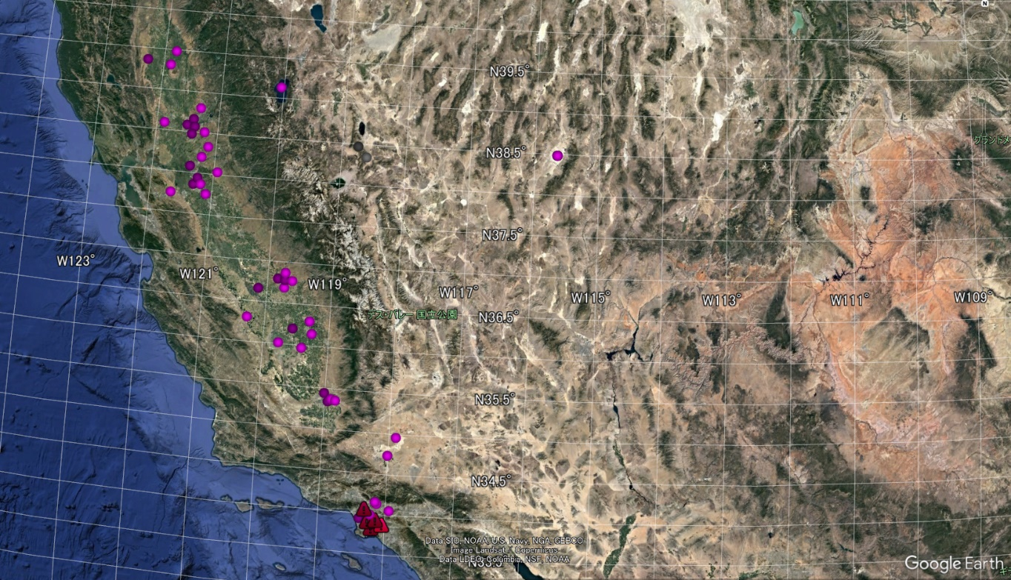
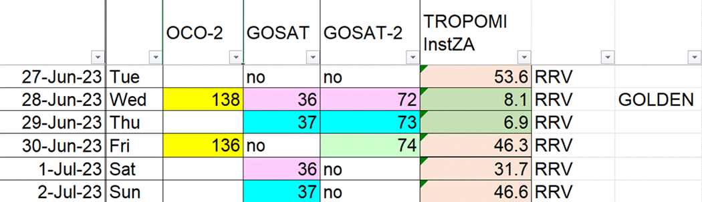
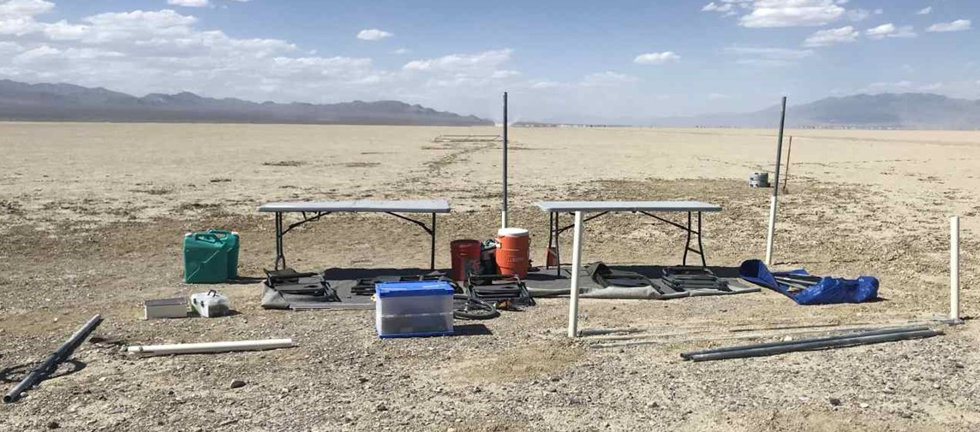
RRV2023 Campaign
2 sites each day.
(2) June 22 (Thurs) and 23 (Fri) EM-27s intercomparison at Caltech TCCON site
(3) GOSAT-2 lunar calibrations scheduled on both July 2 and 3 just after RRV 2023
(4) US AEROMMA Campaign: June 26-30 over Southern CA
Railroad Valley
Fresno
Harris Ranch
Bakersfield
AFRC
East Lancaster?

Slide 12
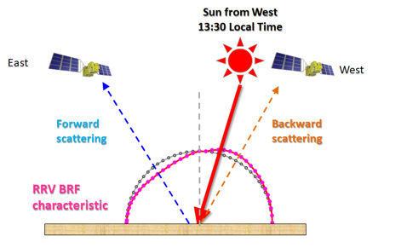
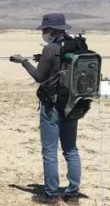


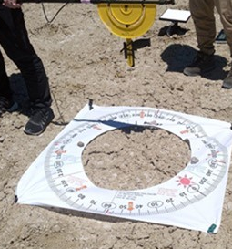
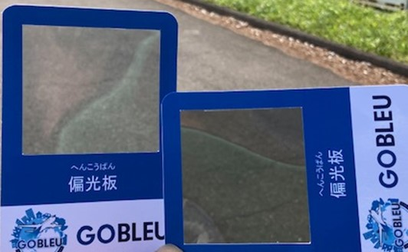
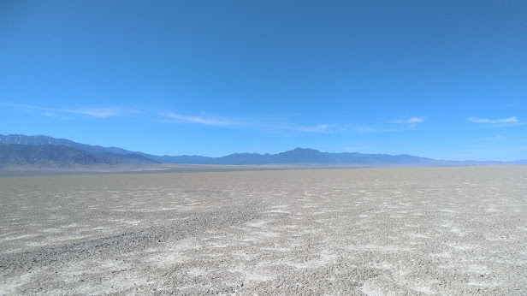
RRV2023 Polarization Measurement
Polarization in (1) Instrument in orbit (2) aerosol and thing cloud scattering and (3) surface reflection cause large uncertainties in forward calculation.
RRV surface are diffusive, but it has polarization.
Polarization measurements had been tried in RRV2009 and 2019, but too complicated.
Try again with vey simple method with a pistol with a polarizer and ASD and estimate uncertainty.
Dark
Forward
M_20 site
Bright
Backward

Slide 13
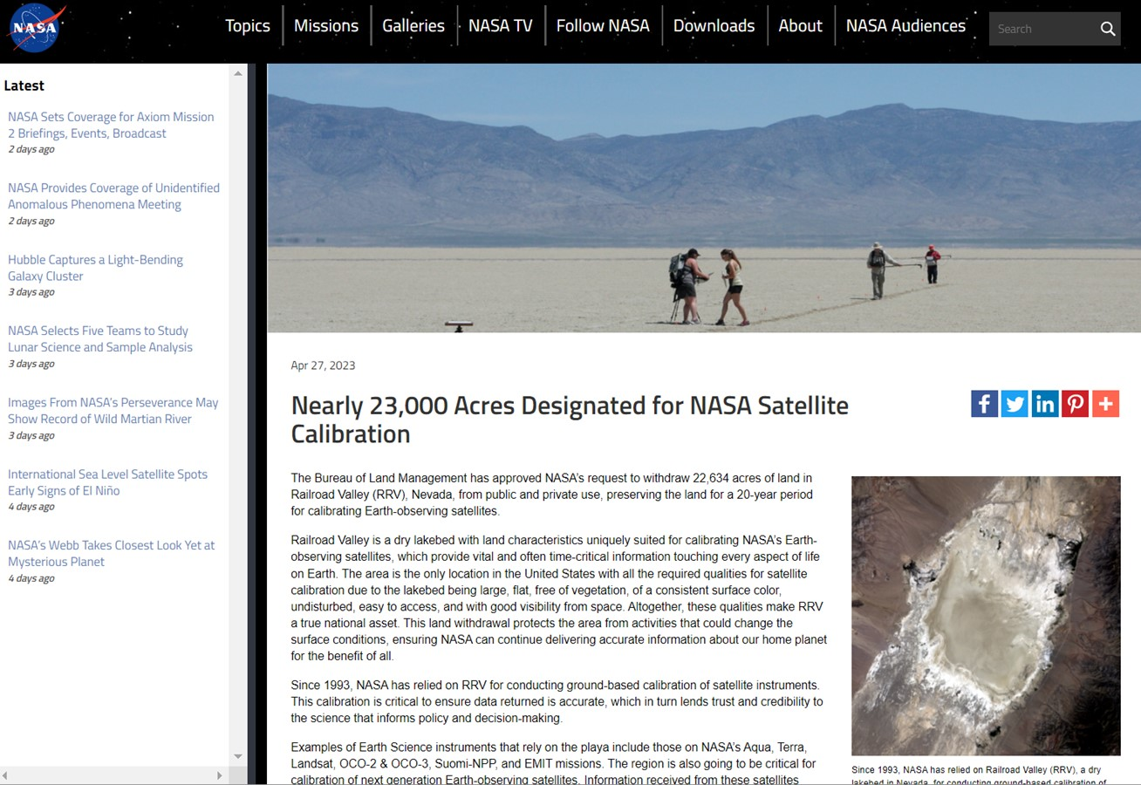
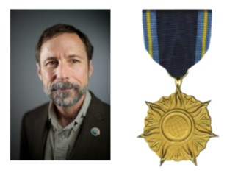
Nearly 23,000 Acres Designated for NASA Satellite Calibration
The Bureau
of Land Management has approved our “Withdrawal” petition, which should prevent lithium miners from destroying the
surface of the playa.
Dr. Dave Crisp has been awarded the NASA Distinguished Public Service Medal

Slide 14
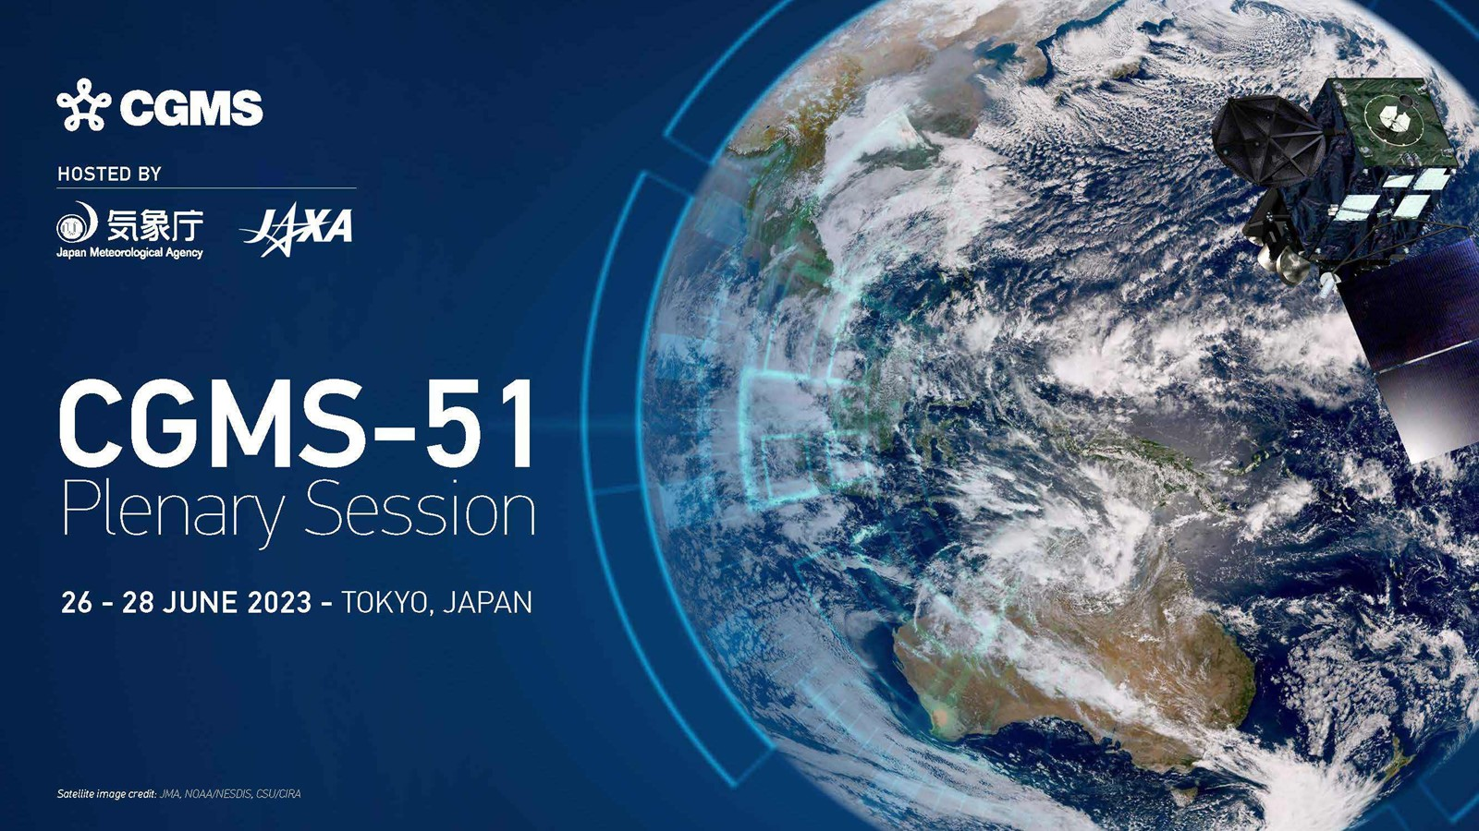
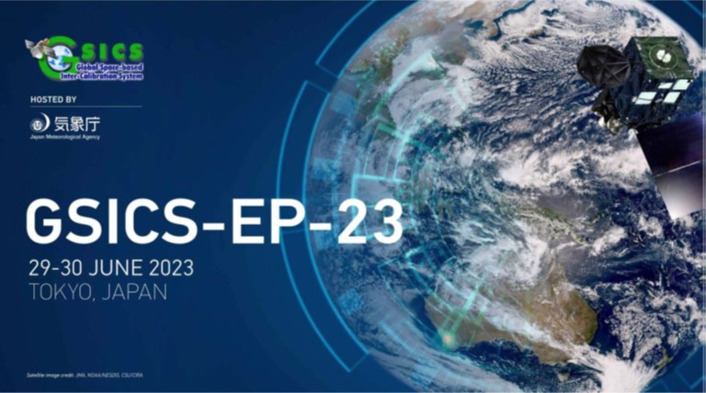
Collaboration with GSICS
Collaboration with GSICS on SWIR spectrometers
CGMS-GSICS meeting in Tokyo June 26
https://cgms-info.org/meeting/cgms-51/ https://community.wmo.int/en/meetings/gsics-ep-23
Lunar calibration: Lunar albedo phase dependency, Polarization
TSIS solar database: (1)Collaboration with LASP, University of Colorado (May 11, telecon)
(2) Use of TROPOMI, OCO, GOSAT solar calibration data

Slide 15
Other topics
(1) GHG Pre-flight calibration WS : GHG team are interested in pre-flight CAL WS

