Slide 1
WGCV-52
SRIX4Veg: Surface Reflectance Inter-comparison eXercise for Vegetation
Valentina Boccia, ESA
Cindy Ong, CSIRO
Agenda Item #2.7
WGCV-52, ESA/ESRIN, Italy
6th June 2023

Slide 2
FRM4Veg
FRM4Veg = Fiducial Reference Measurements for Vegetation
FRM4Veg is an ESA-funded activity aimed at defining and applying the FRM concept to the vegetation biophysical variables acquired by European satellites, i.e. surface reflectance (SR), fraction of absorbed PAR (fAPAR), and canopy chlorophyll content (CCC).
FRMs have the following properties:
Documented SI traceability (or conform to international community standards)
Independent from the satellite geophysical retrieval process
Accompanied by an uncertainty budget for all instruments and derived measurements
Adhere to community-agreed, published and openly-available measurement protocols
Accessible to other researchers allowing independent verification of processing systems
Slide 2

Slide 3
SRIX4Veg
In the context of the FRM4Veg activity, we developed the SRIX4Veg concept.
SRIX4Veg = Surface Reflectance Inter-comparison eXercise for Vegetation using UAVs
RATIONALE for using UAVs:
Significant interest in UAV-based hyperspectral instruments.
UAVs usage is expected to grow as instruments get lighter, cheaper and easier to use.
UAVs have several advantages when used for validating vegetation biophysical variables:
Cover a greater area
Remove site disturbance
Measure inaccessible sites (water, trees, etc.)
Complement permanent infrastructure
Measure complicated sites (mixed pixels, etc.)
Protocols yet to be developed and lots of people are developing different things (some more systematically than others)
BUT
Slide 3

Slide 4
SRIX4Veg
In the context of the FRM4Veg activity, we developed the SRIX4Veg concept.
SRIX4Veg = Surface Reflectance Inter-comparison eXercise for Vegetation using UAVs
GOAL:
Assessing the variability associated with different teams conducting the same SR validation work with drones and moving towards a community-agreed Protocol to reduce this variability, following the FRM principles.
Slide 4

Slide 5
SRIX4Veg
Endorsed by:
Funded by:
In collaboration with:
In partnership with:
Project partners:
Slide 5

Slide 6
SRIX4Veg
3 MAIN STEPS:
1st SRIX4Veg Workshop
28th March 2022
@virtual
SRIX4Veg Field Campaign
with ALL teams
18th – 22nd July 2022
@Las Tiesas (Barrax, Spain)
2nd SRIX4Veg Workshop
23rd – 24th November 2023
@ESA-ESRIN
WE ARE HERE
Slide 6

Slide 7
SRIX4Veg
3 MAIN STEPS:
1st SRIX4Veg Workshop
28th March 2022
@virtual
SRIX4Veg Field Campaign
with ALL teams
18th – 22nd July 2022
@Las Tiesas (Barrax, Spain)
2nd SRIX4Veg Workshop
23rd – 24th November 2023
@ESA-ESRIN
WE ARE HERE
Slide 7

Slide 8
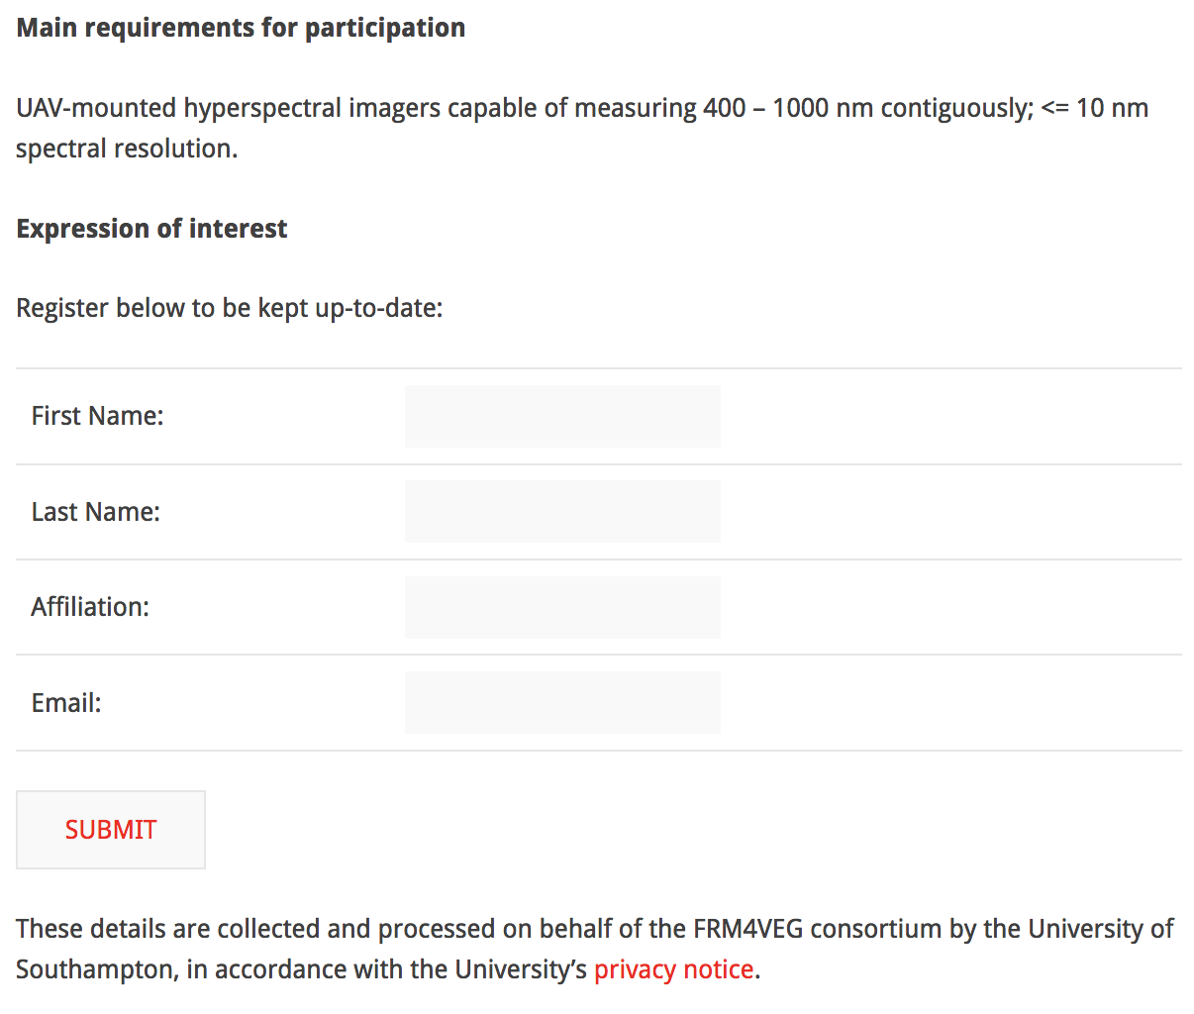
SRIX4Veg
1ST STEP:
PREPARATORY WORK before the Workshop:
Definition of a data collection plan based on a draft protocol based on a typical Sentinel-2 overpass.
Setting up of a dedicated webpage for registration to SRIX4Veg and related info & news.
One-to-one meetings with each participating team.
Preparation of all the logistics in view of the SRIX4Veg field campaign (e.g. equipment shipping and storage, potential issues, UAV regulations in Spain, UAV EU licence, UAV insurance, travel and accomodation, helath and safety, etc.).
1st SRIX4Veg Workshop
28th March 2022
@virtual
https://frm4veg.org/srix4veg/
Slide 8

Slide 9
SRIX4Veg
1ST STEP:
GOALS of the 1st WORKSHOP:
Presentation of the several teams participating in SRIX4Veg.
SRIX4Veg Strategy and Logistics in view of the filed campaign.
Preparatory activities for the field campaign.
Attendance and reporting from the several agencies and institutions supporting SRIX4Veg.
1st SRIX4Veg Workshop
28th March 2022
@virtual
Slide 9

Slide 10
SRIX4Veg
3 MAIN STEPS:
1st SRIX4Veg Workshop
28th March 2022
@virtual
SRIX4Veg Field Campaign
with ALL teams
18th – 22nd July 2022
@Las Tiesas (Barrax, Spain)
2nd SRIX4Veg Workshop
23rd – 24th November 2023
@ESA-ESRIN
WE ARE HERE
Preparatory work before the Field Campaign:
Collection of the validation strategy plans prepared by each team participating in SRIX4Veg
Slide 10

Slide 11
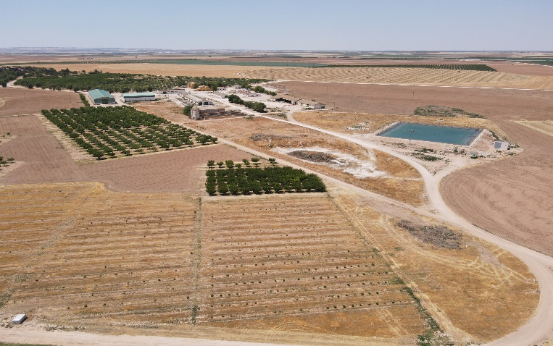
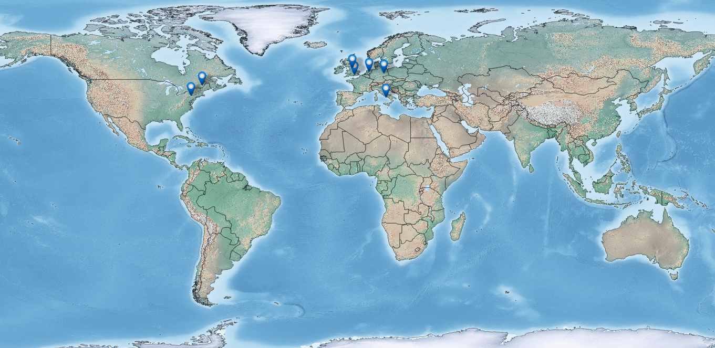
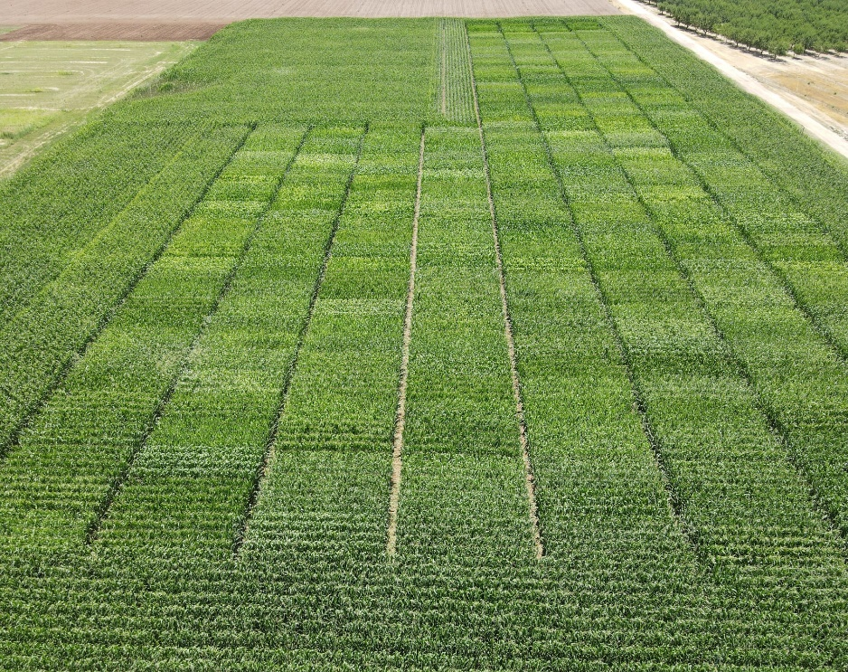
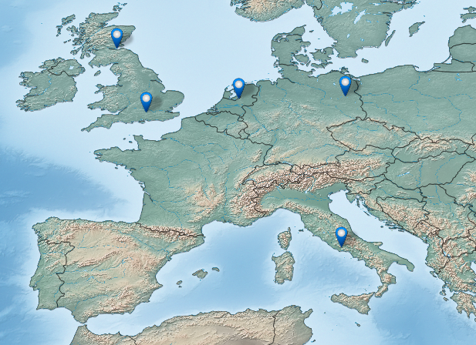
SRIX4Veg
2ND Step: SRIX4Veg Field Campaign
Las Tiesas Experimental Farm, Barrax, Castilla-La Mancha, Spain
(39.054313°, -2.101054°)
NRC
RIT
FRM criteria
1 | Vegetation Type
2 | Representativeness
3 | Extent
4 | Homogeneity
5 | Topography
6 | Weather
7 | Accessibility
8 | Site Maturity
NERC
NPL
GFZ
WUR
PARTICIPATING
TEAMS
GEO-K
Slide 11

Slide 12
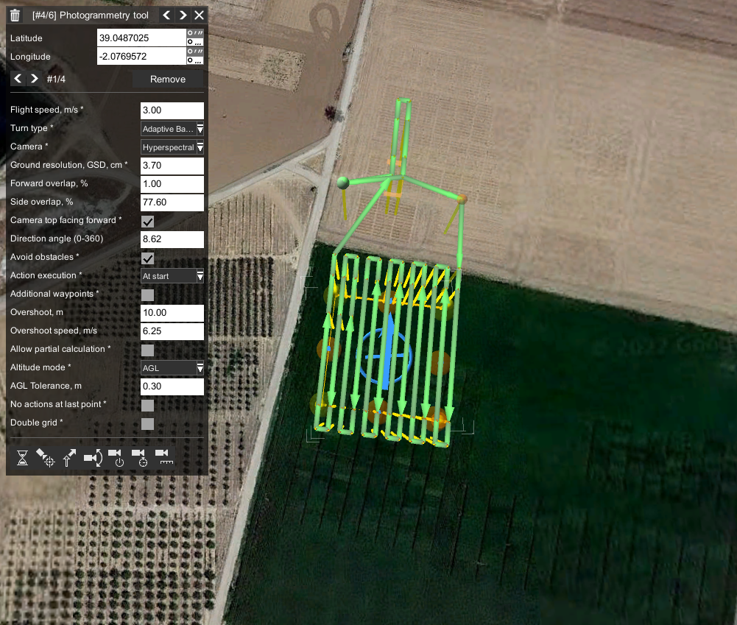
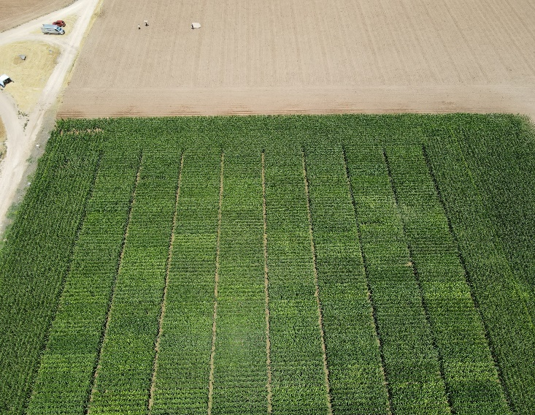
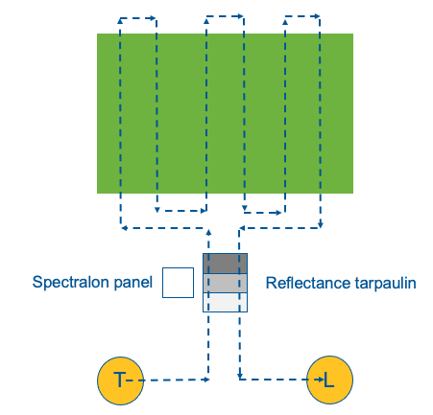
SRIX4Veg
EXPERIMENT 1: Each team was given a data collection plan based on an initial, draft protocol based on a typical Sentinel-2 overpass.
Area: 60 m x 60 m (consistent with 3 x 3 pixels at 20 m resolution)
Flight lines orientated to the Sentinel-2 orbit inclination: 98.62°
Overlap (80%) increased to get as many pixels at each angle
Speed
Height
Sampling
Optimised to ensure the UAV
can cover the area within the battery limits
EXPERIMENT 2: Each team collected data according to their own plans but given the same information
about a satellite overpass.
Slide 12

Slide 13
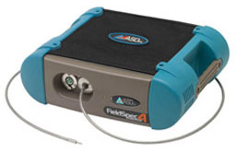
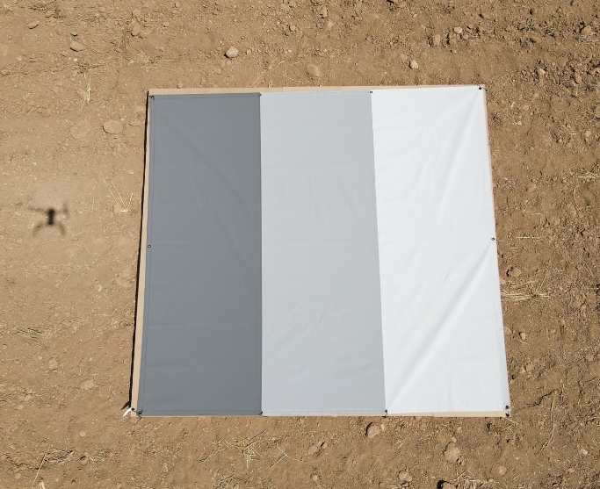
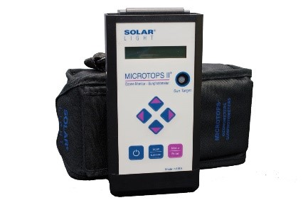
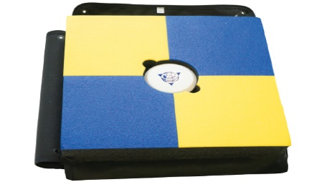
SRIX4Veg
ON GROUND INSTRUMENTS
ASD
SI
Spectralon Panel
ASD measurements:
Spectralon > Light > Middle > Dark > Spectralon
5 spectrums per location @ 4 locations
GNSS
Smart Target
Base station
Microtops II
Sunphotometer
Three step grey scale Tarpaulin
11%, 30%, 56%
Slide 13

Slide 14
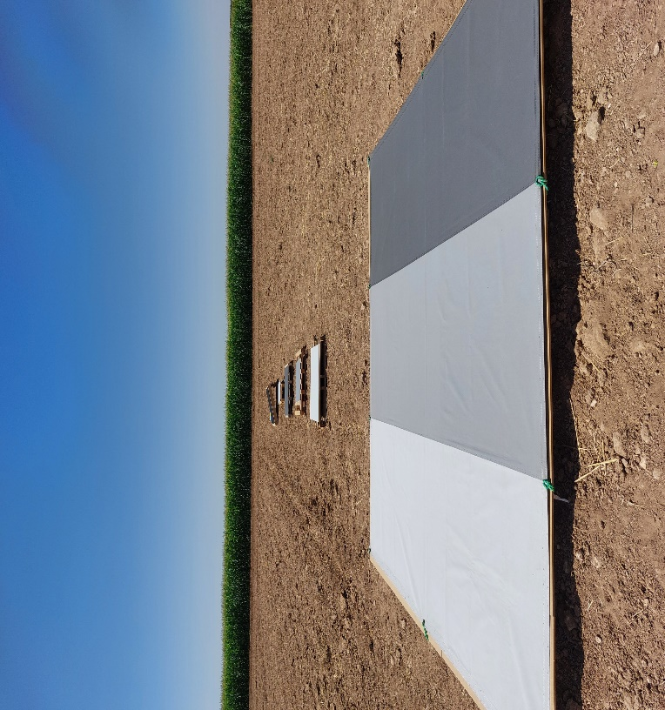
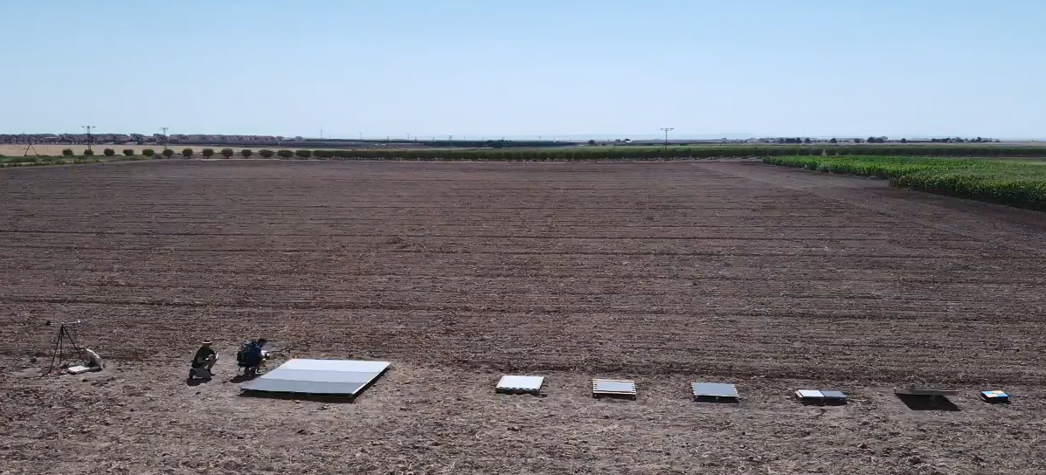
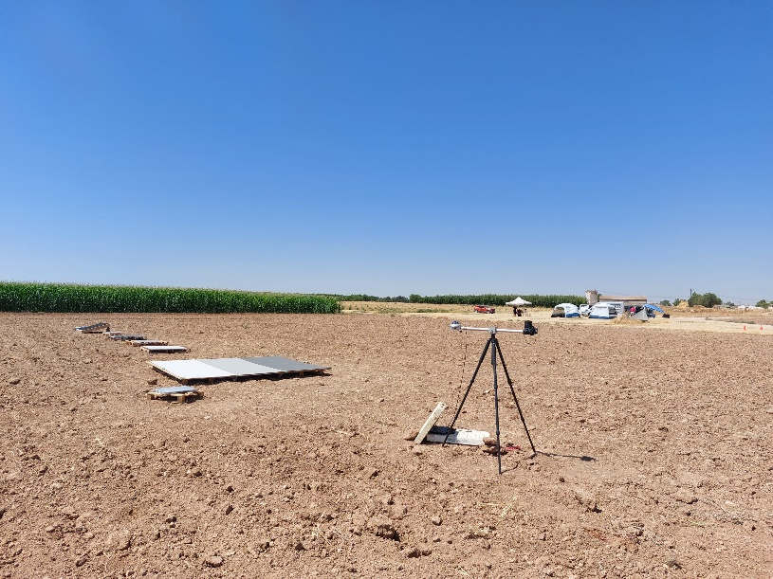
SRIX4Veg
ON GROUND INSTRUMENTS
Slide 14

Slide 15
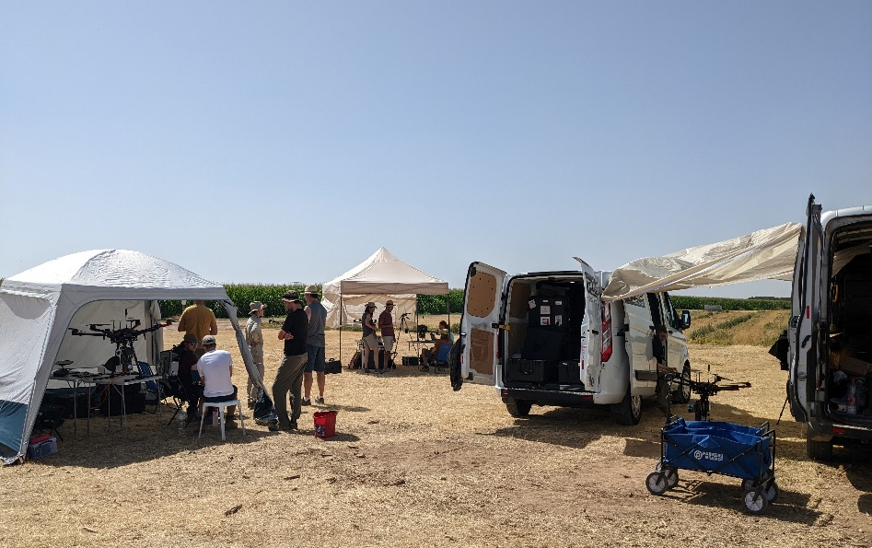
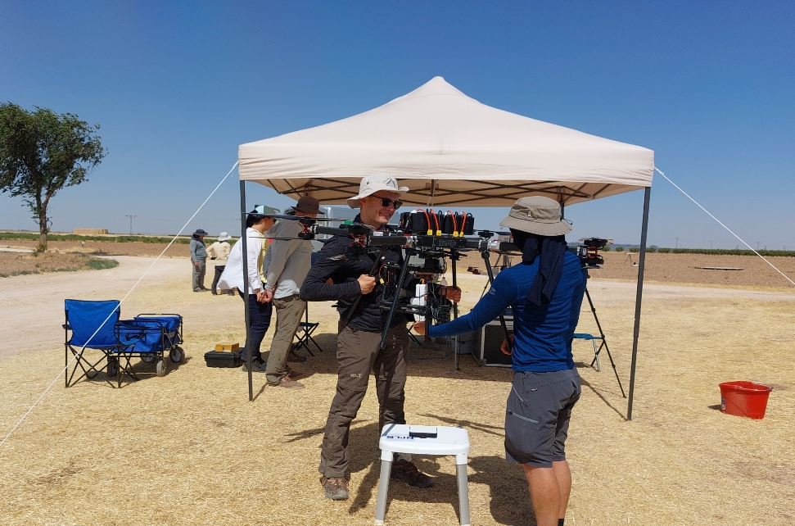
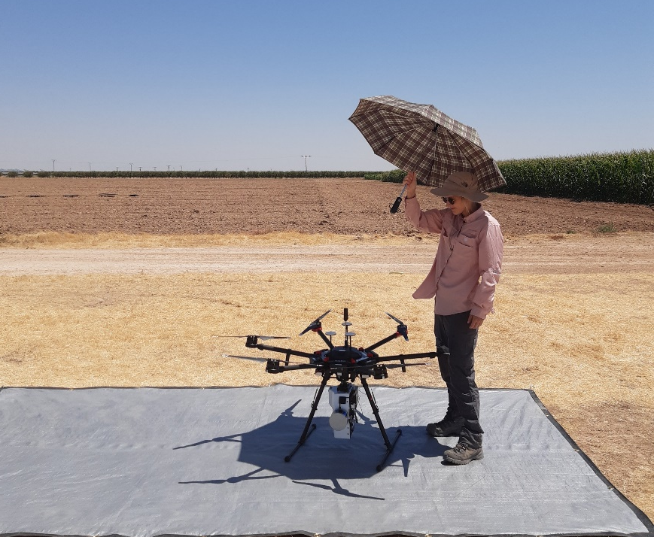
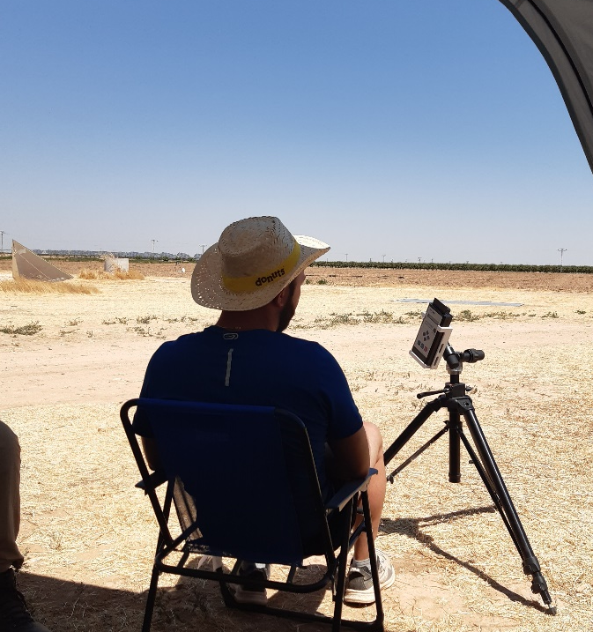
SRIX4Veg
LOGISTICS and CHALLENGES
Organisation
&
logistics
52 flights in total!
Software issues….
Heat
Slide 15

Slide 16
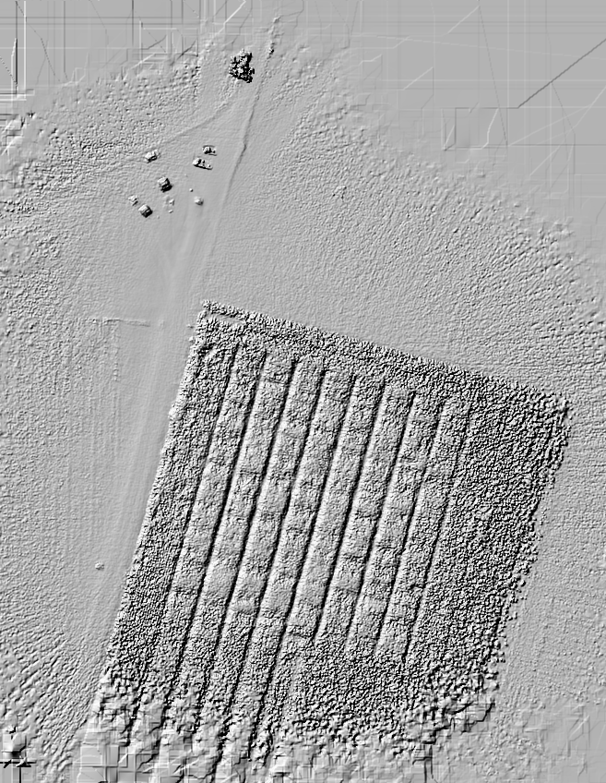
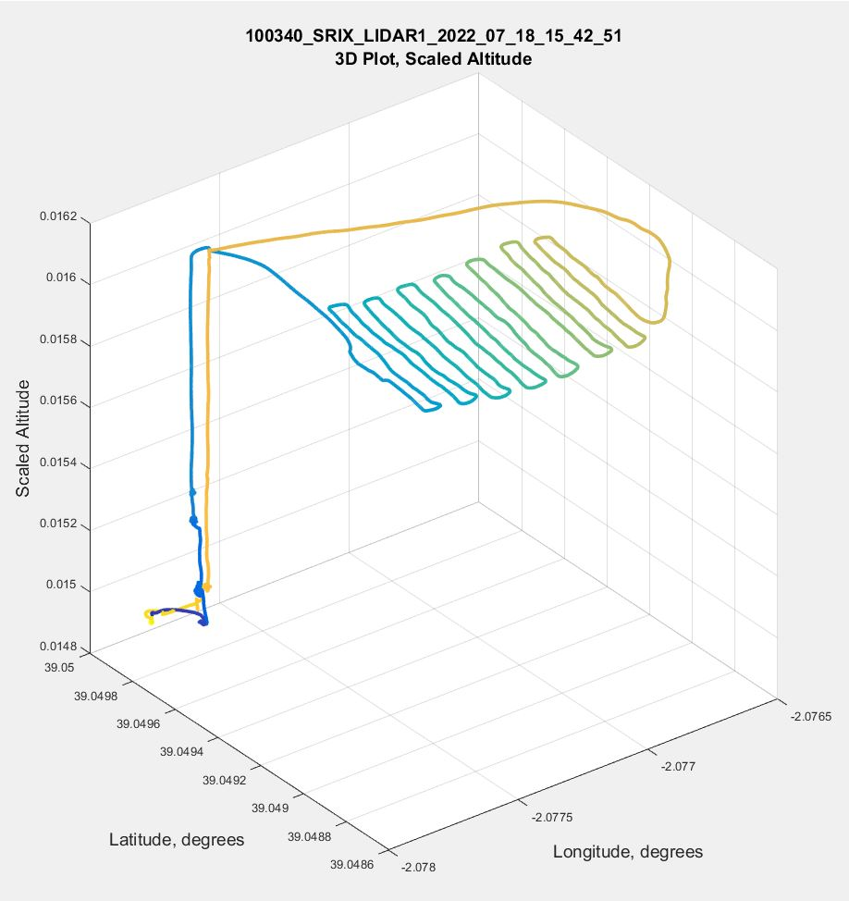
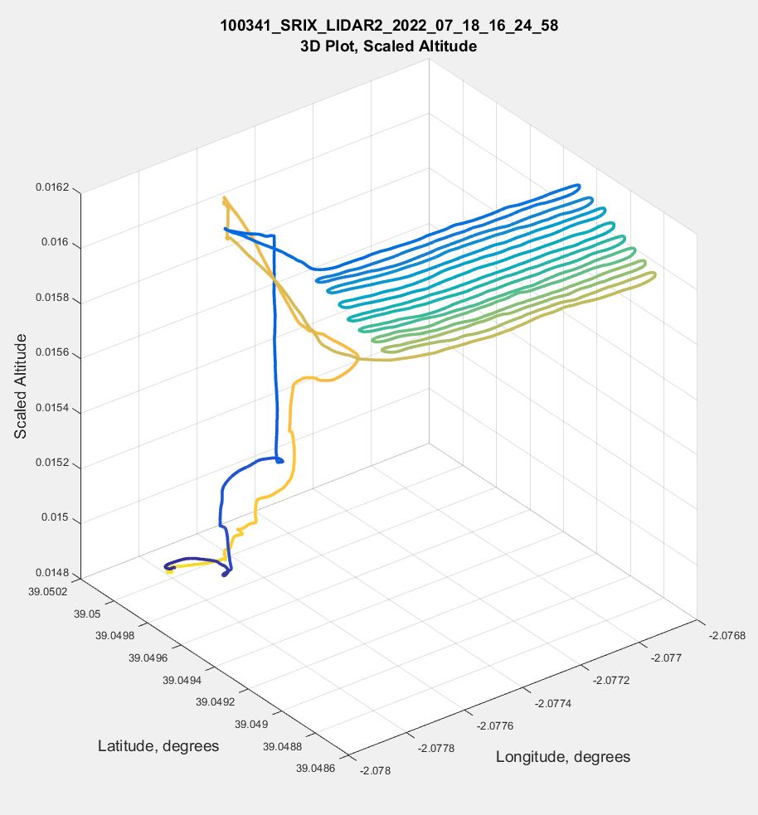
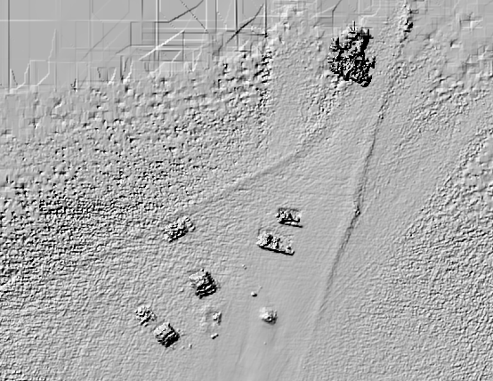
SRIX4Veg
A big part of the experiments was ensuring that the participants just had to bring their UAVs and not set up all the supplementary instrumentation
This meant providing them with IMU/GPS corrections through a fixed GPS sensors (left demonstrated for an NPL flight)
And a DEM of the measurement area (middle and right)
(bottom right image) you can see the tents and the vehicles
(top right image) you can see a close up of the rows in the corn
Slide 16

Slide 17
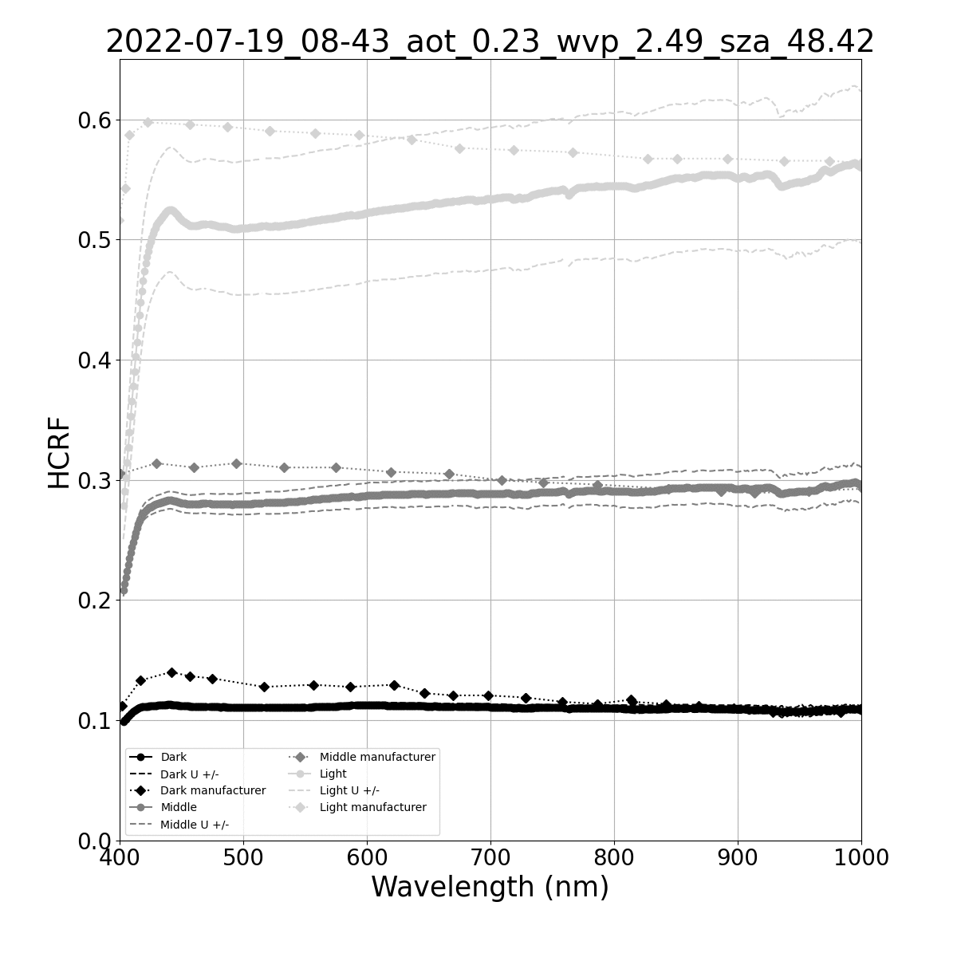
SRIX4Veg
Because of changes to illumination conditions, different instrument operators (of the ASD), and the occasional mistake in the data collection we needed to do some quality control (QC).
This meant flagging individual spectra or sequences of spectras and removing them; for the latter case we also used temporal interpolation to fill in gaps.
The gif here shows what the reflectance looks like without QC, you’ll notice that:
The reflectance jumps around when it should increase as it gets closer to midday
The uncertainties can be very large (>50%)
Processing steps:
Individual scans within each set of 10 spectra are flagged and removed from if they are more than 2 standard deviations away from the mean DN value.
For each sequence of measurements (panel -> tarp -> panel) reflectance values are calculated for the middle timestep between the panel measurements.
For each flight, interpolated reflectances are calculated w.r.t the middle of the flight time.
Slide 17

Slide 18
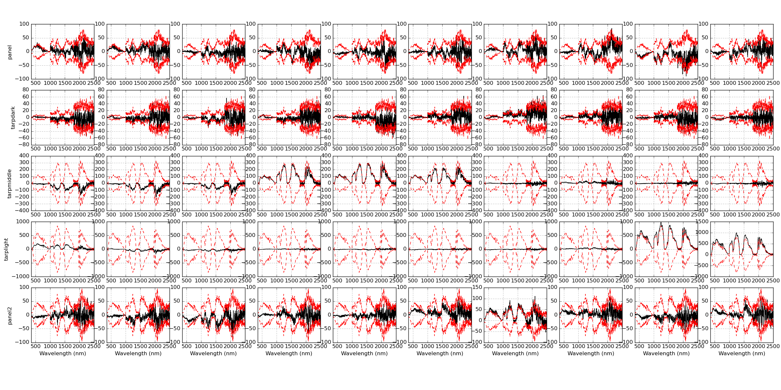
SRIX4Veg
This gives an example of the removal of individual spectra which are outside 2 standard deviation of the median.
The flagged spectra could be caused by the instrument operator moving the FOV so it’s not looking at the target anymore (it was uncomfortable so might be as simple as a fidget!).
This will also make the uncertainty big if left.
To be removed
Slide 18

Slide 19
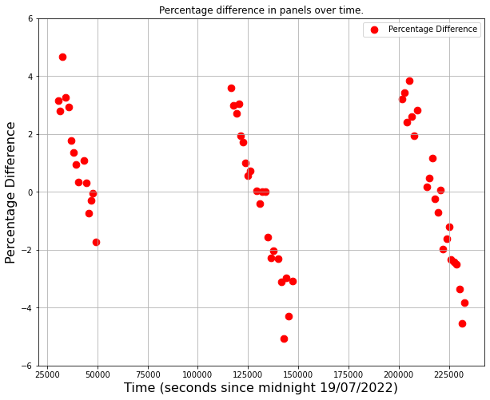
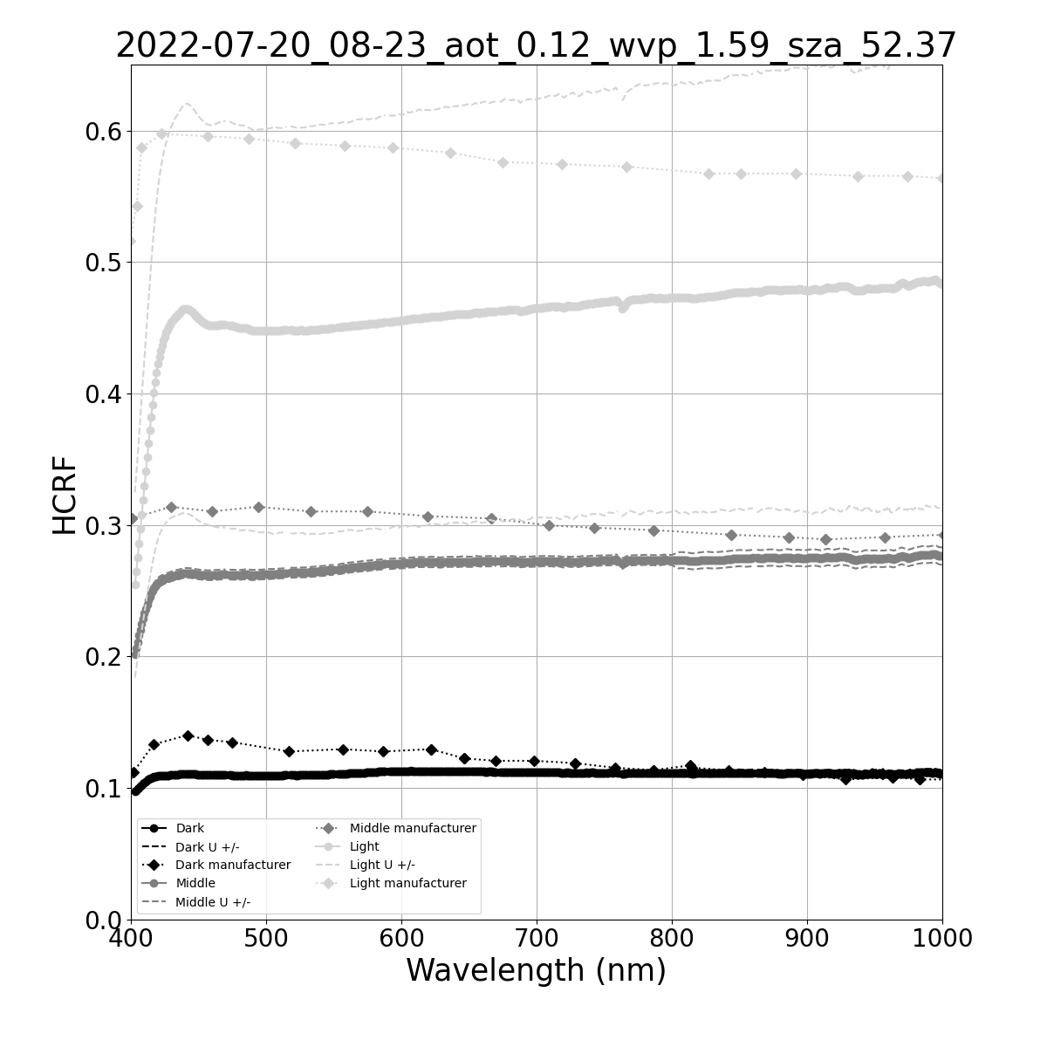
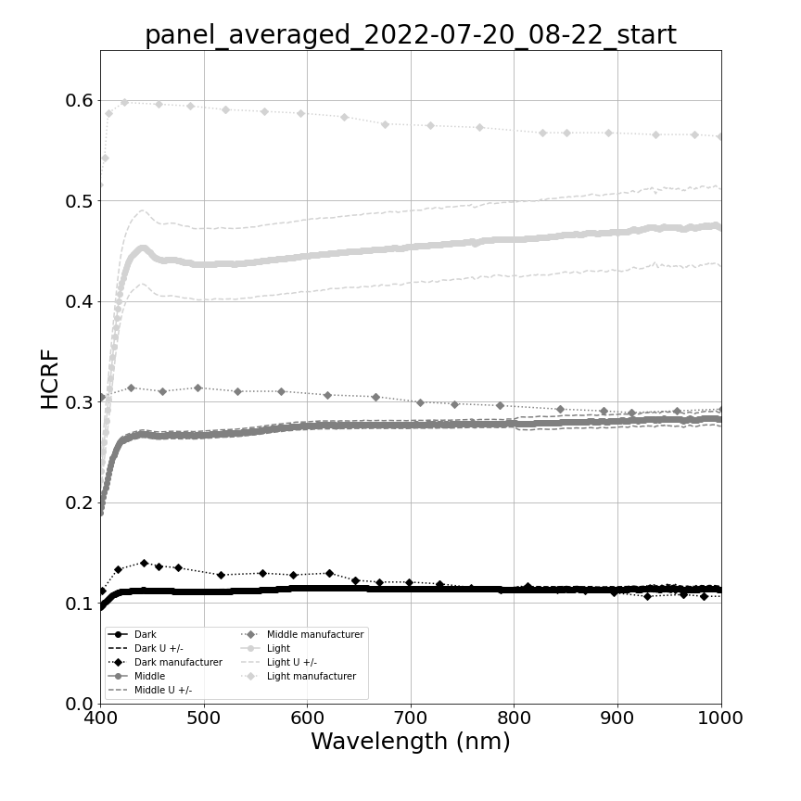
SRIX4Veg
We interpolated to the middle of the flight so the reflectance data were representative of as much of the flight as possible
The left plot shows the change in the brightness of the white reference panel measured before and after each flight
Which explains why we interpolated the reflectance to the middle of the flight
The right two plots show the before and after filtering of the individual spectra (note the reduced uncertainty in the second plot)
Slide 19

Slide 20
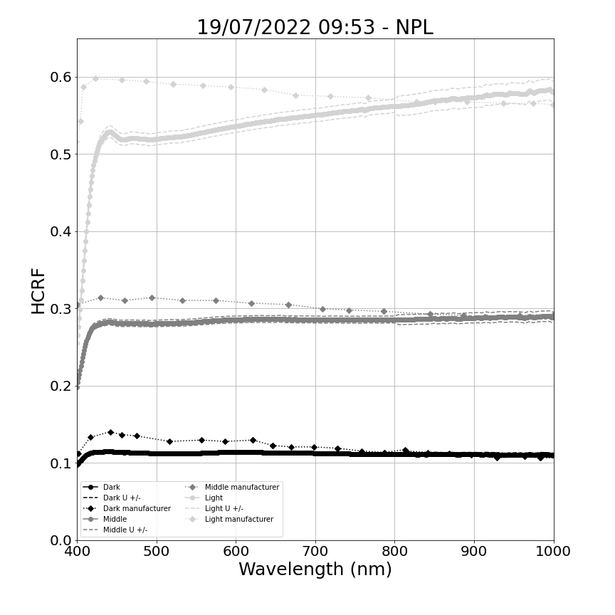
SRIX4Veg
This is the gif from a few slides ago but after full QC:
The spectra rises up to noon and then decreases (small variations are now because of natural illumination changes)
Uncertainties are all reasonable
This data was sent to participants
Slide 20

Slide 21
SRIX4Veg
3 MAIN STEPS:
Mark your Calendars !
1st SRIX4Veg Workshop
28th March 2022
@virtual
SRIX4Veg Field Campaign
with ALL teams
18th – 22nd July 2022
@Las Tiesas (Barrax, Spain)
2nd SRIX4Veg Workshop
23rd – 24th November 2023
@ESA-ESRIN
WE ARE HERE
Slide 21

Slide 22
SRIX4Veg
3RD STEP:
Mark your Calendars !
1st SRIX4Veg Workshop
28th March 2022
@virtual
SRIX4Veg Field Campaign
with ALL teams
18th – 22nd July 2022
@Las Tiesas (Barrax, Spain)
2nd SRIX4Veg Workshop
23rd – 24th November 2023
@ESA-ESRIN
WE ARE HERE
GOALS of the 2nd SRIX4Veg Workshop:
Discuss together about the outcomes of the SRIX4Veg field campaign;
Receiving feedback on the draft Protocols and Procedures for SR validation using UAVs.
Slide 22

Slide 23
SRIX4Veg
Proposed Future Steps:
Updated version of the Protocols and Procedures for SR validation using UAVs to be shared with CEOS WGCV LPV and IVOS for review and contribution in Q1 2024.
CEOS WGCV LPV and IVOS review process (2-3 months?).
Inclusion of feedback and updated version of Protocols & Procedures to be submitted to CEOS WGCV for potential endorsement in Q3 2024.
In Parallel:
- Cooperation with SRIX4Veg-II in Australia by sharing the latest version of the Protocols & Procedures document available at that time, so to be used by SRIX4Veg-II participants. Detailed plan to be discussed.
- Cooperation with SRIX4Veg-II in order to prepare updated Protocols & Procedures, based on the outcomes of both SRIX4Veg-I and -II.
Slide 23

Slide 24
SRIX4Veg-II
Australia has an active community deploying UAS for Earth Observation including the development of complementary methods, protocols & apps, e.g. TERN Drone Protocols for Data Collection, RGB and Multispectral Imagery Processing, Lidar Processing;
There is a recognised need to develop a community approach/guideline for the collection of data from UAS for the validation of satellite-derived surface reflectance products across vegetated areas;
Good synergies to extend effort and be involved in co-development with international partners;

Slide 25
SRIX4Veg-II
Underlying aims:
To harness the Australian community;
Development of a EO community project (as an EOA calval WG initiative);
To showcase Australian EO capabilities & infrastructure (sites, facilities, labs)
Slide 25

Slide 26
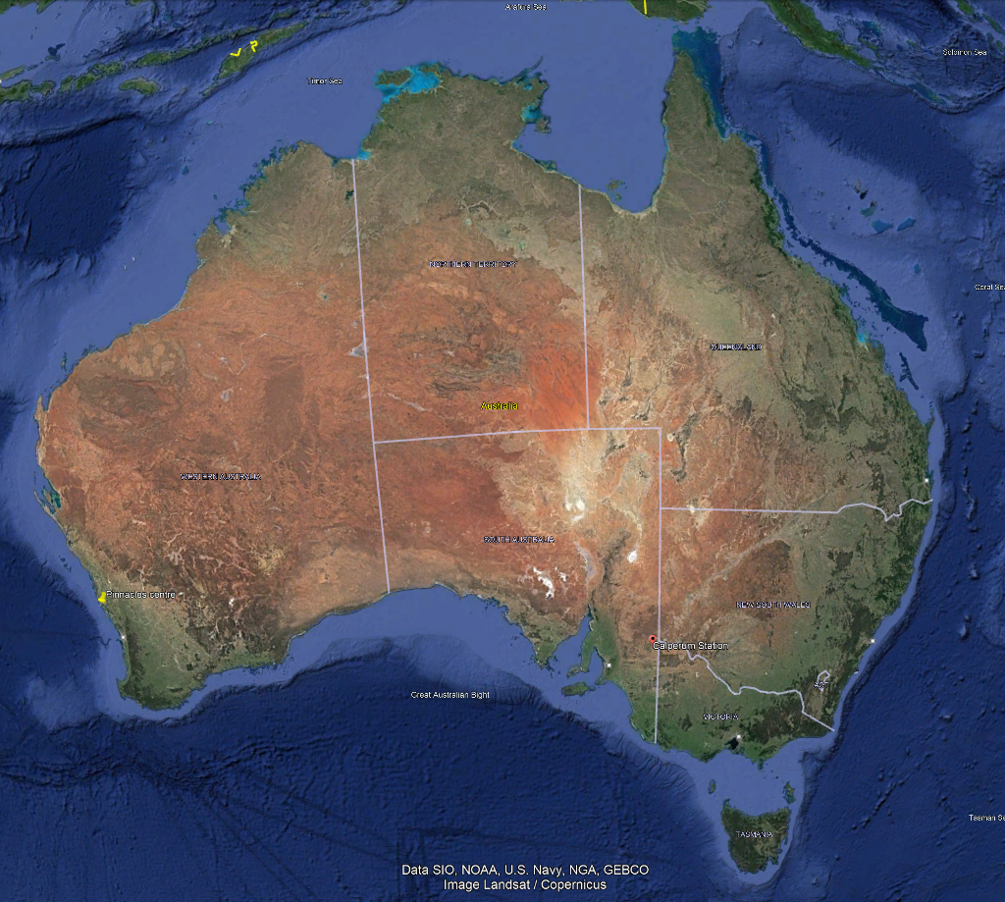
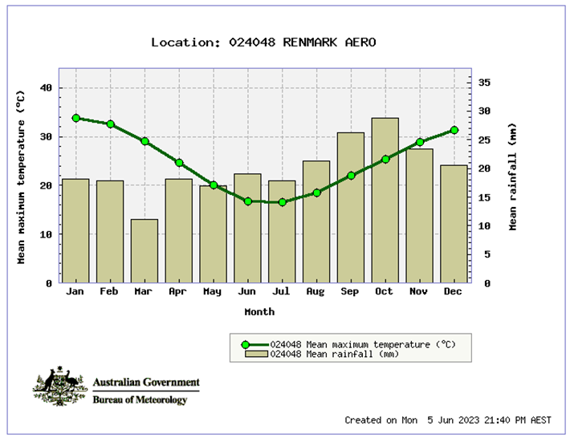
SRIX4Veg-II
Image credit: TERN
Site
TERN/LPV supersite Calperum (https://www.tern.org.au/tern-observatory/tern-ecosystem-processes/calperum-mallee-supersite/, https://www.tern.org.au/site-of-the-month-calperum-mallee-supersite/) across 9000 km² ~270 km E of Adelaide, close to Renmark;
13 years measuring fundamental carbon, water, energy and nutrient pools and fluxes;
One eddy-covariance flux tower
Soil water content, temperature and electrical conductivity probes
Phenocams
Groundwater bores with nested piezometers
18 x 1 ha Surveillance monitoring plots
Airborne LiDAR and hyperspectral imagery calibrated using SLATS star transects, leaf sampling, tree structure and LAI measurements
Mallee semi-arid ecosystem, fringing the River Murray floodplains on Calperum Station, South Australia;
Comprises undulating mallee woodlands and riverine vegetation alongside the river;
Pinnacles
Calperum
Slide 26

Slide 27
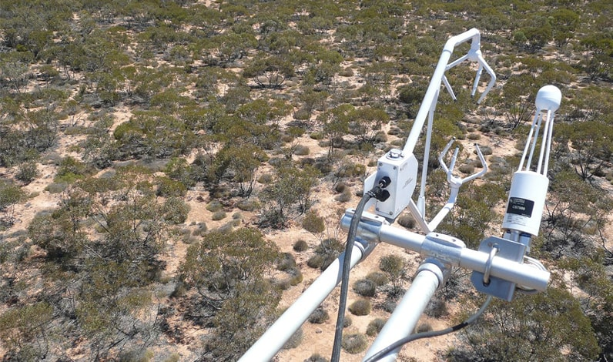
SRIX4Veg-II
Plan
Timing
postponed to weeks of 4th or 11th March 2024;
Methodology
Based on SRIX4Veg-I, updated to reflect outcomes & adjusted for Calperum;
Logistics
Insurance, licencing, regulations, shipping, etc.
Field equipment & ancillary equipment, e.g. reference panels, gazebos, tables, etc.
Accommodation, food, etc;
Strong in-kind support from TERN, administration/promotional support from EOA;
Developing proposition for support beyond best efforts;
Teams
Currently 7 local teams, 1-2 international team, noting that this is close to the limit, 52 flights for 7 teams for SRIX4Veg-I
Slide 27

