Slide 1
WGCV-52
BRIX-2
(definition, status and way forward)
Clement ALBINET, ESA
Agenda Item 2.6
WGCV-52, ESA/ESRIN, Italy
5th - 9th June 2023

Slide 2
What is BRIX-2?
BRIX-2 represents a joint effort between ESA and NASA to intercompare algorithms specifically for biomass mapping using current and future spaceborne missions.
Co-lead by ESA (Clement Albinet), NASA-JPL (Marco Lavalle) and university of Maryland (Laura Duncanson).
These objectives shall be achieved by making available standardised test cases (based on airborne campaign and spaceborne simulated data), inviting the scientific community to develop and apply retrieval algorithms based on this test case, and finally compare and evaluate the performance of submitted results.
For the purpose of an objective algorithm evaluation, the exercise will be based on the ESA-NASA joint-Mission Algorithm and Analysis Platform (MAAP).

Slide 3
The objectives of BRIX-2 are:
Provide an objective, standardized comparison and assessment of biomass retrieval algorithms developed for the BIOMASS, NISAR and GEDI missions, and fusion of these mission datasets.
Establish a forum to involve scientists in the development of retrievals that have so far not been part of the biomass community.
The adoption of vetted validation standards and methods to compare biomass estimates to reference datasets (e.g. field plots or airborne lidar biomass maps).
Collect inputs from the biomass user and scientific community on data formats and characteristics towards the generation of Analysis Ready Data.

Slide 4
What BRIX-2 is not!
BRIX-2 should not be a competition where the best performing algorithm wins. The exercise should be a scientific experiment with a focus on the inter-comparison of algorithms by validating derived biomass maps against in-situ reference measurements.
BRIX-2 allows an increased understanding of strengths of the next generation of active remote sensing datasets, with a focus toward algorithm fusion. This is not intended as an algorithm competition, but how we can combine lesson learned from the strengths of a range of algorithms.

Slide 5
BRIX-2 has following challenges:
How to optimally use the available P-band SAR, L-band SAR and LIDAR data in the retrieval?
Retrieval will be tested on a limited geographic area but the algorithm has to be applicable globally…
How to use datasets, including time-series, from future BIOMASS, NISAR and GEDI missions?
How to make retrieval consistent globally and in agreement with each mission requirements?

Slide 6
Evaluation of Results & Publication
The evaluation will be done by ESA/NASA, following standards from the CEOS LPV protocol. This should guarantee a fair evaluation. ESA/NASA will release a report to the participants summarising the evaluation results.
After the experiment has been closed we will make the evaluation scripts available on the ESA-NASA MAAP. This allows people to repeat the experiment and compare their results against the published ones.
ESA/NASA commit not to distribute the outcome of the exercise without prior consent of the participants.
The results should easily be adapted for publication as a peer reviewed article co-authored by all participants who wish to publish the outcomes of the activity.

Slide 7
Approach and datasets
Participants shall generate a biomass map and an uncertainty map within a given geographic bounding box using a pre-determined BRIX-2 dataset that includes radar, lidar and field data.
Participants are not requested to use all datasets.
Data that has been acquired during the ESA-NASA AfriSAR campaign in Gabon.
Additional relevant data can be considered.

Slide 8
Evaluation
Validation data:
In-situ measurements for Lopé, Mabounie, Rabi and Mondah sites:
  Pre-processed 1 ha forest plots (including subplots) data at Lopé, Mabounie, Rabi and Mondah with estimated AGB (ton/ha) and forest height (m).
Airborne lidar maps derived from field data and LVIS at Lope, Mabounie, Rabi and Mondah (https://daac.ornl.gov/cgi-bin/dsviewer.pl?ds_id=1775)
Evaluation approach:
Notebooks for conducting the validation will be developed in collaboration with the full BRIX-2 team, and implemented on the MAAP with a transparent visualization of outputs and summary statistics for each candidate algorithm.

Slide 9
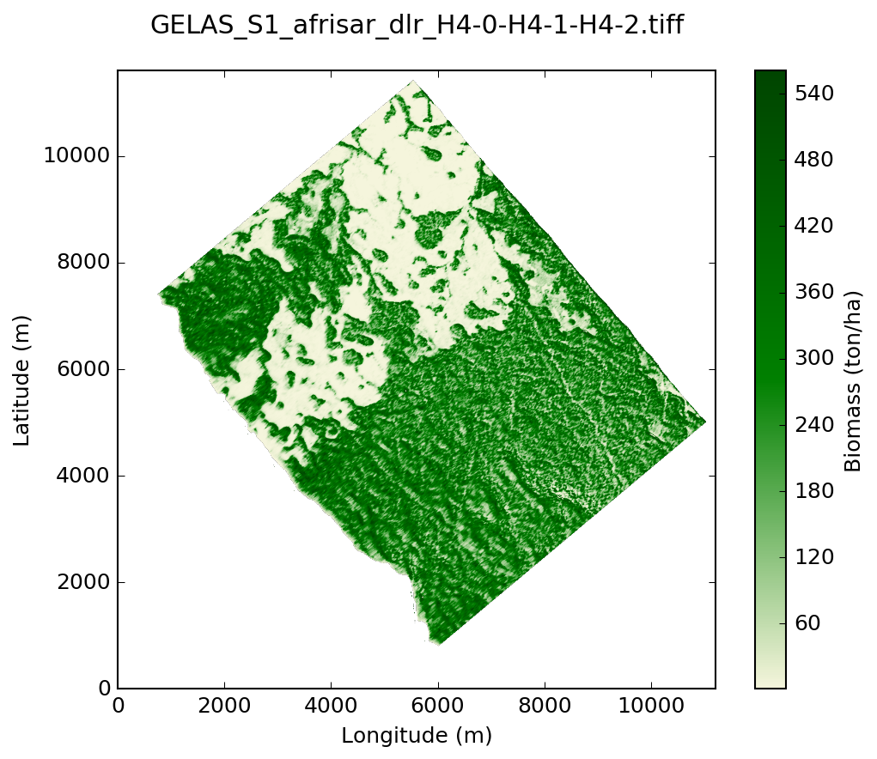
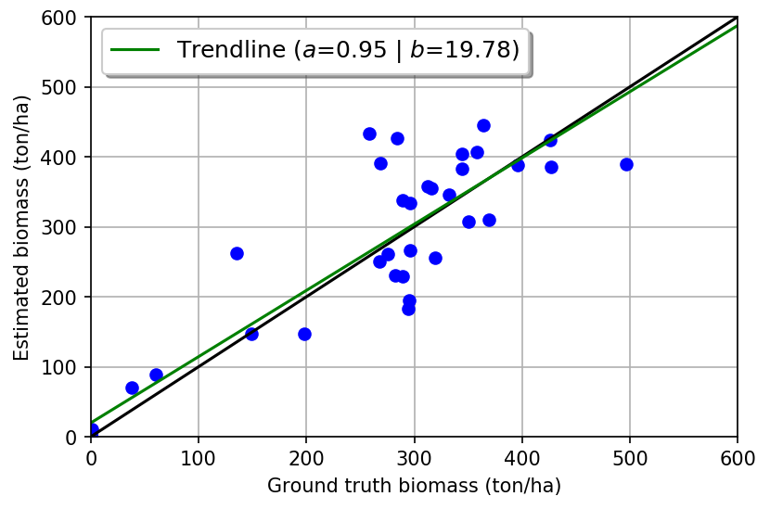
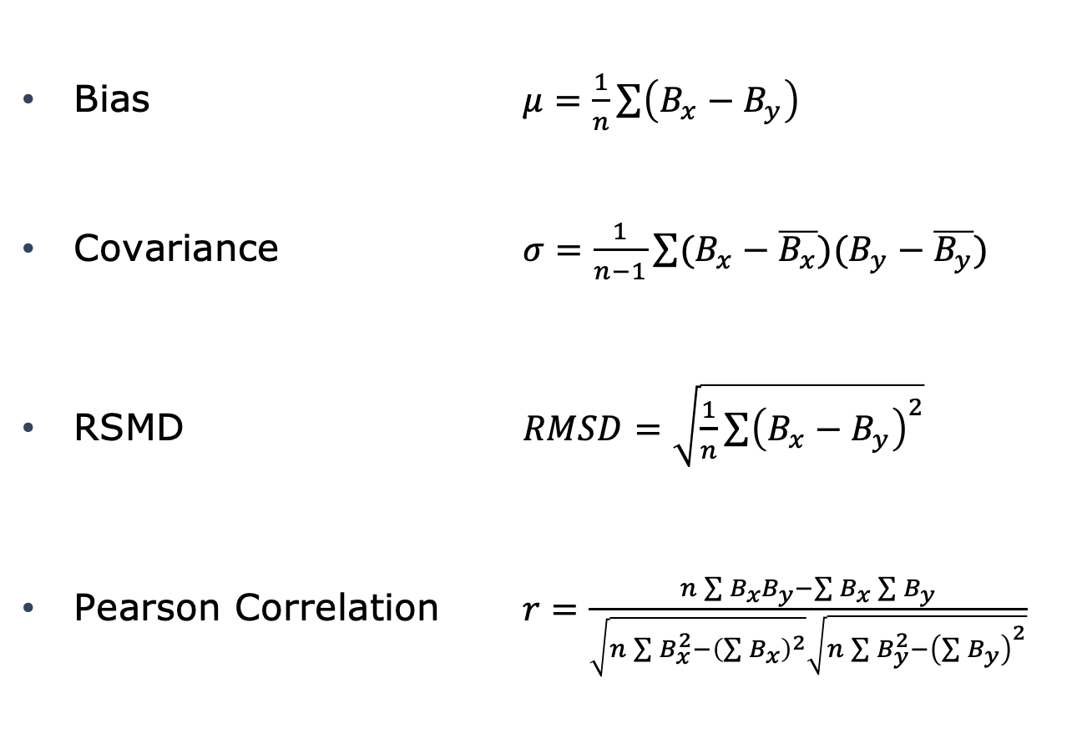
Evaluation metrics
Bias $μ=\frac{1}{n}\sum{\left(B_{x}−B_{y}\right)}$
Covariance $σ=\frac{1}{n−1}\sum{(B_{x}−\overline{B_{x}})(B_{y}−\overline{B_{y}})}$
RSMD $RMSD=\sqrt{\frac{1}{n}{\sum{\left(B_{x}−B_{y}\right)}}^{2}}$
Pearson Correlation $r=\frac{n\sum{B_{x}B_{y}}−\sum{B_{x}}\sum{B_{y}}}{\sqrt{n\sum{B_{x}^{2}}−{\left(\sum{B_{x}}\right)}^{2}}\sqrt{n\sum{B_{y}^{2}}−{\left(\sum{B_{y}}\right)}^{2}}}$

Slide 10
Steps and original schedule
START
Test and Submission Phase
Results Inter-Comparison & Publishing
END
BRIX-2 coordinators
Ingest in the MAAP the data acquired over the test sites
BRIX-2
coordinators
Synthesise all the
Experimental results
to be published in
the scientific
literature
BRIX-2 participants
Access the data through the MAAP
Milestones:
First Workshop (29-30 April 2021)
Results Submission Deadline (December 2021)
Results Evaluation Report (February 2022)
Second workshop (March-April 2022)
BRIX-2 coordinators
Analyse the results and report the inter-comparison outputs
BRIX-2
joint-MAAP & website
BRIX-2 participants
Run their biomass retrieval processor and benchmark their data
BRIX-2 coordinators
Retrieve the submitted results and reports
BRIX-2 participants
Submit their results and information about their algorithm
END of Test and submission Phase

Slide 11
Original list of BRIX-2 participants
Qian Song [DLR, DE]
Sean Healey [US Forest Service national forest inventory, US]
Zheng-Shu Zhou [CSIRO - Australian Resources Research Centre, AU]
Polyanna da Conceição Bispo [University of Manchester, GB]
Pedro Rodriguez-Veiga [University of Leicester, GB]
Rubén Valbuena [Bangor University, GB]
Emanuele Santi [CNR-IFAC, IT]
Helen Baldwin Parache [NASA - University of Alabama Huntsville, US]
Juan Guerra-Hernandez [Universidade de Lisboa, PT]
Harry Carstairs [University of Edinburgh, GB]
Ana Maria Pacheco Pascagaza [University of Leicester / Manchester, GB]
James R. Kellner [Brown University / GEDI Mission Science Team, US]
Adrian Pascual [ASU, US]
Iain McNicol [University of Edinburgh, GB]
Michael Schlund [University of Twente, NL]
Christiane Schmullius [Friedrich-Schiller-University Jena, DE]
Mikhail Urbazaev [Friedrich-Schiller-University Jena, DE]
Richard Lucas [Aberystwyth University, GB]
Wangfei Zhang [Southwest Forestry University, CN]
Pierre-Antoine Bou [CESBIO, FR]
Chiara Aquino [University of Edinburgh, GB]
Joao Carreiras [University of Sheffield, GB]
Thomas Chen [Academy for Mathematics, Science, and Engineering, US]
Maryam Pourshamsi [Airbus, GB]
Karimon Nesha [Wageningen University, NL]

Slide 12
BRIX-2: Status and outcome
18 teams were originally participating (12 teams on ESA element, 6 teams on NASA element).
lack of participation to the inter-comparison exercise (No team ever submitted their results while the original submission deadline was December 2021).
Decision to close the exercise and support the 2 only teams that provided preliminary results in order to provide:
  The Biomass maps of estimates over the 4 sites defined in the exercise.
  The algorithm (= the software), in order to allow MAAP users to regenerate the results.
  The documentation of the algorithm.
  A brief experience report on the exercise set-up (limitations of their algorithm, suitability of data, what’s good/what’s bad, etc.).

Slide 13
BRIX-1 summary
ESA only
ESA lead and based on the « precursor of the MAAP ».
Intercompare a biomass retrieval models based on the data that has been acquired during the AfriSAR campaign for the La Lopé super site.
The retrieval was evaluated over the three independent test sites Mondah, Rabi and Mabounie with existing forest plot data and lidar estimates of biomass.
4 teams took part to the experiment with their model:
  Leicester/JPL ➔ Modelling
  CESBIO ➔ Semi-Empirical/Likelihood
  IFAC ➔ Machine Learning
  EURAC ➔ Machine Learning

Slide 14
BRIX-1 summary
ESA only
Analysis
Similar behaviour observed for the 4 models, while they are based on different methods.
Very good results on Lopé (where the training ROIs were provided). Worse results on the other sites (where the training ROIs were not provided).
A first conclusion is that using the same ROIs for training and validation will introduce strong bias in the estimation of the retrieval.
Observations:
The standard file format and georeferencing helped a lot the analysis.
The algorithms were well documented (paper, user manual for algorithm…)

Slide 15


If you are interested in more information on…
BRIX-1:
BRIX-2:
https://earth.esa.int/web/sppa/meetings-workshops/hosted-and-co-sponsored-meetings/brix
http://polinsar-biomass2021.esa.int/brix-2/
Thank you!

