Slide 1
WGCV-52
ACIX/CMIX and Cloud Camera Network
Eric Vermote, NASA/GSFC
Agenda Item 2.3
WGCV-52, ESA/ESRIN, Italy
5th - 9th June 2023

Slide 2
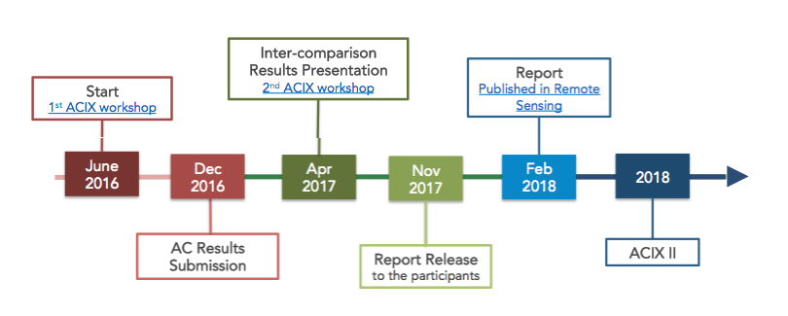
Atmospheric Correction Intercomparison eXercice
ACIX is a joint effort between ESA and NASA to organize the inter-comparison of atmospheric correction processors for Landsat 8 and Sentinel 2. A common and harmonized inter-comparison procedure was agreed and followed by all the participants.
Doxani, G.; Vermote, E.; Roger, J.-C.; Gascon, F.; Adriaensen, S.; Frantz, D.; Hagolle, O.; Hollstein, A.; Kirches, G.;Li, F.; Louis, J.; Mangin, A.; Pahlevan, N.; Pflug, B.; Vanhellemont, Q. "Atmospheric Correction Inter-Comparison Exercise." Remote Sens. 2018,10,352. doi:10.3390/rs10020352.
Slide ‹#›

Slide 3
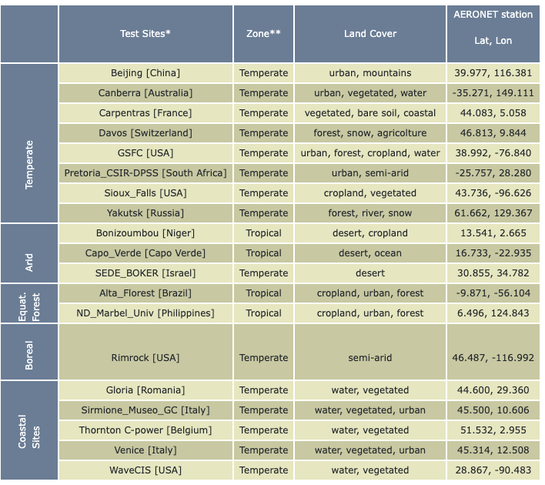
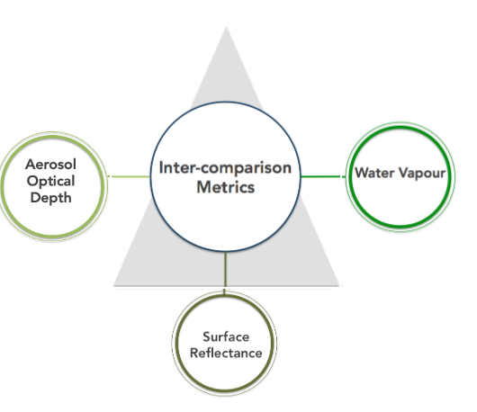
ACIX-I Intercomparison metrics
The inter-comparison was performed separately for all the AC products, i.e. AOT, WV and SR, and on image subsets of 9 km x 9 km centered on the AERONET Sunphotometer station of every test site.
Slide ‹#›

Slide 4
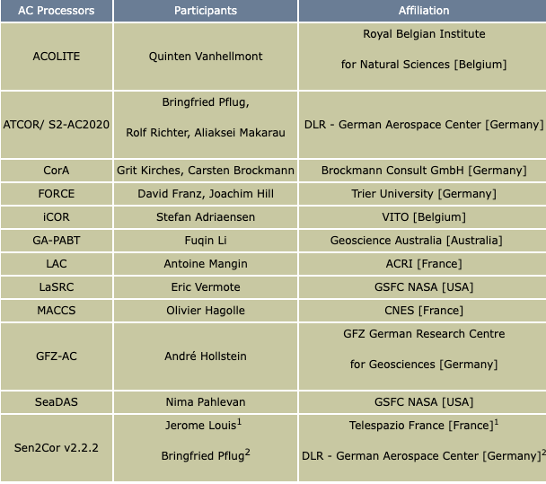
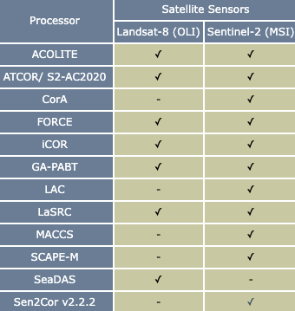
ACIX-I participants
Slide ‹#›

Slide 5
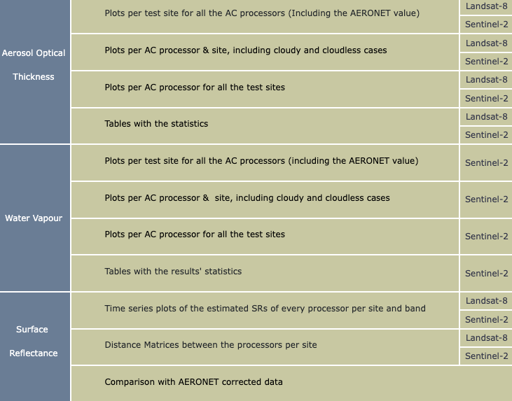
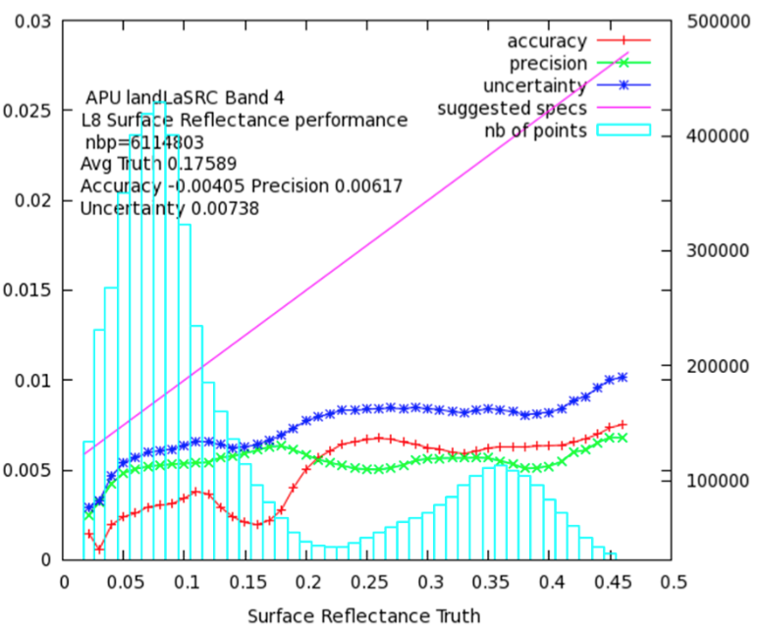
ACIX-I Results
OLI band 4
https://calvalportal.ceos.org/results
Slide ‹#›

Slide 6
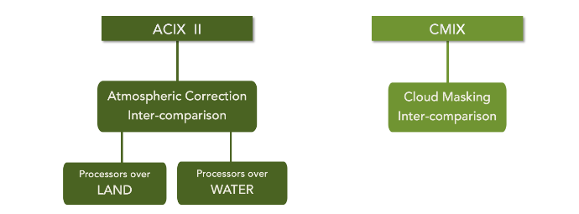
ACIX-II / CMIX
Georgia Doxani, Eric F. Vermote, Jean-Claude Roger, Sergii Skakun, Ferran Gascon, Alan Collison, Liesbeth De Keukelaere, Camille Desjardins, David Frantz, Olivier Hagolle, Minsu Kim, Jérôme Louis, Fabio Pacifici, Bringfried Pflug, Hervé Poilvé, Didier Ramon, Rudolf Richter, Feng Yin, 2023. Atmospheric Correction Inter-comparison eXercise, ACIX-II Land: An assessment of atmospheric correction processors for Landsat 8 and Sentinel-2 over land. Remote Sensing of Environment, 285, p.113412. https://doi.org/10.1016/j.rse.2022.113412
Sergii Skakun, Jan Wevers, Carsten Brockmann, Georgia Doxani, Matej Aleksandrov, Matej Batič, David Frantz, Ferran Gascon, Luis Gómez-Chova, Olivier Hagolle, Dan López-Puigdollers, Jérôme Louis, Matic Lubej, Gonzalo Mateo-García, Julien Osman, Devis Peressutti, Bringfried Pflug, Jernej Puc, Rudolf Richter, Jean-Claude Roger, Pat Scaramuzza, Eric Vermote, Nejc Vesel, Anže Zupanc, Lojze Žust, 2022, Cloud Mask Intercomparison eXercise (CMIX): An evaluation of cloud masking algorithms for Landsat 8 and Sentinel-2,2022. Cloud Mask Intercomparison eXercise (CMIX): An evaluation of cloud masking algorithms for Landsat 8 and Sentinel-2. Remote Sensing of Environment, 274, p.112990. https://doi.org/10.1016/j.rse.2022.112990
Slide ‹#›

Slide 7
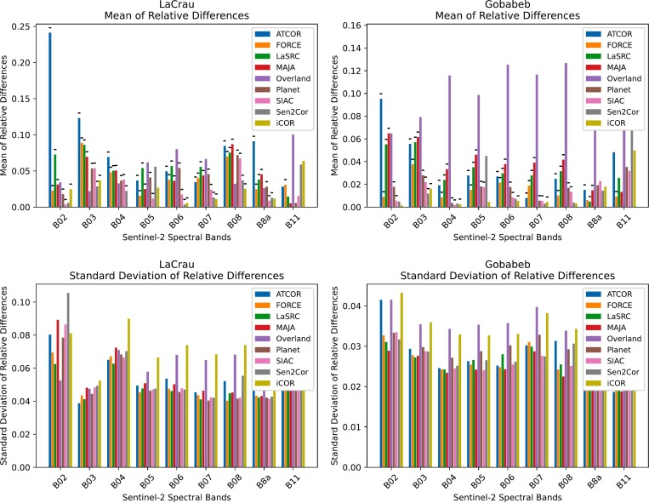
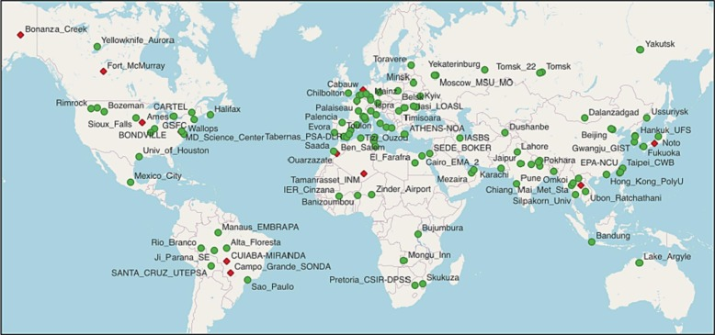
ACIX-II Land Intercomparison sites
AERONET SITES (~120)
Slide ‹#›

Slide 8
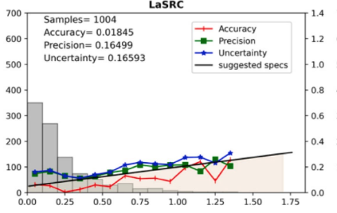
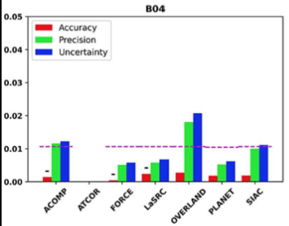
ACIX-II Land outcomes
Aerosol Optical Depth retrieval errors for Sentinel-2 and Landsat-8 were 0.1–0.2.
Water vapour retrieval errors for Sentinel-2 were 0.2–0.4 g/cm².
Lower surface reflectance uncertainties for SWIR and NIR than visible bands.
Surface reflectance uncertainties < 0.01 for the best performing processors.
“Good performances with standard deviations of the relative differences mostly <0.05 were witnessed in the analysis based on the RadCalNet measurements. Nevertheless, the available observations in this case were limited over stable surface and atmospheric conditions. Networks of ground-based stations distributed globally and dedicated to SR validation are expected in the near future to provide valuable data for robust quality assessment of optical missions over land.”
Slide ‹#›

Slide 9
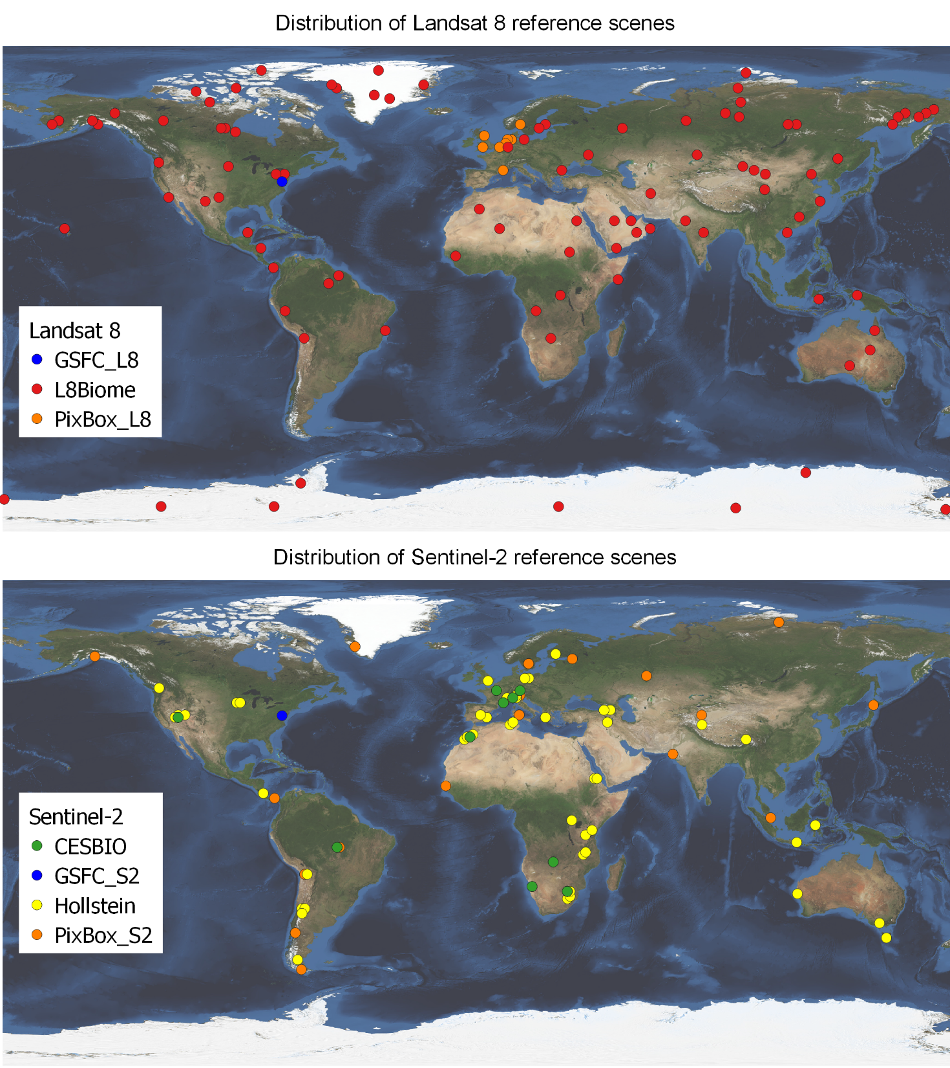
CMIX reference datasets
Dataset | Spatial domain | Spatial resolution | # scenes
CESBIO | Fully classified Sentinel-2 scenes | 60 m | S2: 30
GSFC | Sample polygons | Polygons (vector) | L8: 6 S2: 28
Hollstein | Sample polygons | Polygons (at 20 m) | S2: 59
L8Biome | Fully classified Landsat 8 scenes | 30 m | L8: 96
PixBox | Sample pixels | S2: 10 m L8: 30 m | S2: 29 L8: 11
Slide ‹#›

Slide 10
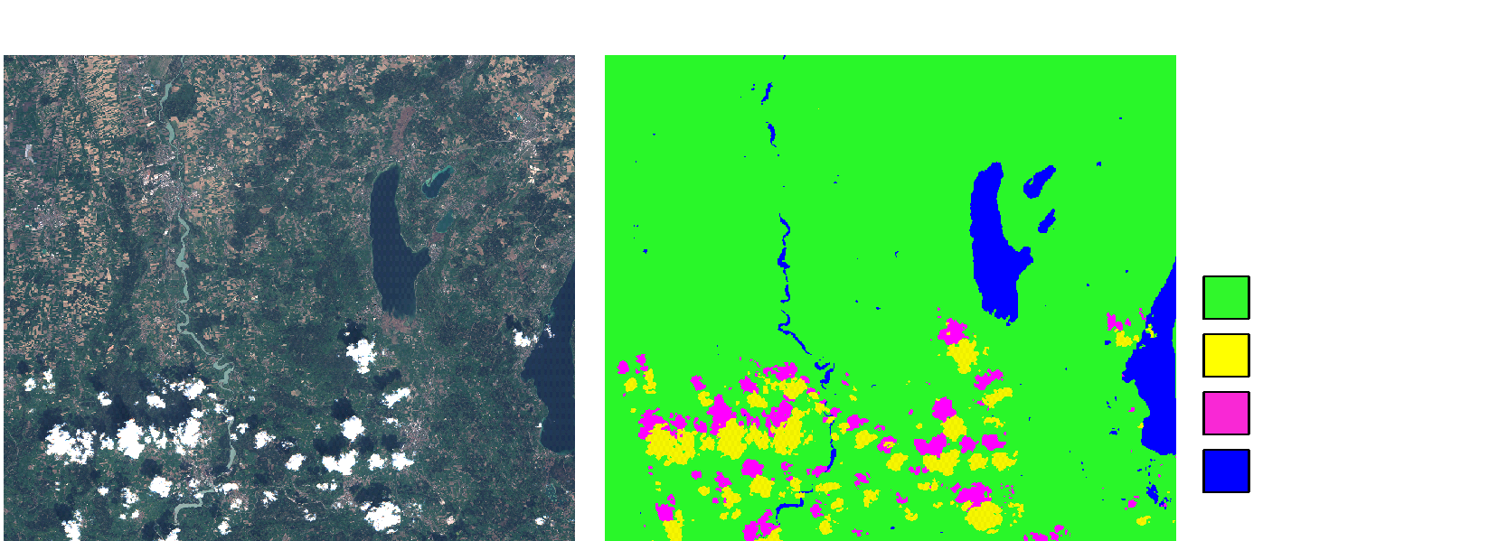
CESBIO reference dataset
CMIX reference datasets

Slide 11
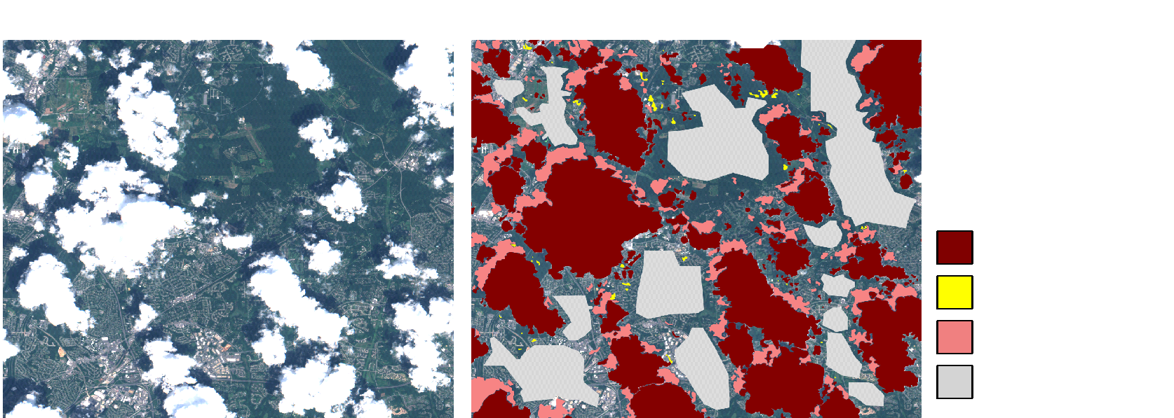
GSFC reference dataset polygons

Slide 12
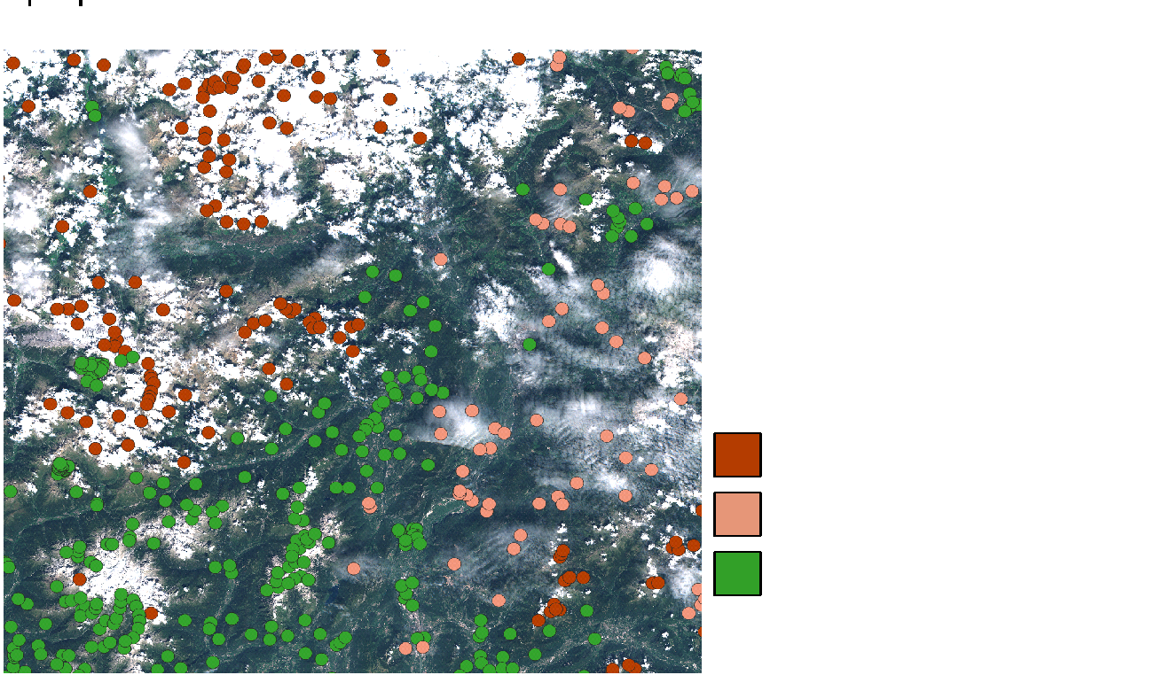
Pixbox reference dataset

Slide 13
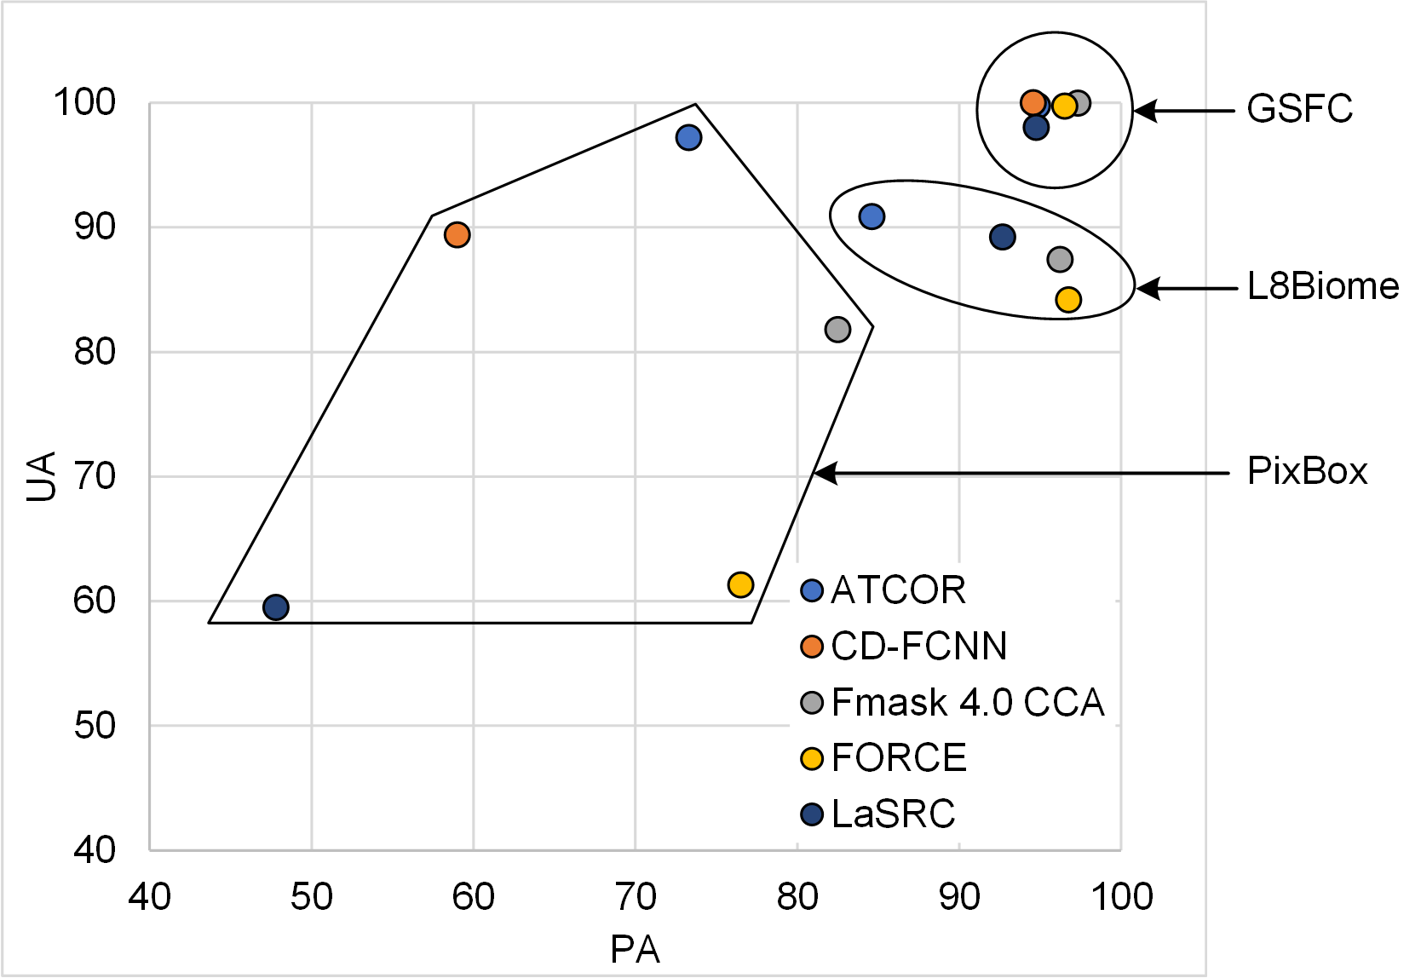
CMIX : Landsat 8 results
Slide ‹#›

Slide 14
CMIX outcomes
Performance varied depending on the reference data
Average OA for Sentinel-2: 80% to 89%
Average OA for Landsat 8: 80% to 98%
Performance improved when thin/semi-transparent clouds not considered
“further activities include provision of a quantitative definition for clouds (targeting moderate spatial resolution imagery by Landsat 8 and Sentinel-2), generation of new reference datasets, and expansion of the analysis framework (for example, multi-temporal analysis and application-driven validation). Such intercomparison studies will hopefully help the community to improve the algorithms and move towards standardization of cloud masking. Given the importance of cloud masking in optical imagery we encourage CEOS to continue the CMIX activities.”

Slide 15
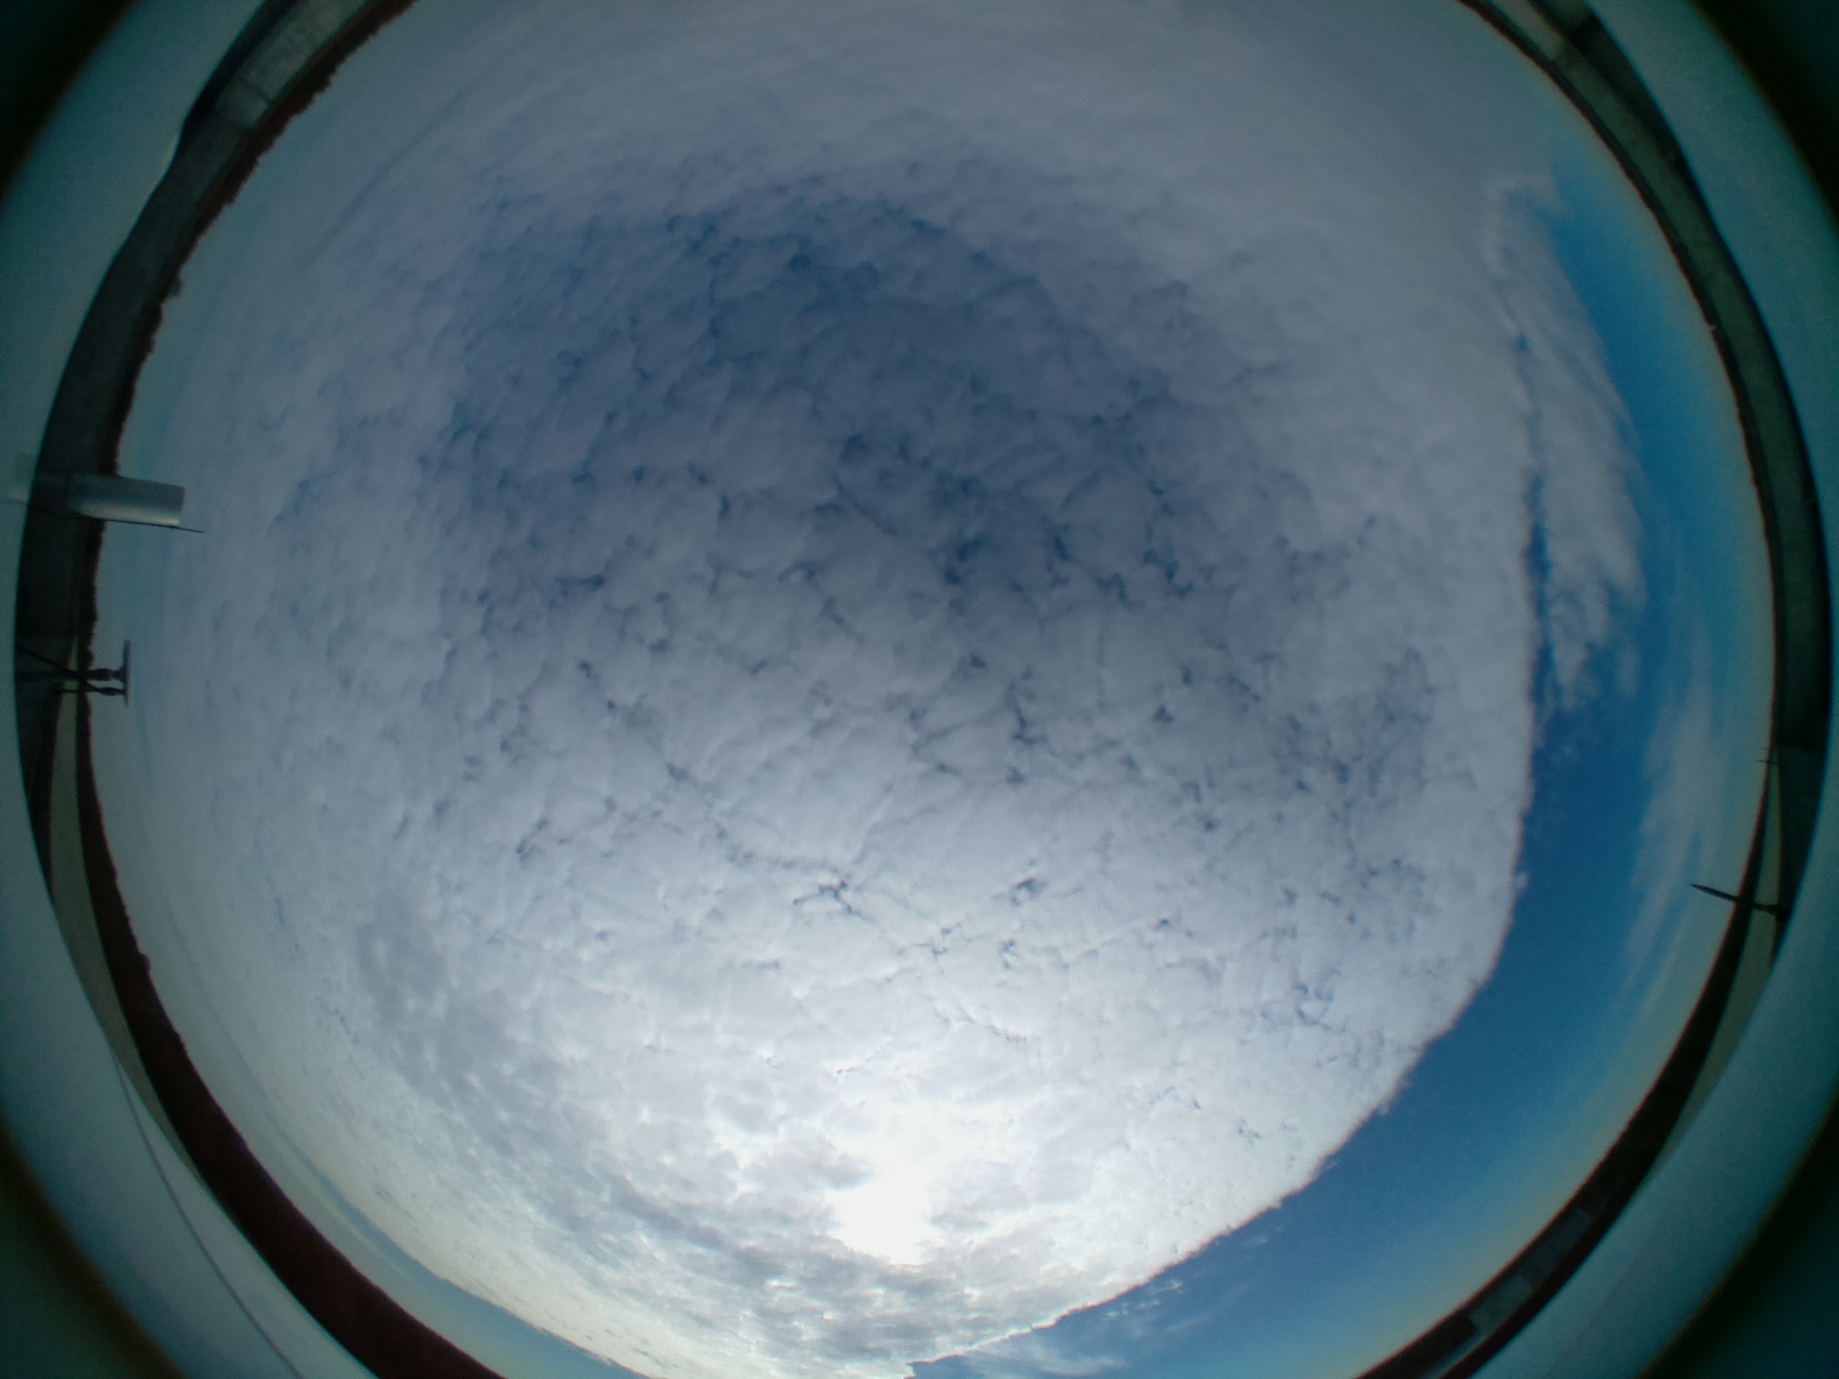
SKYCAM Camera network for cloud characterization

Slide 16
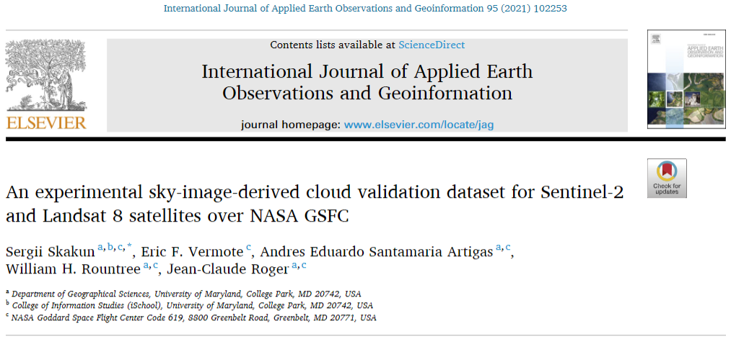
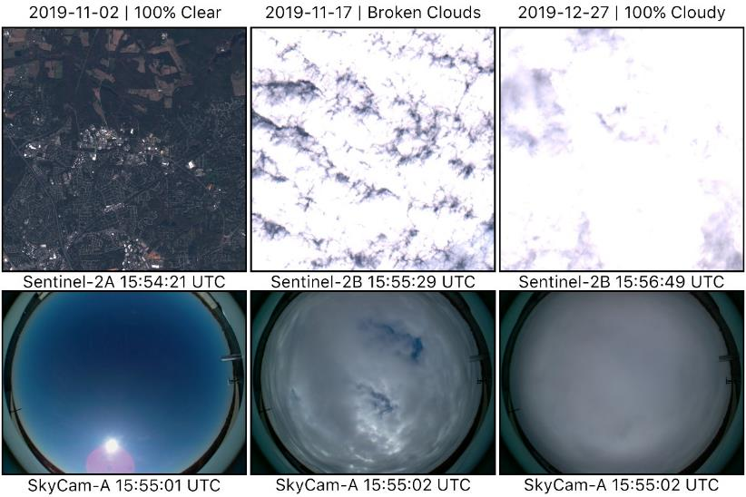
Cloud validation: SKYCAM
Ground-based sky camera network
For objective validation of satellite-derived cloud masks.
Proof of concept: manual iPhone with fisheye lens over NASA GSFC.
Next step: automatic system, enabling replication over multiple sites: SKYCAM Project.

Slide 17
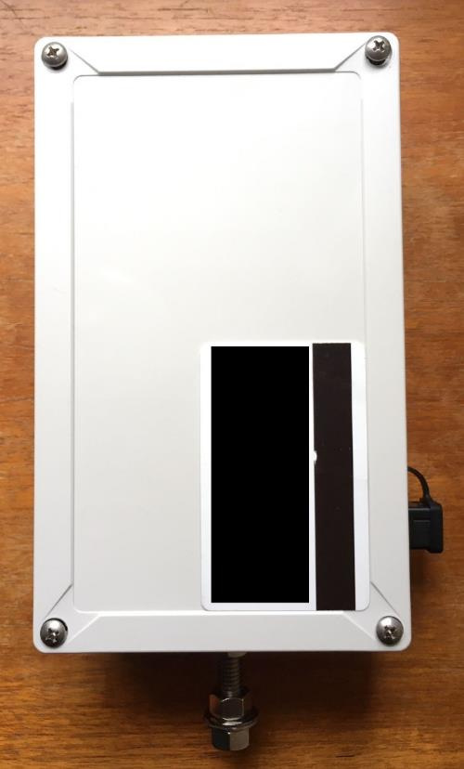
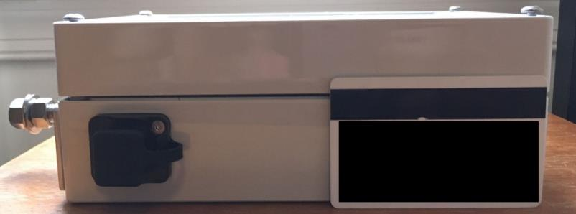
SKYCAM System
12 cm
Self-contained system:
RGB camera
~180-degree lens
Single board computer (Raspberry-Pi)
Power delivery (POE/Alternatives)
Weatherproof* enclosure (IP66/IP67)
Weight ~750g per unit.
20 cm
7.5 cm

Slide 18
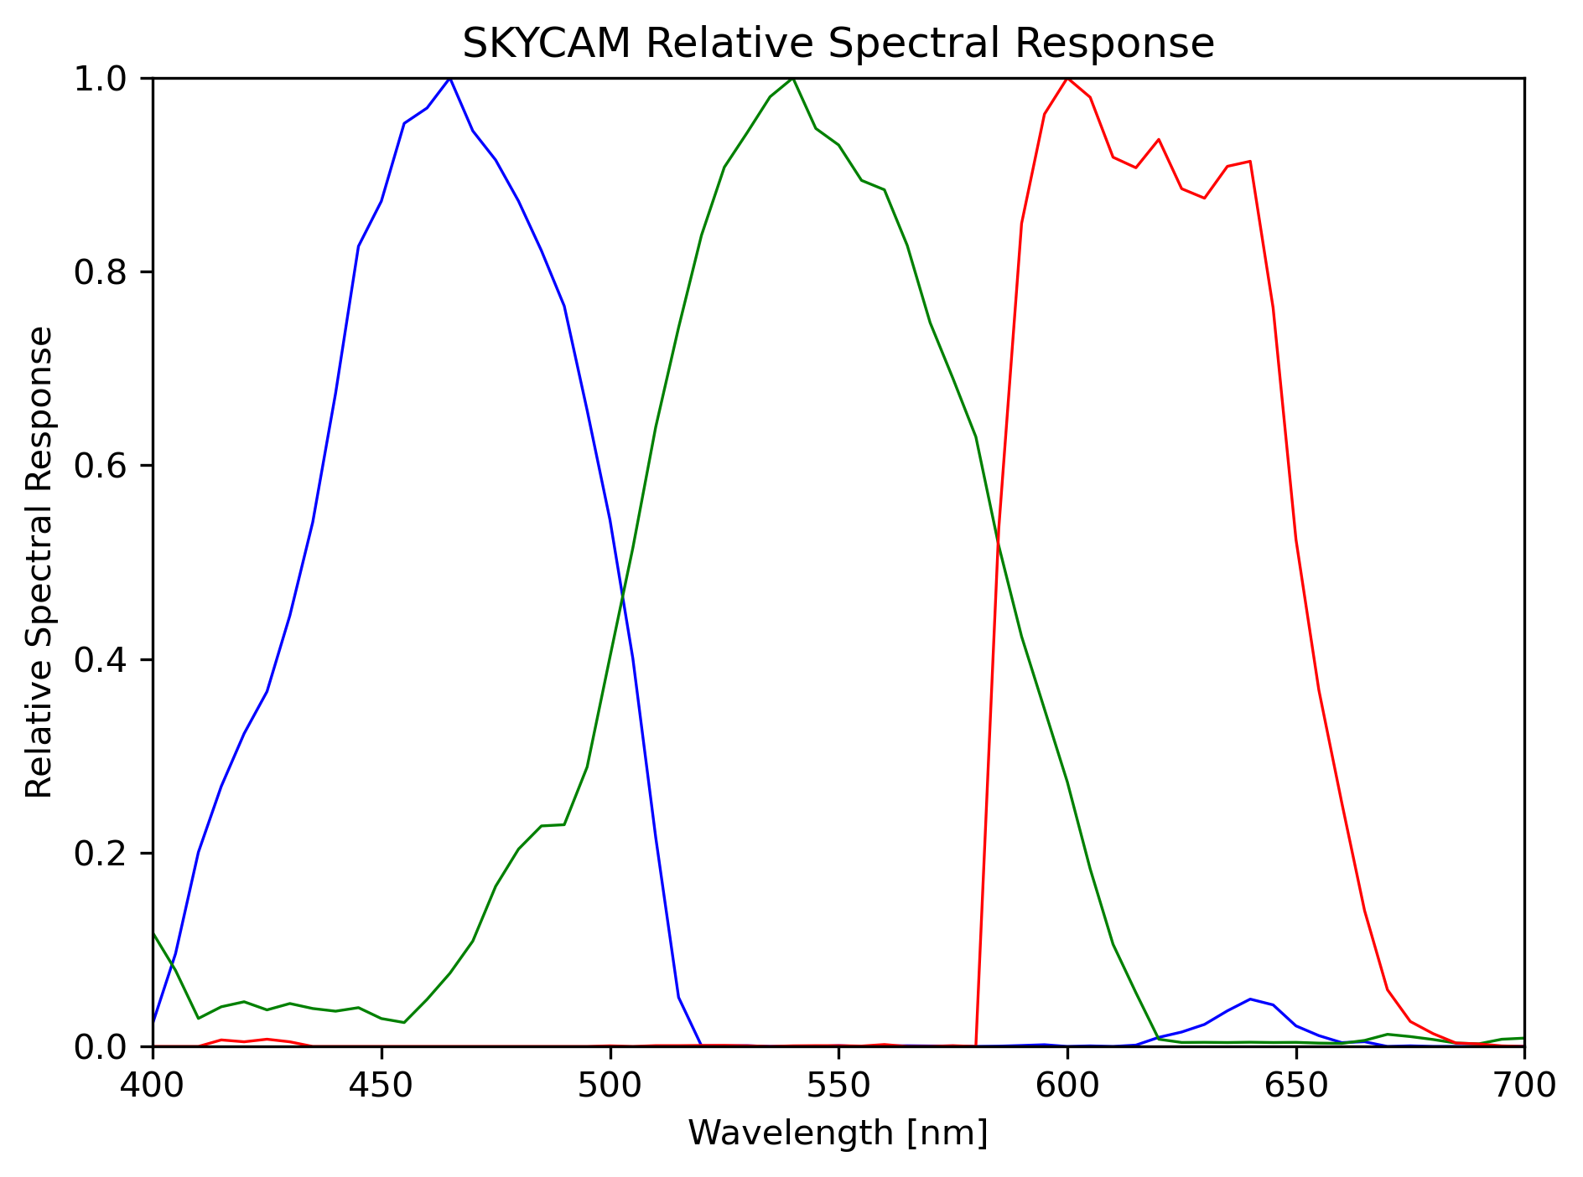
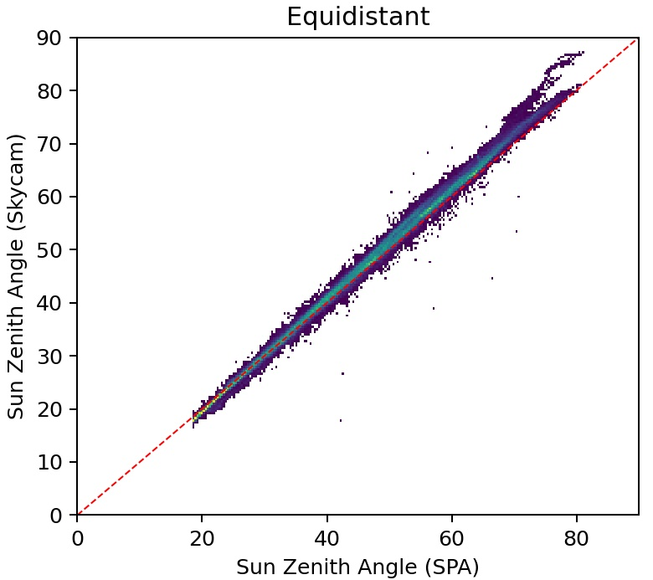
SKYCAM Characterization
Sun Zenith Angle
SKYCAM estimation vs NREL SPA²
SKYCAM Relative Spectral Response¹
¹Measured at GSFC Code 618 using Digikröm DK240 Monochromator
and ASD Fieldspec Spectroradiometer
²US National Renewable Energy Laboratory Solar Position Algorithm

Slide 19
SKYCAM Basic Requirements
Power:
Power over ethernet.
Power over USB (5V/3.0A)
Data collection and management:
Remotely via internet (WIFI/Ethernet).
Locally via direct connection (WIFI/Ethernet).
Locally via included USB drive.
Ideally two cameras installed per location.

Slide 20
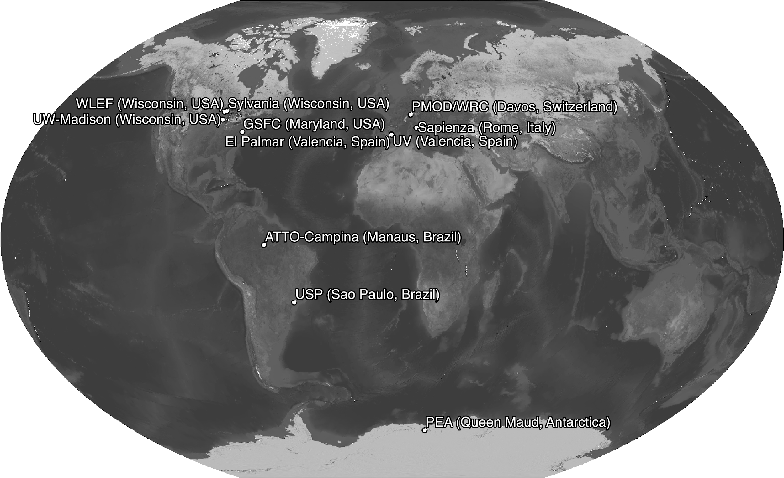
Current SKYCAM Sites

Slide 21
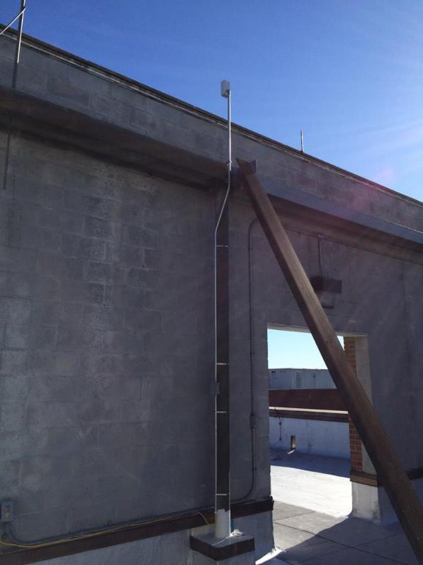
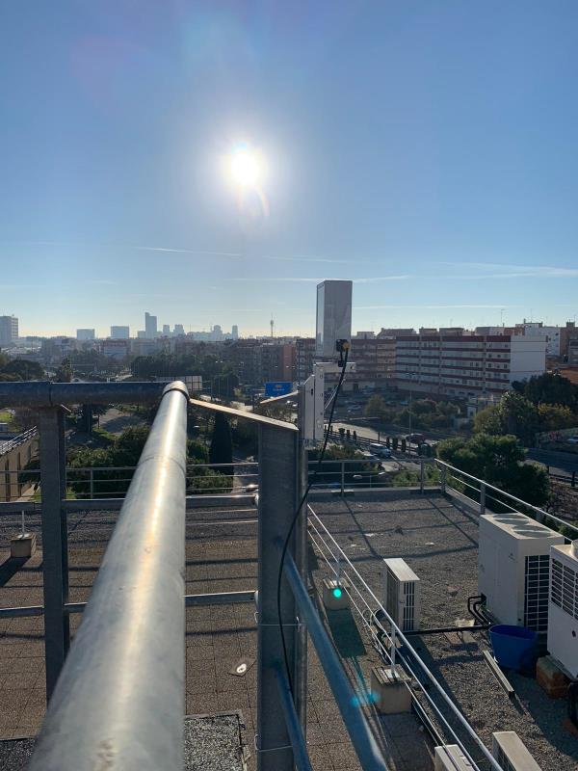
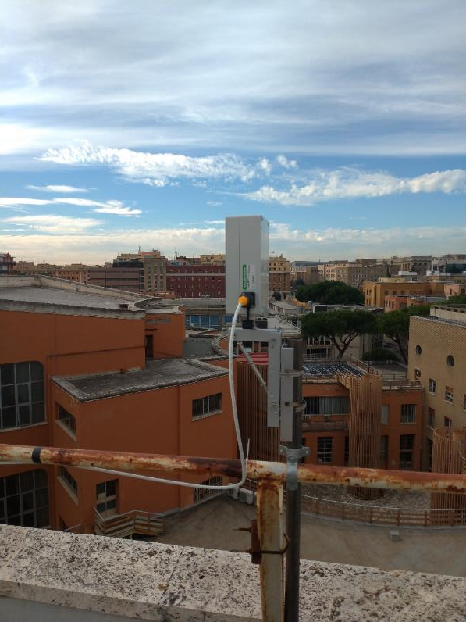
Example of current SKYCAM sites
SKYCAM1 at GSFC Building 33
Maryland, USA
SKYCAM2 at U. Sapienza Physics Dept.
Rome, Italy
SKYCAM2 at U. Valencia Physics Dept.
Valencia, Spain

Slide 22
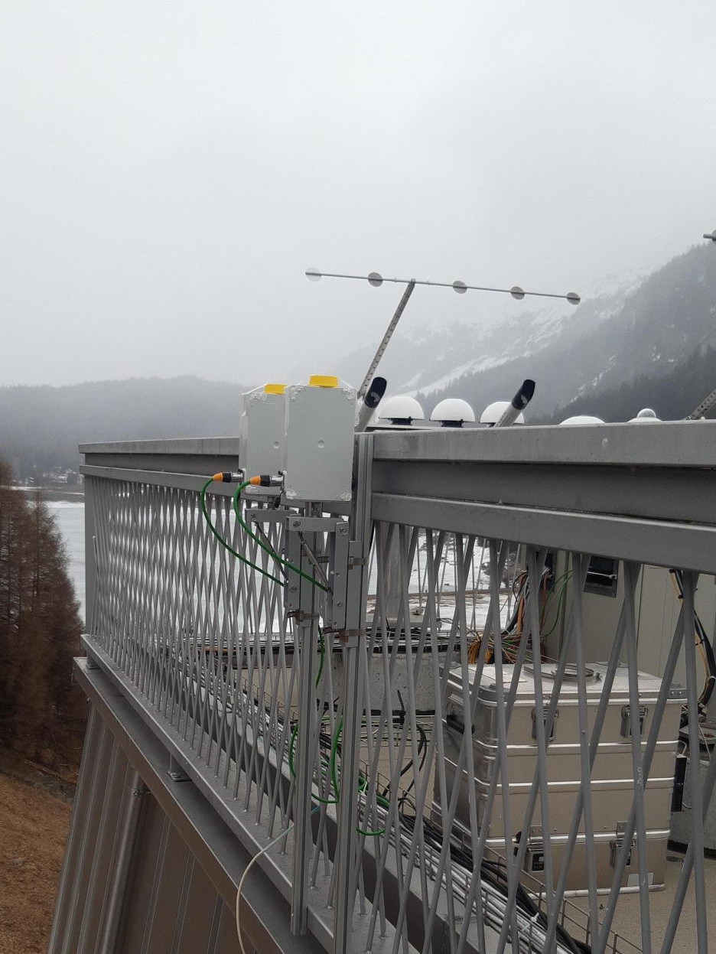
Example of current SKYCAM sites
SKYCAM1 at PEA
Queen Maud, Antarctica
SKYCAM2 at El Palmar
Valencia, Spain
SKYCAM1 at PMOD/WRC
Davos, Switzerland

Slide 23
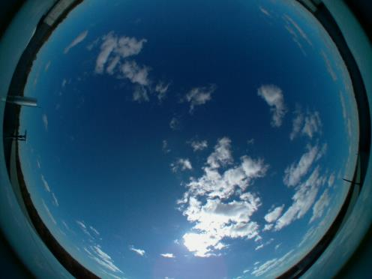
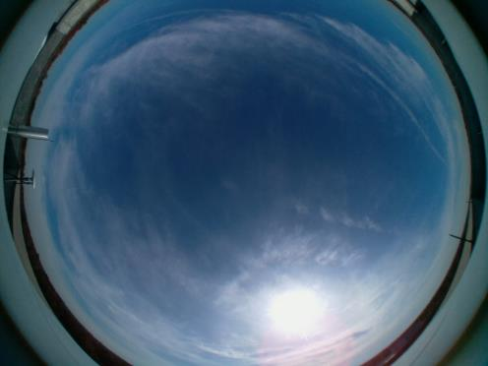
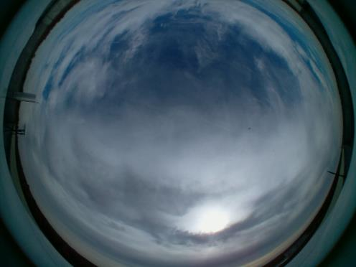
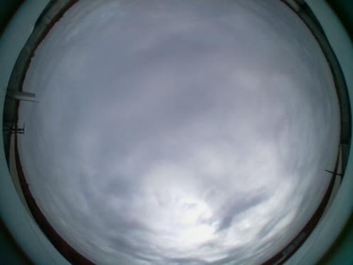
SKYCAM Imagery

Slide 24
SKYCAM Example Imagery

Slide 25
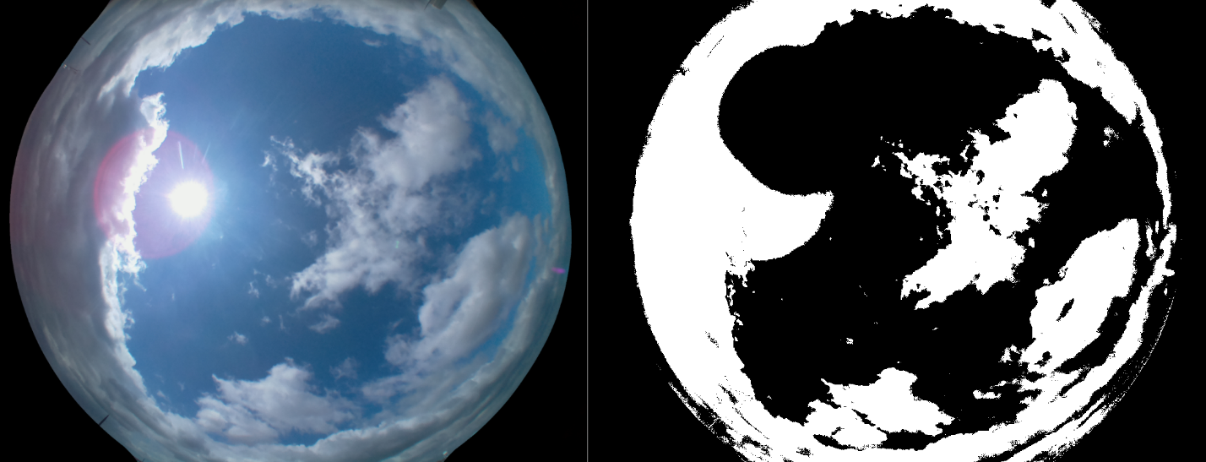
Prototype algorithm: cloud detection in ground imagery
Detection of clouds in ground-based image.
Area close to sun will be masked out in the future version of the algorithm.

Slide 26
Comparison to MODIS/Terra
Accuracies for extreme cases:
fully clear (with AOT values <0.06)
overcast (fully cloudy)
The average MODIS-derived cloud proportions were: 0.5±0.9% (for clear) and 99.2±1.1% (for overcast).

Slide 27
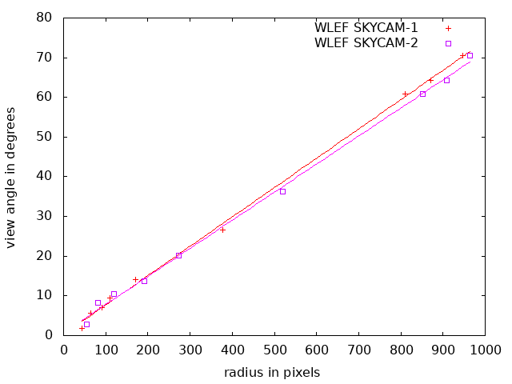
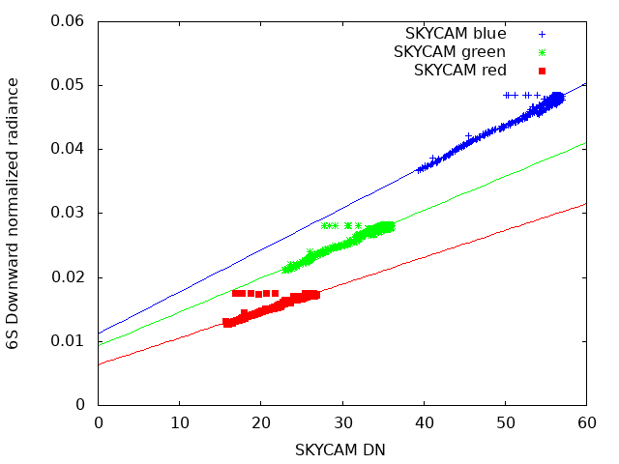
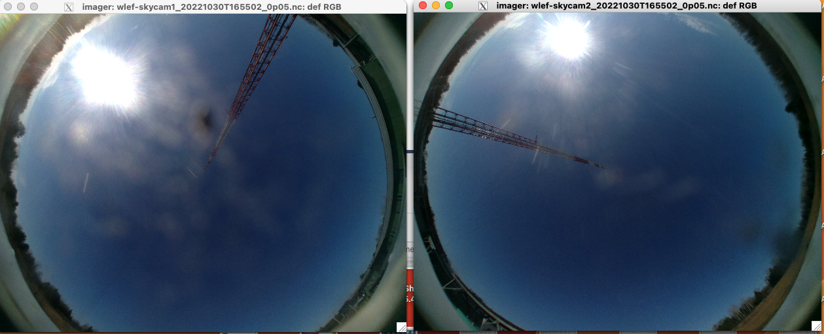
SKYCAM Calibration

Slide 28
Current work

Slide 29
Data access

