Slide 1
WGCV-52
Atmospheric Composition
Subgroup (ACSG)
Jean-Christopher Lambert
BIRA-IASB
Agenda Item 2.2
WGCV-52, ESA/ESRIN, Italy
5th - 9th June 2023

Slide 2
Atmospheric Composition Updates
New satellite missions
L1b calibration and validation
Ground-based Network Design and Evolution
Maturity Assessment Procedures (FRM-MAP & ValMet-MAP)
Aerosols and cloud profile validation protocol [CV-22-01] by R. Koopman
Tropospheric ozone harmonization and validation [VC-20-01]
Air Quality Constellation validation [VC-20-02/03/04] by B. Veihelmann

Slide 3
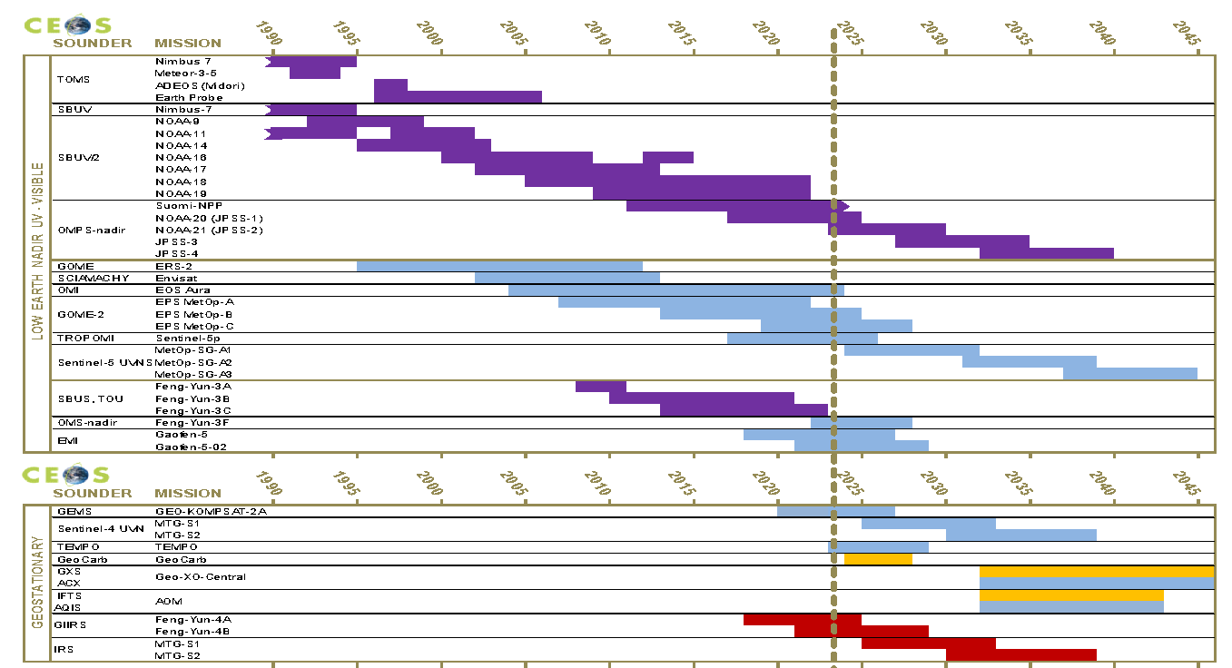
Missions Updates: LEO Nadir UV-VIS
Just launched
NOAA-21 OMPS-NP and VIIRS (2022/11)

Slide 4
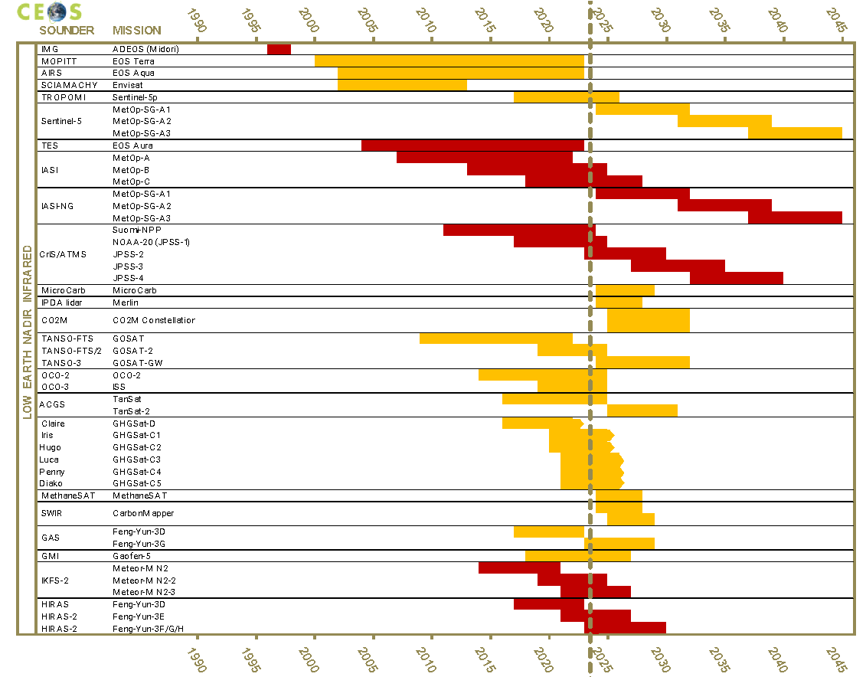
Missions Updates: LEO Nadir IR
Just launched
NOAA-21 CrIS (2022/11)
Upcoming
MicroCarb
Merlin IPDA lidar
MethaneSat
CarbonMapper
Sentinel-5 UVNS and IASI-NG
CO2M
…
GHG Constellation and New Space challenges

Slide 5
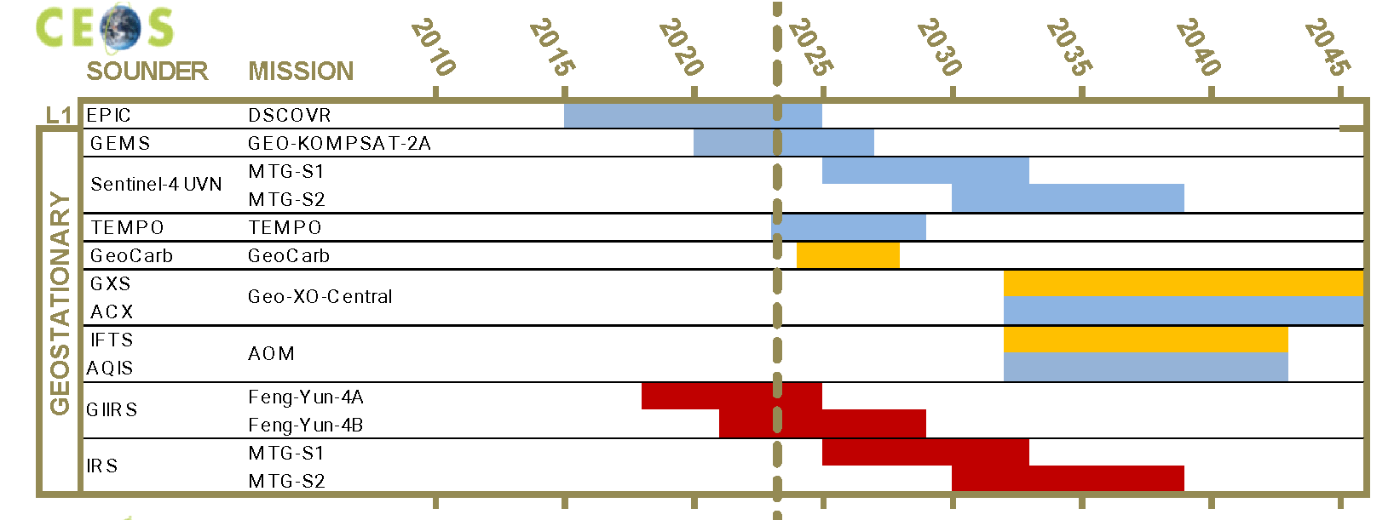
Missions Updates: GEO Nadir
Just launched
TEMPO (2023/04) (see AC-VC VC-20/02-03-04 report later)
Cancelled
GeoCarb

Slide 6
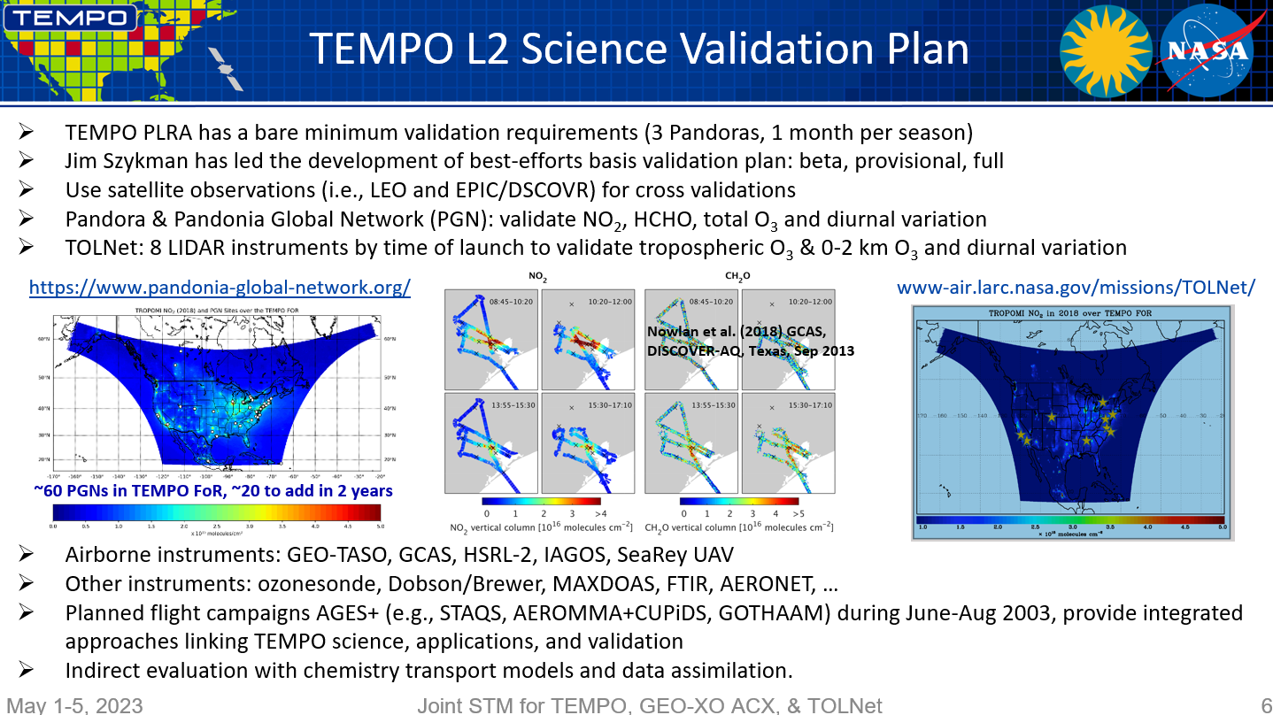
Missions Updates: GEO-AQ

Slide 7
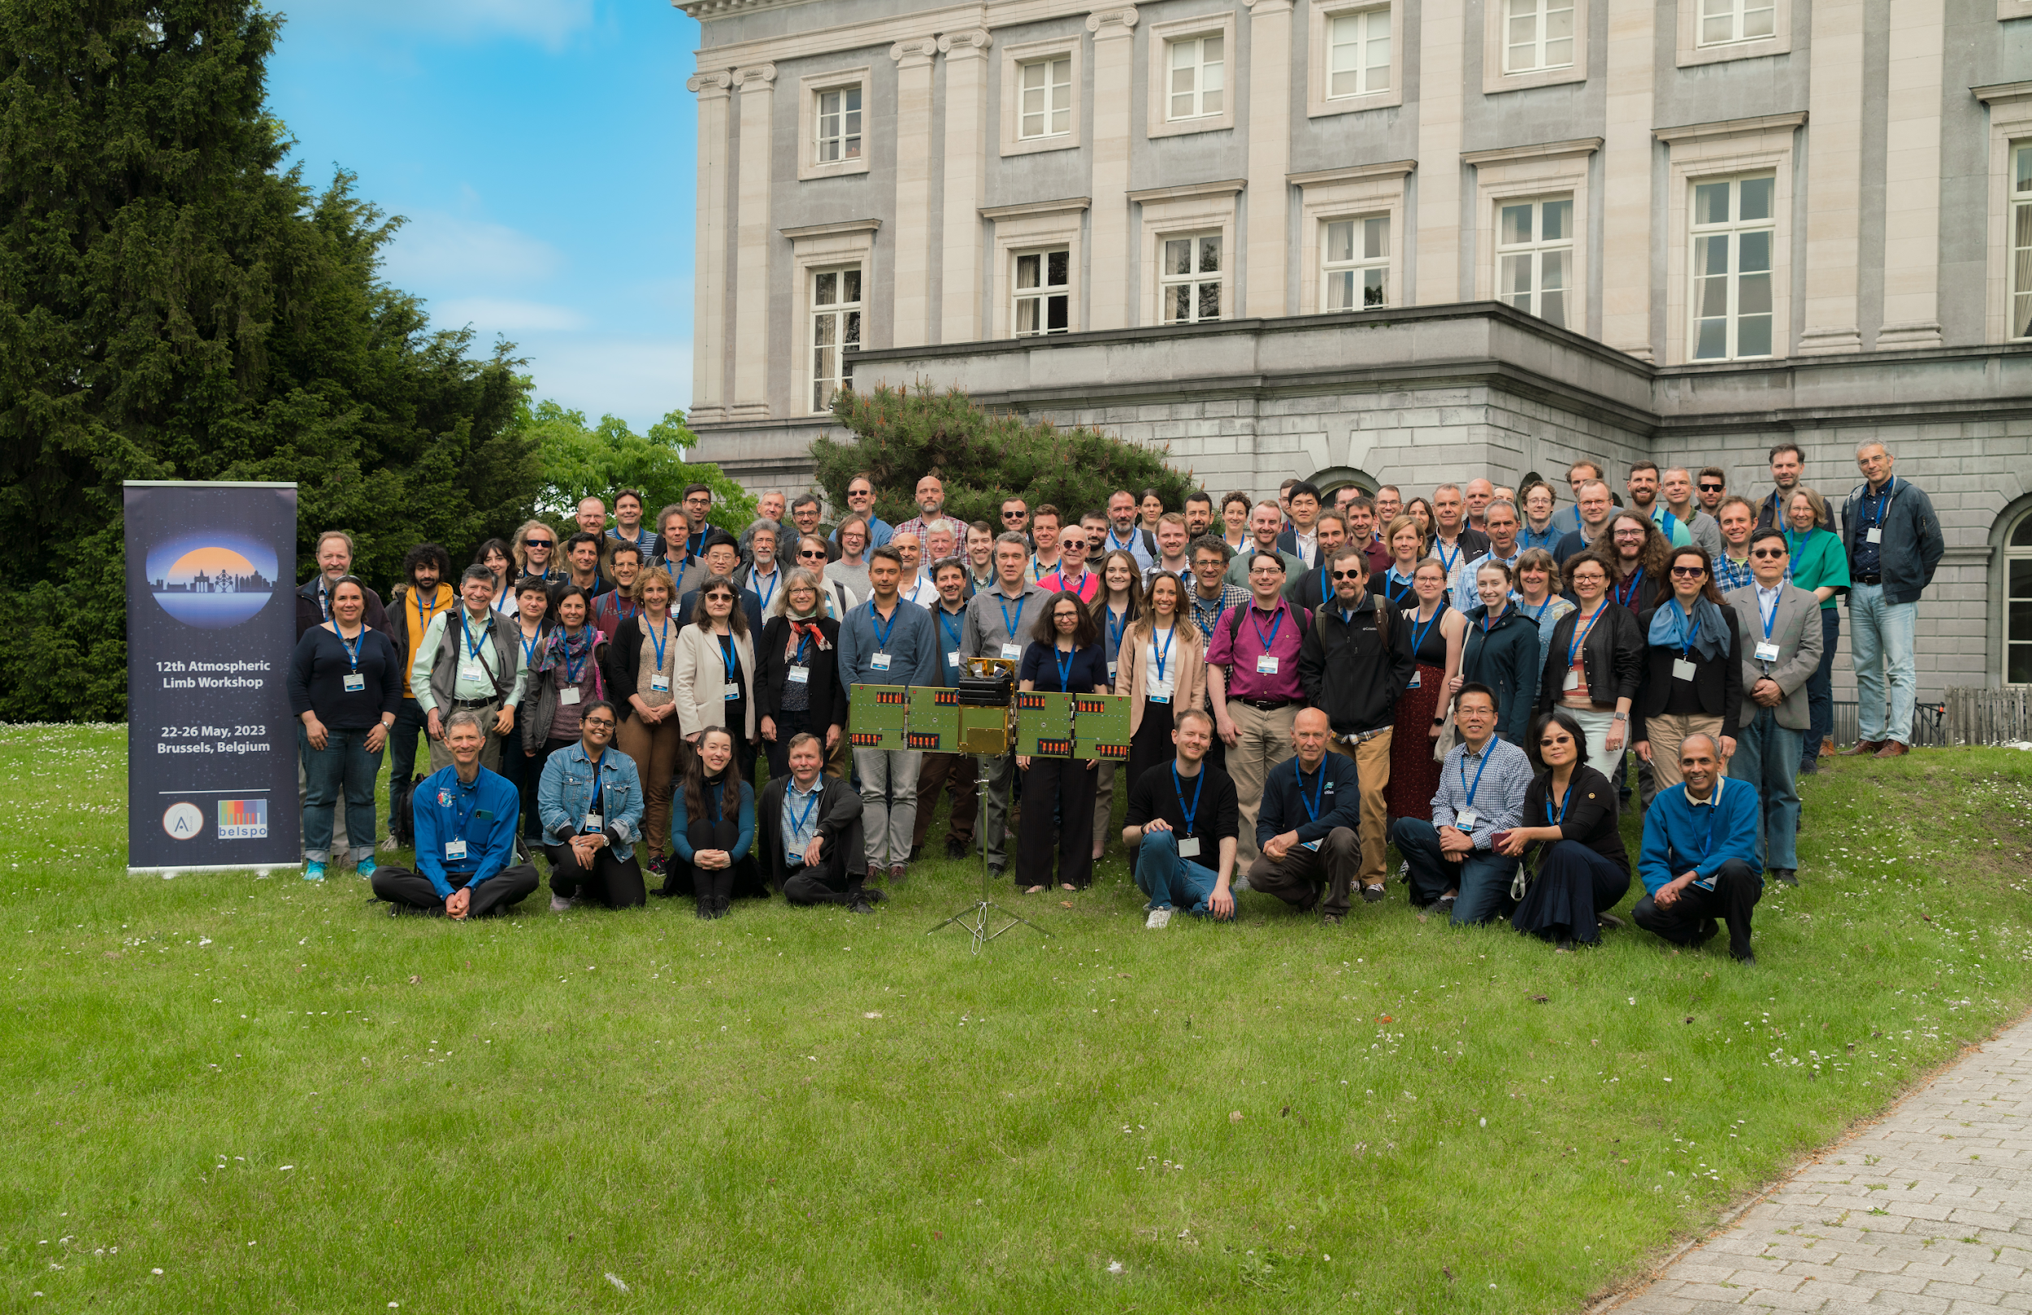
Missions Updates: Limb
12th International Atmospheric Limb Workshop, Brussels, 22-26 May 2023
Sponsored by BIRA-IASB, BELSPO, ESA and SPACEBEL https://events.spacepole.be/event/146/timetable/#20230522.detailed
Techniques, algorithms, products
  Occultation
  Limb scattering
  Planetary atmospheres
Assimilation, synergistic applications
Upcoming limb instruments
ALTIUS
Product validation
Profiles and trends of trace gases
Aerosols and clouds
Planetary trace gases and aerosols

Slide 8
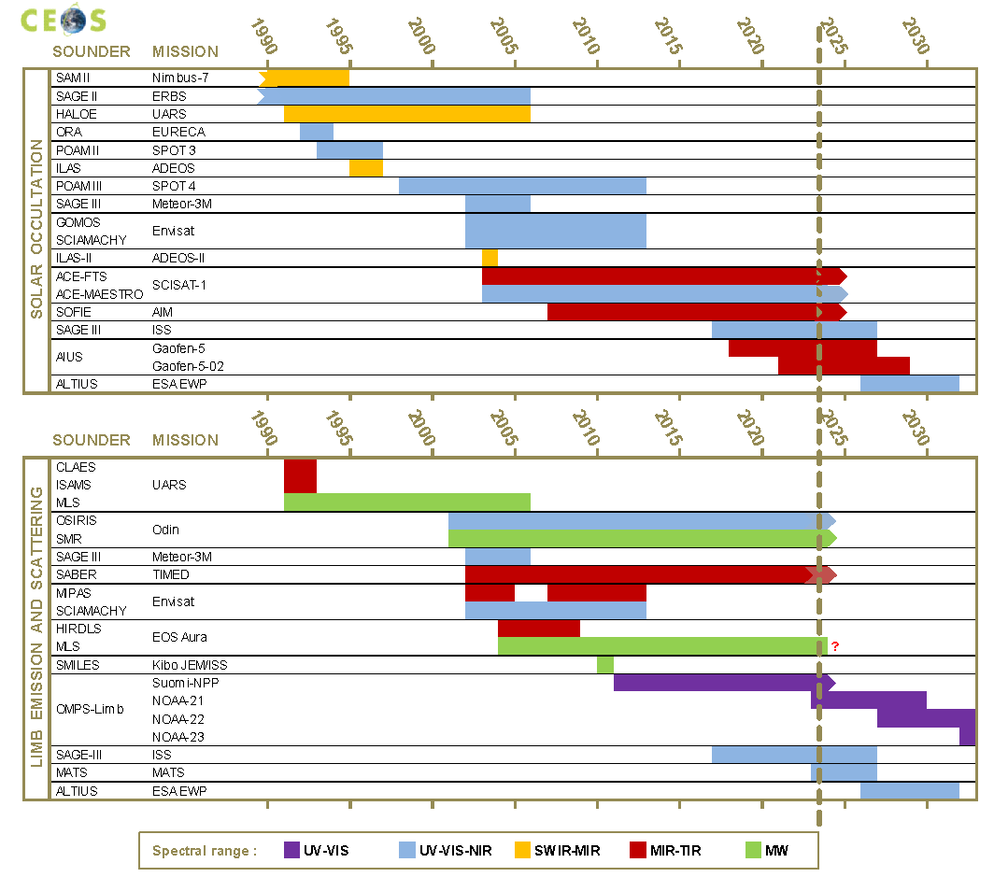
Missions Updates: Limb
New/upcoming missions
MATS (L 2022/11)
NOAA-21 OMPS (L 2022/11)
ARGOS (2024/Q2)
ALTIUS (2026/03)
Developments
C-MLS, SMILES-2
SAGE IV, CubeMAP
CAIRT (candidate EE-11)
HAWC ALI, TICFIRE and SHOW
Validation challenges: mesosphere, aerosols and clouds, water vapour, waves, 3D/tomography, constellations

Slide 9
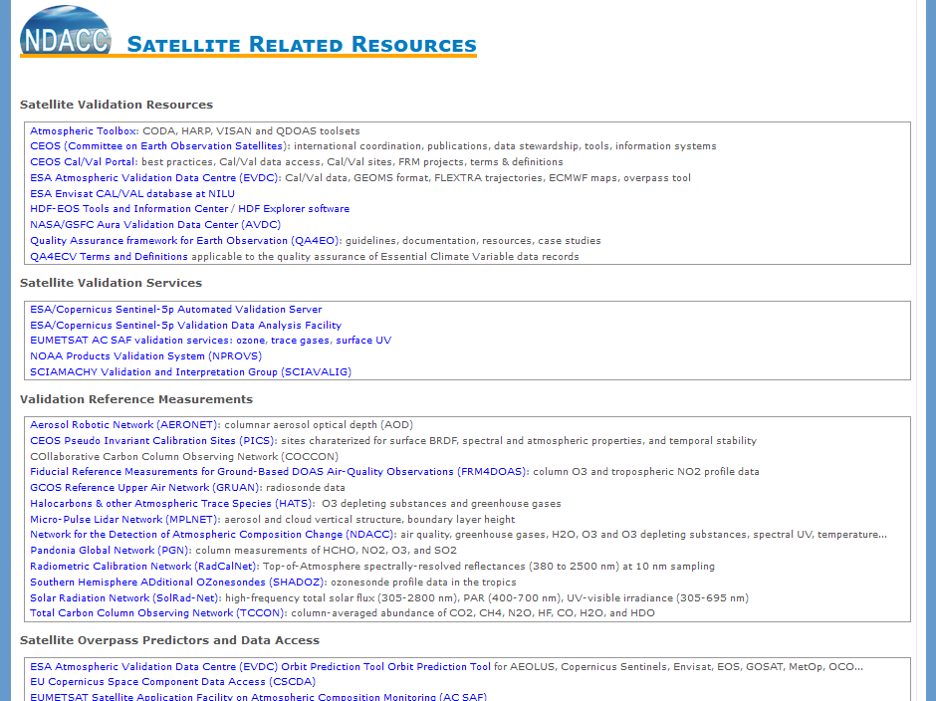
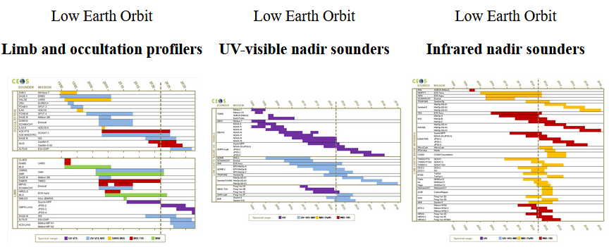
Synergies Cal/Val Portal and NDACC Satellite Website
NDACC Satellite WG website update access via main website https://ndacc.org
and https://accsatellites.aeronomie.be
  Directory of atmospheric composition (trace gases) satellite missions
  Satellite validation resources and services, reference data, overpass predictors…
Exchanges with Cal/Val Portal in progress [WGCV-50-ACT-05]

Slide 10
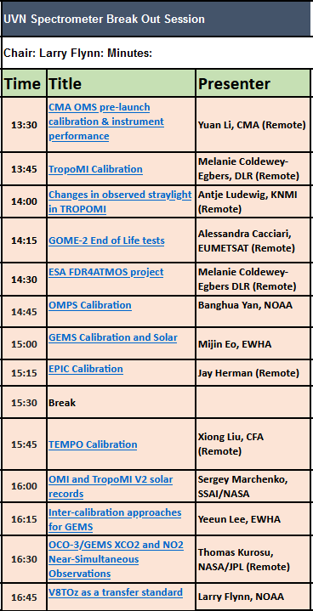
L1B Calibration and Validation
WGCV-50 question: does L1B verification/validation require a new ACSG activity?
Methods: vicarious Cal/Val campaigns, DCC, PICS, SNO, Rayleigh Scattering, GEO/LEO intercomparisons
SWIR Cal/Val for GOSAT-1/2, OCO-2/3 & TROPOMI (see report by A. Kuze et al. in WGCV-52 Item 2.8)
  OCO-TROPOMI-GOSAT Calibration Team Meeting #6 2023/01
  RRV campaigns website at JAXA https://www.eorc.jaxa.jp/GOSAT/GHGs_Vical/index.html
GSICS annual meeting 2023/03 at NOAA/NCWCP http://gsics.atmos.umd.edu/pub/Development/Gsicsannualmeeting2023/GSICS%20Annual%20Meeting%20Agenda%202023.html
  GEO-AQ constellation: GEMS, TEMPO, EPIC
  LEO-LEO, LEO-GEO, GEO-GEO
  UVN Spectrometer Break Out Session
Conclusion: ACSG should be at least observer of ongoing initiatives and identify gaps if any

Slide 11
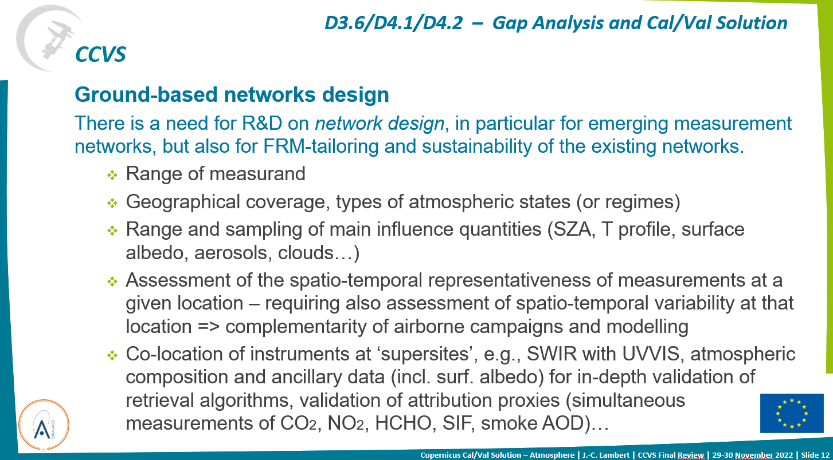

Network Design and Evolution
Multi-variate nature of satellite validation

Slide 12
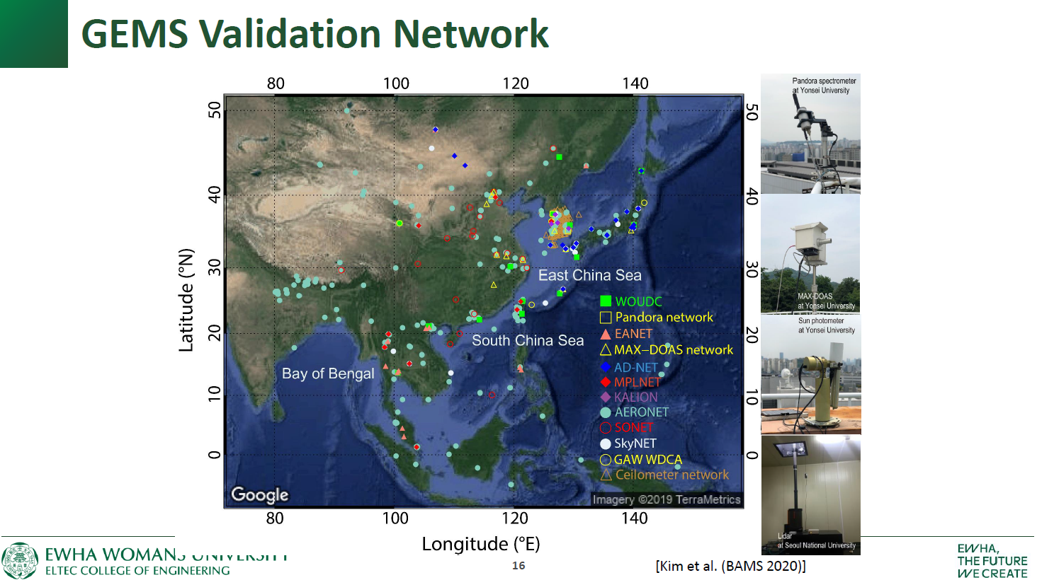

Slide 13
Network Design and Evolution
ESA FRM4xxx, EUMETSAT tailoring (AERONET, CLOUDNET), EUBREWNET, PGN v1.8, TCCON GGG2020…
EUMETSAT capacity/science studies for CO2M Cal/Val (Item 2.8): CO2M / MicroCarb workshop in Paris, July 7, 2023
NDACC Measurement Strategies and Emphases
  Update of network strategy in view of NDACC Symposium 2025 celebrating 35th anniversary of the network (formerly NDSC, incepted in 1990)
  Satellite validation strategies for NDACC-certified networks of Brewer/Dobson, FTIR, lidar, MWR, sondes, spectral UV and UV-VIS instruments
WMO RRR / Statements of Guidance (SoG)
  In preparation, initiated in November 2022 for atmospheric composition Monitoring and Forecasting, and Urban applications
  Guidance for networks evolution with consideration of satellite validation needs

Slide 14


FRM Maturity Assessment (FRM-MAP)
Context
Operational validation needs + CCVS workshops and WGs
→ Gap analysis and recommendations https://ccvs.eu
NDACC Steering Committee meeting 2022 (Sept. 26-30, Paris, hybrid)
Participants
  NDACC Instrument WGs: Brewer/Dobson, FTIR, lidar, MW, sondes, spectral UV, UVVIS
  Space agencies delegates: ESA, EUMETSAT, NASA, NIES, NOAA
  Cooperating networks representatives: AERONET, AGAGE, BSRN, EUBREWNET, GAW, GRUAN, HATS, MPLNET & GALION, PGN, SHADOZ, TCCON
ACSG relevant agenda topics:
  Satellite WG Report 2022 – incl. presentation of CEOS WGCV/ACSG and AC-VC updates
  Presentation of CCVS outcome in atmospheric domain
  Discussion on FRM maturity of NDACC measurements

Slide 15
FRM Maturity Assessment (FRM-MAP)
NDACC Steering Committee meeting 2022 discussion
FRM Maturity Assessment Procedure
  Appreciated as a guidance (i) for assessing level of maturity of NDACC sub-networks of instruments for satellite validation, and (ii) for identifying potential improvements
  Complexity: FRM criteria dependent on species/product and on satellite capabilities
  FRM maturity depends on application: absolute accuracy, vertical smoothing, spatial smoothing, long-term stability, quality of uncertainty estimates… => rather document maturity to ‘enable validators to judge themselves the fitness-for-purpose of the FRM data’
  Self-assessment procedure, as light (but still rigorous!) and objective as possible
  External supervision welcome; official accreditation (ISO…) not seen as useful
Actions taken (to be reported at annual meeting 2023):
  Satellite WG (incl. ACSG members) to better define FRM criteria in AC domain
  Instrument WGs to develop and apply tentatively a FRM Maturity Evaluation Procedure applicable to all NDACC instruments and data products

Slide 16
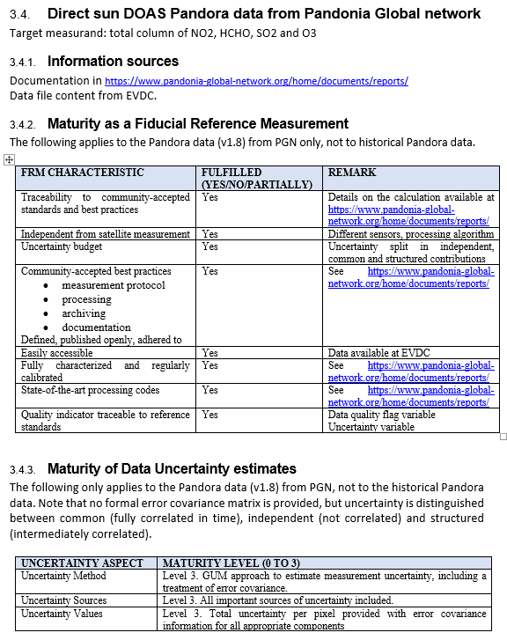
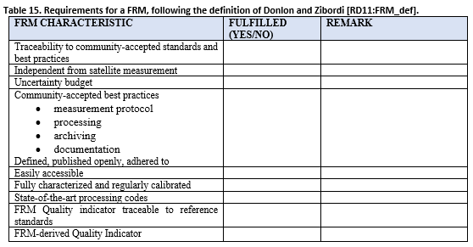
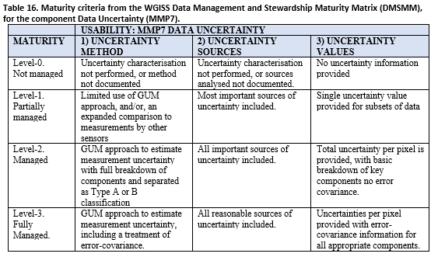
FRM Maturity Assessment (FRM-MAP)
Definition Donlon and Zibordi (2014) + QA4EO principles
CEOS WGISS DMSMM assessment for Data Uncertainty

Slide 17
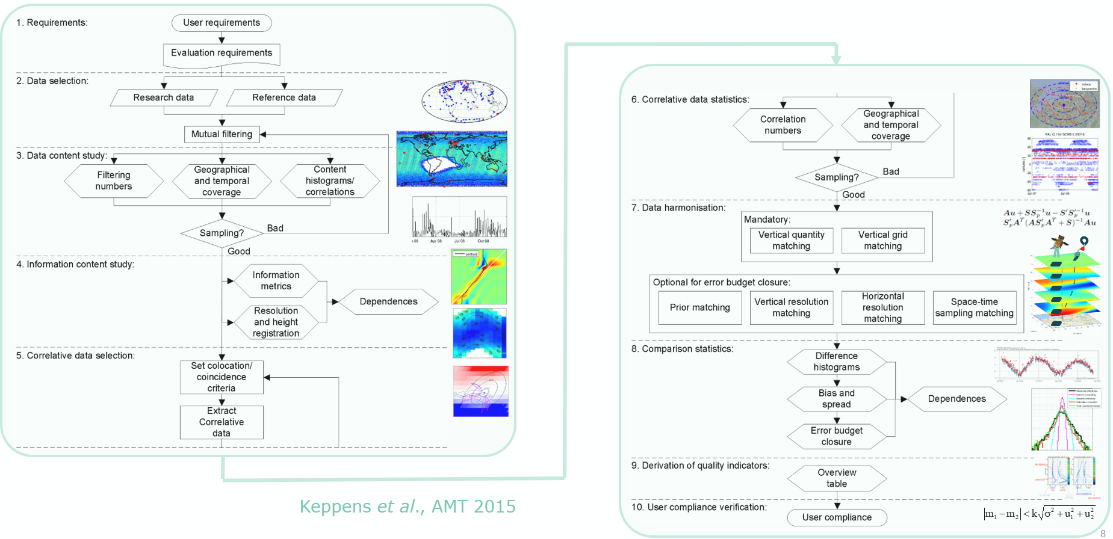
Maturity of Validation Method (ValMet-MAP)
Generic round-robin & validation chain for atmospheric composition data

Slide 18
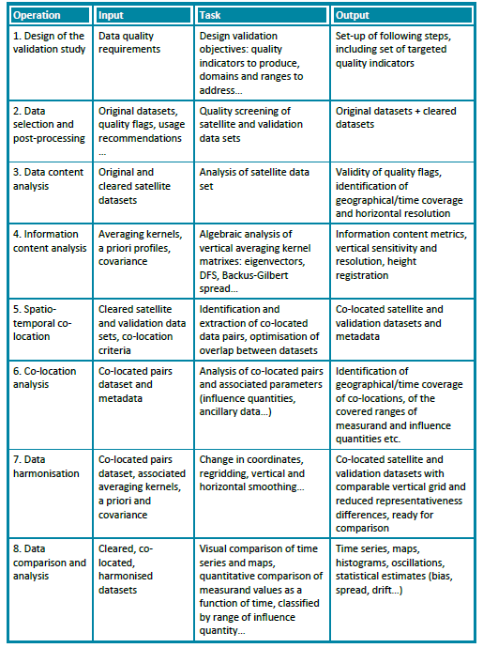
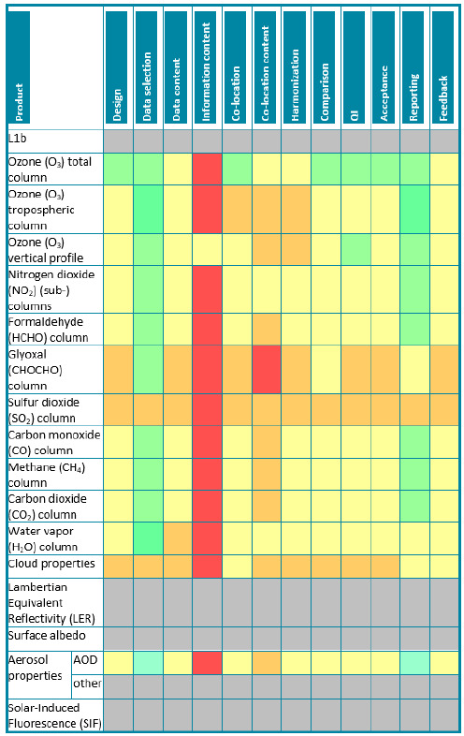
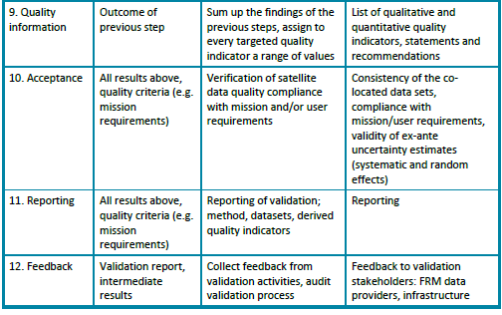
Maturity of Validation Method (ValMet-MAP)
Maturity assessment process for AC validation methods based on
Round-robin generic chain (Keppens et al., AMT 2015)
QA4ECV Automated Validation Server DPM v2 (Compernolle et al., 2016)
Validation across EO domains (Loew et al., Rev. Geophys. 2017)
Application to Sentinel data products
(Verhoelst et al., CCVS D3.2, 2022)

Slide 19
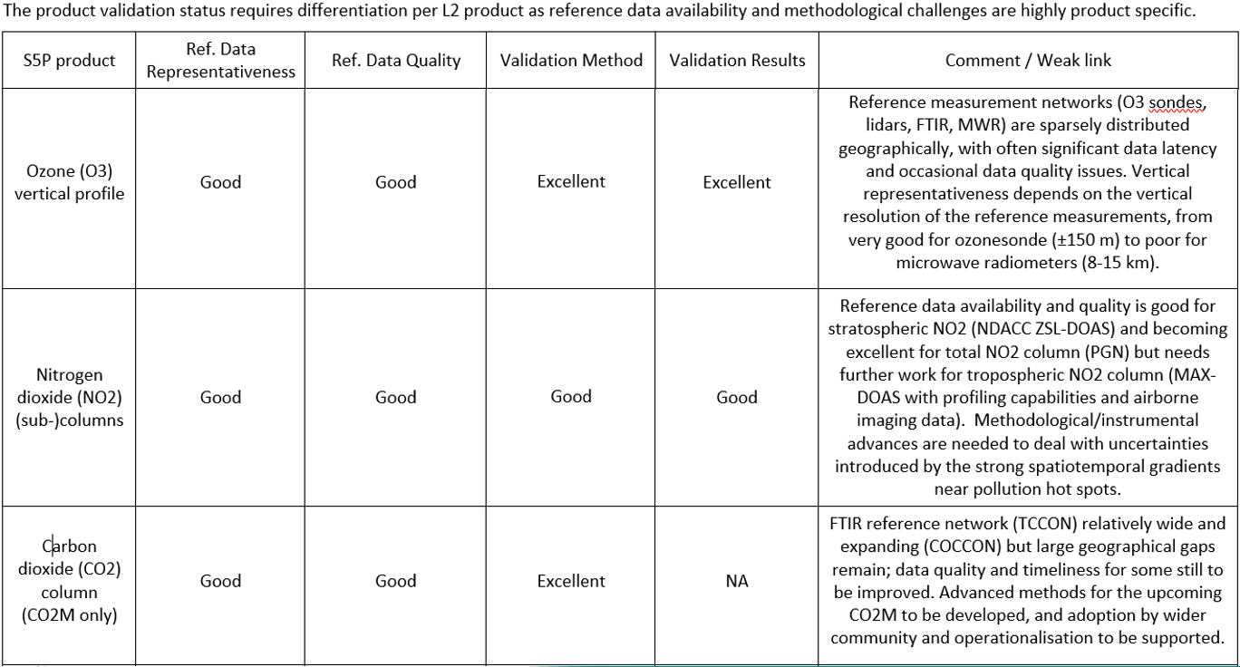
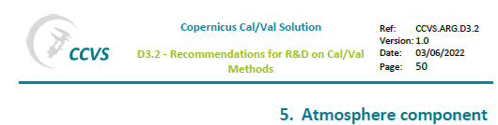
Maturity of Validation Method (ValMet-MAP)

Slide 20
FRM-MAP & ValMet-MAP
Conclusion
Development of FRM and Validation Method Maturity Assessment Procedures undertaken by NDACC in response to recommendations from H2020 Copernicus Cal/Val Solution (2020-2022)
Draft FRM-MAP and ValMet-MAP tested on several cases
Fair convergence with draft WGCV FRM Assessment Framework Roadmap (version for review received on May 25, 2023) encouraging, although applicability to atmospheric composition products not always obvious and key specificities not considered
NDACC Satellite WG & Instrument WGs happy to cooperate with WGCV on further developments, convergence, feedback, test cases…

Slide 21
CV-22-01 Aerosols and Clouds
CV-22-01: To establish validation protocols for atmospheric aerosol and cloud profiles
PoC: Rob Koopman, ESA/ESTEC
Agencies: ESA, NASA, JAXA and EUMETSAT, group expanding with 83 contributors at present
Status: see wider picture and details in EarthCARE Cal/Val presentation by Rob Koopman (Monday June 5, Item 1.3)
Deliverable: 7 chapters to be submitted to AMT, and an overview paper to BAMS; first draft by July 2023, final version in 2024/Q1

Slide 22
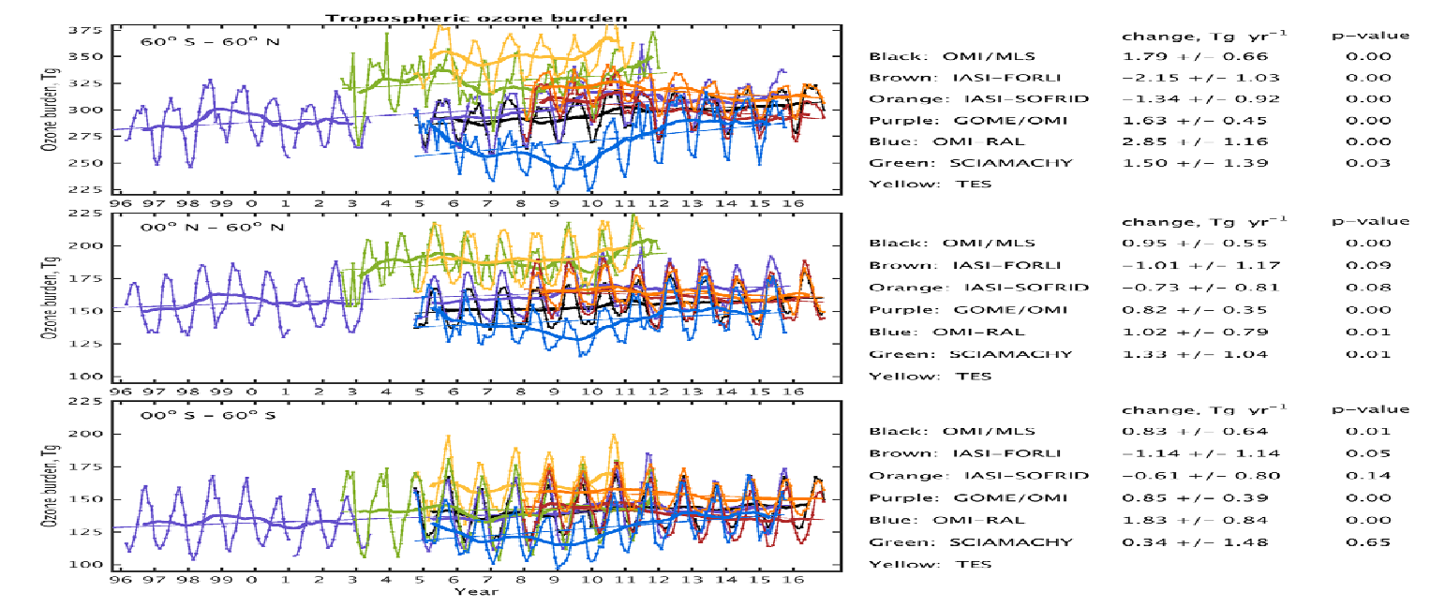

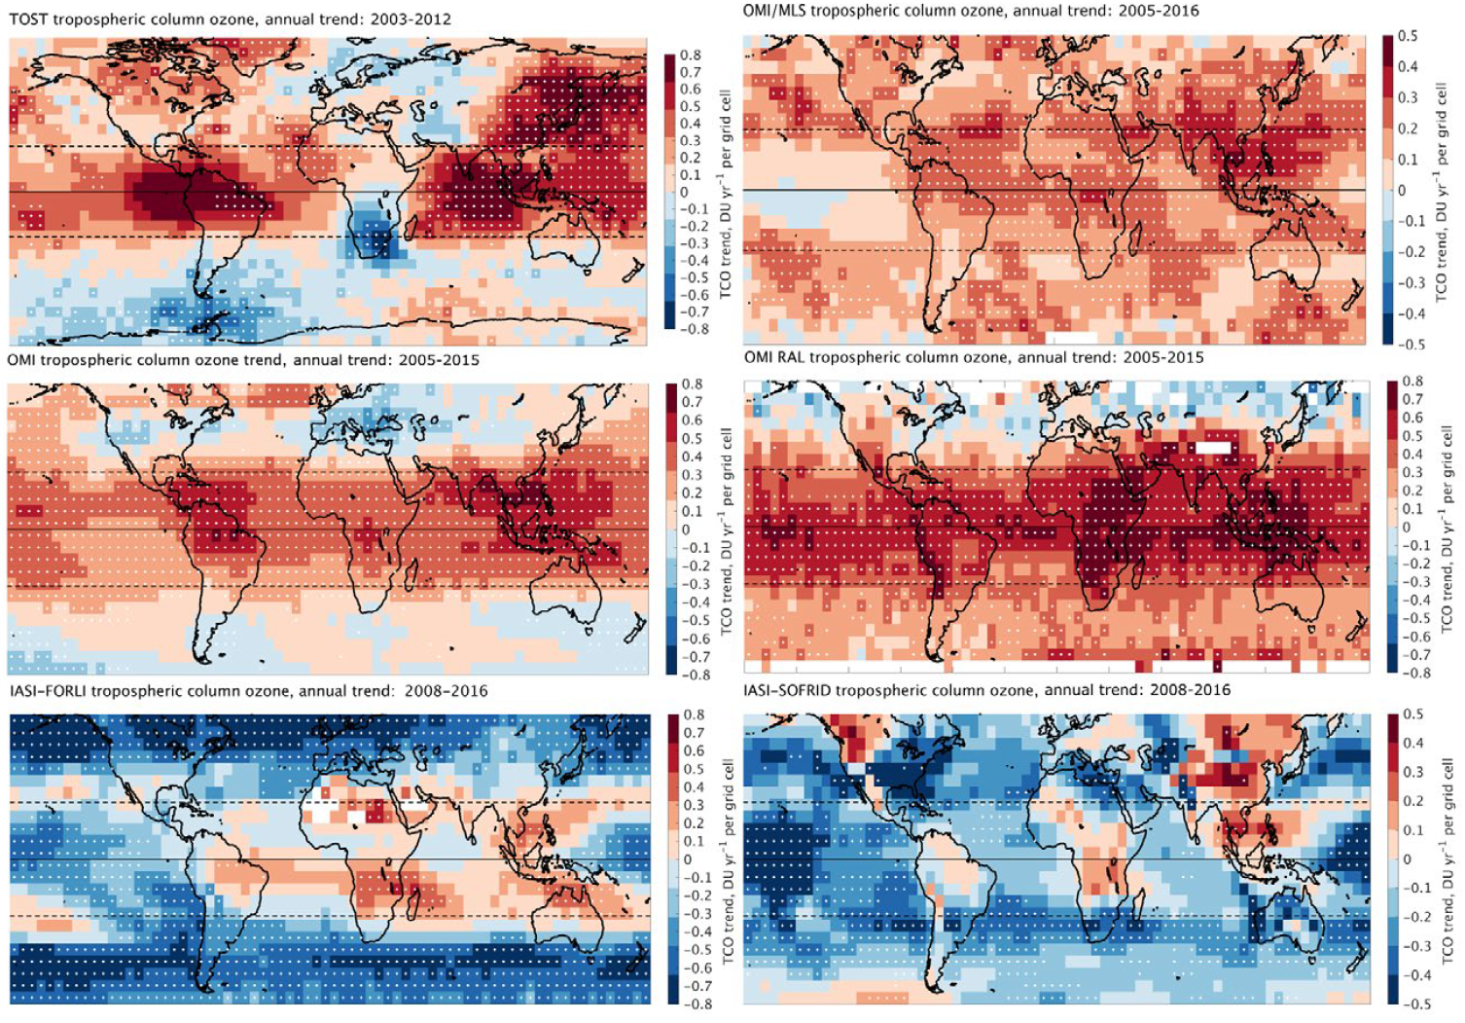
VC-20-01 Tropospheric Ozone
IGAC Tropospheric Ozone Assessment Report
Questions from TOAR-I (Gaudel et al., 2018)
Why do measured distributions and trends differ (i) among satellites, and (ii) w.r.t. monitoring networks ?
Differences in vertical sensitivity and sampling ?
Differences in tropopause column definition ?
(In)consistencies with TOST (ozonesonde based trajectories) ?
TOAR-II Satellite Ozone Working Group
Address above issues
Reconcile satellite-, ground- and aircraft-based data
Global chemistry transport models as transfer standard
Provide common methodology for validation of trends
Tropospheric Ozone Burden
Tropospheric Ozone Annual Trend

Slide 23
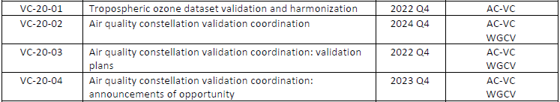
VC-20-01 Tropospheric Ozone
→ CEOS response to IGAC TOAR-II needs
Coordinator: D. Loyola (DLR)
Contributors: BIRA-IASB, DLR, ESA, FMI, JPL, KNMI, LISA, NASA, NOAA, RAL, ULB, U.Busan…
Close cooperation with TOAR-II Satellite Ozone WG and HEGIFTOM WG
VC-20-01 schedule and status:
    Kick-off at AC-VC-16 (2020/06), harmonization and validation protocol AC-VC-17 (2021/06)
    Several TOAR-II SOWG and HEGIFTOM meetings in 2021 and 2022
    VC-20-01 report at AC-VC-18 (March 2022/03): first harmonization and validation results
    Methods and validation results discussed at TOAR-II Workshop (2023/03, Cologne),
    Ongoing: more datasets, large scale validation, scoping of TOAR-II publications (2023+)
    VC-20-01 report at AC-VC-19 (October 2023/10, Brussels)

Slide 24
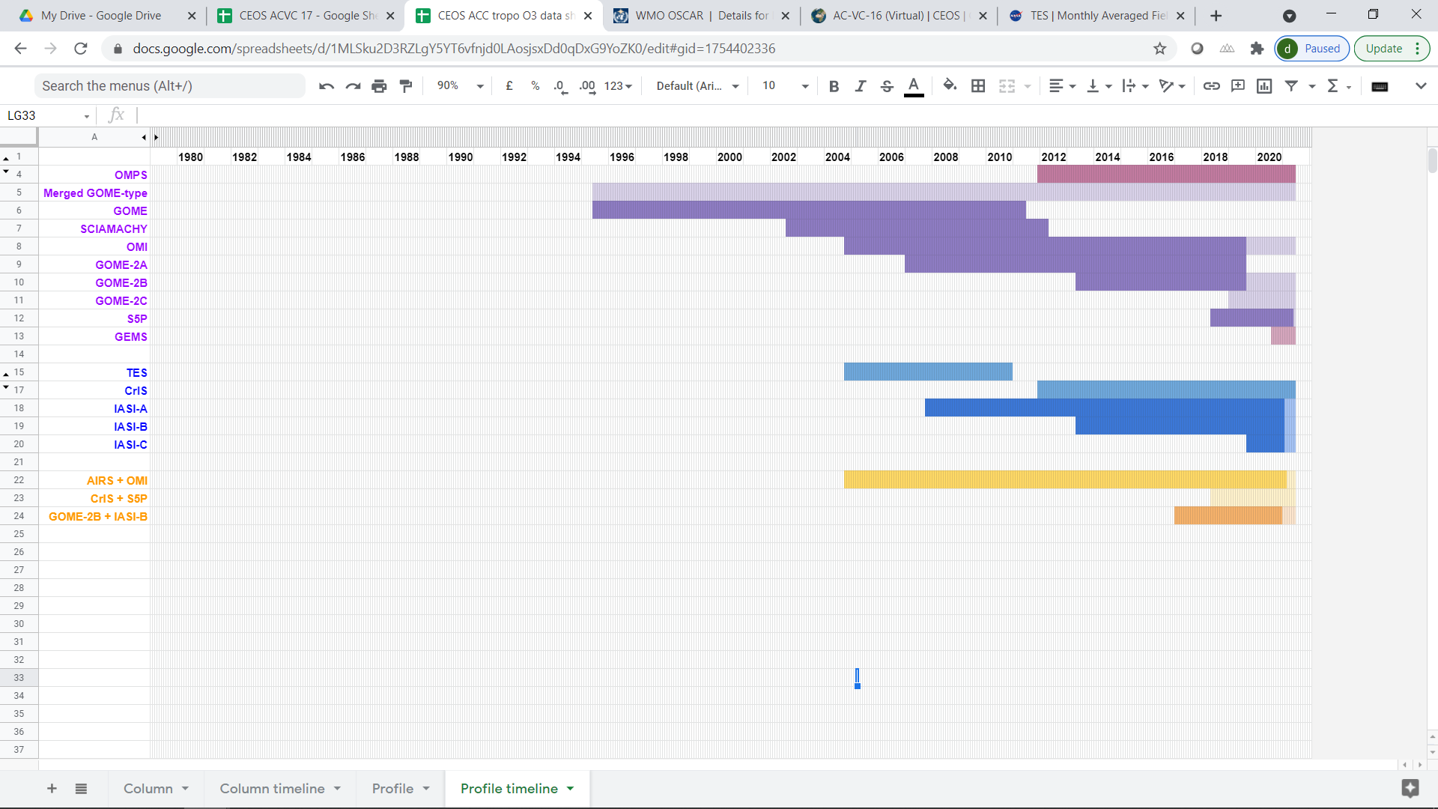
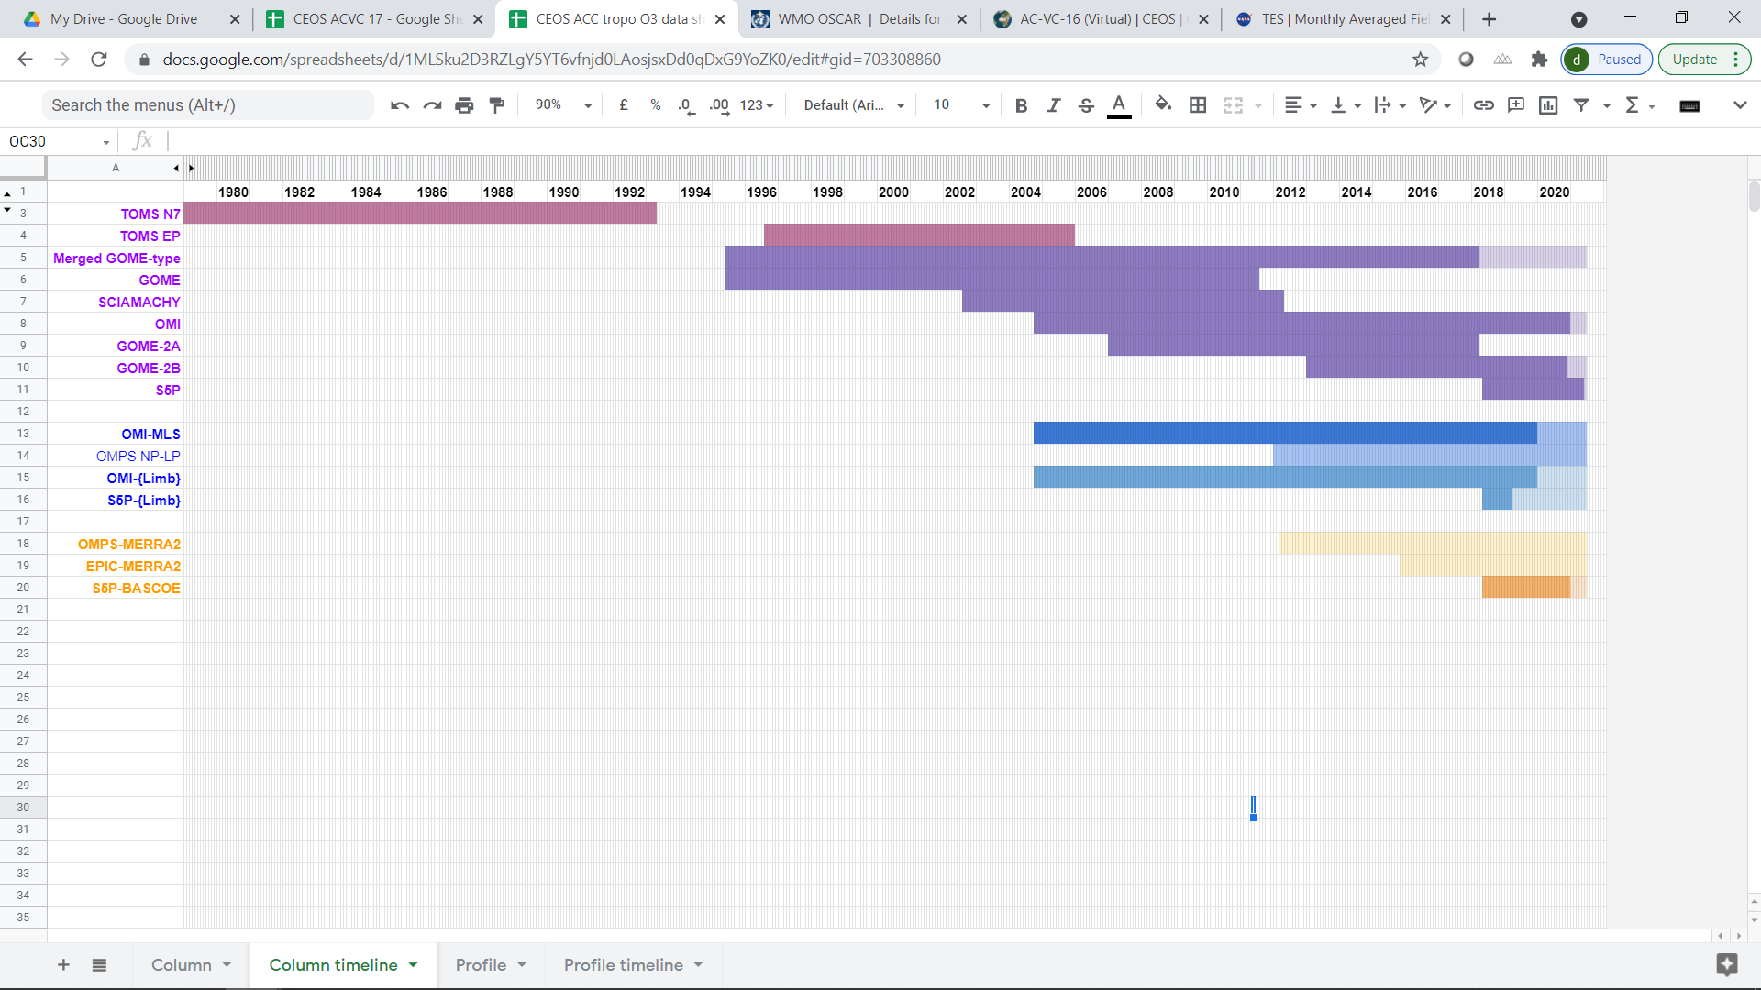
VC-20-01 Tropospheric Ozone
Optimal Estimation retrieval
🡪 vertical profile at pixel level or at pixel-cluster level
UV-VIS
TIR
Synergy UV-VIS+TIR
Residual techniques
🡪 partial column calculated as difference between total and pseudo-stratospheric columns,
often gridded in time & space
Cloud-free TC minus
above Convective Cloud TC
Nadir TC minus Limb PROF
Nadir TC minus Reanalysis PROF

Slide 25
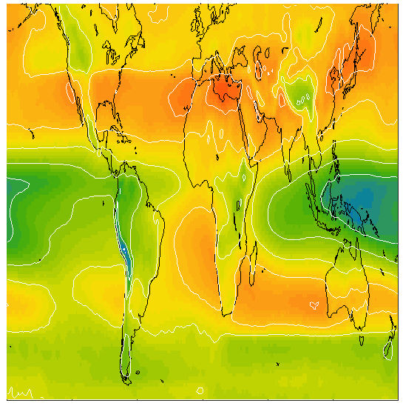
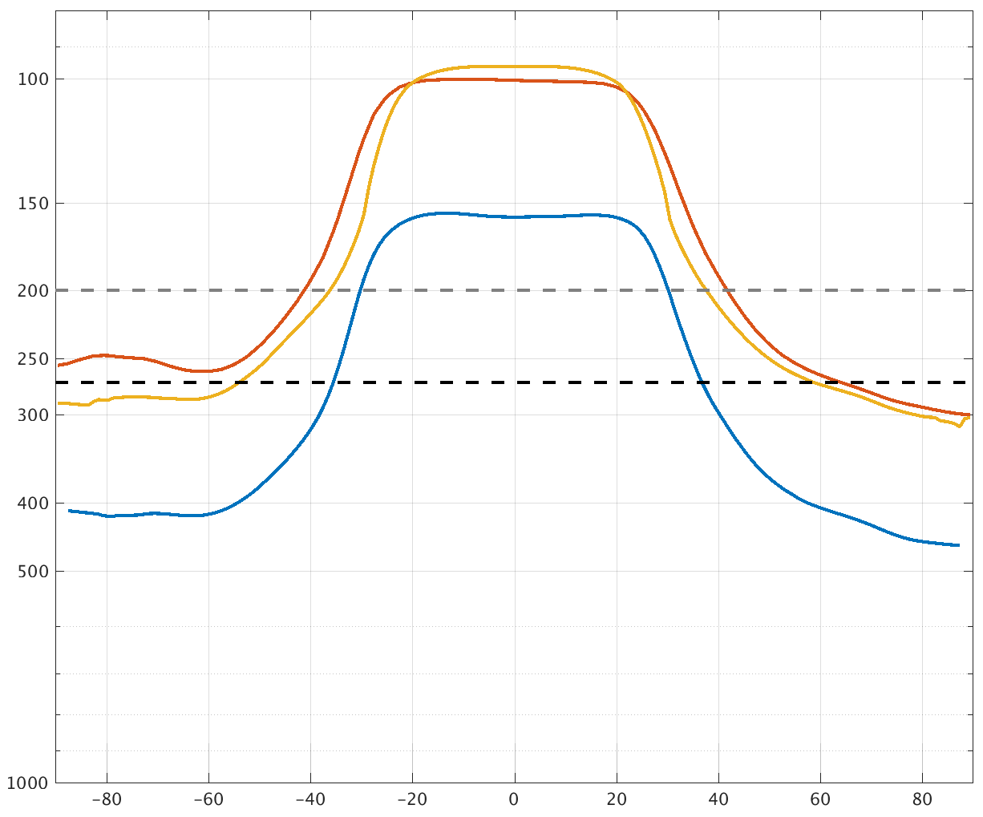
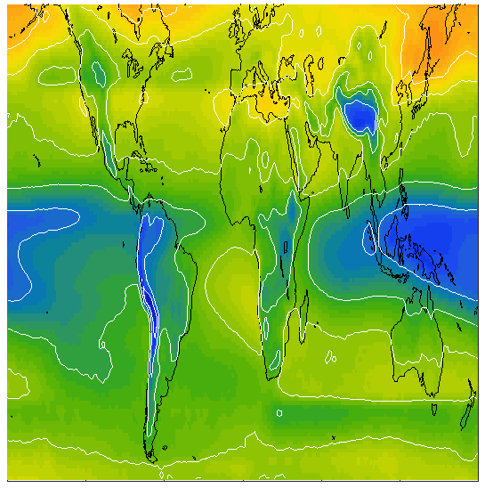
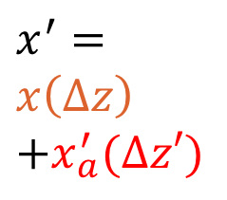
VC-20-01 Tropospheric Ozone
TrC : Harmonisation of residual tropospheric column
lapse rate tropopause
top of tropospheric column (pressure, hPa)
Transfer standard: CAMS reanalysis, interpolated to 1° x 1° LST noon
dynamical TP
TOAR “A”
lapse rate TP
270 hPa
270 hPa
TOAR “B”
fixed levels
lapse rate TP – 3 km
Latitude

Slide 26
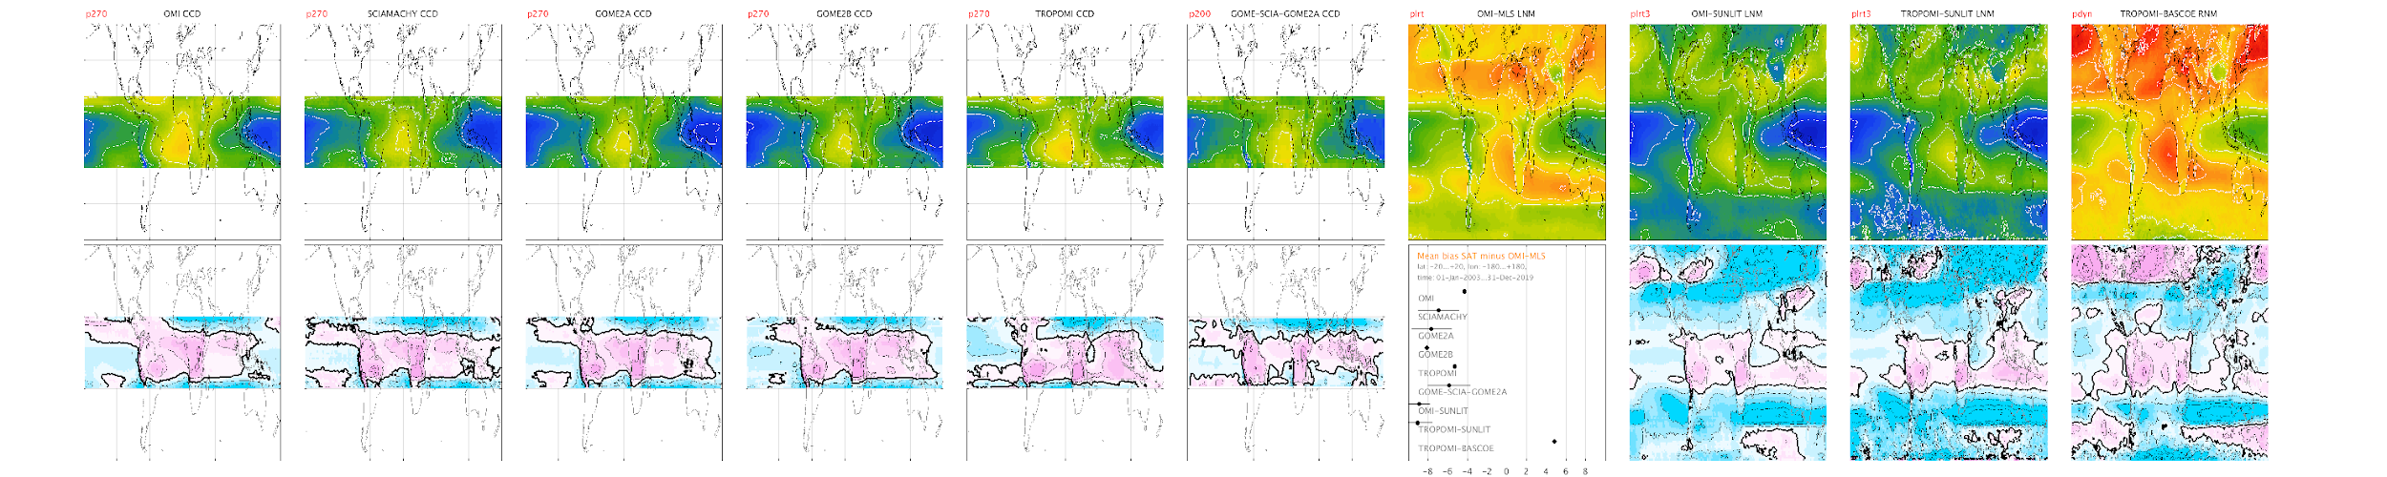
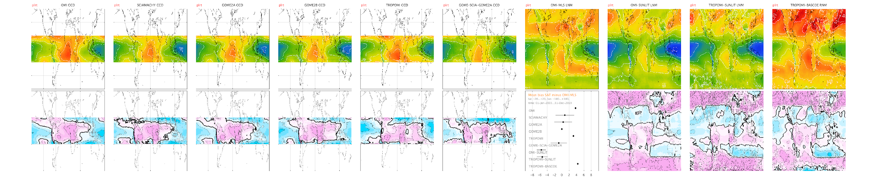
VC-20-01 Tropospheric Ozone
Mean differences in tropics before/after harmonisation
native top level
harmonized top level (LRT)
~10 AM
~2 PM
270 hPa
200 hPa
LRT-3km
dyn TP
Mean bias SAT – OMI-MLS [DU]
(20°S-20°N)
Mean bias SAT – OMI-MLS [DU]
(20°S-20°N)

Slide 27
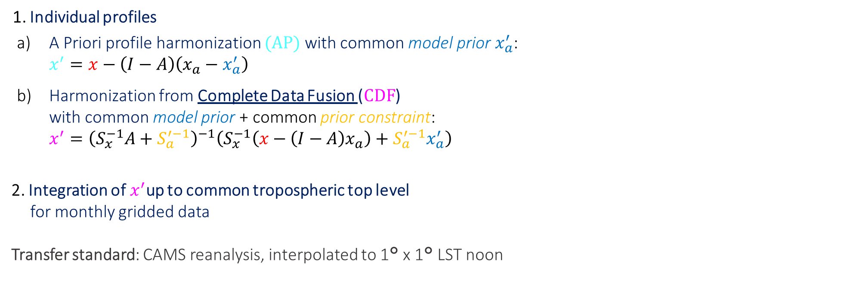
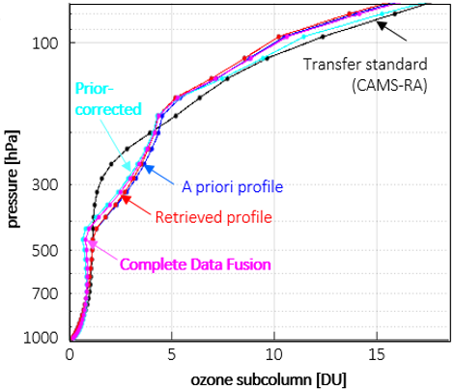



VC-20-01 Tropospheric Ozone
APH, CDF : Harmonisation of Optimal Estimation-based ozone profile retrievals
Details in:
Harmonization methods: Keppens et al., Atmos. Meas. Tech. (2019) https://doi.org/10.5194/amt-12-4379-2019
Complete Data Fusion method: Ceccherini et al., Atmos. Meas. Tech. (2022) https://doi.org/10.5194/amt-15-7039-2022
CDF removal of a priori information: Keppens et al., Remote Sens. (2022) https://doi.org/10.3390/rs14092197

Slide 28
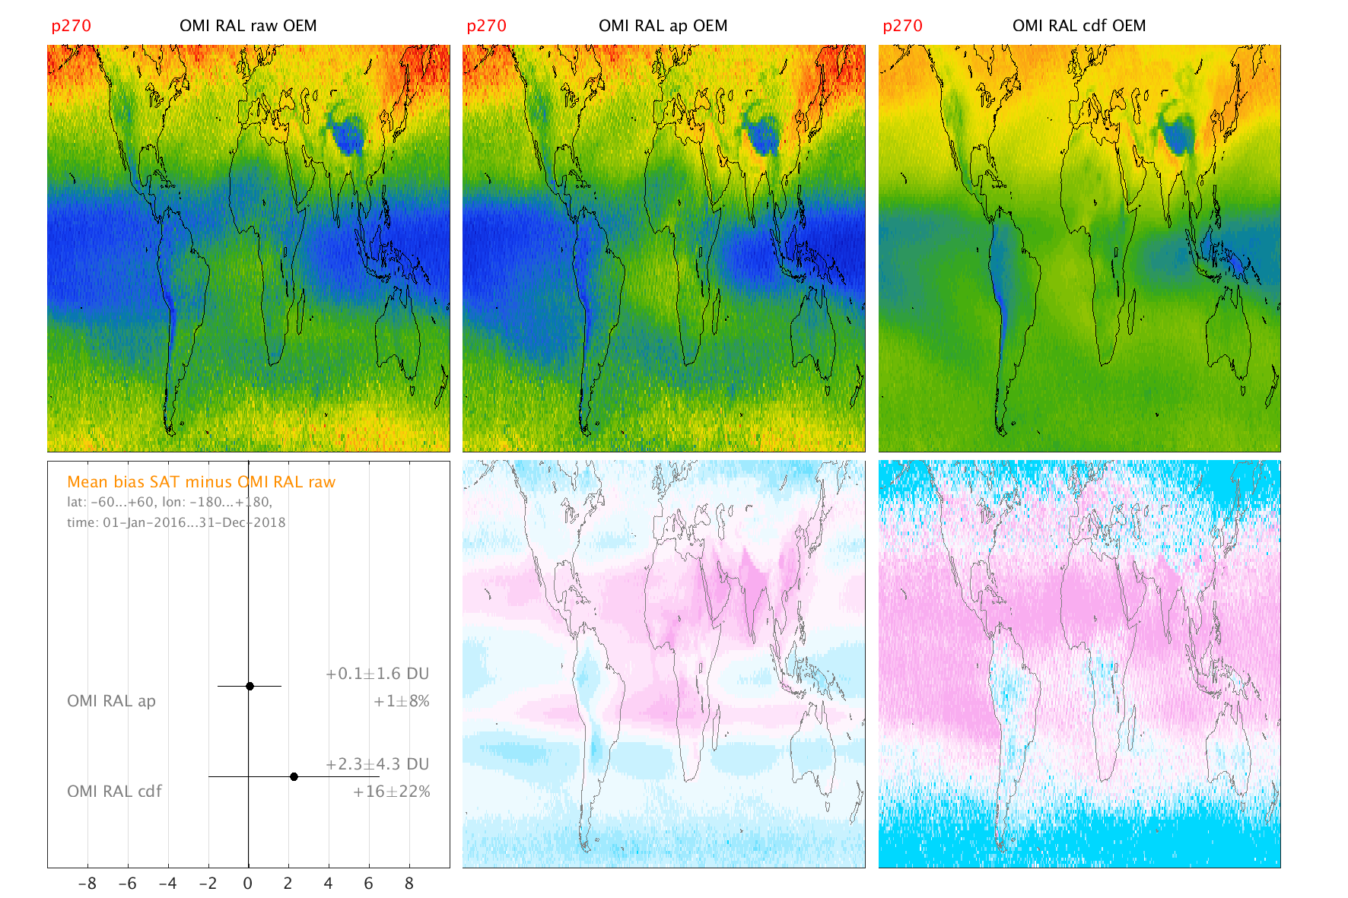
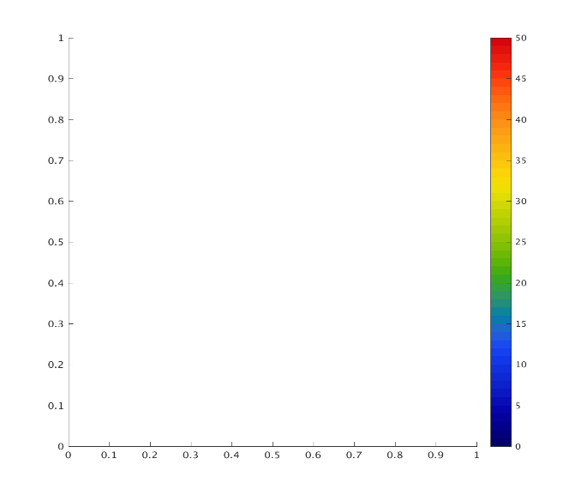


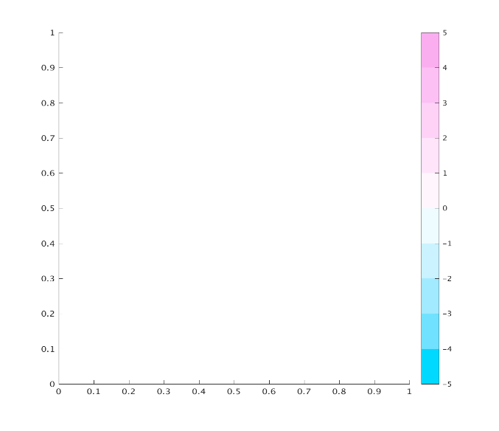
VC-20-01 Tropospheric Ozone
APH, CDF : Harmonisation of Optimal Estimation-based ozone profile retrievals
O3 subcolumn [DU]
Subcolumn diff. [DU]

Slide 29
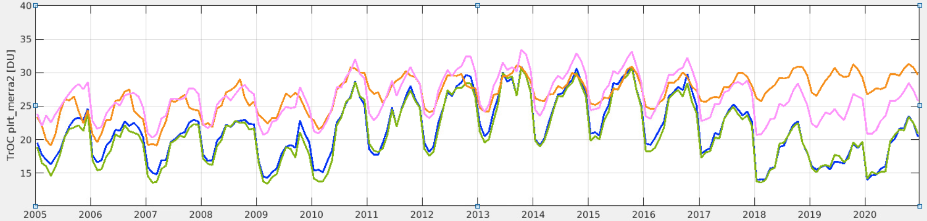
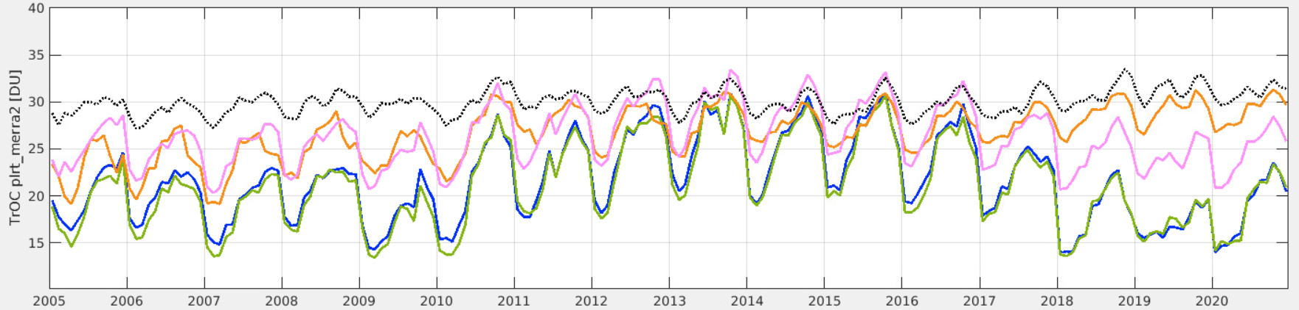
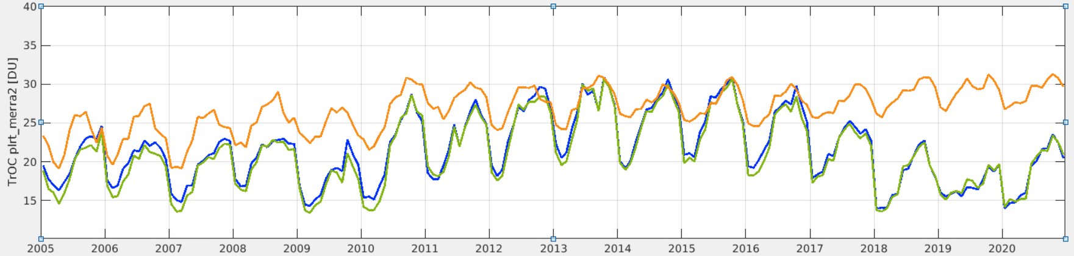
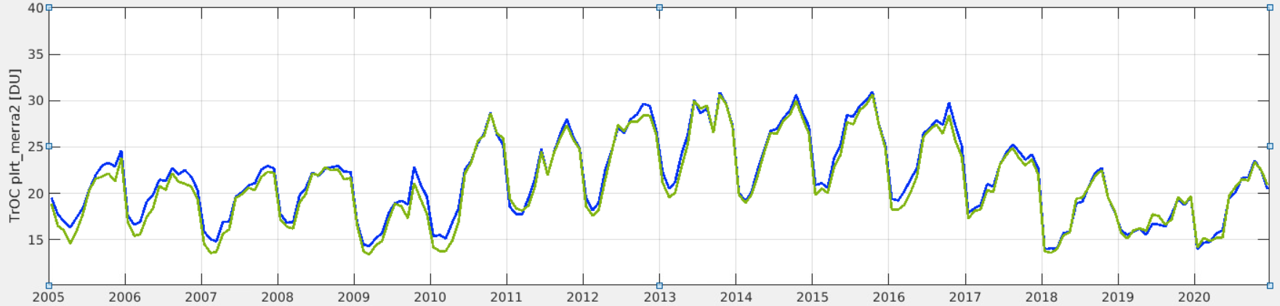
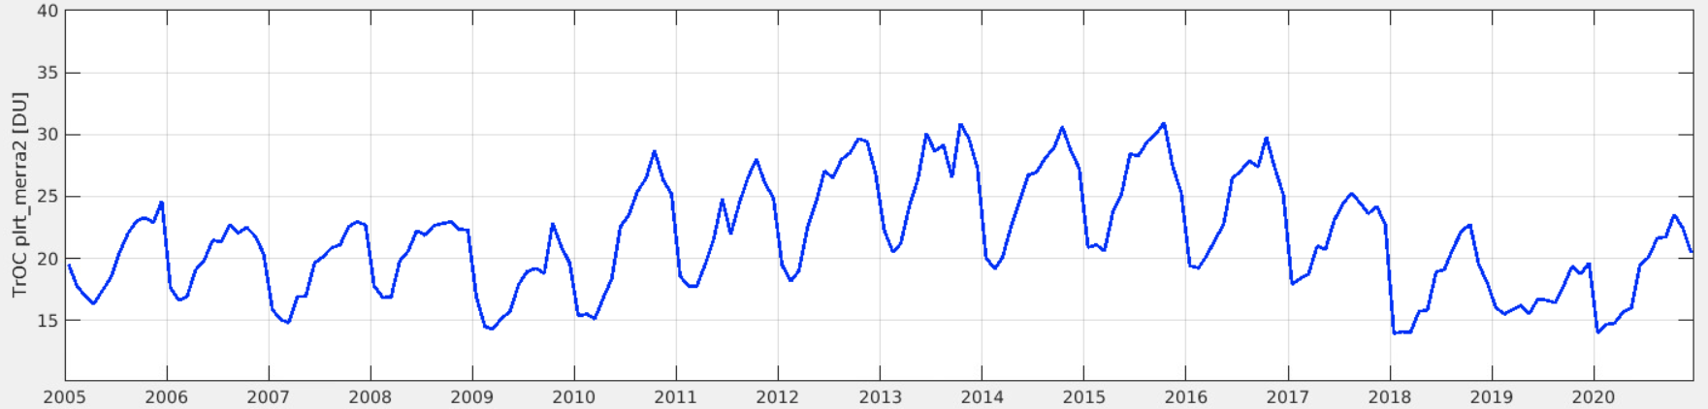
VC-20-01 Tropospheric Ozone
Influence of harmonization on OMI time series in the tropics
OMI RAL, 20°S-20°N: column surface – lapse rate tropopause (MERRA2)
Original OMI
Harmonised OMI :
Transfer standard CAMSRA
AP
CDF
TrC

Slide 30
AC-VC
Status of WP Actions and
Coordination with WGCV
Ben Veihelmann, ESA
Agenda Item 2.2
WGCV-52, ESA/ESRIN, Italy
5th - 9th June 2023

Slide 31
Air Quality Constellation
Cal/Val coordination (VC-20-02) plans (-03) Announcements of Opportunities (-04)
  GEMS AO (issued in 2018) 🡪 Cal/Val activities with international participation, comparisons with Sentinel-5P, testing of Sentinel-4 L2 algorithms
  Sentinel-4/-5 AO preparation started, Call to be issued end 2023
Growing Pandora Asian Network complements coverage of Pandora Global Network for operational acquisition of reference data for validation
TEMPO (launched on 7 April 2023), joint NASA/NOAA summer 2023 science field campaigns will contribute to validation, Mission Validation Plan (next slide)

Slide 32
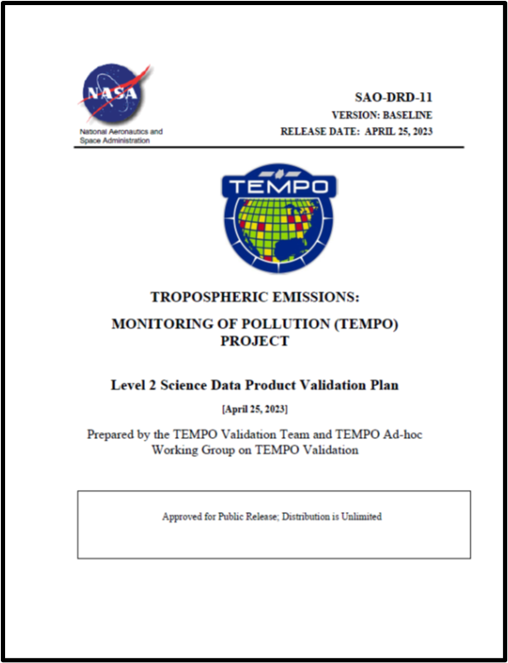
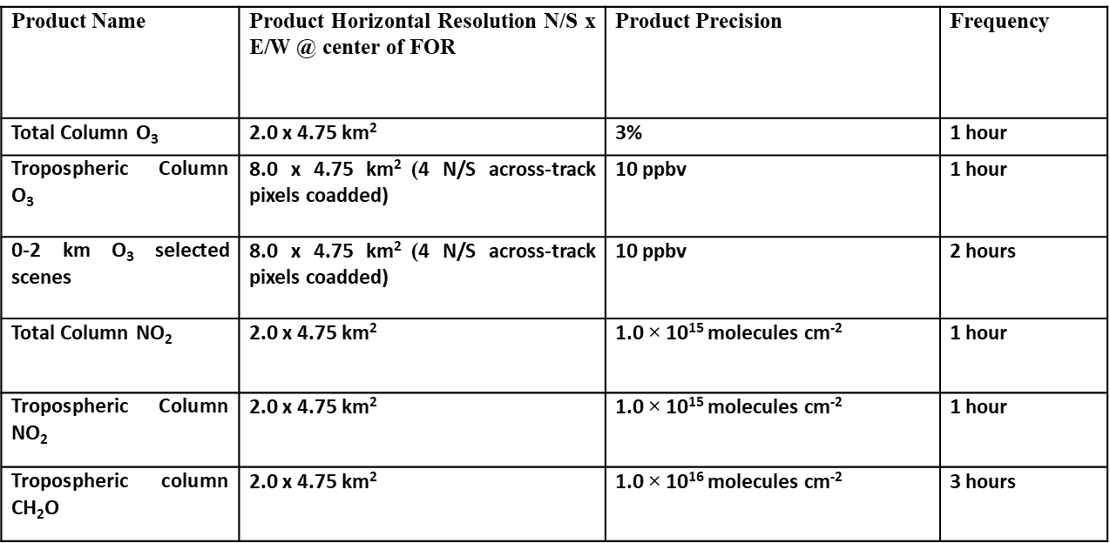
Air Quality Constellation: TEMPO Mission Validation Plan
Outlines a best-efforts validation approach for the ozone, nitrogen dioxide, and formaldehyde data products.
Leverages a comprehensive set of existing measurements (ground-based and satellite) for routine validation enhanced by episodic field mission and modeling efforts.
Describes a structure for the geophysical data product maturity progression and discusses specific metrics to be generated to provide a ‘fit for purpose’ applications framework. Three stages of validation: beta, provisional, and full maturity of products

Slide 33
Air Quality Particulate Matter
Whitepaper “Monitoring Surface PM2.5” (VC-20-05) endorsed at plenary 2022
Next step: roadmap 🡪 contribution welcome!
Cal/Val related recommendations:
  Rec 4: Continue efforts to enhance the consistency of satellite aerosol products
  Rec 6: Continue efforts to enhance the radiometric consistency of satellite sensors
  Rec 14: Use co-located in-situ PM sensors, radiometers, and ceilometers, to enhance the understanding of the link between satellite observables and PM
  Rec 15: Validate satellite-informed PM products

Slide 34
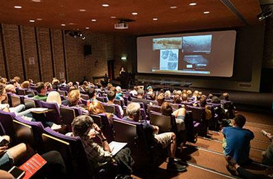


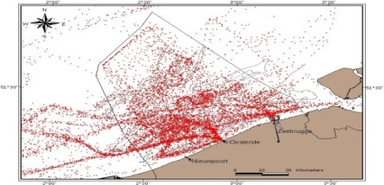
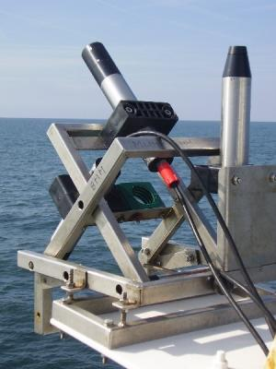


AC-VC#19 + ACSG Joint Meeting
AC-VC-19 and ACSG joint meeting, Brussels, Belgium, October 24-27, 2023
  Monday: ACSG only (at BIRA-IASB)
  Tuesday-Thursday: joint AC-VC & WGCV ACSG
  Friday: recap of joint sessions + AC-VC only
https://events.spacepole.be/event/126/
Slide ‹#›

Slide 35
Thank you !

