Slide 1
WGCV-51 In-Person Participant Information
WGCV-51
Tokyo, Japan (JAXA)
3-6 October 2022

Slide 2
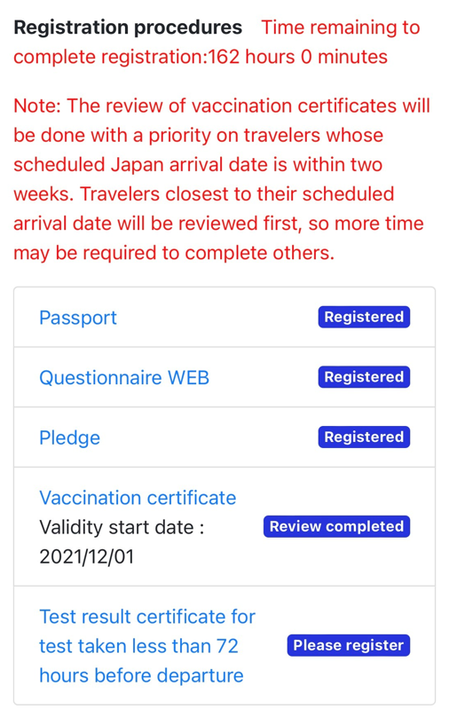
What you need
Remember to use the MySOS app on your mobile (see appendix 1)
You don’t need the test taken less than 72 hours before your departure anymore if you got vaccines satisfying the guideline defined by the Japanese government and have the certification, even if MySOS request the registration of the test certification as shown below. (Please make sure that the bottom of “vaccination certificate” turned blue.)
You should wear a mask at all times when in public areas (see Appendix 2)
It is recommended that you bring some spare cash. Credit cards like Master card, Visa card,
etc. are available at most places, but those might not be available at a small restaurants,
shops, privately owned taxis etc.
It is a good idea to carry your vaccination card and your passport to the meeting

Slide 3
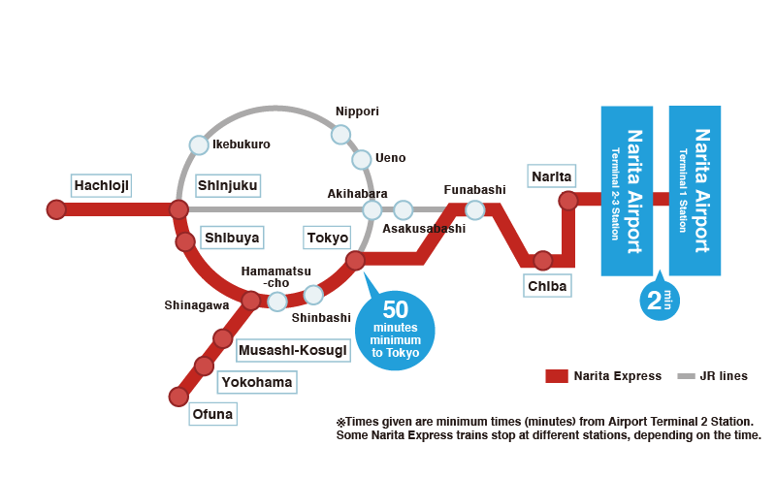
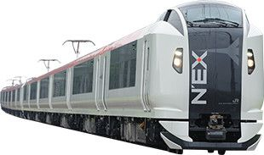
Travel Tips
Transportation Service From Narita Intl. Airport to Roppongi
There are some options.
https://www.narita-airport.jp/en/access/city_access
We’d like to recommend to use Narita Express (NEX), which is a super express of JR (Japan Railway).
Narita Intl. Airport – (NEX) – Tokyo Station (50mins ; ¥ 3,070)
Tokyo Station – (Taxi) – Mitsui Garden Hotel Roppongi Premier (around 20mins ; around \2,500)
※ 1 USD/Euro = around \140
※ Details on NEX can be viewed here: https://www.jreast.co.jp/multi/en/nex/
※ Special offer from JR: https://www.jreast.co.jp/multi/en/pass/nex.html
How to buy a NEX ticket
Go to “Midori no Madoguchi” at Narita Airport.
Buy your ticket at the desk.
A credit card is available.
Slide 3

Slide 4
Travel Tips
Other Options
Slide 4

Slide 5
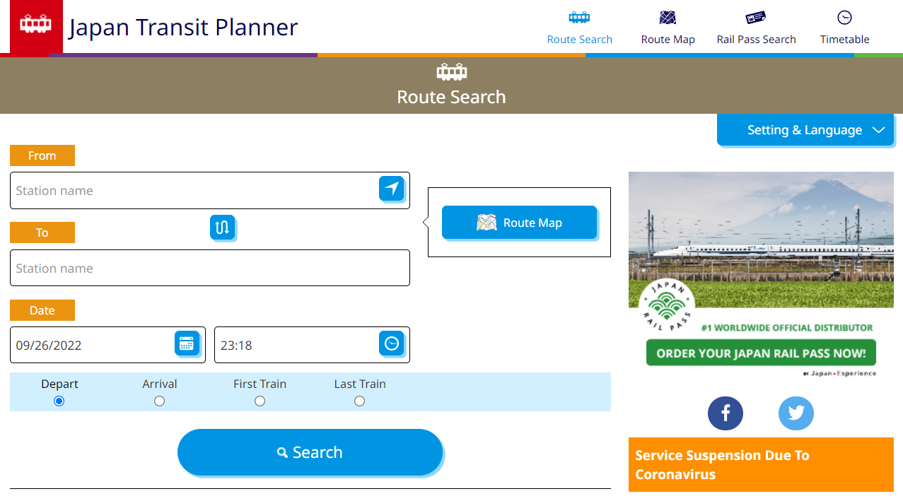
Travel Tips
Jorudan will assist your route search. https://world.jorudan.co.jp/mln/en/?sub_lang=nosub
Slide 5

Slide 6
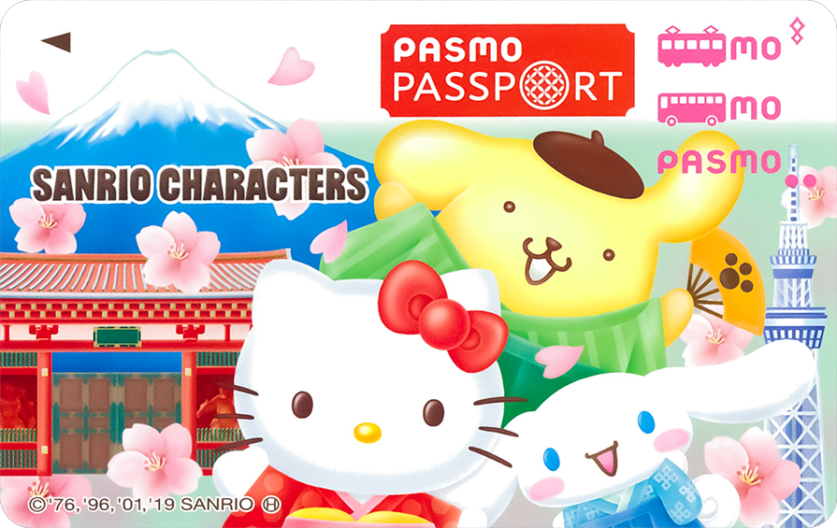
Travel Tips
No Tips
Most of the Japanese services don’t request tips. You don’t have to pay tips even in a restaurant, hotel, taxi, etc.
PASMO
If you use subway, bus etc. without cash, a pre-paid card “PASMO” might be convenient. You can buy and charge it at the subway station.
https://www.pasmo.co.jp/visitors/en/
Some vending machine, stores, etc.. might also accept PASMO.
Slide 6

Slide 7
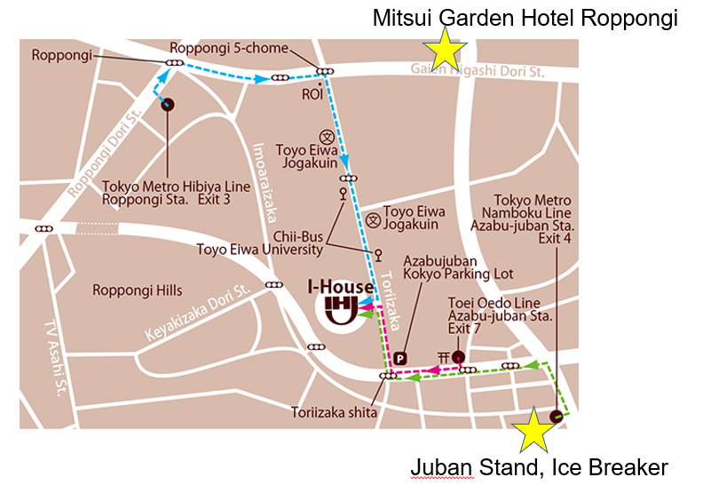
Access
5 min. walk from Exit 7, Azabu-juban Station, Toei Oedo Line
8 min. walk from Exit 4, Azabu-juban Station, Tokyo Metro Namboku Line
(Please note that there is a steep upward slope on the way from Azabu-juban Station.)
10 min. walk from Exit 3, Roppongi Station, Tokyo Metro Hibiya Line

Slide 8
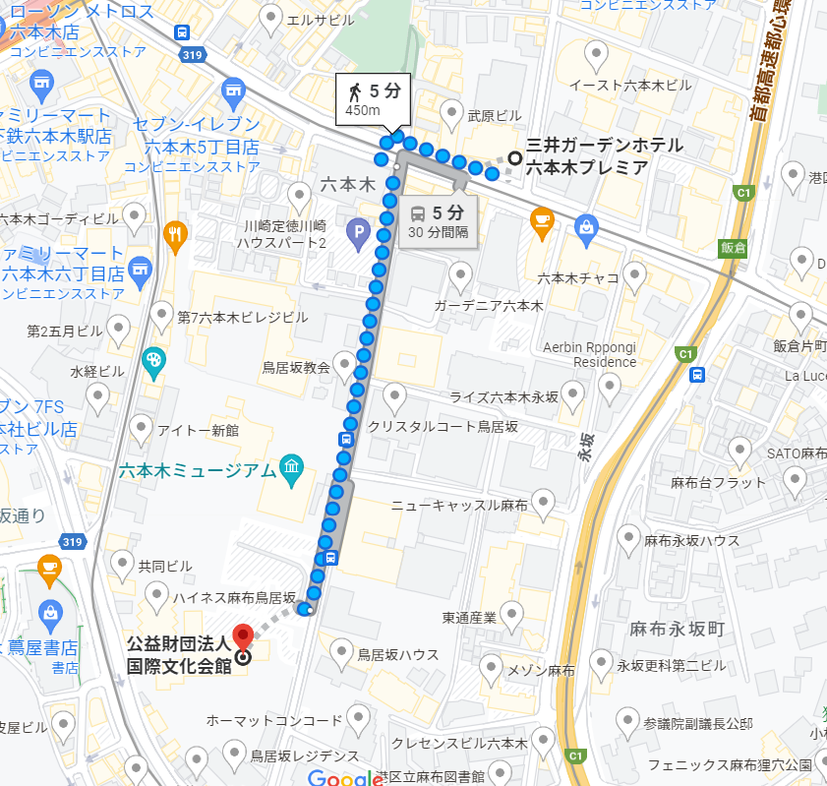
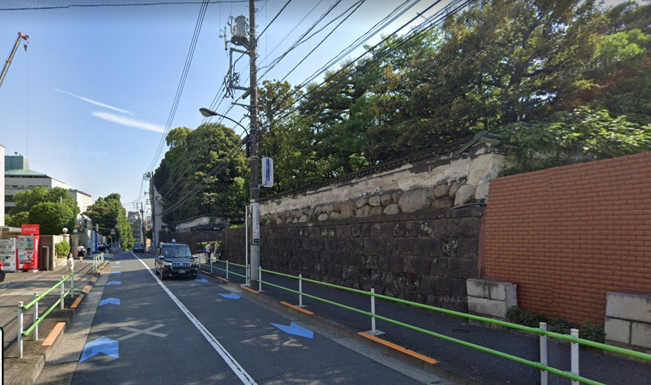
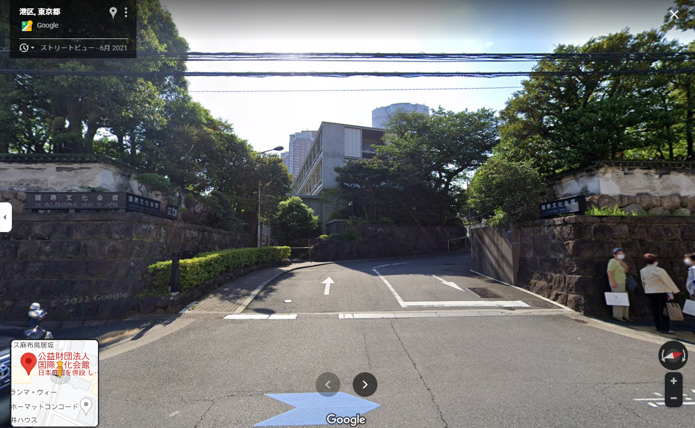
Travel Tips
International House of Japan (IHJ)
It might be difficult to find IHJ from the street. When you access to IHJ from Mitsui Garden Hotel Premier Roppongi through Roppongi station, please go past the Roppongi museum and find historical brick wall, which is a part of IHJ.
① Street View from the hotel
Roppongi St.
Mitsui Garden Hotel
② Entrance of IHJ
Roppongi Museum
①
②
IHJ
@ 2022 Google Map
Slide 8

Slide 9
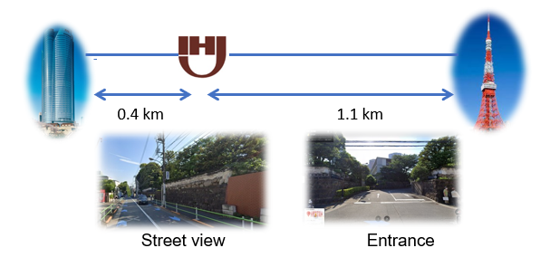
Useful Information
IHJ telephone: 03-3470-4611 When you get lost, please look for Roppongi Hills (the tallest building in Tokyo) or Tokyo Tower.IHJ is located in between.

Slide 10
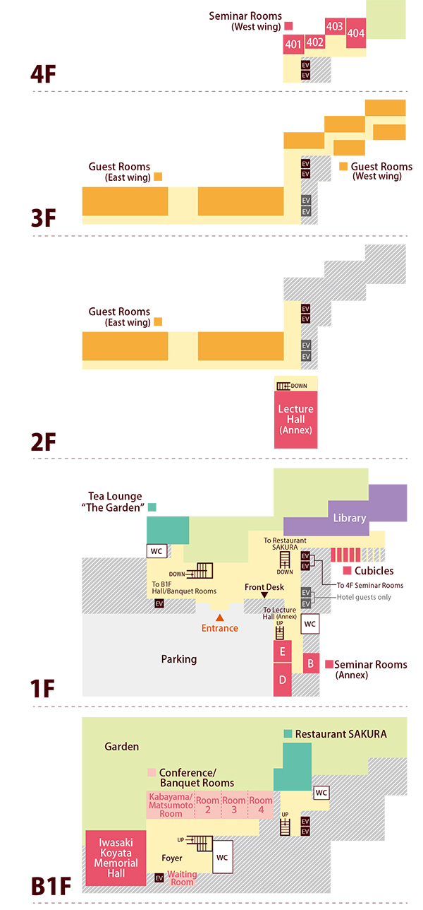
IHJ Floor Map
Room 403-404
WGISS
Oct. 5 afternoon
Lecture Hall
WGISS-WGCV joint
Lunch, tea, light dinner
Room D
WGCV
Oct. 5 after lunch
Garden entrance
Team Photo
Full course Lunch Full course dinner
Slide 10

Slide 11
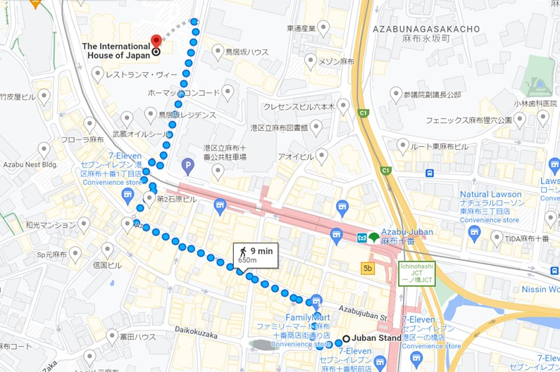
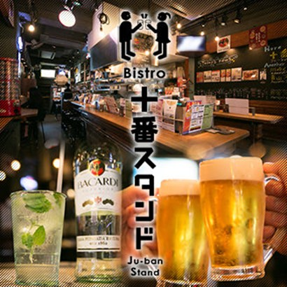
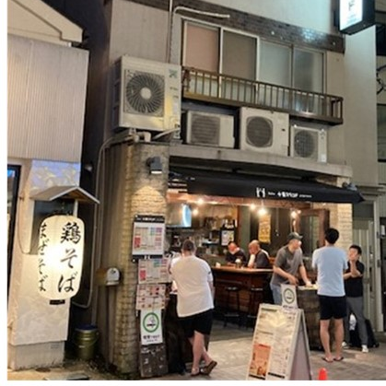
Ice Breaker on October 5, 2022
Venue: “Juban Stand”
https://a023701.gorp.jp/
Tel : 050-5485-5709
Lat. Lon. : 35deg39’18.84”N 139deg 44’10.38E
Date & Time:
Oct. 5 (Wed) 18:15- Start 18:30- “Kanpai”
Roppongi
Slide 11

Slide 12
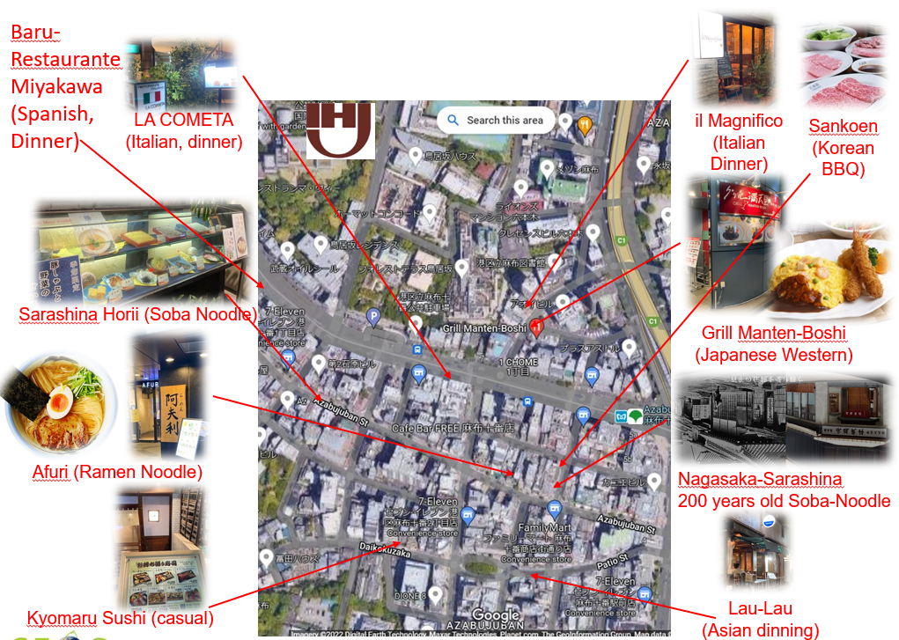
Historic Juban Lunch and Dinner Map

Slide 13
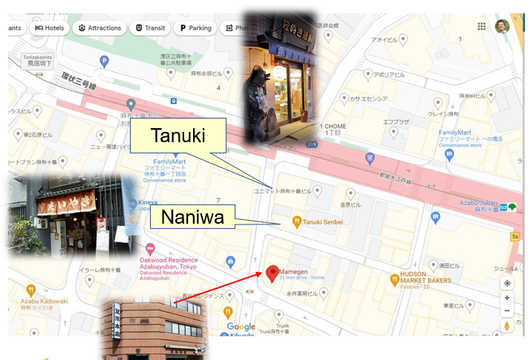
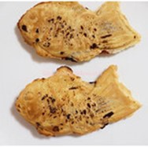
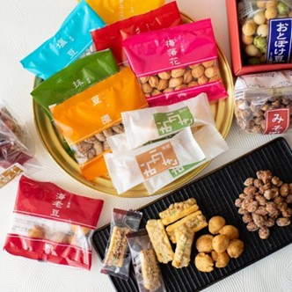
Japanese Sweets Map
Naniwa Taiyaki: Japanese soul sweets
Tanuki Senbei: raccoon rice cracker
Mamegen: Beans: 100 kinds of flavor (sugar, salt, curry ….)
Slide 13

Slide 14
References : City Guide & Travel Tips
Near Hotel
https://www.gardenhotels.co.jp/roppongi-premier/eng/sightseeing/
MATCHA – Tourist Info.
https://matcha-jp.com/en/
MATCHA – Subway Guide
https://matcha-jp.com/en/4409
BOUTIQUE – Expert Advice for Japan Trip
https://boutiquejapan.com/japan-travel-tips/
10 Must Know Things Before You Go To Japan – Expert Advice for Japan
https://youtu.be/oVFjA7Qy1as
A Guide to Your First Hour in Tokyo, Japan
https://youtu.be/IsngamFa1ps
Slide 14

Slide 15
Contact Information
Akihiko Kuze:
Work cell phone number: shared via email

Slide 16
Appendix 1

Slide 17
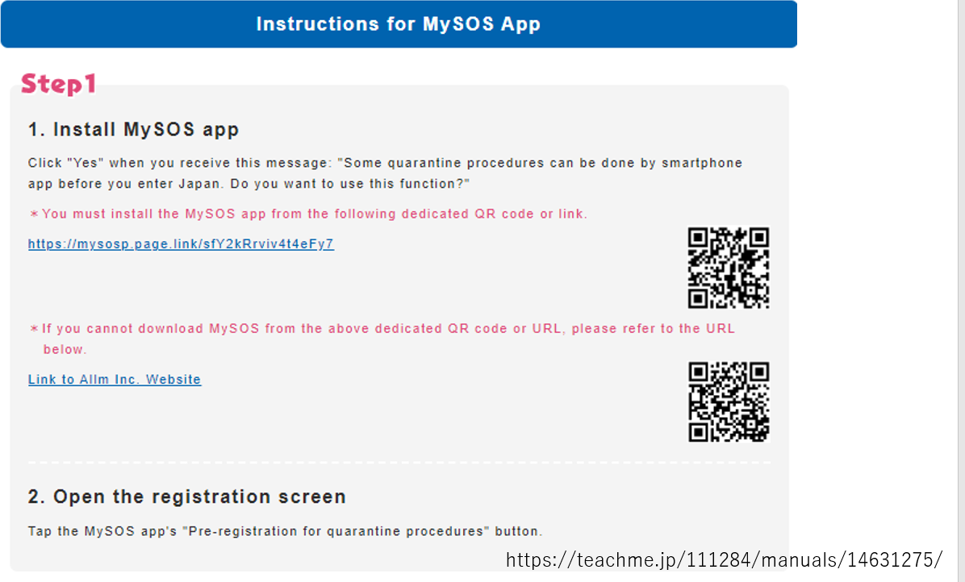
Appendix 1

Slide 18
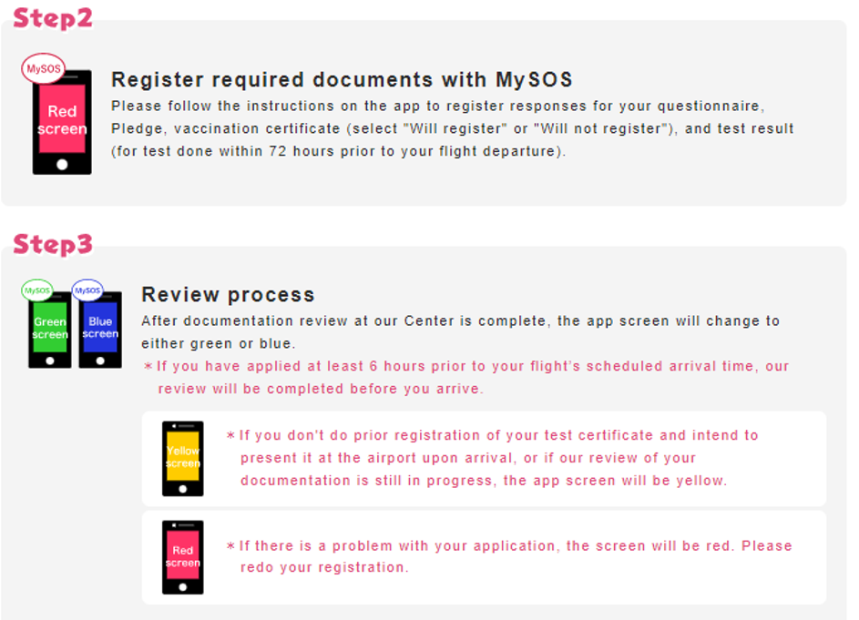
Appendix 1

Slide 19
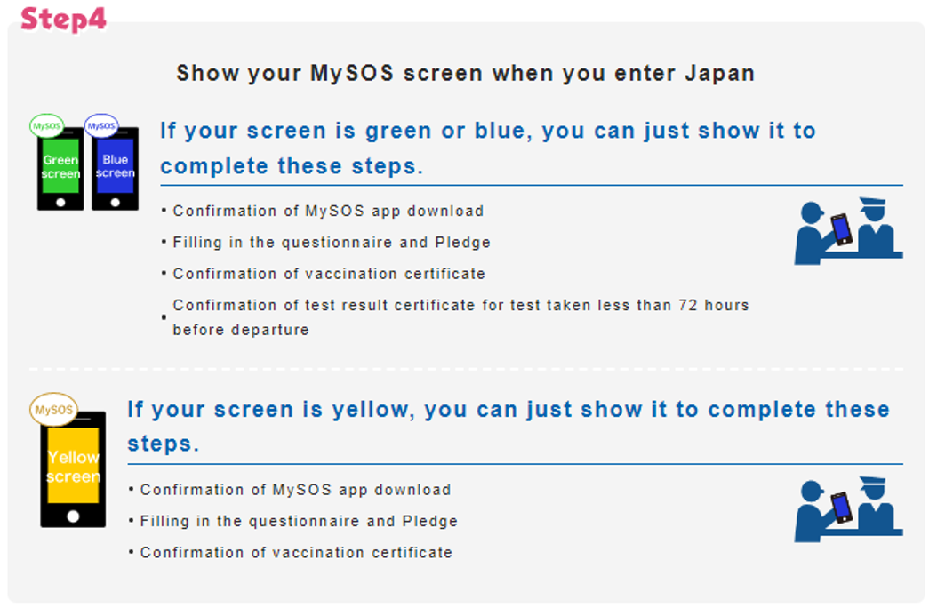
Appendix 1

Slide 20
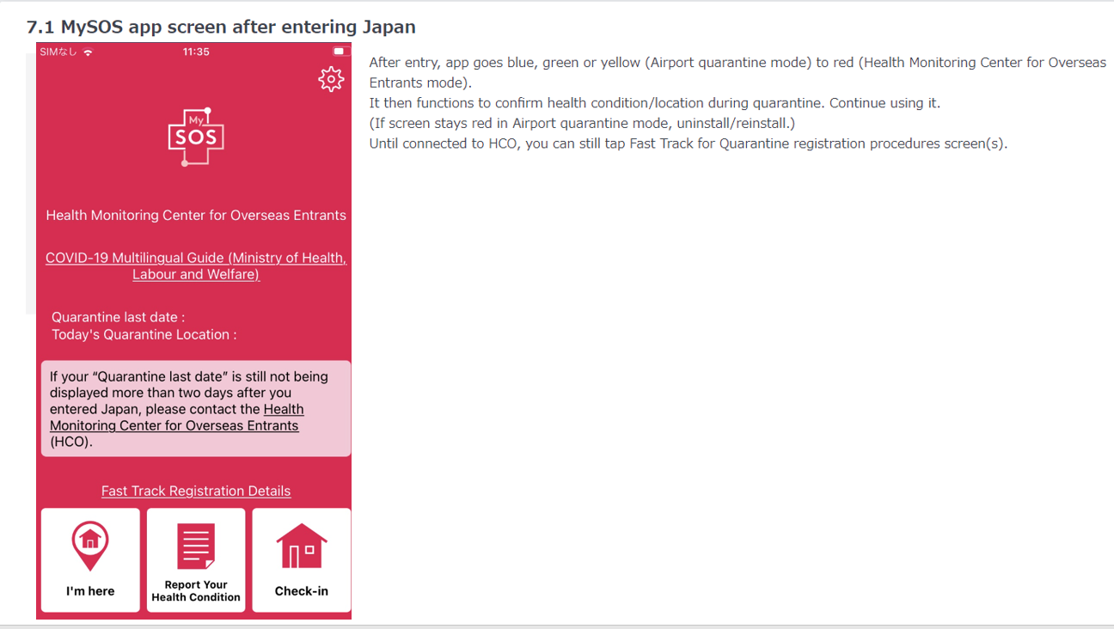
Appendix 1

Slide 21
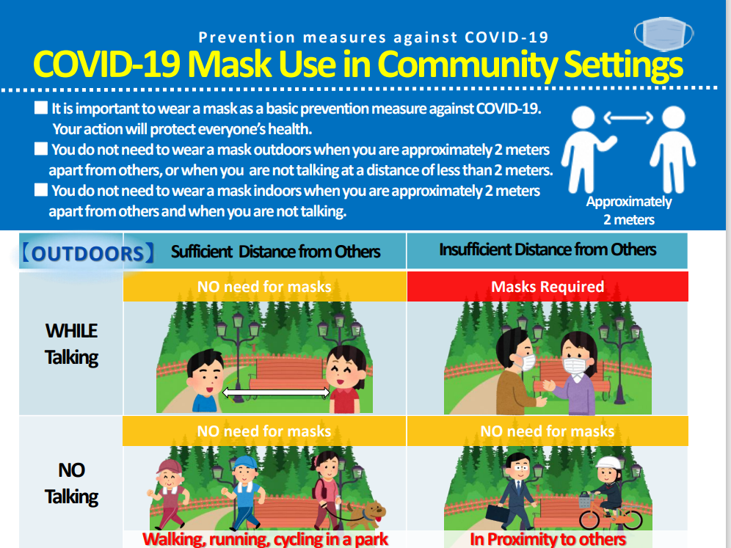
Appendix 2

Slide 22
Appendix 2

