Slide 1
VIIRS Instrument Calibration Status
Jack Xiong, NASA
Agenda Item #: 3.9
WGCV-51, Tokyo, Japan
3rd - 6th October 2022

Slide 2



VIIRS Instrument Calibration Status
Jack Xiong¹, Amit Angal², Vincent Chiang², Jeff McIntire², Junqiang Sun², and Kurt Thome¹
¹NASA Goddard Space Flight Center, Greenbelt, MD 20771
²SSAI, 10210 Greenbelt Rd, Lanham, MD 20706
VIIRS Characterization Support Team (VCST)
Report at CEOS WGCV-51, Tokyo, Japan (October 6, 2022)
2

Slide 3
Contents
VIIRS Instrument
S-NPP and N-20 VIIRS On-orbit Calibration Performance
JPSS-2 and JPSS-3 VIIRS Pre-launch Calibration Performance
Summary
S-NPP: launched on Oct 28, 2011
JPSS-1: launched on Nov 18, 2017 (N-20)
JPSS-2: scheduled to launch on Nov 1, 2022
JPSS-3: PSR completed on June 22, 2022
JPSS-4: TVAC testing planned in 2023
3

Slide 4
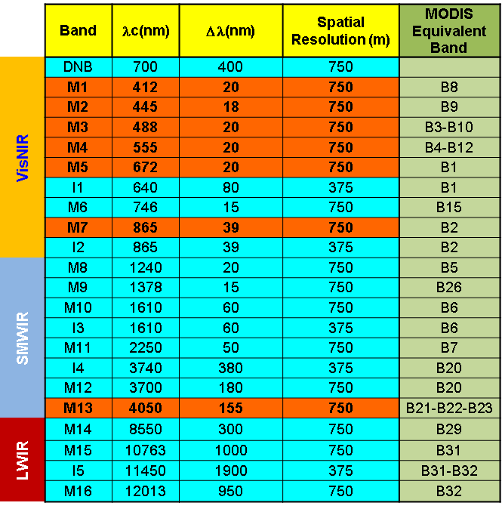
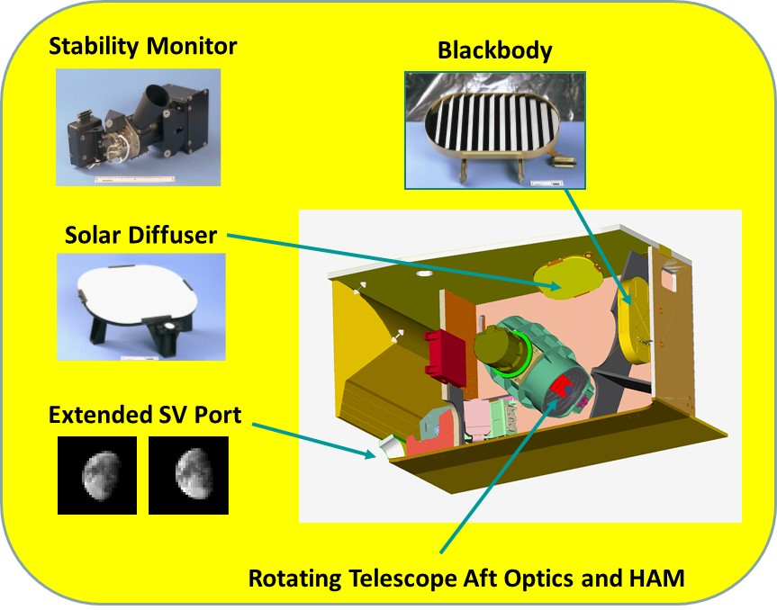
Visible Infrared Imaging Radiometer Suite (VIIRS)
Extensive pre-launch testing performed for each instrument
22 bands (16 M-band, 5 I-band and 1 DNB)
14 reflective solar bands (RSB)
7 thermal emissive bands (TEB)
1 day and night band (DNB)
7 dual gain bands
4

Slide 5
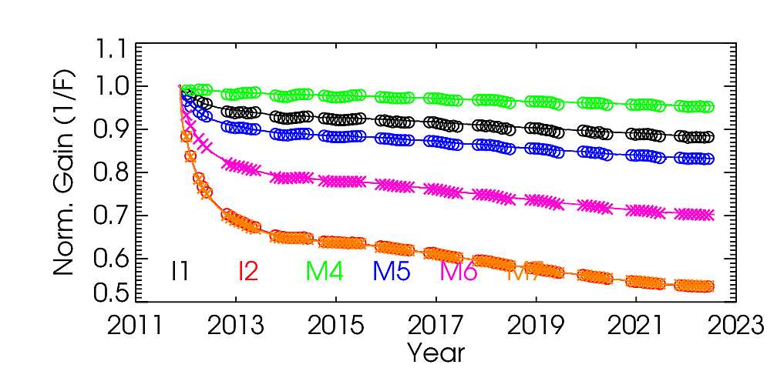
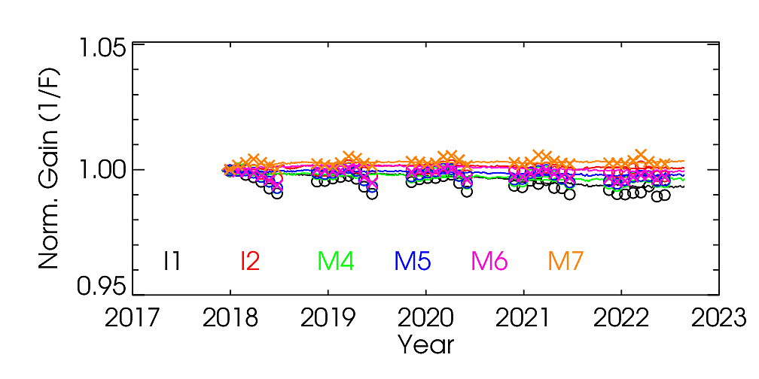
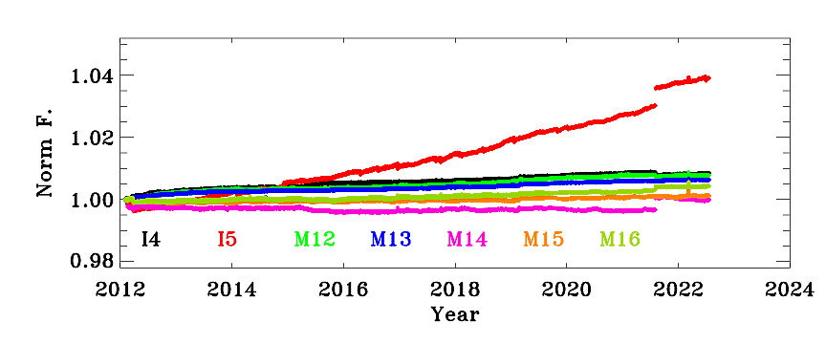
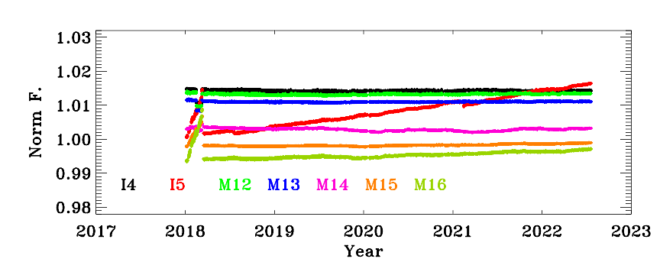
S-NPP and N-20 VIIRS On-orbit Performance: Radiometric
Large response changes at NIR and SWIR wavelengths - a known issue for S-NPP; very stable responses for N-20 RSB.
TEB gains (N-20) have remained stable since the mid-mission outgassing (MMOG); slow decrease of I5 gain (1/F) in both S-NPP and N-20.
S-NPP
N-20
RSB
Safe mode
MMOG
TEB

Slide 6
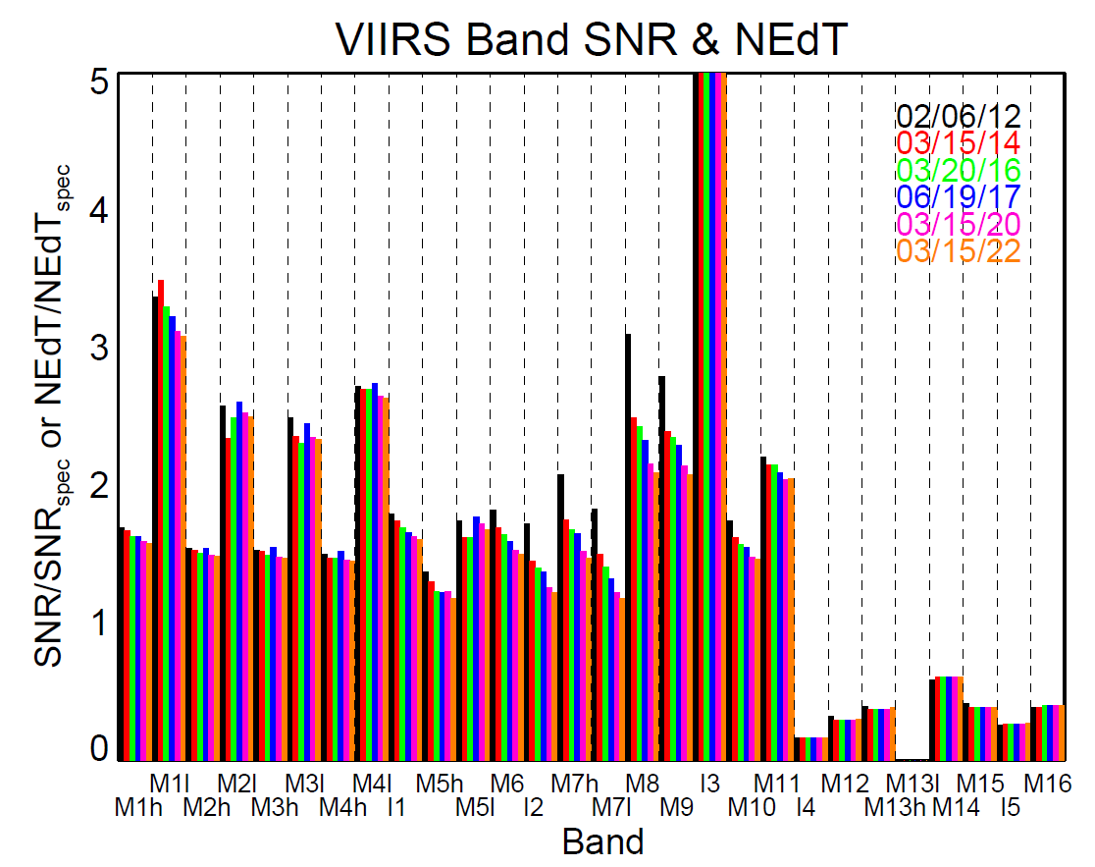
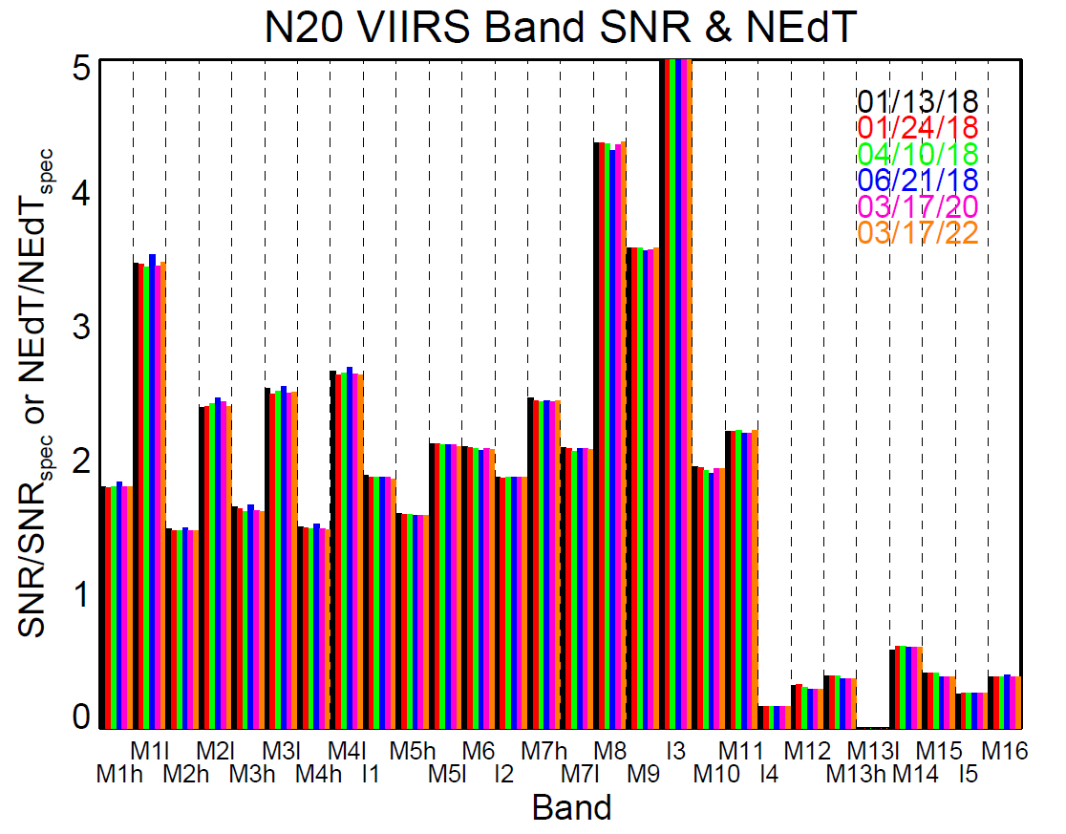
S-NPP and N-20 VIIRS On-orbit Performance: Radiometric
SD: large degradation at short wavelengths (not shown).
BB: excellent short- and long-term stability (not shown).
SNR and NEdT continue to exceed design specifications; degradation of S-NPP optical throughput in S-NPP led to decrease of SNR in a few NIR and SWIR bands (sufficient margins remain).
RSB
RSB
TEB
TEB

Slide 7
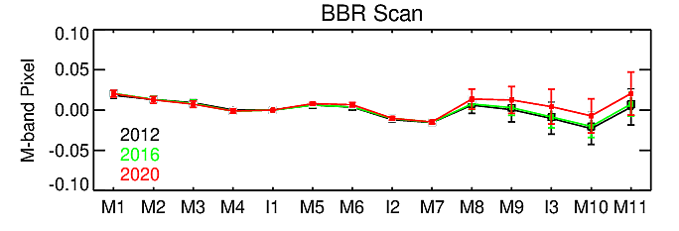
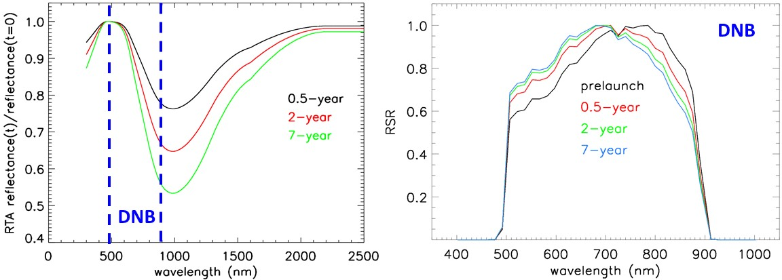
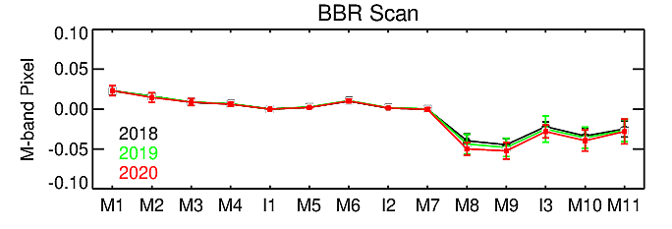
S-NPP and N-20 VIIRS On-orbit Performance: Spatial and Spectral
Band-to-band registration (BBR): stable since launch (derived using lunar observations).
S-NPP modulated RSR: caused by wavelength dependent optics degradation (changes are small in recent years); noticeable impact on DNB RSR.
DNB stray light correction remains effective for both S-NPP and N-20.
Modulated RSR (S-NPP only)
S-NPP VIIRS
N-20 VIIRS

Slide 8
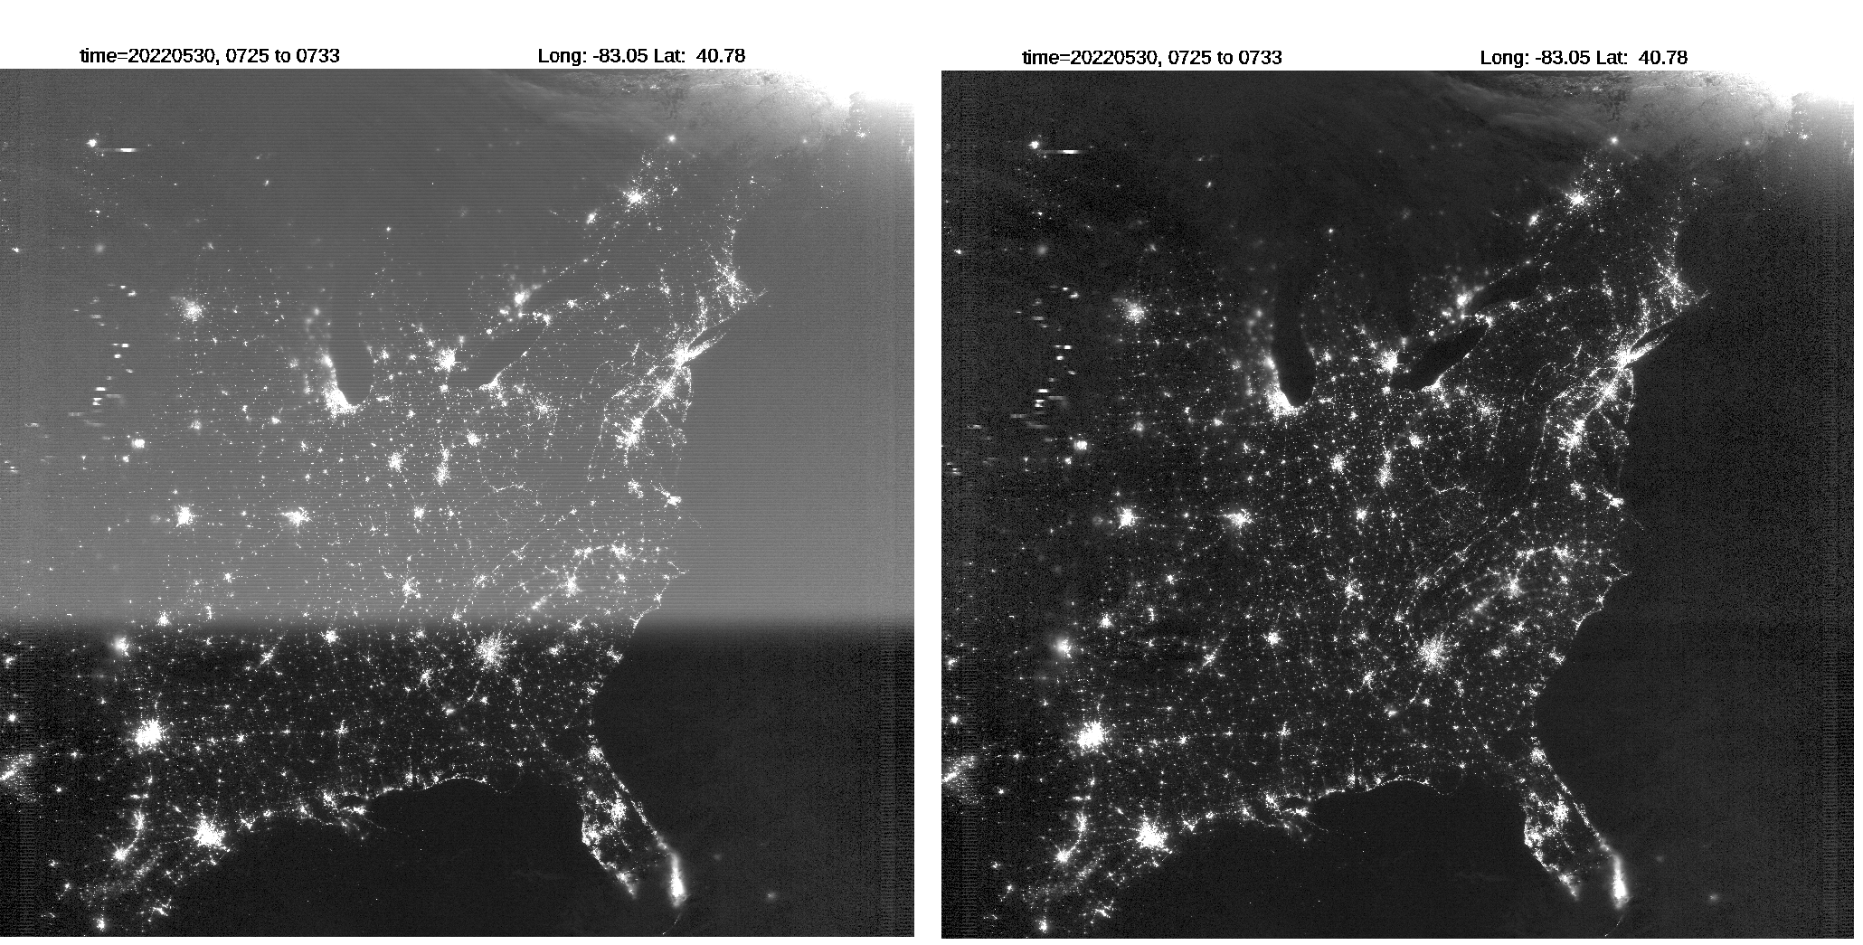
Example: S-NPP DNB Stray Light Correction
S-NPP DNB nighttime scene collected over the North America on May 30, 2022, between 07:25 and 07:33 GMT before (left) and after (right) straylight correction (Chen et. al, SPIE 2022).

Slide 9
JPSS-2/-3 VIIRS Pre-launch Calibration (Sensor Level Testing)
Test program developed with lessons from S-NPP and JPSS-1
Characterize sensor performance
  Radiometric (SNR/NEdT, detector gain and dynamic range, …)
  Spectral (IB and OOB RSR, …)
  Spatial and geometric (BBR, MTF, …)
  Thermal, vibration, and EMI
  Other key performance parameters include polarization sensitivity, RVS, stray light, …
Ensure that sensor performance meets its design requirements and that data quality is adequate to achieve science objectives
Analyze testing data to help derive sensor key performance parameters for its on-orbit operation and calibration
Develop and support implementation of mitigation strategies to address potential noncompliance issues
Test data independently analyzed and reviewed by the instrument vendor and government calibration teams via DAWG
J2 VIIRS Testing:
Sensor level
  Ambient: Apr - Aug 2016
  Pre-TVAC: Mar - May 2017
  TVAC: June - Dec 2017
Observatory level: 2021 - 2022
Launch: Nov 1, 2022
J3 VIIRS Testing:
Sensor level
  Ambient: Oct 2019 - Jan 2020
  Pre-TVAC: June - Aug 2020
  TVAC: Sep 2020 - May 2021
Observatory level: TBC
Launch: 2027
9

Slide 10
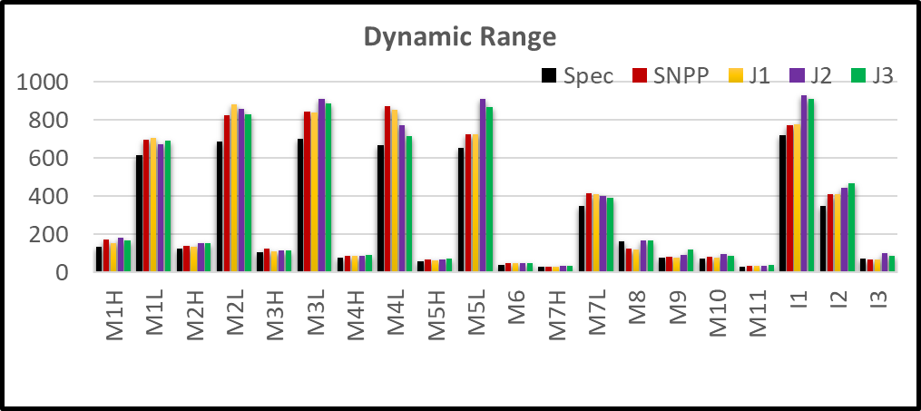
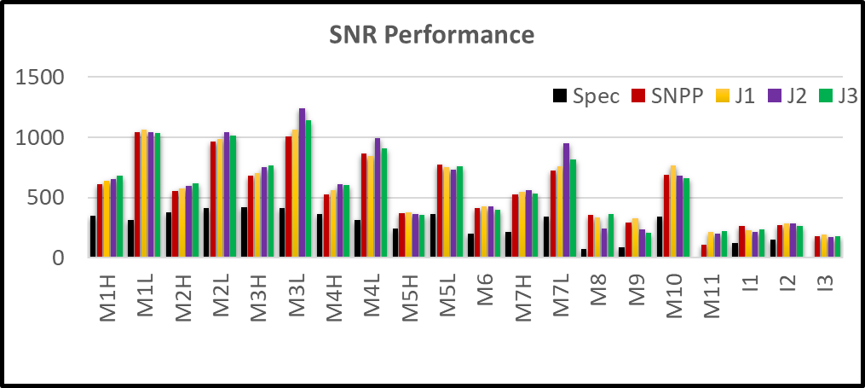
JPSS-2/-3 VIIRS Pre-launch Calibration Performance: RSB and DNB
J2 RSB/DNB: meeting nearly all requirements for dynamic range, gain transition and SNR (as good as J1)
  Minor non-compliances
    M8 dynamic range (96%)
  Improvements:
    VisNIR FPA ROIC circuit to correct the band signal roll-over after Lsat (e.g. in M6)
    Baffling and stray light closeouts to reduce the stray light for the DNB
J3 RSB/DNB: meeting nearly all requirements for dynamic range, gain transition and SNR (as good as J2)
  Minor non-compliances
    Radiometric uniformity (consistent with earlier VIIRS builds)
    Slight nonlinearity in a few DNB aggregation zones (agg mode 29), which could affect on-orbit gain ratio calculation.
  JPSS-2/3 saturation radiance above spec
  JPSS-2/3 SNR compliant with large margin
10

Slide 11
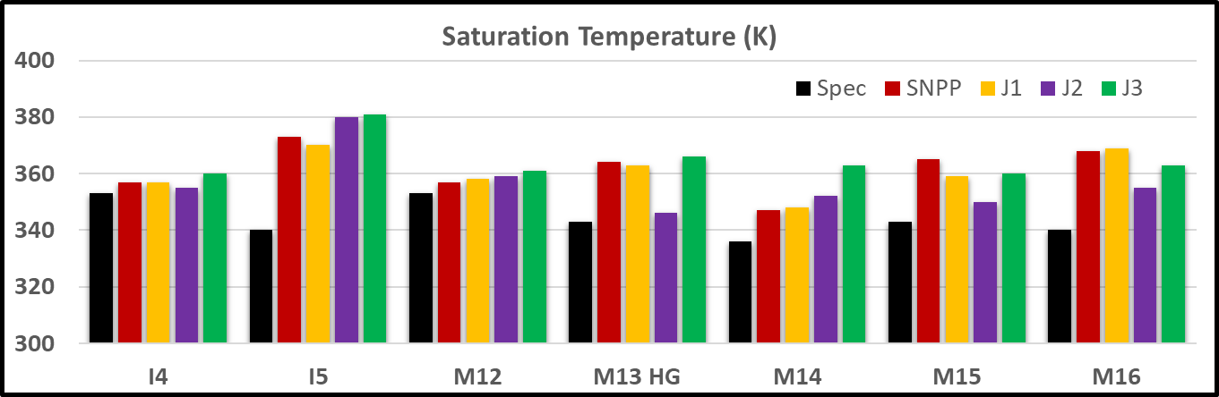
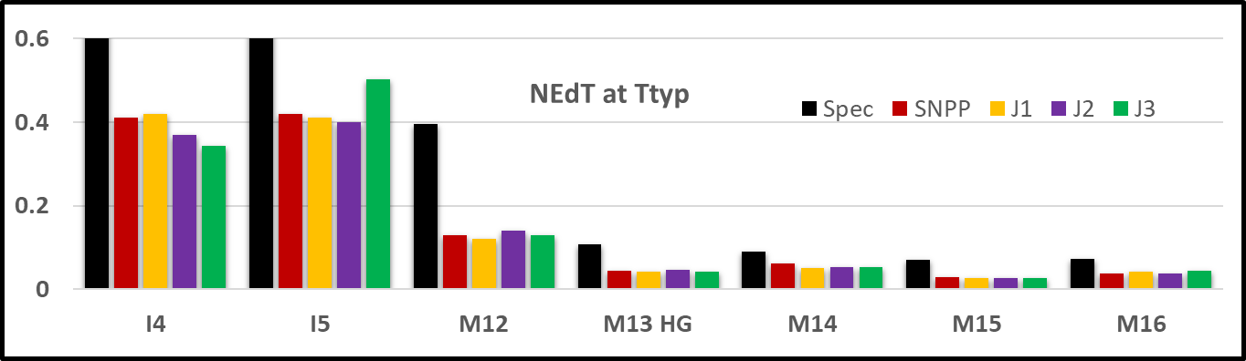
JPSS-2/-3 VIIRS Pre-launch Calibration Performance: TEB
J2 TEB: meeting all requirements for dynamic range, non-linearity, NEdT, uncertainty, and uniformity
  Minor non-compliances
    OBC BB non-uniformity (up to 50 mK vs 30 mK Spec).
    Cryo-cooler margin led to decision to set CFPA temperature at 82 K (small impact on NEdT and up to 5% gain changes).
J3 TEB: meeting all requirements for dynamic range, non-linearity, NEdT, uncertainty, and uniformity
  Minor non-compliances
    OBC-BB non-uniformity (up to ~40 mK vs 30 mK Spec)
  FPAs set to 80K (better than JPSS-2, which was set to 82 K).
  JPSS-2/3 TEB saturation temperature above spec
  JPSS-2/3 RSB NEdT compliant with large margin
11

Slide 12
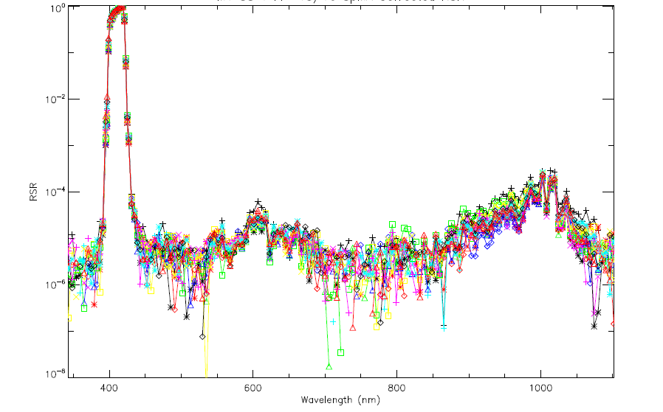
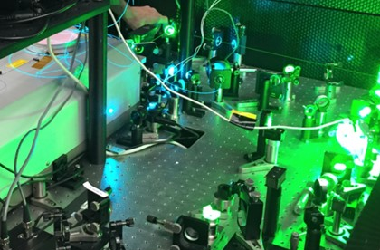
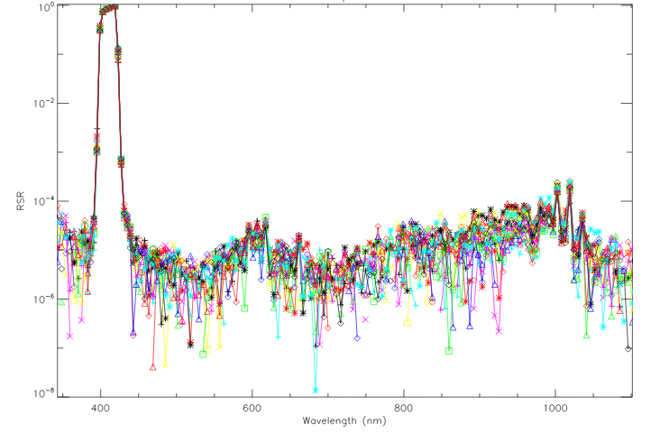
JPSS-2/-3 VIIRS Pre-launch Calibration Performance: Spectral
J2 and J3 VIIRS spectral performance in general is as good as J1
  Successful measurements with NASA GLAMR (benefit future testing program)
  J2 at-launch RSR (Moeller et.al, 2019 SPIE): https://ncc.nesdis.noaa.gov/NOAA-21/J2VIIRS_SpectralResponseFunctions.php
  J3 RSR to be updated by fusing the GLAMR and SpMA measurements
J2 M1 RSR
J3 M1 RSR
GLAMR: Goddard Laser for Absolute Measurement of Radiance
12
Notes:
Pick 2 bands (M1 and I1) plot in-band band-averaged RSR. Each sensor separate RSR.

Slide 13
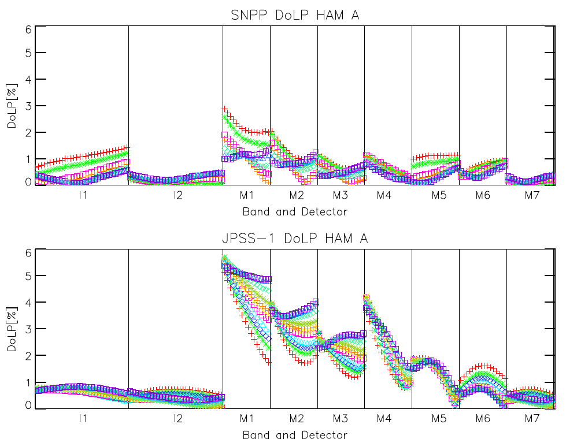
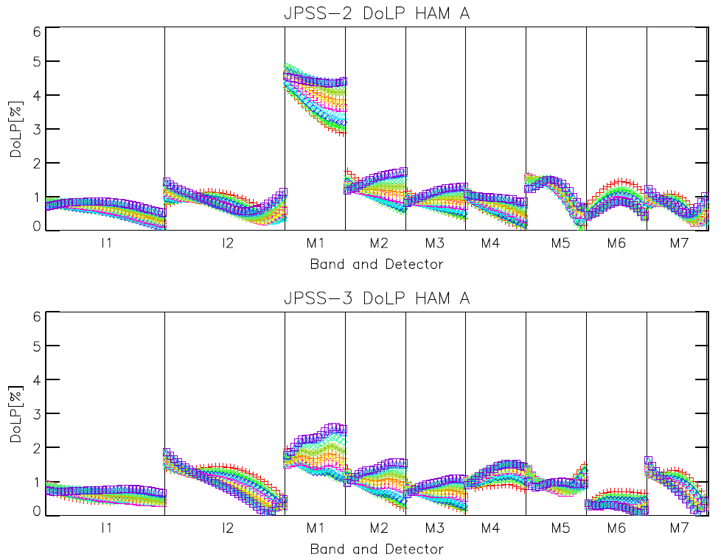
JPSS-2/-3 VIIRS Pre-launch Calibration Performance: Polarization
  JPSS-1 had non-compliances for bands M1-M4 due to filter and dichroic issues
  JPSS-2 had non-compliance for band M1 due to a dichroic issue
  Redesign of the filters and dichroic led to improved performance of JPSS-3, comparable to S-NPP and better than JPSS-1 and JPSS-2.
S-NPP
JPSS-2
JPSS-1
JPSS-3
13

Slide 14
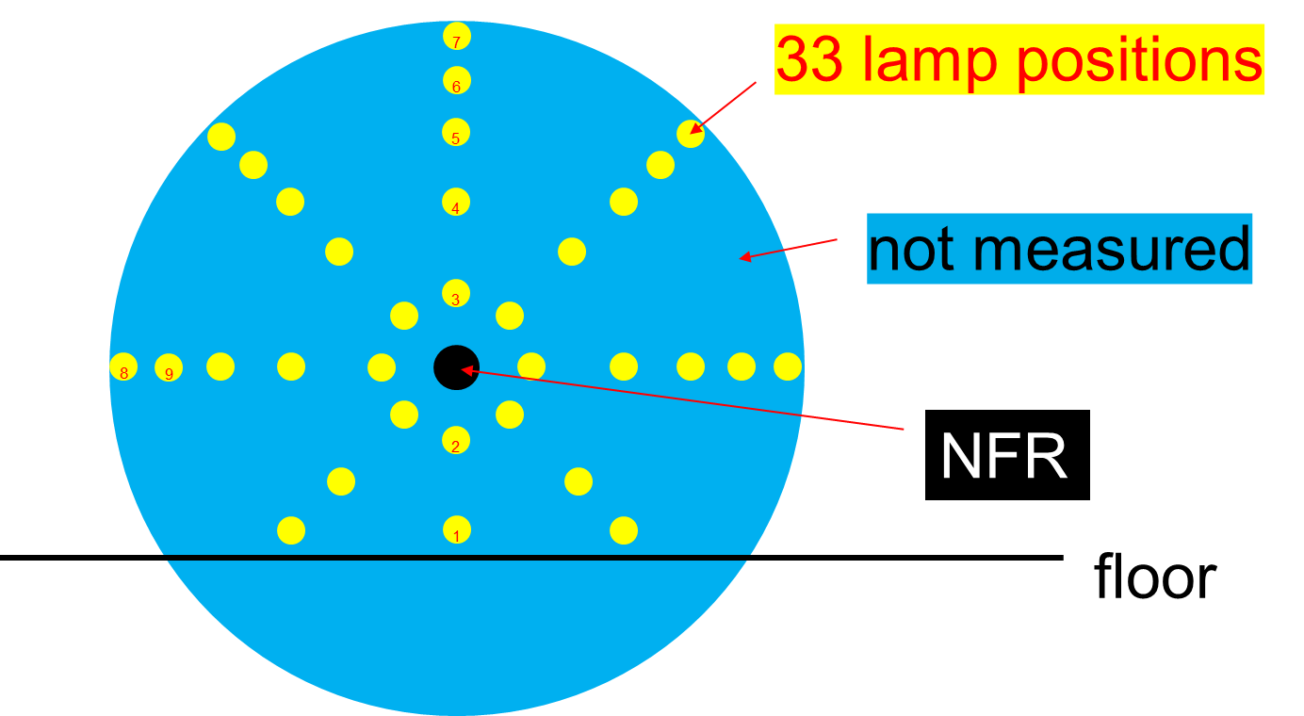
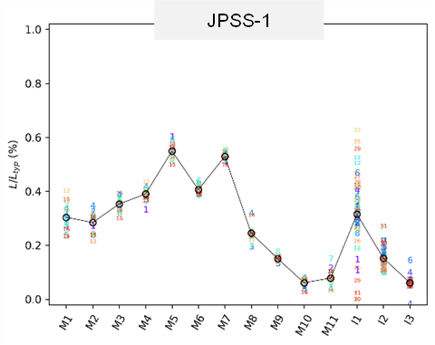
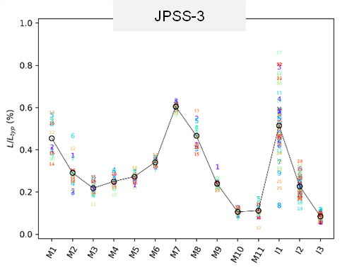
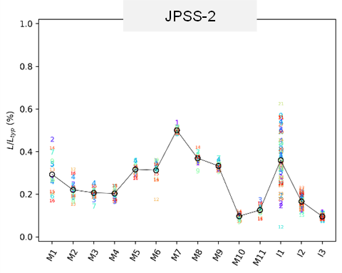

JPSS-2/-3 VIIRS Pre-launch Calibration Performance: NFR and Stray Light
NFR test data quality is very good.
  All band meet the requirements.
Stray light performance also very good.
  All bands meet the requirements.
Results are comparable to JPSS-1.
Stray Light Characterization and Results
NFR: M1, Det8
Comparison of $\frac{L}{L_{typ}}$ percentage in RSB (Specification is 1%)
14

Slide 15
Summary
Both S-NPP and N-20 VIIRS continue to perform well; changes in spectral band responses are accurately tracked via on-board calibrators (OBC) as well as lunar observations; data quality continuously maintained through timely updates of calibration look-up tables.
J2 and J3 VIIRS pre-launch test program was successfully completed; high quality data collected and analyzed to support sensor performance assessment; Overall performance exceeds requirements with a few non-compliances; all non-compliances have been reviewed with impacts investigated and mitigation plans prepared and tested for on-orbit processing.
Lessons from S-NPP/J1/J2/J3 VIIRS to be applied for J4 VIIRS; JPSS-4 VIIRS sensor TVAC testing to start in 2023.
Ongoing preparation for J2 launch; VIIRS algorithm changes and LUTs development have been made in support its SDR processing.
15

Slide 16
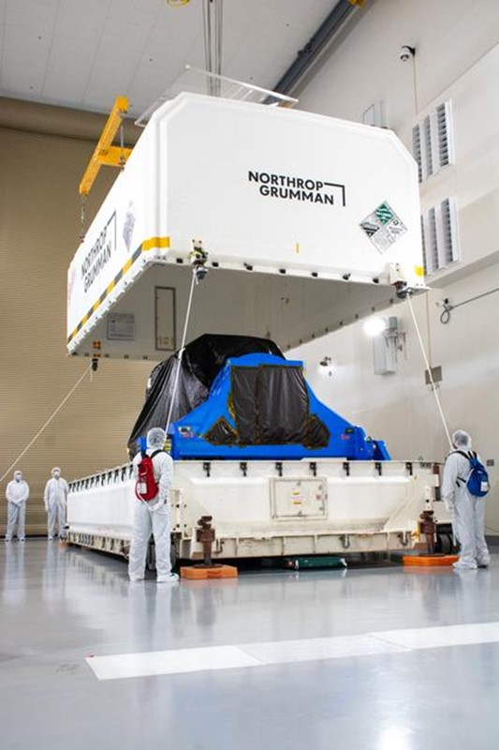
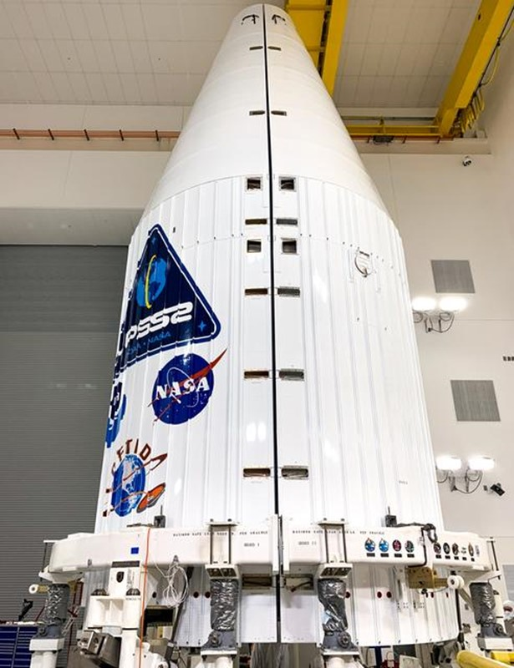
Preparation for JPSS-2 Launch: November 1, 2022
JPSS-2 Spacecraft Uncrating and Lift to Vertical
JPSS-2 Atlas V Fairing Fit Check

