Slide 1
WGCV-51
CEOS Cal/Val Portal
Specific Tasks and
Inputs / Discussion
Paolo Castracane,
Rhea System for ESA/ESRIN
Agenda Item 3.8
WGCV-51, Tokyo, Japan
3rd - 6th October 2022

Slide 2
CEOS Cal/Val Portal
Table of Contents:
CEOS Cal/Val Portal status and latest updates
Next steps and plan
Slide 2

Slide 3
CEOS Cal/Val Portal: numbers
https://calvalportal.ceos.org
Some numbers: 26th September 2022:
Users
1069 Registered Users
155 CEOS WGCV SAR Subgroup and 3 super-users
25 MTF Members
6 Cal/Val Doc Repository (rights for editing)
21 Terms and Definitions (rights for editing)
System availability
BC uses Nagios (http://www.nagios.org/) for monitoring the IT services.
The availability of the Cal/Val Portal is close to 100%.
Slide 3

Slide 4
Latest Updates
There have been some updates in the portal, beyond maintenance and routine ones, the most relevant are:
CCN1 CEOS Cal/Val Portal and MySPPA maintenance and support (for 2 years starting from 2023) - SoW: ESA-EOPG-EOPGMQ-SOW-52 (July 2022) proposal in-progress
New pages:
SALVAL (Surface Albedo VALidation) (https://calvalportal.ceos.org/salval) - June 2022
TSIS-1 Hybrid Solar Reference Spectrum (https://calvalportal.ceos.org/tsis-1-hsrs) – June 2022 (to be finalized)
LPV DIRECT V2.1 database (https://calvalportal.ceos.org/lpv-direct-v2.1) - April 2022
Terms and Definitions Wiki –(https://calvalportal.ceos.org/t-d_wiki) in continuous progress
QA4SM Evolution in FRM4SM in NEWS, Tools and (FRM4SM) in Project – June 2022
GSICS Tools – Links – Aug 2022
CEOS SAR Subgroup Workshop 2022 Announcement, Program and materials (https://calvalportal.ceos.org/ws2022) – July to Sept. 2022
ACIX-II Land (https://calvalportal.ceos.org/acix-ii-land) - Jan. 2022
ACIX-II Aqua (https://calvalportal.ceos.org/acix-ii-aqua) - Jan. 2022
CMIX (https://calvalportal.ceos.org/cmix) - Jan. 2022

Slide 5
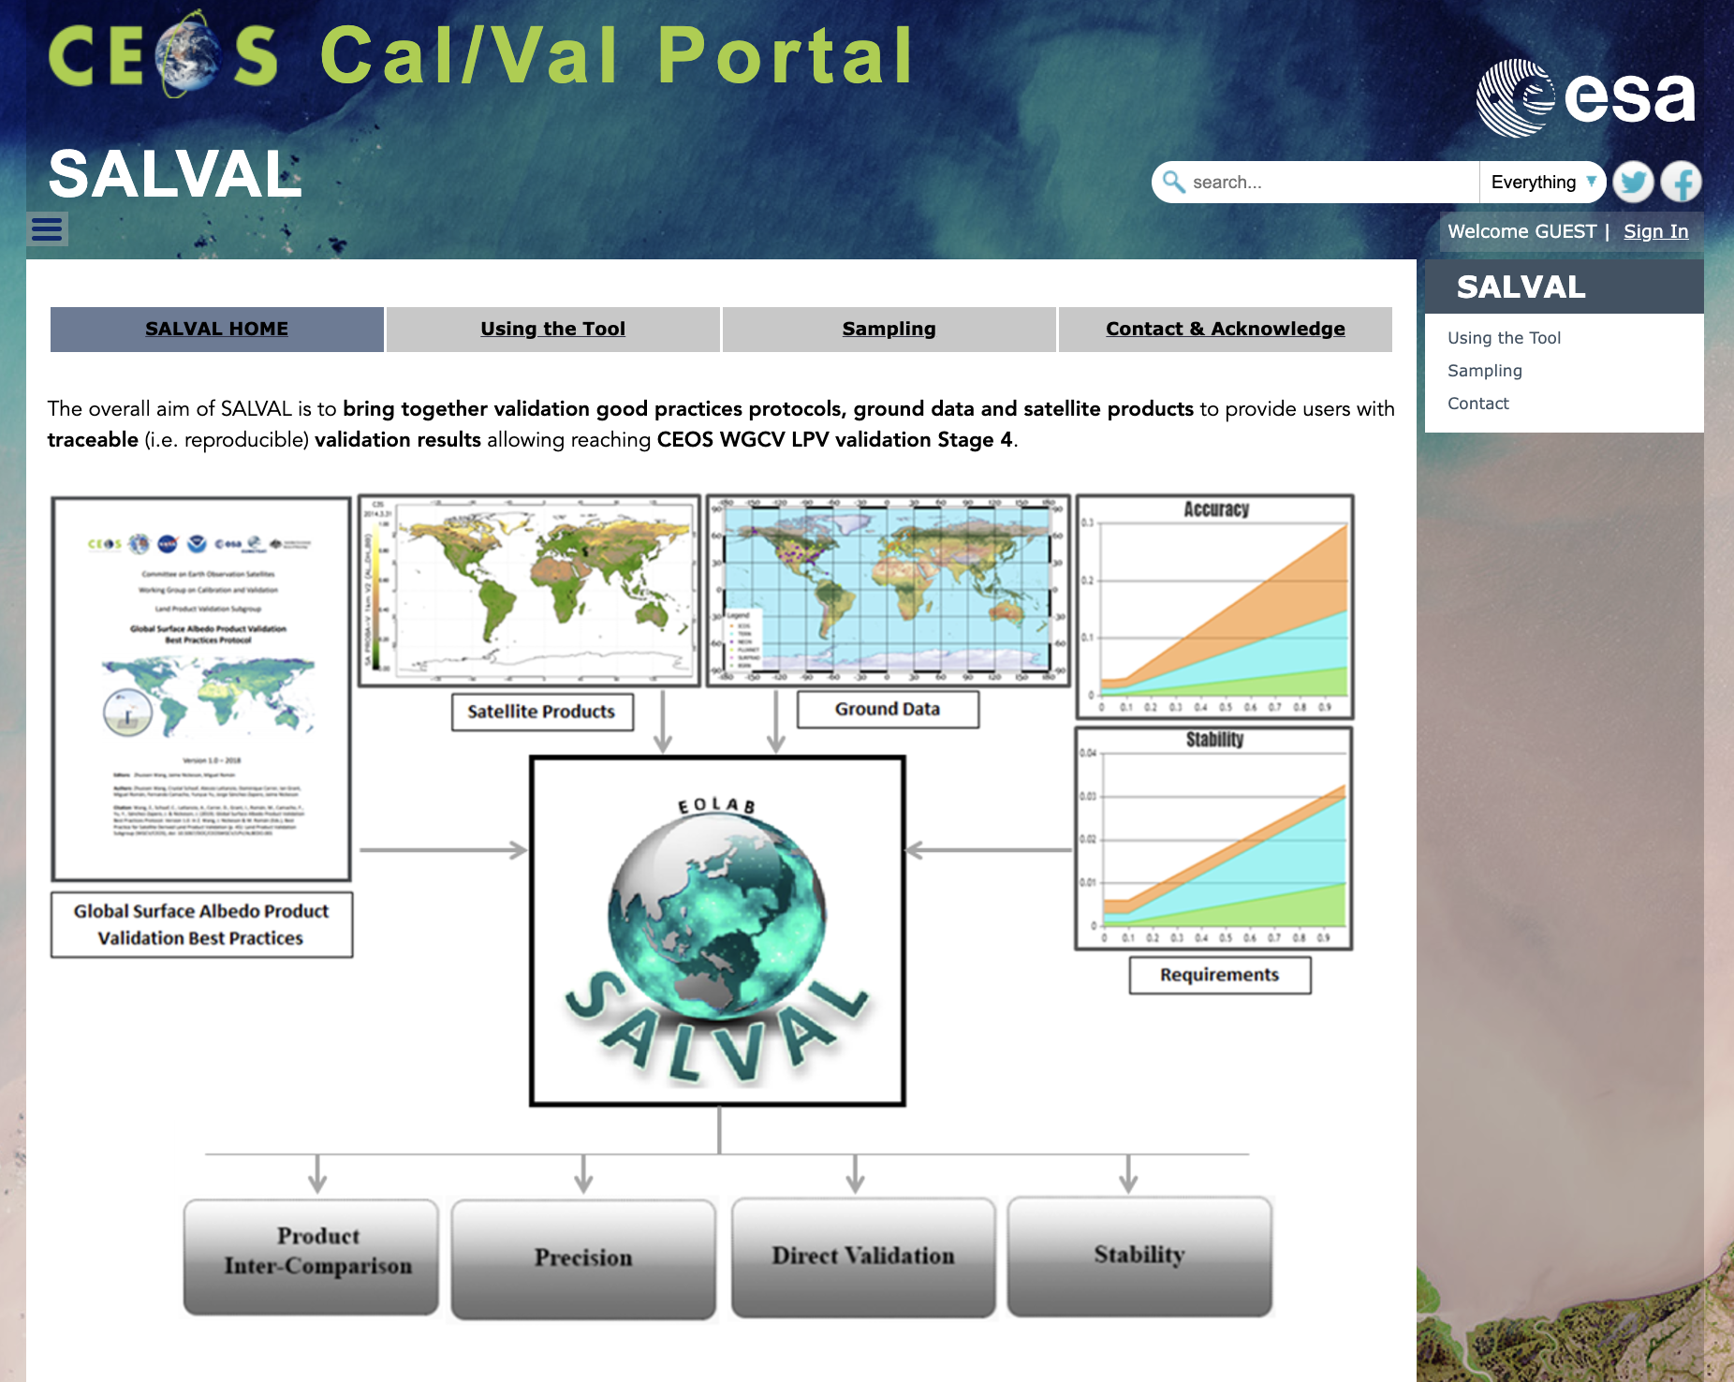
SALVAL (Surface Albedo VALidation)
The SALVAL (Surface Albedo VALidation) tool provides the user with:
A user-friendly interface for comparison of new satellite-based land surface albedo data products against ground reference data and existing validated land surface albedo products.
A traceable, transparent, and consistent methodology following the CEOS WGCV LPV Surface Albedo validation good practices protocol for conducting the validation exercise.
A flexible tool that allows for setting up the exercise with user defined requirements, albedo quantities, extents, or periods of interest to analyse results either interactively (via graphs and maps) or creating a standardized validation report in pdf format.
A tool to benchmark new products, update product validation results or add new ground reference data.
References:
Wang, Z., et. al., Best Practice for Satellite Derived Land Product Validation (p. 45): Land Product Validation Subgroup (WGCV/CEOS), doi: 10.5067/DOC/C [WWW Document]. https://doi.org/doi: 10.5067/DOC/CEOSWGCV/LPV/ALBEDO.001

Slide 6
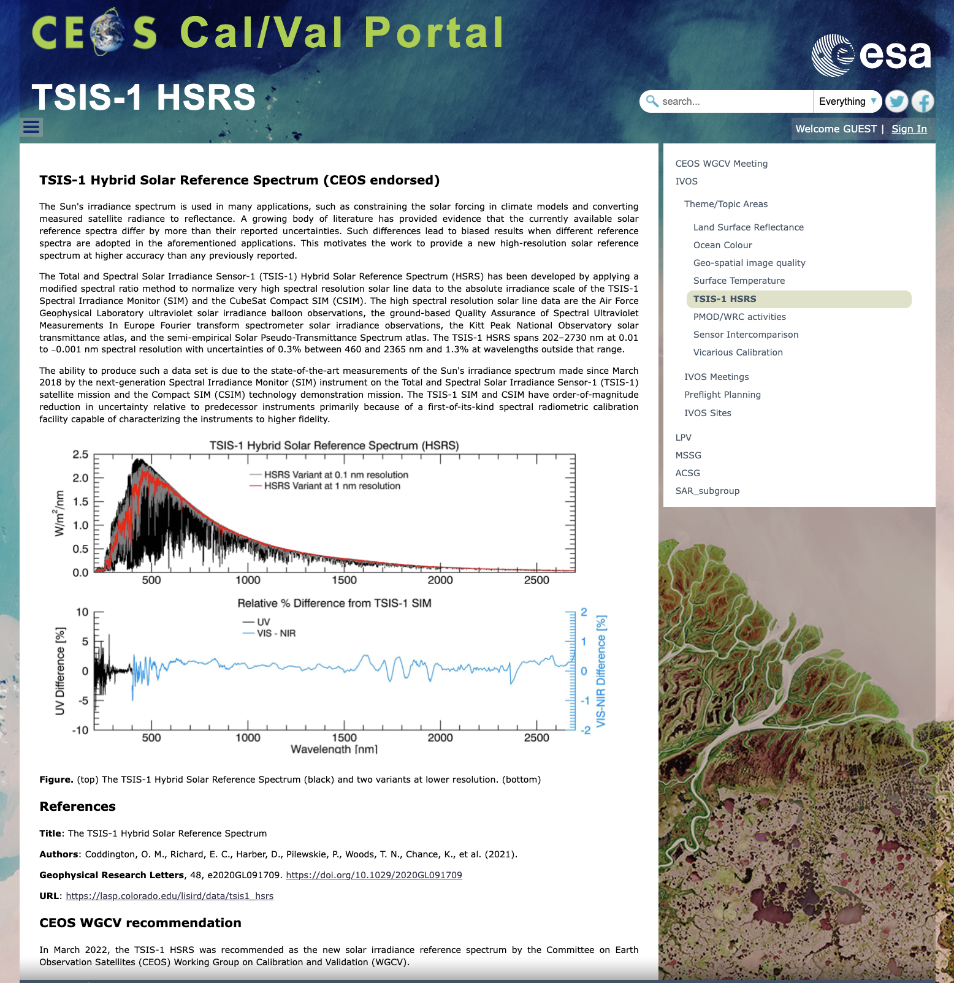
TSIS-1 Hybrid Solar Reference Spectrum (CEOS endorsed)
References
Title: The TSIS-1 Hybrid Solar Reference Spectrum
Authors: Coddington, O. M., Richard, E. C., Harber, D., Pilewskie, P., Woods, T. N., Chance, K., et al. (2021).
Geophysical Research Letters, 48, e2020GL091709. https://doi.org/10.1029/2020GL091709
URL: https://lasp.colorado.edu/lisird/data/tsis1_hsrs
CEOS WGCV recommendation
In March 2022, the TSIS-1 HSRS was recommended as the new solar irradiance reference spectrum by the Committee on Earth Observation Satellites (CEOS) Working Group on Calibration and Validation (WGCV).

Slide 7
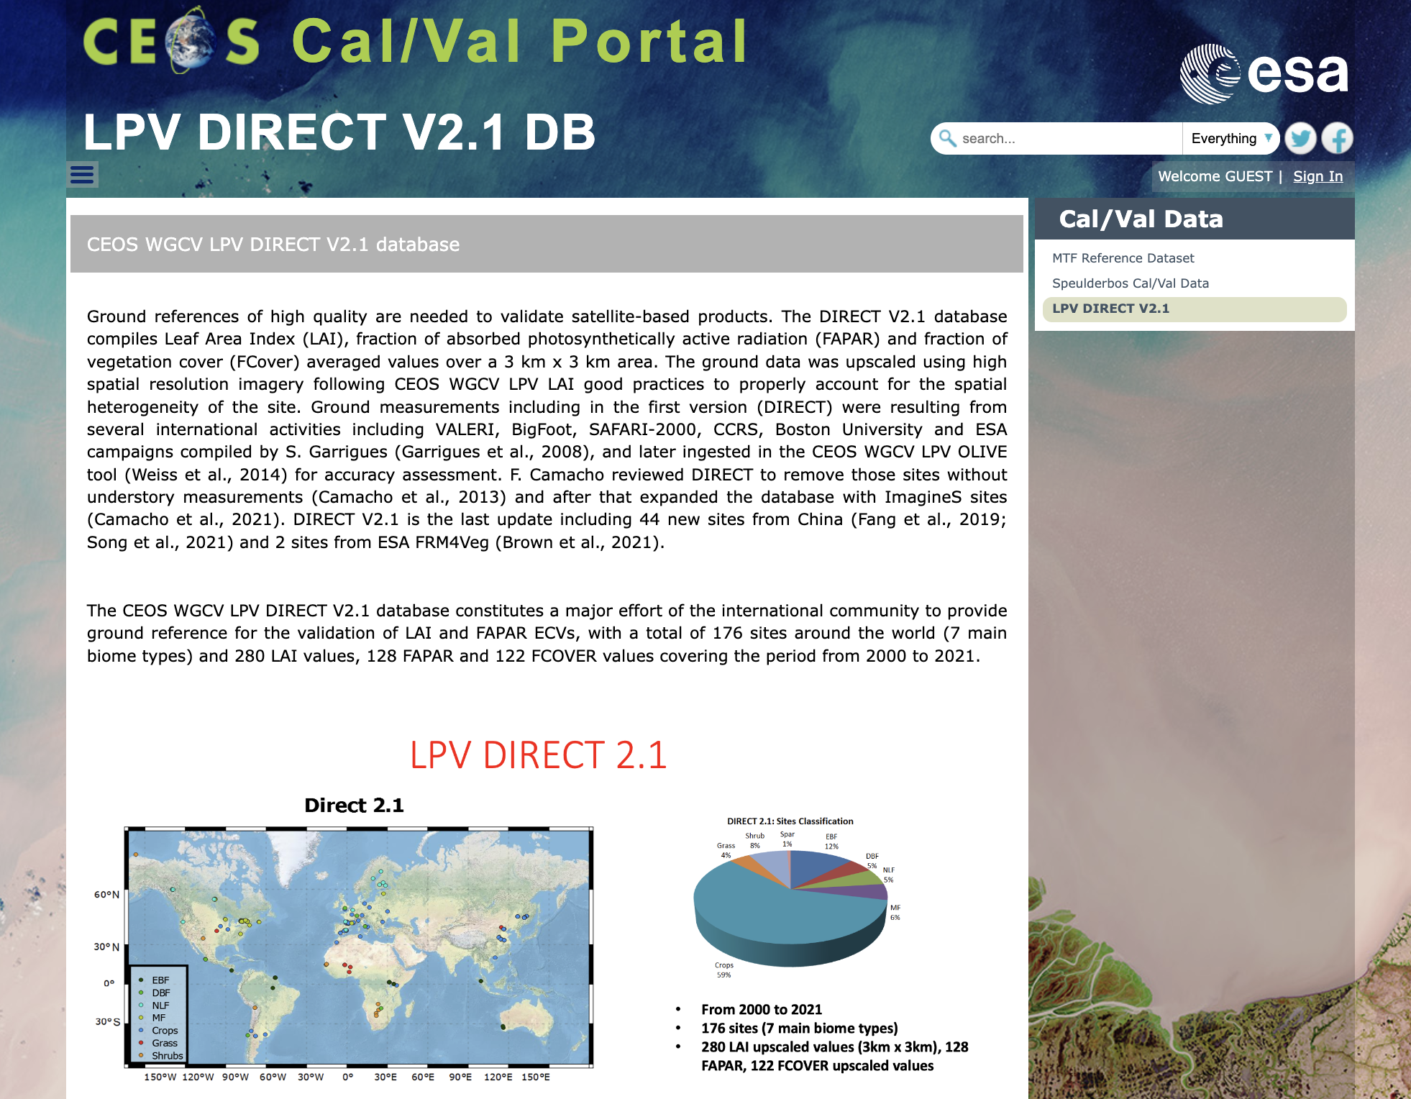
LPV DIRECT V2.1 database
Please download here the DIRECT V2.1 database
Contact:
Fernando Camacho fernando.camacho@eolab.es
The CEOS WGCV LPV DIRECT V2.1 database constitutes a major effort of the international community to provide ground reference for the validation of LAI and FAPAR ECVs, with a total of 176 sites around the world (7 main biome types) and 280 LAI values, 128 FAPAR and 122 FCOVER values covering the period from 2000 to 2021.

Slide 8
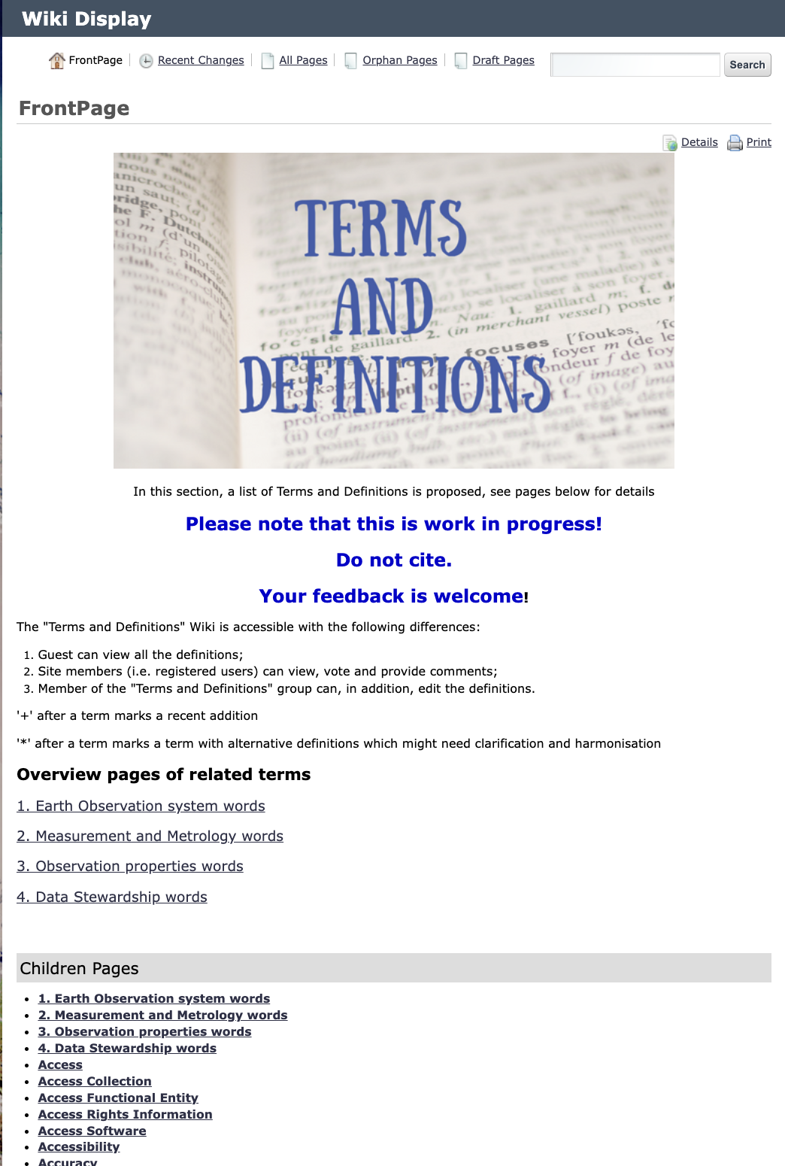
Terms and Definitions Wiki
The Terms and Definitions are in continuos progress thanks to the “Terms and Definitions” specific group. The webpage is accessible with the following differences:
Guests can view all the definitions;
Site members (i.e. registered users) can view, vote and provide comments;
Members of “Terms and Definitions group” can, in addition, edit the definitions.
Feedback is welcome!

Slide 9
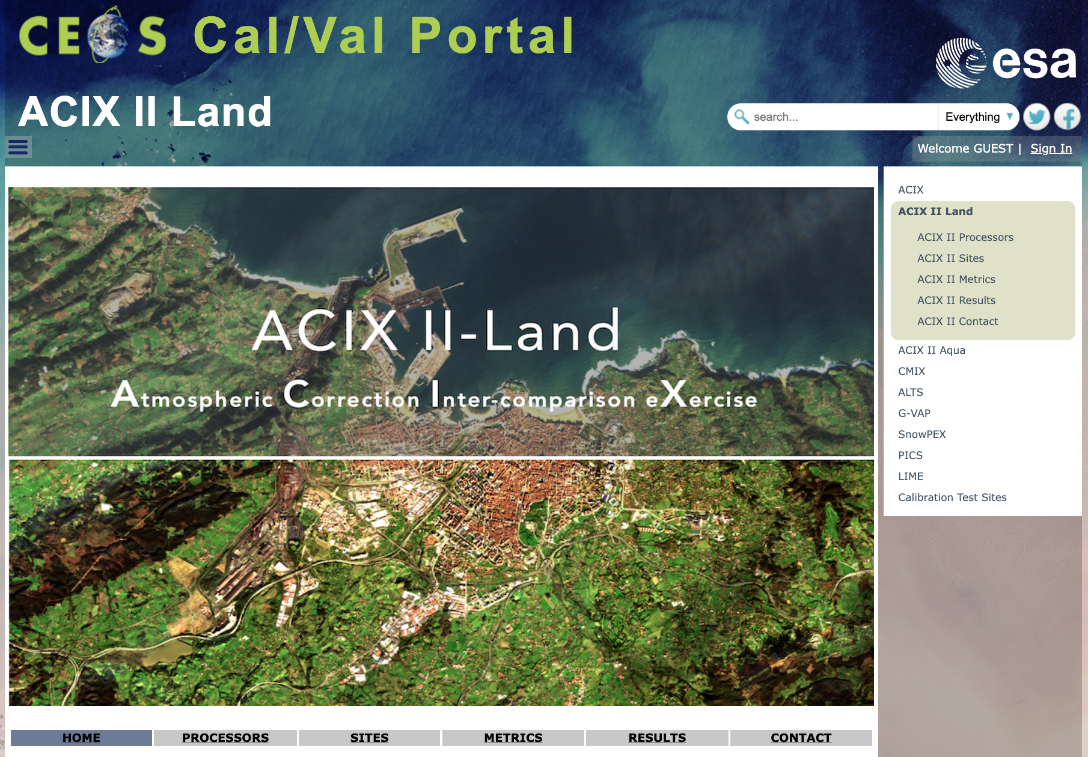
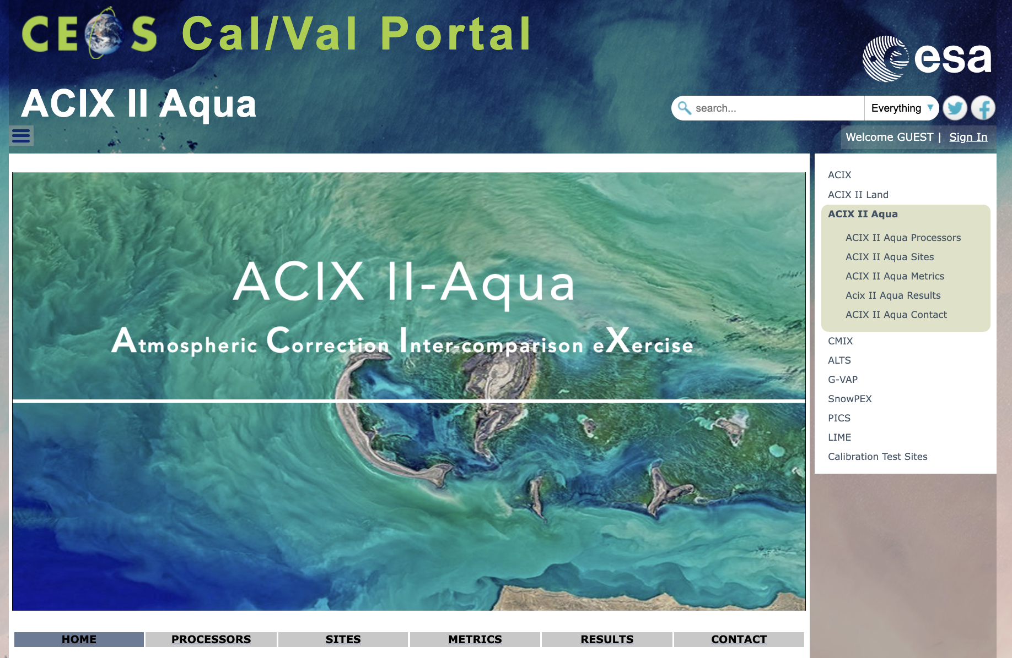
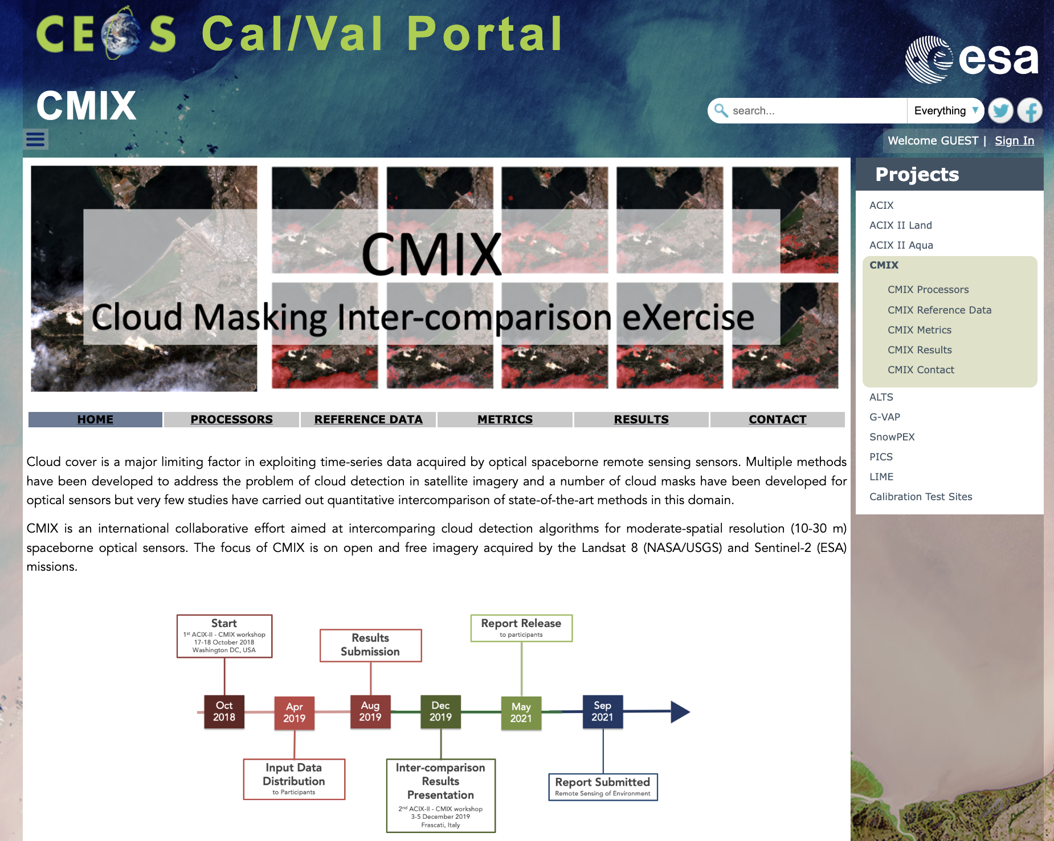
ACIX-II Land, Aqua and CMIX webpages
Webpages are available for Atmospheric Correction Inter-comparison eXercises (Land and Aqua) and for Cloud Masking Inter-comparison eXercise. Description of the projects, processors, sites, reference data, metrics as well as results have been included.

Slide 10
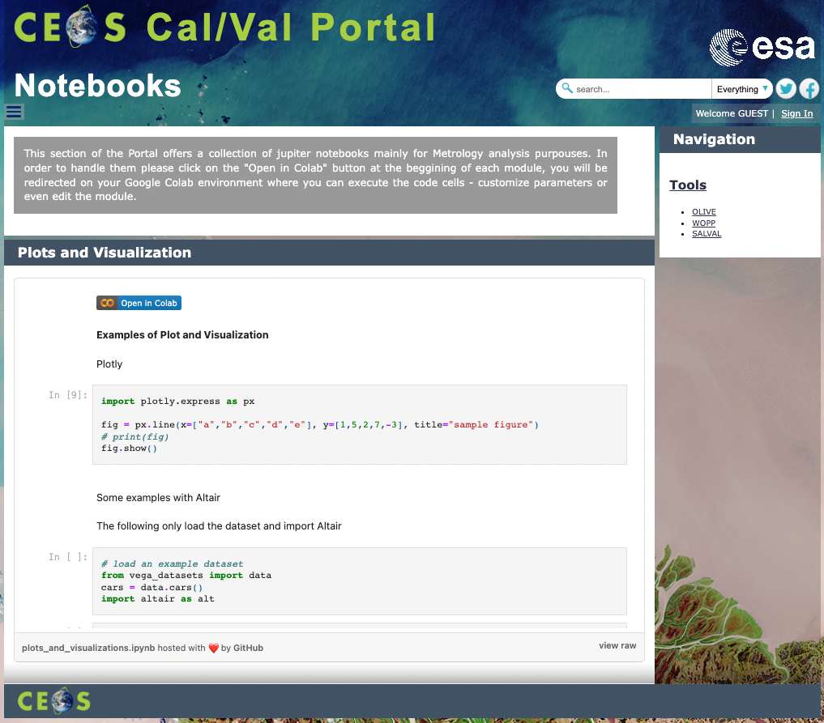
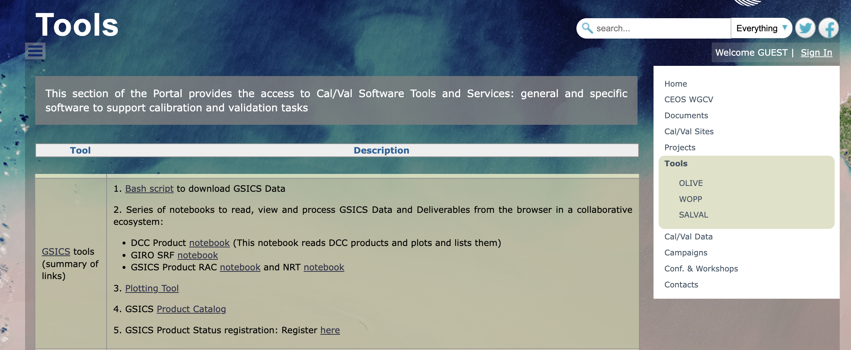
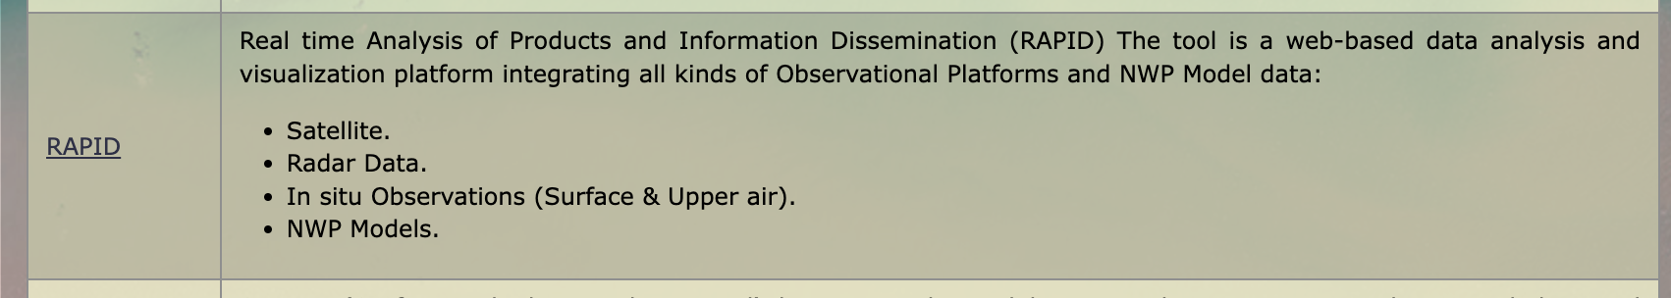
GSICS tools – links
In the contex of GSICS Group Data – relevant links to GSICS scripts and notebooks have been included in the Tools section – as well as – the link to RAPID (by Satellite Application Centre (SAC), ISRO in collaboration with India Meteorological Department IMD ).
– a web-based data analysis and visualization platform integrating all kinds of Observational Platforms and NWP Model data.
The Cal/Val portal hosts notebooks via Google Colab for demos/exercises (in progress)

Slide 11
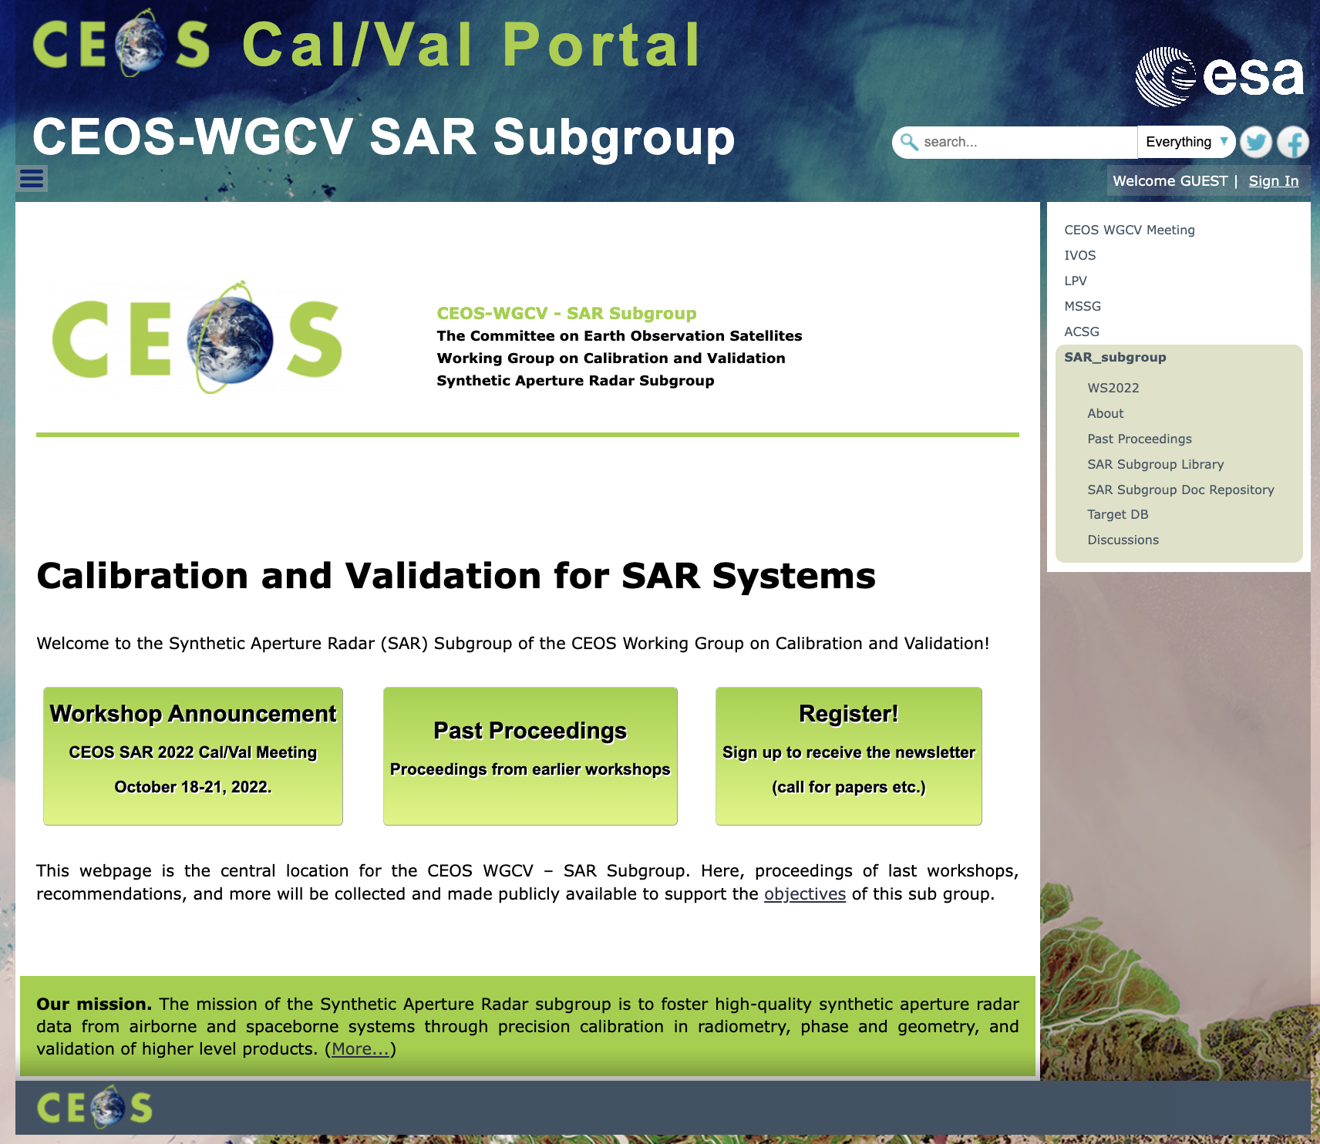
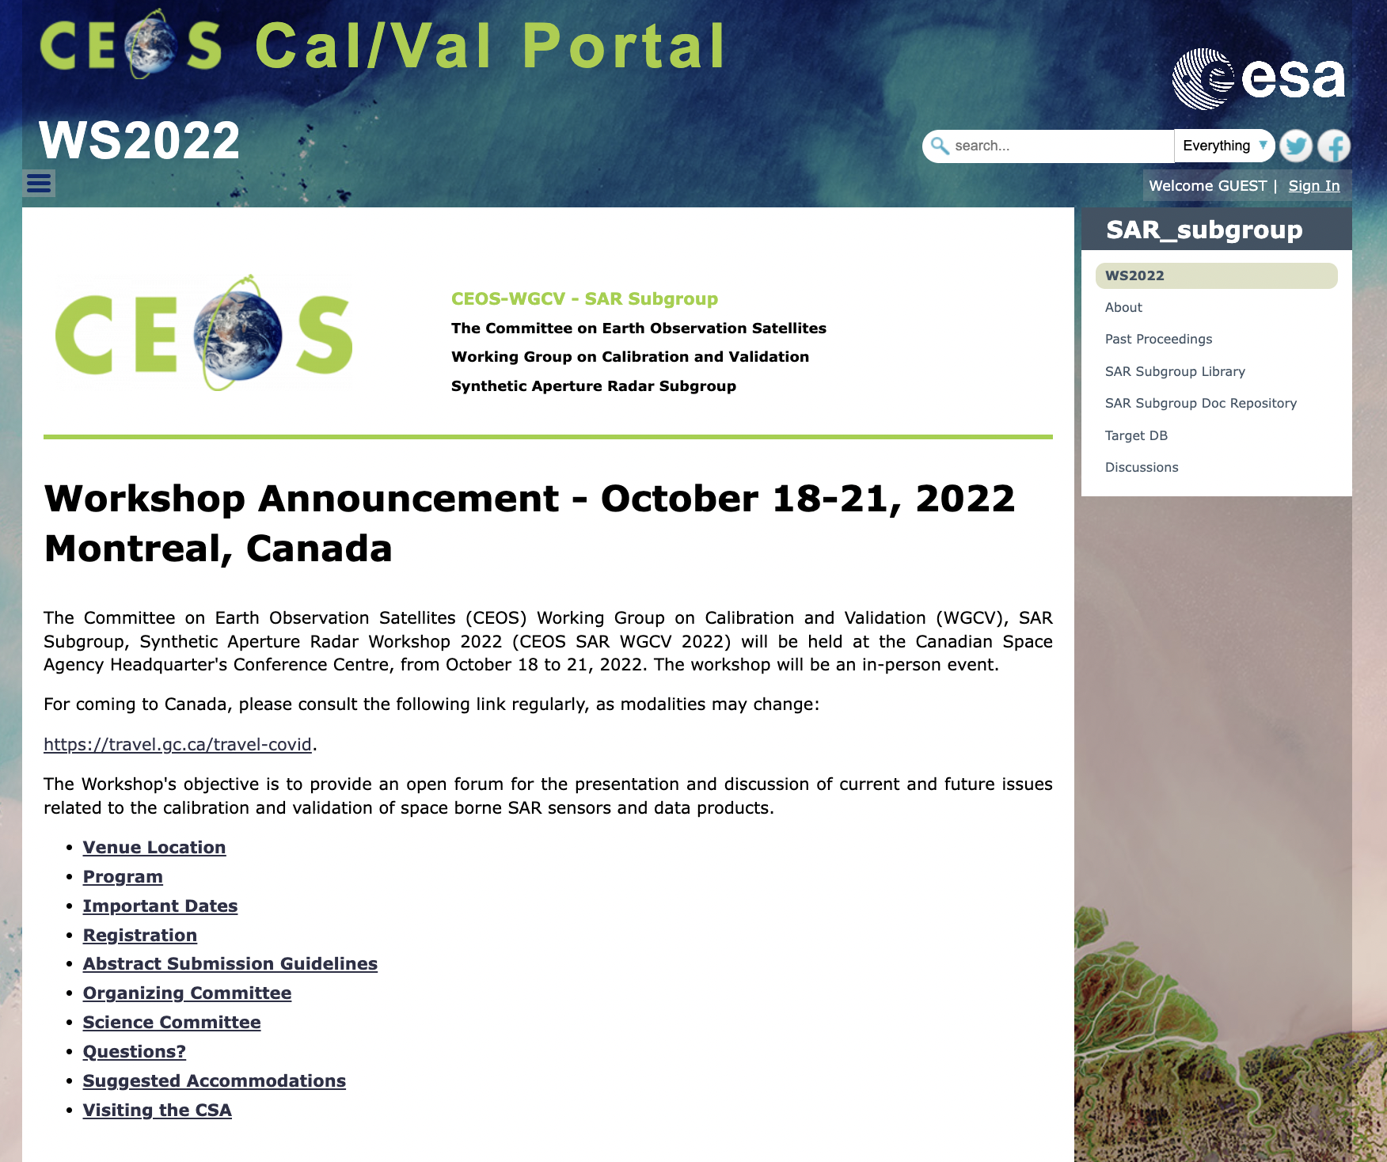
CEOS SAR Subgroup

Slide 12
Microwave Subgroup MSSG
Reffering to WGCV-50-ACT-08 ([…] to discuss increased MSSG representation on the WGCV Cal/Val portal)
Input received from Prof. Xiaolong Dong
Project Summary
Work Plan Outlines
Scatterometers and Wind Retieval Practices
Scatterometer Biographies
Implementation in progress

Slide 13
Atmospheric Composition Subgroup ACSG
Reffering to WGCV-50-ACT-05 (the addition of a specific resource section on the CEOS Cal/Val Portal for surface-related validation activities for atmospheric missions, and to explore support for / synergies with NDACC resources.)
Input received from Jean-Christopher Lambert:
"Use of PICS for calibration evaluation for atmospheric sounders".
ACSG website
Relevant links
Updates on Cal/Val Sites; Projects
Implementation in progress

Slide 14
Input from IDEAS-QA4EO ESA projects
Action in progress.
IDEAS QA4EO Task 2 teams have been contacted and they provided material. In particular:
UAV for BRDF - GOE-K and University of Tor Vergata (Italy)
Land Validation Forest and UAV for SR - WUR (Netherlands) and GFZ (Germany)
Land Validation Mer Bleue (NRC CNRC, Canada)
Snow Cover Validation - FMI (Finland)
Metrology an Campaigns for Aerosols – CNRS LOA Univ. of Lille, France

Slide 15
Next Steps and Plan
To implement actions in progress:
  MSSG input
  ACSG input
  ESA IDEAS/QA4EO Cal/Val data and activities.
CCN1 finalization – KO and PM technical teleconf (by end of this year)
(this includes CEOS Cal/Val Portal maintenance/support and the new SARCalNet website)
Proposals:
Latest updates and news - every two months – email to WGCV comunity
Periodic Newsletter – 9 months (after WGCV plenary)
To increase activities on twitter account: @CEOS_WGCV

