Slide 1
A Network of Sites for Land Surface Temperature (LST) Measurements based on Thermal IR sensors
Aimé MEYGRET and
Patrice HENRY, CNES
WGCV 51
October 6, 2022

Slide 2
Context
Several existing TIR operational missions: ECOSTRESS, ASTER, LANDSAT-8&9, MODIS, VIIRS, SLSTR…
TIR future missions with increased spatial resolution: TRISHNA, LSTM, SBG,…
More and more demanding LST accuracy requirements (even better than 0.1K for climate studies)
Importance of vicarious calibration for the validation of on-board calibration systems (black bodies) or direct calibration
L2 products (temperature, emissivity) validation need
Slide <numéro>

Slide 3
General objectives
Why a new network of instrumented sites dedicated to the radiometric calibration of Earth Observation Thermal IR optical sensors?
To collect surface temperature and emissivity, and atmospheric data necessary for the simulation of observations by TIR optical sensors and thus verify their radiometric calibration
To increase the number of matchups between in-situ measurements and space sensor observations and reduce the overall uncertainties, and reduce the efforts of individual agencies
To ensure traceability of the space sensor radiometry to the “Système International” (SI)
To support the establishment of the Global Earth Observation System of Systems by providing measurements to verify the radiometric consistency between EO space sensors
The success and experience return from RadCalNet network dedicated to VNIR-SWIR optical sensors cal/val
Slide <numéro>

Slide 4
Network objectives
To focus on providing ToA spectra for ToA calibration/validation as the main purpose of the automated network
Network requirement to provide a spectral sampled Brightness Temperature at ToA to 0.5K
Uncertainties have to be provided
Main ‘customers’ for this ToA service remain space agencies (NASA, ESA, CNES, etc) with their higher resolution missions to come
But few commercial missions in TIR are being planned and could be interested in this service
Initially the network shall not aim to publicly disseminate products but serve as a tool to space agencies for their own TIR needs (still experimental exercise)
Slide <numéro>

Slide 5
First steps
Establishing a dedicated Working Group (first meeting: Sept. 14)
  Including : WGCV/IVOS & LPV members, TIR experimentation experts, agencies representative
  Composition: Simon Hook (NASA), Kurt Thome (NASA), Darren Ghent (U. Leicester), Jose Sobrino (U. Valencia), Mark Irvine (INRAE), Frank Goettsche (KIT), Dave Smith (RAL), Nigel Fox (NPL), Esad Micijevic (USGS), Aimé Meygret (CNES), Steffen Dransfeld (ESA)
Inventory of the existing sites and methods
Focus on few high quality sites rather than a larger number of sites that may lack in parts of required characterization
Focus on the way to establish uncertainties budget at ground and ToA level
  A dedicated study to be defined and funded
Slide <numéro>

Slide 6
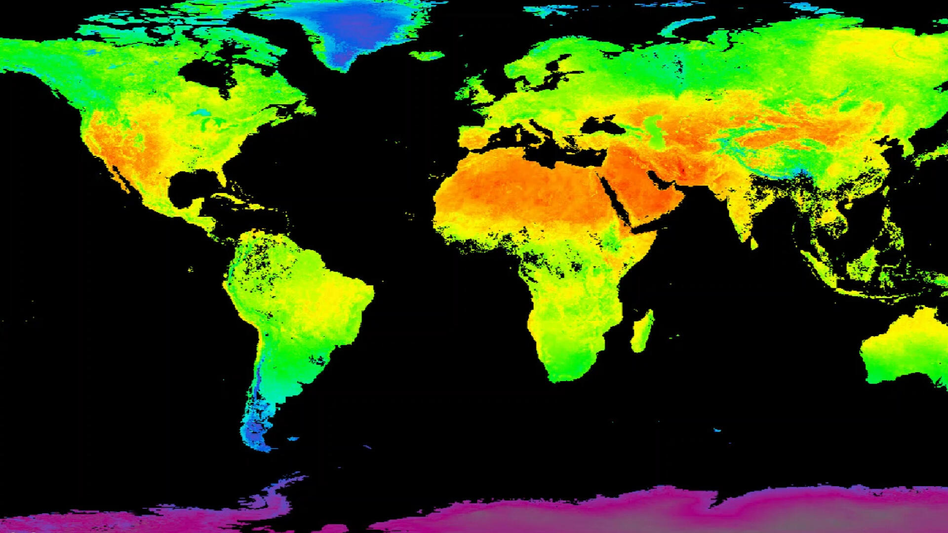
Thanks for your attention

Slide 7
Existing “Networks”
Reference to the excellent work performed by WGCV/LPV subgroup and dedicated to Land Surface Temperature Product Validation Best Practice Protocol (jan. 2018) which identifies the existing networks and their limitations
SURFRAD: Surface Radiation, NOAA
GCU: Global Change Unit, University of Valencia
KIT (Karlsruhe Institute of Technology) stations
JPL network
USCRN: US Climate Reference network
Location of ground observational networks currently used to validate standard LST products derived from US and European spaceborne instruments.
Slide <numéro>

