Slide 1
WGCV-51
TRUTHS
Nigel Fox, NPL/UKSA
Agenda Item 3-6
WGCV-51, Tokyo, Japan
3rd - 6th October 2022

Slide 2
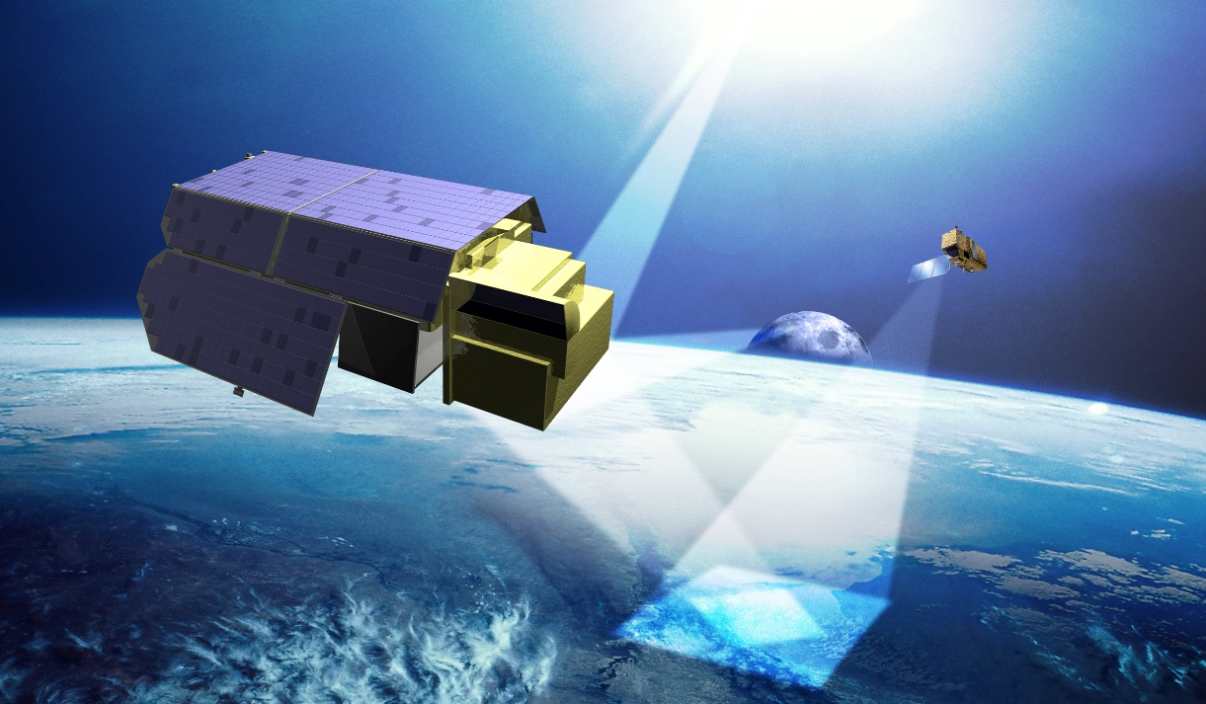
T raceable
R adiometry
U nderpinning
T errestrial- &
H elio-
S tudies
An ESA EarthWatch mission
A ‘gold standard’ reference in space to support the climate emergency

Slide 3
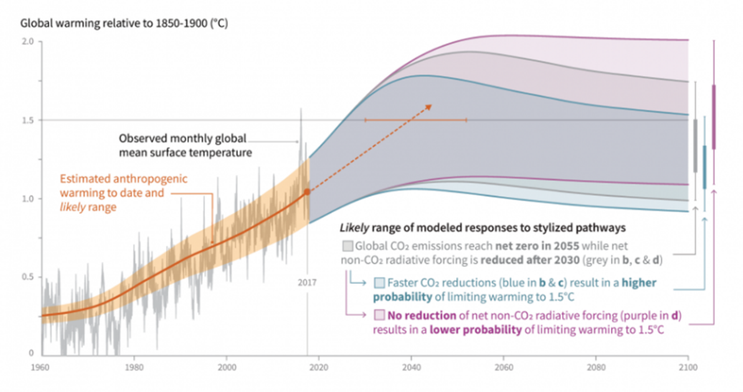
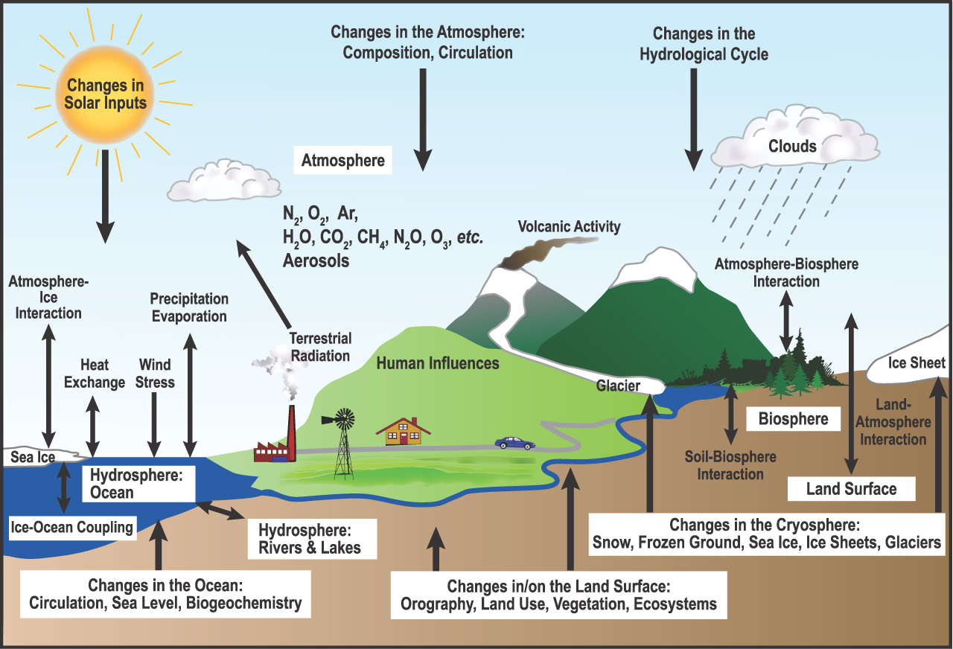
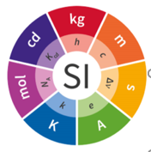
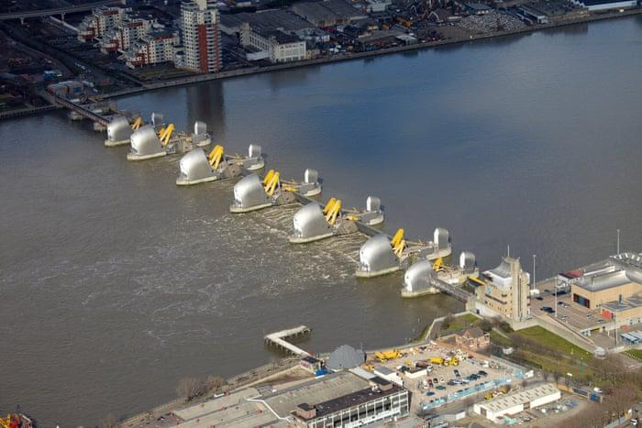
Societal Challenge: sustainable growth in a changing environment – ‘damage limited’ by climate action
Time to reach 1.5 C
(IPCC 2018)
NEED:- Trustworthy observations from space to:
Monitor and assess progress resulting from mitigation
Improve understanding of climate sensitivities, dependencies & forecasts
Support adaptation, Food security emergency response, de-risk investments
REQUIRES
Quantitative, comprehensive, accessible, useable data
Integrated, interoperable global observing system (space and in-situ)
Robust reference(s) (benchmarks) against which to reliably measure change in as short a timescale as possible
International acceptance
Is Net Zero the right target?
When & how big do we build the next Thames barrier?
Confidence from metrological traceability to international standards (SI) at location of measurement
Notes:
Society is under pressure to urgently address the impending disaster resulting from human led climate change. However, the need for economic growth and improved quality of life is a counter balance that can’t be ignored – Requiring actions and impacts to be robustly evidenced.
In the top right plot, variance in the forecasts of climate models, the shaded areas, may help or hinder our damage limitation strategies so we must seek to reduce these uncertainties. Similarly, how the planet responds, not only directly to human activity but also secondary consequences such as thawing of Siberia need to be accounted for.
Global policymakers and societal action require comprehensive data of sufficient accuracy to provide the evidence needed to instil confidence in decision making. There must be robust benchmarks to demonstrate progress from our actions.
Such benchmarks need to be unambiguous, transparent and unchallengeable and thus tied to international standards, the SI.

Slide 4
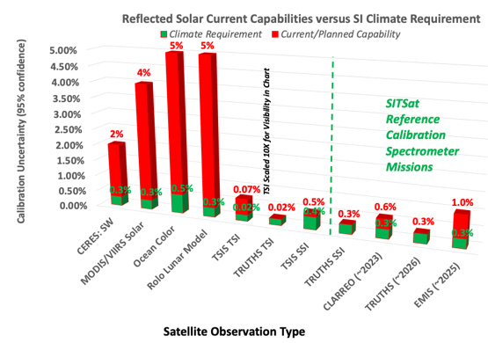
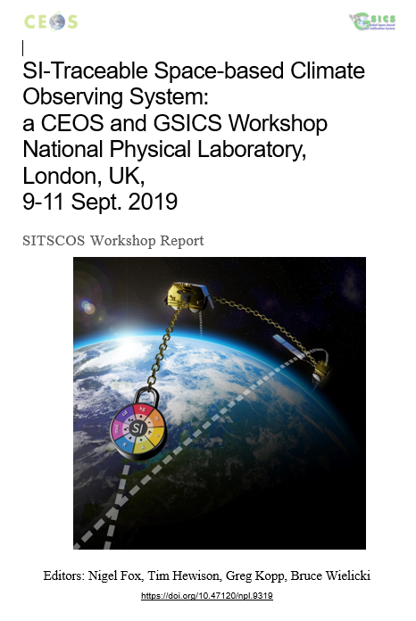
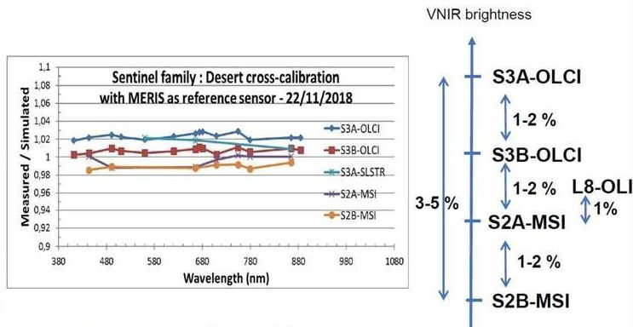
Climate Need & observation challenges
Libya 4, a CEOS PICS site is a desert with a relatively stable long-term reflectance, but absolute value of reflectance les certain.
Most satellites not designed for climate: performance to suit application
Climate trends need decades! Trustable harmonised time series require stable/understood sensors anchored to invariant references
Vegetation index
http://calvalportal.ceos.org/report-and-actions
https://doi.org/10.47120/npl.9319
A Meygret CNES
What is the Truth?

Slide 5
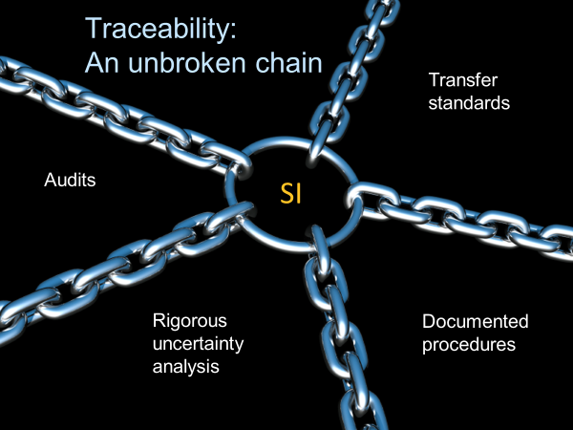
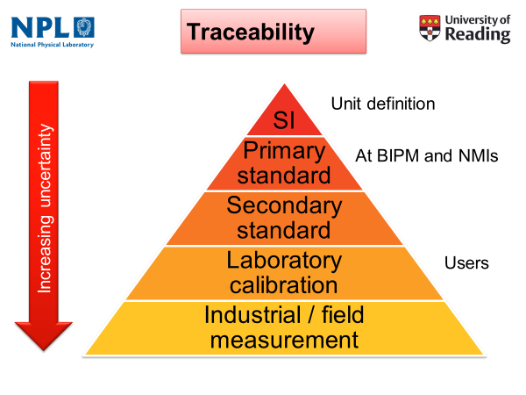
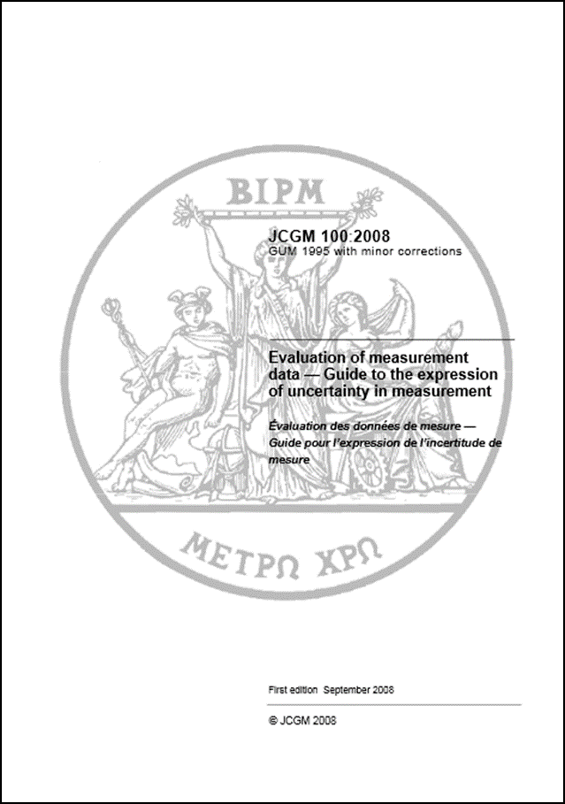
Long-time-base & societal/economic critical applications like Climate require robust ‘trustworthy’ data:
e.g detection of small signals of change out of a noisy background of nat variability
At location of observation
GUM

Slide 6
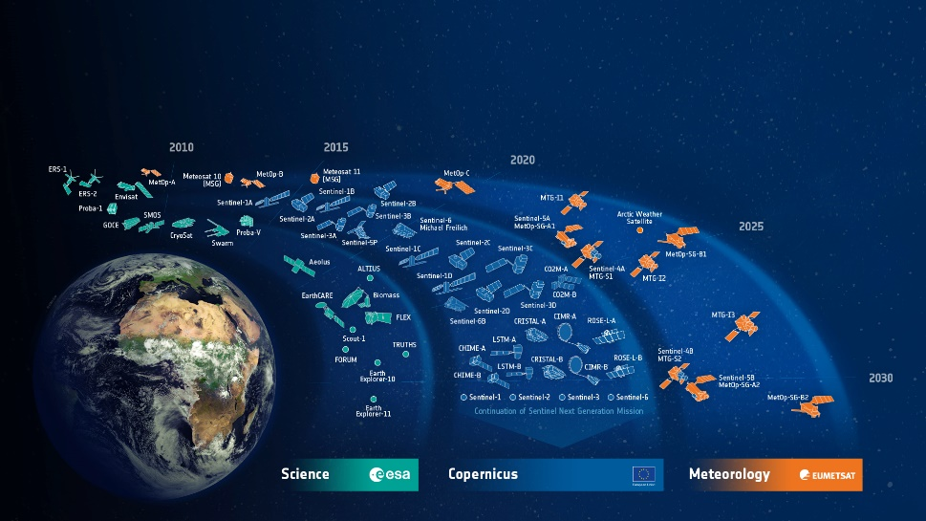
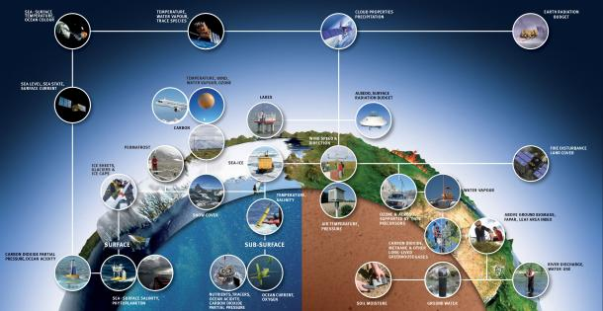
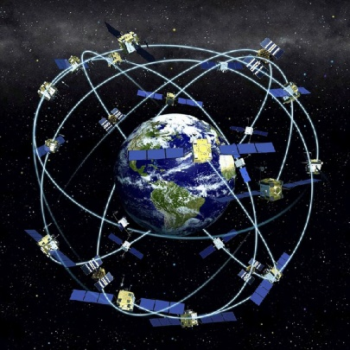
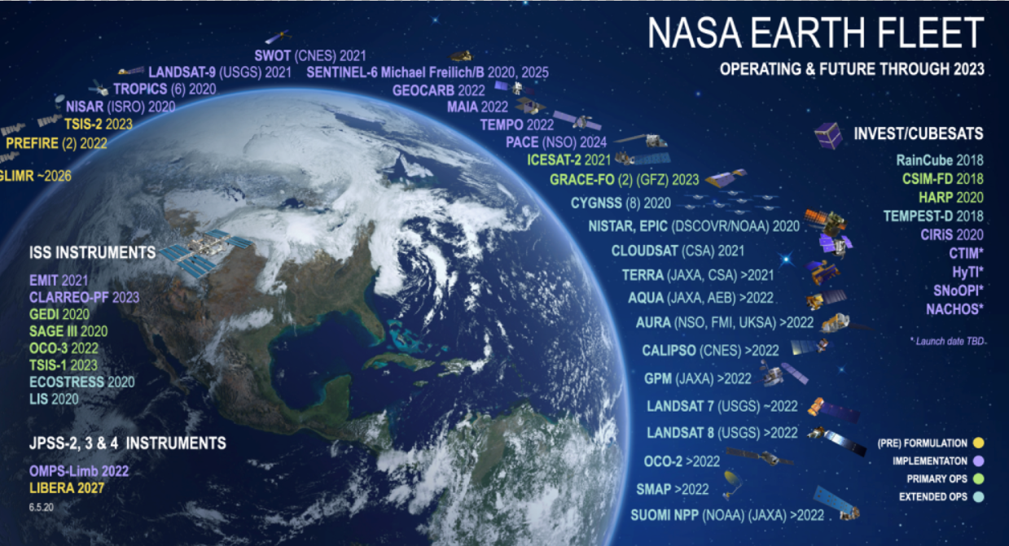
Interoperable observing system
ESA Developed Earth Observation Satellites
Maximise utility of data
New Space!
>60% of ECVs requires space observations
(TRUTHS supports ~>1/2 of these)
Satellites can suffer biases and degradation in performance due to launch and harshness of space.
SITSats such as TRUTHS/CPF can help enable a new epoch for space-based Earth Observation
Notes:
GCOS has identified a set of 54 key essential climate variables and GEO has helped identify additional key observations and strategies to support the Sustainable Development Goals and create a Global Earth Observation System of Systems.
The World’s space agencies and their international coordinating bodies are working to create an observing system to meet these needs, a goal now complemented though commercially provided constellations.
For this observing system to be integrated and interoperable requires as a minimum, harmonised and consistent data where any observational biases are understood and correctable.
Space agencies have and continue to expend great efforts to ensure satellite data is robust and of good quality, however the harshness of launch and the environment of space places a limit on what is currently achievable.
New types of satellites with embedded on-board traceability to international SI standards, so call SITSATS like TRUTHS provide an opportunity to change this paradigm.

Slide 7
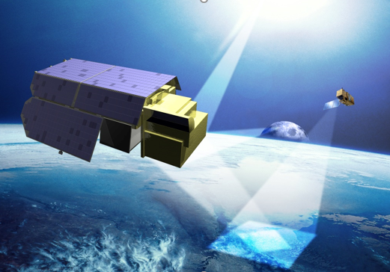
SITSats and TRUTHS Mission Objectives
What is a SITSat?: ‘Space borne missions specifically designed, characterised and documented to provide high accuracy SI-Traceable ‘reference’ measurements.’ (Evidencing comprehensive uncertainty to SI, ‘in-space’, of all contributors to observations made from the satellite)
TRUTHS is an operational climate mission, aiming to:`
Climate benchmarking: enhance our ability to estimate the Earth Radiation Budget (and attributions) through direct measurements of incoming & outgoing energy and reference calibration of other ERB & similar missions.
A standards lab in orbit:
on-board replica of on-ground methods, using a cryogenic absolute radiometer as primary standard
2. Satellite cross-calibration: establish a ‘standards laboratory in space’ to create a ‘gold standard’ reference data set to cross-calibrate other sensors and improve the quality and interoperability of their data throught: simultaneous observations, surface reference sites and the moon
3. provide SI-traceable measurements of the solar spectrum (incoming & reflected) to address its impact on climate and interactions with the atmosphere and surface
A benchmark measurement is one with characteristics (documentation, SI-Traceable uncertainty, representative sampling) that allows it to be unequivocally considered a ‘reference’ of the specified measurand against which future measurements of the same measurand, can be compared.

Slide 8
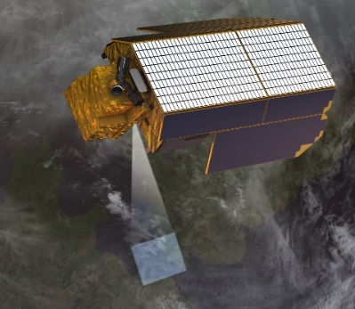
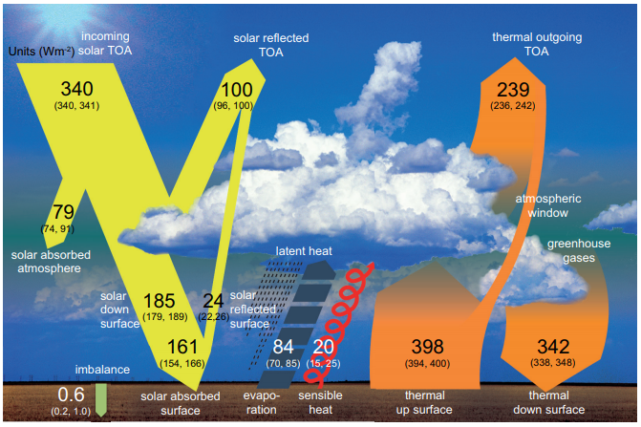
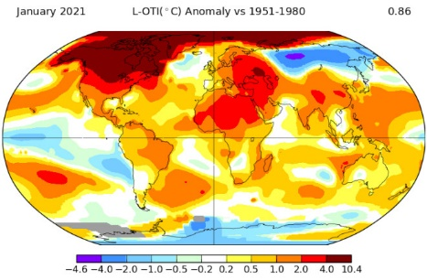
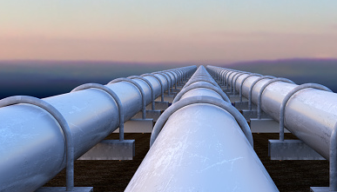
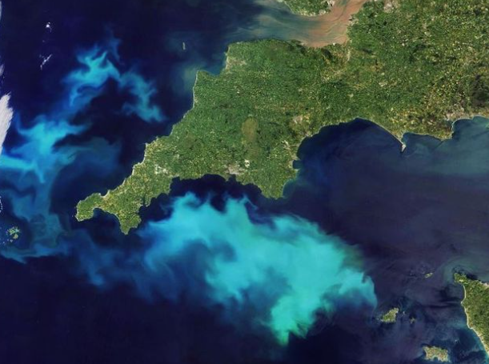
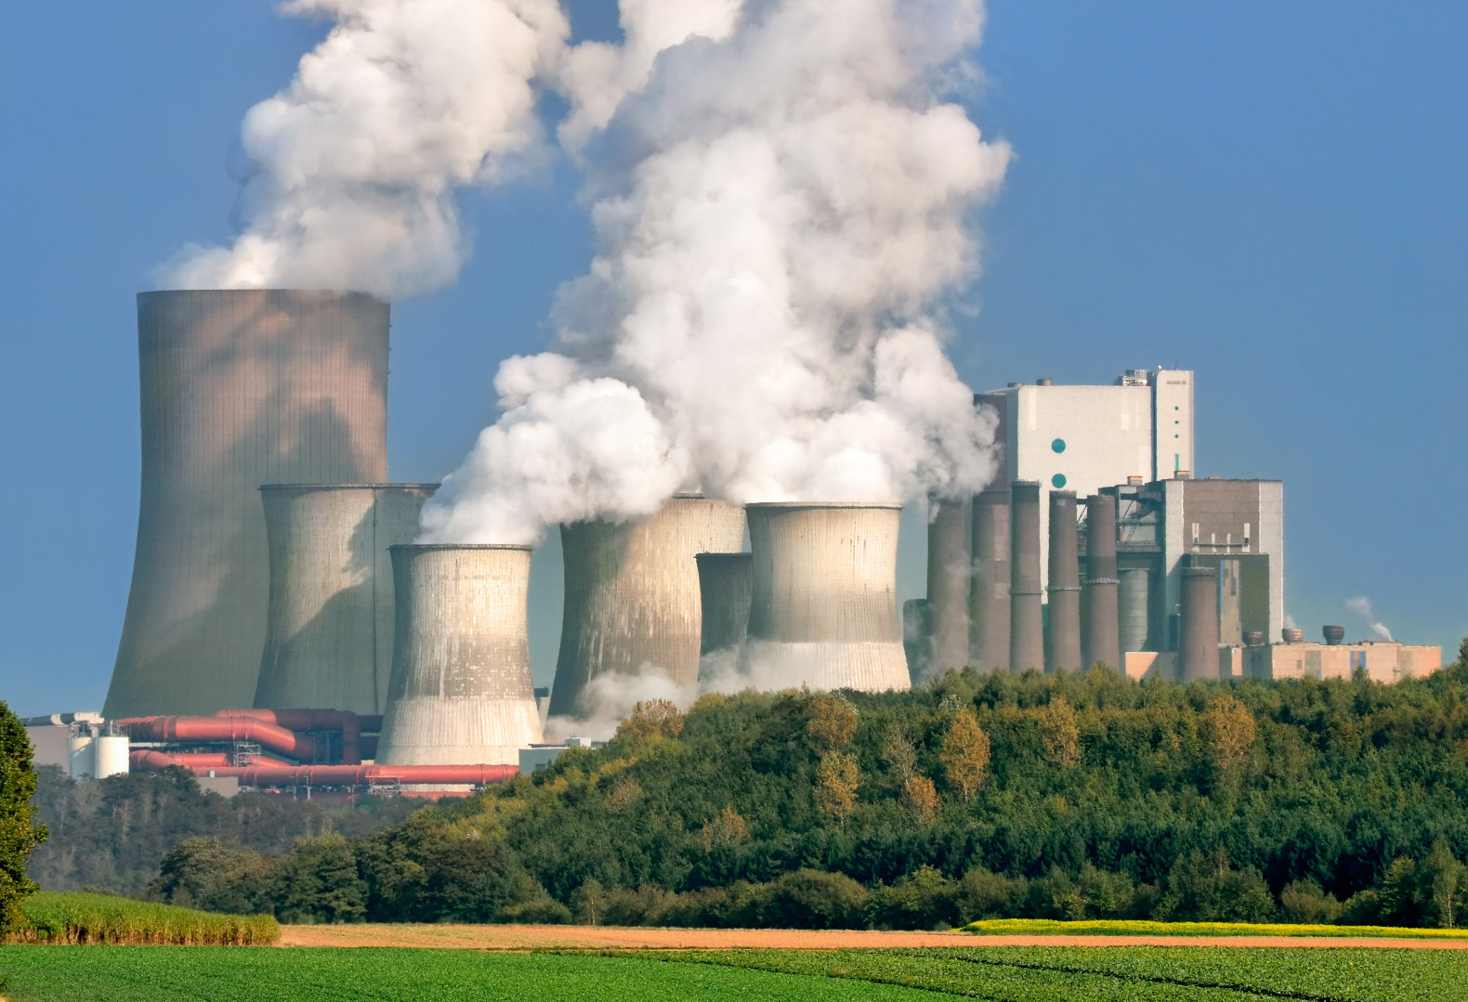
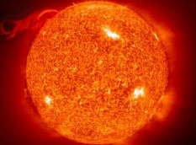
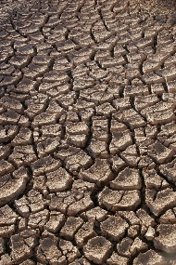
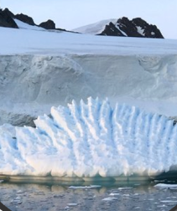
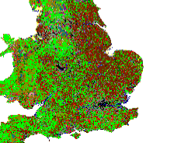
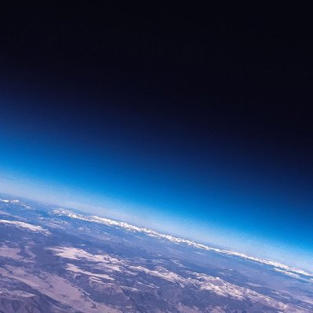
What does TRUTHS do?
Measures incoming and earth reflected radiation from the sun
320 to 2400 nm @ ~4 nm intervals (1 nm for solar UV)
Global nadir @ 50 m ground resolution with 100 km swath (capability)
Target uncertainty of 0.3% (k=2)
Establishing a benchmark of the radiation state of the planet at ToA (radiance/reflectance) & BoA surf reflectance to help enable:
Calibration
- Interoperability
- data-gaps
- performance
- Utility
Observations
- Benchmark
- monitoring
- Litigation
- algorithm improvement
Climate action: Supporting ‘Net Zero’
Climate sensitivity/response
Climate action/mitigation
Adaptation/sustainability

Slide 9
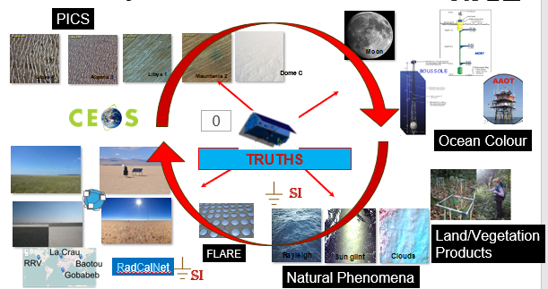
SI-Traceability to Cal/Val infrastructure

Slide 10
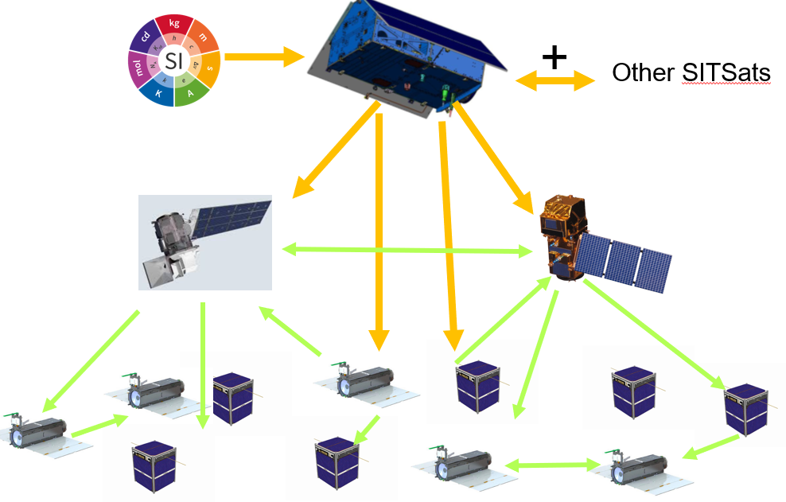
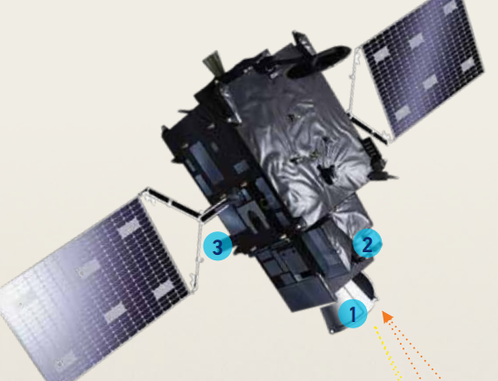
SI-Traceability to Cal/Val infrastructure

Slide 11
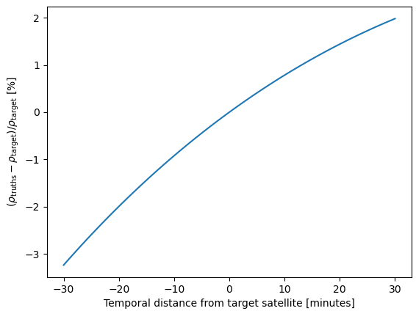
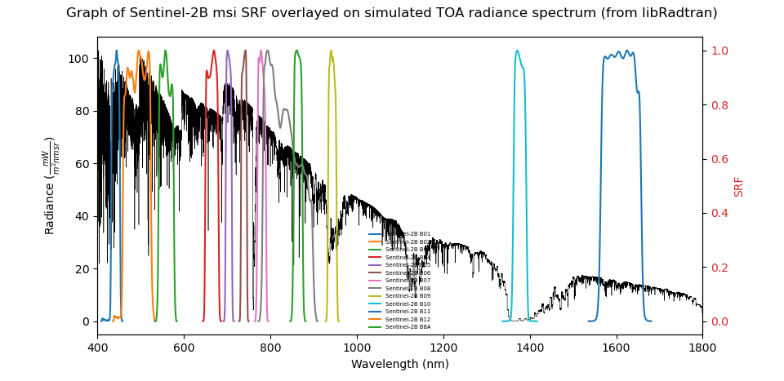
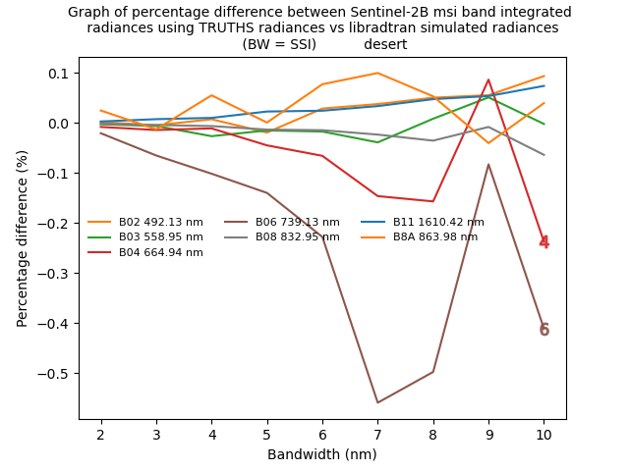
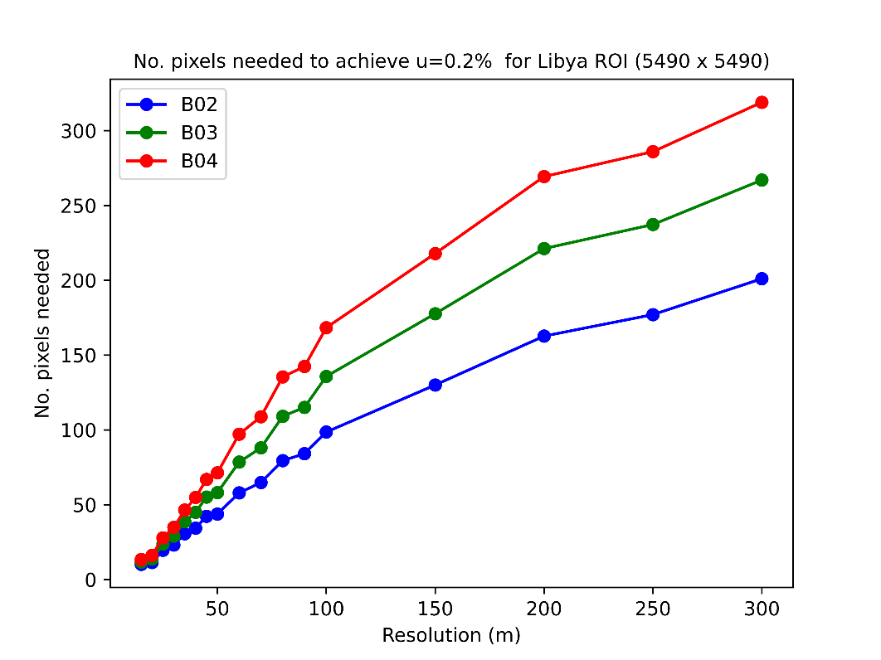
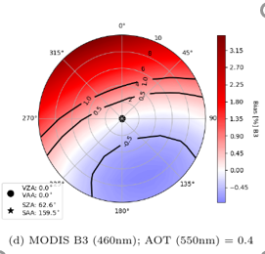
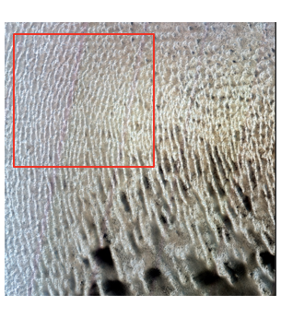
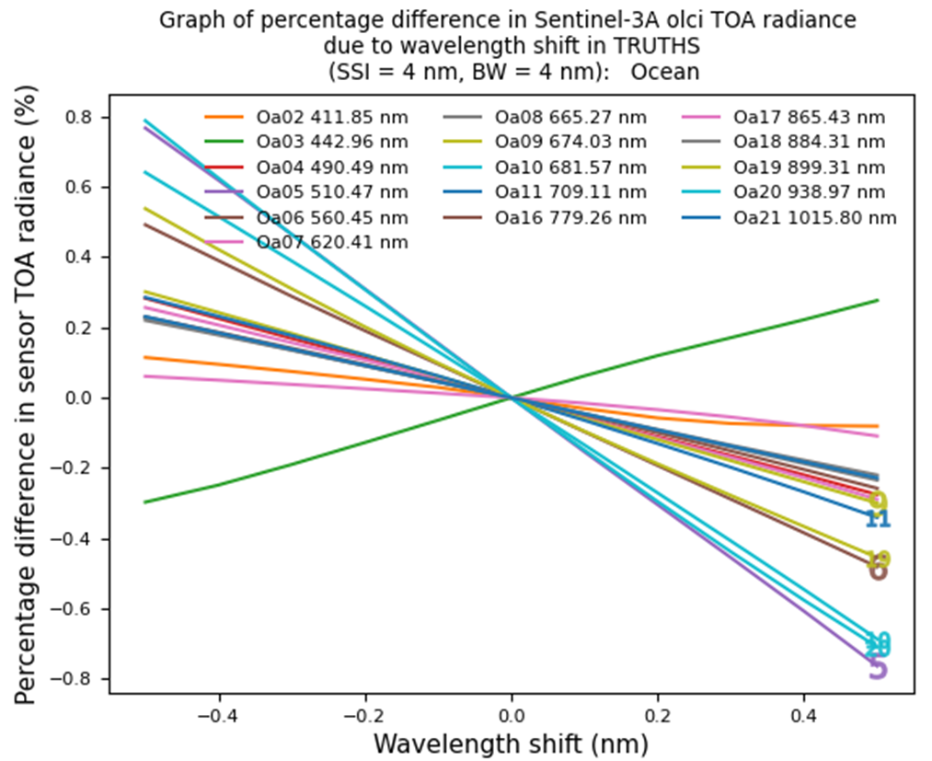
Transferring TRUTHS accuracy to other Sensors: establishing mission requirements (S2S calibration (Fahy, Hunt, Stedman, Gorrono)
Spectral Bands of Sentinel 2
Impact of TRUTHS bandwidth
Impact of TRUTHS wavelength knowledge
Uniformity of Cal Target (Libya 4) area to be sampled (2.5 km to achieve 0.2% @ 50 m)

Slide 12
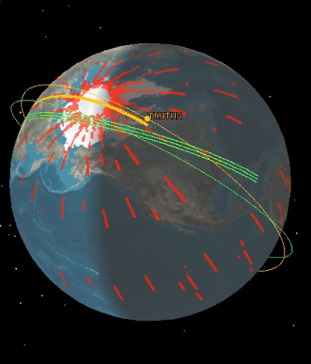
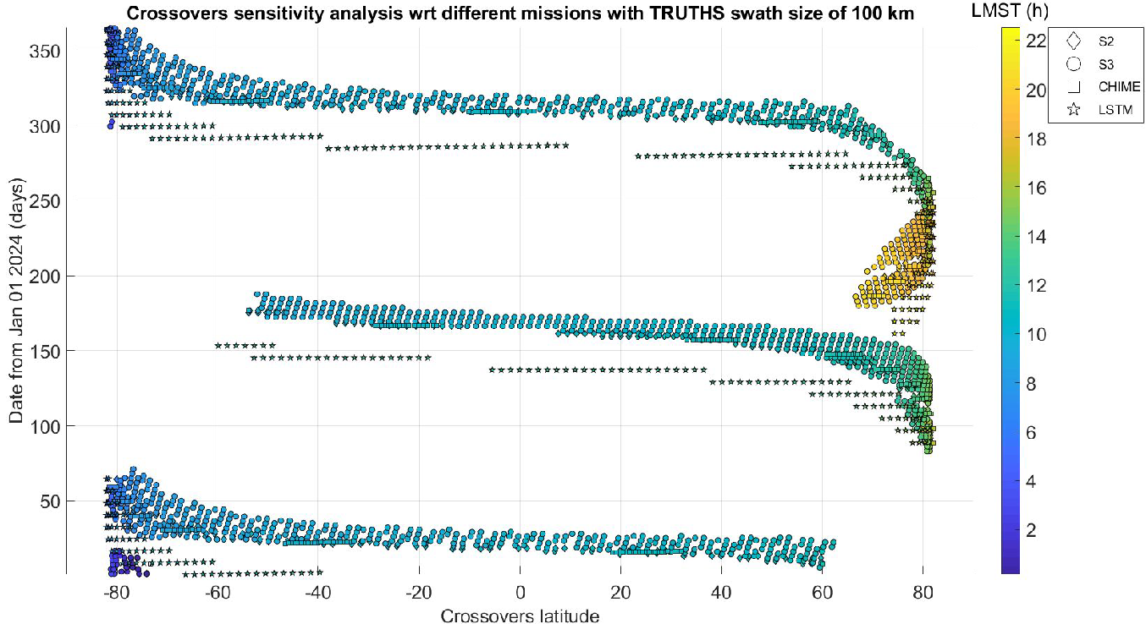
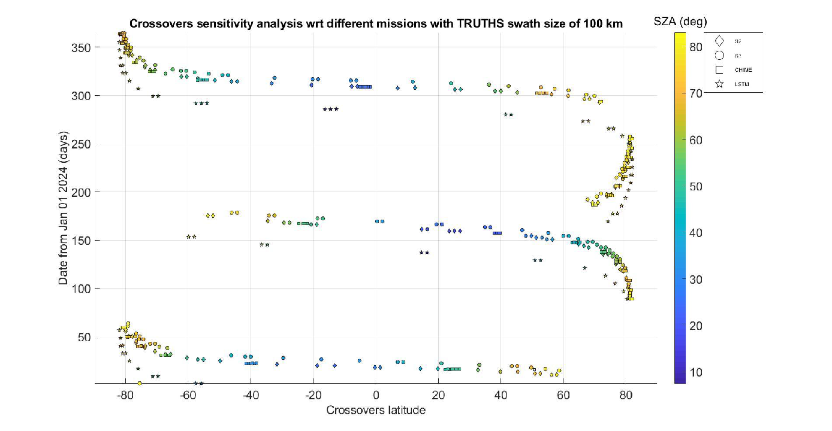
Reference Calibration
Enables interoperability & Harmonisation
Prospect of ‘certified calibration’
TRUTHS 90°pole to pole orbit, observing through the diurnal cycle, allows many opportunities to overpass orbit of sun-synchronous sensors
Summary after 6 months
TRUTHS provides the means to transform global EO system, including constellations of micro-sats so they deliver traceable scientific/climate quality observations -
<30 s time difference Swath overlap
1 year of near perfect nadir overlaps for TRUTHS & satellite under test
(<1° (no pointing) <30 s time difference

Slide 13
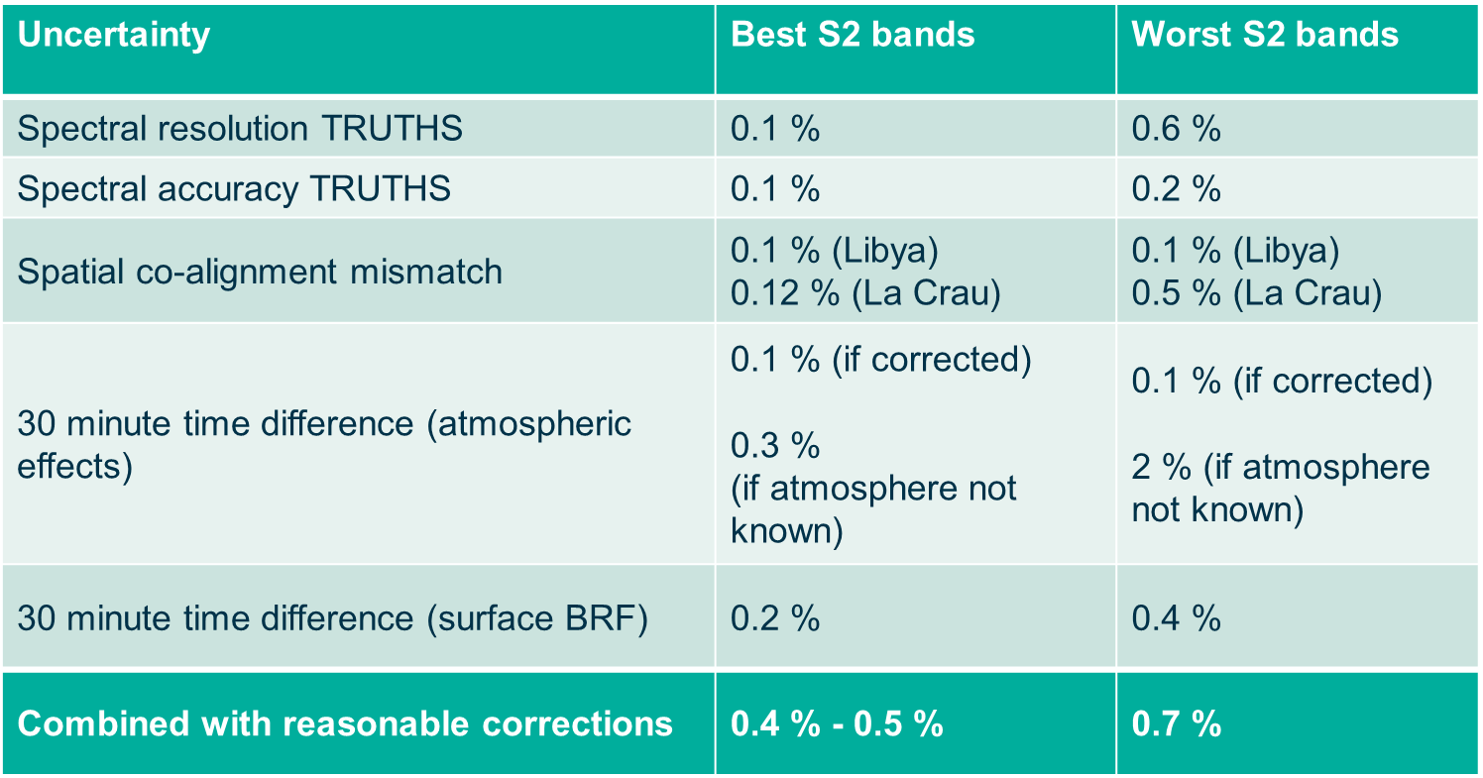
Uncertainty budget for TRUTHS – satellite comparisons (Gorrono et al)

Slide 14
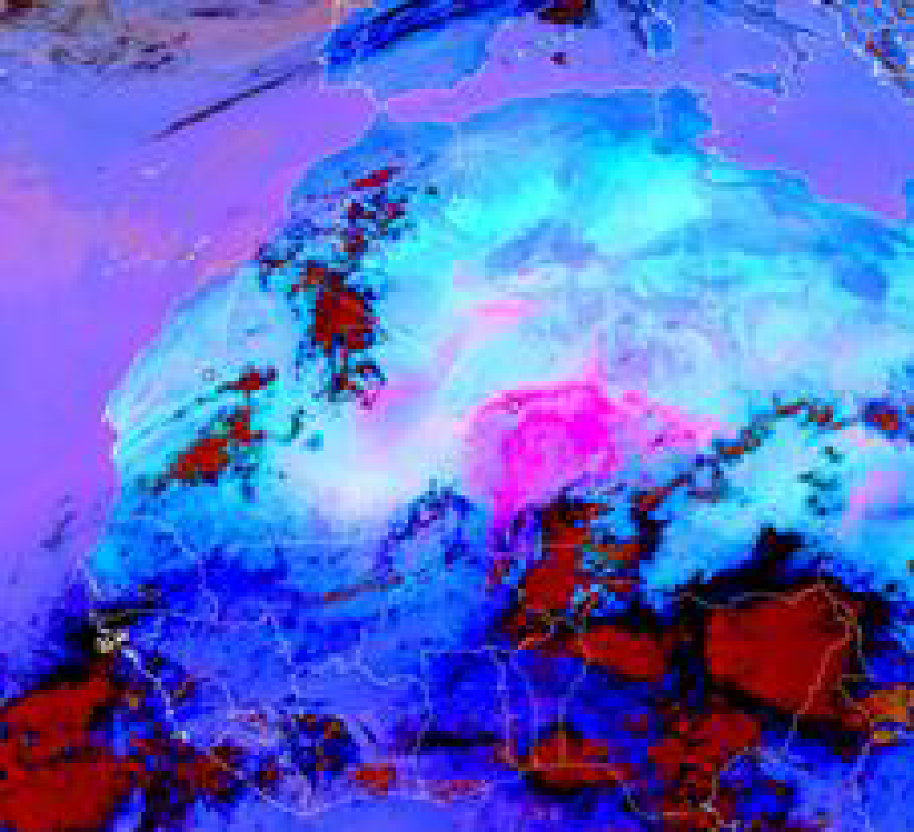
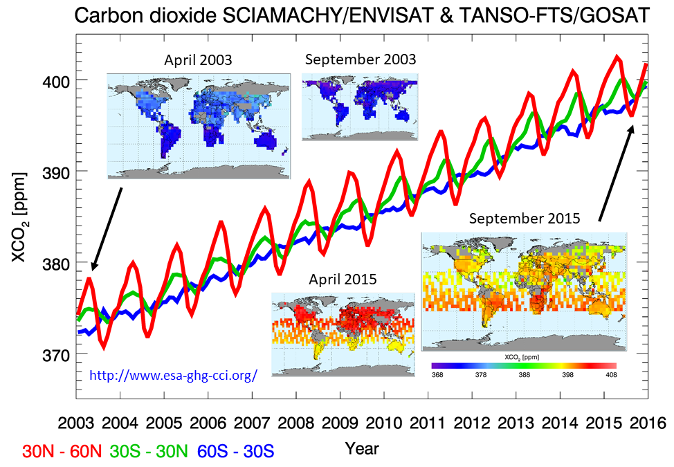
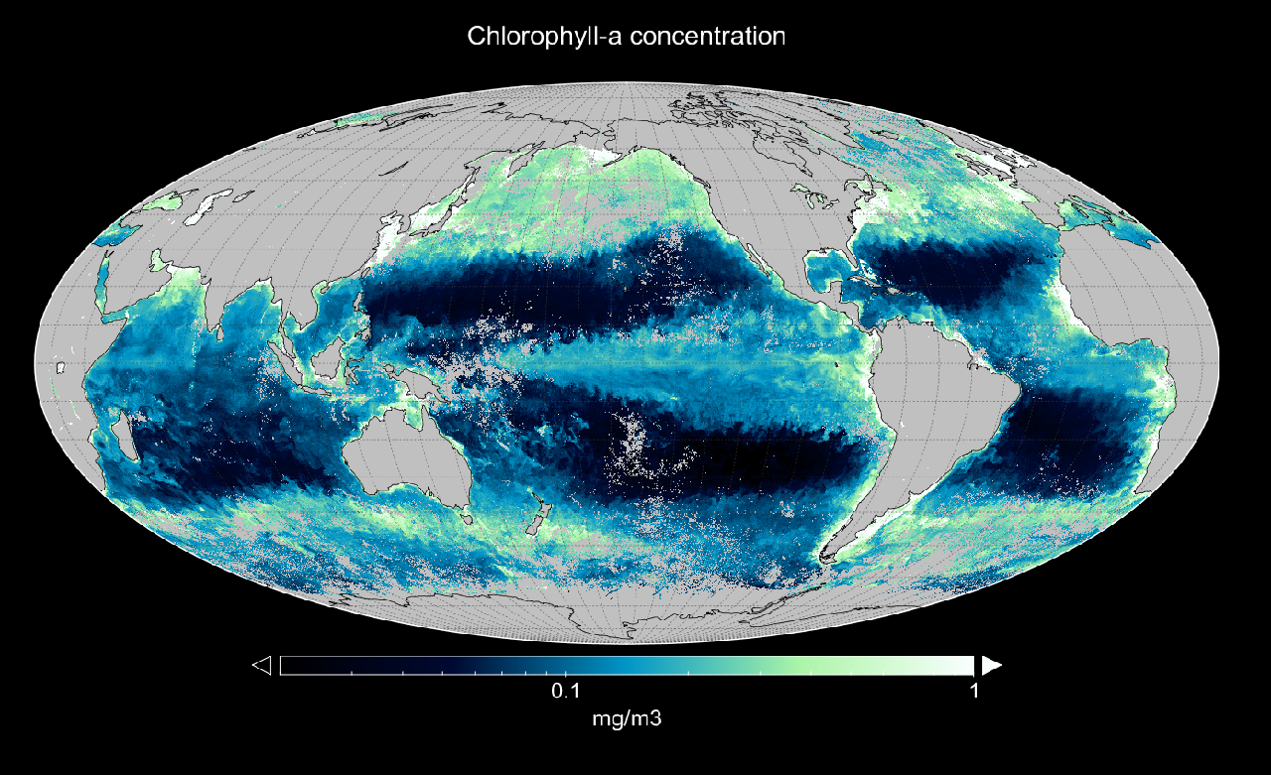
TRUTHS: Underpinning operational ECV retrievals for climate monitoring, data set harmonisation, data-gap risk mitgation and model improvement
TRUTHS contributions | Climate data records
Provides reference calibration | Cloud properties, ozone, aerosol optical depth, greenhouse gases
Provides reference calibration AND direct observation | Solar irradiance, Earth radiation budget, surface albedo, cloud cover, cloud particle size, water vapour, ocean colour, ice and snow cover, vegetation indices such as leaf area index, land cover …..
Aerosols: “Climate closure points” unifying ground networks and multiple optical sensors through the TRUTHS FCDR.
Ocean colour: direct TOA cross- calibration of sensors to absolute radiometric accuracy of ~0.5%, meeting GCOS requirements – global 200 m observations but
poor temporal coverage
GHG: Referencing Copernicus and multi-agency CO₂ constellations at 0.5-1.0% radiometry through cross-calibration. Large scale GHG emissions detection
Notes:
Aerosols Improving consistency between different sensors/retrieval schemes, potentially merging data from different sensors.
For CO2, there is both the Copernicus CO2M constellation and the wider constellation provided by multiple space agencies contributing missions. They are all necessary to build the ultimate GHG constellation which will exist in the mid 2020s. Consistency of calibration and bias correction of these sensors at the radiance level will be absolutely essential for inversion of the observations to fluxes at the desired accuracy levels. Even if individual instruments achieve the calibration, this will need verifying in-orbit and so TRUTHS becomes a powerful part of the system in principle.

Slide 15
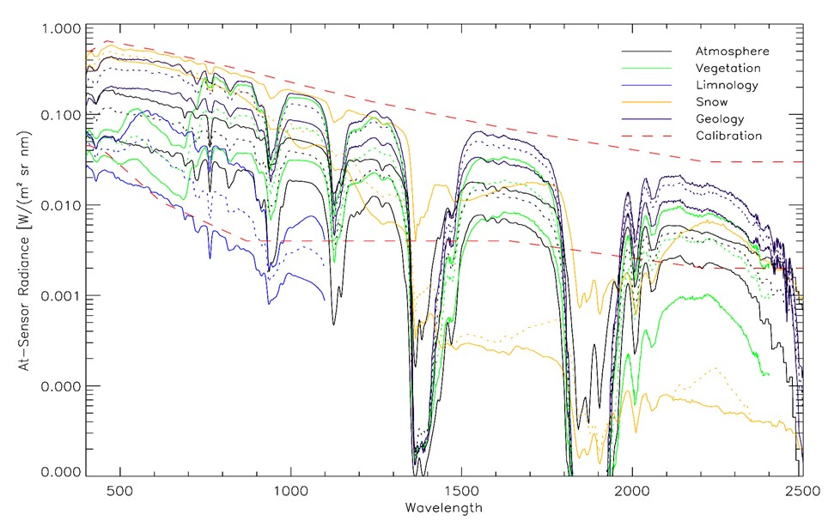
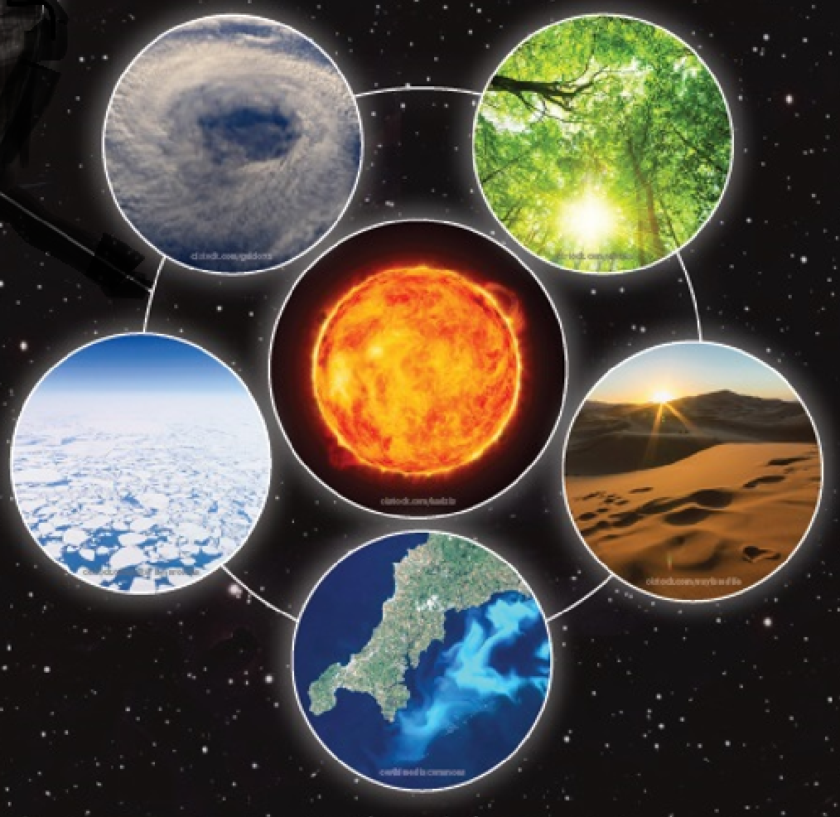
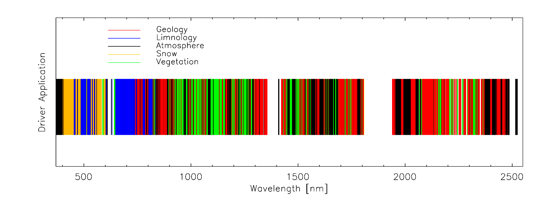
Hyper-spectral applications: ‘Analysis Ready’ (ARD) Surface reflectance
Hyperspectral data can be convolved for many applications enabling an earth system science approach
(not temporally critical applications (61 day repeat)
Directly
Upgrading other sensors
Test & Improve retrieval algorithms
Validation establishing references surface reflectance
e.g. Fluxnet
Complementary to EnMAP, PRISMA, CHIME, SBG ….
Land-cover change
Forest
Surface Albedo
Agriculture
Pollution
Resource prospecting
…….
Notes:
As a secondary objective TRUTHS will deliver hyperspectral ToA radiances/reflectances and BoA reflectances at relatively high spatial resolution with unprecedented accuracy.
This will allow science studies and other application in their own right and also where timeliness is not adequate (TRUTHS repeat time is 61 days) robust validation will be possible, not only of other satellites but also ground networks and observations as well.

Slide 16
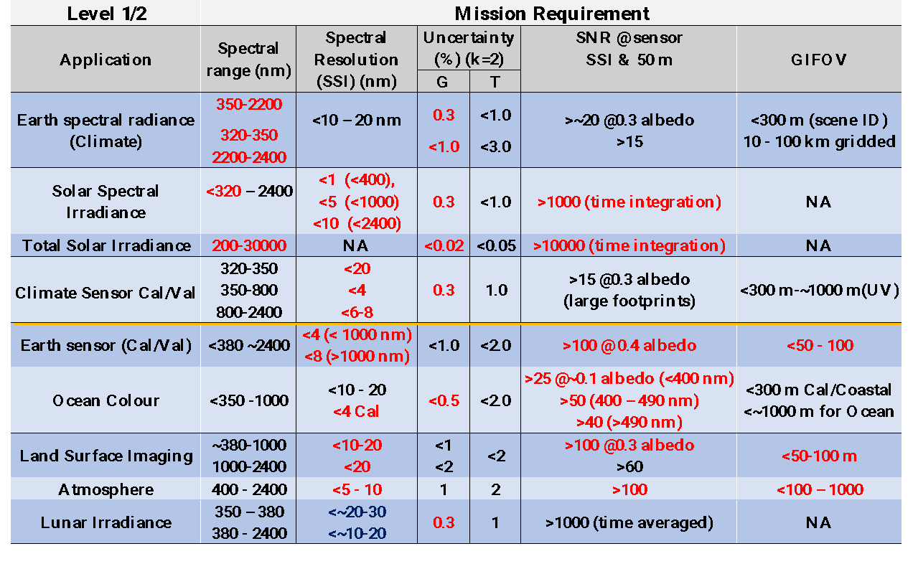
System Drivers: 90 deg precessing 61 day, ~605 km polar orbit for satellite cross-cal & for uniform diurnal sampling for Climate benchmark
Driving requirements
in Red
Climate ‘Benchmark’
Earth Observation

Slide 19
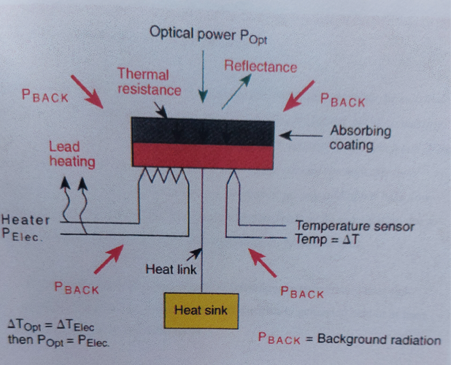
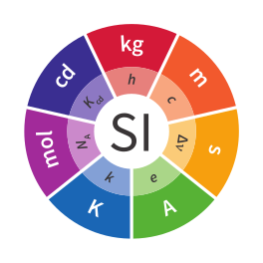
Metrology laboratory in-space
Measuring energy from the sun, providing the direct traceability to International Standards (CSAR)
Compares heating effect of optical power with electrical power (Volt)
‘Camera’ (Hyperspectral Imaging Spectrometer, HIS) observing the direct incoming and Earth reflected
sunlight at high spectral and spatial resolution
Novel on-board calibration system (OBCS) ensuring traceability to the absolute reference (Cryogenic, 60K,
Solar Absolute Radiometer, CSAR) (mimicking terrestrial methods)
Link to SI = Volt
TRUTHS
HIS
CSAR
HIS
OBCS
OBCS
CSAR

Slide 20
In-Orbit Primary Standard – CSAR:
Cryogenic Solar Absolute Radiometer (CSAR)
Evolution of the terrestrial cryogenic radiometer used for four decades in NMIs
Electrical substitution method (equivalence in optical and electrical heating of a cavity) (>120 yrs of use)
Traceable to electrical standards - V & Ω
Performance limited to cavity absorptance (>0.99995)
Stability of Voltage Ref

Slide 21
TRUTHS on-orbit calibration philosophy: (Rev 36)
CSAR measures optical power in SMC output then calibrates TR
SMC generates beam of ‘monochromatic
radiation from sun which can be distributed to
different parts of the calibration system
2. The transfer radiometer (TR) serves two
purposes
Conversion from power to radiance
Intermediate ‘fast’ radiance reference allowing full spectral calibration of HIS
3. Concept of Operations based on
geometric knowledge & stability,
Calibrating out in-flight degradation
only repeatability assumptions based on
mechanical and thermal control.
Discreet spectral bands
Solar Monochromator scans through entire HIS spectral extent
Deconvolve HIS response from scan series
Continuous spectral scan

Slide 22
Open access data with full transparency of uncertainties and traceability – a ‘metrology lab in space’
Upto ~4 Tbytes a day download
UK ‘Data processing hub’
Baseline ‘archived’ Level 1B products
ToA Earth, Moon, Sun
Toolbox to enable customisable ‘on-demand’ processing of Level 1B, 1C and 2 (BoA reflectance) with pixel level uncertainties
Coefficients to facilitate sensor SI-traceability and/or recalibration
Unequivocal litigation quality data
‘effects table’ for each error source
Fahy & Hunt
Fiduceo like analysis of end to end traceability and uncertainties – an exemplar for other missions

Slide 23
Pre-flight calibration & characterisation philosophy
Objective: to confirm design/build specification and to facilitate comparison with Terrestrial SI-standards
Tiered hierarchy of characterizations and calibrations
Mirrors the uncertainty budget bottom-up approach
Includes algorithm approach and concept of operations assumptions.

Slide 24
Pre-flight radiometric calibration philosophy

Slide 25
STAR-CC-OGSE Overview:
STAR-CC-OGSE provides radiometric calibration and characterization of satellite sensors.
Fully automated and SI-Traceable
The main components of the STAR-CC-OGSE system are:
A collimated beam source, with field mask for optical performance (geometric) characterization & 200 mm diameter exit port ntegrating sphere for flat-field radiometric calibration.
A CW laser allowing monochromatic continuous tuneability from 260 nm to 2700 nm with a broadband (white light) source extending over the same spectral extent (for both illuminations).
A vacuum-compatible SI-traceable radiance detector module containing both broadband photodiodes & a spectrometer, installable in TVAC at the sensor-under-test entrance aperture

Slide 26
Terrestrial HIS pre-flight calibration
Spectral calibration
Monochromatic via tuneable laser traceable via high accuracy wavemeter to the metre & frequency standard.
Simultaneous measurement of spectral straylight and ISRF etc.
Radiometric calibration
State-of-the-art following philosophy employed by NMIs for thermodynamic temperature determination (0.03%,)
here <0.2% (k=2)

Slide 27
On-orbit spectral calibration: critical for S2S cal:
Fraunhofer lines
33 identified lines/groups
300 nm - 900 nm
Use Solar spectral irradiance observation – few seconds
<0.025 nm accuracy est.
Onboard Rare-earth oxide doped filter reference
Features over 300 – 1950 nm
Solar illuminated convolved with Fraunhofer lines, but feature width allows reliable determination.
<0.1 nm accuracy est.
Overlap region adds confidence.

Slide 28
TRUTHS: SI-Traceability summary
In-flight (space)
Pre-flight (Ground)
Cryogenic Radiometer (Lab)
CSAR
COMPARISON
OBCS
Solar with SMC
HIS
Laser radiation
STAR

Slide 29
Completing Phase A/B1 to provide a mature concept
Agile Platform recurrent from CRISTAL
Payload key technical features:
HIS: Four-mirror anastigmatic telescope, Offner (two-prisms) spectrometer, single MCT detector at 150 K, thermally stable optical bench.
CSAR– three high-absorbance cavities, operated at 60 K with cryocooler, design heritage of NPL (UK) and PMOD/WRC (CH)
OBCS (On-Board Calibration System) – traceable set of absolute wavelength anchors (solar monochromator + TBD filter ), high-dynamic transfer radiometer, precise and stable wavelength scanning mechanism, relay optics, diffuser to HIS
Calibration process: novel methodology, heritage of metrology lab (NPL), rigorous traceability of uncertainties, need for demanding on-ground calibration
Pre-developments running for all critical items (detector, coating, CSAR, mirror, calibration detectors…)
Phase A/B1 led by Airbus UK completed Mid June.
Gate review (July 22) confirmed technical, scientific and programmatic maturity of the proposed solution ready for subscription in CM 22
TRUTHS
satellite
TRUTHS
Payload
CSAR layout/OBCS I/F
HIS layout
SMC - OBCS layout

Slide 30
TRUTHS technology gallery
T-E2V Detector layout and FEE test assembly
CSAR Voltage Ref: LTZ1000 Board
1K X 2K CMT array
Mirror coatings
WSM actuator: TRISHNA EM
CA OBCS TR photodiodes

Slide 31
TRUTHS Timeline
TRUTHS was proposed by UKSA in May 2019 as a new Earth Watch (EW) Element.
TRUTHS Phase A/B1 has been fully subscribed at Space19+ by 5 Participating Countries: UK (85.5%), GR (6.2%), CH (5.6%), CZ (1.5%), RO (1.2%)
Industrial Phase A/B1 system studies and technology predevelopments initiated in Oct-20.
Phase-A kicked-off in Oct-20 and completed at end-July 2021
Phase B1 completed in Q2-2022 _ extended for technology maturing and to bridge to B2 phase to start in 2023. (TRL 5/6 by Phase B2 and SRL 5)
Mission Advisory Group (MAG): Science/Engineering/User expertise primarily from Europe (not limited to funding nations) inc NASA CLARREO Pathfinder
Programmatic “Gate Review”: go decision, taken in July-22, to submit program to CM-22
Phase B2/C/D/E to be funded at CM-22/-25 -> Program plan being currently prepared
Phase A/B1 +Tech.dev
B1-ext
Phase B2/C/D
Science activities
Science activities
Phase E1/E2 + Science Exploit.
Gate review
Cmin-19+
Cmin-22
Cmin-25
2019 2020 2021 2022 2023 2024 2025 2026 2027 2028 2029 2030 2031

Slide 32
International (CEOS?) climate & calibration Observatory
TRUTHS ~ 2029/30 will help initiate a sustainable long-term international climate & calibration observatory
A direct response to international requests
NASA CLARREO-Pathfinder ‘sister mission’ which will be launched to the ISS in 2023/24.
- Hope for overlap!
- Also potential Chinese Libra
TRUTHS & CPF SITSats will provide unique and critical information for understanding and monitoring
Climate and environmental change from space and support climate action (WG-Climate key objective)
– A resource for ALL nations
TRUTHS

