Slide 1
Satellite Cross Calibration Radiometer (SCR)
Medhavy Thankappan
Geoscience Australia
Agenda Item # 3.4
WGCV 51 Plenary
Tokyo, 3-6 October 2022

Slide 2
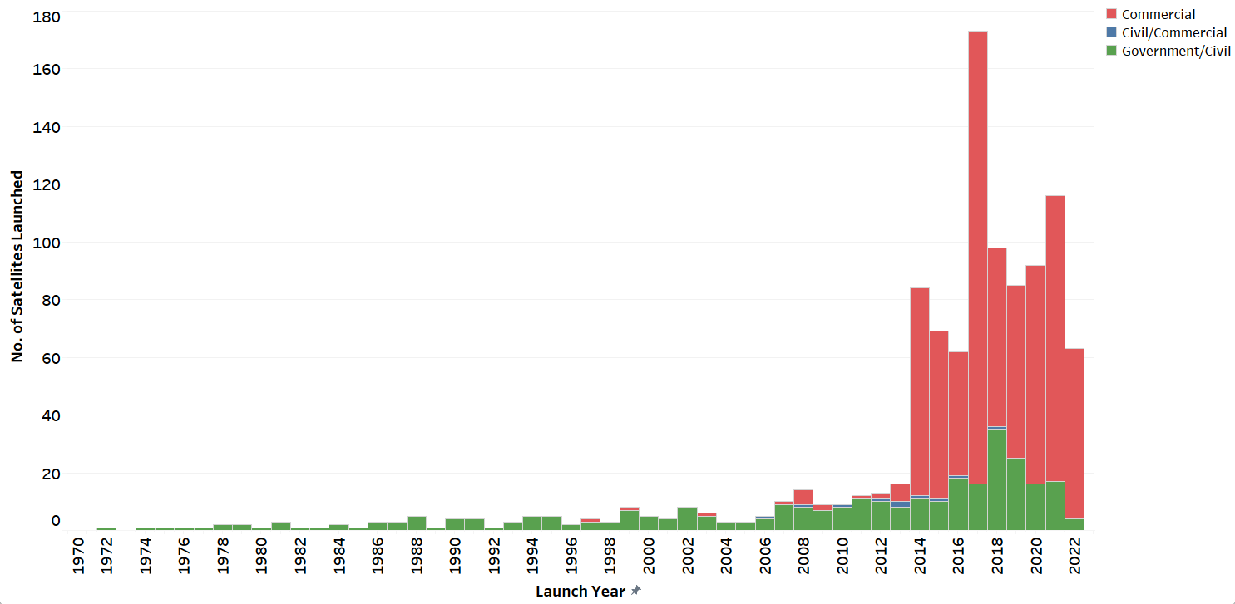






Data Rich But Information Poor!
The EO data ‘explosion’
  More satellites, greater coverage
  Better temporal, spatial, spectral resolution
  Now over 50 countries with Earth observation (EO) satellites
  Commercial EO is growing fast
  Already over 60 EO satellites launched in 2022, most of them commercial
Potential for enormous scientific value if we can use these data together!

Slide 3
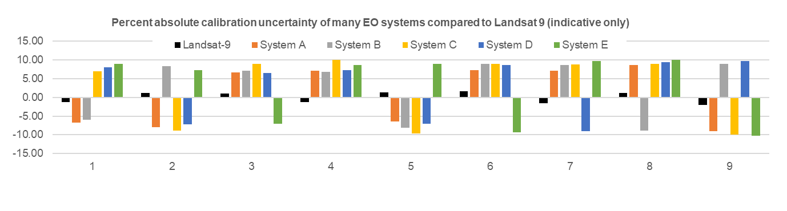
What is the Issue?
Many EO systems generate data with variable quality and no quantified uncertainties
On-board self calibration systems are expensive (increases mass, complexity)
Limitations with ground-based calibration (coverage, cloud, limited opportunities)
Role for space based cross calibration
Absolute Calibration Uncertainty (%)
Spectral Bands

Slide 4
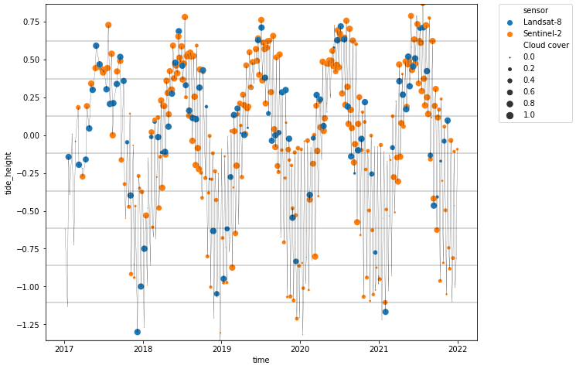
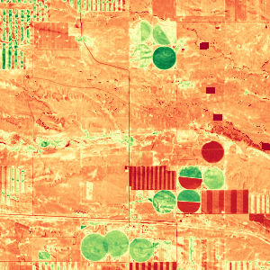
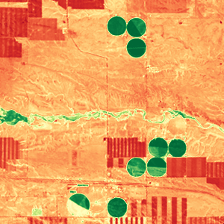
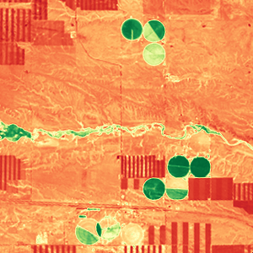
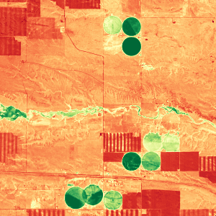
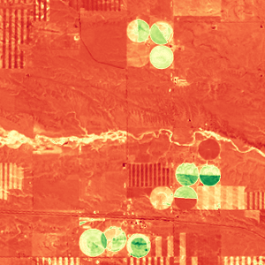

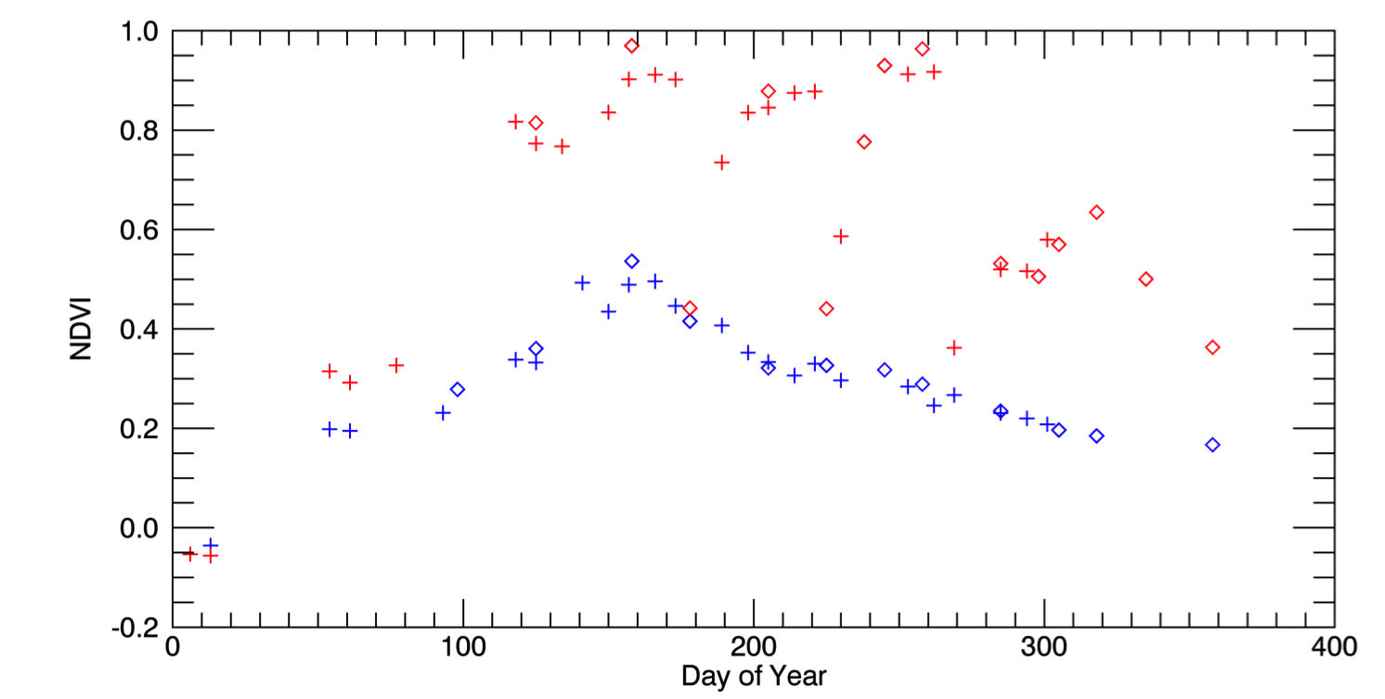
Cross Calibration Benefits
May 4, 2016 (S2)
Aug 8 (L8)
Aug 17 (L8)
Sep 1 (S2)
Oct 20 (L8)
Landsat-8
Sentinels
Landsat-8
Sentinel-2
% Clear Pixels
3km
0.1 NDVI 0.9
Tide Height (m)
Example from the US: Seasonal phenology (greening) for natural grassland (blue line) and irrigated alfalfa fields (red line) near Cheyenne Wyoming observed from Harmonized Landsat/Sentinel-2 data products. The high temporal density of observations allows individual mowing events to be detected within alfalfa fields. HLS Products available from https://hls.gsfc.nasa.gov
Credit: Jeff Masek, NASA
Sentinel-2
Landsat-8
+
Alfalfa
NDVI
Time (year)
mowing
Grassland
Example from Australia: By combining Landsat and Sentinel-2 data, a set of observations that best represent the tidal range in coastal northern Australia can be achieved. Note that most of the Sentinel-2 observations at low tide are cloud or glint impacted (smaller dots), but the Landsat data with clearer observations at low tide make up for the shortfall. Similarly, Landsat observations are sparse at high tide, with higher density of Sentinel-2 observations. This allows for fuller capture of the intertidal zone extent in a shorter time period.
Credit: Robbi-Bishop Taylor, GA

Slide 5
SCR Background
2019 US Architecture Study Team recommendation for Landsat Next and SCR
September 2019, US Joint Agency Commercial Imagery Evaluation (JACIE) presentation “An SLI Cross-Calibration Radiometer (SCR) Concept for Improved Calibration of Disaggregated Earth Observing Satellite Systems” by Jon Christopherson
February 2021, Director USGS submission to the Australian House of Representatives Inquiry into Developing Australia's Space Industry
March 2021, Australian Technical feasibility study undertaken by University of New South Wales Australian National Concurrent Design Facility (ANCDF) upgraded to a Pre-Phase A report in August 2021
May 2021, Establishment of the ASA, GA, CSIRO, USGS and NASA Technical Interchange Meetings
Late 2021, Mission partner agreement discussions (Agency – NASA and GA - USGS) - in progress
March 2022, Mission Concept Review (MCR) / Key Decision Point (KDP)-A
Spring (Fall in US) 2022, Formulation Technical Interchange Meeting in Canberra

Slide 6
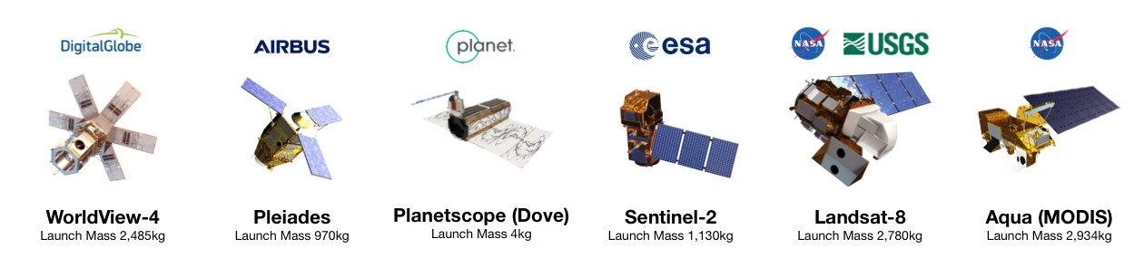

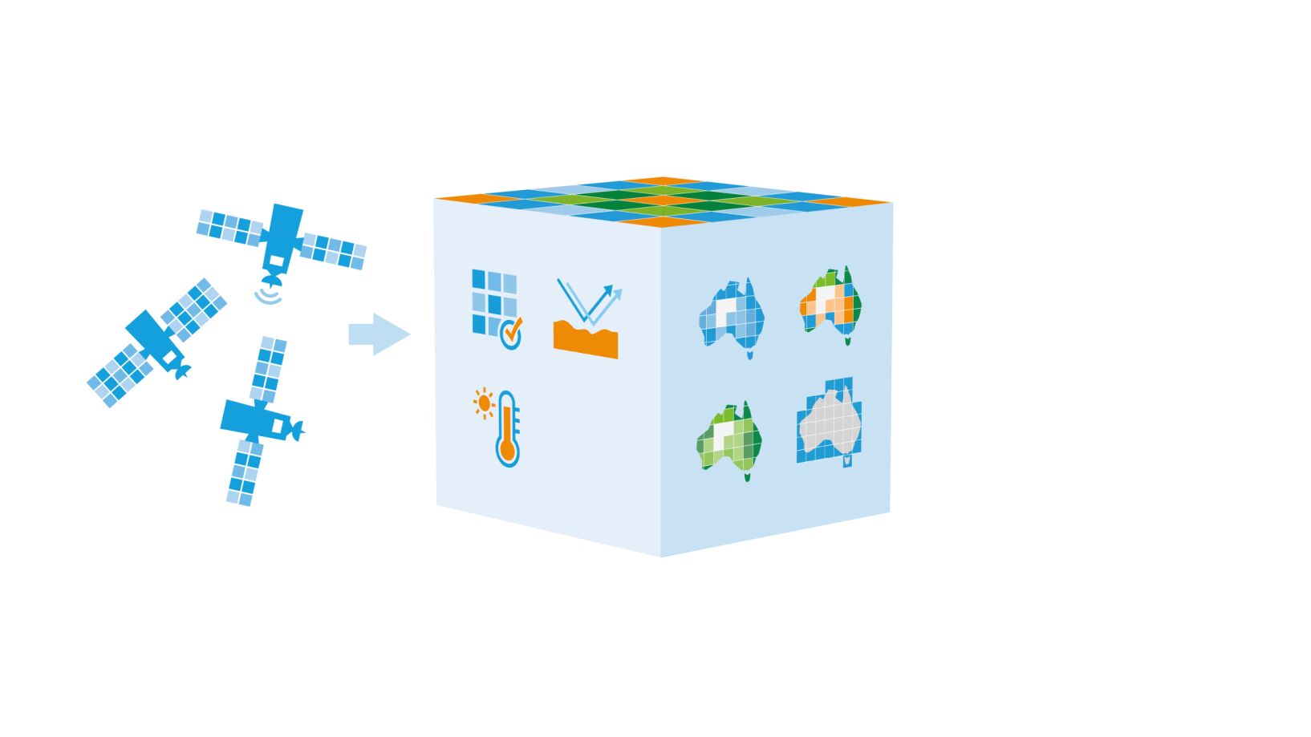



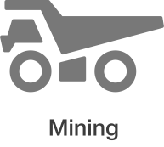
SCR Rationale
Australia is reliant on international collaborators for enduring access to EO data
National programs need ongoing, sustainable access to EO data and meet multi-sensor use objectives
  Potential for combined use of multi-sensor EO data remains under utilised due to variable quality
Cross calibration enables consistent data quality through quantified uncertainty for multi-source data to be used together
Provide on-orbit reference for cross calibration, opportunities are frequent, global, with open access
Leverage capability that Australia is well regarded for, effective contribution to global data quality and grow sovereign space industry capability
Combined use of multi-source EO data
Earth observation satellites
Space-based cross-calibration
Combined use of multi-source EO data
Industry capability and economic growth

Slide 7
What is SCR?
The Satellite Cross-Calibration Radiometer (SCR) is a series of satellites
Designed to collect hyperspectral data for calibrating other remote sensing systems
    Block-A: Two-satellite Class-D demonstrator constellation (SCR-1 and 2)
  Block-B: Two-satellite Class-C full-capability system (SCR-3 and 4)
Primary objective is to transfer calibration from Reference systems (e.g. Landsat, Sentinel) to Client systems
Secondary objective is collection of hyperspectral imagery for science applications
Will also support development of the Australian space industry (from 5 - 6 kg to 75 -100 kg class)

Slide 8
National Space Program for Earth Observation (NSP-EO)
Four new SCR satellites for Australia
Geoscience Australia
will develop the
satellite specifications
The Australian Space Agency will procure the satellites from Australian industry
Geoscience Australia
will operate the satellites
and distribute the data
Mentoring and support from the United States Government – GA & USGS MoU
Industry
Capability Uplift
Current capability
5-6 kg
SCR1/2
50-75 kg
SCR3/4
100-150 kg
Notes:
HIGH (3-4mins)
In 2022, the Australian Government announced the establishment of Australia’s first civilian satellite program, a whole-of-government initiative worth $1.16 billion to 2038-39 and $38.5 million per annum ongoing for Phase 1 of a National Space Program for Earth Observation (NSP-EO), which will see Australia design, build, and operate four new satellites.
____________________________________________________
Australia is a major user of satellite Earth observation data. This data contributes between $3 and $5 billion of value to Australia every year, benefitting community safety and driving productivity in key sectors of the economy from agriculture to resources to financial services.
Australia is currently entirely dependent on foreign satellites for land imaging data. Moreover, most users in Australia are entirely dependent on data from a single satellite or satellite series – making them vulnerable to technical failures or sudden policy changes by foreign governments or companies.
_____________________________________________________
Through the National Space Program for Earth Observation we will, with our partners at the Australian Space Agency, address this by working with local industry to develop, launch and operate four (4) Australian satellites.
The Program will be led by the Australian Space Agency in partnership with Geoscience Australia, the CSIRO, Bureau of Meteorology and the Department of Defence.
As Australia’s satellite land remote sensing organisation, and part of NSP-EO, Geoscience Australia will determine the specifications for a series of four Satellite Cross-calibration Radiometers (SCR), operate the satellites after launch and in-orbit testing, and ensure open data is distributed to Australian users and international partners.
Geoscience Australia has just signed a Memorandum of Understanding with the US Geological Survey where …...
The Satellite Cross-calibration Radiometer (SCR) series will comprise 4 small satellites with hyperspectral sensors that act as a transfer radiometer to enable the radiometric calibration of a “reference” instrument to be transferred to civil, or commercial satellites (concept of operations shown in next slide).
The SCR mission will help address one of the biggest challenges of successfully integrating satellite data from multiple sources, for interoperable use.
_______________________________________________________
This will benefit our national interest in three ways:
The ability to combine data from different sources will enable our tech sector to develop richer digital products and services with global market potential, giving farmers more frequent updates on crop health for example
Products and services will combine data from multiple satellite systems, reducing single points of failure making this critical part of our digital infrastructure more resilient
Giving us something unique and valuable to trade with key international partners – ensuring we continue to have reciprocal access to data from their satellite programs
The program will also drive maturation and capability uplift within the Australian space industry. By having Australian companies work on a real project, with real customers, on commercial terms not grants, and following international best practices for space systems engineering. Through this activity we will move industry up several ‘weight classes’.
This will position industry to meet more local needs, for example making them more competitive in future Defence and civil procurements, as well as making our companies more competitive in the international satellite market.
Treasury estimates the NSPEO will benefit 100 companies and create 500 jobs over the first four years of the build phase, ranging from engineers, scientists and digital professionals, manufacturing roles, through to ‘space tradies’.
The NSPEO has been designed as a multi-stage project. These first four satellites are just the beginning. Proposals for additional missions, such as weather satellites, are under development, with the goal of progressively growing and maturing the industry over the coming decades.
Geoscience Australia is working with NSMEO partners to establish the Program for operational readiness from July 2023.

Slide 9
SCRs vs SITSATS
Questions around how SCRs are analogous to SITSATs (e.g. CLARREO PF, TRUTHS, LIBRA)
SITSATs - bottoms-up design approach for high accuracy climate monitoring applications with SI traceable radiometric uncertainty below 1%
SCRs - choice of COTS design meeting requirements for calibration transfer from a reference sensor (e.g. Landsat), will perform similar functions, but lack the accuracy or traceability of SITSATs
SCRs will have spectral characteristics and GSD comparable to SITSATs, but high SNR not needed
SCR relative spectral and radiometric calibrations need to be stable for Reference system transfer calibration to work effectively
SCRs operated to maximise cross calibration opportunities with Reference / Client systems, to enable effective and harmonious use of data from multiple systems
SCR - develop sovereign space industry capability in Australia
SCRs seen as a test bed for routine operation of space-based calibration missions and expected to complement benefits from SITSATs

Slide 10
SCR Partner Roles
Entity | Primary Role
Australian Space Agency (Agency) | Program Lead Space segment procurement lead (Bus, Instrument, IPM, I&T) Technology development lead
Geoscience Australia (GA) | Ground Segment Lead and Owner operator Ground station Lead and Alice Springs Station Mission Operations Centre (MOC) Lead DPAS Lead using joint development approach
Commonwealth Scientific and Industrial Research Organisation (CSIRO) | Ground Cal/Val lead Data Distribution Lead
United States (US) Geological Survey (USGS) | GA’s Mission Mentor EROS Station DPAS joint development Instrument Engineering Support/Guidance
National Aeronautics and Space Administration (NASA) | ASA’s Mission Mentor
Industry | Mission Integration

Slide 11
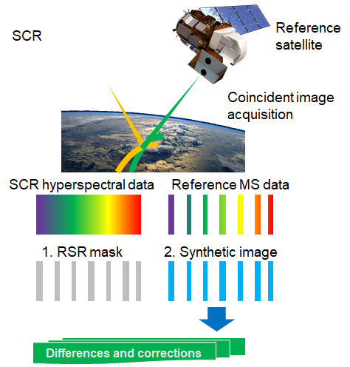
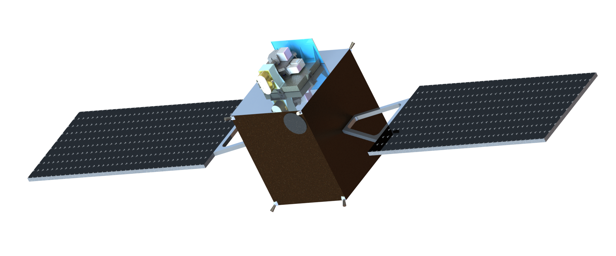
SCR Operations Concept
Use Simultaneous Nadir Overpasses of SCR and Reference or Client Systems
Aggregate SCR data to match Reference or Client system
Create synthetic image
Compare synthetic image with Client or Reference system for cross-calibration
Generate spectral radiometric differences and corrections to update client system calibration

Slide 12
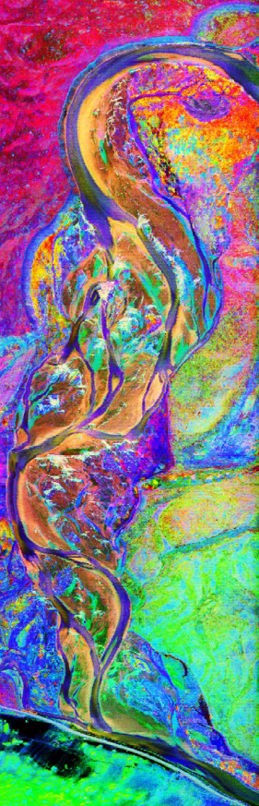
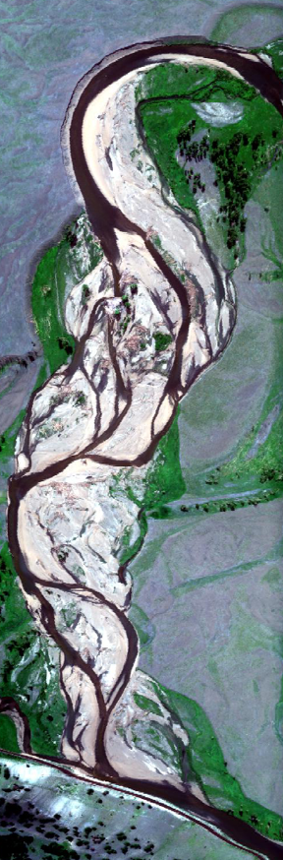
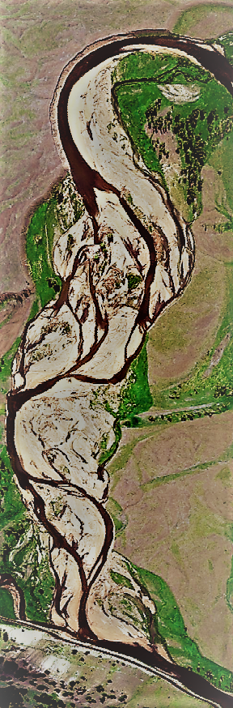
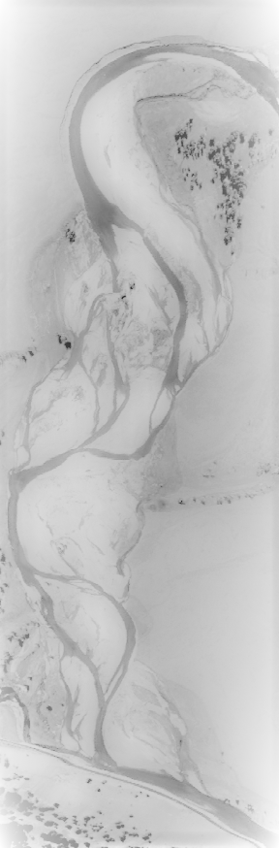
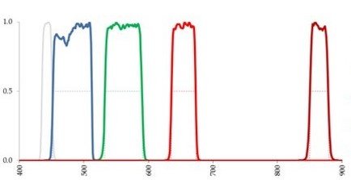
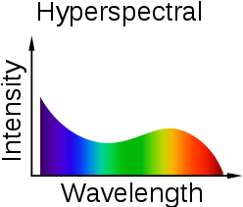
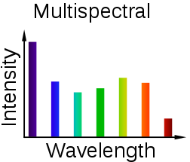
Calibration Transfer
SCR
Image
RSR of Reference Sensor
Synthetic
Image
Reference
Image
Corrections
Relative Spectral Response Function of Reference Sensor
Compare reference image with synthetic image
Develop correction factors for image adjustments

Slide 13
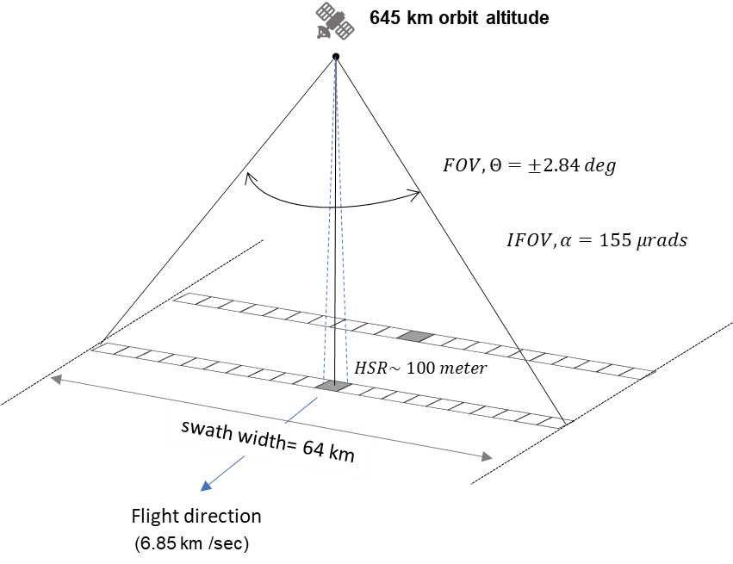
SCR Instrument Characteristics
Requirement | Value
Spectral Band Coverage | 400-2500 nm
Spectral Sampling | ≤ 5 nm VNIR ≤ 10 nm SWIR
Spectral Sampling (goal) | ≤ 3.6 nm VNIR ≤10 nm SWIR
Radiometric Accuracy | ≤ 3 % (Pre-Launch) ≤ 5 % (On Orbit)
Radiometric stability (Threshold) | ≤ 0.2 % (7 days)
GSD | ≤ 100 meter
Swath Width | ≥ 64 Km
SNR (wavelength dependent) | > 50 to 150
Dynamic Range (adjustable integration time) | 1.15×L_{sat}
Polarisation (Threshold) | < 5%

Slide 14
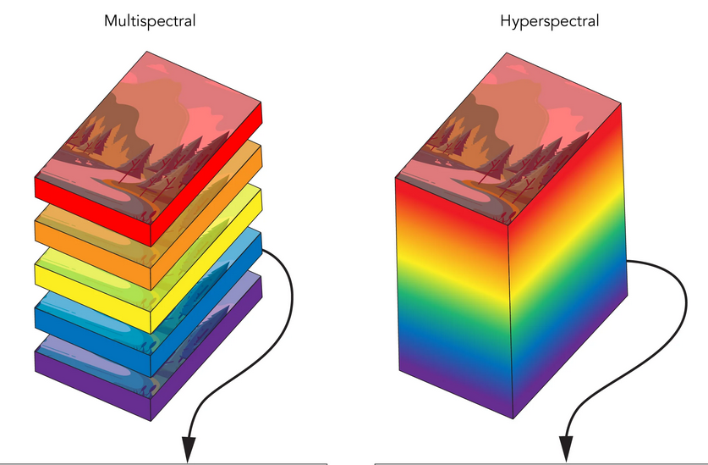
Why Fine Hyperspectral?
Band-to-band comparison not enough; spectral bands need to be recreated
Hyperspectral data needed to synthesise multispectral bands
  Many newer EO satellites have instruments with
  narrow bands, which are not easily or accurately
  synthesised with 10 nm bandwidth data
  Simulations have shown that fine hyperspectral
  (i.e. – many narrow spectral bands) allows for
  most accurate synthesis

Slide 15

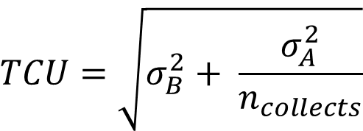

Transfer Calibration Uncertainty
Random errors (Type A) and systematic errors (Type B) contribute to the TCU, and need to be managed
Random (Single Collect) | Threshold Value | Systematic (Multiple Collects) | Threshold Value
Spatial BRDF Drift | 0.02 | Spectral Synthesis | 0.005
Atmospheric Drift | 0.01 | Spectral Straylight | 0.003
Linear Regression Model | 0.01 | Spatial Straylight | 0.003
Scene Polarization Random | 0.005 | Flat Fielding | 0.003
 |  | Sensor Drift | 0.002
 |  | Scene Polarization Bias | 0.005
Type A RSS | 0.025 | Type B RSS | 0.009
$$TCU=\sqrt{σ_{B}^{2}+ \frac{σ_{A}^{2}}{n_{collects}}}$$
$$σ_{A}$$
$$σ_{B}$$

Slide 16
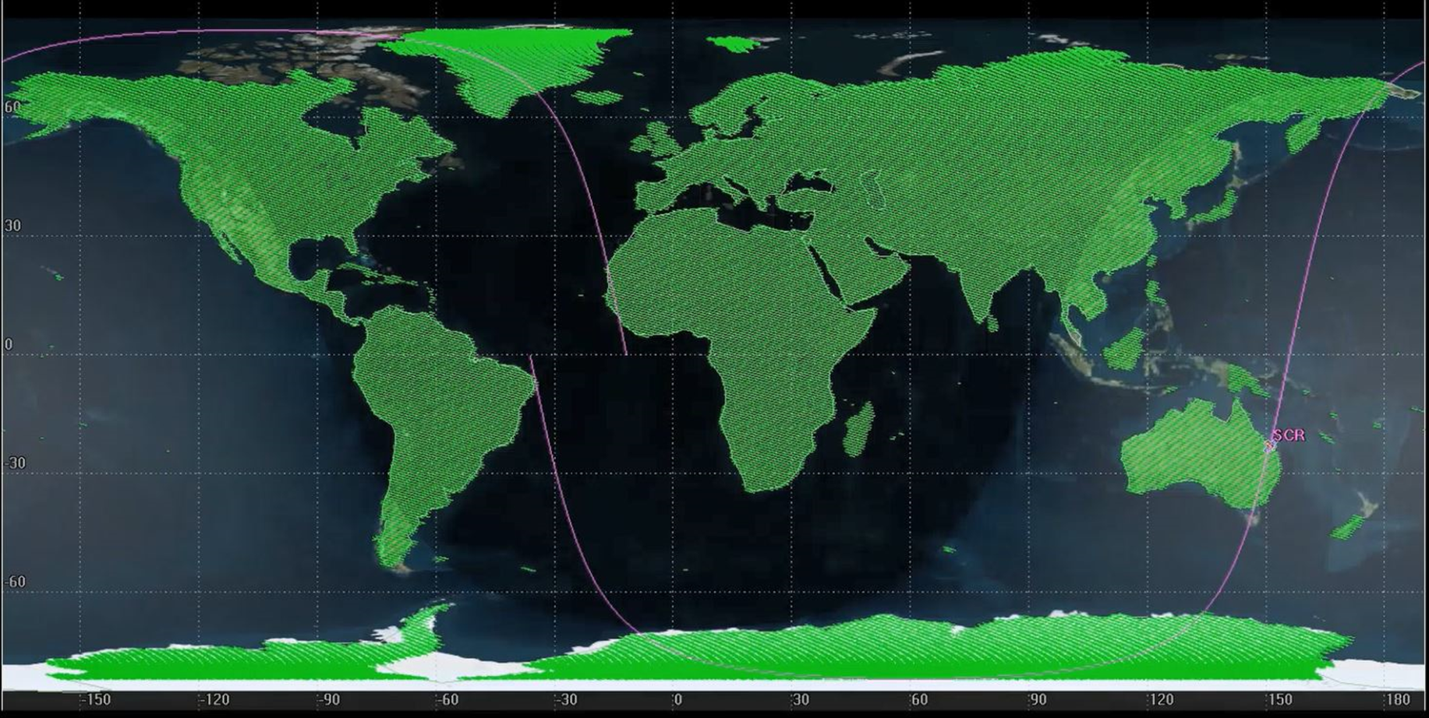
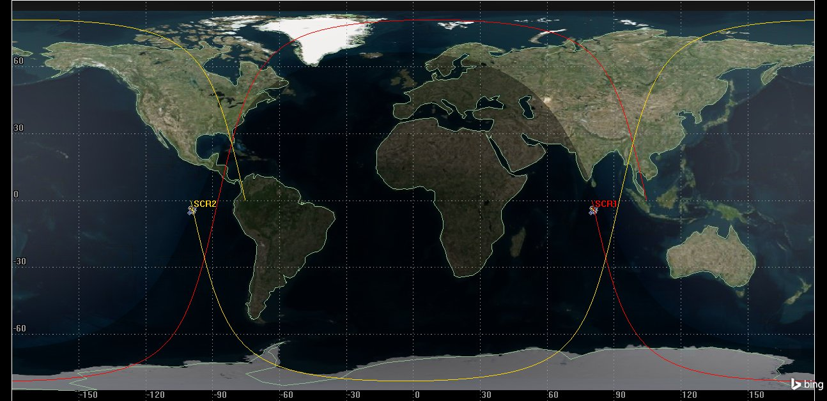
Orbit Selection
645 km with Mean Local (equatorial crossing) Time (MLT) at 10:20 am
Provides numerous daily cross-cal opportunities while avoiding large mega-constellations (StarLink, OneWeb, Kuiper) and optimising viewing geometry
SCR 1 and SCR 2 fly 180° Out-of-Phase

Slide 17
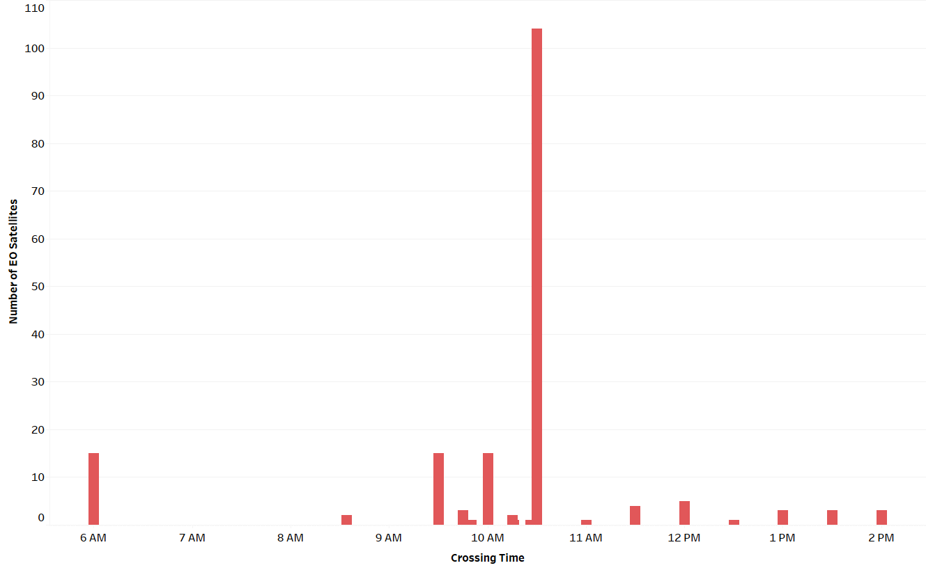
LTDN
Choice of equatorial crossing time (Local Time of Descending Node or LTDN) impacts number of cross-calibration opportunities with reference/client satellites
Preliminary simulations indicate that SCR cross-calibration opportunities are maximised by choosing an equatorial crossing time of 10:20 am
  Cross-calibration opportunities for ~100 EO satellites for 645 km altitude orbit with 10:20 am LTDN
Box includes: EarthDaily, Landsats, Planet Doves, SuperDoves, SkySats, Pléiades-1A,-1B, NEO, ResourceSats, Sentinel-2, Vivid-i, WorldView, and many more

Slide 18
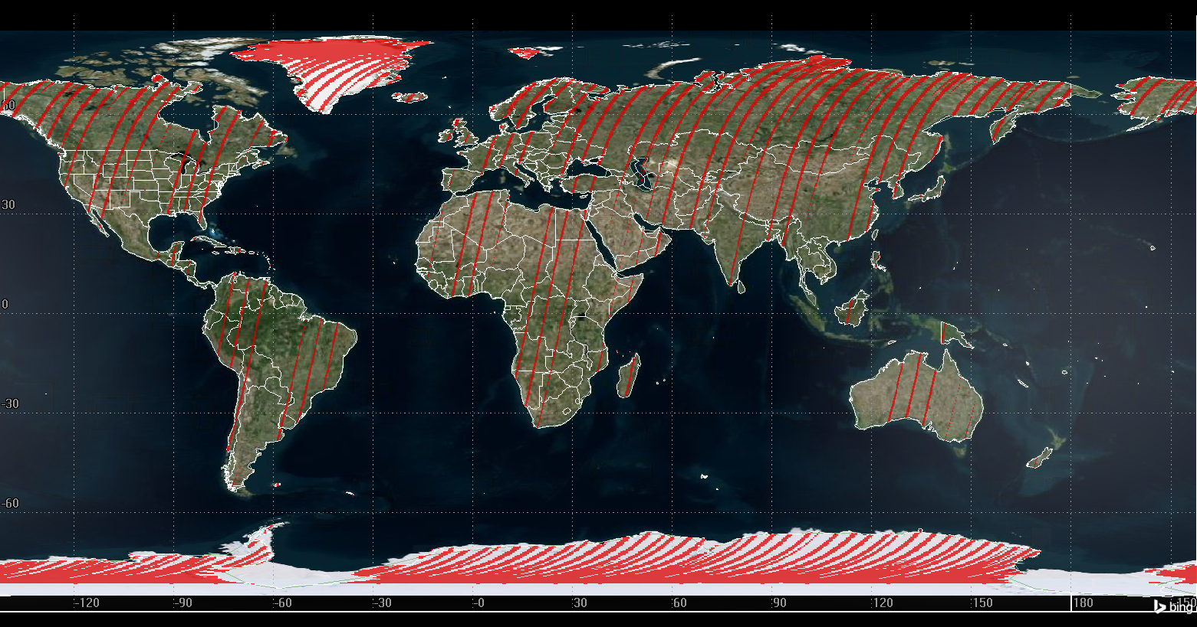
SCR Crossing Time selection
SCR intersections with one Landsat in single 48-day cycle
Results | 645 km (48-day repeat)
No. of SNO opportunities | 659
Total SNO area as % total land area | 10.07 (15 million sq. km)
Average SNO area per intersection | 22,761 sq. km
Max time gap between SNOs | 3 days 0 hrs 40 min 38 sec
No. of > 1-day gaps per cycle | 9
Sunlit only
Center ±3°of Landsat swath
Notes:
The satellites with crossing times within +/- 15 minutes of SCR will have higher intersections over entire landmass.
As the crossing time difference increases the intersections happen more towards the poles.

Slide 19
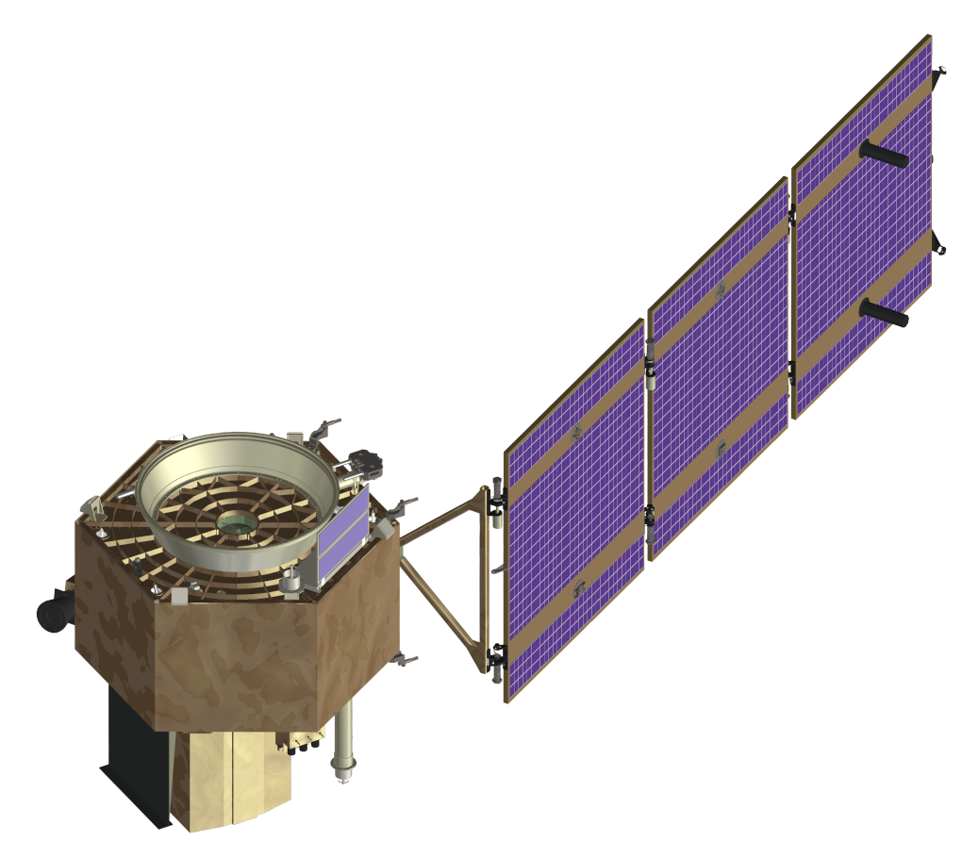
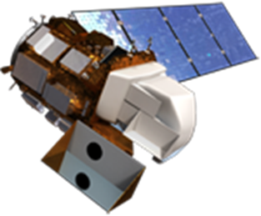
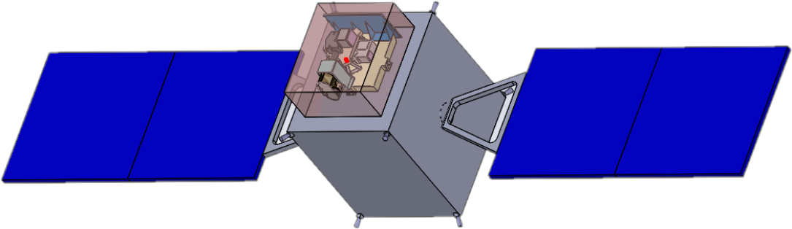


SCR Operations Workflow
Reference
System
Client
System
Mission Data
Ground Network
(ASN/LGS)
Data Ordering
Telemetry & Command
L1 Orders
Data Ordering
L1 Products
USGS L1
L1
Mission Data
MOC
Users
Data Routing Cloud
Mission Data
Processing Cloud
Archive
GA L1
L1
L1
Correction
Factors
Cross-Cal Proc
Corr Data

Slide 20
Thank you
medhavy.thankappan@ga.gov.au

