Slide 1
WGCV 3.3 Review Progress on Other WGCV CEOS Work Plan Activities
Akihiko KUZE
WGCV-51
October 6, 2022
(Tokyo)

Slide 2
CEOS 2022-2024 Work Plan
3.7. Data Quality
The CEOS Working Group on Calibration and Validation (WGCV) continues to evaluate and
recommend best practices for the characterisation / calibration of satellite-based sensors, and the validation of satellite-based Earth observation (EO) data products. The results of this work are the calibration and validation building blocks for data and tools that underpin the work of the Virtual Constellations (VCs) and other Working Groups (WGs). For these underpinning activities, different tasks are focused within subgroups focused on specific areas of interest. Three subgroups serve the calibration of sensors and their link to international acknowledged standards. Another two subgroups are related to topical subjects concerning validation of data products.

Slide 3
CEOS 2022-2024 Work Plan
I. Coordinate and contribute to the development of suitable methodologies for the onground characterisation of satellite-based EO sensors, the on-orbit calibration of EO missions, and the validation of satellite-based Level 1 and Level 2 products.
2022-2024: Interoperability and utility of Analysis Ready Data (ARD) products are an emphasis of CEOS. WGCV efforts to provide the guidance needed to allow users to assess ARD quality will begin with defining and quantifying uncertainties for surface reflectance product validation at continental scales. In addition, the WGCV developed, and will be working with LSI-VC on, the peer review process for the evaluation of documentation of data providers for alignment with CARD4L and will contribute to terminology definitions.
A similar effort will be undertaken related to greenhouse gases (GHG) data products by developing a set of standards for CO2 and CH4 products such as radiance spectra, densities, and flux that are suitable for inter-comparisons across multiple missions. The WGCV will also collaborate with the WGClimate and the AC-VC, contributing to calibration and validation efforts of CEOS GHG initiatives. WGCV activities will build upon the recent progress towards understanding global biomass by developing an initial set of guidance for biomass product validation using near-term missions such as NISAR, GEDI, and BIOMASS. Ensuring that the results of this work are readily available will take place through a significant update to the CEOS Cal/Val portal, the Vicarious Calibration portal, and the WGCV website within the CEOS interface. From these websites, calibration and validation data are available.
The calibration of missions in the thermal infra-red domain is a topic of growing importance, including several CEOS agencies working on future missions covering this spectral domain, in particular SBG (NASA), LSTM (ESA, Copernicus) and Trishna (CNES/ISRO). 2022 will see specific efforts - including the definition of a common network of in situ calibration sites - to harmonise calibration methods for thermal infra-red instruments taking advantage of the previous work done for the “Land Surface Temperature Product Validation Best Practice Protocol”, written by the CEOS WGCV Land Product Validation (LPV) subgroup, to maximise the benefit of these missions for users.

Slide 4
CEOS 2022-2024 Work Plan
II. Continue cooperation with GEO, Global Space-based Inter-calibration System (GSICS), and WMO and ground-based networks in the provision of high quality EO data products.
2022-2024: The WGCV will continue to strengthen its cooperation with GSICS on the topic of sensor calibration following the joint effort on a recommendation for a GSICS/CEOS solar spectrum with various spectral resolutions and solar cycles that ensures interoperability. This includes a crossworking group effort with WGISS on quality indicators, with sea surface temperature (SST) as a test case, and efforts in the standards for calibration of space-based CO2 and CH4 sensors.
The WGCV will continue working with the GEO Secretariat, including work to support relevant GEO activities mainly by encouraging widespread adoption of quality assurance principles. The development of calibration and validation infrastructure and comparison campaigns within the frame of the WGCV will be used to promote these principles and best practices. The WGCV will continue to foster cooperation with WMO, ground-based networks, and CEOS WGs and VCs through dedicated presence during WGCV meetings and by reaching out to the science users and
data product providers in atmosphere, terrestrial, and ocean communities.

Slide 5
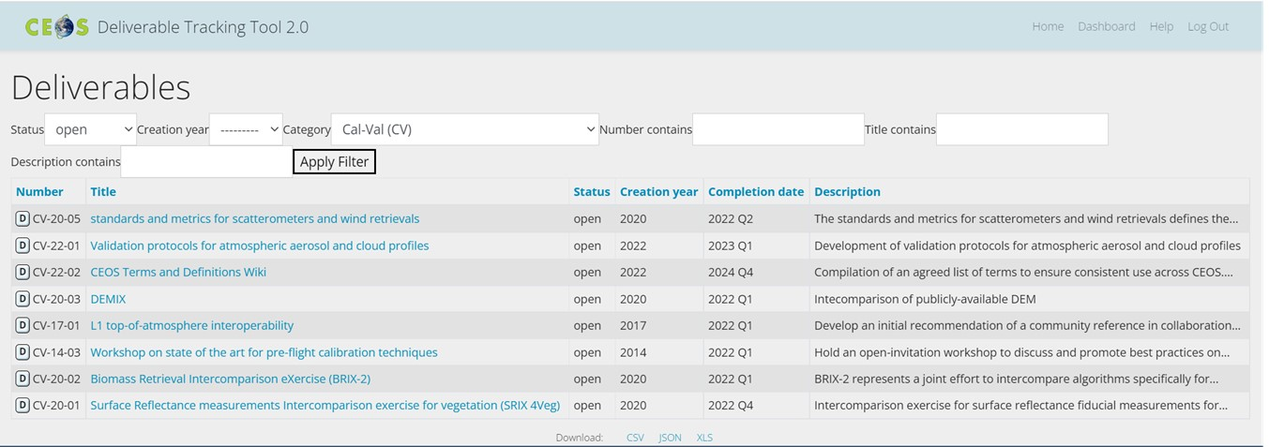
CEOS Deliverables

