Slide 1
WGCV-51 Update on GSICS/WMO and collaboration with CEOS
Philippe Goryl
Agenda Item 3.2
WGCV-51, Tokyo, Japan
6th October 2022

Slide 2
GISCS links and recent/upcaming meetings
GSICS Wiki: http://gsics.atmos.umd.edu/wiki/Home
GSICS Meetings and conferences: http://gsics.atmos.umd.edu/bin/view/Development/MeetingsAndConferences
Notes:
Relent links for GSICS and list of Upcoming/recent meetings. Note the Annual plenary meeting and several monthly sungroups teleconferences

Slide 3
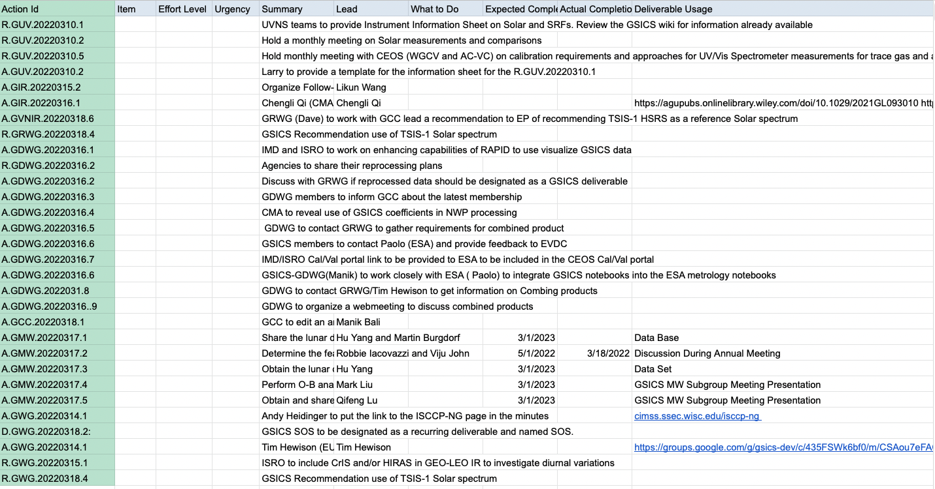
GSICS actions and recommendations
Slide 3
Notes:
This is a screenshot of actions and recommendations from the latest GSICS Annual meeting. Some of them (highlighted) are related to the CEOS activities. See the action related to the CEOS Cal/Val portal and recommendation on use of the TSIS-1 Solar spectrum.

Slide 4
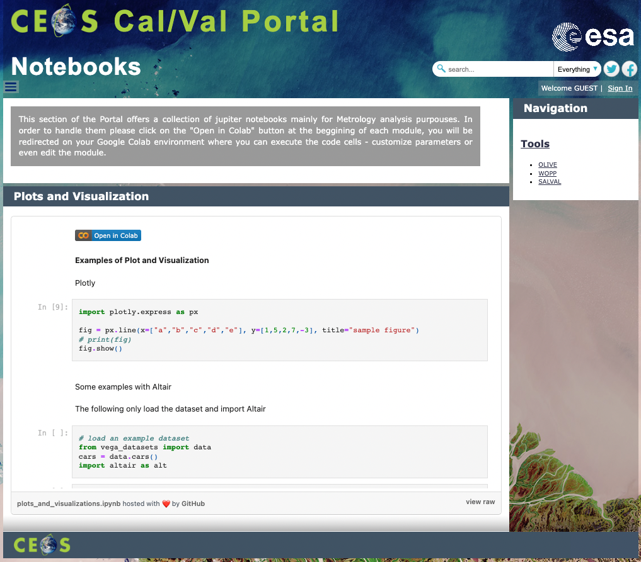
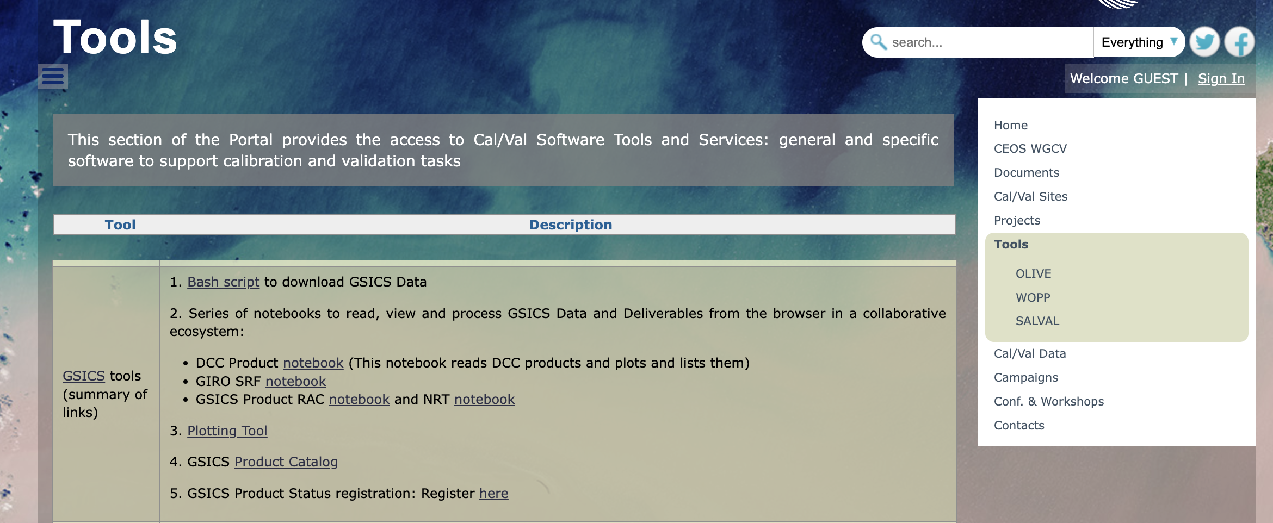
GSICS tools – links
In the contex of GSICS Group Data – relevant links to GSICS scripts and notebooks have been included in the Tools section – as well as – the link to RAPID (by Satellite Application Centre (SAC), ISRO in collaboration with India Meteorological Department IMD ).a web-based data analysis and visualization platform integrating all kinds of Observational Platforms and NWP Model data.
The Cal/Val portal hosts notebooks via Google Colab for demos/exercises (in progress)
Notes:
Regarding the actions defined in the GSICS Group Data and related to the CEOS Cal/Val portal we put the relevant links to GSICS scripts and notebook in the Tool Section. The Link and description of the “RAPID” platform (ISRO/IMD) has been also included. The Cal/Val portal has moreover the capability to hosts notebooks for demos/execrise this is an activities in progress with Manik Bali GDWG.

Slide 5
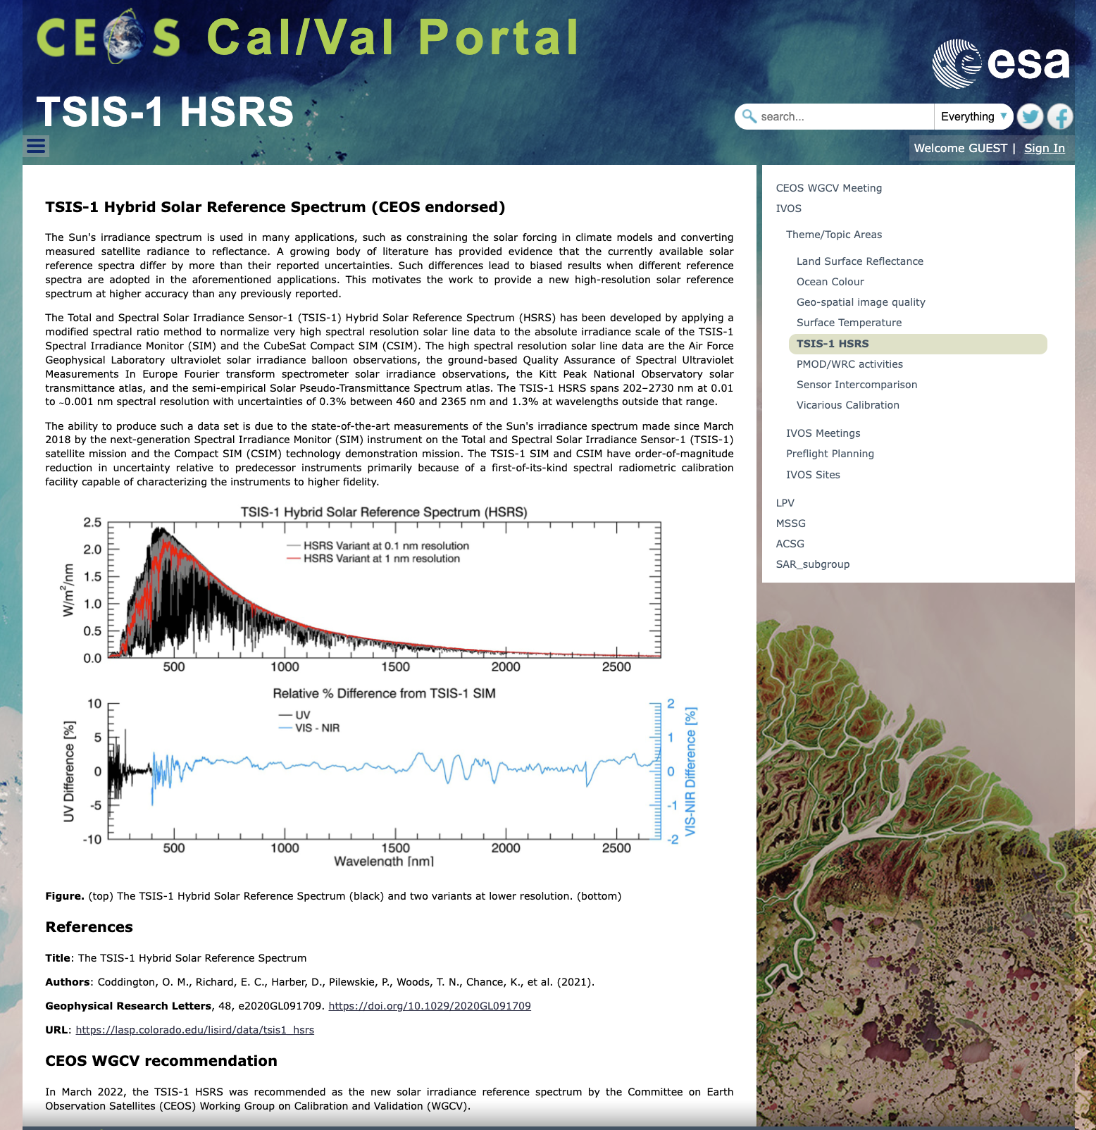
TSIS-1 Hybrid Solar Reference Spectrum (CEOS endorsed)
References
Title: The TSIS-1 Hybrid Solar Reference Spectrum
Authors: Coddington, O. M., Richard, E. C., Harber, D., Pilewskie, P., Woods, T. N., Chance, K., et al. (2021).
Geophysical Research Letters, 48, e2020GL091709. https://doi.org/10.1029/2020GL091709
URL: https://lasp.colorado.edu/lisird/data/tsis1_hsrs
CEOS WGCV recommendation
In March 2022, the TSIS-1 HSRS was recommended as the new solar irradiance reference spectrum by the Committee on Earth Observation Satellites (CEOS) Working Group on Calibration and Validation (WGCV).
Notes:
Following the recommendation from CEOS (IVOS) – the same we had from GSICS – A dedicated page has been implemented on the Cal/Val Portal for the TSIS-1 reference spectrum

Slide 6
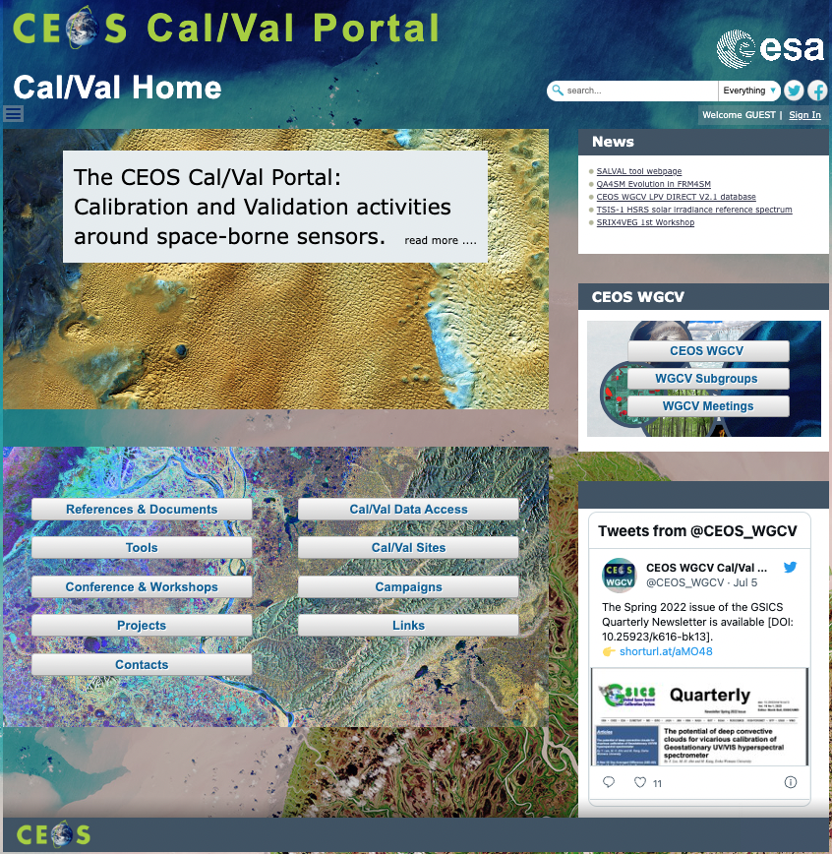
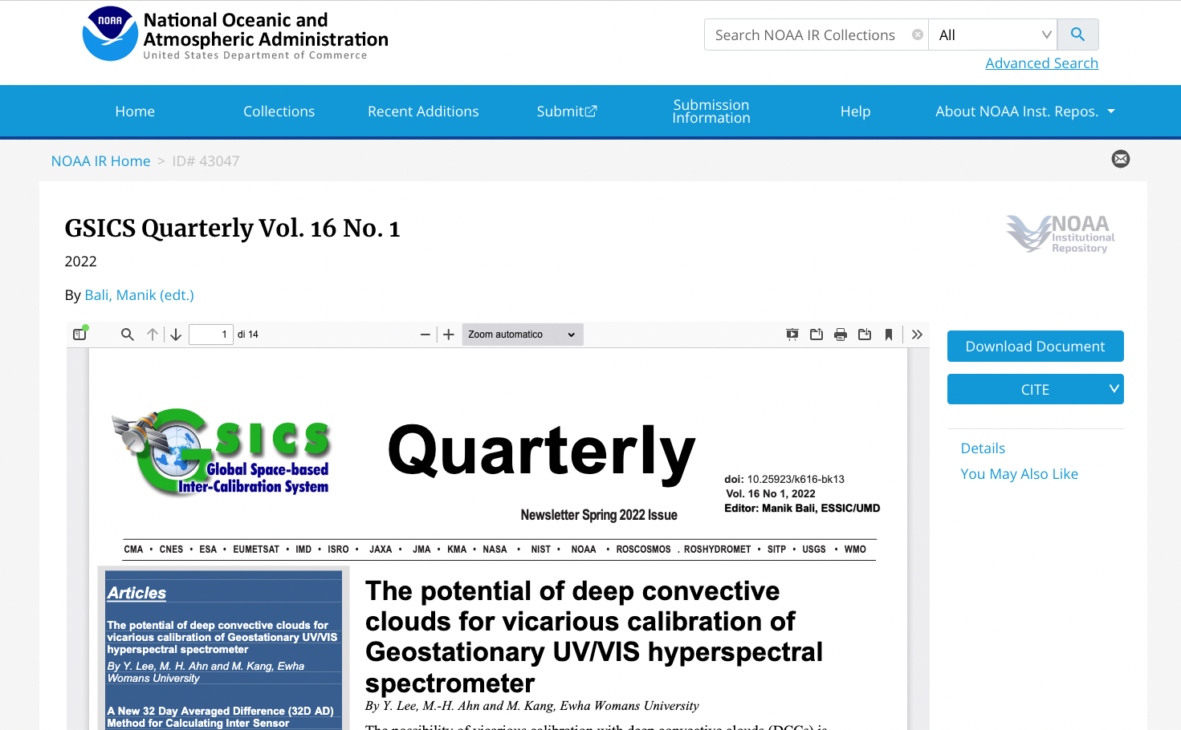
GSICS Quarterly Newsletter
Notes:
In terms of outreach – the GSICS Quarterly newsletter are perodically posted via the CEOS WGCV twitter account

Slide 7
Area of cooperation
WGCV and GSICS share methods and protocols (vicarious calibration)
WGCV and GSICS look for REFERENCE
- SITSAT becoming reference from space SI traceable
- co-organised the SITSCOS workshop https://calvalportal.ceos.org/sitscos-ws
Joint Organisation of the Workshop Calibration / Characterisation Pre-Flight
– TO BE ORGANISED
Notes:
@Philippe please add/modify steps, plan and conclusion here.

Slide 8
Next Steps and Plan
To implement/finalize actions in progress:
To increment CEOS/GSICS interactions
To increase activities on twitter account: @CEOS_WGCV
Notes:
@Philippe please add/modify steps, plan and conclusion here.

