Slide 1
WGCV
3.10 Greenhouse Gas Cal/Val Update
GHG Vicarious Calibration Portal
CEOS-IMEO Collaboration
Akihiko KUZE
WGCV-51
October 6, 2022
(Tokyo)

Slide 2
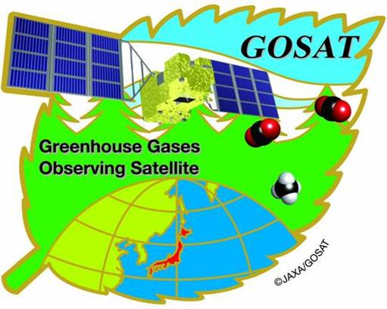




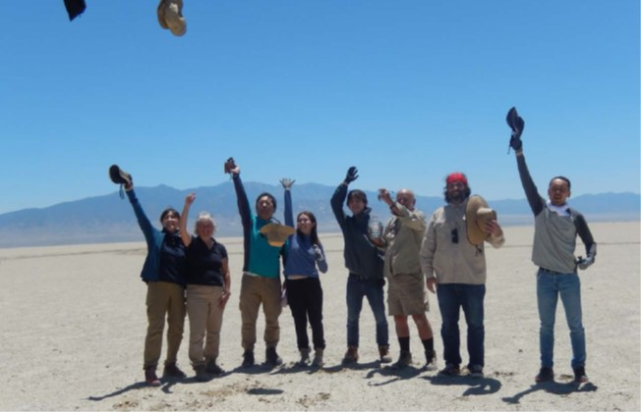
Joint RRV 2022 campaign
14th annual vicarious calibration campaign was successfully completed in June 2022, Railroad valley Nevada.
Coincident measurements of GOSAT, GOSAT-2, OCO-2 (partially cloud), OCO-3, TROPOMI (everyday).

Slide 3
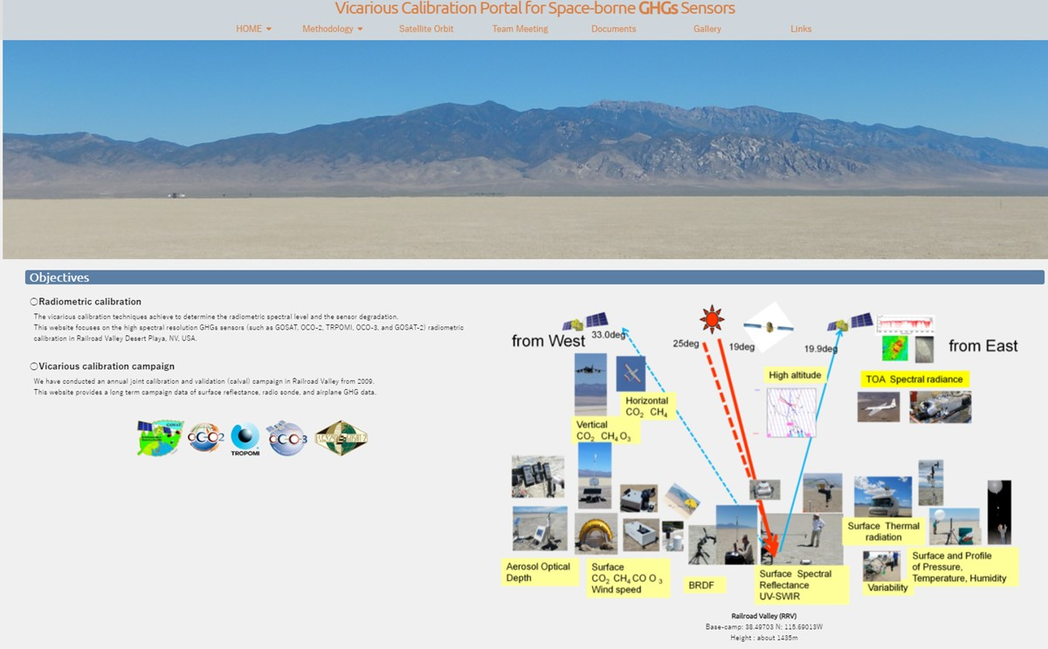
GHG Vicarious Calibration Portal
Linked with CEOS https://www.eorc.jaxa.jp/GOSAT/GHGs_Vical/index.html
The VCAL Portal site provides
Methodology of vicarious calibration for various size footprint and off-nadir data.
14-year annual joint campaign data for CAL-VAL: surface albedo, radiosonde data, XCO2, CH4 by EM27-FTS, alpha jet vertical profile
Dataset for analysis: solar irradiance, molecule cross section
Analytical results from various type of spectrometers: GOSAT FTS, OCO, S5P TROPOMI……
3

Slide 4
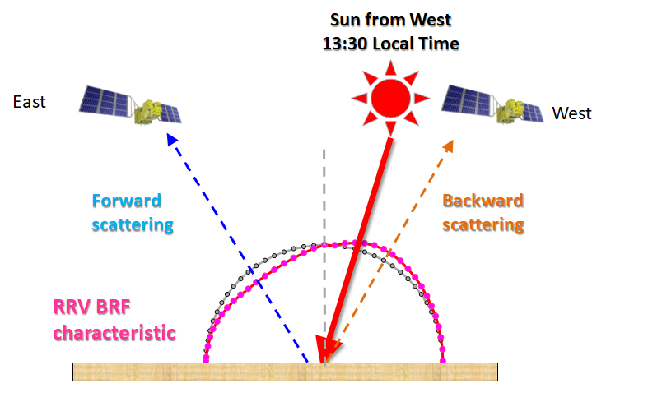
Challenges
(A) Reanalysis: Forward calculation vs. prelaunch or radiance converted-Level 1 data
Long term analysis using the common campaign data and radiative transfer code: GOSAT(RRV2009-) OCO-2 (RRV2015-) TROPOMI (RRV2018-) GOSAT-2 (RRV2019-), OCO-3 (RRV2019-)
(2) Estimate Radiance Degradation Factor (RDF) of 5 instruments
(B) Intercomparison of calibrated radiance-spectra and retrieved column density during the campaign data
(1) Radiance comparison by applying simple BRDF correction
(2) Retrieved XCO₂, XCH₄ and XCO comparison with EM27 at RRV-desert playa
Challenges
(A) Database: HITRAN and database
(B) Variety of footprint and observation geometry
(C) Polarization
1. instrument especially grating
2. aerosol and cloud scattering
3. surface BRDF (forward
4

Slide 5
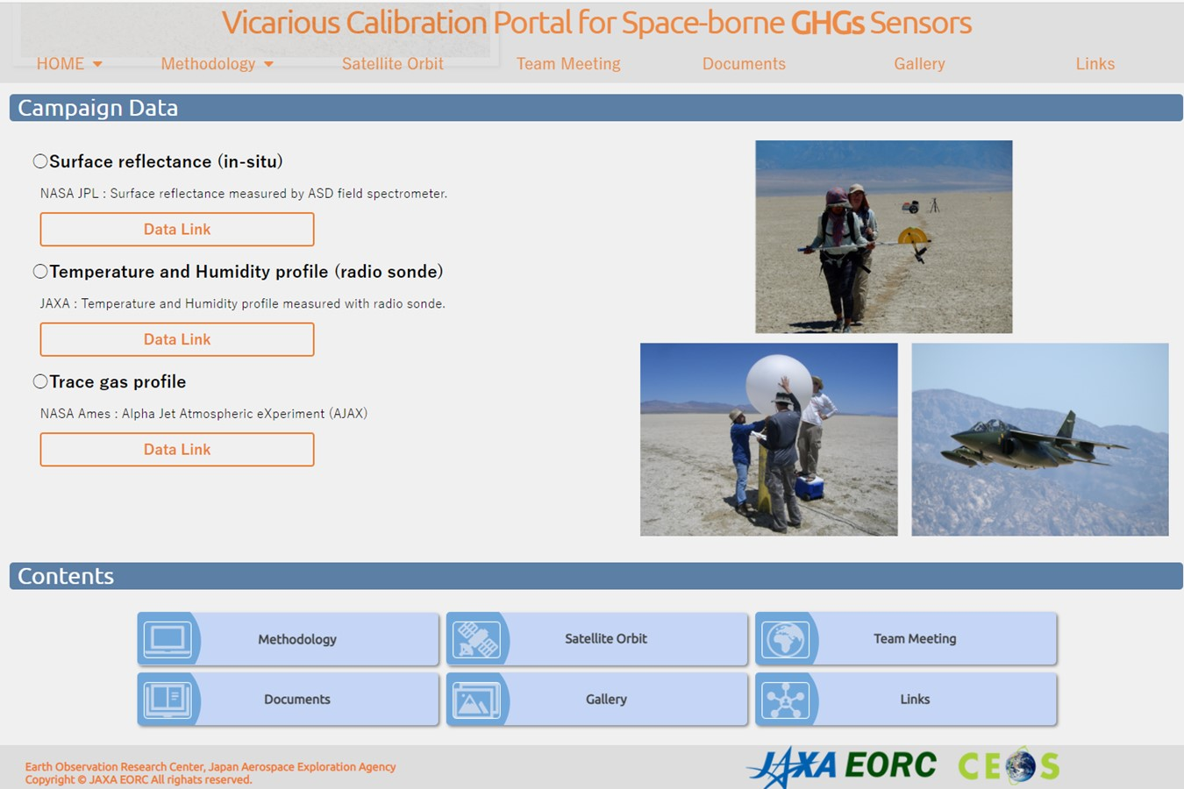
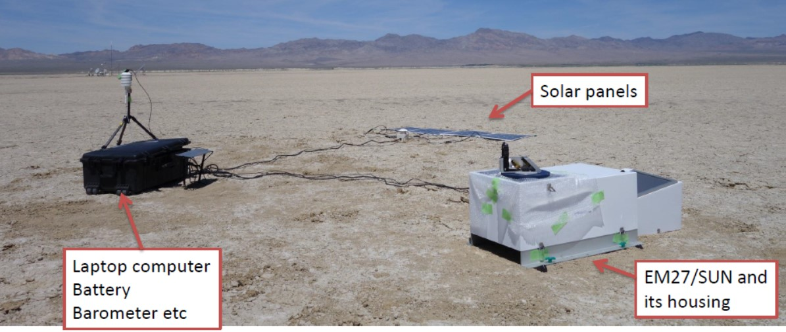
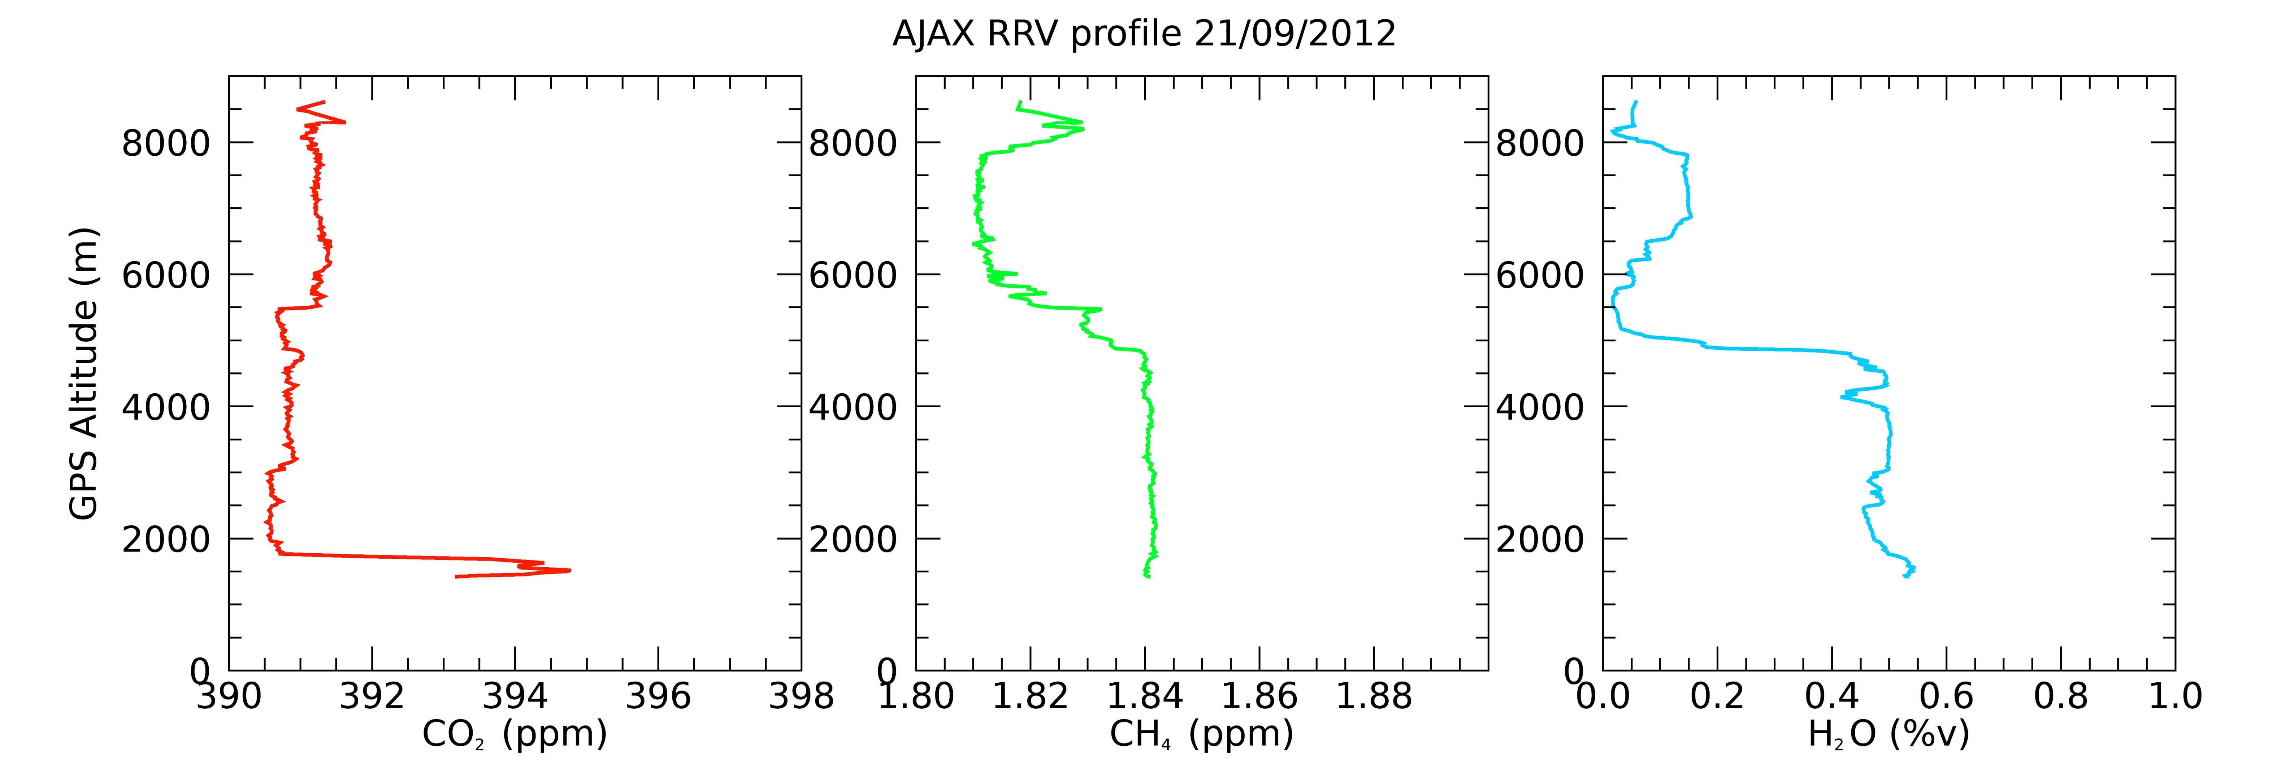
GHG VCAL Portal (Validation)
(Collaboration with IMEO)
The GHG VCAL Portal site provides
14-year joint Nevada campaign data for CAL-VAL: surface albedo, radiosonde, XCO₂, XCH₄ by surface EM27-FTS,
Alpha jet vertical profile CO₂, CH₄, H₂O
(by NASA Ames)
Analytical results from various type of spectrometers: GOSAT FTS, OCO, S5P TROPOMI…
Slide 5

Slide 6
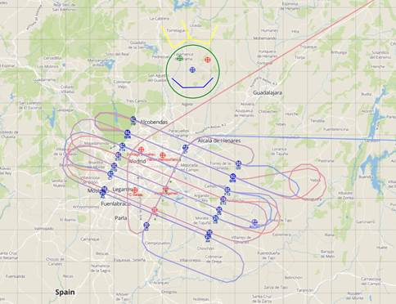
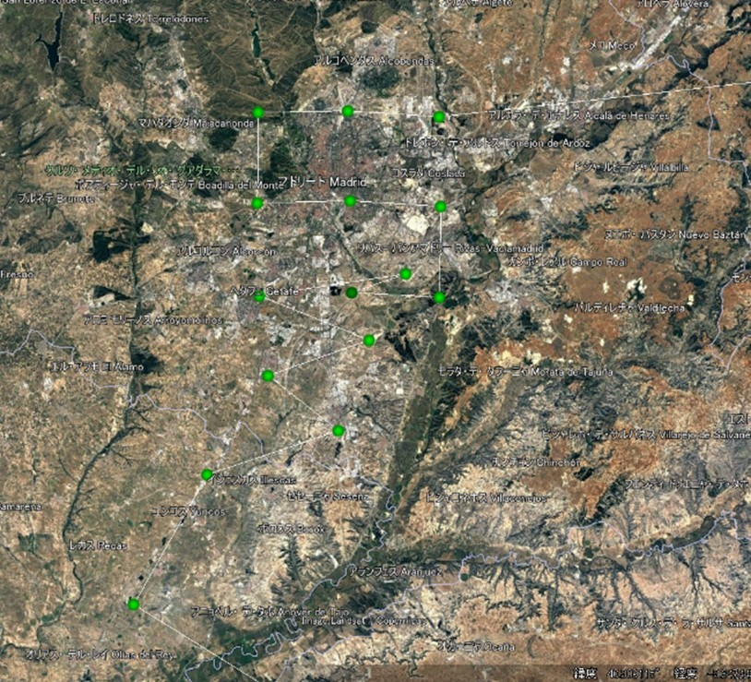
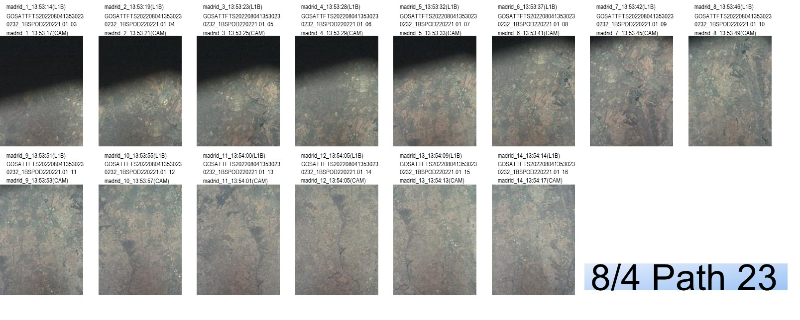
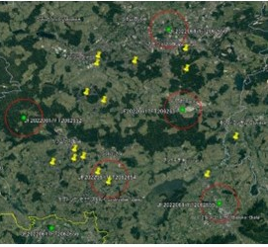
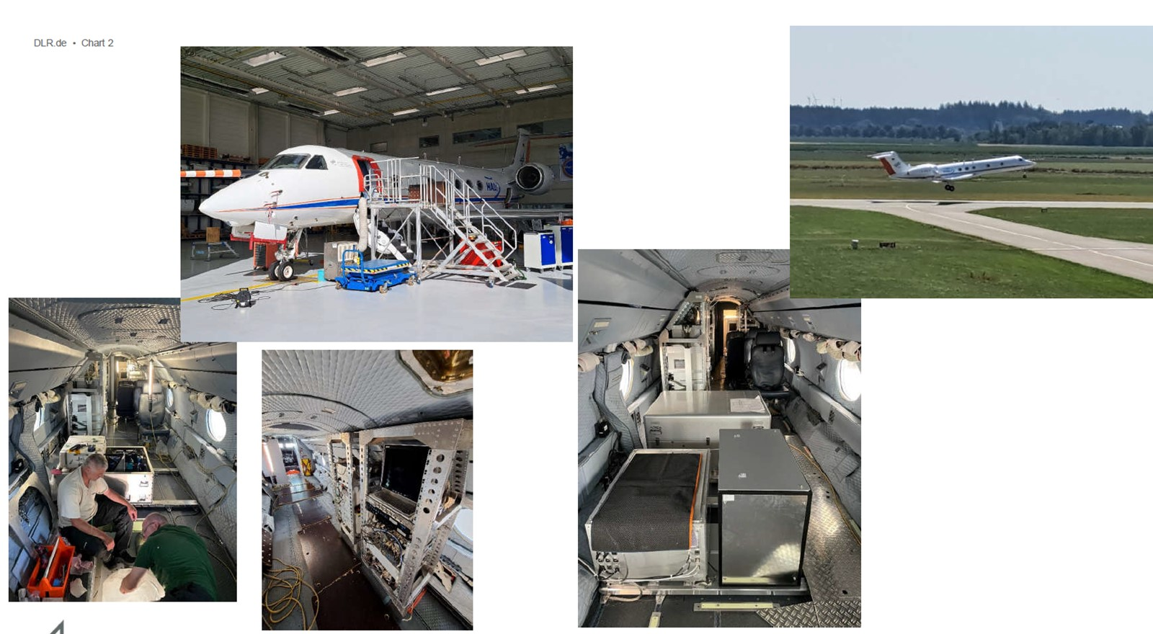


2022 Summer Methane Campaign
Satellites and airplane coincident measurements
Madrid CoMet 2.0
August 4 GOSAT, GOSAT-2
S5P TROPOMI GHGsat
(Courtesy of Andreas fix)
(2) Katowice Poland
ESA Methane campaign in August
(3)Albert Canada Oil and Gas DLR CoMt2.0 Arctic
GOSAT, GOSAT-2 in August
(Courtesy of Andreas fix, DLR)
Over Landfills, CoMet flight pattern, GOSAT-2 pointing pattern, GOSAT onboard camera image over landfills in Madrid
GOSAT pointing pattern over coal mines

