Slide 1
WGISS / WGCV-51
Data Quality Assessment and Indicators, and DMSMM Maturity Matrix
Data Quality Indicators
Philippe Goryl, ESA
Joint WGISS/WGCV
WGCV-51, Tokyo, Japan
3rd - 6th October 2022

Slide 2
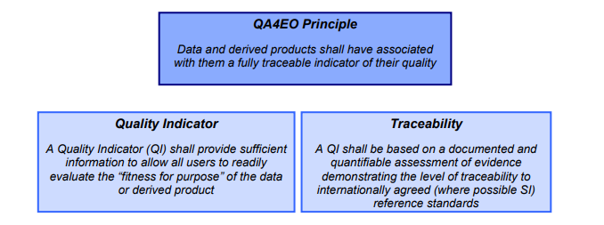
QA4EO Principle
QA4EO has been endorsed by CEOS as a contribution to facilitate the GEO vision for a Global Earth Observation System of Systems (GEOSS). The aim of GEOSS is to deliver comprehensive and timely knowledge / information products worldwide to meet the needs of its nine “societal benefit areas”: If the vision of GEOSS is to be achieved, Quality Indicators (QIs) should be ascribed to data and, in particular, to delivered information products, at each stage of the data processing chain - from collection and processing to delivery. A QI should provide sufficient information to allow all users to readily evaluate a product’s suitability for their particular application, i.e. its “fitness for purpose”.

Slide 3
Quality Indicators
Quality Indicators can be expressed in different layers of information:
per pixel quality info (e.g.: cloudy, saturation, straylight, algorithm failed, etc.);
Uncertainties per measurements (pixels/bands);
Cal/Val results summary (geometry; radiometry; algorithms/methods and results compliance…) per data set;
Summary quality in the metadata (importance of standardization);
Tools and Procedures (including Product Generation and Quality tools)

Slide 4
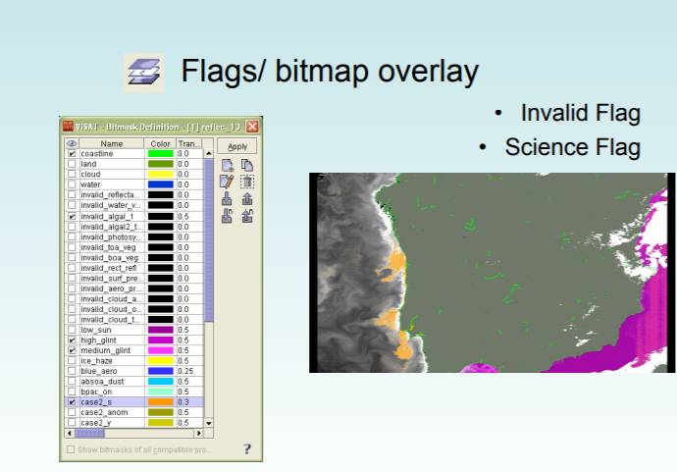
Quality layer (per pixel)
Basic information at pixel level is provided to give confidence on the pixel quality to a “certain extend”
Quality layer (per pixels → e.g.: cloudy/saturation/straylight/algorithm failed/….etc….)
Examples;
Cloud
Cloud shadow
Saturation
Straylight
algorithm failed
Glint/Glint risk
etc….
See e.g.: Introduction into MERIS data and BEAM software.
C. Brockmann & R. Doerffer http://www.cearac-project.org/wg4/3rdRST/Day2_H1_Doerffer.pdf

Slide 5
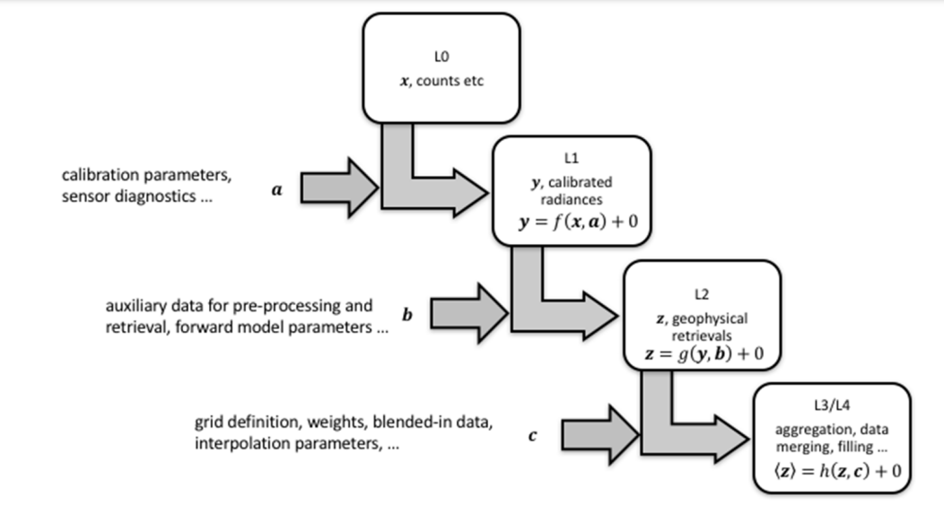
Pixel-level uncertainties
A barrier to improved uncertainty information in EO is the absence of pixel-level uncertainty information in level-1 radiance products (with few exceptions, e.g. Gorroño et al (2017) for Sentinel-2; or the MODIS uncertainty index see MODIS Level 1B Product User’s Guide https://mcst.gsfc.nasa.gov/ sites/mcst.gsfc/files/file_attachments/M1054.pdf).
The Quality Assurance framework for Earth Observation (QA4EO) Looks to make the GUM accessible to the EO community. The Guide to the expression of Uncertainty in Measurement (GUM) • The foremost authority and guide to the expression and calculation of uncertainty in measurement science • Written by the BIPM, ISO, etc
http://www.bipm.org/en/publications/guides/gum.html
All applications follow from the transformation of satellite data from level 1 to higher-level data
REF: [Jonathan Mittaz et al 2019 Metrologia 56 032002 - https://iopscience.iop.org/article/10.1088/1681-7575/ab1705/pdf]
→ Uncertainty in lower-level data propagates to the
higher level

Slide 6
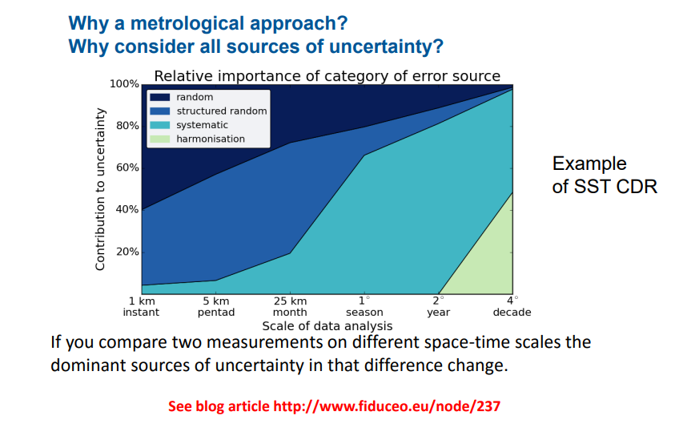
Metrology and Uncertainty Characterisation
Metrology is the science of measurement; It covers the aspects of the mission related to measurement quality, including calibration, traceability and uncertainty.
Uncertainty values should be provided in EO data products per-pixel, in a manner that describes the pixel error-covariance. Since it is not practical to provide a full error-covariance matrix for an EO data product due to their data volume various approaches have been developed to approximate this. For example, the FIDUCEO project FCDRs contain three components of uncertainty – independent, structured and common – to describe the three typical scales of error correlation. It is still typical however for uncertainty values to be provided, if at all, on a per-product or, more often, a per-mission basis – losing a great deal of information
See also:
https://earth.esa.int/eogateway/documents/20142/37627/1_Metrology_Nigel_Fox_et_al_.pdf

Slide 7
Cal/Val definitions
Calibration is the process of quantitatively defining the system response to known controlled signal inputs. Hence the calibration process aims at determination of the sensor model parameters precisely. This is the working definition used by the Working Group on Calibration and Validation (WGCV) of the international Committee on Earth Observation Satellites (CEOS).
Validation is the process of assessing, by independent means, the quality of the data products derived from the system outputs. The validation process aims to check the quality of the data. According to the accuracy results obtained in the validation process, the calibration procedure might be repeated. On the other hand, the validation process can be applied for the methods as well. This is the working definition used by WGCV of CEOS.
Calibration and Validation are part of the Space Component
Satellite program includes a Cal/Val plan
Calibration/Validation rely also on On-Ground system (vicarious calibration)
Validation is based on the synthesis from various input:
→ Fitness for purpose

Slide 8
Summary Quality in the Metadata
An important aspect of EO data products that ensures they are most easily accessible to the widest variety of users is their format. Product metadata and flags offer users important extra layers of useful descriptive information in addition to the measurements themselves that can be crucial to their analysis.
In the ideal case, an assessed mission product format should meet any appropriate CEOS Analysis Ready Data (ARD) metadata guidelines, for example CARD4L requirements in the case of surface reflectance products
CEOS LSIVC
https://ceos.org/ard/
Product Family Specification

Slide 9
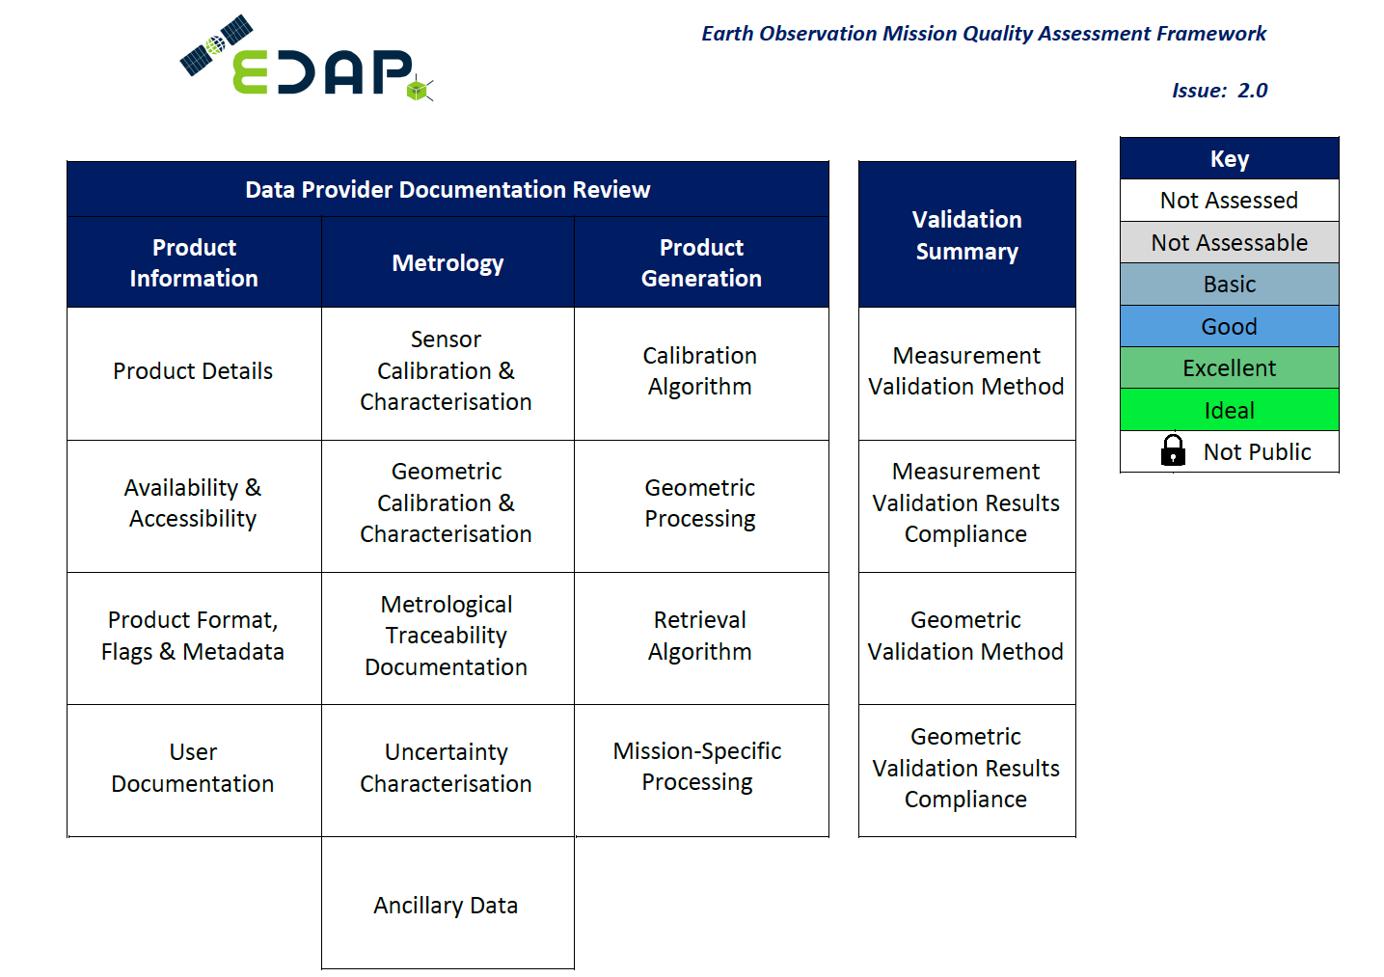
Cal/Val Maturity Matrix
A Cal/Val maturity matrix provides a reader with the high-level summary of the output of a quality assessment. The matrix contains a column for each section of analysis and cells for each sub-section of analysis. Sub-section grades are indicated by the colour of the respective grid cell, which are defined in the key.
REF: EDAP Best Practice Guidelines
https://earth.esa.int/eogateway/activities/edap/edap-best-practice-guidelines
https://www.youtube.com/watch?v=IRjR_611-ao

Slide 10
Conclusion
The following aspects are recognized crucial for an optimal EO data quality assessment:
The overall strategy shall be in line with the QA4EO principles
It is optimal to have quality information per pixel and at lower processing level
Uncertainty Characterization for EO Product shall follow standard guidelines
Cal/Val activities shall be part of the overall Satellite Mission
Metadata shall include quality information and follow good practices and standards
Post-launch Cal/Val activities shall exploit appropriate infrastructure/methods traceable to SI (e.g. FRM).
Validation plans are implemented involving: Mission Performance Centres and Validation Teams
State-of-the-art algorithms, tools and procedures used, easily “fit for purpose” in terms of the mission’s stated performance.

