Slide 1
EAIL Use-cases and vision
Jonathan Hodge, CSIRO Chile
Agenda ID: 2022.10.06_10.00
WGISS-54
Tokyo, Japan (JAXA)
3-7 October 2022

Slide 2
Summary
The Earth Analytics Interoperability Laboratory (EAIL) has been operating for the last two years
Significant data updates have occurred over the last 6 months including increased coverage and new products
There are a range of potential data sources, services and applications which could be added to EAIL if there is interest
New capabilities could include significant enhancements in Machine Learning and GPU capabilities

Slide 3
EAIL update and vision
EAIL is built using the Open Data Cube software and CSIRO’s Earth Analytics, Science and Innovation platform
Scalable Production Workflows
Dashboards
Web Applications
Web Mapping Services
Exploratory Data Analysis
Powered by Open Data Cube and the Python data science ecosystem
Slide ‹#›

Slide 4
EAIL
EAIL is operated by CSIRO Chile with significant support from the Chilean Data Observatory, a public-private-academic partnership founded by the Chilean Government (Ministry of Science, Ministry of Economy), Adolfo Ibáñez University and AWS.
www.dataobservatory.net

Slide 5
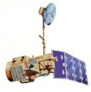
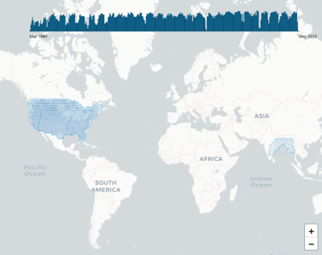
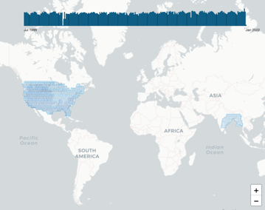
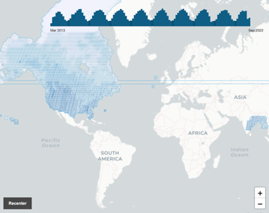
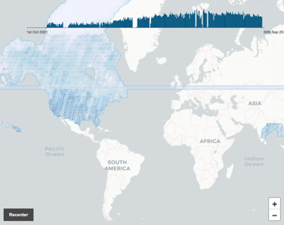
Data update
Landsat 5 | Landsat 7 | Landsat 8 | Landsat 9
Contiguous USA Bay of Bengal | Contiguous USA Bay of Bengal | USA Canada Bay of Bengal | USA Canada Bay of Bengal
1984 – 2011 | 1999 – 2022 | 2013 – 2022 updated daily | 2021 – 2022 updated daily

Slide 6
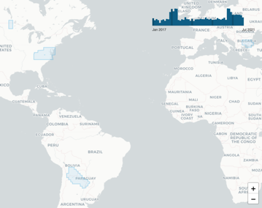
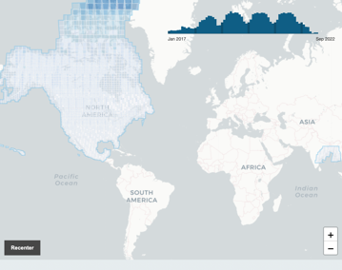
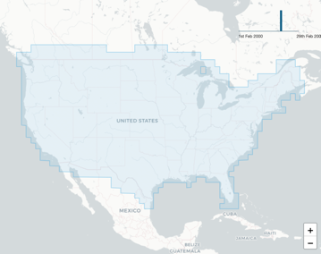
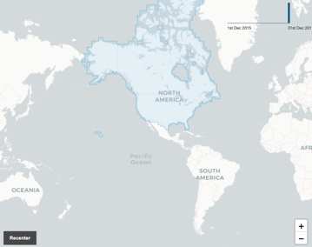
Data update
Sentinel 1 | Sentinel 2 | NASADEM | Copernicus DEM
Focus areas in USA, Canada, South America, eastern Europe | Continental USA Bay of Bengal | Contiguous USA | USA Canada
2017 – 2021 | 2017 – 2022 | latest version | latest version

Slide 7
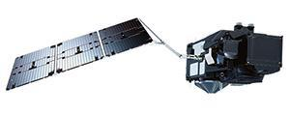
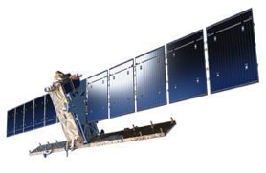
Potential data sources
Sentinel 3
New data workflows to process Sentinel 3 data from EUMETSAT
Currently tested with:
OLCI Level 1B full resolution (OL_1_EFR - EO:EUM:DAT:0409)
OLCI Level 2 full resolution (OL_2_WFR - EO:EUM:DAT:0407)
OLCI Level 2 full resolution reprocessed (OL_2_WFR - EO:EUM:DAT:0556)
Sentinel 1
Significant work has gone into testing and confirming new Sentinel 1 products to ensure the best possible result
New capabilities can include:
Customised RTC backscatter
Polarimetric decomposition

Slide 8
Potential data sources
Numerous other data sources either under development or in operation in related projects which could benefit EAIL, including:
MODIS (numerous products)
Sentinel 5P
GEDI
Related projects (e.g. Aquawatch Australia) are improving integration with time-series data sources, enabling improved connection with sensor and cal/val data.

Slide 9
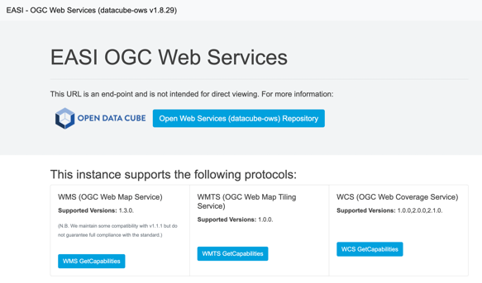
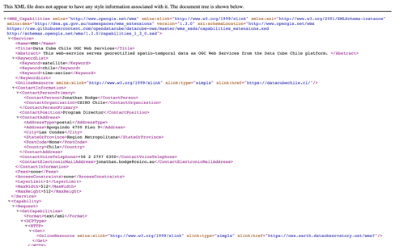
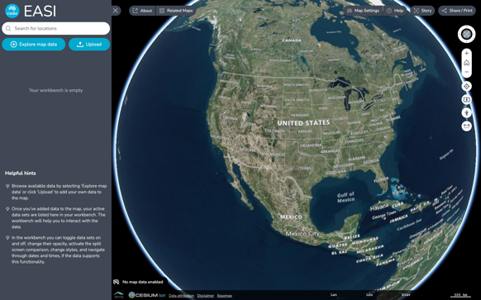
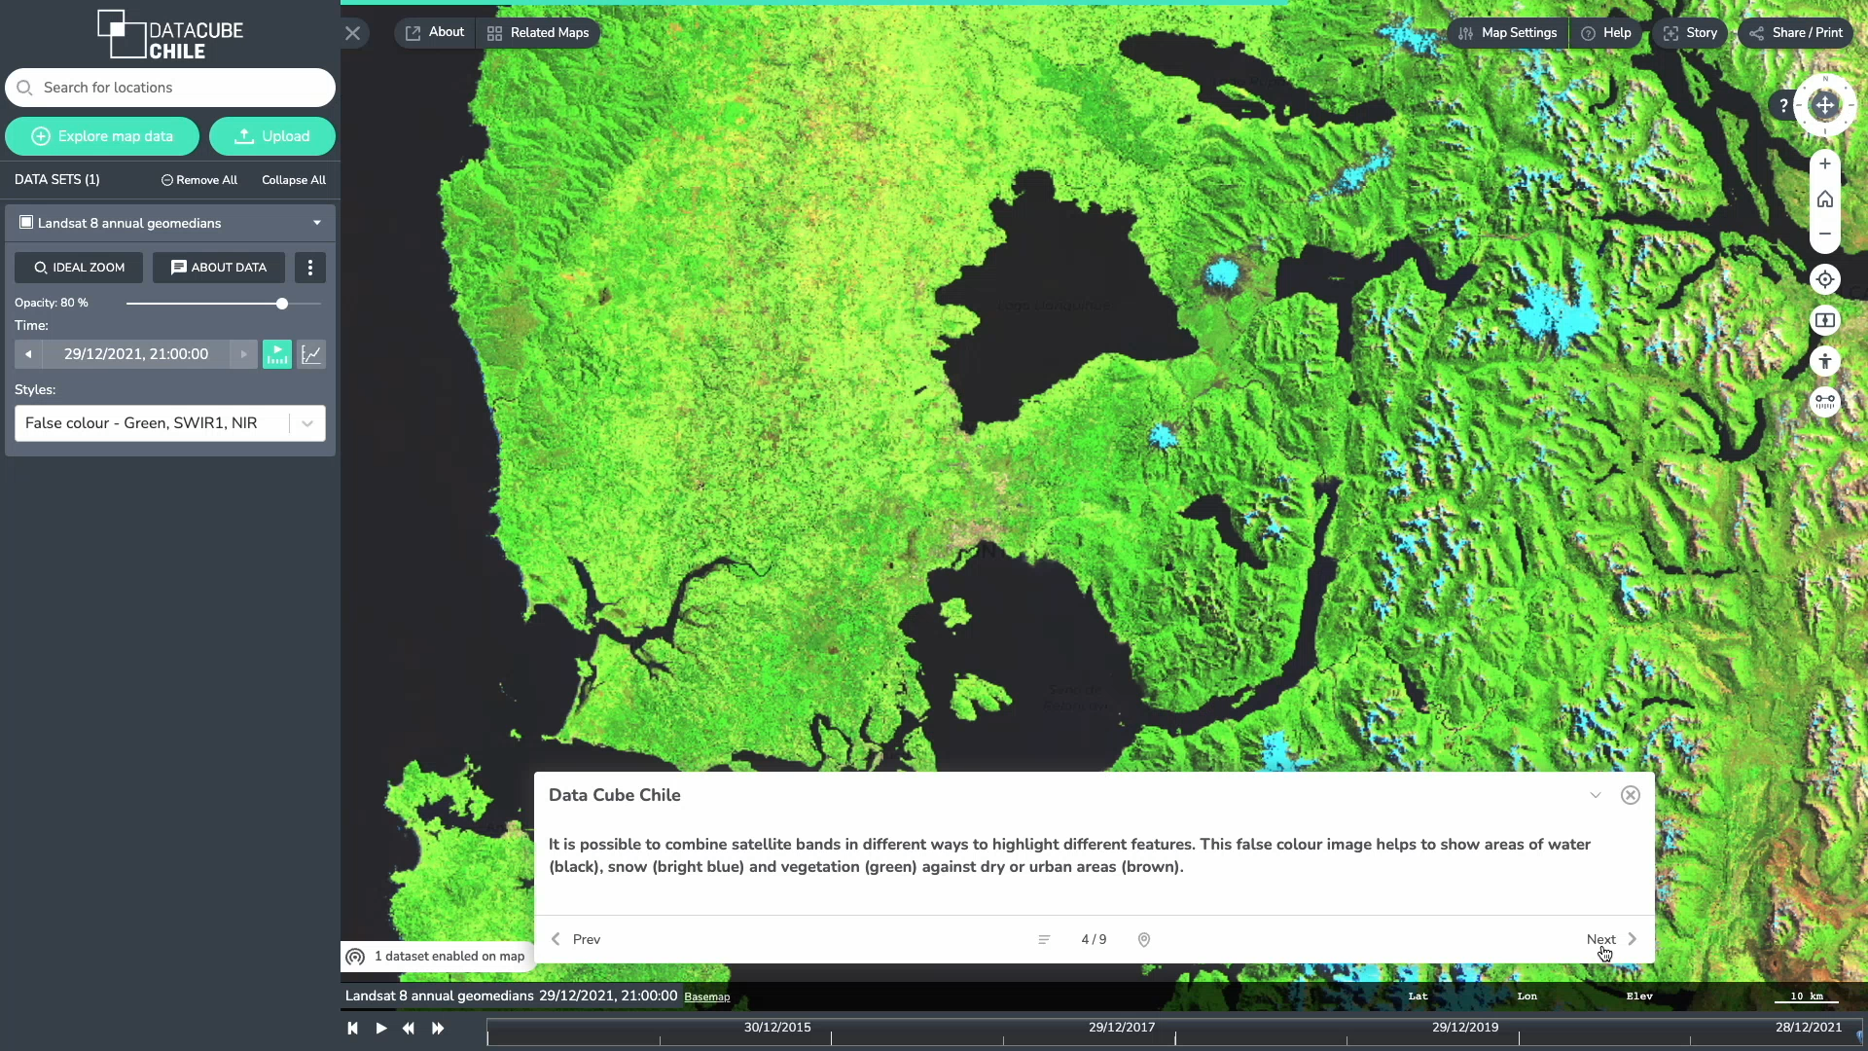
Potential application capabilities
OWS service layer ready for implementation
WMS, WMTS and WCS services
Exposes data cube layers to the outside world
Supports multiple styling options, band combinations and index generation
Terriamap web visualization tool
Connects directly to WMS services above
Supports over 30 data and services type including time-series data and processing services (WPS)

Slide 10
New & potential analytics capabilities
GPU processing with AWS GPU nodes
Additional scientific programming options with R
New machine learning capabilities
+
+

Slide 11
Current issues and challenges
Detecting and resolving issues in third-party catalogues
Some data catalogues are a “best effort” initiative which inevitably can contain small but significant errors
New workflows are in development to identify and respond to these errors
Should be fixed at source
Current issues affect in particular Sentinel 2 and Landsat 8/9
User support and training
New ML and GPU capabilities bring huge opportunities but will require a deeper level of support and discussion
Financing and ongoing support

Slide 12
What’s next
Updates to backend infrastructure in October/November 2022
Improvements to existing data holdings in October 2022, prioritising current issues with Sentinel 2 and Landsat 8/9
Addition of demonstration datasets for Sentinel 1 and Sentinel 3
Need to prioritise new data products and new capabilities based on user interests and requirements
Need to identify options for ongoing operation of EAIL

Slide 13
Future use cases
In addition to supporting an array of current use cases, these new capabilities could enable improved functionality, including:
Analysis, modelling and integration of Cal/Val data
Dynamic analytics via web-based processing services
Improved aquatic remote sensing products and inter-comparisons
Improved classification options (via ML as well as with new radar products)
Multi-platform analyses and product generation

