Slide 1
CEOS Common Online Dictionary
Peter Strobl, EC-JRC Emma Woolliams, NPL Katrin Molch DLR
Agenda ID: 2022.10.05_15.50
WGISS-54/WGCV-51
Tokyo, Japan (JAXA)
3-7 October 2022

Slide 2
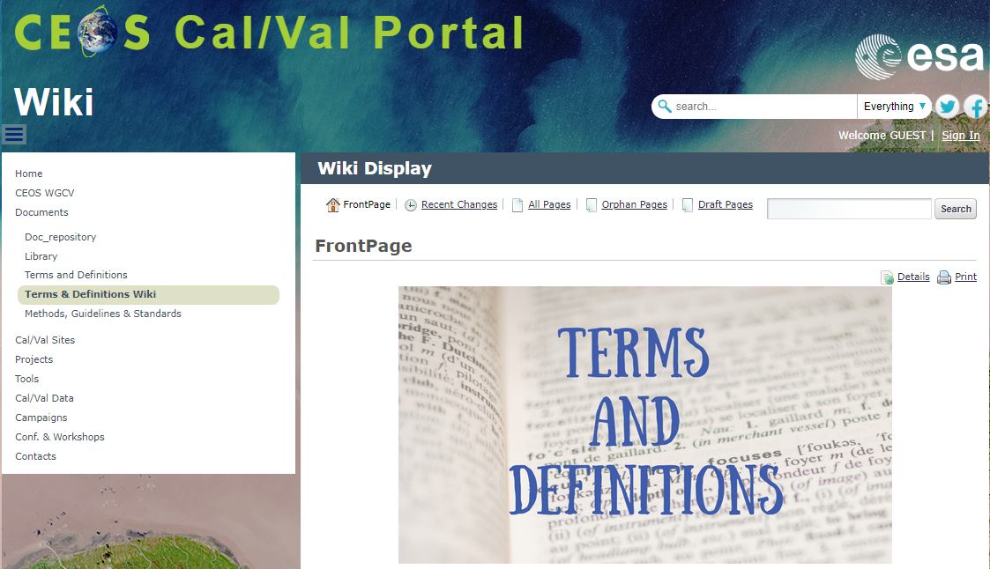
Executive Summary
Done: merged WGCV and WGISS glossaries and NOAA NESDIS Lexicon on a technical level into a temporary Wiki solution (http://calvalportal.ceos.org/ca/t-d_wiki)
To do – the real task: to harmonise the concepts across domains and build consistent ontologies and taxonomies
Intervention during revision of ISO standard 19156 “Geographic information - Observations, measurements and samples” - not successful
Definition of “Observation” includes model outputs, e.g. “simulation”, ”forecast”
1:1 use of ISO definitions in CEOS context questionable
Strategy proposed for next steps

Slide 3
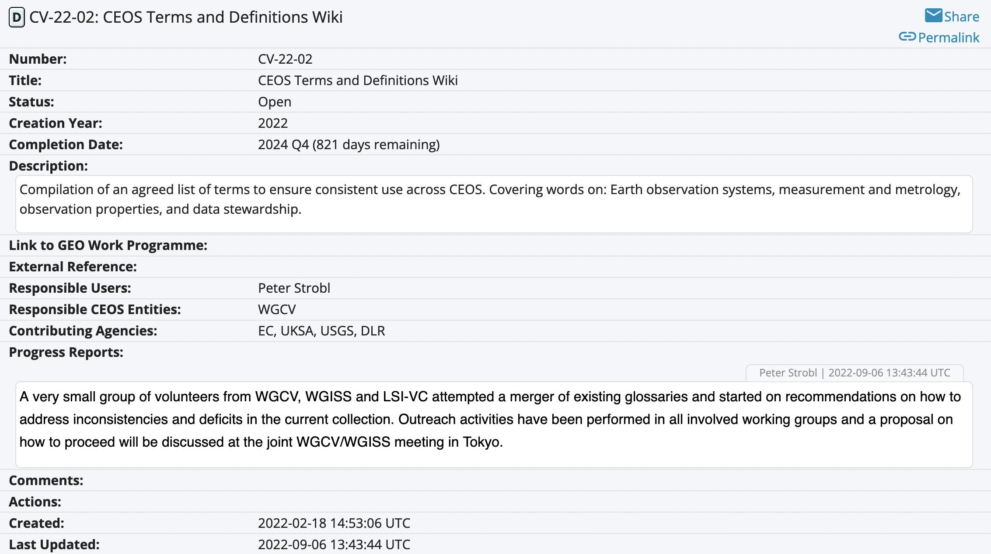
Background
CEOS-WGCV deliverable on ‘Terms and Definitions’
(Feb 2022)

Slide 4
Glossaries
Definition: (https://en.wikipedia.org/wiki/Glossary)
A glossary, also known as a vocabulary or clavis, is an alphabetical list of terms in a particular domain of knowledge with the definitions for those terms. Traditionally, a glossary appears at the end of a book and includes terms within that book that are either newly introduced, uncommon, or specialized. While glossaries are most commonly associated with non-fiction books, in some cases, fiction novels may come with a glossary for unfamiliar terms. A bilingual glossary is a list of terms in one language defined in a second language or glossed by synonyms (or at least near-synonyms) in another language. In a general sense, a glossary contains explanations of concepts relevant to a certain field of study or action. In this sense, the term is related to the notion of ontology. Automatic methods have been also provided that transform a glossary into an ontology^{[1]} or a computational lexicon
With the advent of ‘Big Data’, Earth Observation, Geospatial Sciences and many of their fields of application become increasingly intertwined, i.e. they become a single ‘domain of knowledge’
Traditions and legacy usage make their vocabularies increasingly complex and confusing as soon as previous ‘communities’ are crossed.
Multidisciplinary working groups need to agree on terminology when starting their work, often struggling with diverging practices and then starting own tailored versions (often as “least common denominator”)

Slide 5
The ‘big’ ones in EO/Geosciences:
The variety of glossaries in EO is huge, some key ones:
ISO/TC 211 terminology management group: https://isotc211.geolexica.org/
OGC: https://www.ogc.org/ogc/glossary/, http://www.opengis.net/def/glossary/
INSPIRE glossary: https://inspire.ec.europa.eu/glossary
CEOS: http://ceos.org/document_management/Working_Groups/WGISS/Interest_Groups/Data_Stewardship/White_Papers/EO-DataStewardshipGlossary_v1.2.pdf
NASA: https://earthobservatory.nasa.gov/glossary
Of these only the ‘Geolexica’ is interlinked and addressable (per term)!
None shows structure or ontology
All have gaps and inconsistencies!

Slide 6
Example: “Observation”
ISO 19156:2022 / OGC OMS:
3.13 observation
act carried out by an observer to determine the value of an observable property of an object (feature-of-interest) by using a procedure, with the value is provided as the result
3.14 observer
identifiable entity that can generate observations pertaining to an observable property by implementing a procedure
Note 1 to entry: An observer is an instance of a sensor, instrument, implementation of an algorithm or a being such as a person.
INSPIRE/CEOS/NASA:
not available
How to distinguish results of ‘simulation’ from those of ‘observation’?
Are properties which can be simulated also automatically observable (e.g. MSL)?
Are a model and a sensor both ‘observers’?
This includes models and essentially qualifies a ‘simulation’ as ‘observation’

Slide 7
Why another one?
There were ten different dictionaries that were all different, so we set up a committee to consolidate them.
– and now we have eleven different dictionaries ….
How do we avoid this scenario?

Slide 8
How can we do better?
Consolidate consensus on necessity to act (within CEOS and beyond)
Solicit support and build a coalition of the willing
Outline scope, principles and purpose of the new dictionary
Issue a clear mandate
Agree on common rules and platform
Set realistic short-term (half yearly) and mid-term (1-2 yearly) goals
Ensure commitment and resources (!!!)
Actively organise the transition (e.g. discourage use of ‘one-off linear’ glossaries, encourage collaboration on common glossary)

Slide 9
Principles and Ambition (proposal)
Consistent and based on a firm foundation. We will define ‘base terms’ that will be used in other definitions. Those base terms will form a consistent set, with each uniquely identifying a concept and making an unambiguous distinction with other base terms
Hierarchical. More complex concepts are built on ‘base terms’ with clear parent-child relationships defined between them. Circular relations are avoided. Definitions are complete (building on base terms and everyday language that requires no special interpretation)
Understandable by non-specialists. To improve communication within cross-disciplinary teams it should be written so that a wide range of different experts can understand it, and it should not use specialist jargon from data and information curation.
Enlightening. It should help highlight where terms are used in different ways in different communities
Interesting. As far as possible, we want to produce something that people “enjoy” reviewing!

Slide 10
Terminology good practice (proposal)
A stable and unique entry point (DOI)
Each term needs to be individually addressable
Each term needs to be uniquely defined, incl. unified spelling
Each definition needs to be complete, i.e. building only on everyday language or other defined terms
All terms used in a definition which are defined themselves need to be marked and linked (parent-relations)
All related terms where a term is (re-)used need to be listed and linked (sibling and child relations)
Circular relations (child becomes parent) shall be avoided
Categorisations need to be unambiguous (no overlaps) and wherever possible complete (no ‘grey zones’)

Slide 11
What do we call this?
There are many terms used to describe a collection of concepts (terms):
(controlled) vocabulary,
terminology,
lexicon,
taxonomy,
dictionary,
glossary,
thesaurus,
ontology, …
…most of these were already used in this presentation. Did you notice? Could you tell the difference?
Notes:
No time to explain differences here, but important to highlight that all have their specific purpose and none is fully compliant with what we want to achive

Slide 12
Way forward: Pragmatic Realism
ambition is extremely challenging
work for probably a decade
involves a whole meta-level of discussion, research and expertise
take advantage of work done before by experts in terminology and ontologies
approach discussion with initial thinking in place (next slides)
start with a small number of ‘base terms’ to set the stage
expand with a few ‘high impact terms’ to show how structure works

Slide 13
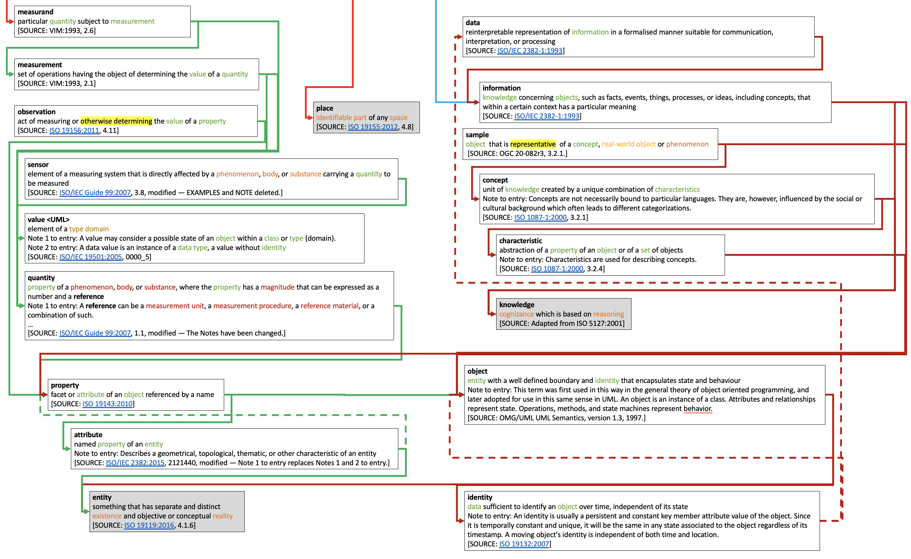
ISO-Geolexica Metaverse
Main purpose is not explanation but function
Observation functionally same as simulation
Property and attribute defined cyclic
Notes:
Note that entity speaks of two types of realities! That is what can be used to clearly define ‘observation’ and distinguish it from ‘simulation’ or ‘modelling’

Slide 14
Proposed ‘base term’ concept for EO
Disentangle the ‘conceptual’ and the ‘objective’ reality by the ability to observe it
Necessary to uniquely reserve the concept of ‘observation’ to a physical interaction of a sensor with a phenomenon
Distinguish between observable attributes (‘properties’) and all other which also can be just attributed or assigned (e.g. by algorithms)

Slide 15
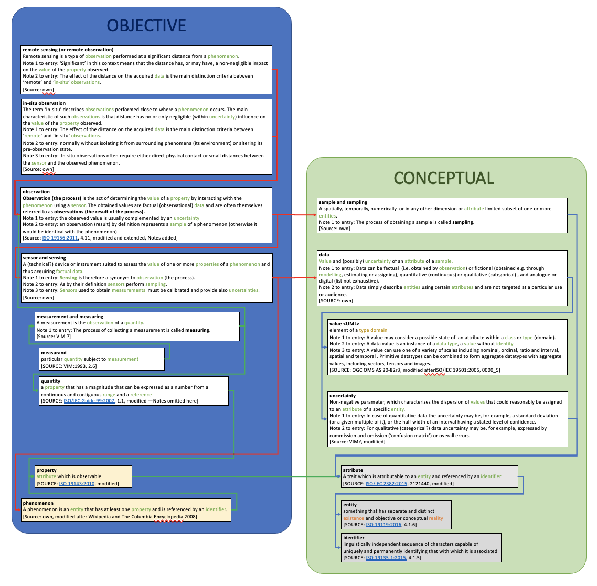
Hierarchy of terms
Build a hierarchy of terms that are reserved for the objective reality, like ‘observation’ or ‘measurements’
On these ‘base terms’ all other concepts should build.
E.g. what general types of observations exist?

Slide 16
Example of ‘high impact’ terms
ISO definitions for ‘remote sensing’ and ‘in situ’
Do not seem to be related in any sense

Slide 17
Example: “Remote sensing”
ISO
collection and interpretation of information about an object without being in physical contact with the object
NASA:
The technology of acquiring data and information about an object or phenomena by a device that is not in physical contact with it. In other words, remote sensing refers to gathering information about the Earth and its environment from a distance, a critical capability of the Earth Observing System. For example, spacecraft in low-Earth orbit pass through the outer thermosphere, enabling direct sampling of chemical species there. These samples have been used extensively to develop an understanding of thermospheric properties. Explorer-17, launched in 1963, was the first satellite to return quantitative measurements of gaseous stratification in the thermosphere. However, the mesosphere and lower layers cannot be probed directly in this way--global observations from space require remote sensing from a spacecraft at an altitude well above the mesopause. The formidable technological challenges of atmospheric remote sensing, many of which are now being overcome, have delayed detailed study of the stratosphere and mesosphere by comparison with thermospheric research advances. Some remote-sensing systems encountered in everyday life include the human eye and brain, and photographic and video cameras.
INSPIRE:
The FeatureOfInterest is a sampling feature which is also the ultimate FeatureOfInterest (i.e. the sampledFeature).
OGC:
Acquisition of raster images of the Earth, often involving spectral frequencies other than the visible band, by devices typically carried on airborne or satellite platforms. Sometimes refers also to image analysis of these images

Slide 18
Example: “In-situ”
ISO
direct measurement of the measurand in its original place
CEOS
direct measurement of the measurand in its original place
any sub-orbital measurement of the measurand
NASA:
Latin for 'in original place.' Refers to measurements made at the actual location of the object or material measured. Compare remote sensing.
INSPIRE:
The FeatureOfInterest is a sampling feature which is co-located with the ultimate FeatureOfInterest (i.e. the sampledFeature).
OGC:
Not available
No consistent spelling: in_situ, in-situ, in situ, in-Situ, insitu, …

Slide 19
Proposal for a solution
‘in-situ’ and ‘remote’ to be understood as contrary concepts of observations where ‘remote’ denotes the influence of distance on the observed value

Slide 20
Conclusion & way forward
Harmonised terminology is a pre-requisite and a major pillar for any interoperability effort
EO is a particular challenging domain due to its multi-disciplinarity
Current effort cannot be more than a pilot and demonstrator
Terminology is not stand-alone and needs to be linked with other interoperability efforts
Ideally as part of a comprehensive Interoperability Framework! (next presentation)

Slide 21
Thank you!
any questions?

