Slide 1
CEOS Interoperability Framework Initiative
Peter Strobl, EC-JRC
Matt Steventon, Symbioscomms
Agenda ID: 2022.10.05_16.20
WGISS-54/WGCV-51
Tokyo, Japan (JAXA)
3-7 October 2022

Slide 2
Executive Summary
An Interoperability Framework should help coordinate and streamline CEOS efforts
Support by LSI-VC and SIT decisions(Sep 2022)
Primarily now outreach
Involvement sought especially of WGISS ‘data interoperability and use interest group’
Any other contributors welcome

Slide 3
Why interoperability (and standards)?
From WGISS presenters guidelines (“WGISS-54 Presentation Template and Guidelines.pptx”)
Presenters should name their file using the following convention:
Agenda date/time and presentation title (e.g., 2022.10.04_10.00_WGISS Chair Report)
If an updated version is submitted, please do not change the file name.
From WGCV presenters guidelines (“2022_CEOS_WGCV-51_Template.pptx”)
Presenters should name their file using the following convention:
AgendaItemNumber_LastName_Subject_Version (e.g., 1.1_Kuze_WGCV-51_Welcome_v1)
Because they might make your life a little easier! 😉 … especially if you are supposed to deliver a file for a joint session

Slide 4
What is Interoperability?
Interoperability is the “ability of two or more systems or components to exchange information and to use the information that has been exchanged.”
ISO 25964 Thesauri and Interoperability with other Vocabularies (ISO 25964-2:2013)
Interoperability has several aspects with different requirements, e.g:
Exchange requires technical and organisational connectivity
Use requires common understanding and legal agreement
… and what exactly is ‘information’ btw?

Slide 5
Background
CEOS Analysis-Ready Data (CEOS-ARD) suite of specs aims at increasing the interoperability of Earth observation datasets.
CEOS-ARD is a first step on the interoperability spectrum :
From WGISS & LSI developed CEOS Interoperability Terminology Report (2020)

Slide 6
CEOS (LSI) ‘Interoperability Spectrum’
CEOS LSI-VC Vision:
Sensor Agnostic Land Surface Data from all Missions
Total Interoperability, straight from data providers – increased transparency and openness vs downstream efforts (e.g., GEE, Sinergise), for all users, and taking advantage of broad range of CEOS missions
Enable the use of complementary sensors to achieve a coherent single data stream to enable characterization of change on the Earth’s surface through time.
Harmonisation vs homogenisation?
Structural / Data Architecture
CEOS-ARD
Minimum Data Processing Level + Documented
Uncertainty measures
Consistent / Interoperable Metadata
MRI Framework and PFS parameters?
LSI-VC / CEOS-ARD OG
Interoperability Blocks / Activity Areas
Common References: Grids, DEM, GCP(?)
Discrete Global Grid System (DGGS)
Strobl / WGCV
Terminology / Semantics / Data Context
Strobl / Molch / Woolliams / WGCV
Formats / Syntactic / Data Language
COG / Cloud-enabling
WGISS
Accessibility / System / Data Presentation
STAC
Hanson / USGS
WGISS

Slide 7
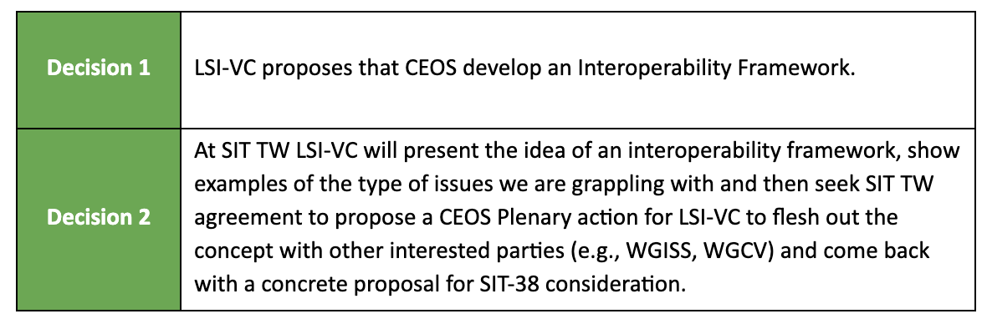
LSI-VC-12 Decisions

Slide 8
Why a framework?
Complex issues are best tackled by breaking them down to simpler and related sub-parts: “Separation of Concerns”
Sub-division should:
help to treat the issue comprehensively (no gaps) and efficiently (no overlaps)
be as much as possible independent from each other and with clear delineations and interfaces
have the right granularity to distribute the effort equally and assemble enough contributors

Slide 9
Why a framework?
Addressing the full scope of interoperability requires a framework that captures all aspects of the problem.
The following (non-exhaustive list) are equally important factors to consider, and each have a number of component pieces:
Structural / Data Architecture
Accessibility / System / Data Presentation
Formats / Syntactic / Data Language
Terminology / Semantics / Data Context
Factors and components are distributed across many CEOS groups (e.g., LSI-VC, WGISS, WGCV, etc.), and therefore a robust framework and coordination mechanisms are needed to address all of the necessary pieces.

Slide 10
(n)one fits all?
However, we are not acting in free space:
Interoperability is a major common concern in all modern societies
Interoperability has been extensively studied in areas ranging from public administration, to transportation, supply chains, health care and of course IT-systems
hierarchical models exist side by side with sequential and transversal approaches, certain elements are common, others differ
a few examples:

Slide 11
A bit of brainstorming…
Various (non-EO-specific) frameworks exist…

Slide 12
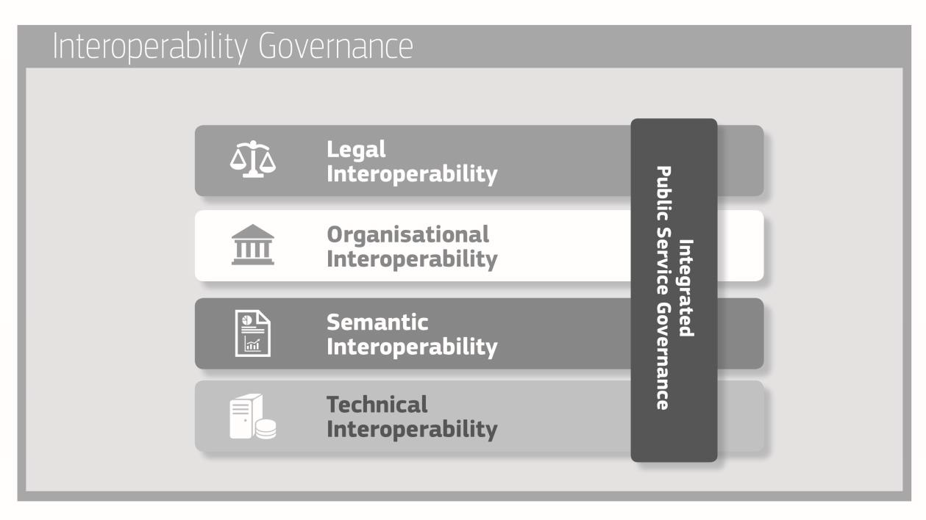
European Interoperability Framework
https://eur-lex.europa.eu/resource.html?uri=cellar:2c2f2554-0faf-11e7-8a35-01aa75ed71a1.0017.02/DOC_3&format=PDF

Slide 13
IF for Knowledge Management
Example from knowledge organisation (KO), https://www.isko.org/cyclo/interoperability

Slide 14
IF of the European Open Science Cloud
Legal interoperability* is about ensuring that organisations operating under different legal frameworks, policies and strategies are able to work together. This might require that legislation does not block the establishment of European public services within and between Member States and that there are clear agreements about how to deal with differences in legislation across borders, including the option of putting in place new legislation.
Organisational interoperability refers to the way in which organisations align their business processes, responsibilities and expectations to achieve commonly agreed and mutually beneficial goals (source: European Interoperability Framework).
Semantic Interoperability. It ensures that the precise format and meaning of exchanged data and information is preserved and understood throughout exchanges between parties, in other words ‘what is sent is what is understood’.*
Syntactic interoperability. If two or more systems use common data formats and communication protocols and are capable of communicating with each other using open standards (source: Interoperability - Wikipedia)
Technical interoperability. A characteristic of an Information Technology (IT) system, whose interfaces are completely understood, to work with other IT systems, at present or in the future, in either implementation or access, without any restrictions or with a controlled access (source: Interoperability - Wikipedia).
https://op.europa.eu/en/publication-detail/-/publication/d787ea54-6a87-11eb-aeb5-01aa75ed71a1/language-en
*https://joinup.ec.europa.eu/collection/nifo-national-interoperability-framework-observatory/glossary

Slide 15
… and a preliminary EO adaptation …

Slide 16
An early EO IF?
https://www.researchgate.net/publication/321385814_The_Six_Faces_of_the_Data_Cube

Slide 17
Faces 1-3
Parametrisation
Semantics
Quality metrics
Metadata
Discretisation
Digitisation
Binning (1D)
Gridding (2D)
Encoding
Formats
File systems
Databases
Tiling
Organisation
[some illustrations courtesy: R. Gibb; P. Baumann/rasdaman]
Notes:
Parameter: definitions such as ‘clouds’, land cover’, ‘spectral reflectance’, maybe also ‘Level 2’, or resolution classes (MR, HR, VHR), quality parameters etc.
Binary, continous, discontinuous, categorical,

Slide 18
Faces 4-6
IT Hardware (storage, proc. network)
Facilities (buildings, power, …)
Functionality:
Querying
I/O
Manipulation
Analysis
Visualisation
APIs
Standards
P. Strobl, P. Baumann, A. Lewis, Z. Szantoi, B. Killough, M. Purss, M. Craglia, S. Nativi, A. Held and T. Dhu, (2017), "The Six Faces of the Data Cube” BiDS’17, Toulouse (France), https://publications.europa.eu/en/publication-detail/-/publication/78a7f64a-d3ee-11e7-a5b9-01aa75ed71a1/language-en
Notes:
7

Slide 19
Thoughts on face 3 (organisation)
Interoperability of everything (data) with everything else is neither possible nor necessary
Interoperability requires communalities, i.e. a certain structure or organisation
For EO data that is traditionally the ‘CEOS Levels’
Raw Data
Level 0
Level 1
Level 2
Level 3
Level4
reconstructing
supplementing
reformatting calibration
correction
orthorectification
harmonisation resampling
modelling
fusion
?
Level-1
Interoperability
Analysis Ready Data
“AI Ready Data”
“Inference Ready Information”
inference
fusion

Slide 20
re-thinking CEOS Processing Levels
Processing Levels were so far defined as a more or less generic chain of refinement regarding the radiometry (or more general the 'measurand') and the geometry of the (satellite) observation data.
If one considers these two types of refinements separate, a matrix could be built in which classical Processing Levels would (roughly) appear as below:

Slide 21
A new Processing Level matrix
For the discussion of 'Analysis Readiness' of data, a clearer separation of these two 'dimensions' of processing yields a chance to obtain a transparent scheme in which also recommendations about best possible paths (processing sequences) are feasible. This would be advantageous for defining 'Analysis Ready Data' standards at different processing Levels and for their respective interoperability.

Slide 22
Thank you!
any questions?

