Slide 1
Status of CEOS-ARD Activities
Ferran Gascon, ESA
CEOS-ARD Oversight Group Lead
WGCV-WGISS Joint Meeting
Tokyo
5 October 2022

Slide 2
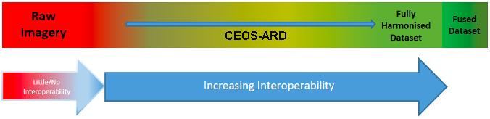
CEOS-ARD Vision / Motivation
Facilitate data usage by reducing data processing burden on users.
A future of sensor-agnostic Earth data.
Maximise the uptake and impact of all data sources for societal benefit.
CEOS-ARD is a key step within the ‘interoperability spectrum’:
From WGISS & LSI developed CEOS Interoperability Terminology Report (2020)

Slide 3

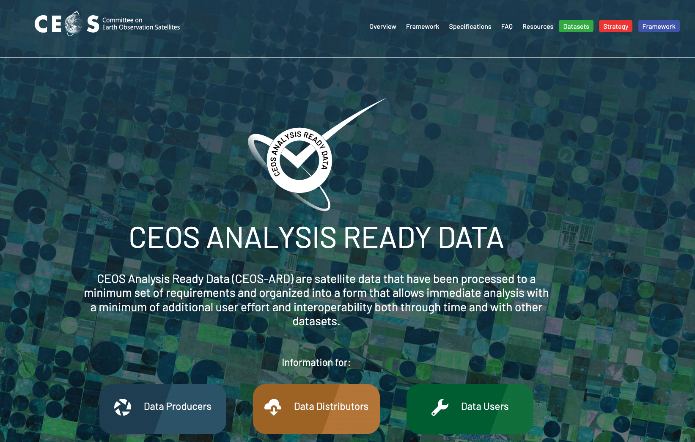
CEOS-ARD Compliance
Products assessed and compliant to CEOS-ARD specifications are known by the community to meet the high standards set by CEOS space agencies.
Compliant products can be branded as such with the CEOS-ARD logo, and will be listed on ceos.org/ard.
Assessments increase confidence and expand the reach and uptake of datasets.

Slide 4
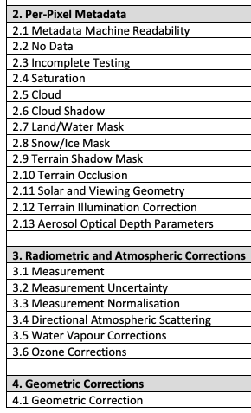
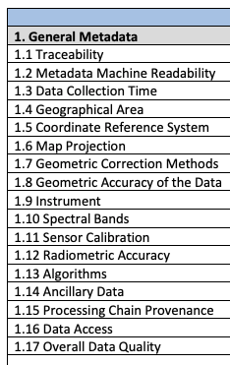
Product Family Specifications (PFS)
The CEOS-ARD Product Family Specifications (PFS) define parameters which facilitate interoperability
A subset of what is needed to achieve full interoperability

Slide 5
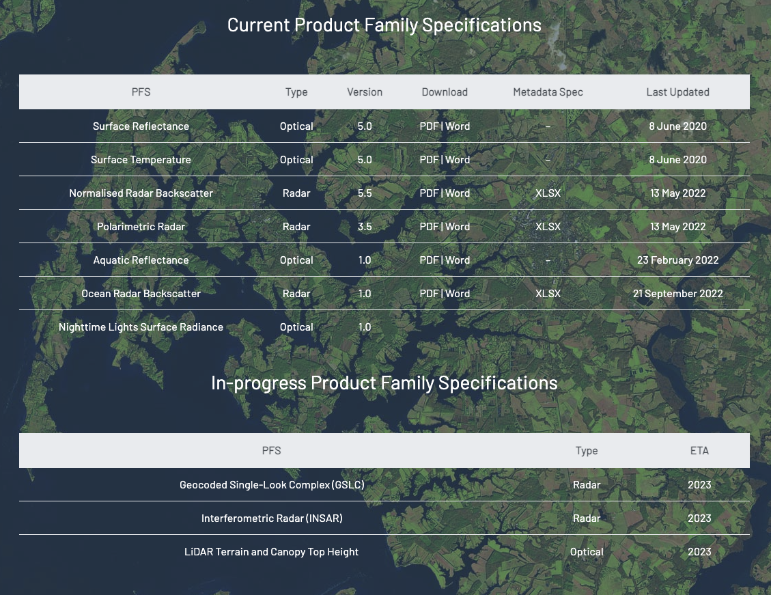
Current Product Family Specifications (PFS)
NEW!
Endorsed Sept. 2022

Slide 6
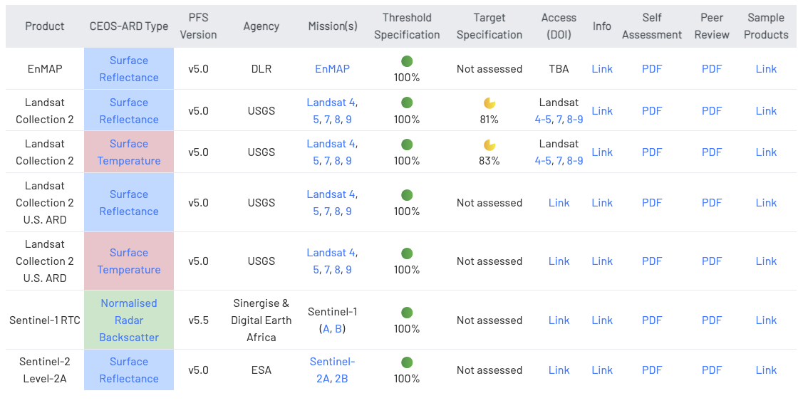
CEOS-ARD Products

Slide 7
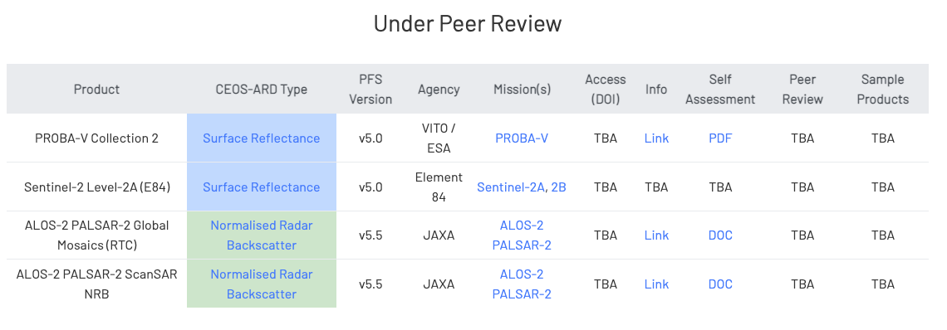
CEOS-ARD Products
Many more under development see: ceos.org/ard

Slide 8
CEOS Role in ARD
Much activity and talk in the community around ‘Analysis Ready Data’
CEOS, with its long heritage, experience and expertise has a key role to play in defining ARD for the community
  Incl. ‘New Space’
Led the way with Land Surface Imaging (by LSI-VC), while CEOS-ARD Oversight Group is now extending to other domains.

Slide 9
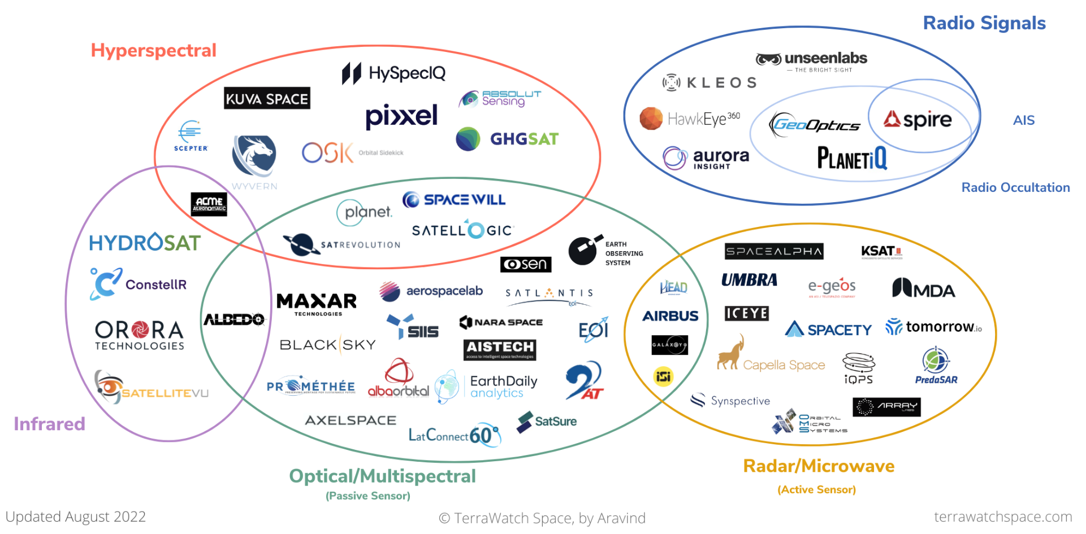

Slide 10
Motivations
Enabling interoperability of all these (+ CEOS!) datasets
  In an ‘open’ way, i.e., direct from the data providers – not relying on others downstream to do the interoperability steps
  Maximimise impact for all users, avoid platform dependency
  Avoid unsuitable downstream handling of data / different approaches
    Undermines idea of interoperability!
CEOS-ARD concepts are the first key step, but also need:
  Gridding
  Cloud-optimisation
  Discoverability (STAC)
  Consistent terminology
  Consistent radiometric & geometric references and traceability
➤ Critical role for WGCV & WGISS in CEOS Interoperability Framework

Slide 11
ARD Standards
Overwhelming feedback from industry: formal standards are needed for ‘ARD’
  Without a standard: difficult to implement CEOS-ARD into operational workflows and to ensure products interoperability.
  Government and commercial sectors will likely not reference documents unless they have gone through an open standard process.
  Standards built on the foundation of CEOS-ARD would be helpful
Increase reach of the concepts of CEOS-ARD

Slide 12
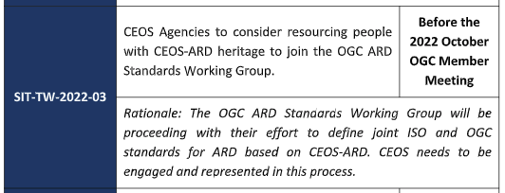
SIT TW Action re: ARD standards
OGC meeting this week
CEOS representation: …

Slide 13
WGCV & WGISS Support
Encourage reprocessing to CEOS-ARD for older missions
Participation in standardisation effort of ARD
  Ensure sufficient resources to engage
  CEOS-ARD as basis
Promote and support to commercial and new space sector to meet CEOS-ARD specifications
Seek to evolve CEOS datasets along the interoperability spectrum - working on the additional components needed:
  CEOS Interoperability Framework
  Data quality and Cal-Val
Continued support of CEOS-ARD Oversight Group and ARD activities

Slide 14
CEOS-ARD OG Members
Ferran Gascon (Lead) SIT Chair Team
Matthew Steventon Secretariat
Andreia Siqueira LSI-VC
Steve Labahn LSI-VC
Peter Strobl LSI-VC
Maycira Costa OCR-VC
Mark Higgins OST-VC
Ed Armstrong SST-VC
Chris Kidd P-VC
Medhavy Thankappan WGCV
Philippe Goryl WGCV
Makoto Natsuisaka WGISS
Jorge Del Rio Vera WGCapD
Thank you!!
Mailing list: ard-oversight-group@lists.ceos.org

Slide 15
Thanks!
Questions?

Slide 16
CEOS-ARD Oversight Group: Reference / Backup Slides

Slide 17
CEOS-ARD Oversight Group
Identified as a core component of the CEOS-ARD Governance Framework.
Act as a forum for all matters related to CEOS-ARD.
Representatives from the CEOS Virtual Constellations are integral to the effort going forward, as these are the CEOS entities with the technical expertise to recommend, develop and maintain Product Family Specifications.
Also provide:
  Strong coordination across CEOS
  Promote CEOS-ARD in a unified way

Slide 18
CEOS-ARD Oversight Group
Terms of Reference for CEOS-ARD OG Endorsed at SIT-37
Elaborates and clarifies the role of the group beyond what appears in the CEOS-ARD Governance Framework
Document here
Covers: Mission Statement, Scope of Activities, Membership and Leadership, Meetings

Slide 19
CEOS-ARD OG Activities
CEOS coordination on ARD
Maintenance of the CEOS-ARD Strategy and CEOS-ARD Governance Framework
Support and guidance to data providers
Coordination of CEOS-ARD Product Family Specifications (PFS)
Template PFS
Technical topics related to CEOS-ARD: accessibility and utilisation, data discovery mechanisms, data and metadata formats, STAC, pilots, etc.
CEOS-ARD representation to broader community
Coordination of outreach activities: webinars, conference representation, promotion and information resources (CEOS-ARD website, presentations, flyers/brochures, etc.)
Championing the ARD concept and providing guidance for the community
Primary external focal point for CEOS on matters related to ARD
Represent CEOS on matters related to the further standardisation of ARD in the wider community

Slide 20



Motivations
If using different starting points/Levels for data, and different platform specific approaches for interoperability, will we achieve true interoperability at all?
  Fragmented
  Will not maximise impact of EO for societal benefit
CEOS-ARD helps in providing a common starting point

Slide 21
‘New Space’ Engagement so far…
Increasing engagement with private sector/new space on CEOS-ARD
  Sinergise: Produced the first Normalised Radar Backscatter CEOS-ARD – Sentinel-1 RTC for Digital Earth Africa
  Satellogic: Presented to LSI-VC, will consider CEOS-ARD PFS, currently developing their Surface Reflectance product – potential for CEOS-ARD from outset
  Capella: Free SAR imagery via the Registry of Open Data on AWS, CEOS-ARD Oversight Group engaged with them on possibility of CEOS-ARD assessment of products.
Earlier CARD4L PFS dialogue w/ Planet, PCI Geomatics, and Maxar in 2020
All ad hoc, past relationships, engagement of opportunity, etc.
Proposed update of Commercial (incl. New Space) Engagement Strategy in LSI-VC – increase engagement coordination

