Slide 1
WGCV-51
Role of WGCV to provide guidance similar to CEOS-ARD for conducting self-assessment of Fiducial Reference Measurements
Philippe Goryl, ESA
Agenda Item 2.4
WGCV-51, Tokyo, Japan
3rd - 6th October 2022

Slide 2
Calibration and Validation
The calibration and validation (Cal/Val) activities are a key component of an EO mission, as it is the foundation for credibility for the mission data. Cal/Val activities require continuous efforts during and after the mission life time.
The Cal/Val activities have two main objectives:
to provide data products with documented and associated traceable uncertainty estimates;
to gain knowledge in the sensor performance and the algorithms characteristics in order to improve their quality and reliability.
The understanding of the uncertainties has a long term impact for most EO products and in particular for downstream and climate applications.

Slide 3
Calibration and Validation
A Calibration and Validation programme is composed of different complementary activities that need to be combined together to produce fully documented and consolidated performances.
In general terms the different Cal/Val components are as follows:
Inter-comparison against tailored and precise Fiducial Reference Measurements (FRM):
few points but precise;
Inter-comparisons against in-situ data: more points less precise;
Inter-comparisons against others sources: inter-satellite comparisons, mono-sensor L3, climatologies, etc.;
Inter-comparisons against models: data assimilation rejection statistics, integrated model analyses, forward modelling, etc.;
Inter-calibration between operational satellites (e.g. using GSICS best practises).
All the above components are important and necessary; the first component (FRM) is of particular importance because it gives a reference properly characterised and traceable to standards and/or community best practises on which the Cal/Val results can be anchored.
Cal/Val activities – Generic Approach

Slide 4
FRM – Generic definition
The defining mandatory characteristics for FRM are:
FRM measurements should ideally have documented SI traceability (e.g. via round-robin characterisation and regular pre-and post deployment calibration of instruments) using metrology standards and/or community recognised best practices;
FRM measurements are independent from the satellite geophysical retrieval process;
An uncertainty budget for all FRM instruments, and derived measurements, is available and maintained;
FRM measurement protocols, procedures and community-wide management practices (measurement, processing, archive, documents, etc.) are defined, published and adhered to by FRM instrument deployments;
FRM are accessible to other researchers allowing independent verification of processing systems;
FRM are required to determine the on-orbit uncertainty characteristics of satellite geophysical measurements via independent validation activities.

Slide 5
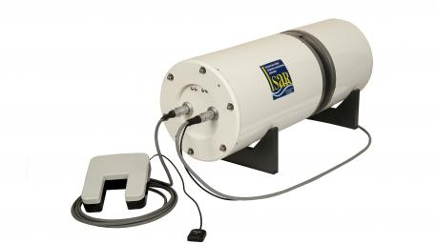
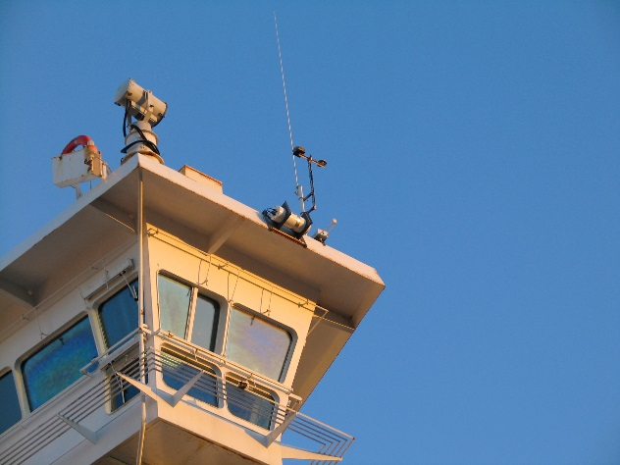
FRM – Historical example
Sea Surface Temperature accuracy
Sea Surface Temperature accuracy experiences from Envisat
High quality, calibrated, radiometer mimicking satellite measurements (http://www.isar.org.uk )
Follows well defined calibration and measurement protocols
traceable to National Metrology Institutes (NMIs): NPL (UK), NIST (USA)
Deployed as self-contained packages on ferries
Pride of Bilbao (Bay of Biscay and English Channel)

Slide 6
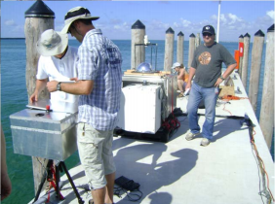
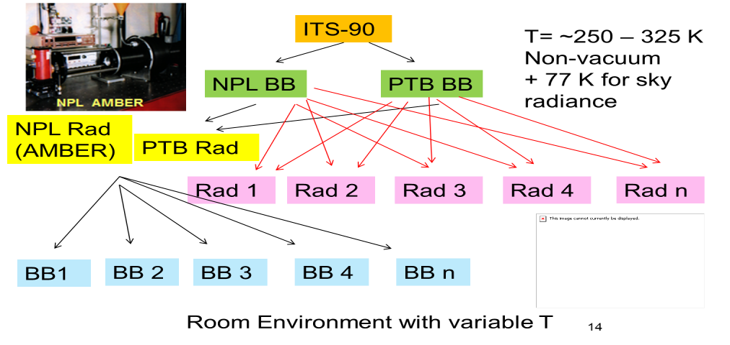
FRM – Historical example
Sea Surface and Land Temperature accuracy
→ Started with MIAMI experiment under CEOS auspice
→ Followed by FRM4STS
Sea Surface Temperature accuracy experiences from Envisat
High quality, calibrated, radiometer mimicking satellite measurements (http://www.isar.org.uk )
Follows well defined calibration and measurement protocols
traceable to National Metrology Institutes (NMIs): NPL (UK), NIST (USA)
Deployed as self-contained packages on ferries
Pride of Bilbao (Bay of Biscay and English Channel)

Slide 7
Question - Issues
There is a growing interest in FRM concept
improving the quality and knowledge of the measurements
QUESTION:
How do I know if my measurement is FRM compliant ? (question coming from various forum, including the CCVS project)
Who is “certifying” ?
Role of CEOS ?

Slide 8
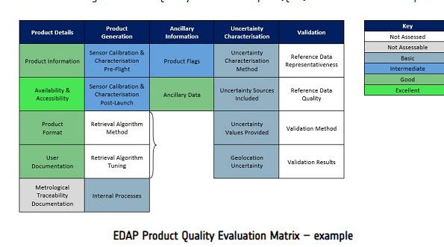
Proposition for discussion
CEOS WGCV is a natural place for coordinating
Approach can follow the ARD model
Self assessment
Check by a board from CEOS WGCV
Publication in CalVal portal
Open points:
Should allow some flexibility for not excluding/discouraging
Could be based on Maturity Matrix with Level (not binary)
Issue:
Resource
Other ???

