Slide 1
EO-AIM: EO Assurance and Integrity Monitoring
Agenda Item #2.2
WGCV-51, Tokyo, Japan
3rd - 6th October 2022

Slide 2
Background
Australia has announced its first National Satellite Program for Earth Observation, the SCR series of cal-val satellites
SCR will support improved characterisation and calibration of other satellites - making them fit for more uses more of the time
More broadly, Australia is proposing programmes to support improved data quality of the many smallsat missions expected in the coming decade
For maximum benefit, this would ideally be undertaken in cooperation with our CEOS partners and under a CEOS banner - benefiting from their extensive experience and supporting their individual commercial sector operators

Slide 3
Concept overview
EO AIM aims to improve confidence and trust in more EO data sources and to thereby provide increased commercial opportunities for New Space companies and associated societal benefit for many applications
EO AIM will provide access to legacy public cal-val ground sites and an automated open source toolkit to participating data providers to allow them to undertake routine checks on fundamental data quality measures
Frequent characterisation and reporting of these measures is assumed to foster improved trust in the data and its fitness for new purposes
Ideally we would integrate checks required by CEOS partners such that their qualification schemes (eg JACIE, EDAP) might be available as part of the process
This process would open new commercial opportunities to providers and enable them to participate in agency data buys etc
EO AIM seeks to mainstream application of regular cal-val to New Space missions and to provide free, open and transparent tools (as automated as possible) to incentivise uptake
Cal-Val as a service (CVAAS)
In an exploratory phase only – budget application in progress in Australia
Building on Australia’s strong heritage in the cal / val and data quality domains

Slide 4
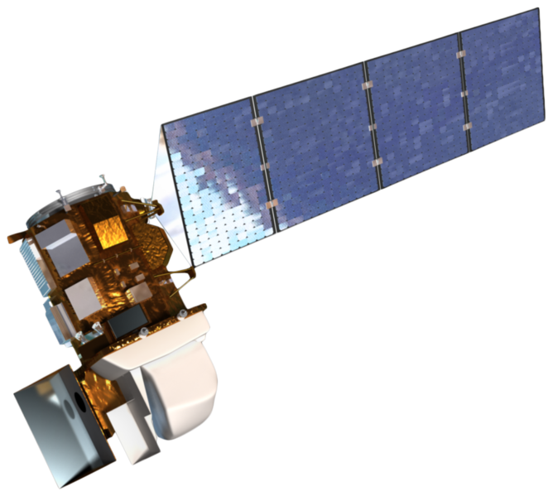
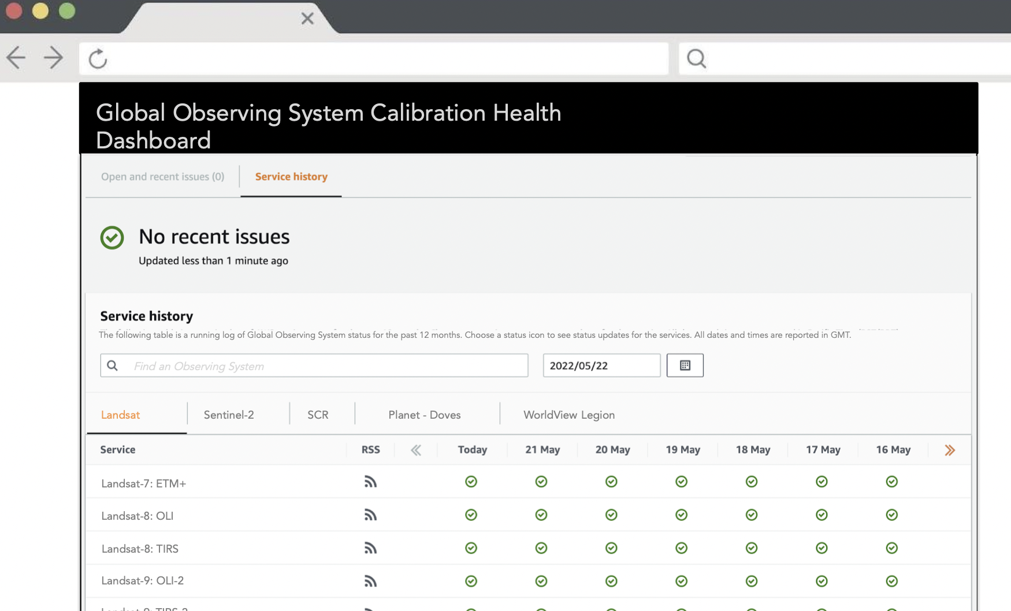
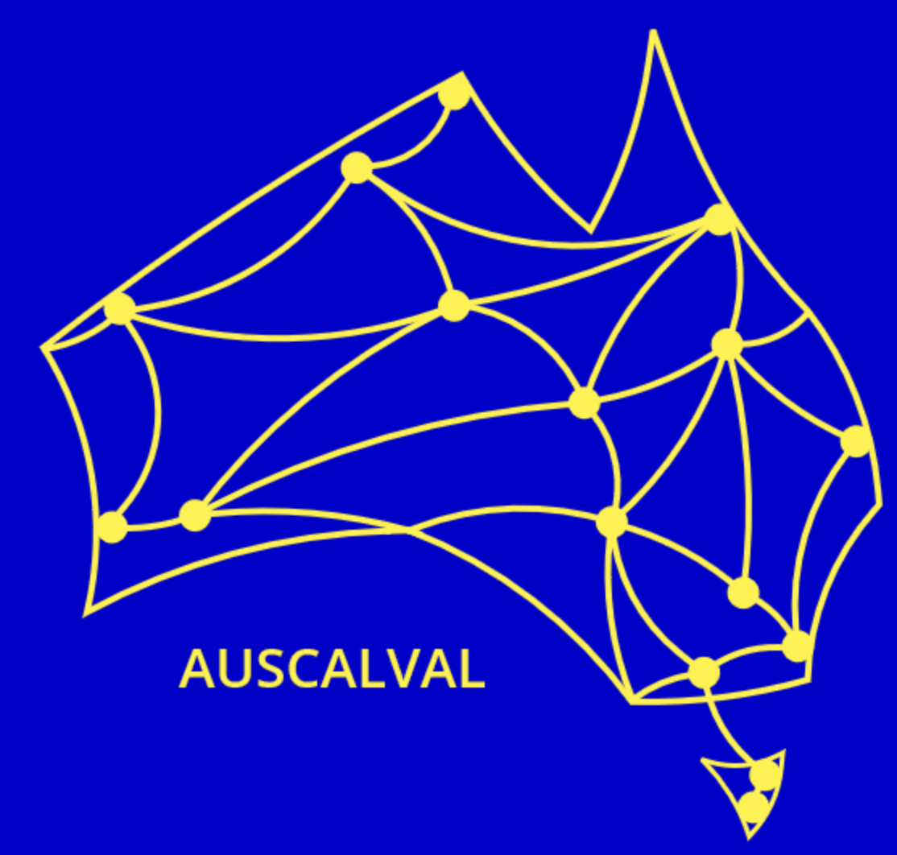
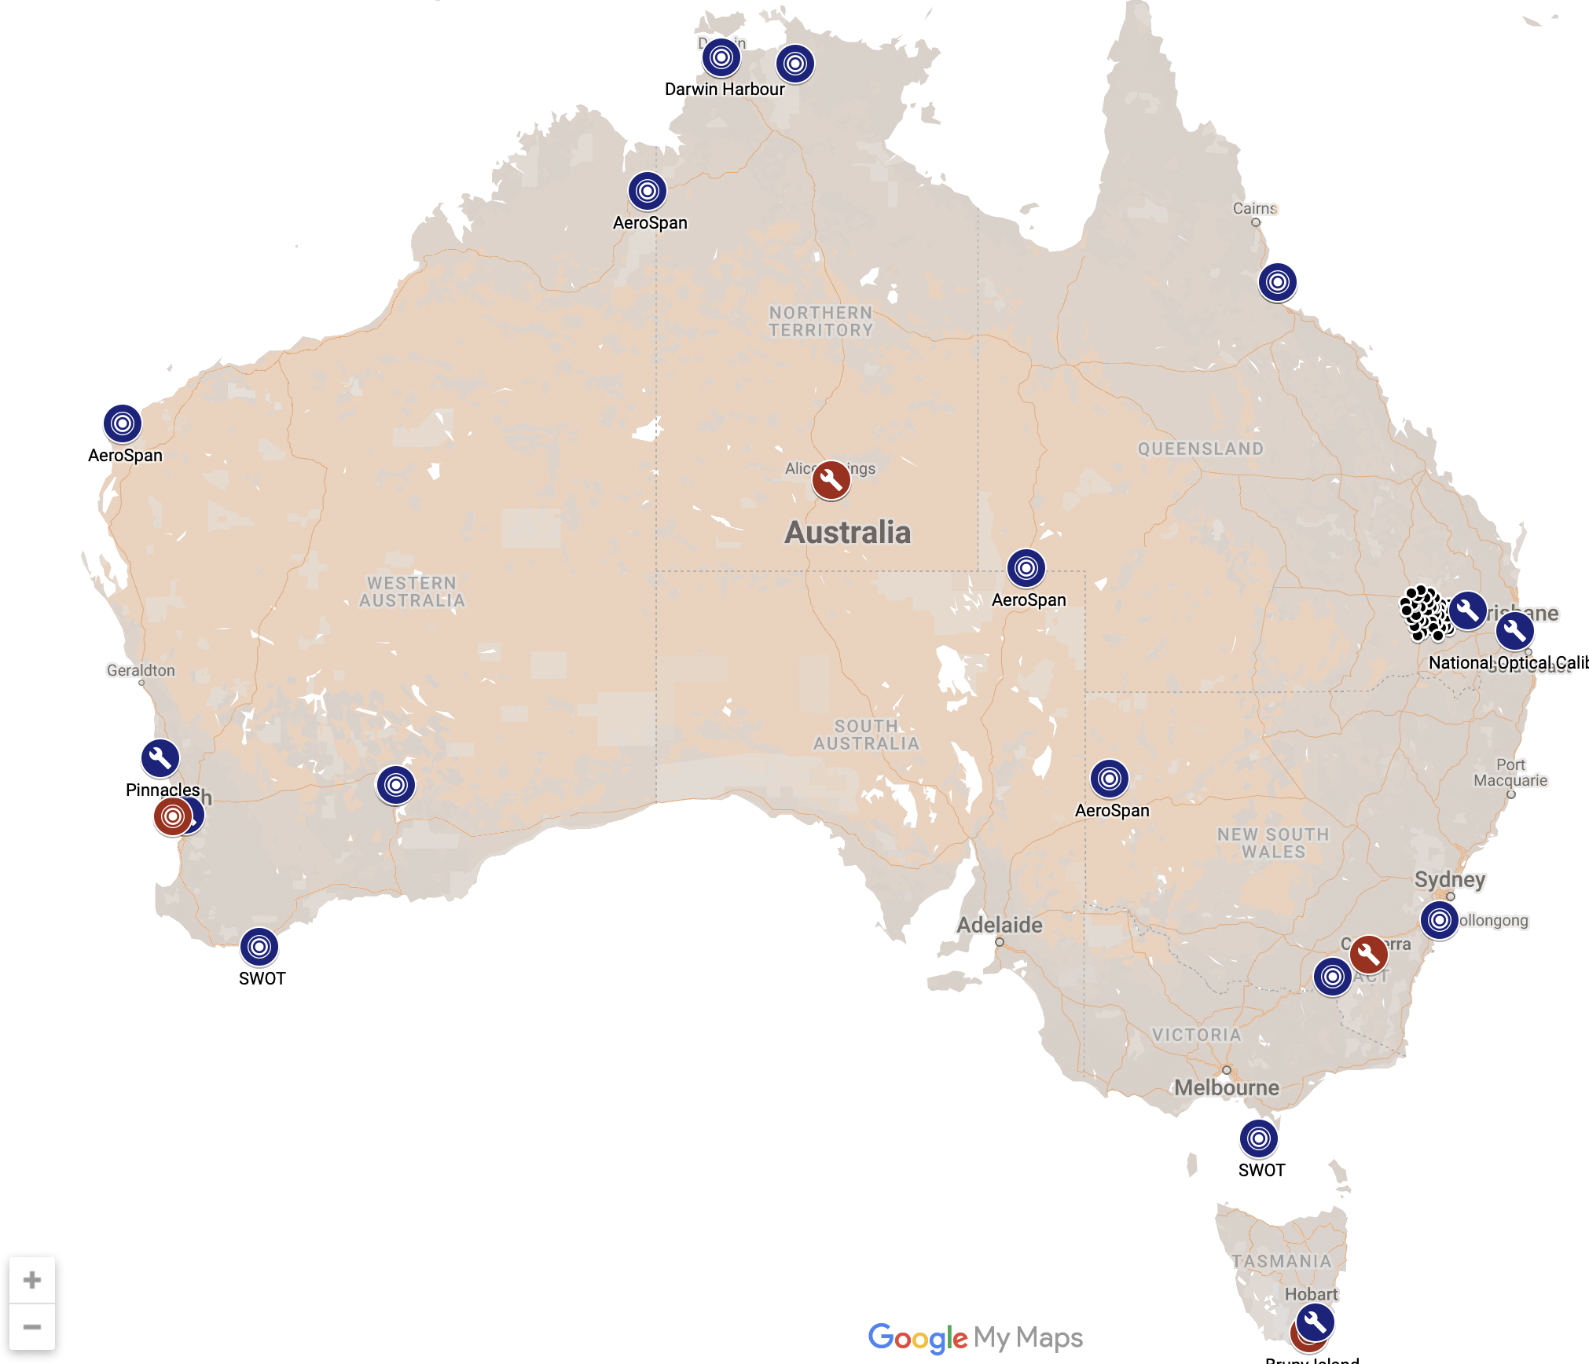
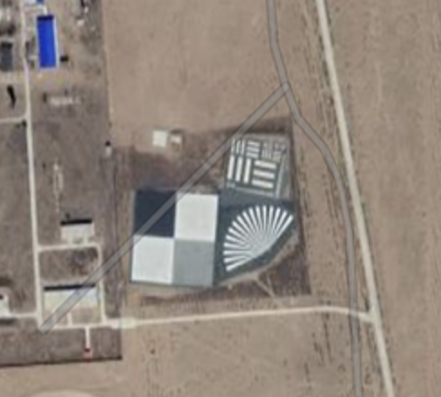
Concept Overview (Freemium model)
Marketplace of
commercial services
EO AIM
Cal-Val Sites
Satellite Systems Database & Assurance Dashboard
- Satellite characterisation
- Satellite Status
- Check history
- Performance against select thresholds
Access to Australian and CEOS Cal-Val Sites & Datasets
- Network of participating sites
- Range of calibration and validation infrastructure
Open Source Cal-Val Toolkit
- Mainstream & automate CVAAS
- Radiometric, Geometric, Spatial checks
- Results to data providers and optionally to the dashboard
- Indicates whether thresholds met for given applications or agency data buy
Operations Team
- On call engagement and support
- Coordination of facility providers

Slide 5
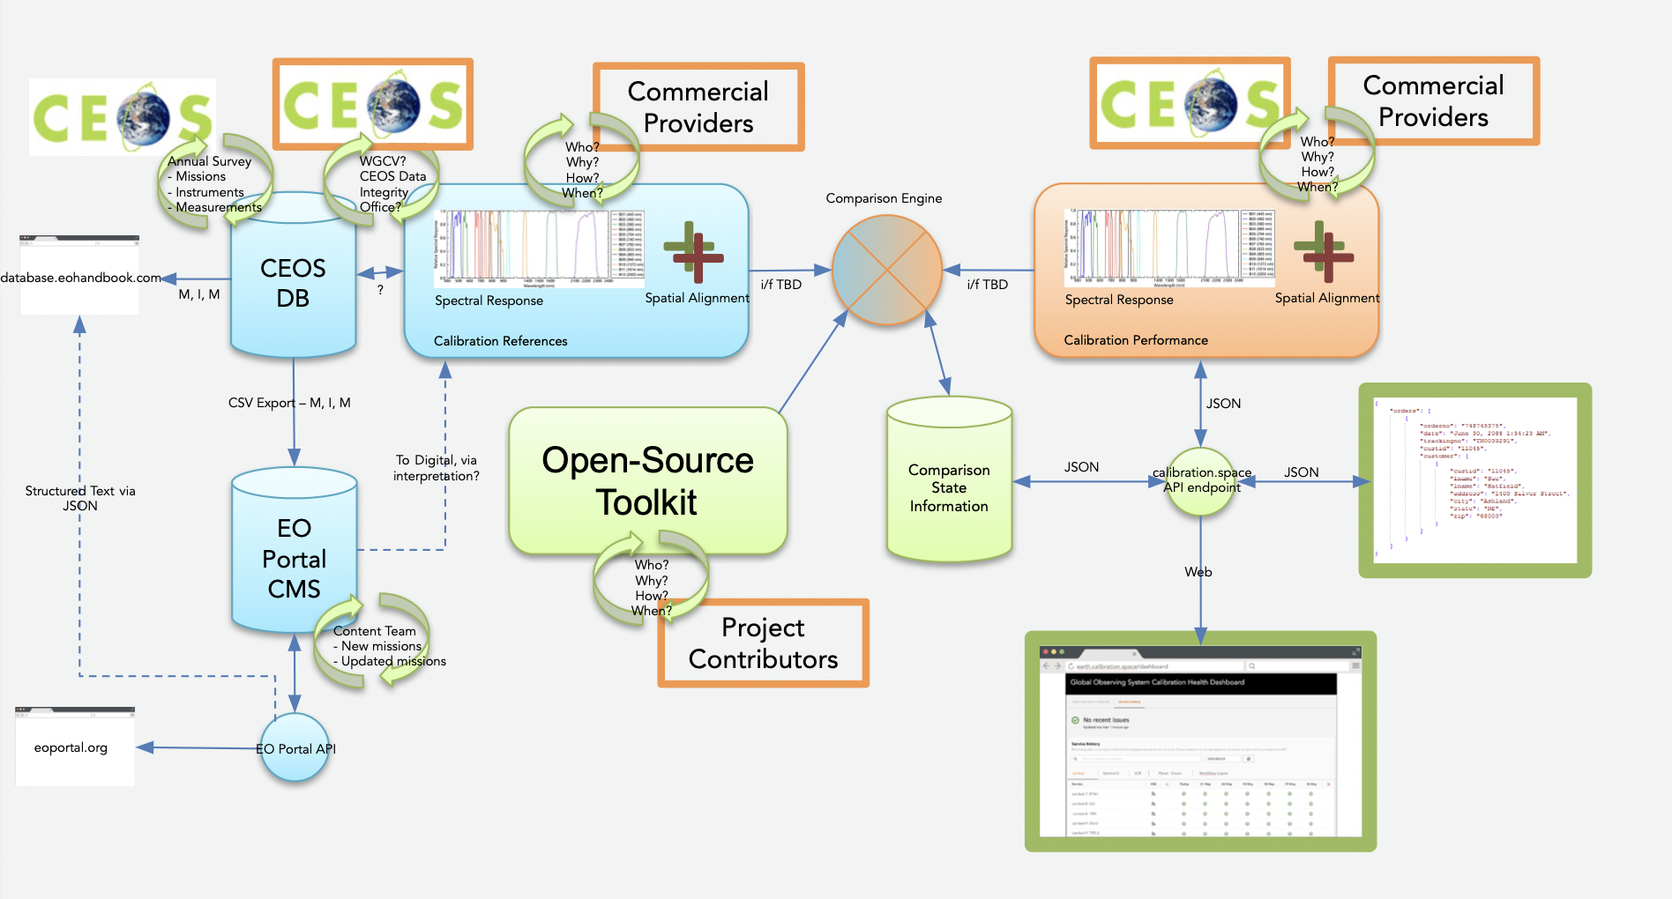
Concept Overview Draft v0 (to be revised)

Slide 6
EO AIM modules and functions
How will it work?
Characterising and naming the modules
Their functionality
Open-source toolkit
Metadata, Radiometric, Geometric, Spatial…
What exists for inclusion?
Whats feasible for automation?

Slide 7
Supporting the “New Space Future CEOS activity”
ESA SIT Chair is promoting initiatives to support consideration of significant sectoral changes and of New Space sector
Emphasis on societal benefits
Individual CEOS agencies are all reflecting on similar issues
Legacy cal-val infrastructure identified as a key tool for CEOS - supporting increased quality and application of smallsats
Australian team will aim to coordinate with SIT Chair Team and with WGCV to identify synergies and how best the EO AIM concept can support

Slide 8
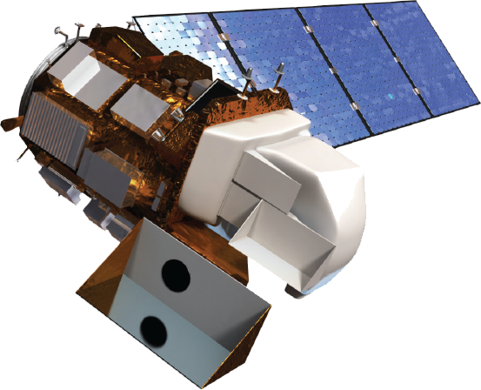
CEOS Agencies collaboration
Emphasising communication with data providers of targets for data utility and supporting their achievement and confirmation
CEOS Agencies
EO AIM
Satellite characterisation database and dashboard
Data characteristics and quality targets for opportunities eg specific ECVs, SDGs etc
Access to CEOS cal-val sites
US JACIE
ESA TPM etc
Open Source CalVal Toolkit
Data characteristics and quality targets for data buys
Satellite operators provided with guidance on possible space agency data buy and thematic observing gaps and required data characteristics associated with each
EO AIM offers opportunity for operators to test and prove their data meets required standards
Opens up data supply opportunities and participation
Long term impact on improved data quality and utility
SCR brings further support when available!

Slide 9
Discussion Questions
General feedback and suggestions
What functions should be at the core of EO AIM?
What type of checks and measurements are possible? Categories and details
What tools and systems are you aware of that could be an early building block for a CEOS approach?
QA4EO, EDAP, JACIE, EOSure…
documentation that we can consult and learn from?
How realistic is automation?
How real is the ‘so what?’ risk from industry?
Any stakeholders to speak to?

Slide 10
Inputs to follow up
Documentation
relevant EO QA schemes
calval toolkits
Contacts
Space agencies
QA specialist companies
EO data providers (IcEye, Planet, Satellogic, Axelspace…)

