Slide 1
The Development of CEOS SARCalNet Bruce Chapman and Dirk Geudtner Jet Propulsion Laboratory California Institute of Technology European Space Agency
CEOS WGCV - SAR Subgroup

Slide 2
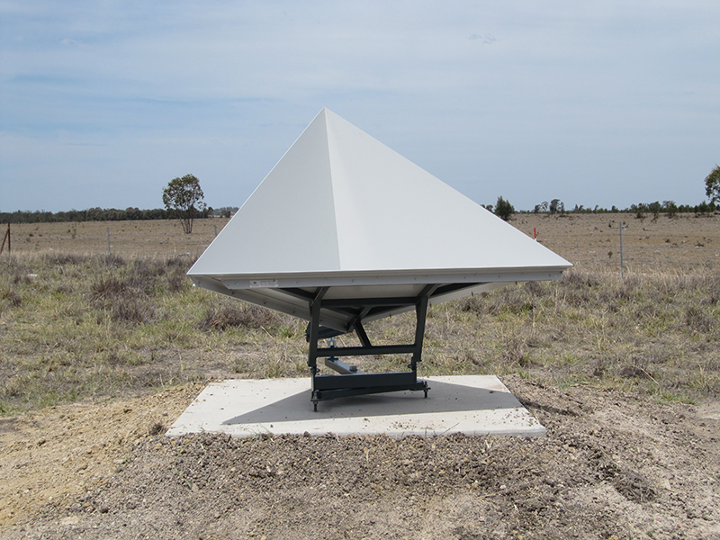
Introduction
SAR instruments need external calibration targets in order to calibrate imagery and for long term monitoring of image calibration stability
Currently, most missions design their own external targets, typically a combination of natural and artificial calibration targets
There is a strong desire by CEOS and the SAR community to have an established network of calibration sites that would facilitate collaboration between sensors by using the same calibration references.
Australian Geophysical Observing System

Slide 3
What is SARCalNet?
SARCalNet is an initiative of the SAR subgroup of the Working Group on Calibration and Validation (WGCV) of the Committee on Earth Observation Satellites (CEOS).
It is the next step in decades-long efforts to coordinate SAR multi-sensor Cal/Val.
SARCalNet, when fully implemented, will provide reliable, pre-defined information about SAR calibration targets, both natural and artificial, to facilitate joint calibration and performance evaluations as well as assist post-launch Cal/Val of any operating SAR sensor operating at typical SAR frequencies and polarizations.
When possible, SARCalNet will also provide access to the calibration data sets that were used to either calibrate or monitor calibration and performance of specific sensors.

Slide 4
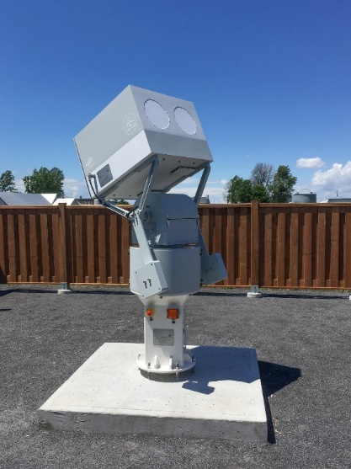
SARCalNet
Currently, the CEOS WGCV SAR subgroup hosts a target database
http://calvalportal.ceos.org/point-distributed-targets-db
However, while information is earnestly provided, the information on this site is lacking in some ways:
Natural targets
not curated
Regions are broadly specified, and sensor frame based
Incomplete
No reporting of image backscatter
Artificial targets
User submitted, but not curated
Can be out of date
Varying degrees of measurement specificity
Different measurement techniques and requirements
No reporting of RCS or background clutter
DLR Transponder

Slide 5
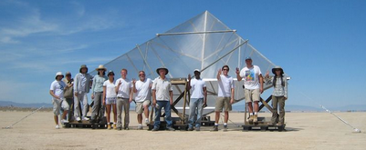
Making SARCalNet a reality
Establish requirements for inclusion in SARCalNet
Guidelines for artificial and natural targets
Recommended minimum analysis to facilitate intercomparison of results
Handbook that describes procedures
Curate the content
Submission protocols
Annual review
Annual summary report on SARCalNet
JPL P-band reflector 4.8 m at Rosamond Dry Lake

Slide 6
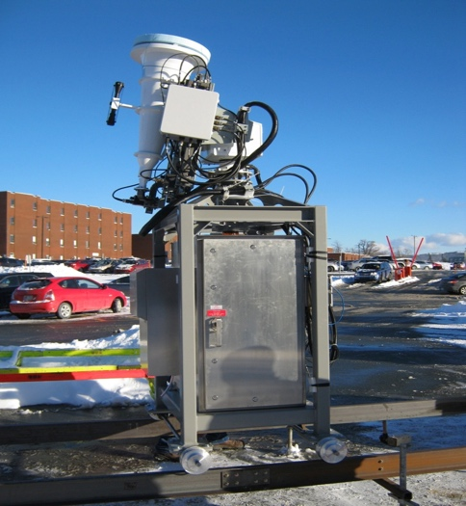
Current status of SARCalNet
For the past year, the CEOS WGCV SAR subgroup has been meeting regularly to write guiding requirements documents:
Requirements and guidelines for Artificial and Natural calibration targets
Guidelines for image calibration analysis
A handbook that describes how SARCalNet operates
Requirements for the web portal that will host SARCalNet
Writing committee:
Marc Thibeault (CONAE)
Muriel Pinheiro (ESA)
Shweta Sharma (ISRO)
Jens Reimann (DLR)
Dirk Geudtner (ESA)
Medhavy Thankappan (GA)
Ron Muellerschoen (NASA/JPL)
Matt Garthwaite (CSIRO)
Nuria Casal Vazquez (INTA)
Takeshi Motohka (JAXA)
Stephane Cote (CSA)
Juan Manuel Cuerda (INTA)
Patrick Klenk (DLR)
Michael Duersch (Capella)
Paolo Castracane (ESA)
Antonio Valentino (ESA)
Wang Yu (China)
Patricia Cifuentes Revenga (INTA)
Bruce Chapman (NASA/JPL)
ESA Transponder

Slide 7
Challenges for Coordinating SAR Cal/Val
Many SAR Cal/Val activities are associated with individual SAR projects and in particular with those needed during the commissioning phase of the instrument
Often this entails a large initial investment in resources
But – when the commissioning phase has completed, project resources often become more limited, and the calibration arrays may not have sufficient long-term support (such as that needed for monitoring long term SAR system performance)
SAR missions often build resources specifically designed for their instrument only
Support for multi-sensor or multi-agency Cal/Val is rare
Frequency and polarization diversity necessitate different standards and requirements for different missions.
Notes:
One of the longest operating and frequency diverse SAR calibration arrays is operated for airborne instruments

Slide 8
Recommendations:
Long-term support directly from the space agencies rather than the projects themselves for international SAR calibration arrays and their maintenance.
Coordination of regular multi-sensor and multi-agency calibration campaigns over the same natural and artificial target sites.
Freely sharing of all data and results from calibration sites through a single, reliable and long term data archive
ESA Sentinel-1

