Slide 1
WGCV-51
Land Product Validation
Sub Group
Michael Cosh, USDA
Fabrizio Niro, ESA
Agenda Item 1.6
WGCV-51, Tokyo, Japan
3rd - 6th October 2022

Slide 2
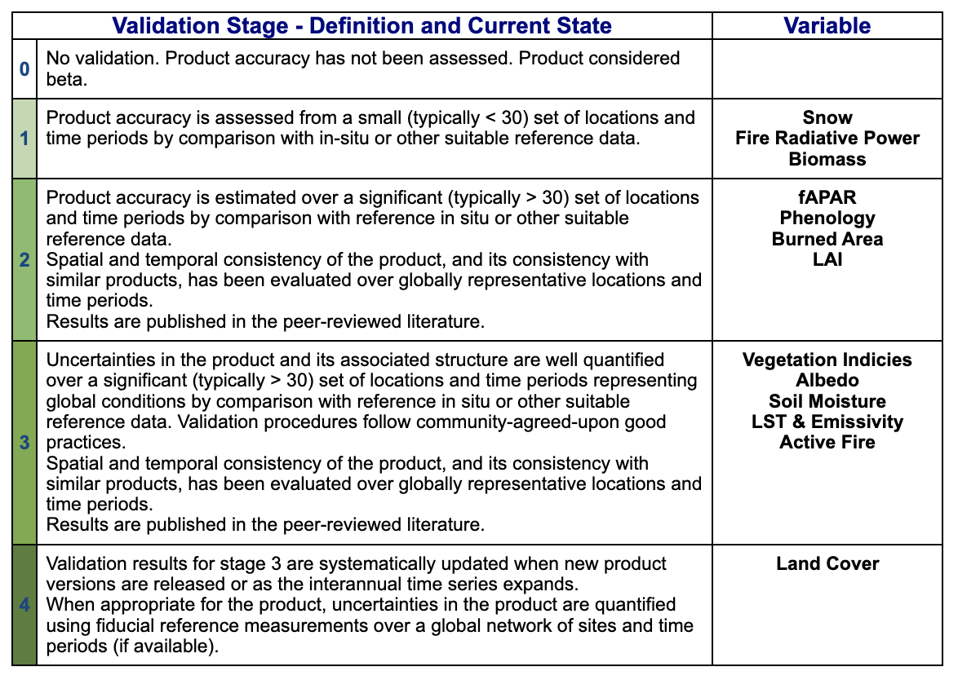
Validation Stages

Slide 3
Protocols Progress
Focus Area | Protocol
Biophysical | LAI(2014)
Fire/Burn Area | Targeting summer 2023
Phenology | Targeting summer 2023
Vegetation Index | Targeting summer 2023
Land Cover | Targeting spring 2023
Snow Cover
Surface Radiation | Albedo(2019)
Soil Moisture | SM(2020)
LST and Emissivity | LST (2019)
Aboveground Biomass | AGWB(2021)

Slide 4
Focus Area Leads
 | First Name | Last Name | Institution | Location | End of Term
Main | Michael | Cosh | USDA | USA | Apr 2025 (final)
Main | Fabrizio | Niro | ESA | Italy | Apr 2025(promotion to Chair)
Main | Jaime | Nickeson | GSFC | USA | never
Land Cover | Alexandra | Tyukavina | University of Maryland | USA | March 2024 (1st term)
Land Cover | Sophie | Bontemps | Université Catholique de Louvain | Belgium | Oct 2023 (2nd term)
Biophysical | Marie | Weiss | INRA | France | Sep 2023 (2nd term)
Biophysical | Sylvain | Leblanc | Natural Resources Canada | Canada | Sept 2023 (2nd term)
Biophysical | Hongliang | Fang | CAS | China | Dec 2022 (2nd term)
Fire/Burn Area | Louis | Giglio | University of Maryland | USA | Sep 2023 (1st term)
Fire/Burn Are | Gareth | Roberts | University of Southampton | UK | Dec 2022 (2nd term)
Surface Rad | Zhuosen | Wang | UMD/GSFC | USA | Dec 2022 (2nd term)
Surface Rad | Dominique | Carrer | Météo-France | France | Sept 2022 (1.5 term)
Soil Moisture | John | Bolten | NASA GSFC | USA | Apr 2023 (1st term)
Soil Moisture | Carsten | Montzka | Jülich Research Centre | Germany | Sept 2023 (2nd term)
LST | Glynn | Hulley | NASA/JPL | USA | July 2024 (2nd term)
LST | Frank | Goettsche | Karlsruhe Institute of Technology | Germany | Dec 2022 (2nd term)
Phenology | Joshua | Gray | North Carolina State University | USA | Jan 2025 (2nd term)
Phenology | Victor | Rodríguez-Galiano | University of Seville | Spain | Aug 2025 (2nd term)
Snow Cover | Simon | Gascon | cesbio | France | May 2023 (1st term)
Snow Cover | Chris | Crawford | USGS | USA | May 2023 (1st term)
Veg Index | Tomoaki | Miura | University of Hawai'i | USA | Dec 2022 (2nd term)
Veg Index | Else | Swinnen | VITO | Belgium | Apr 2023 (2nd term)
Biomass | Laura | Duncanson | UMD/GSFC | USA | Dec 2022 (2nd term)
Biomass | John | Armston | UMD/GSFC | USA | Dec 2022 (2nd term)
Biomass | Mat | Disney | UCL | UK | Dec 2022 (2nd term)

Slide 5
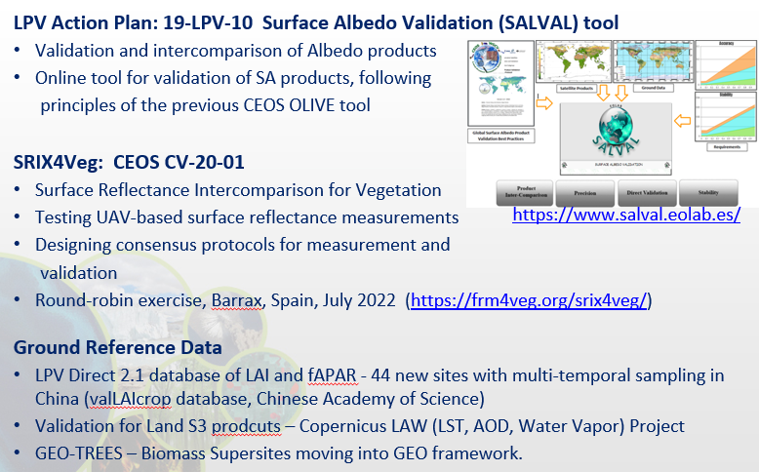
SALVAL

Slide 6

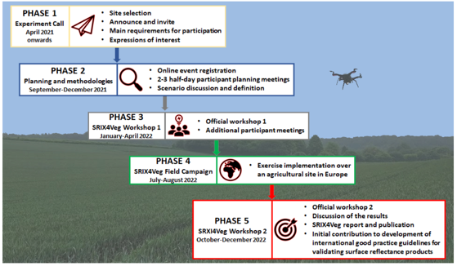
SRIX4Veg: Context, Motivations and Objectives
Context
SRIX4Veg represents a joint effort to ensure consensus on Surface Reflectance (SR) validation protocols using drones
It has been endorsed by CEOS and conducted in the framework of ESA FRM4Veg project
Motivations
Growing interest in UAV-based optical sensors for SR Cal/Val
UAV provide flexible and cost-effective solution for SR Cal/Val: cover greater areas, survey of inaccessible sites, complement in-situ infrastructure, enhanced spatial sampling
However, protocols around this are yet to be developed and lots of people are developing different procedures
Objective
Contribute towards defining global community-agreed guidelines, protocols and procedures for UAV-based SR product validation
https://frm4veg.org/srix4veg/

Slide 7
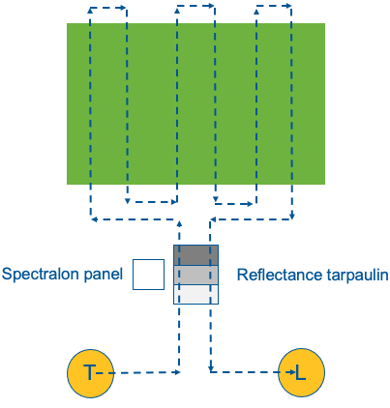
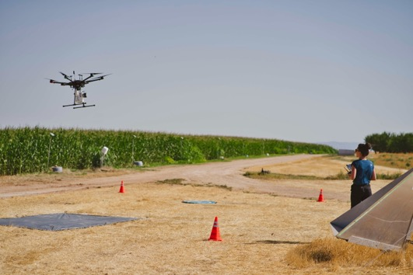
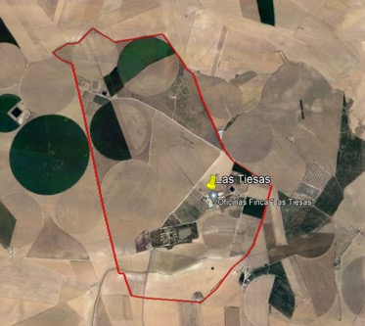
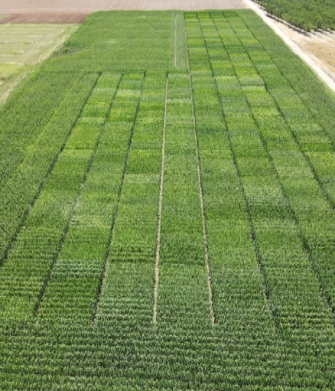
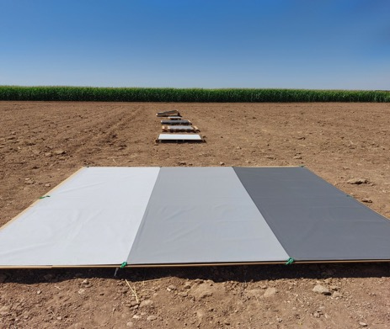
SRIX4Veg intercomparison excercise
(18-22 July 2022, Barrax, Spain)
7 teams from EU, Canada, US; 52 UAV flights in total
Different UAV-based hyper- and multi-spectral sensors in VNIR/SWIR range + ground based : ASD FieldSpec, reflectance panels, GPS base station, Microtops for AOT
Round-robin: each participant flew back-to-back with every other in turn, common flight plan, pairwise comparison
Participants
Corn field
(250 m x 250 m)
Reflectance panels
Flight Plan

Slide 8
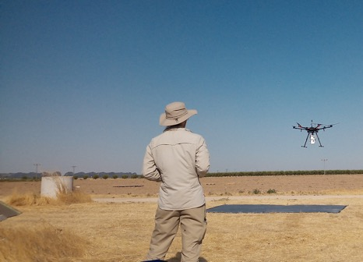
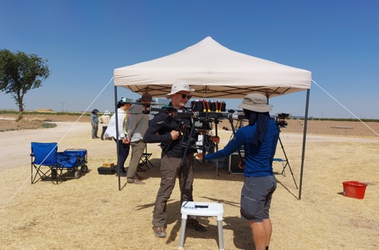
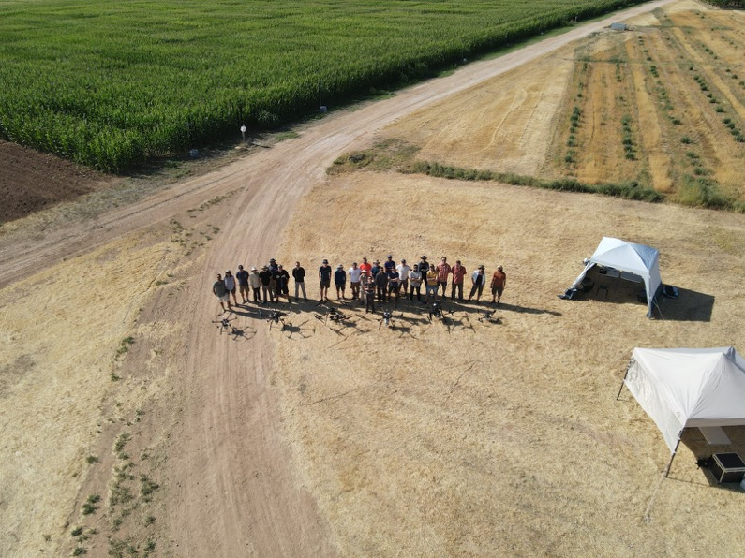
SRIX4Veg status and way forward
Status and Plans
Processing UAV data on-going; after gathering the results, comparison over integrated spectral bands matching S2 will be undertaken
Variability among results will be analysed and discussed in a WS planned in Q1 2023
Inter-comparison results will be published in a peer-reviewed journal (Q2 2023)
Best practices protocol for UAV-based SR product validation will be prepared and agreed; first version expected in Q2 2023 for endorsement by CEOS
Outlook
Plans to perform new campaign and repeat the inter-comparison exercise in different site, dialogue on-going at international level

Slide 9
Second Biomass Retrieval Inter-comparison eXperiment (BRIX-2) - Overview
Co-lead by ESA (Clement Albinet), NASA-JPL (Marco Lavalle) and university of Maryland (Laura Duncanson)
Overview:
Intercomparison of biomass algorithms based on a test dataset, and comparison with ground-truth (representative of BIOMASS, NISAR and GEDI mission data).
Use of the ESA-NASA joint-MAAP.
18 teams were originally participating (12 teams on ESA element, 6 teams on NASA element).

Slide 10
Second Biomass Retrieval Inter-comparison eXperiment (BRIX-2) - Approach and datasets
Participants shall generate a biomass map and an uncertainty map within a given geographic bounding box using a pre-determined BRIX-2 dataset that includes radar, lidar and field data.
Participants are not requested to use all datasets.
Data that has been acquired during the ESA-NASA AfriSAR campaign in Gabon.
Additional relevant data is to be considered.

Slide 11

Second Biomass Retrieval Inter-comparison eXperiment (BRIX-2)
Status:
The participants are currently integrating/developing their biomass retrieval algorithms on the MAAP.
Joint-paper in preparation.
Since the beginning, 2 new teams joined the exercise.
The deadline for results submission was extended from December 2021 to October 2022 (and could be further extended).
The exercise being best-effort, it is difficult to keep the participants involved.
Today, only half a dozen of teams are still active.
3 to 6 contributions are expected at the end.
BRIX-2:
http://polinsar-biomass2021.esa.int/brix-2/

Slide 12
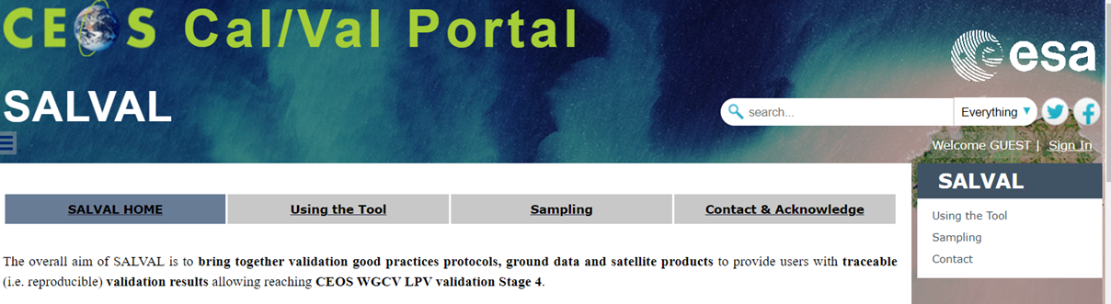
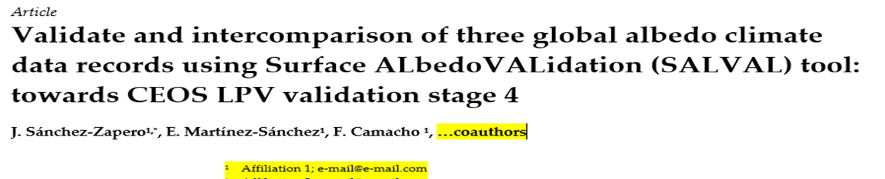
Surface Radiation
•Surface Albedo Validation tool (SALVAL) published in the CEOS CAL/VAL portal
•A draft article on Albedo validation using SALVAL is in internal review
12

Slide 13
Land Surface Phenology
New Validation & Intercomparison Initiatives
    Intercomparison between the Copernicus product “Vegetation Phenology and Productivity Parameters” and the following “new” ground observational networks in Southern Europe:
      The phenological network of the meteorological survey of Spain (AEMET)
      The phenological network of France (INRAE)
Recent Accomplishments
Special sessions in conferences
  New Developments and Applications of Land Surface Phenology (LSP) (A3.2). 44th COSPAR Scientific Assembly 2022. Main organizers: Jadu Dash and Victor Rodriguez-Galiano
Conferences on phenology
  PHENOLOGY 2022 - Phenology at the crossroads - Avignon, France - 20 - 24 June 2022
    Keynote: Land surface phenology as indicator of global terrestrial ecosystem dynamics. Victor Rodriguez-Galiano
Progress on CEOS LPV LSP Protocol
  Most chapters now have leads, uneven but tangible progress across the chapters
13

Slide 14
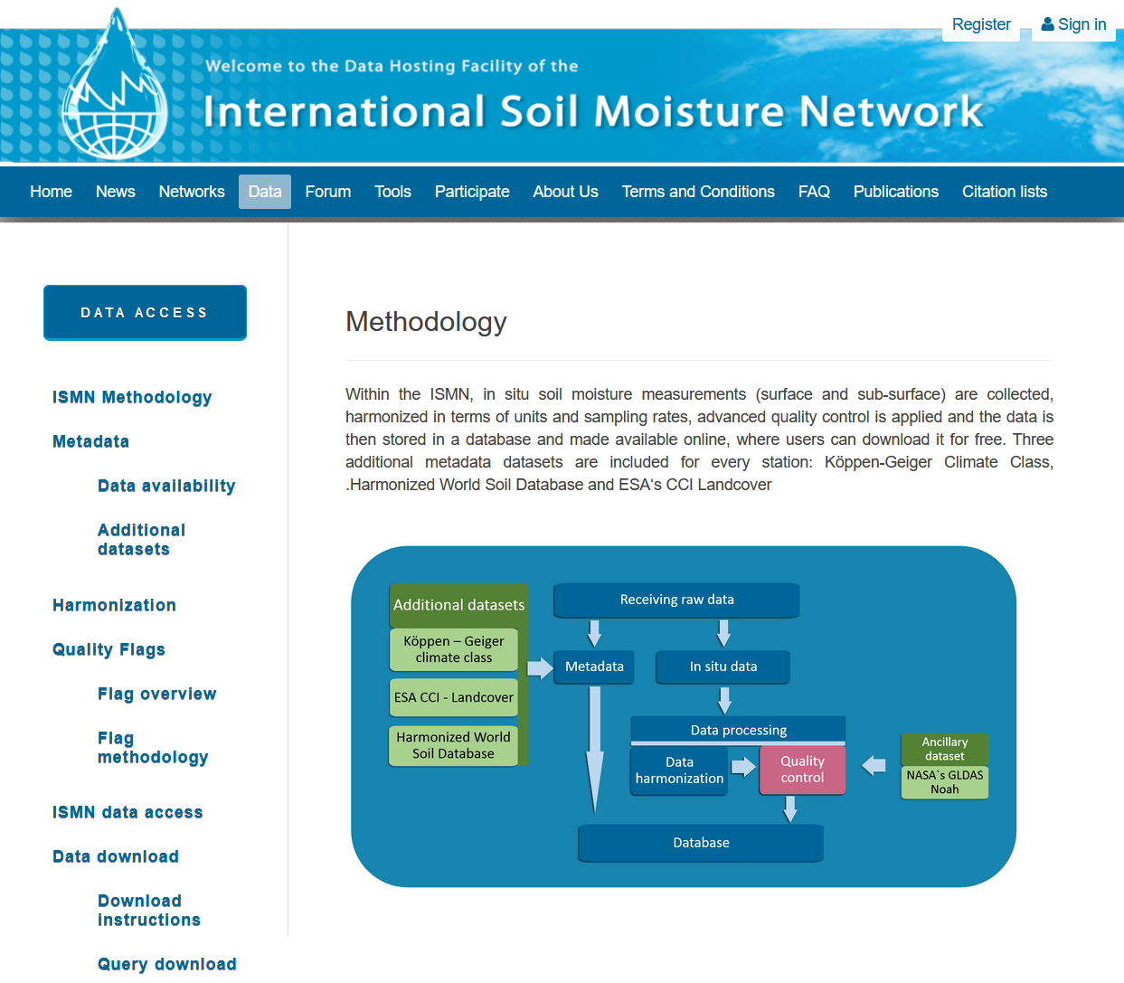
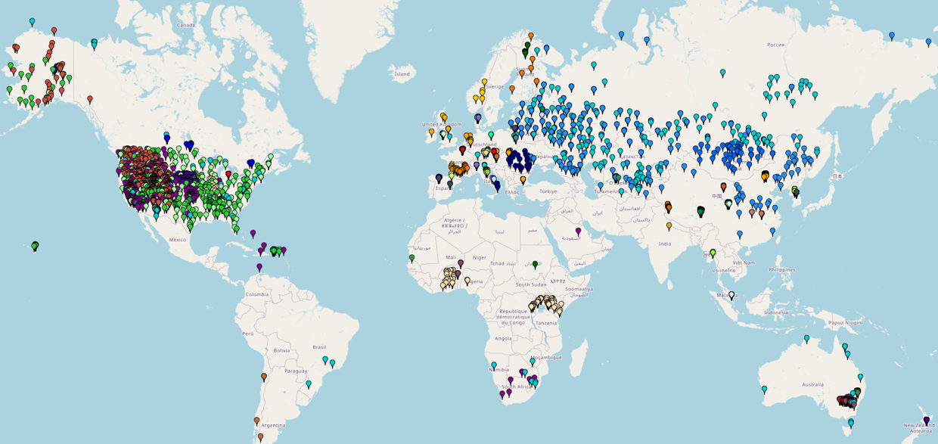
Soil Moisture: The ISMN
Long-term service ensured
14

Slide 15
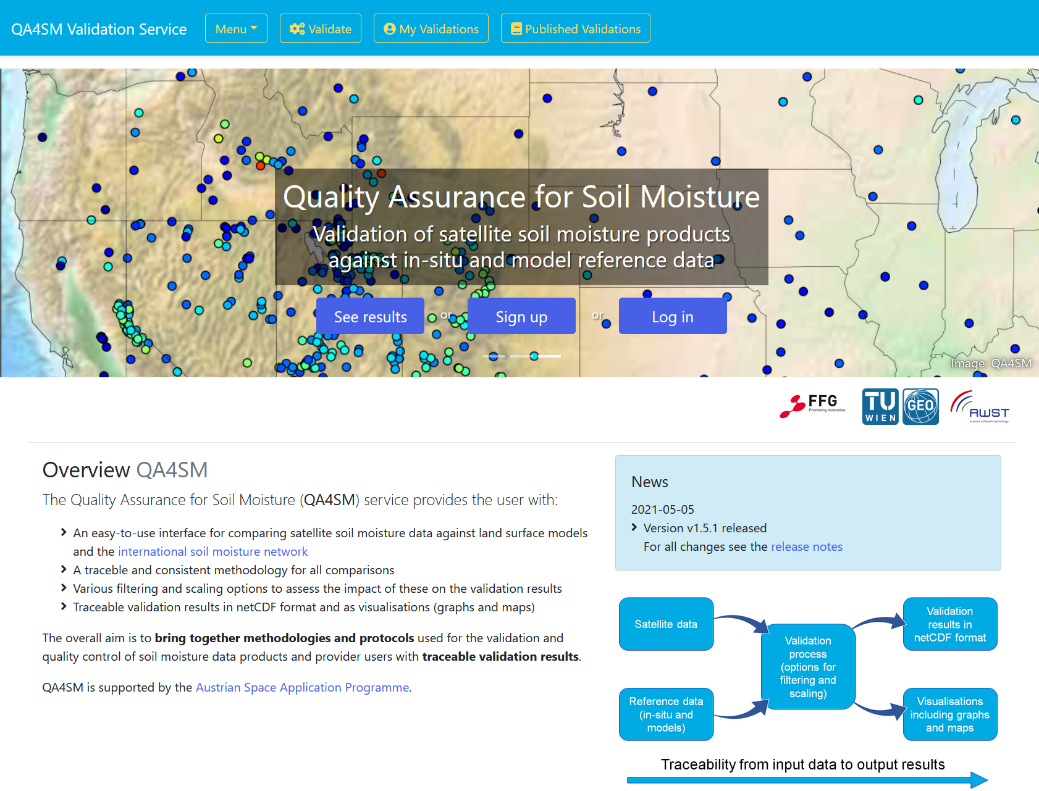
SM: QA4SM – An online validation tool

Slide 16
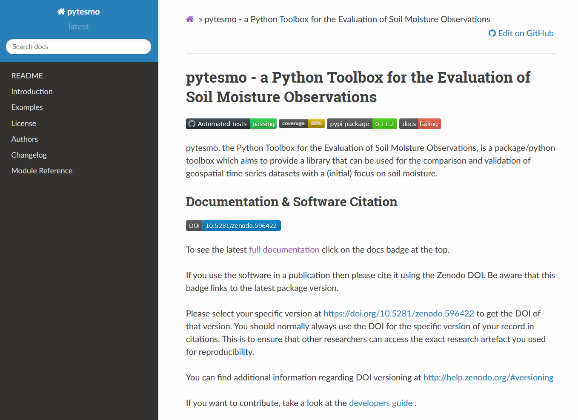
SM: Python validation toolbox

Slide 17
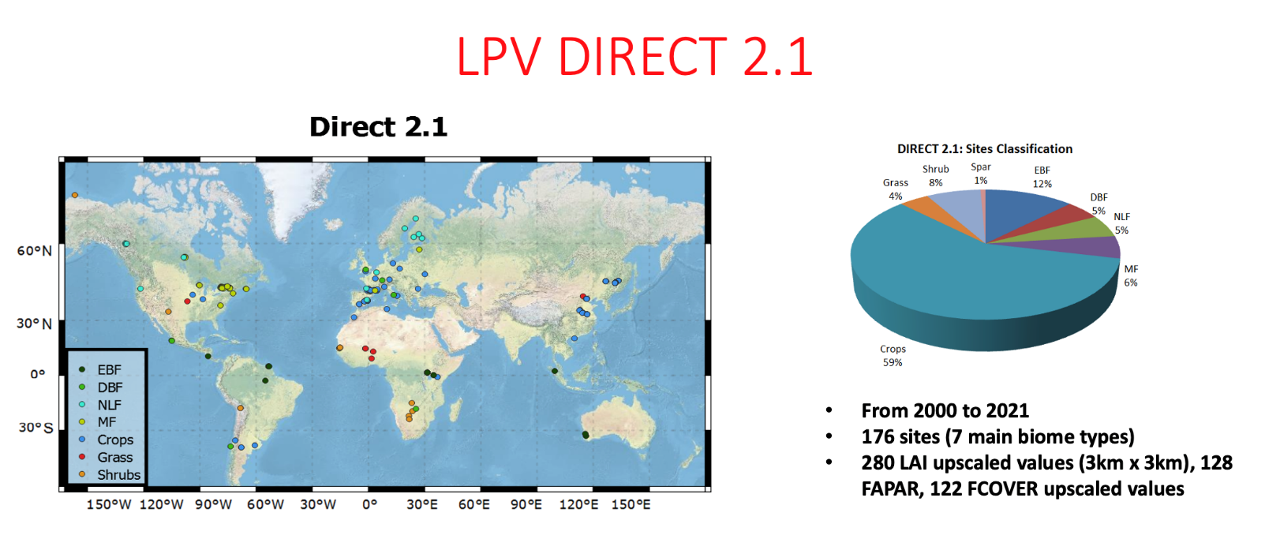
Biophysical: DIRECT 2.1
Updated CEOS DIRECT 2.1 database (new sites from Asia & FRM4VEG)
  NECC: Field and upscaled biophysical data (from HJ-1, L7/L8 & S2) for 2 sites (30 ESUs) in NE China crops (LAI, CI, FAPAR, and FVC), 2012-13, 2016, 2019.
  ValLAI_Crop: LAI field destructive measurment over 5 crops sites (1010 ESUs) in China, 2003-2017 (https://doi.org/10.5281/zenodo.5091251).
  ValLAI_Crop: Corresponding 80 upscaled reference data (3 km * 3 km, from Landsat) (http://www.nature.com/articles/s41597-021-01024-4)
https://calvalportal.ceos.org/lpv-direct-v2.1
17

Slide 18
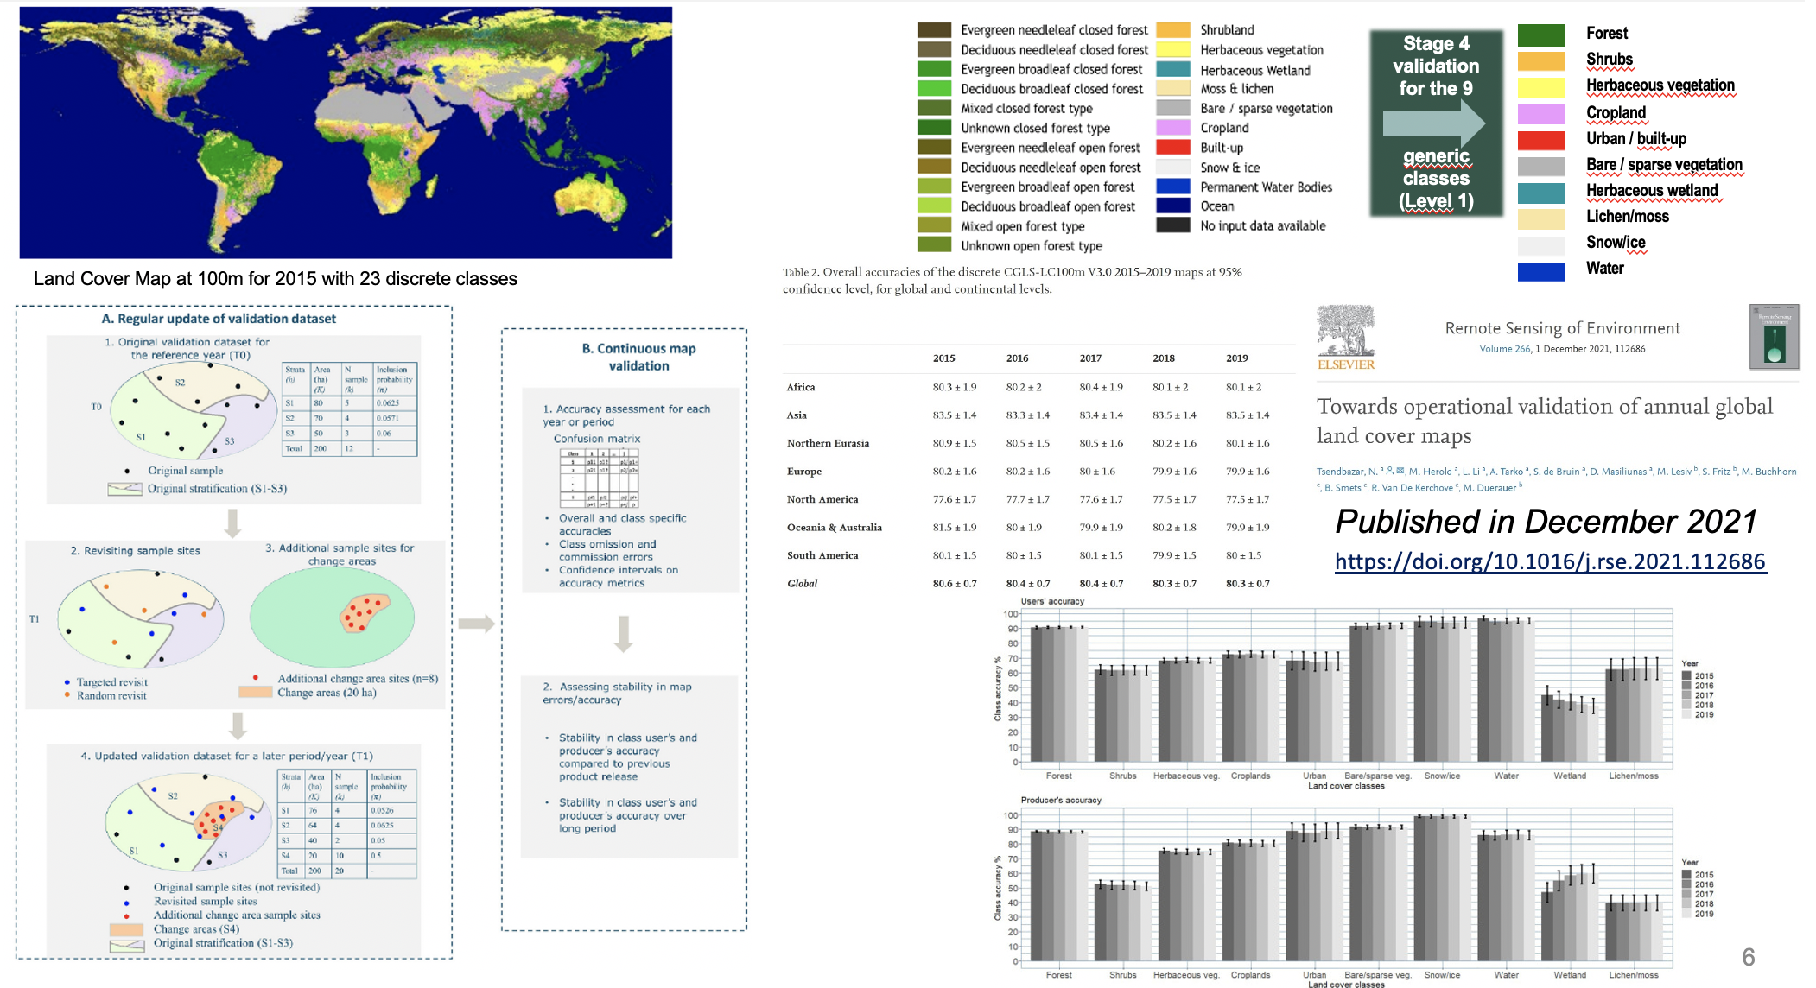
LC: Validation Stage 4 of Copernicus Land Cover product

Slide 19
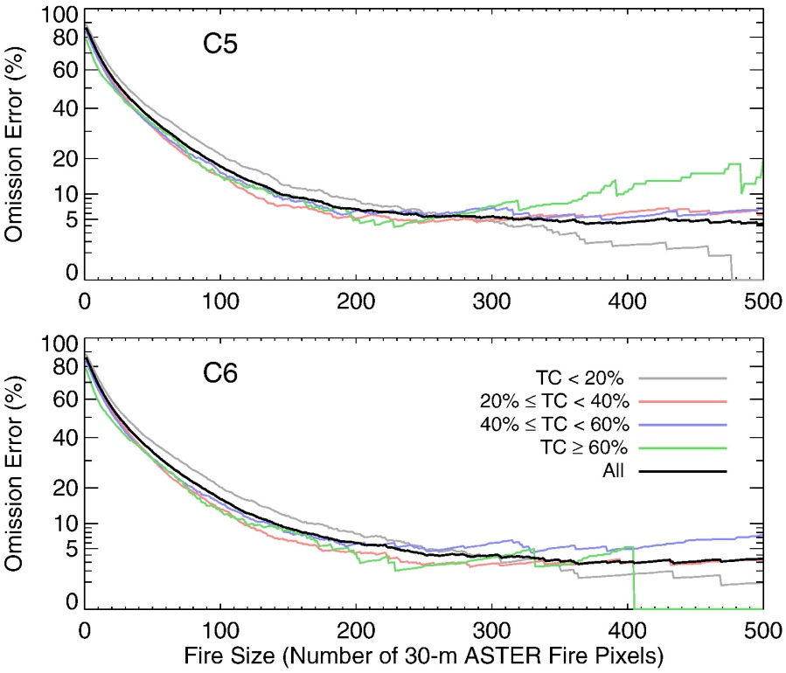
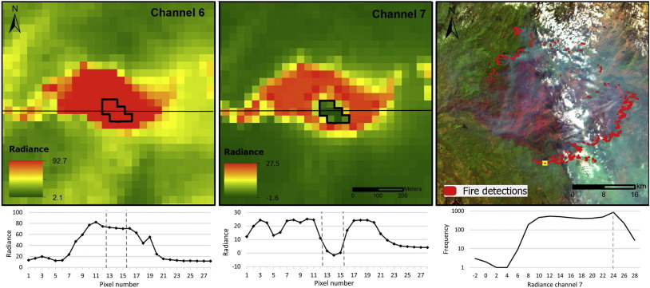
Active Fire Validation
Contemporaneous product inter-comparison
  Moderate (m) resolution data
    Fire omission/commission as a function of fire size (e.g.)
      ASTER, Landsat & Sentinel-2 active fire
  Coarse (km) resolution data
    Fire omission/commission (e.g.)
      MODIS/VIIRS inter-comparison with geostationary products
Prescribed fire programmes
  Few global locations
  Typically small fires
Giglio et al., 2016; RSE
Schroeder, W., et al., 2016. RSE
19

Slide 20
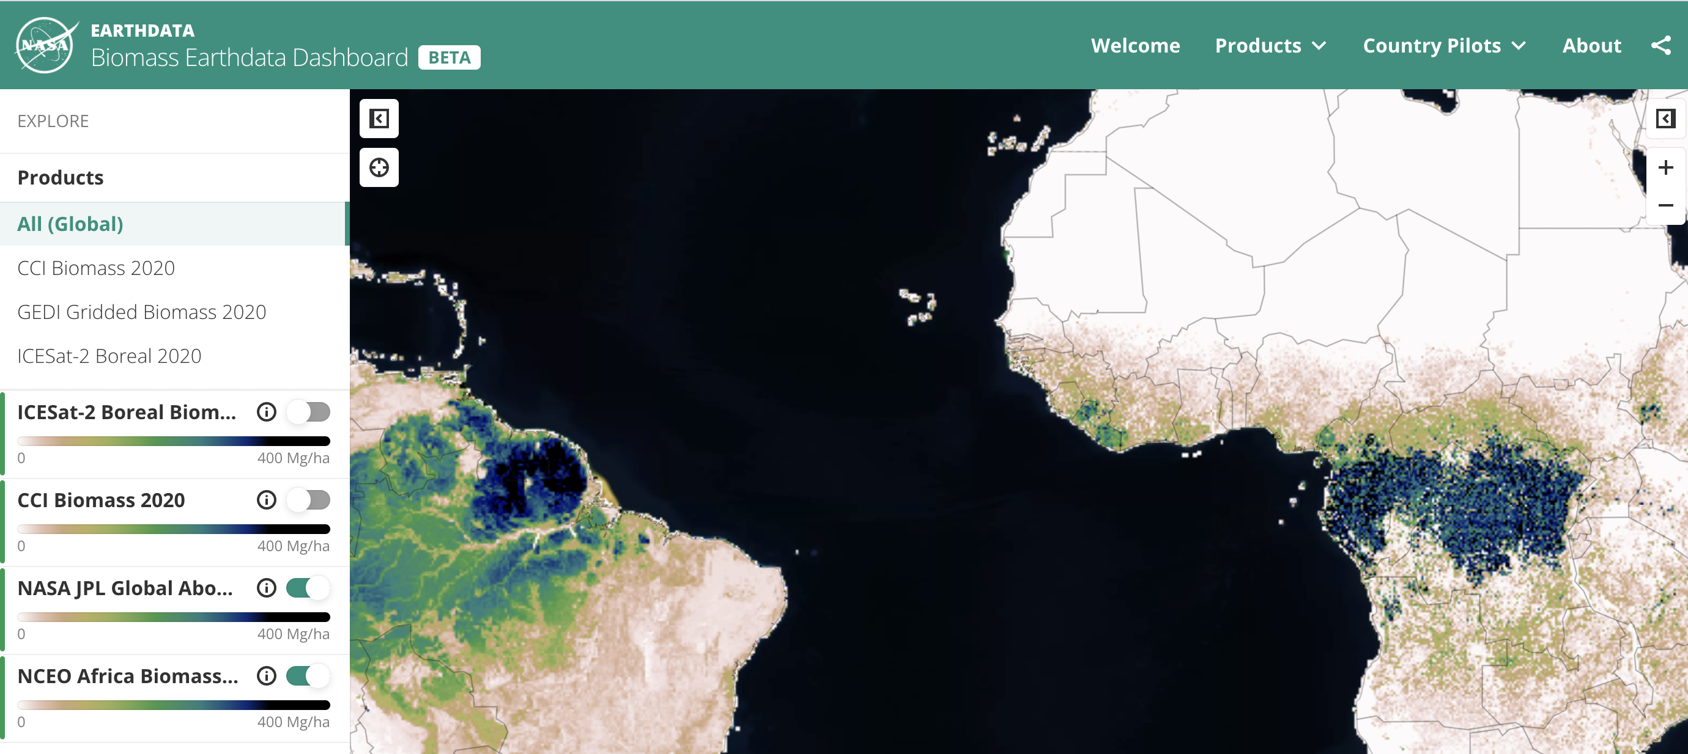
Dashboard for COP26 – Explore 2020 Biomass Products!

Slide 21
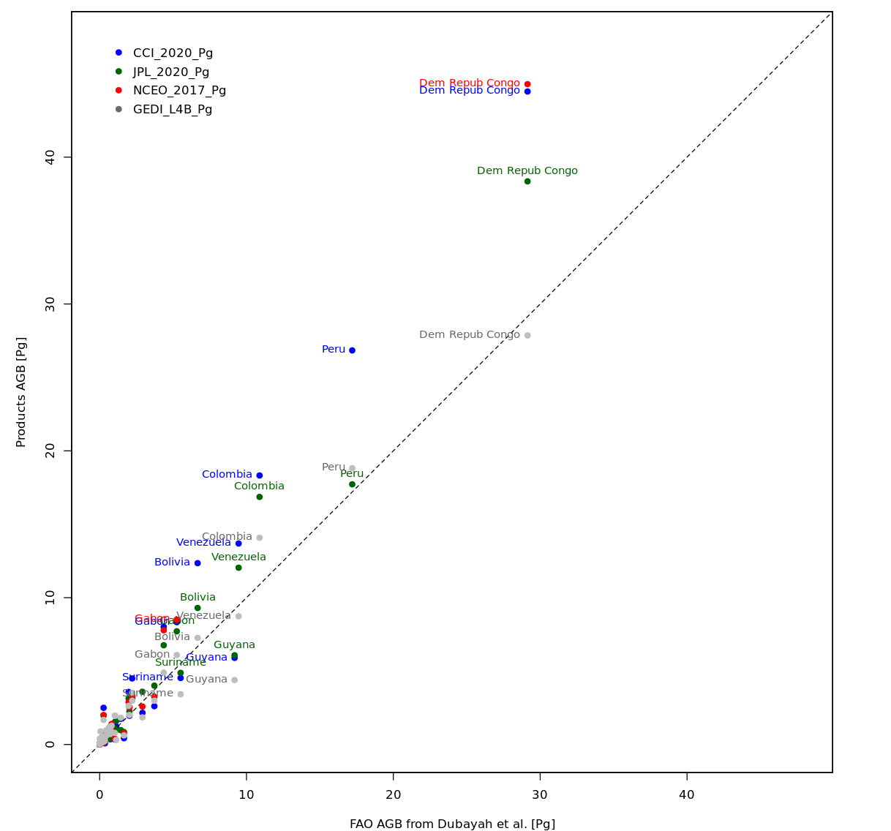
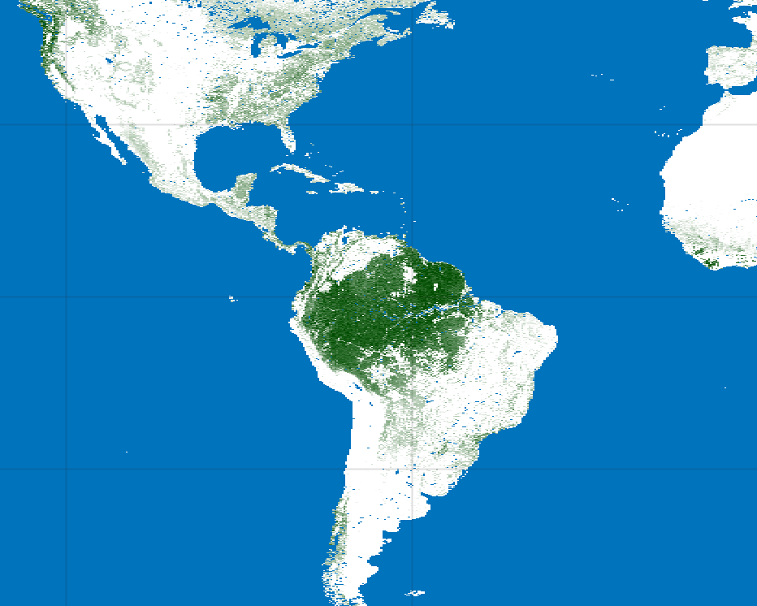
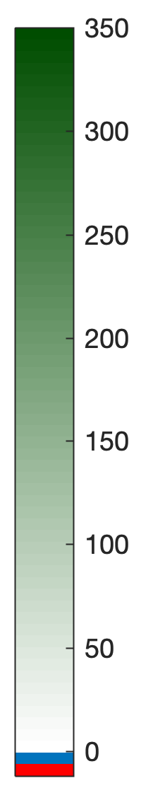
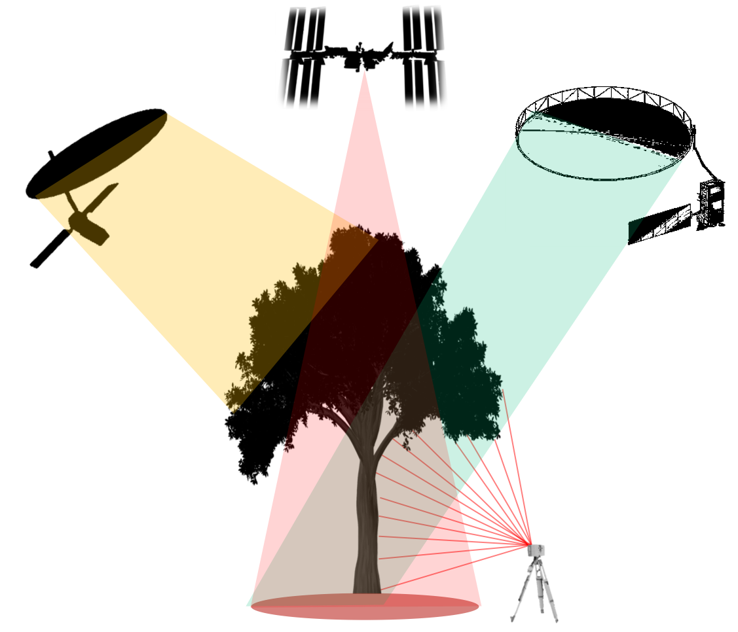

Toward Harmonization of Global Biomass Products for Policy Applications
Aboveground Biomass Density (Mg/ha)
CCI Biomass
2020
JPL Biomass
2020
EO Product Biomass (Pg)
GEDI Biomass
2020
Open Science Activity aimed at country and biome-level intercomparison and validation of new biomass products to increase uptake for national reporting and the Global Stocktake. Harmonization with country definitions of forests increases correlation with national reporting to FAO. All data are code are open and analysis is conducted on the ESA-NASA MAAP.
National Reported Biomass (Pg)
Hunka, Leitold, Minor, Duncanson et al., in prep

Slide 22
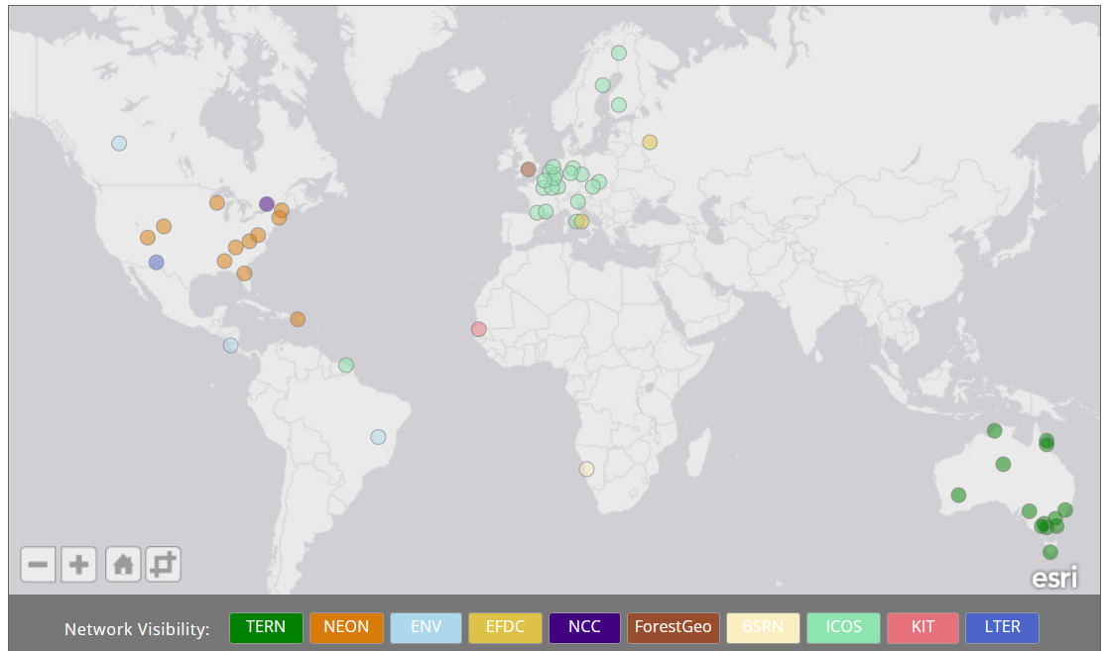
Supersites
Super characterized (canopy structure and bio-geophysical variables) site following well- established protocols useful for the validation of at least 3 satellite land products and for radiative transfer modeling approaches.
Active, long-term operations, supported by appropriate funding and infrastructural capacity.
Supported by airborne LiDAR and hyperspectral acquisitions (desirable).
The supersites were selected primarily from well known and established networks
=> Quite biased towards forest sites

Slide 23
Questions
Large turnover of FA leads
Where does Solar Induced Flourescence fall within LPV hierarchy?
Where does Evapotranspiration fall within LPV hierarchy?
Interacting with ICOS for updating of protocols for supersites and LPV products.
Discussion with IVOS on TOA calibration of LST
What does Stage 4 validation look like for many LPV products

Slide 24
Proposed LPV Plenary 2023
March 2018, Frascati, Italy
April 2019, Milan Italy
May 2021, Virtual
Sep 2022 Virtual
Summer 2023
ESRIN,LPVE June ‘23

