Slide 1
WGCV
1.5 TSIS updates
Akihiko KUZE and Odele Codington
WGCV-51
October 4, 2022
(Tokyo)

Slide 2
TSIS updates
(1) WGCV-50 in March : WGCV recommend TSIS-HSRS
CEOS CAL-VAL portal News on TSIS
The direct TSIS-1 observations continue in good form, producing high quality daily SSI and TSI.
A paper on version 2 of the TSIS-1 HSRS (the hybrid, composite, spectrum), plus extension in wavelength from .115 to 200 micron using independent observations and theory has bee submitted.
This latter work has a change in the UV between 202 and 210 nm. It also updates solar lines in the JPL/SPTS database, primarily impacting around 1.3 microns.
Secondly, with the extension to the "full spectrum", we have provided a reference spectrum that integrates to TSI, within uncertainties. For climate studies that require a solar spectrum that integrates to TSI, a <0.1% adjustment (for all wavelengths) to identically match TSIS-1 TIM observations for that period is recommended.

Slide 3
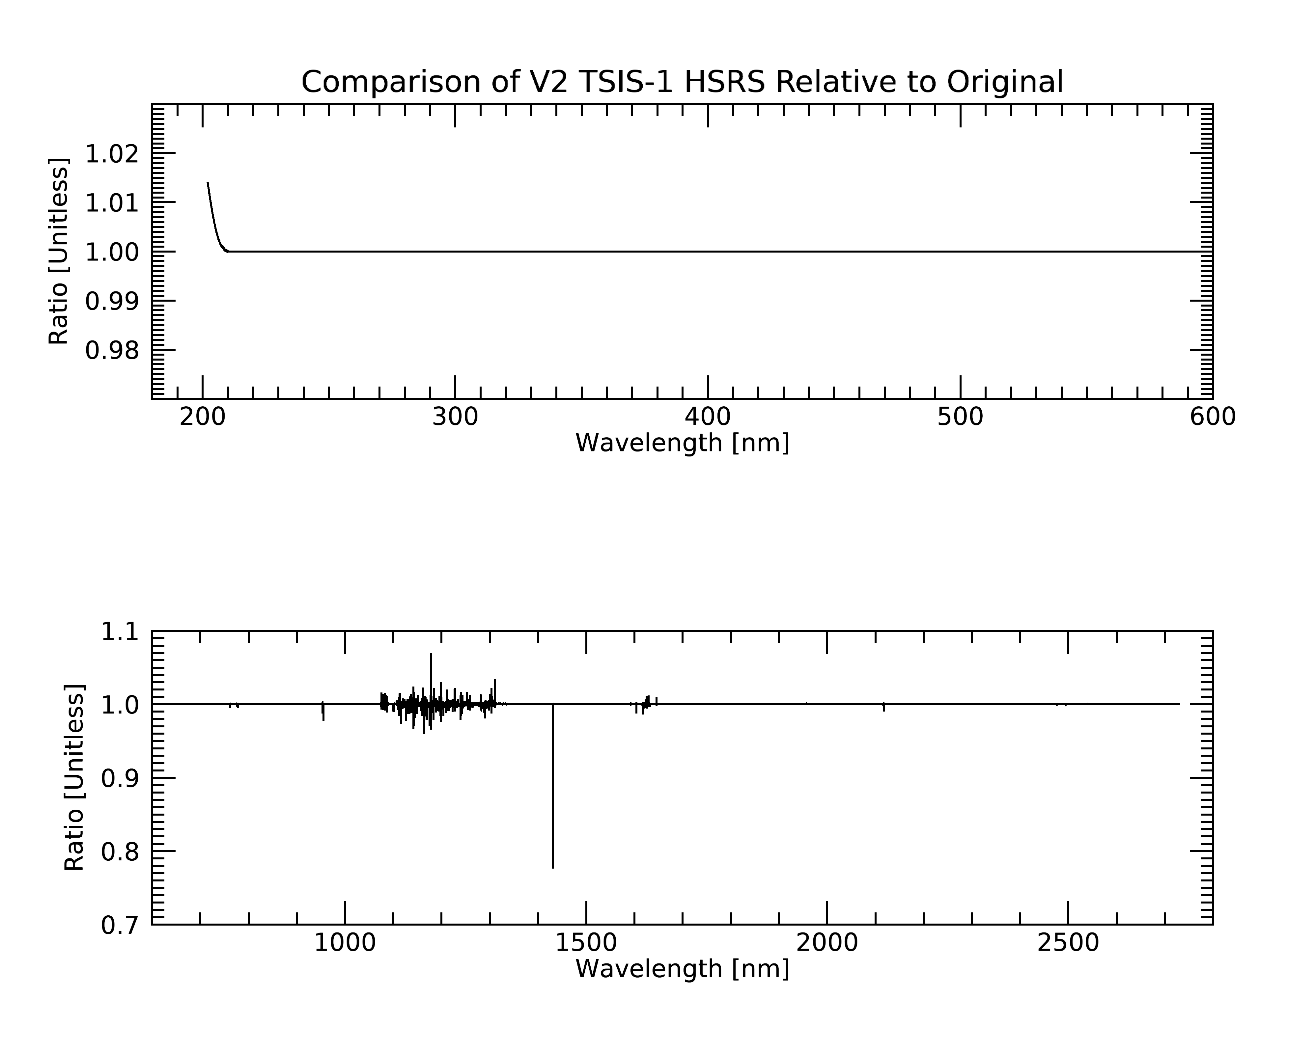
Version 2 of the TSIS-1 HSRS
…is an incremental update.
  A reprocessing changes the radiometric baseline between 202 and 210 nm.
  Updates the JPL SPTS high spectral resolution lines to the latest version
  [G. Toon, https://mark4sun.jpl.nasa.gov/toon/solar/solar_spectrum.html]

Slide 4
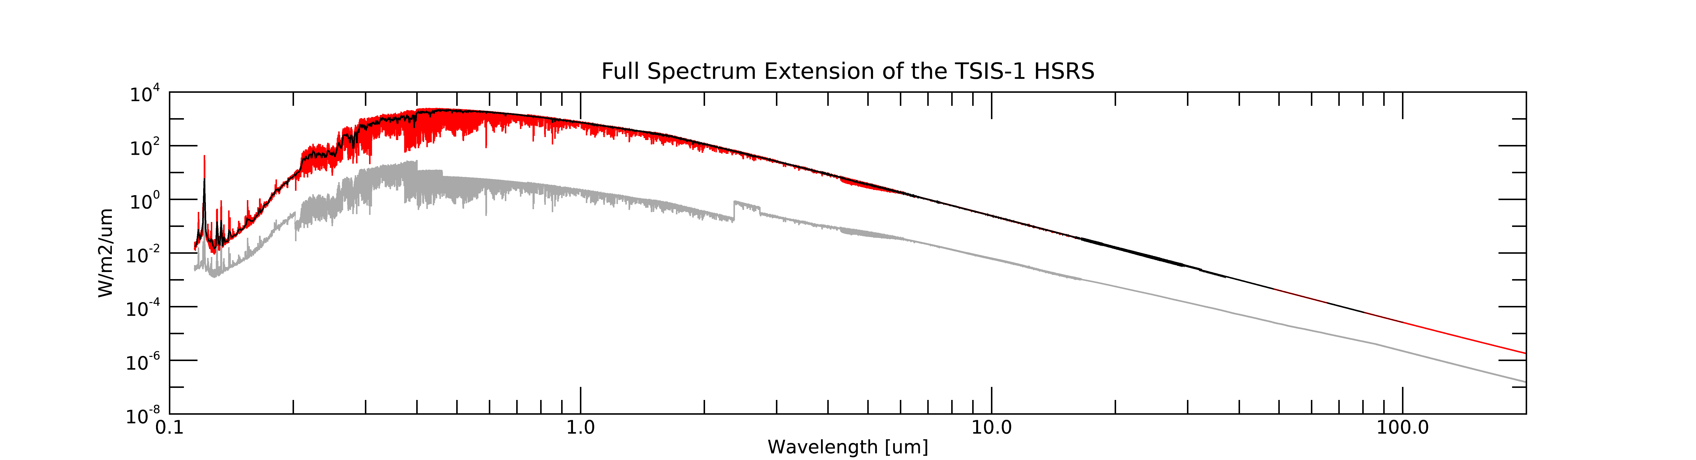
The ‘Full-Spectrum’ TSIS-1 HSRS
Irradiance
1-nm Binned Variant
Uncertainties
SORCE SOLSTICE (version 18)
0.115-0.202 μm
∑SSI = 0.12 W/m²
(<0.01% of TSI)
TSIS-1 HSRS (version 2)
0.202-2.73 μm
∑SSI = 1327.03 W/m²
(97.5% of TSI)
IR Extension ‘A’
2.73-16.5 μm
JPL/SPTS solar lines
scaled to Kurucz [1997]
Scaled (reduced) by ~0.6%
∑SSI = 35.46 W/m²
(2.6 % of TSI)
IR Extension ‘B’
Kurucz [1997] irradiance model
16.5-200 μm
Scaled (reduced) by ~0.6%
∑SSI = 0.19 W/m²
(0.01% of TSI)
SORCE SOLSTICE direct measurement uncertainty
TSIS-1 HSRS (v2) uncertainty
(unchanged from original, v1)
Uncertainty Estimated
Equal to the relative difference between Kurucz [1995] and one Fontenla irradiance model [current MODTRAN default solar spectrum]; ranges from ~1-8%
∑SSI .202-2.73 μm [W/m²] | ∑SSI .115-200 μm [W/m²] | TSIS-1 TSI [W/m²] | Difference from TSI [%]
1327.0 | 1362.8 | 1361.5 | <0.1
Coddington, O., Richard, E., Harber, D., Pilewskie, P., Woods, T., Snow, M., Chance, K., Liu, X., and Sun, K, “Version 2 of the TSIS-1 Hybrid Solar Reference Spectrum and Extension to the Full Spectrum ”, Earth and Space Science, submitted
Notes:
Kurucz, The Solar Irradiance by Computation, 1997 is a “purely theoretical model photosphere that reproduces the irradiance measurements of Neckel and Labs in the visible for bandpasses of approximately 2 nm. That model and Avrett's empirical quiet sun model (Fontenla, Avrett, and Loeser 1993) (which includes a chromosphere) are used to predict irradiance out to 200 microns.

Slide 5
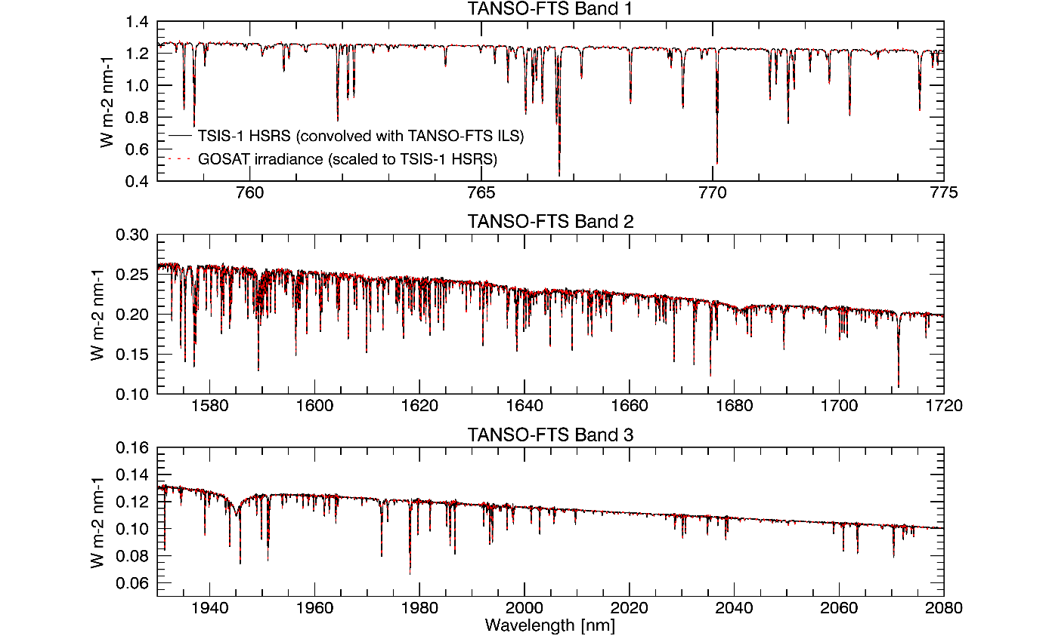
TSIS SIST meeting this week and Long-term data from GOSAT team
TSIS-SIST meeting at LASP, U. of Colorado, Oct. 4 and 5
GOSAT can provide 13-year (165 months) data
Highest spectral resolution at the top of atmosphere
Simple instrument line shape function with FTS
New GOSAT irradiance set for TSIS community
Correction of GOSAT operation and instrument specific items
BRDF corrected : incident flux varies with season, output flux: fixed (pointing A: 2009-2015) pointing B (2015-)
Radiance degradation of FTS excluding calibration diffuser corrected
Assumption
Space grade Spectralon: the material has no degradation and contaminant causes degradation depending on UV exposure.
Front side: always exposed. Backside: shorter than 163 hour (about 0.1%) since GOSAT launch
TSIS HYBRID (0.001nm) convoluted with GOSAT ILS vs. GOSAT solar calibration data. Courtesy of Odele Coddington, LASP

