Slide 1
WGCV-51
WGCV Vice Chair 2023-2024
Cody Anderson, USGS
1.4
WGCV-51, Tokyo, Japan
3rd - 6th October 2022

Slide 2
Outline
Professional Background
Education and Work History
USGS Cal/Val
USGS CEOS/International Engagement and Priorities

Slide 3
Professional Background

Slide 4
Professional Background
Education: South Dakota State University (SDSU) – 2005-2010
Degrees in Electrical Engineering and Mathematics
Research Assistant for SDSU Image Processing Lab
Optical Satellite Imagery Calibration
Radiometry, Landsat, Commercial
Dennis Helder – Lab Director and Advisor

Slide 5
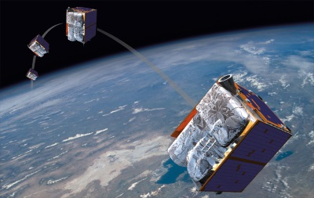
Professional Background
RapidEye – Berlin, Germany – 2010-2015
BlackBridge, Planet
Calibration Engineer
Optical Satellite Imagery Calibration
Radiometry

Slide 6
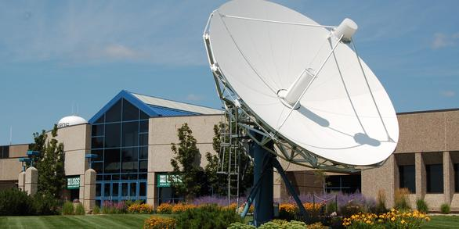
Professional Background
Stinger Ghaffarian Technologies (SGT), U.S. Geological Survey (USGS) Earth Resources Observation and Science (EROS) Center – 2015-2018
Landsat 9 Calibration Lead

Slide 7
Professional Experience
U.S. Geological Survey (USGS) – 2018-Present
EROS Cal/Val Center of Excellence (ECCOE) Project Manager

Slide 8
USGS Cal/Val

Slide 9
ECCOE Personnel
Cody Anderson – ECCOE Project Manager
Mike Choate – ECCOE Geometry Lead
Esad Micijevic – ECCOE Radiometry Lead
Jeff Irwin – ECCOE Field Campaign Lead
Jeff Danielson – 3D Elevation Program Project Manager
Greg Stensaas – Emeritus

Slide 10
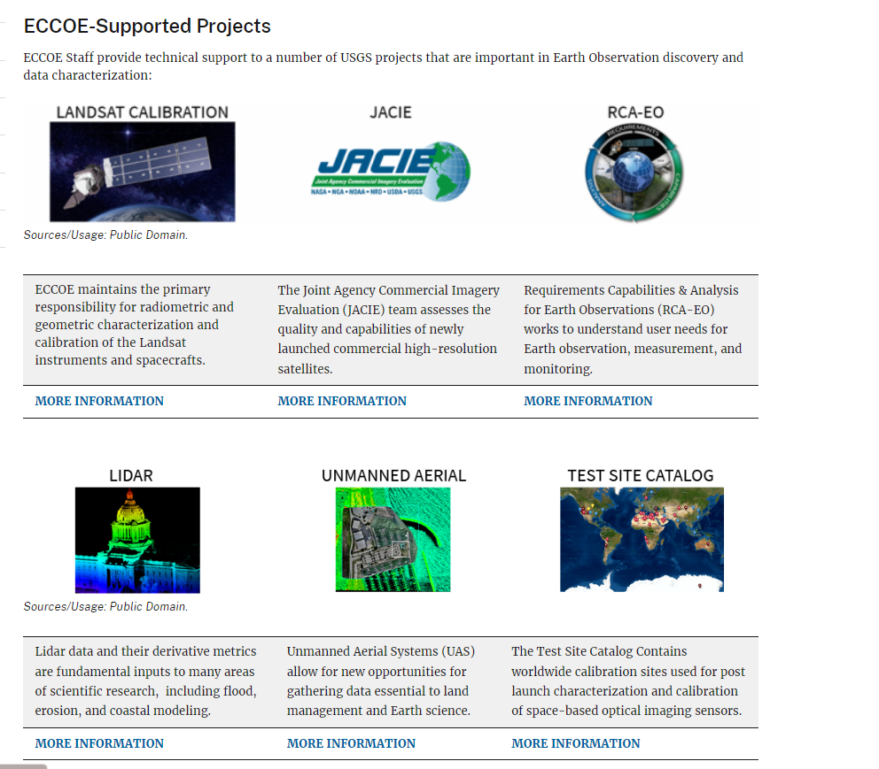
EROS Cal/Val Center of Excellence (ECCOE)
ECCOE Mission Statement:
The EROS Cal/Val Center of Excellence (ECCOE) is a global leader in improving the accuracy, precision, and quality of remote sensing data
https://www.usgs.gov/calval

Slide 11
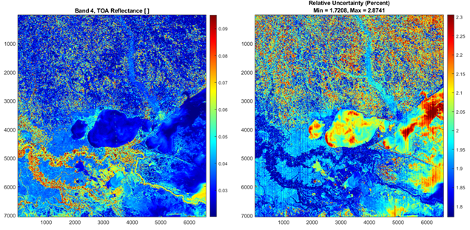
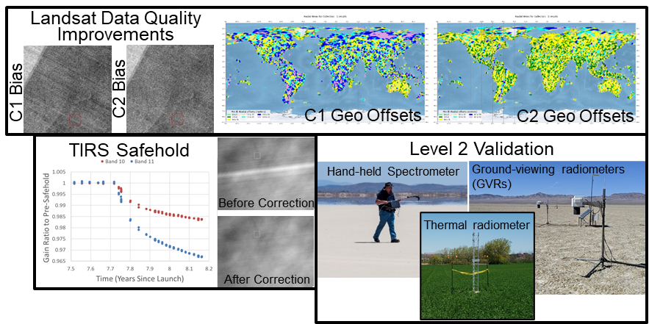
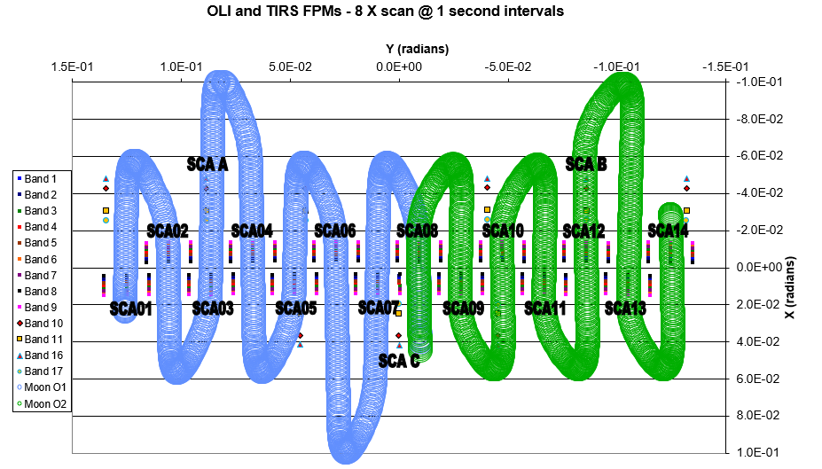
ECCOE – High Level Priorities
Ensure Landsat Data Quality
Top of Atmosphere Reflectance and Brightness Temperature
Surface Reflectance and Temperature
Dataset Collection improvements
Per-Pixel Uncertainty
Lunar Calibration

Slide 12
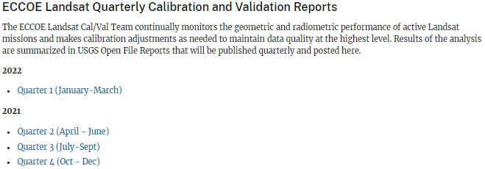
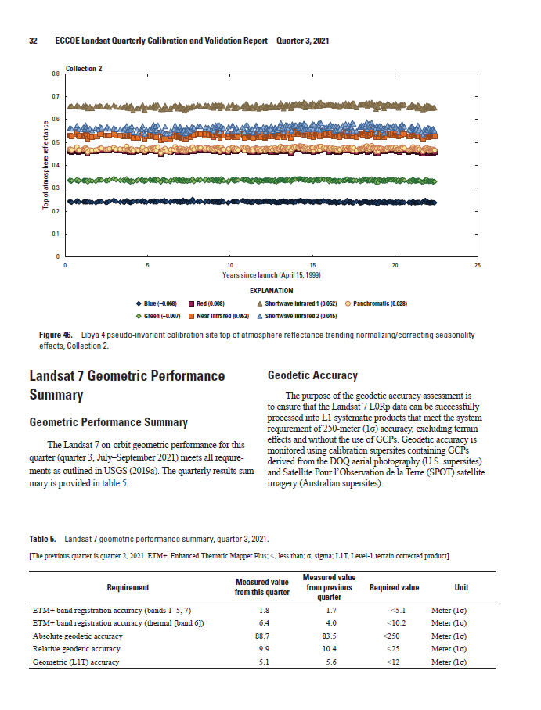
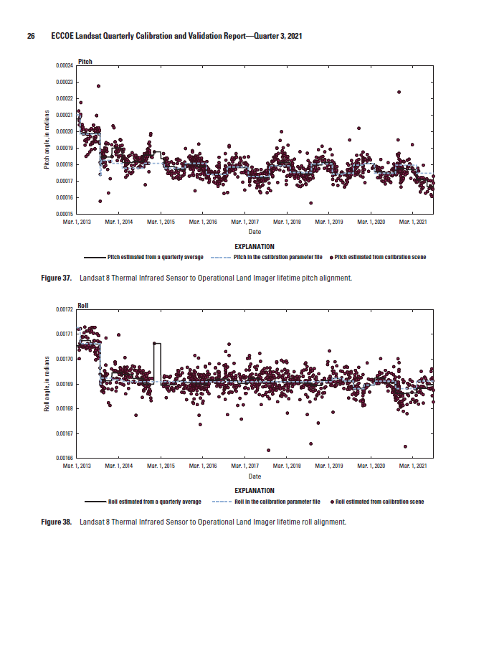
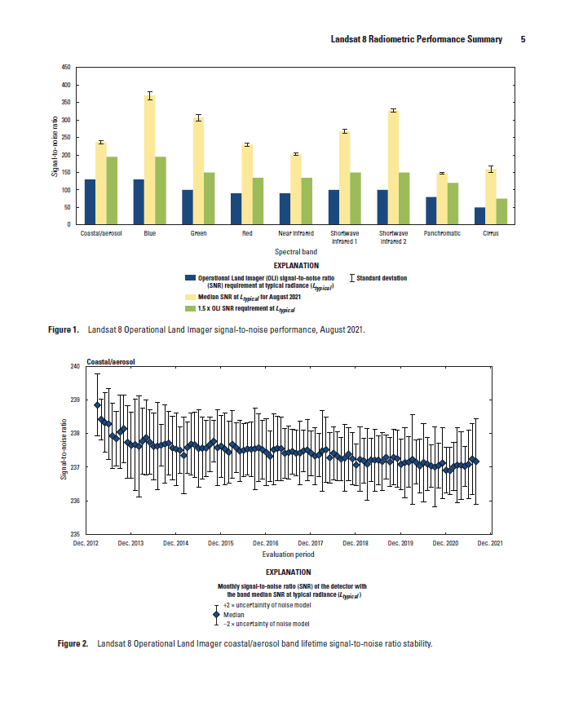
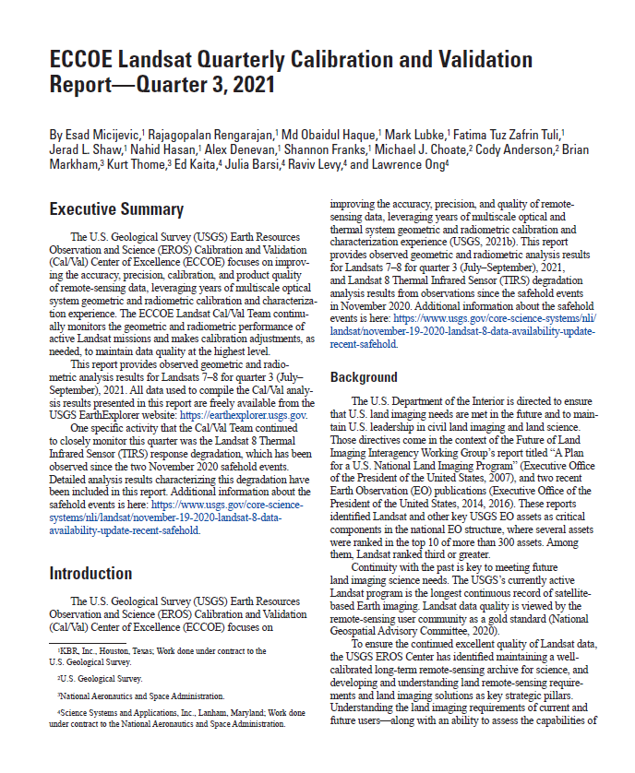
ECCOE – High Level Priorities
https://www.usgs.gov/calval/landsat-calibration-and-validation
‹#›

Slide 13
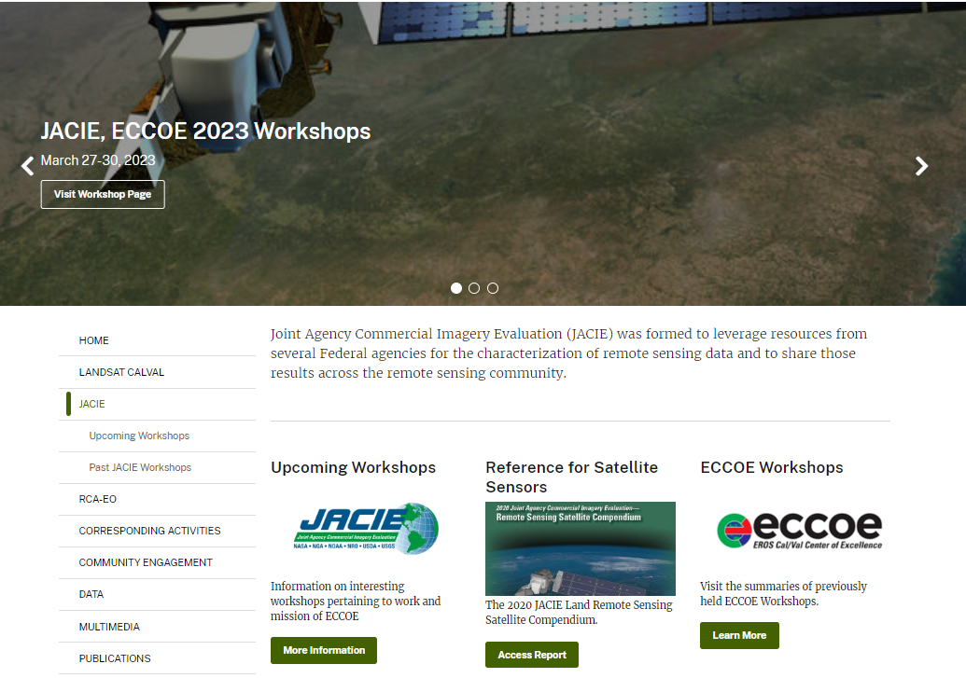
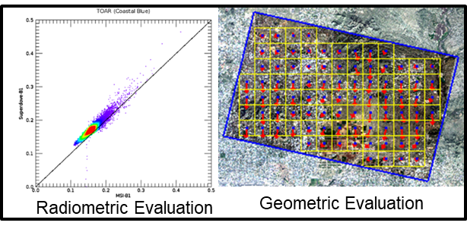
ECCOE – High Level Priorities
Lead the Joint Agency Commercial Imagery Evaluation (JACIE) effort with U.S. partner agencies: NASA, NGA, NOAA,NRO, USDA, and USGS
https://www.usgs.gov/calval/jacie

Slide 14
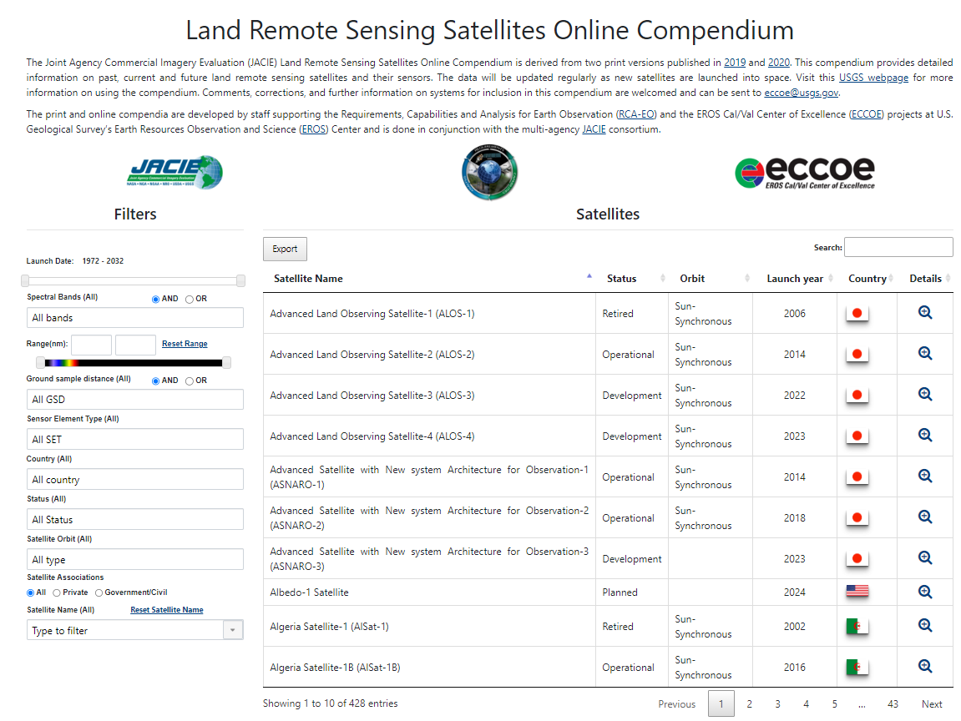
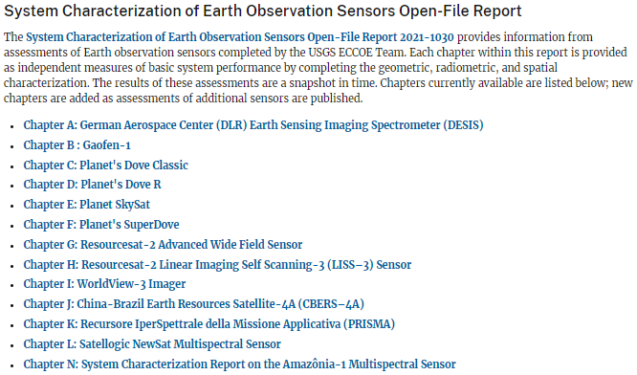
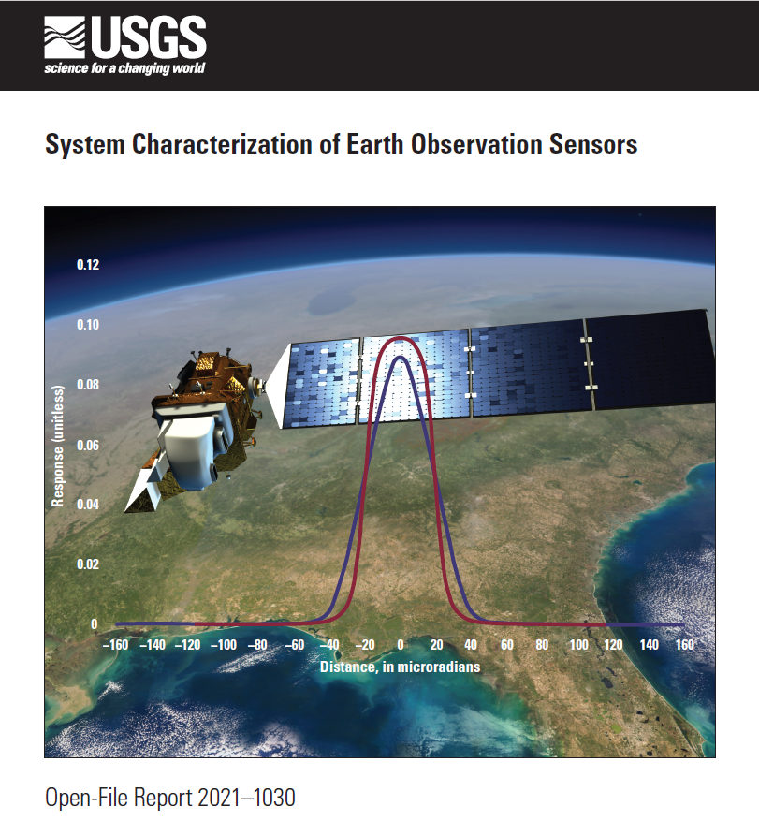
ECCOE – High Level Priorities
Online Compendium https://calval.cr.usgs.gov/apps/compendium
System Characterization Reports
https://www.usgs.gov/calval/system-characterization

Slide 15
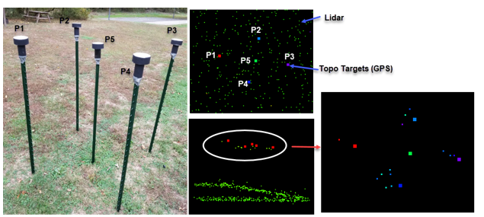
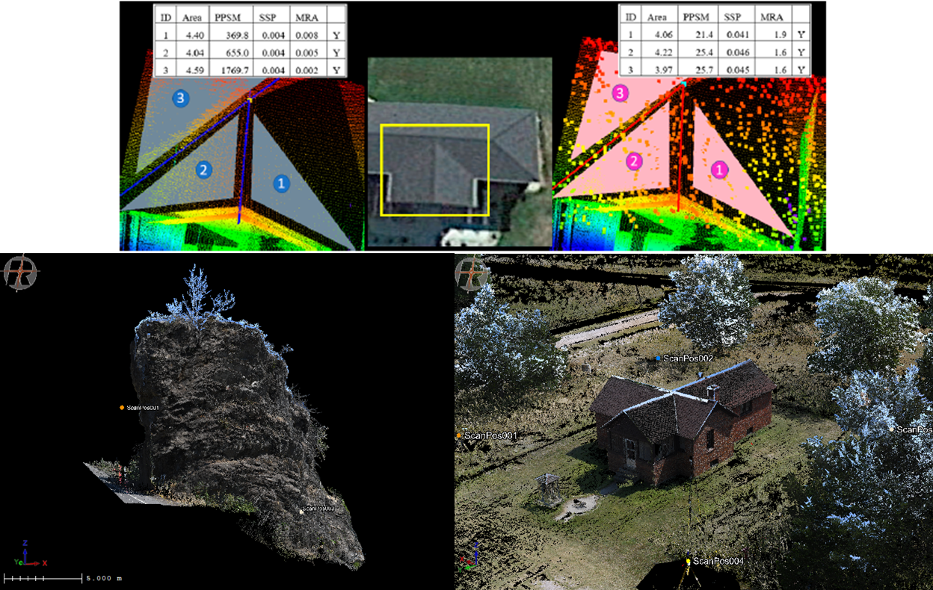
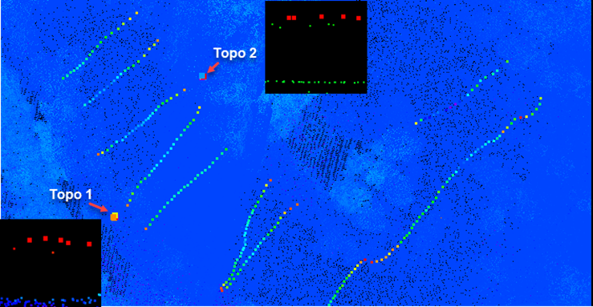
ECCOE – High Level Priorities
Validate National Elevation and Bathymetric Dataset Accuracy
‹#›
3 Plane Geometric Intersection and Amorphous Objects
Bathymetric Targets

Slide 16
ECCOE – High Level Priorities
https://www.usgs.gov/data/central-south-dakota-airborne-lidar-validation-field-survey-data
https://www.usgs.gov/data/chesapeake-bay-region-virginia-river-bluff-and-wetland-extent-mapping
https://www.usgs.gov/data/2020-niobrara-river-topobathymetric-lidar-validation-usgs-field-survey-data

Slide 17
USGS CEOS/International Engagement and Priorities

Slide 18
Formal Partnerships/Agreements
US Agencies
International
Funded Entities
… and others
Commercial
… and others
… and others

Slide 19
USGS CEOS Membership
CEOS
Tim Stryker (Principle)
Steve Labahn (Contact)
Working Group on Capacity Building and Data Democracy (WGCapD)
Chris Barnes (Member)
Working Group on Climate (WGClimate)
Chris Crawford (Member)
Land Surface Imaging – Virtual Constellation (LSI-VC)
Steve Labahn (Co-Lead)
Silva Wilson (Member)
Forests and Biomass Subgroup (FBSG)
Chris Barnes (Member)

Slide 20
USGS CEOS Membership (Cont.)
Working Group on Information Systems and Services (WGISS)
Tom Sohre (Vice-chair)
Working Group on Calibration and Validation (WGCV)
Cody Anderson (Member → Vice-chair)
Infrared and Visible Optical Sensors (IVOS)
Chris Crawford
Land Product Validation (LPV)
Dean Gesch
Terrain Mapping Subgroup (TMSG)

Slide 21
USGS Bi-Lateral Agreements
European Commission (EC), European Space Agency (ESA), National Aeronautics and Space Administration (NASA), and USGS
Geoscience Australia (GA)
Indian Space Research Organisation
Deutsches Zentrum für Luft- und Raumfahrt (DLR) – German Aerospace Center

Slide 22
Commercial Engagement
Technical Assistance Agreements with Planet and Maxar (WorldView)
JACIE, Very High-resolution Radar & Optical Data Assessment (VH-RODA), and Analysis Ready Data (ARD) Workshop Coordination

Slide 23
Potential WGCV Areas of Focus
Analysis Ready Data/Interoperability
CEOS ARD
USGS is the WGISS Vice-chair
USGS is a LSI-VC Co-lead
Reference Calibration and Validation Networks
Top Atmosphere and Surface
Reflectance
Temperature
Commercial Engagement

Slide 24
Thank You ?Questions?

