Slide 1
CEOS SIT TW 2022 Recap
Key Points for WGCV Attention
Presenter, Organisation
Agenda Item #
WGCV-51, Tokyo, Japan
3rd - 6th October 2022

Slide 2
Cal/Val Notes from SIT TW 2022
Highlighted: Joint Draft ESA-NASA Earth Observation Mission Quality Framework Guidelines for Optical and Synthetic Aperture Radar (SAR).
Actioned: Expect a Plenary action on CEOS Interoperability Framework
Suggest: WGCV signal of support and nomination at Plenary welcome
Noted: WGCV and Cal/Val a critical value add from CEOS to ‘New Space’ – legacy experience, infrastructure, tools, SITSATs
Suggest: WGCV should nominate to expected future Task Team on ‘New Space & Future CEOS’

Slide 3
Cal/Val Notes from SIT TW 2022
Actioned: WGCV Chair will support preparation of agenda item on Strategy for CEOS Engagement with Standards Organisations
Actioned: CEOS Agencies to consider resourcing people with CEOS-ARD heritage to join the OGC ARD Standards Working Group
Noted: CEOS GST Strategy Recommendation 4: CEOS should consider…focussed observational campaigns…to understand of trends in natural GHG emissions and removals in key areas
Suggest: Potential role for WGCV

Slide 4
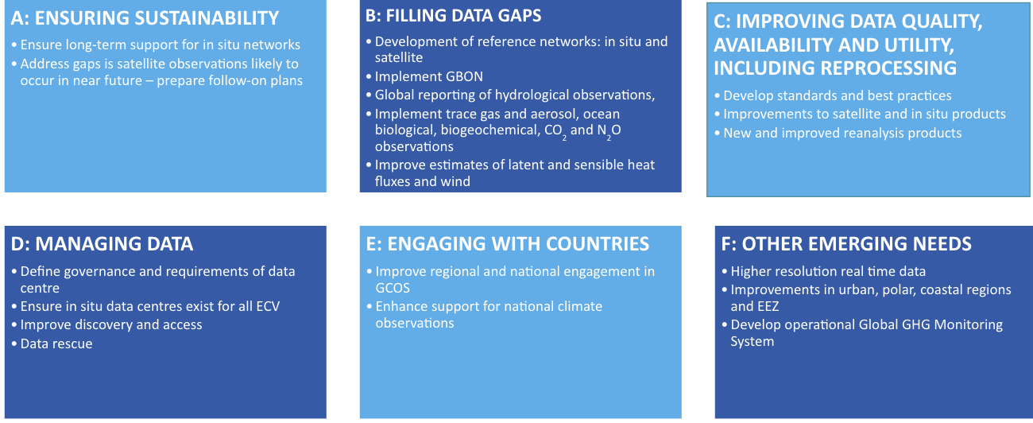
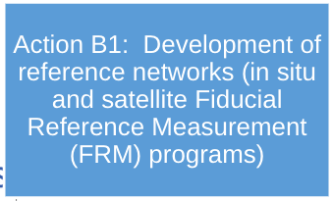
Cal/Val Notes from SIT TW 2022
Noted: AFOLU Roadmap will have a section on “suitable cal-val networks”
Suggest: WGCV to keep watching brief on AFOLU Roadmap development
Noted: Various GCOS IP Themes and Actions related to cal/val
Suggest: WGCV to keep watching brief on GCOS IP and satellite supplement development and engage where appropriate

Slide 5
Cal/Val Notes from SIT TW 2022
Noted: IMEO-MARS Validation Concepts
Suggest: Potential role for WGCV in inter-comparisons (of “operational” MARS algorithms, concurrent acquisitions), controlled methane release experiments, and general validation coordination
Actioned: SIT Chair will follow up
Noted: Numerous other GHG validation needs, incl. for WMO Coordinated Global Greenhouse Gas Monitoring
Suggested: “Include biodiversity needs in multi-thematic Cal/Val and ARD development efforts”

Slide 6
Cal/Val Notes from SIT TW 2022
Noted: Various atmospheric composition cal/val activities and Validation sections of White Paper: “Monitoring Surface PM2.5: An International Constellation Approach to Enhancing the Role of Satellite Observations”
Suggest: WGCV may want to input on draft white paper by 15 Oct 2022 ?
Highlighted: CNES CEOS Chair cal/val priorities:
CEOS protocol to support the cross-calibration of thermal infrared measurements from future CEOS Agency missions
Definition of a common network of in situ calibration sites to harmonize calibration methods for thermal infrared instruments taking advantage of the previous work done in the “Land Surface Temperature Product Validation Best Practice Protocol” written by LPV WGCV subgroup

Slide 7
Thanks!
Full reference notes here

