Slide 1
WGCV-51
Infrared Visible and Optical Sensors (IVOS) subgroup: #34
Nigel Fox, NPL/UKSA
Agenda Item 1-14
WGCV-51, Tokyo, Japan
3rd - 6th October 2022

Slide 2
Terms of Reference
Promote international and national collaboration in the calibration and validation of all IVOS member sensors.
Address all sensors (ground based, airborne, and satellite) for which there is a direct link to the calibration and validation of satellite sensors;
Identify and agree on calibration and validation requirements and standard specifications for IVOS members;
Identify test sites and encourage continuing observations and inter-comparison of data from these sites;
Encourage the preservation, unencumbered and timely release of data relating to calibration and validation activities including details of pre-launch and in flight parameters.
In the context of calibration and validation encourage the full consideration of “traceability” in all activities involved in the end-to-end development of an EO product including appropriate models and algorithms.

Slide 3
IVOS: Vision
To facilitate the provision of ‘fit for purpose’ information through enabling data interoperability and performance assessment through an ‘operational’ CEOS coordinated & internationally harmonised Cal/Val infrastructure consistent with QA4EO principles.
Pre-flight characterisation & calibration
Test – sites
Comparisons
Agreed methodologies
Community Good Practises
Interchangeable/readable formats
Results/metadata - databases
Shared learning
Recommendations as appropriate
Key Infrastructure to be established and maintained independent of sensor specific projects and/or agencies

Slide 4
Work plan
Structured into themes and led by ‘champions’ (Plus specific projects)
Land surface reflectance - Czapler Myers (U of Arizona USA)
Ocean colour (link to IOCCG, VC-OCR etc) - Zibordi (JRC, EU) & Murakami (JAXA JPN)
Surface Temperature (link to VC-SST, GHRSST) - Corlett (Eumetsat)
Geo spatial image quality - Helder (SDSU, USA) & Viallefont (ONERA F)
NEED TO REPLACE + hold meeting to define scope
Atmospheric Correction (Link to AC subgroup) - Thome (NASA, USA) (Activity superseded SRIX)
PROJECTS
PICSCAR P Henry (CNES)
RadCalNet M Bouvet (ESA)
SST & OC Comparisons N Fox (NPL)
Vocabulary E Woolliams (NPL)
Sensor pre-flight workshop N Fox (NPL)
Uncertainty/traceability S Hunt (NPL)

Slide 5
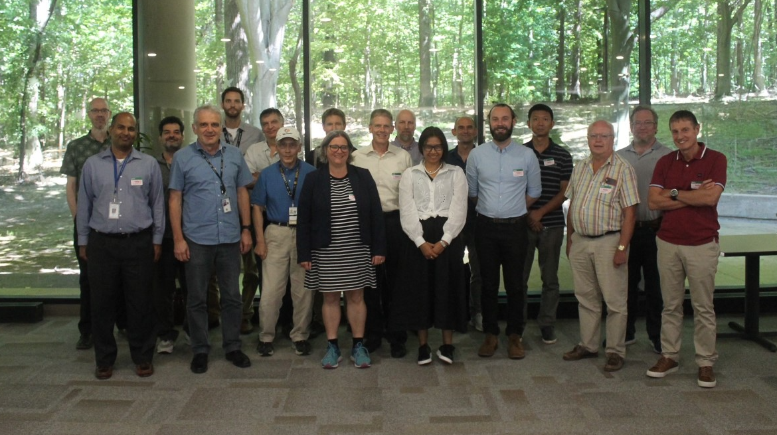
Summary of activities
IVOS 34 @ Reston, USA
hosted by USGS Aug/Sep 2022
last in person meeting Mar 2019!
(next meeting probably Europe looking for host)
May/June 2023
24 agency/orgs represented
34 attendees + 32 on-line +31 OC topic
Most themes and topics (work-plan
discussed or summarised)
Interim virtual discussions:
SITSCOS workshop Sep 2019)
Solar spec irradiance 2021
Calval portal 2021
ARD/Interoperability 2021
PISCAR virtual 2021
mett
Special Projects:
RadCalNet team met Mar 2019/Aug 22 Various telecons since covid inc users workshop
Terminology task team established and active with WGCV
FRM4Veg Comparison (LPV) surf refl Jul 22
FRM4STS comparison Jun 22

Slide 6
IVOS 34 Topics
Vocabulary
Cal/Val methods
SITSats (SI traceable satellites)
Ocean Colour special session (Zibordi retirement)
PICS: Calibration and characterisation
Sensor performance assessment and status
Hyperspectral sensors
Uncertainty, Traceability, interoperability: what and how
CEOS WGCV projects/Actions:
- SST comparison, LST network, SITSCOS, Solar Irradiance

Slide 7
Host overview

Slide 8
vocabulary
Updated IVOS on progress of CEOS wide initiative See Later topic)
Debated if some initial perceived priority words were in fact priorities:
Interoperability – do we actually think more helpful to keep definition lose to give more flexibility?
Rather that we define what we need to do to enable it?
Same for ‘continuity’

Slide 9
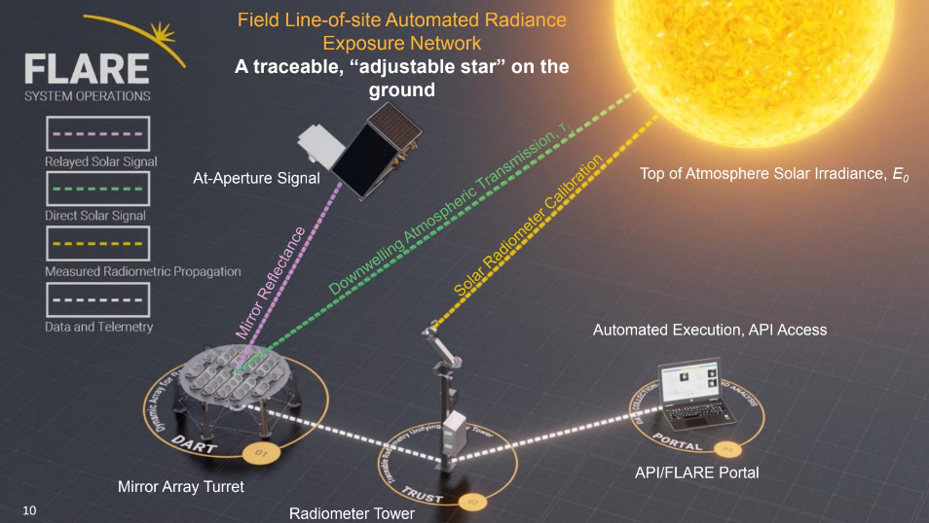
Cal/Val Methods: critical for L1 interoperability
PICS & RadCalNet independent sessions

Slide 10
CV 17-01
Establish means to achieve L1 radiometric interoperability – A community reference
Will create a template on Cal/Val portal (initially private) to record achievable uncertainties for different methods
IVOS team to populate template
Methods must be documented and be subject to peer review (IVOS team)
Evidence of results to specific sensors ideally to include Sensors such as S2, L8/9, S3, VIIRS
Any and all methods to be includable
Next step look to see how to combine results in most effective manner

Slide 11
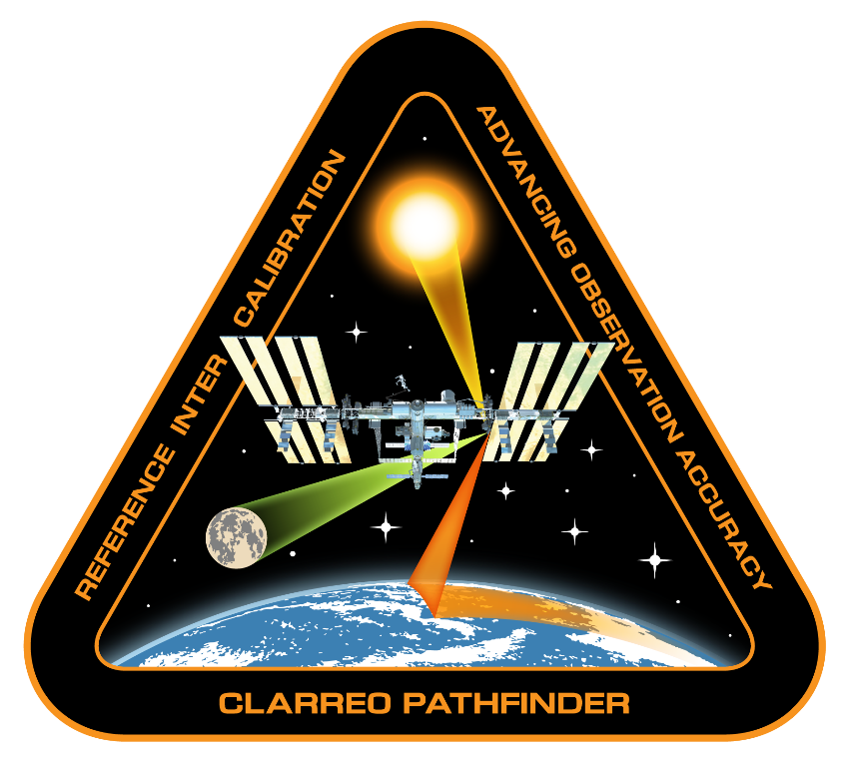
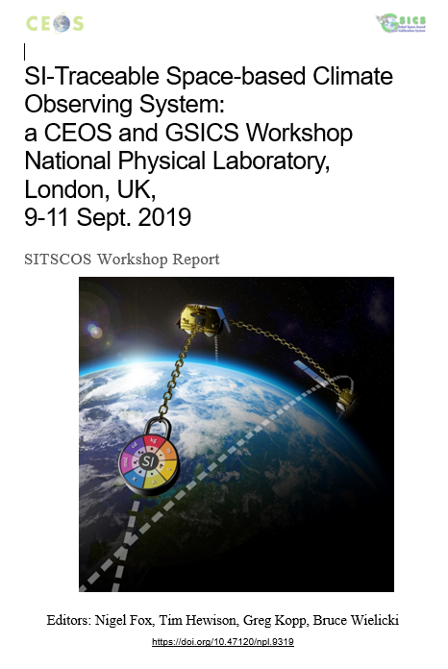
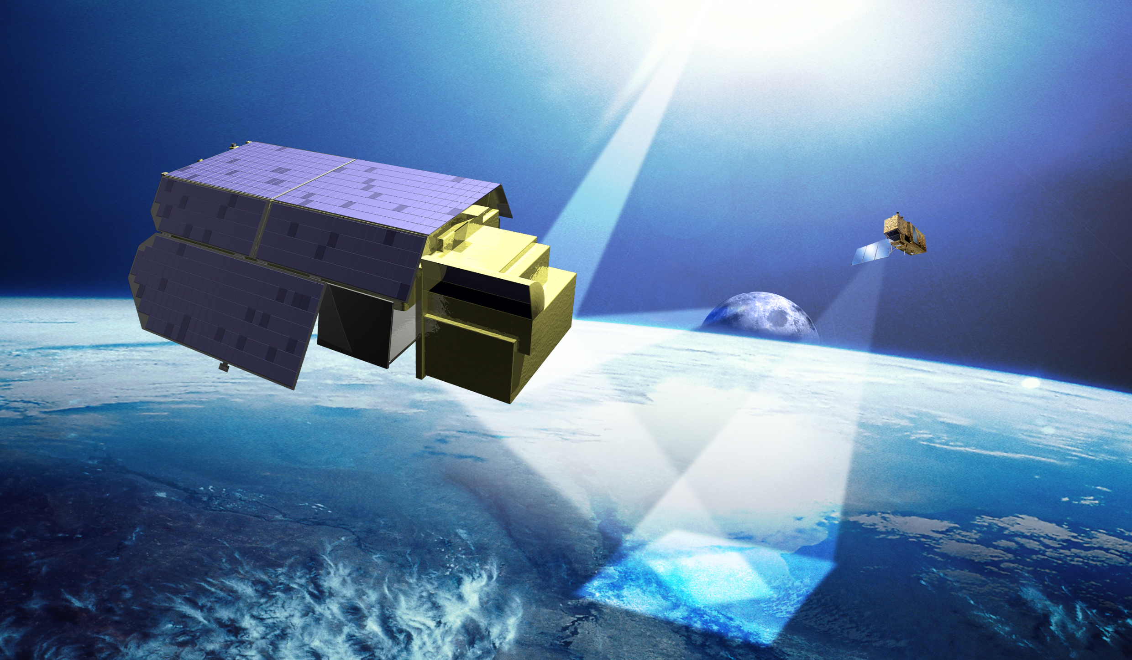
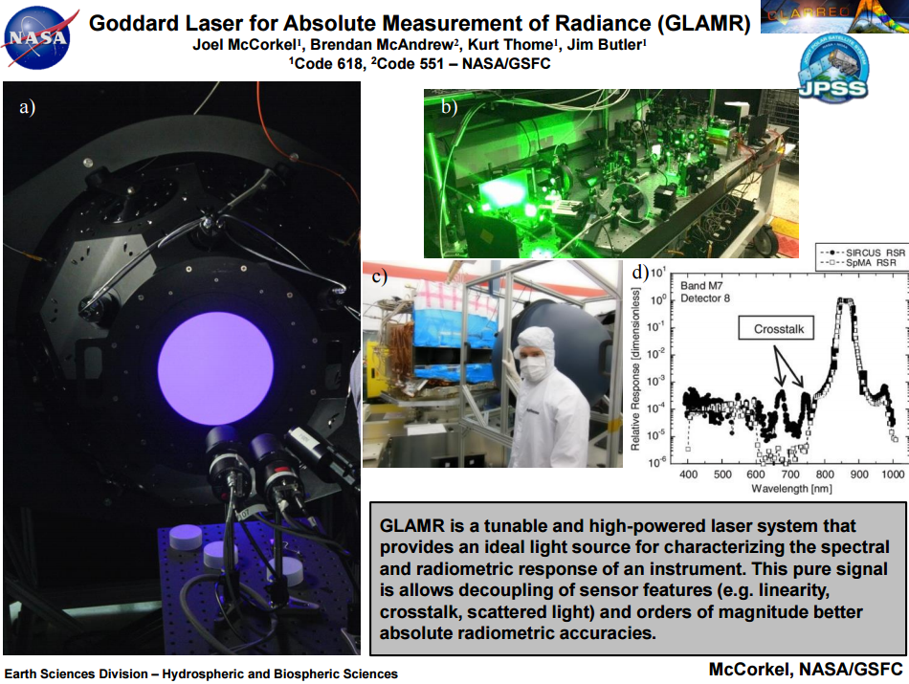
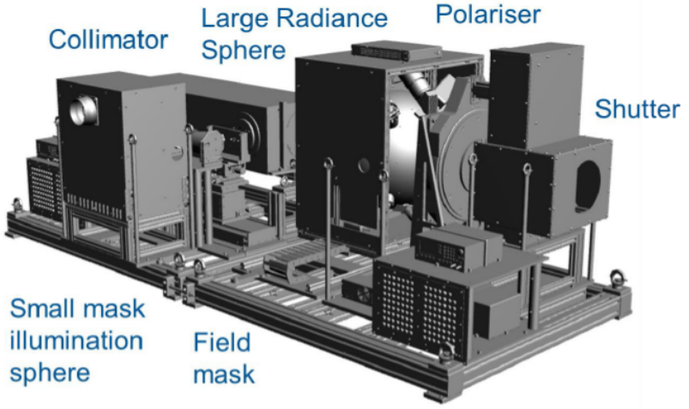
SITSats
TRUTHS
https://calvalportal.ceos.org/sitscos-ws
doi.org/10.47120/npl.9319
Report- Recommendations
How to get wider visibility?
NPL STAR-cc-OGSE
Cal-Val System

Slide 12
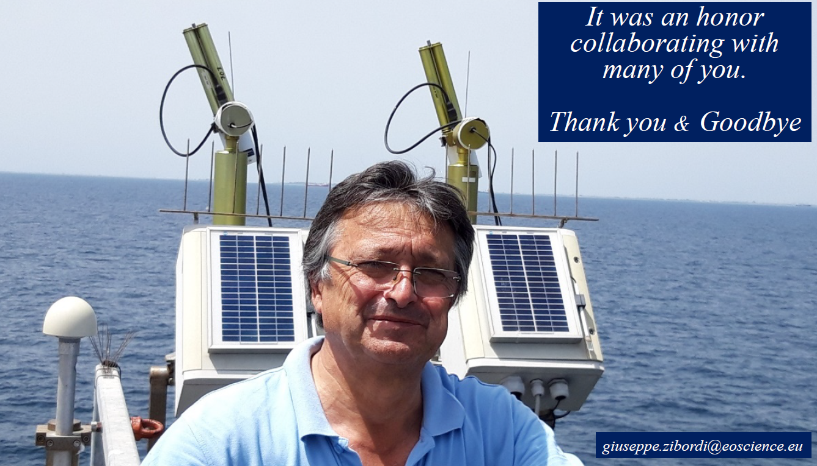
Ocean colour: progress over 25 yrs
Half day - 8 presentations
25 yrs of JRC, PACE, Use of A-OC by missions, FRMs, Moby future
Additional 30+ attendees

Slide 13
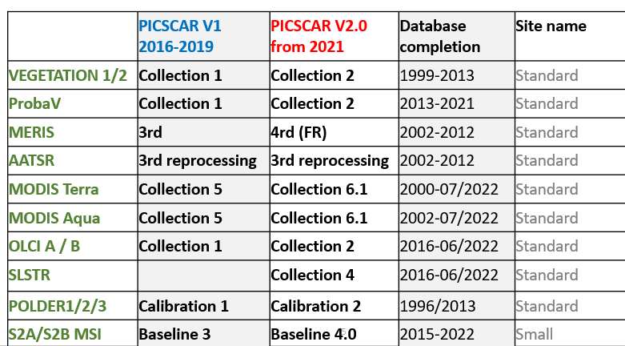
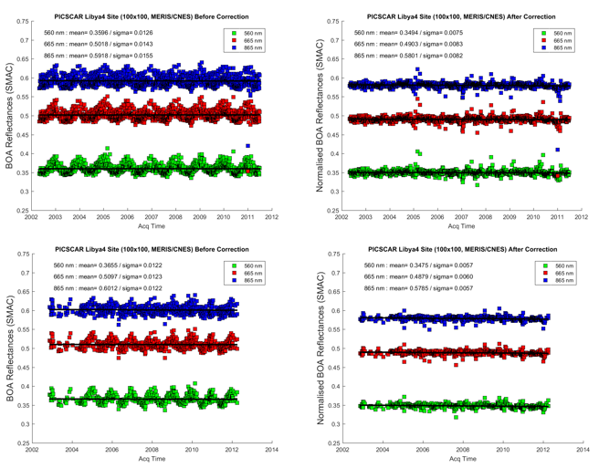
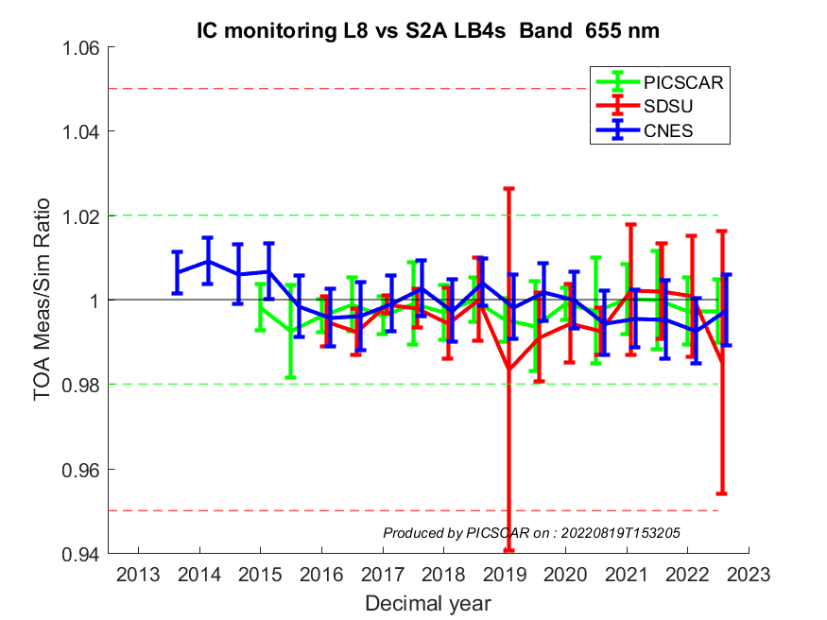
PICS: virtual meet before end 2022)
Access through cal/val portal
Database update:
data sets
Quick looks
Analysis tools being added
Format to NetCDF
Ready to include other PICS
Add additional sensors VIIRS, MISR, +
L8 vs S2A
3 methods (655 nm)

Slide 14
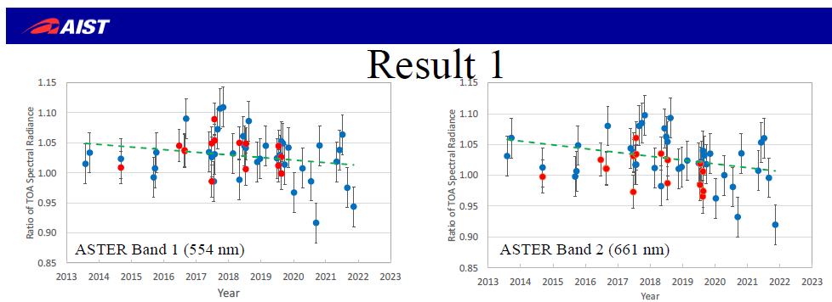
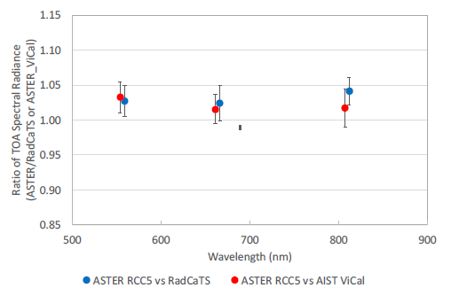
Sensor status and performance

Slide 15
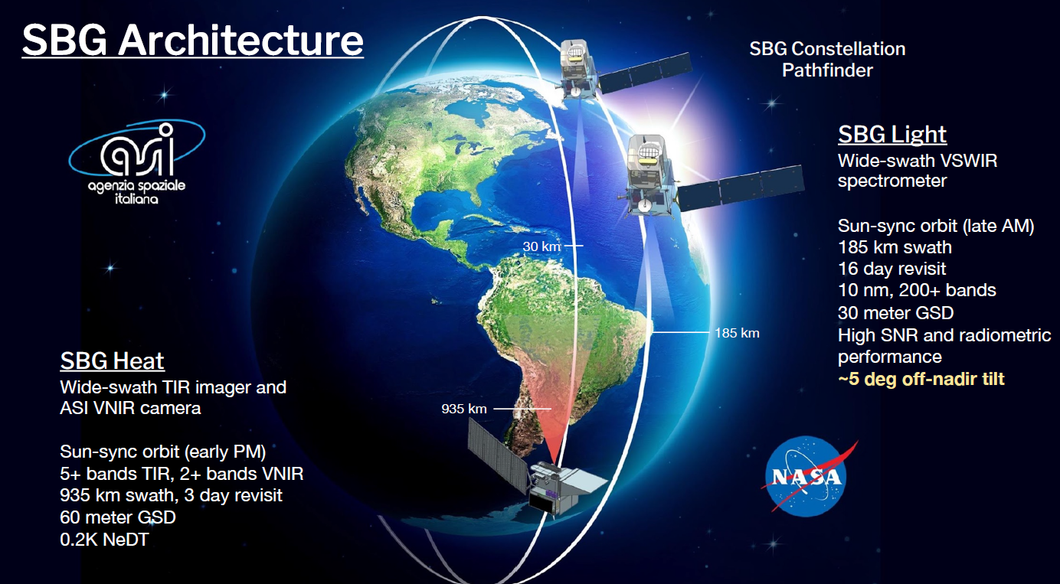
Hyperspectral
DESIS

Slide 16
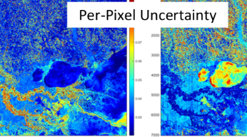
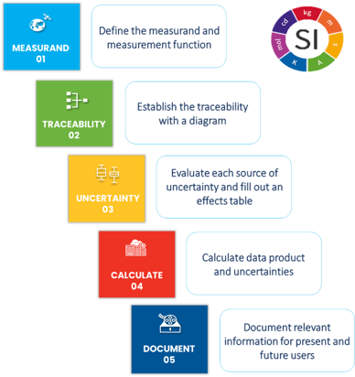
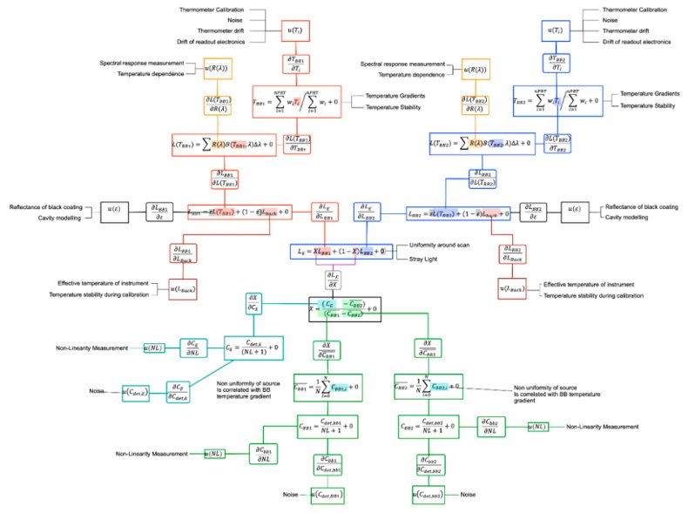
Uncertainty, Traceability and QA
Drivers: ARD, Per pixel Uc, Climate, New space -
What IS Traceability?
What do we have to evidence?
What is enough in terms of Uncertainty?
USGS/NASA initiative to derive per pixel Uc maps for Landsat 8 – comprehensive approach
Challenges – Next steps
Cannot quantify/assess all sources of uncertainty
Per pixel uncertainty is not easy
– accounting for adjacent pixel interactions etc
Data volume increase can be dramatic
– How do we deal with this for user?
Level 1 – Level 2 etc
Follow-on workshop + interactions with WGISS on strategies for handling Uc
On CalVal portal
With new QA4EO

Slide 17
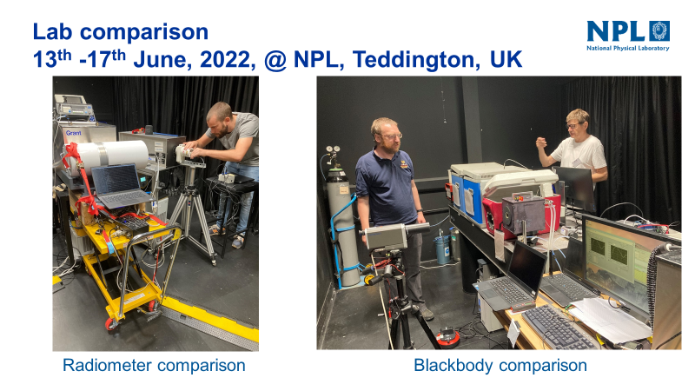
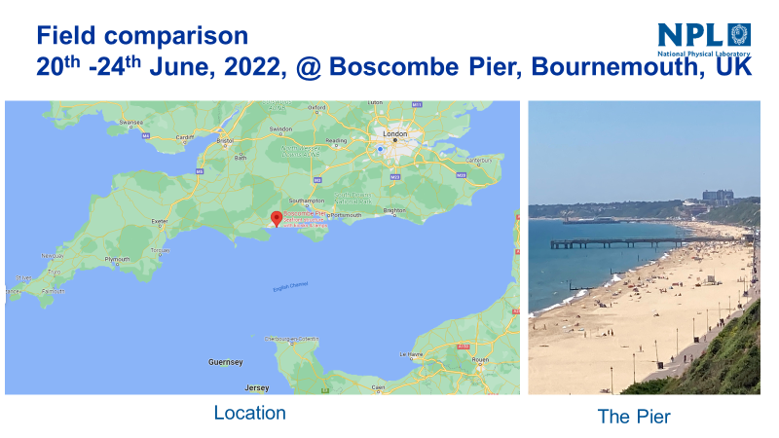
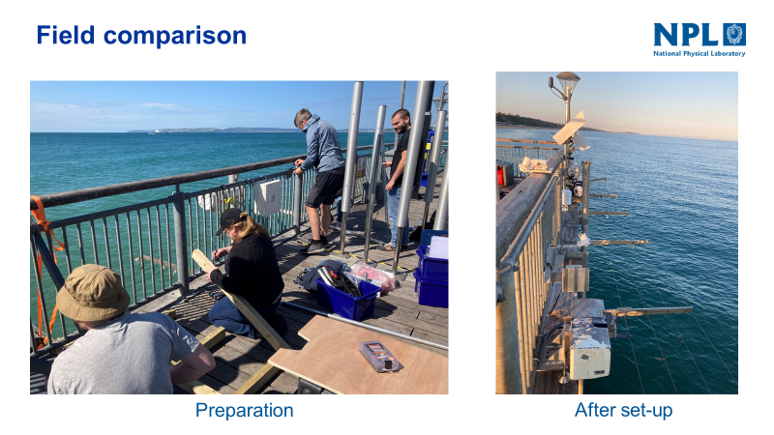
CEOS Projects
CEOS comparison (5) for Surface (water/land) brightness temperature - Results shortly
LST ToA brightness temperature (network)
Discussion on requirements and strategy with LPV members
Agree on ToA brightness temperature per wavelength as a priority
Focus on higher resolution <100 m
Target of 0.5 K as ToA uncertainty (challenging! With land Water oK)
Project to start (see later)

Slide 18
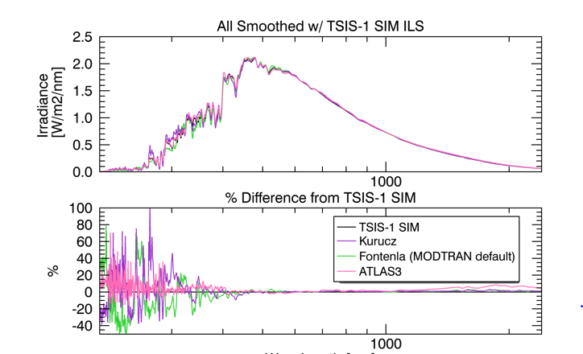
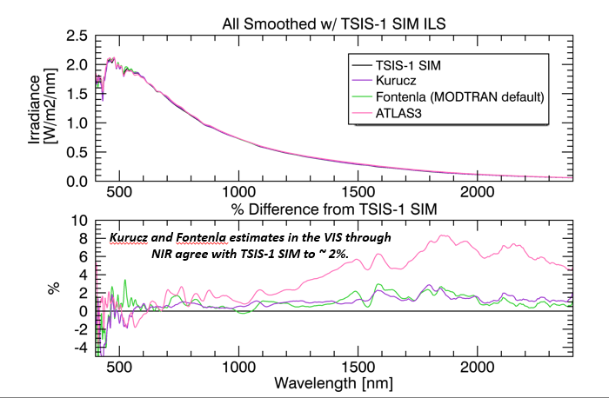
Solar spectral Irradiance
Make clear on Cal/val portal importance of stating reference
Make visible potential biases with using Modtran base values
- Look to encourage Modtran team to include TSIS spectrum
Hold workshop to discuss impact on reporting sensor cal particularly updating operational sensors

Slide 19
Summary
Looking for a volunteer (s) to take leadership of ‘image quality/geometric’ focus group
- Early meeting to define scope and priorities geolocation? Partnership with TM subgroup
Volunteers to add to Vocabulary group
Interoperability (radiometric) L1
– strategy to build a database for users to assess suitability for their application as first step
SITSats and associated recommendations of CEOS GSICS report etc how to make visible within agencies and elsewhere?
Uncertainties, Traceability – lot of interest further workshops include new space
- Engage with WGISS on strategies for communicating / appending per pixel Uc
LST ToA brightness temperature project to start with view to future operational network
Solar Irradiance Spectrum
– large potential impact on changing to TSIS spectrum workshop discussion on how best to deal with it
- Initial discussion to establish examples on impact to define strategy
- follow-up with broader community e.g. operational services

