Slide 1
WGCV-51
RadCalNet
Nigel Fox, NPL/UKSA
On behalf of M Bouvet and RadCalNet team
Agenda Item 1-12
WGCV-51, Tokyo, Japan
3rd - 6th October 2022

Slide 2
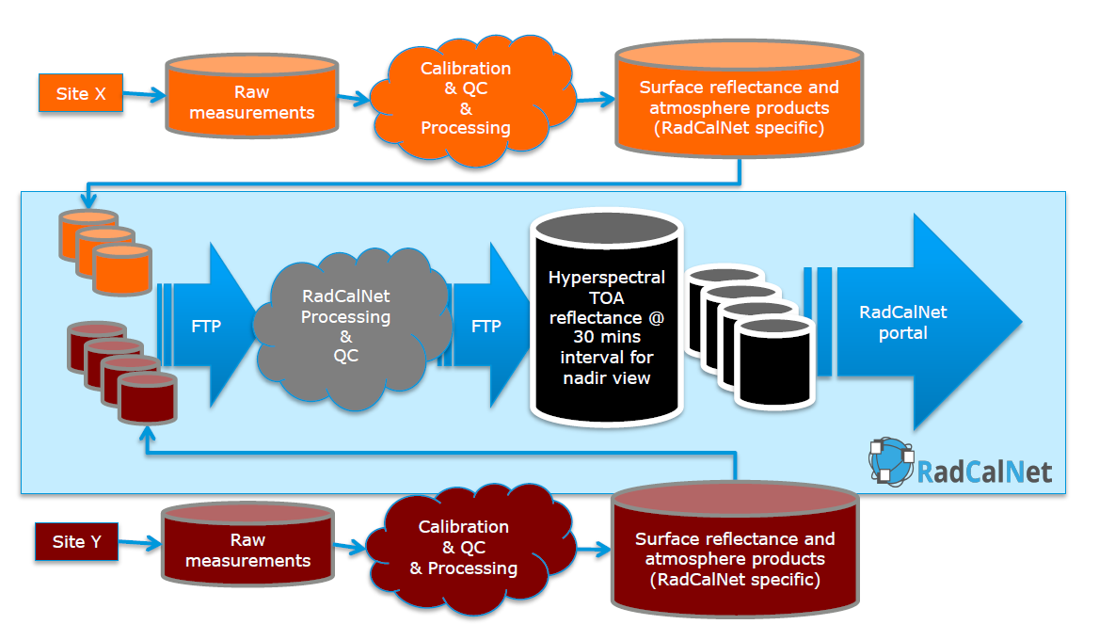
What is RadCalNet

Slide 3
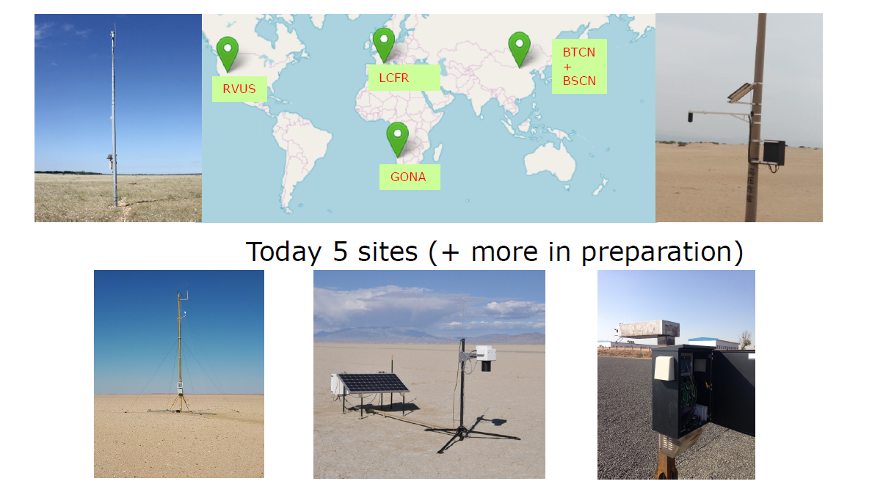
The sites

Slide 4
RadCalNet Processing

Slide 5
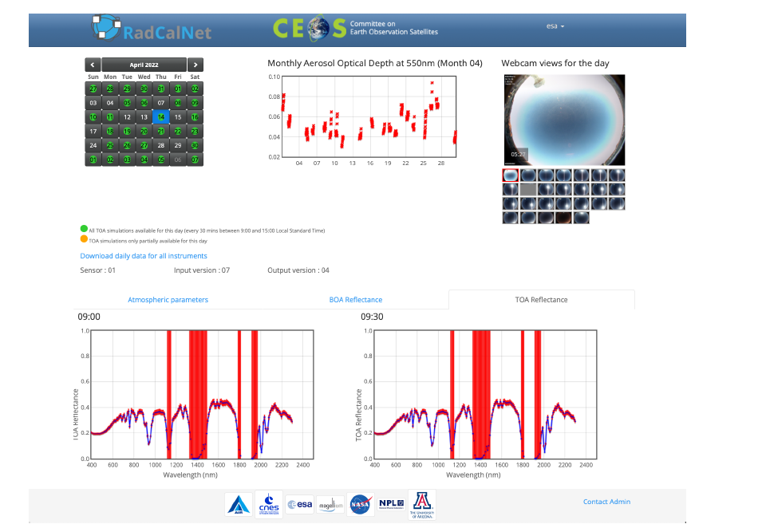
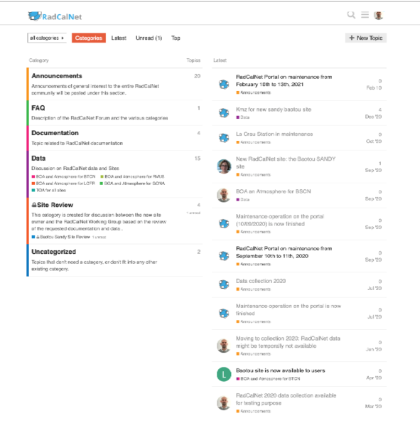
The portal with forum for comment

Slide 6
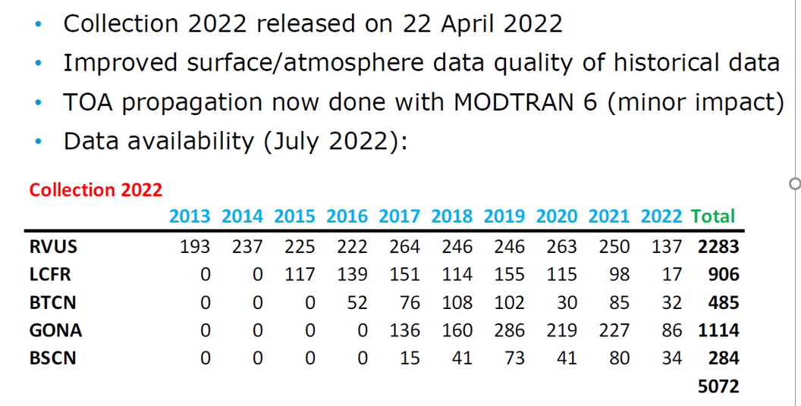
Collection 22

Slide 7
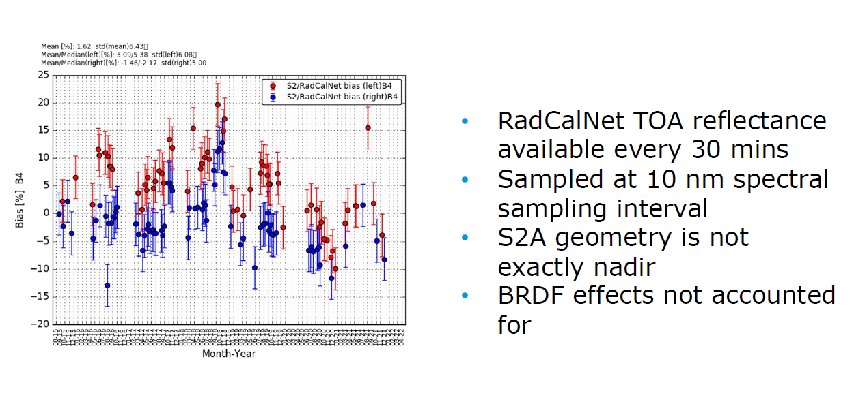
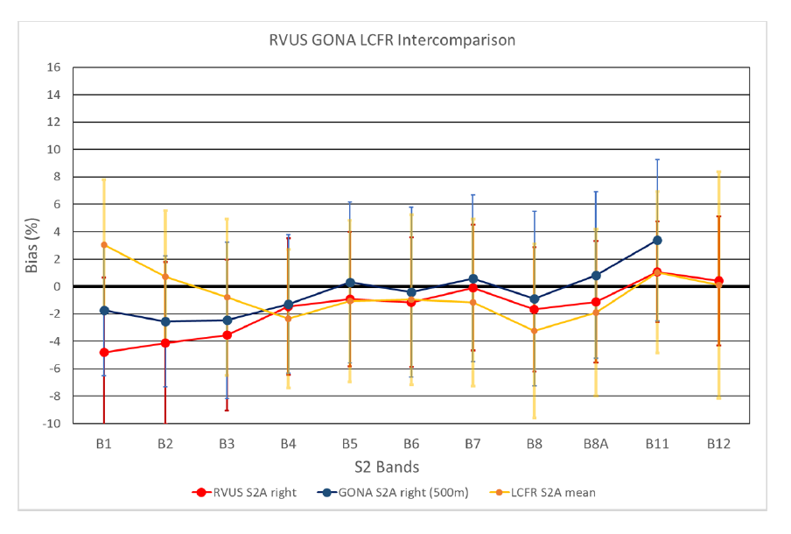
Site intercomparison S2
@RVUS
3 SITES

Slide 8
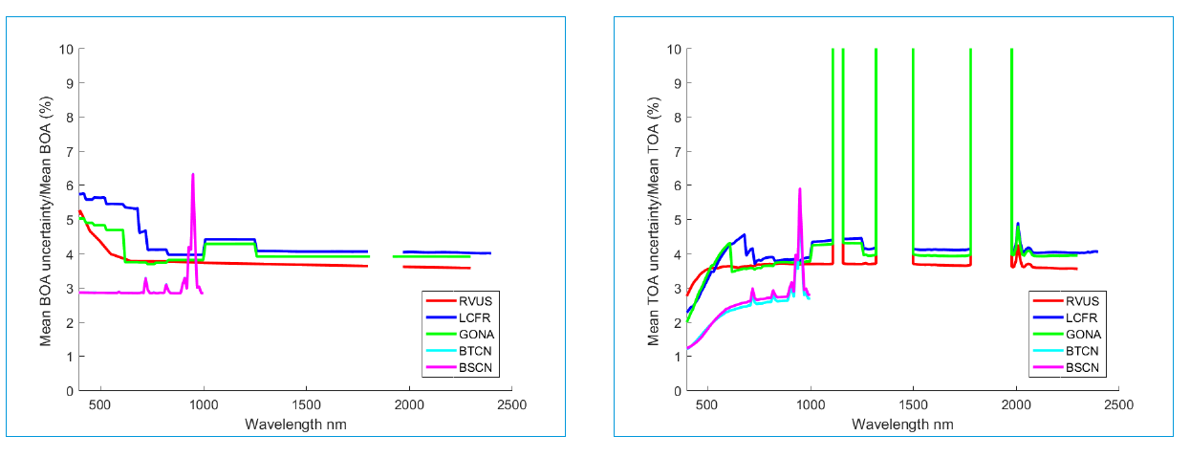
BoA & ToA relative uncertainties

Slide 9
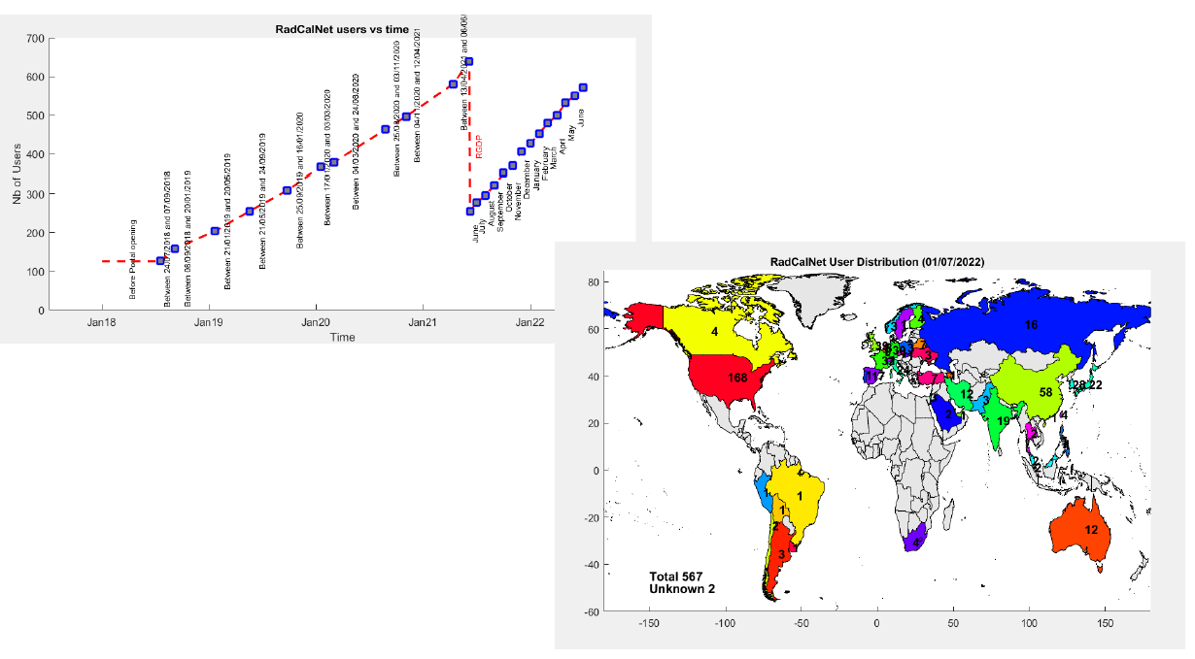
Users

Slide 10
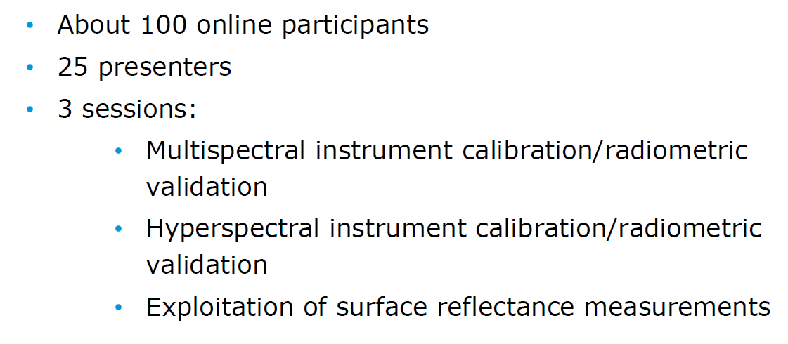
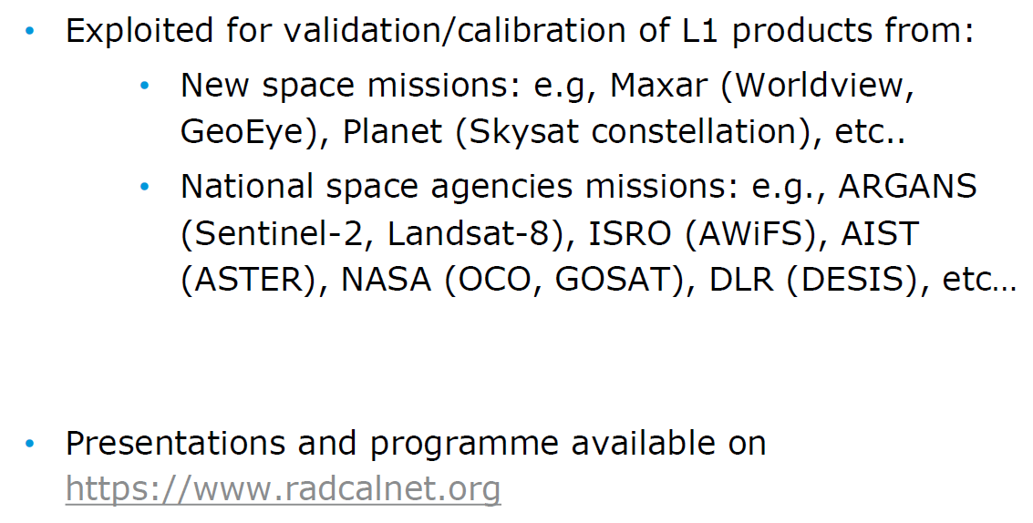
1st RadCalNet Users meeting June 21

Slide 11
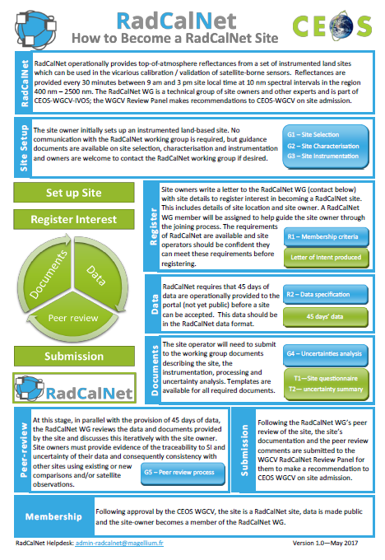
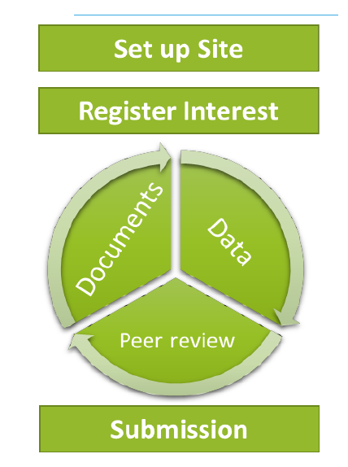
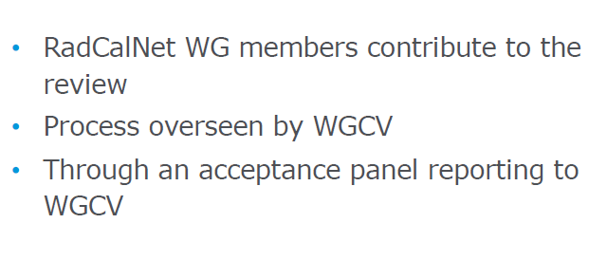
Acceptance process for New sites

Slide 12
New sites progress

Slide 13
Conclusion

