Slide 1
WGCV-51
ACIX / CMIX discussion
Eric Vermote NASA/GSFC
Philippe Goryl ESA/ESRIN
Agenda Item # 1.10
WGCV-51, Tokyo, Japan
3rd - 6th October 2022

Slide 2
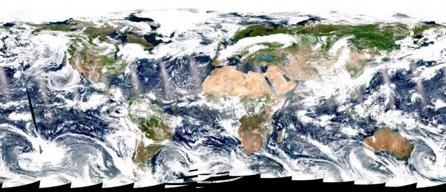
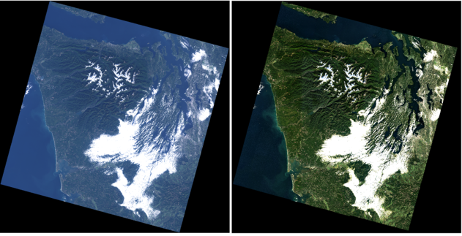
Atmospheric correction (AC) background
Estimate of the surface spectral reflectance, as would have been measured at ground level if there were no atmospheric scattering or absorption
Generic approach for AC for multiple sensors
AC products for EO sensors:
  MODIS (Terra, Aqua)
    Products: MOD09, MYD09
  VIIRS (S-NPP,JPSS1)
    Products: VNP09
  OLI (Landsat-8) and MSI (Sentinel-2)
    LaSRC algorithm/product
    Harmonization Landsat / Sentinel 2 (HLS) project
    USGS’ on demand SR product for OLI
A true color composite of VIIRS/S-NPP image acquired on July, 1, 2017
A true color composite of Landsat-8 image without AC (left) and with AC (right). Image is acquired on October, 14, 2013

Slide 3
Landsat8/OLI and Sentinel 2/MSI Surface Reflectance is largely based on MODIS C6 (LaSRC)
Atmospheric correction (AC) background
Algorithm reference for L8: Vermote E., Justice C., Claverie M., Franch B., (2016) “Preliminary analysis of the performance of the Landsat 8/OLI land surface reflectance product", Remote Sensing of Environment, 185,46-56.
The MODIS Collection 6 AC algorithm relies on
the use of very accurate (better than 1%) vector radiative transfer modeling of the coupled atmosphere-surface system (6S)
the inversion of key atmospheric parameters
  Aerosols are retrieved from Landsat8/Sentinel 2 images
  Water vapor and ozone from daily MODIS product.
Home page: http://modis-sr.ltdri.org

Slide 4
Methodology for evaluating the performance of Landsat8/Sentinel2 LaSRC product
Subsets of Level 1B data processed using the standard surface reflectance algorithm
comparison
Reference data set
Atmospherically corrected TOA reflectances derived from Level 1B subsets
AERONET measurements
(τ_{aer}, H₂O, particle size distribution
refractive indices, sphericity)
Vector 6S

Slide 5
Quantitative Assessment of Performances (APU)
Specification:
Based on error budget for collection 4
E. Vermote and S. Y. Kotchenova, MODIS Directional surface reflectance product: Method, error estimates and validation. 2011. Land Remote Sensing and Global Environmental Change: NASA’s Earth Observing System and the Science of ASTER and MODIS. Series: Remote Sensing and Digital Image Processing, Vol. 11, Springer Verlag. 873p. ISBN: 978-1-4419-6748-0

Slide 6
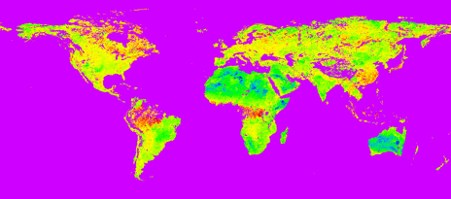

Improving the aerosol retrieval in collection 6 is reflected in APU metrics
ratio band3/band1 derived using MODIS top of the atmosphere corrected with MISR aerosol optical depth

Slide 7
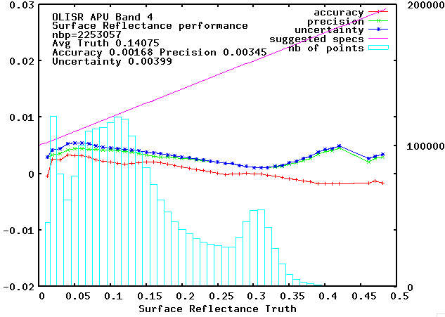
Evaluation of the performance of Landsat8
The “preliminary” analysis of OLI SR performance in the red band over AERONET is very similar to MODIS Collection 6

Slide 8
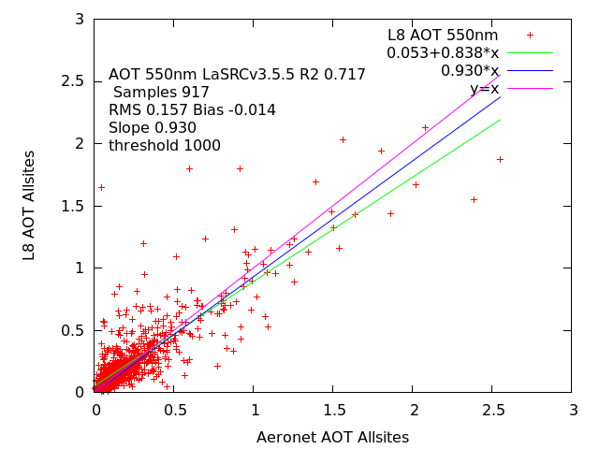
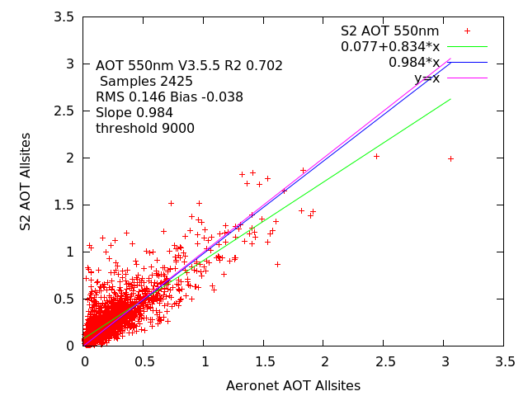
LaSRC AOT Results – L8
LaSRC AOT Results on ACIX-II

Slide 9
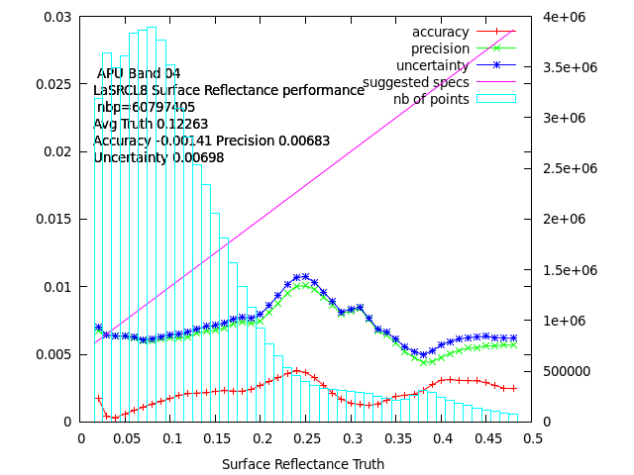
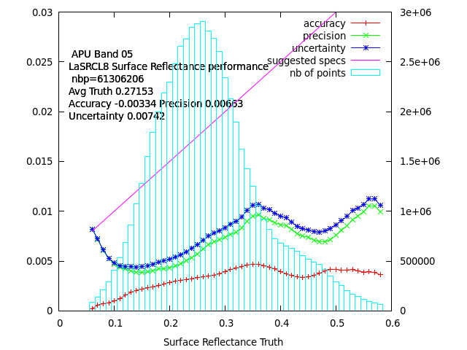
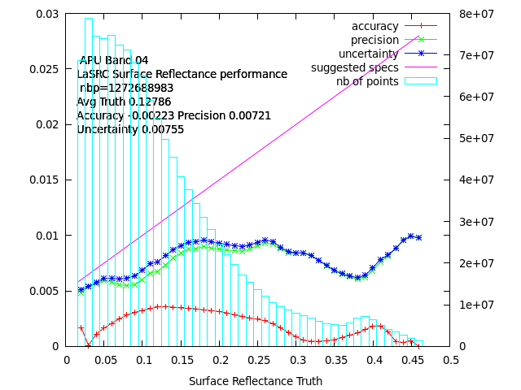
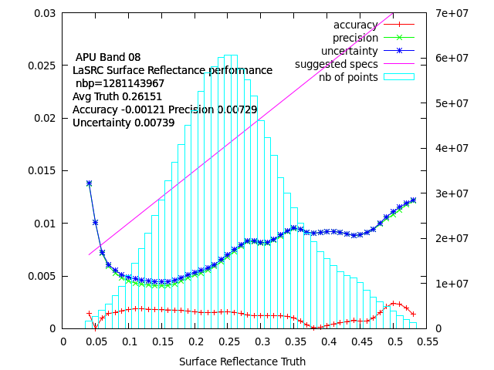
LaSRC APU results on ACIX-II
LANDSAT 8
LANDSAT 8
Sentinel 2
Sentinel 2

Slide 10
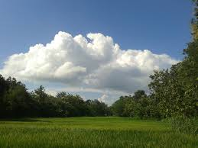
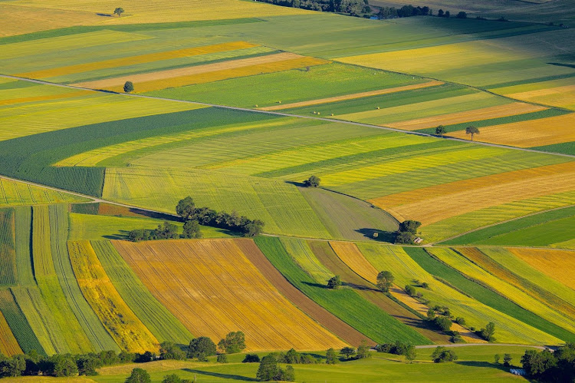
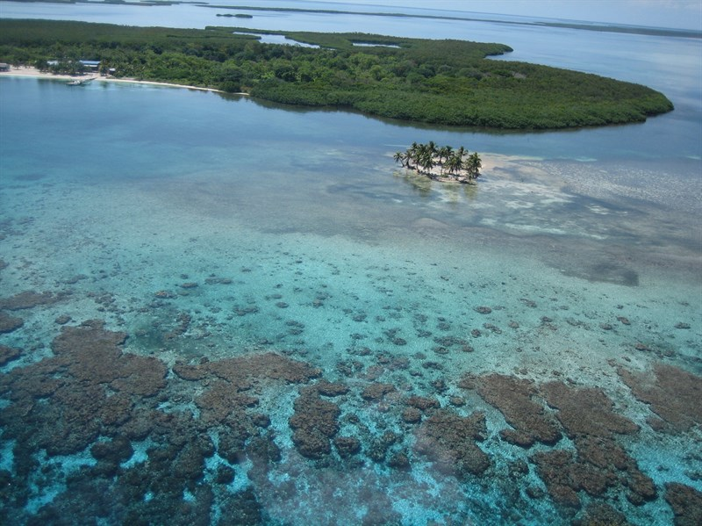

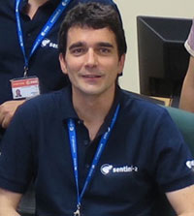
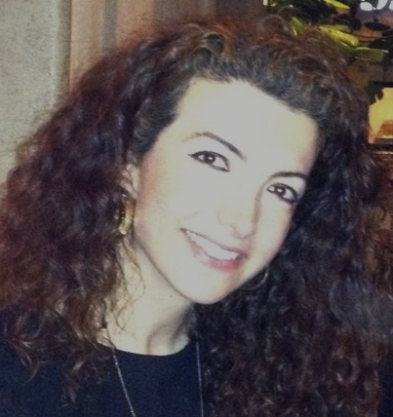
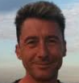

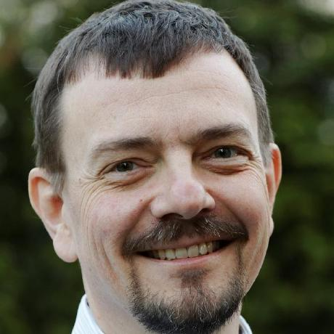
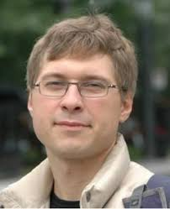

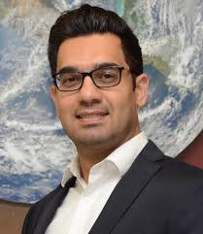
CMIX
ACIX-Land
ACIX-Aqua
ACIX II
CMIX
ACIX I
NASA and ESA have collaborated within the framework of CEOS to conduct three workshops thus far on the intercomparison of Atmospheric Correction and Cloud Mask algorithms. The impetus for such an effort has been the evolution of multiple high-resolution sensors that have facilitated the analysis of long time-series. The essential step of creating consistent surface reflectance (SR) products from these sensors was begun by multiple entities, for SR products from sensors such as Landsat-8 and Sentinel-2. This intercomparison of atmospheric correction processors began in early 2016 and aimed to point out strengths and weaknesses as well as commonalities and discrepancies of the various processors being implemented.
Ferran Gascon
Georgia Doxani
Eric Vermote
Jean-Claude Roger
Atmospheric Correction
Inter-comparison
Cloud Masking
Inter-comparison
Task Co-ordinators
Processors over
LAND
Processors over
WATER
Task Co-ordinators
Carsten Brockmann
Sergii Skakun
https://ceos.org/ourwork/workinggroups/wgcv/current-activites/
Antoine Mangin
Nima Pahlevan
Doxani, G.; Vermote, E.; Roger, J.-C.; Gascon, F.; Adriaensen, S.; Frantz, D.; Hagolle, O.; Hollstein, A.; Kirches, G.; Li, F.; Louis, J.; Mangin, A.; Pahlevan, N.; Pflug, B.; Vanhellemont, Q. Atmospheric Correction Inter-Comparison Exercise. Remote Sens. 2018, 10, 352

Slide 11

WHY?
Free and open access policy to Sentinel-2 and Landsat-8 imagery has stimulated the development and operational use of AC processors for generating Bottom-of-Atmosphere (BOA) products
OPEN
ACCESS
The objective is to point out:
Strengths & Weaknesses
Commonalities & Differences
S
W
C
D

Slide 12
HOW?
Definition of the
inter-comparison protocol
Application of the AC processors
Analysis of the results
  Coordinators & Participants
  discussed all the major points and defined the inter-comparison procedure.
  Participants
  applied their AC schemes on a set of test sites keeping the processing parameters constant. The results were submitted for analysis to ACIX coordinators.
  Coordinators
  processed the AC results and assessed the inter-comparison metrics. The results presented and discussed with the participants.

Slide 13
HOW?
12
120
7
3500
Developer Teams
from various Space Agencies, R&D Companies,
Research Institutes
and Universities
Study Sites
spread globally based on the AERONET stations (coincident measurements availability )
Image Scenes
to be processed acquired by Sentinel-2A, -2B and Landsat-8
Months
for participants to submit results

Slide 14
HOW?
12
S2: 80
L8: 74
7
S2: 1500
L8: 1000
Developer Teams
from various Space Agencies, R&D Companies,
Research Institutes
and Universities
Study Sites
spread globally based on the AERONET stations (coincident measurements availability )
Image Scenes
to be processed acquired by Sentinel-2A, -2B and Landsat-8
Months
for participants to submit results

Slide 15
WHO?
AC Processors | Participants | Organization/Company
AComp | Fabio Pacifici | DigitalGlobe [USA]
ATCOR | Bringfried Pflug | DLR Remote Sensing Technology Institute [Germany]
EMBAC | Kim Minsu | USGS [USA]
FORCE | David Frantz | Humboldt-University [Germany]
iCOR | Liesbeth Dekeukelaere Erwin Wolters | VITO [Belgium]
LaSRC | Eric Vermote Jean-Claude Roger Sergii Skakun | NASA GSFC [USA] Maryland University [USA]
MAJA | Olivier Hagolle Aimé Meygret | CNES/CESBIO [France]
Overland | Hervé Poilvé | Airbus Defence and Space [France]
Planet SR | Alan Collison | Planet [USA]
Sen2Cor | Jérôme Louis Bringfried Pflug | European Space Agency (ESA), Telespazio [France] DLR Remote Sensing Technology Institute [Germany]
SIAC | Feng Yin | University College London [UK]
SMAC-G/MERRA2 | Didier Ramon | HYGEOS [France]

Slide 16
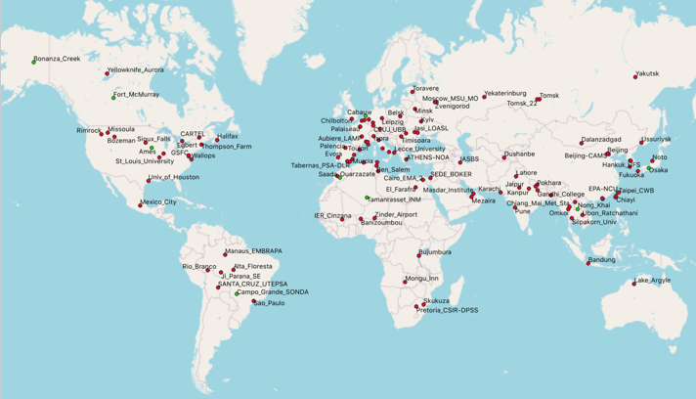
WHERE?
The land cover types of the AERONET sites
Sentinel-2 and Landsat 8
Sentinel-2

Slide 17



HOW?
Aerosol Optical Depth
Surface Reflectance
Water Vapour

Slide 18



Aerosol Optical Depth
Aerosol Optical Depth
Water Vapour
Statistics
No. of samples
R² (Coefficient of determination) RMSE bias
A E R O N E T
Estimated AOD (/WV) & compared to Level 1.5
(cloud screened) AERONET data
Interpolate AERONET values @ λ=550 nm using Angstrom Exponent
Average AERONET values over time period within ±15 min from AOD retrieved values (L-8/S-2A, -2B overpass)
Average estimated AOD values over an image subset of 9 km x 9 km centred on the AERONET Sunphotometer station
    Scatterplots and APU Plots
Accuracy, Precision, Uncertainty

Slide 19
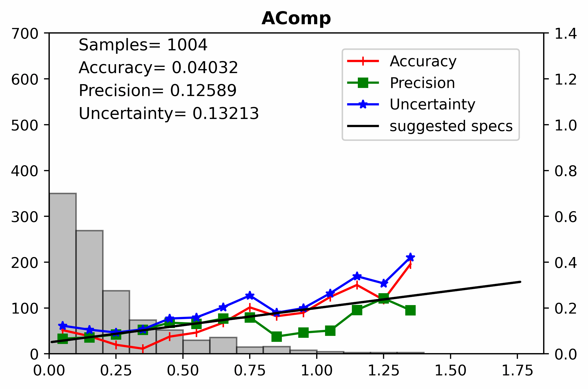
Aerosol Optical Depth
--- Sentinel-2
A
    Accuracy
the degree to which a measured value agrees with the reference value
Mostly inside the suggested specifications → unbiased results
P
    Precision
* specs=0.15*AOD_{550ref} + 0.05
the degree to which repeated measurements agree with each other
Mostly close to specifications
U
    Uncertainty
estimate of amount by which measurement differs from the reference value
Consistent performance of most processors in retrieving relative light to medium aerosol loading (AOD<0.2)
iCOR and SMACG: lowest U <0.12,
SIAC, AComp, MAJA, Sen2Cor: U< 0.14
Notes:
the uncertainty limits specifications, specs=0.15*AOD_{550ref} + 0.05, according to the empirical uncertainty of MODIS land AOD retrievals

Slide 20
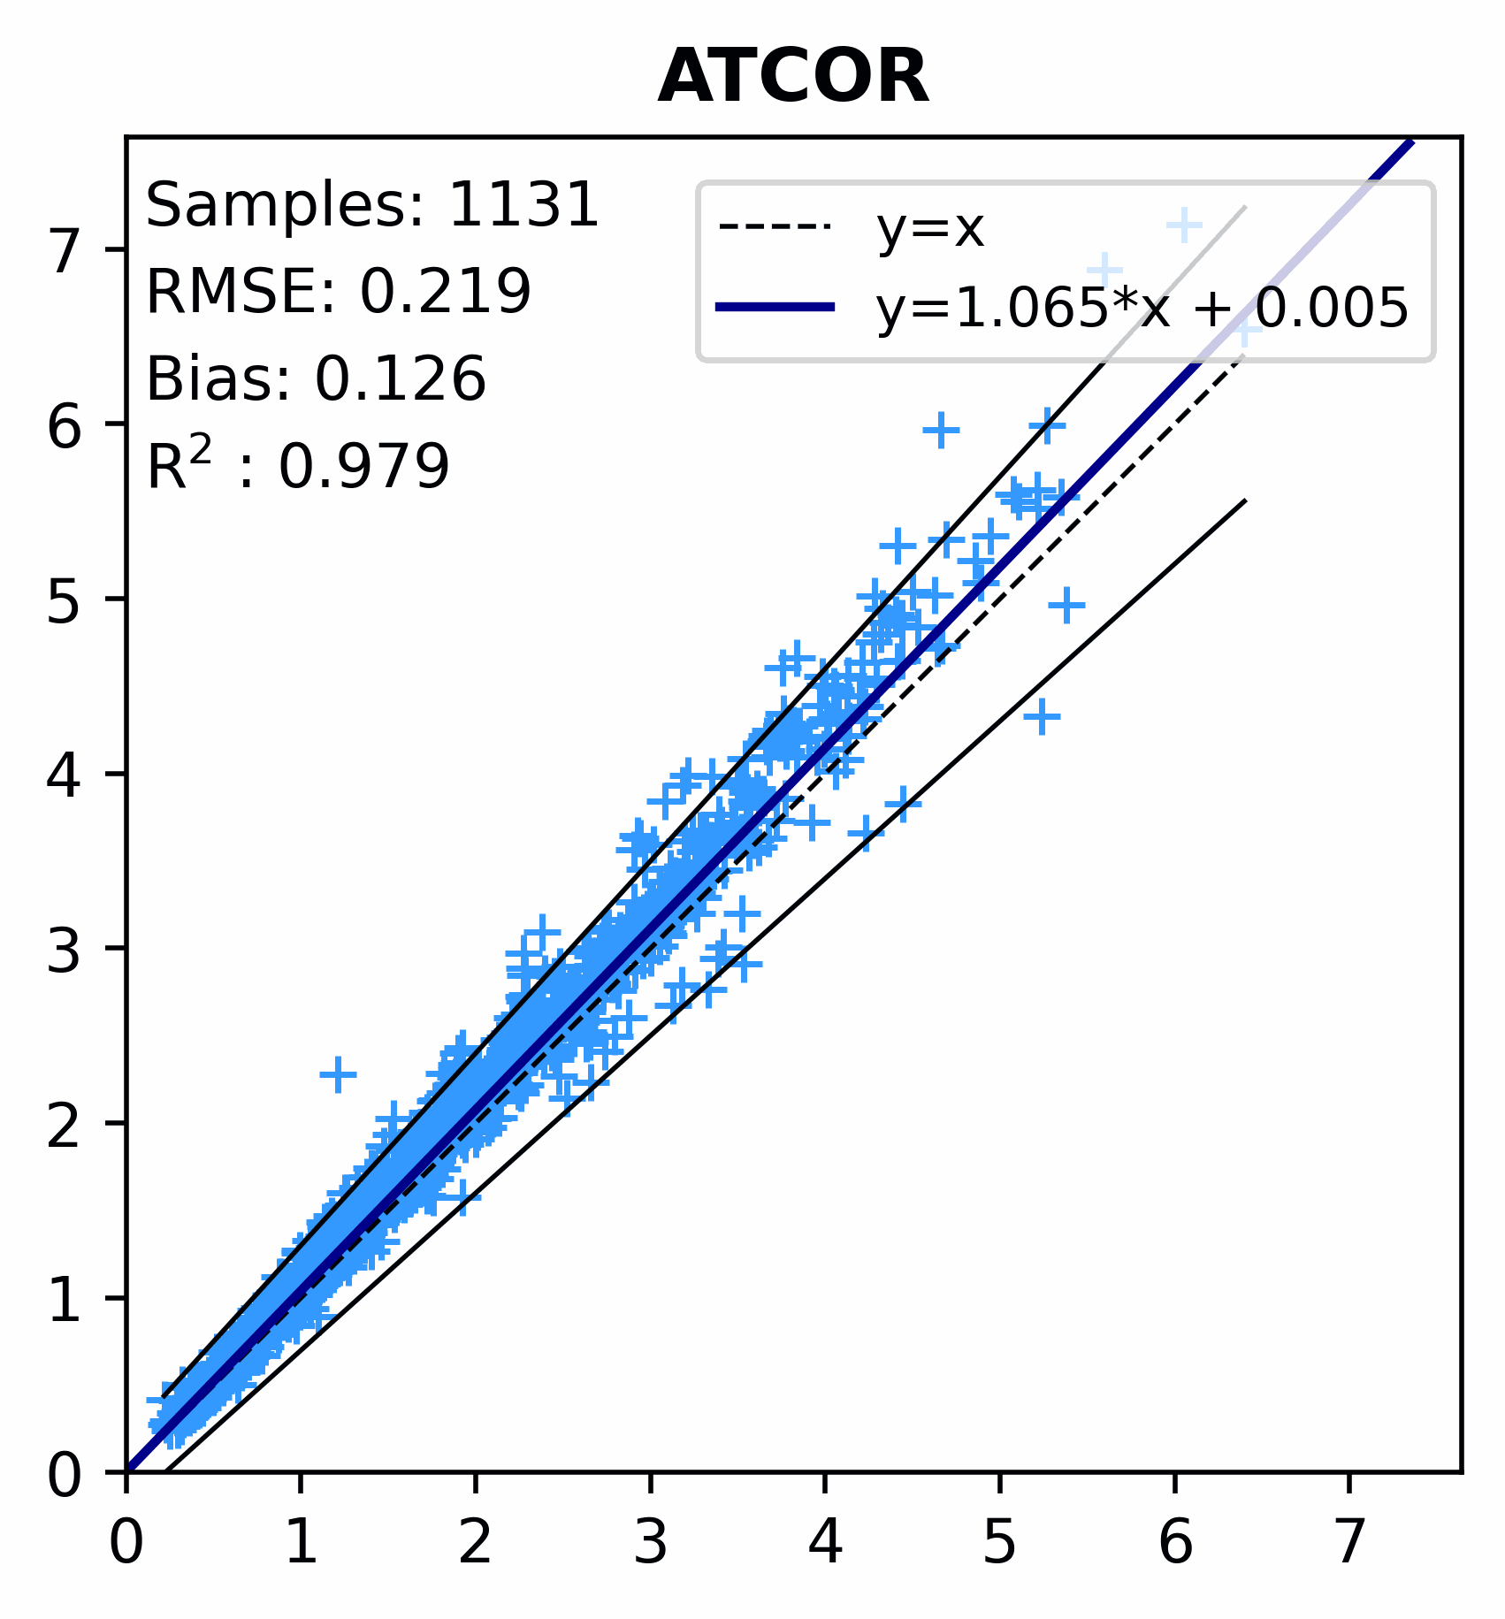
Aerosol Optical Depth
Water Vapour
--- Sentinel-2
    Root Mean Square Error
E
WV retrieval is very accurate
R²>0.9 and RMSE<0.25
P
    Percent
More than 90% of the results are falling within the specifications for all the processors except LaSRC (89.5%), SIAC (85%) and FORCE (70%) whose results are more dispersed, mainly for WV values over 3 g/cm2.
*specs=0.1*WV_{ref} + 0.2

Slide 21
HOW?
Aerosol Optical Depth
Surface Reflectance
Water Vapour

Slide 22
HOW?
    02. AERONET corrected data
01. Ground based validation
AC data generated by 6SV radiative transfer model using AERONET data. AOT, aerosol model and column water vapour will be derived from AERONET sunphotometer measurements and will be used in the radiative transfer model in order to perform the AC of TOA reflectance.
Surface Reflectance
RadCalNet [La Crau] (France), Gobabeb (Namibia)], SR are provided by CNES in the same angular conditions as L8, S2A & S2B
    05. SR inter-comparison
    03. Noise Estimation
Plotting the SR time series per date, band and AC approach.
Assuming that there is a linear SR variation between two consecutive acquisition days; for three successive observations the statistical difference between, the center measurement and the linear interpolation between the two extremes quantifies the “noise” :
    04. Distance Matrix
Distance Matrix was shaped based on the Euclidean distances calculated for the corresponding bands, dates and sites for every combination of couple of processors

Slide 23


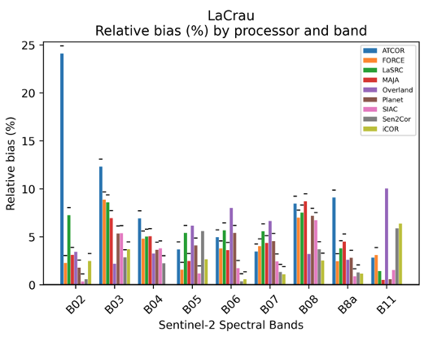
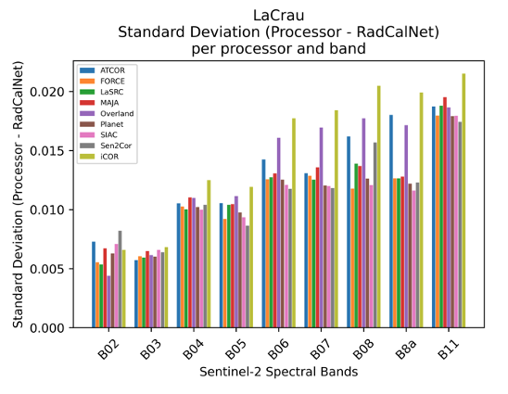

--- Sentinel-2
01. Ground based validation
La Crau [France ]: 44 S2 scenes
Mostly SR underestimation
Relative Biases
La Crau<± 9%
La Crau -> Increasing values from VNIR and SWIR
Stdv Difference
La Crau<0.02
Notes:
La Crau: 44 S2 scenes
Gobabeb: 40 S2 scenes

Slide 24


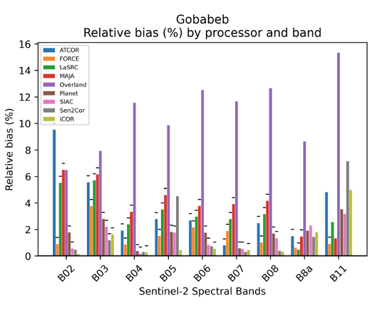
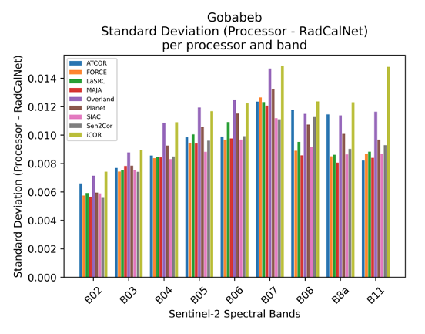
--- Sentinel-2
01. Ground based validation
Gobabeb [Namibia]: 40 S2 scenes
Mostly SR underestimation
Relative Biases
Gobabeb<± 6%
Gobabeb -> Increasing values up to B07, improving NIR and SWIR
Stdv Difference
Gobabeb<0.01
Notes:
La Crau: 44 S2 scenes
Gobabeb: 40 S2 scenes

Slide 25
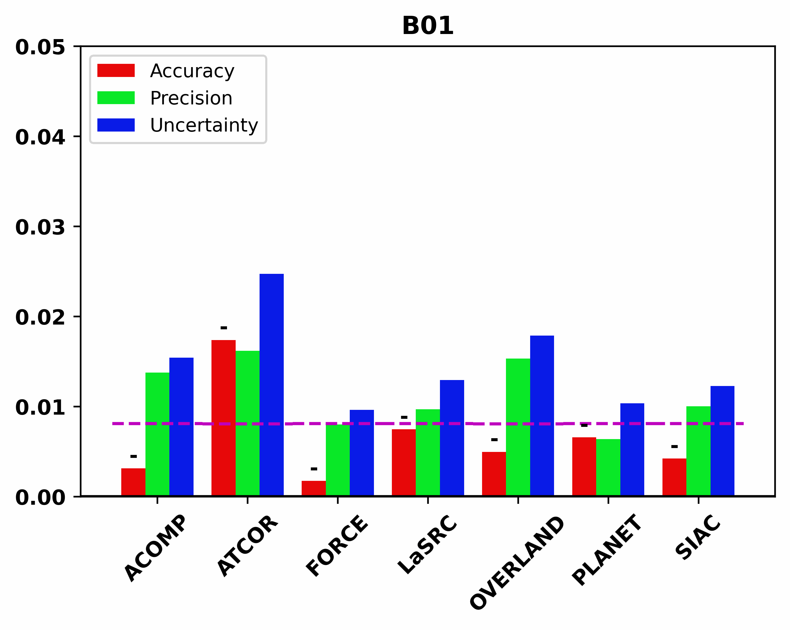
--- Sentinel-2
    02. AERONET corrected data
Improved results from VNIR (V: B01, B02, B03, B04, (RE/NIR: B05, B06, B07, B08, B8a) to SWIR (B11, B12),
*specs=0.05*SR_{ref} + 0.005
FORCE & Planet retrievals within the specifications across all bands (not for B01 & B09), similar for LaSRC and SIAC (not for B01, B02 & B09)
AComp’s SR retrievals closer to specifications from VNIR to SWIR spectral range, apart from B05 and B12 for which uncertainty exceeds the suggested requirements.

Slide 26
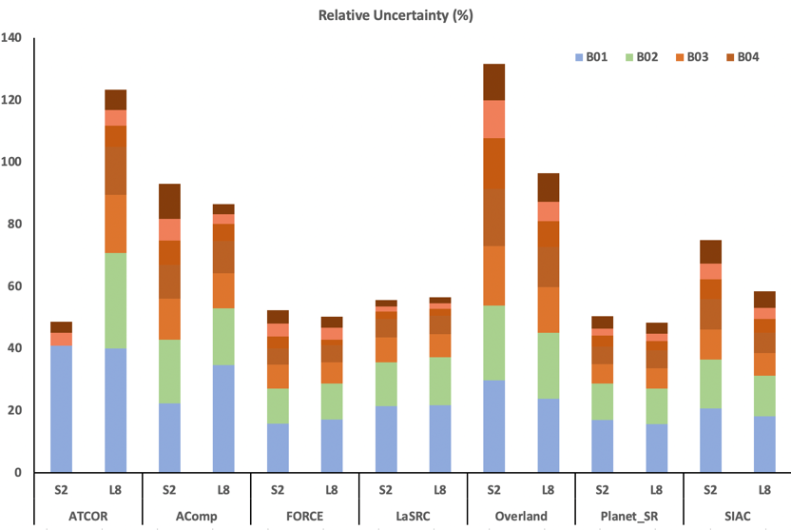


--- Sentinel-2 & Landsat 8
    02. AERONET corrected data
$rU=100\%∗U/\overline{x}$
$U :$uncertainty and
$\overline{x}:$the average truth

Slide 27
>>
Arid sites [4 sites]
--- Sentinel-2
    03. Noise Estimation
Only sites with >20 scenes from the same orbit
Common sites, dates and quality pixels for all processors [available masks union]
Similar variability of SR over short time amongst al processors for both site types
>>
Vegetated sites [6 sites]
LaSRC produces the ‘smoothest’ time series for both site types

Slide 28
SUMMARY
    ACIX-II Land in Numbers
11 processors implemented on 1500 Sentinel-2 scenes over 80 common sites
9 processors implemented on 1000 Landsat 8 scenes over 74 common sites
    Aerosol Optical Depth
mostly in moderate agreement with the AERONET reference values, ∼ 0.65 < R² < 0.775 and ∼ 0.115 < RMSE < 0.2
    Water Vapour
strong correlations with the AERONET data, ﻿ R² > 0.9 and RMSE<0.25

Slide 29
SUMMARY
    Surface Reflectance
RadCalNet measurements: similar results for most processors in the SR comparison [La Crau, Gobabeb]
Simulated SR reference using 6SV and AERONET : Overall the results are improving from VNIR to SWIR, variation in the results amongst processors with improved results for the processors using variation of 6S RTM
    Overall
No clear superiority - Similar results for most processors when compared to in-situ measurements and variance when compared to simulated reference
    Suggestions
More in situ SR measurements are needed (CESBIO agricultural site [RadCalNet], HyperNet)
Some geographical areas were missing (Africa, South America, Australia) & many sites close to big cities, deserts

Slide 30
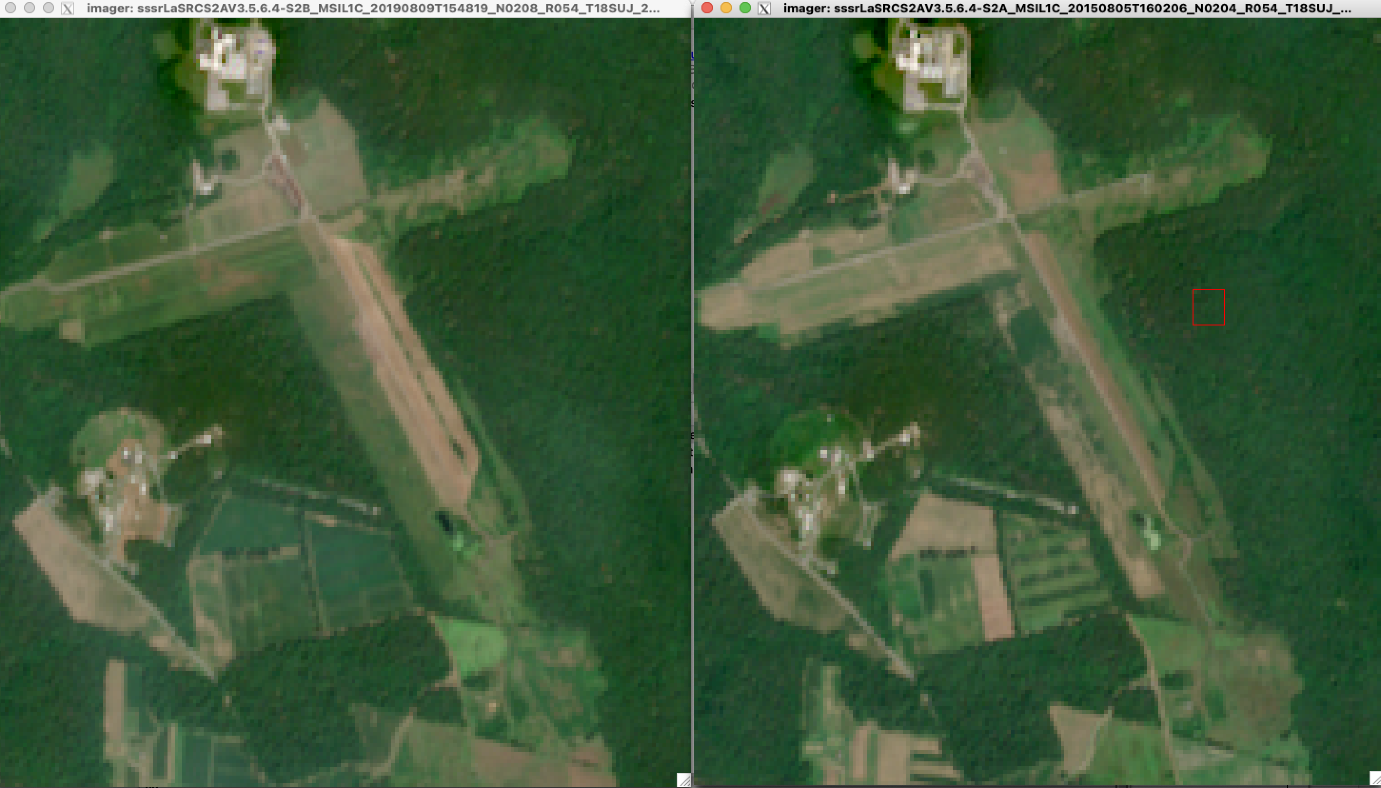
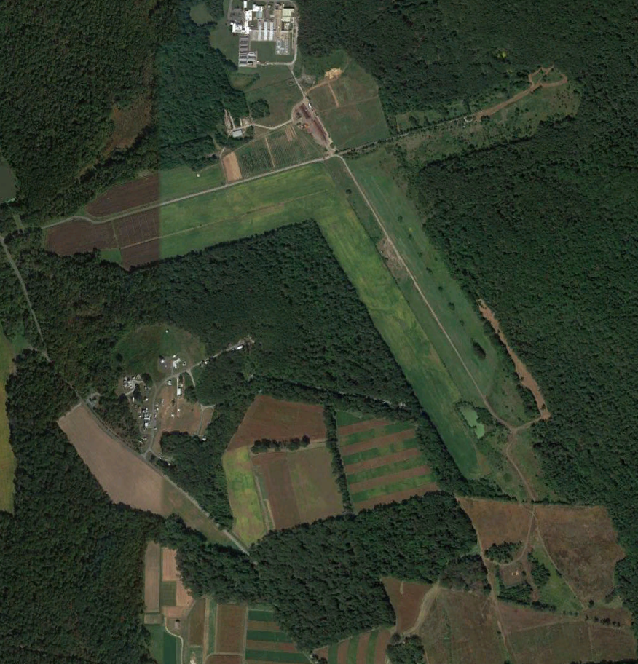
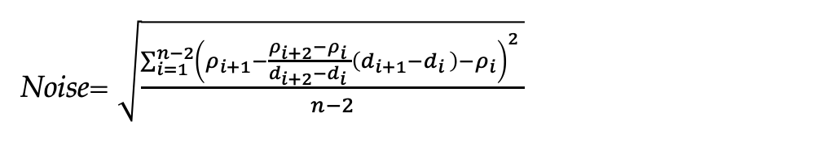
GSFC-BELTSVILLE Site 1920 meters x 1920 meters
Time series analysis
August 2019 (S2B)
August 2015 (S2A)
Google Earth (Oct 2020,Sept 2021)
Noise= $\sqrt{\frac{\sum_{i=1}^{n−2}{{\left(ρ_{i+1}−\frac{ρ_{i+2}−ρ_{i }}{d_{i+2}−d_{i }}\left(d_{i+1}−d_{i }\right)−ρ_{i}\right)}^{2} }}{n−2}}$
Original formula Vermote et al. 2019 (with threshold 20 days)

Slide 31
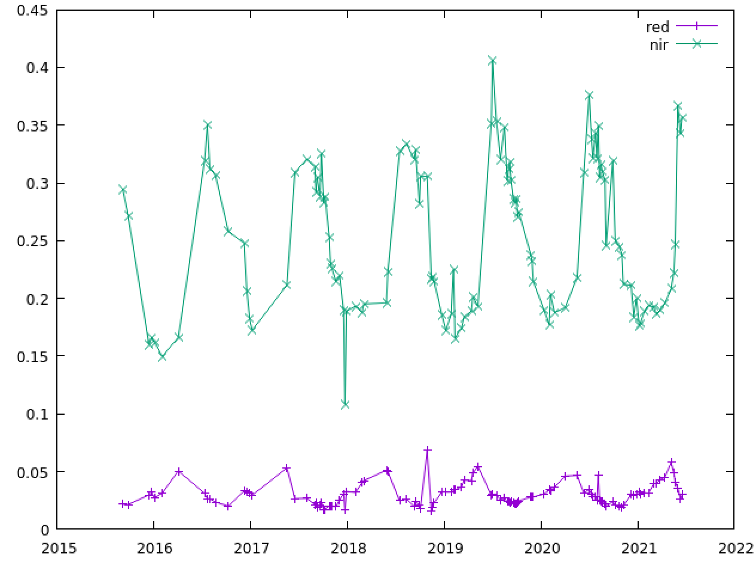
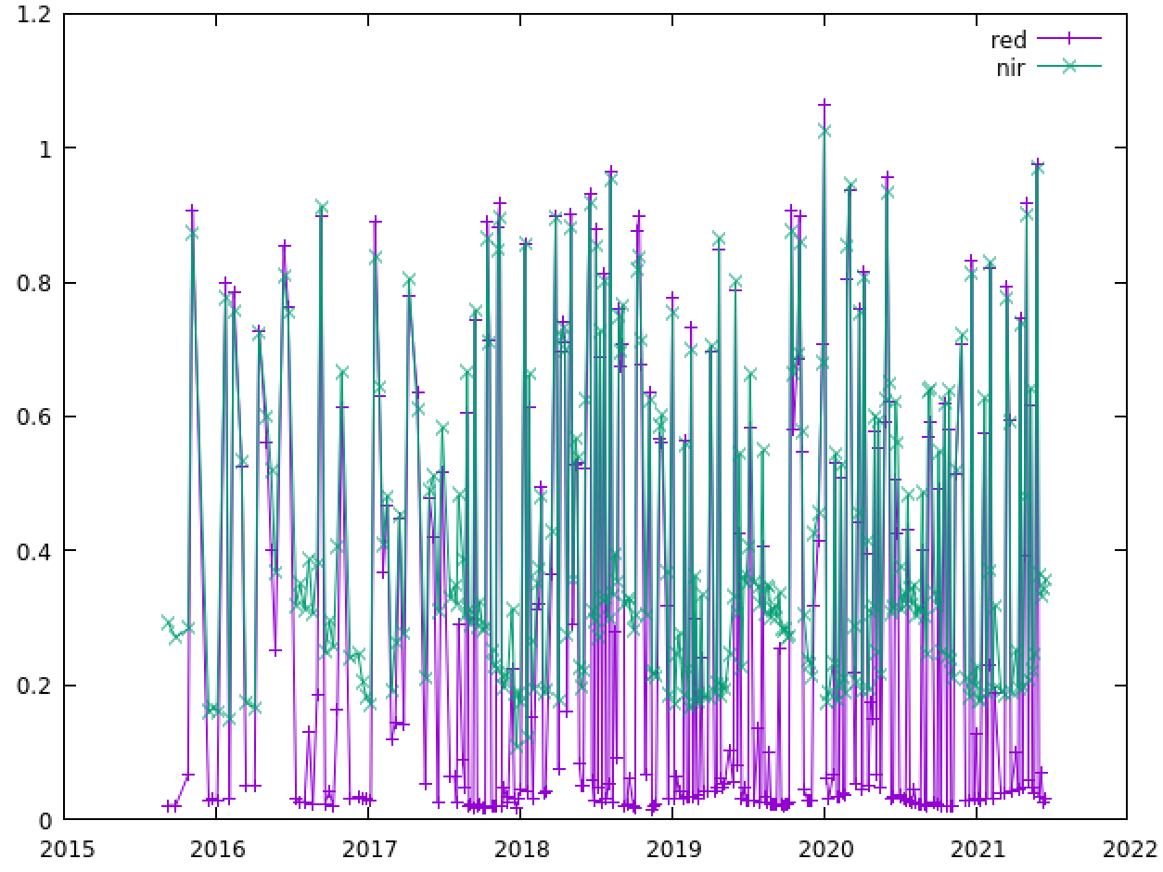
Time Series and noise with threshold at 60 days
Surface reflectance LaSRC S2A,B
Surface reflectance LaSRC S2A,B no QA applied
band | Avg | Std | CV Std/Avg | NB
red | 0.030 | 0.010 | 0.326 | 116
nir | 0.252 | 0.064 | 0.255 | 116
band | Avg | Std | CV Std/Avg | NB
red | 0.277 | 0.314 | 1.134 | 296
nir | 0.415 | 0.227 | 0.547 | 296
band | Noise | Noise (95%) | NB
red | 0.003 | 0.003 | 94/89
nir | 0.021 | 0.022 | 94/89
band | Noise | Noise (95%) | NB
red | 0.332 | 0.340 | 294/279
nir | 0.239 | 0.245 | 294/279

Slide 32
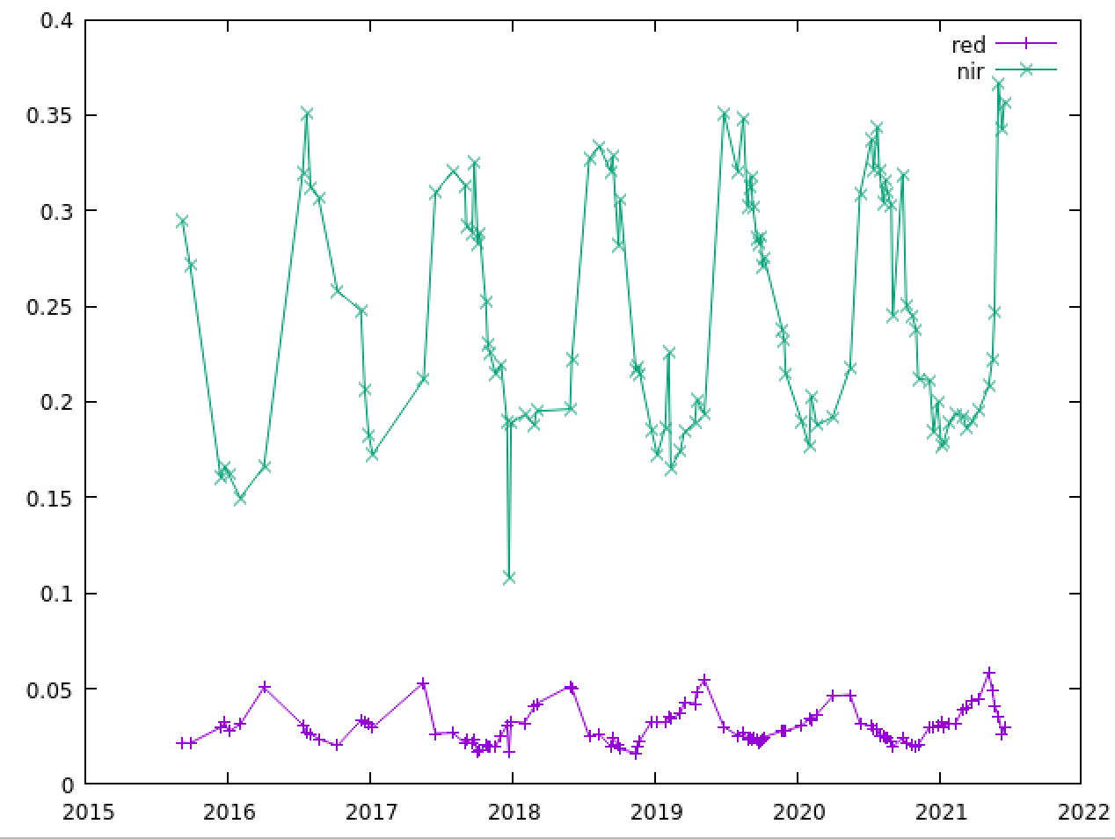
Time Series and metrics (threshold at 60 days)
Surface reflectance LaSRC (QA Next generation experimental applied)
band | Avg | Std | CV | NB
red | 0.030 | 0.009 | 0.310 | 110
nir | 0.247 | 0. 061 | 0.248 | 116
band | Noise | Noise (95%) | NB
red | 0.002 | 0.002 | 87/82
nir | 0.019 | 0.019 | 87/82

Slide 33
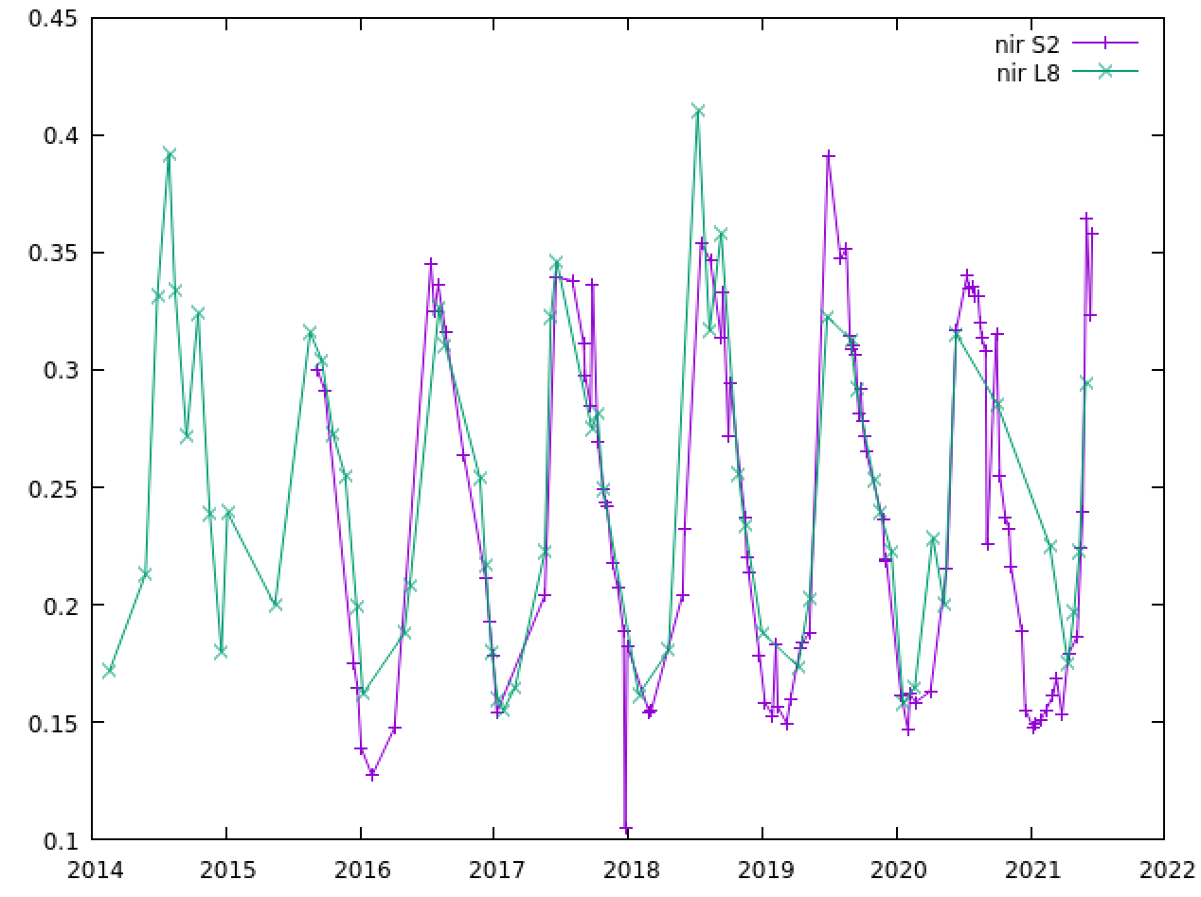
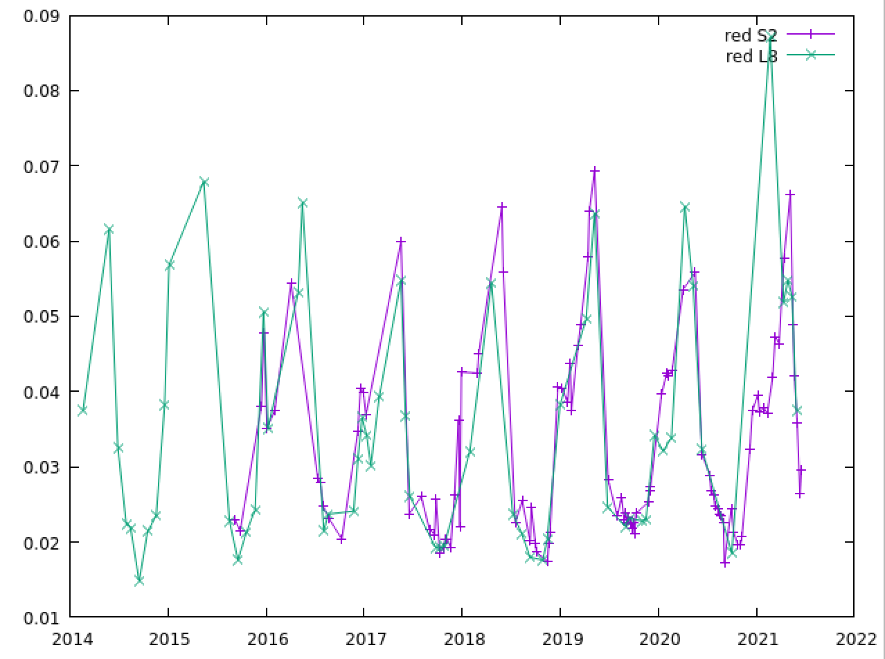
Combining with Landsat 8
S2 (3x3)
L8
S2+L8
band | Noise | Rnoise % | NB
red | 0.0029 | 8.9 | 83
nir | 0.0171 | 7.1 | 83
band | Noise | Rnoise % | NB
red | 0.0038 | 10.8 | 13
nir | 0.0222 | 9.0 | 13
band | Noise | Rnoise% | NB
red | 0.0036 | 10.7 | 146
nir | 0.0201 | 8.3 | 146
RNoise = 100*Noise/average

Slide 34











CMIX:Cloud Mask Intercomparison eXercise
Sergii Skakun, Jan Wevers, Carsten Brockmann, Georgia Doxani, Matej Aleksandrov, Matej Batič, David Frantz, Ferran Gascon, Luis Gómez-Chova, Olivier Hagolle, Dan López-Puigdollers, Jérôme Louis, Matic Lubej, Gonzalo Mateo-García, Julien Osman, Devis Peressutti, Bringfried Pflug, Jernej Puc, Rudolf Richter, Jean-Claude Roger, Pat Scaramuzza, Eric Vermote, Nejc Vesel, Anže Zupanc, Lojze Žust

Slide 35
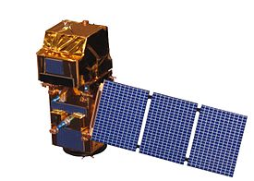
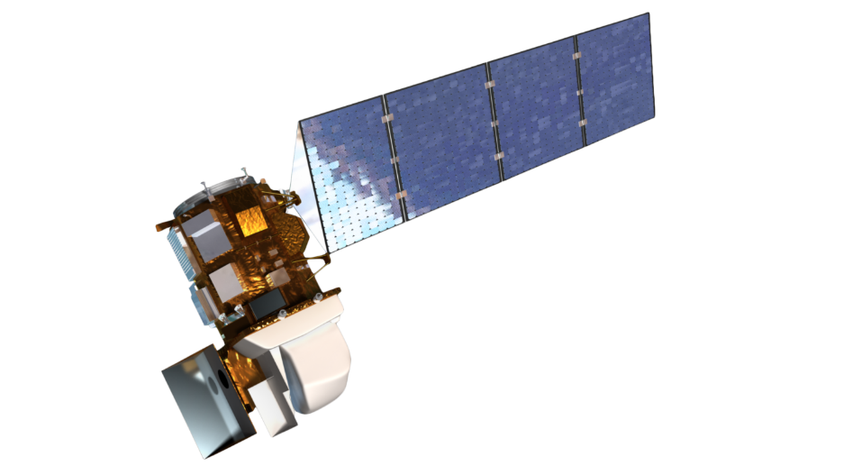
GOAL
GOALS
To inter-compare a set of cloud detection algorithms for space-borne high-spatial resolution (10-30 m) optical sensors
Focus on Landsat 8 and Sentinel-2 data
Not a competition, but inter-comparison
Notes:
CMIX, as one such activity, is an international collaborative effort aimed at intercomparing cloud detection algorithms for moderate-spatial resolution (10-30 m) spaceborne optical sensors. The focus of CMIX is on open and free imagery acquired by the Landsat 8 (NASA/USGS) and Sentinel-2 (ESA) missions.

Slide 36
PERFORMERS
Processor | Organization | Methodology
ATCOR | DLR | Spectral tests (L8, S2)
CD-FCNN | University of Valencia | Machine learning (L8, S2)
Fmask 4.0 CCA | USGS | Spectral tests (L8, S2)
FORCE | Humboldt-Universität zu Berlin / Trier University | Spectral test + parallax (for S2) (L8, S2)
IdePix | Brockmann Consult | Spectral tests (S2)
InterSSIM | Sinergise | Machine learning + spatio­temporal context (S2)
LaSRC | NASA / University of Maryland | Spectral tests (L8, S2)
MAJA | CNES / CESBIO | Multi-temporal and spectral tests (S2)
s2cloudless | Sinergise | Machine learning (S2)
sen2cor | ESA / Telespazio France | Spectral test + auxiliary data (S2)
Notes:
Ten algorithms developed by nine teams from fourteen different organizations representing universities, research centers and industry, as well as space agencies (CNES, ESA, DLR, and NASA), are evaluated within the CMIX. Those algorithms vary in their approach and concepts utilized which were based on various spectral properties, spatial and temporal features, as well as machine learning methods.

Slide 37
REFERENCE DATASETS
Dataset | Spatial domain | Spatial resolution | # scenes
CESBIO | Fully classified Sentinel-2 scenes | 60 m | S2: 30
GSFC | Sample polygons | Polygons (vector) | L8: 6 S2: 28
Hollstein | Sample polygons | Polygons (at 20 m) | S2: 59
L8Biome | Fully classified Landsat 8 scenes | 30 m | L8: 96
PixBox | Sample pixels | S2: 10 m L8: 30 m | S2: 29 L8: 11
Notes:
Algorithm outputs are evaluated against existing reference cloud mask datasets. Those datasets vary in sampling methods, geographical distribution, sample unit (points, polygons, full image labels), and generation approaches (experts, machine learning, sky images).

Slide 38
Fully classified scene
CESBIO REFERENCE DATASET

Slide 39
Polygons
GSFC S2 REFERENCE DATASET

Slide 40
Samples
PIXBOX S2 REFRENCE DATASET

Slide 41
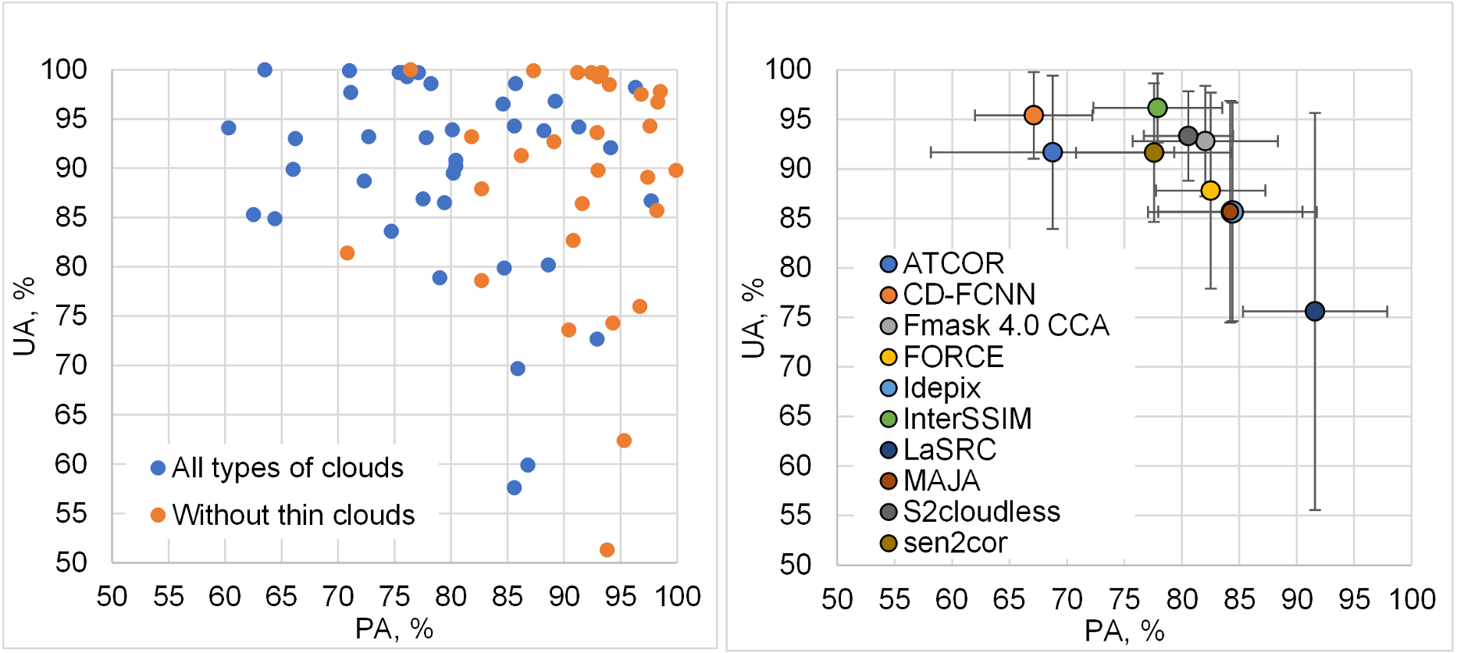
Results: Sentinel-2

Slide 42
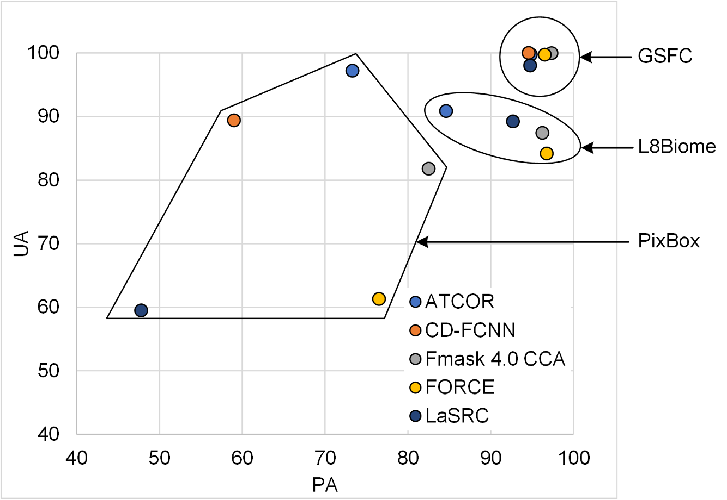
Results: Landsat 8

Slide 43
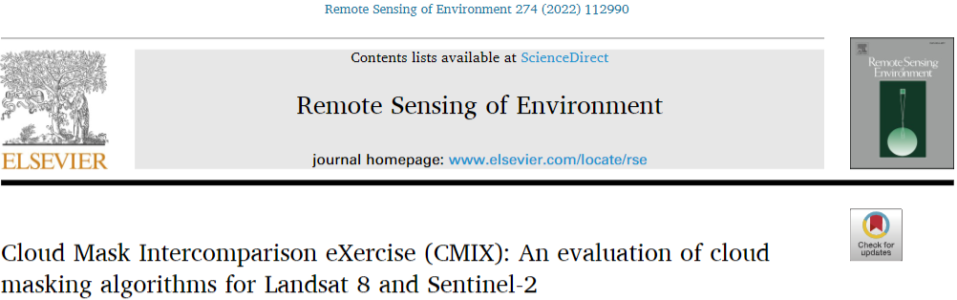
Major findings
  Performance varied depending on the reference data
  Average OA for Sentinel-2: 80% to 89%
  Average OA for Landsat 8: 80% to 98%
  Performance improved when thin/semi-transparent clouds not considered

Slide 44
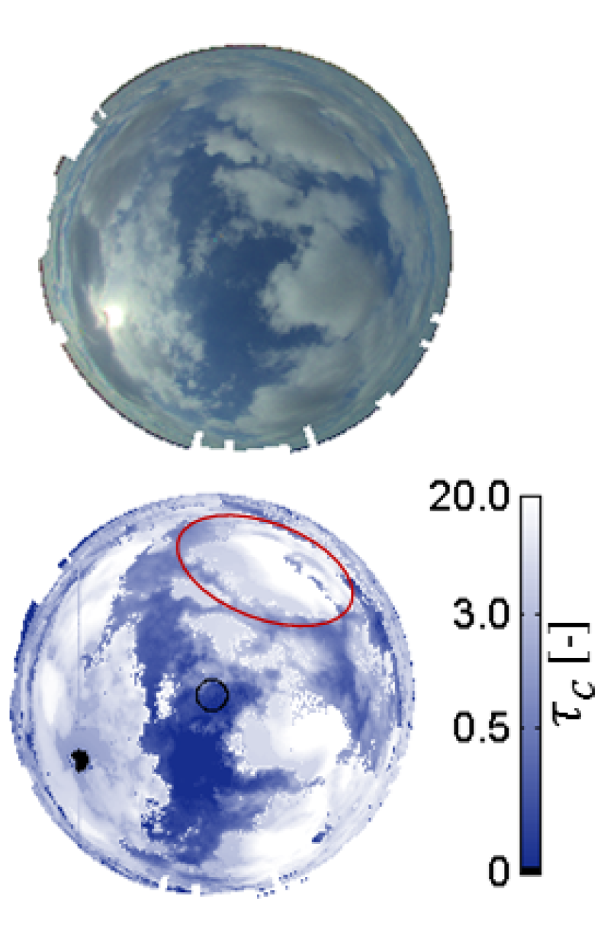
Recommendations
Definition of clouds
  Cloud optical depth
New validation/reference data
  Consistent cloud definition
  Cloud boundary
  Time series
Analysis framework
  Sample-based vs area-based
  Temporal analysis
  Application-based
Network of sky imagery:
NASA GSFC, Greenbelt, MD, USA
Sapienza University, Rome, Italy
Valencia University, Valencia, Spain
Sao Paulo University, Sao Paulo, Brazil
Princess Elisabeth Station, Antarctica
WLEF, Park Falls, WI, USA
Cloud optical depth retrieval from ground-based cloud imager (Mejia et al., 2016)

Slide 45
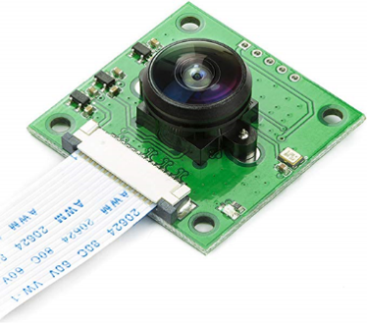
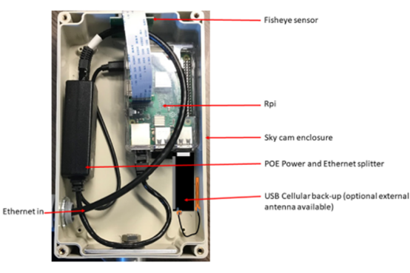
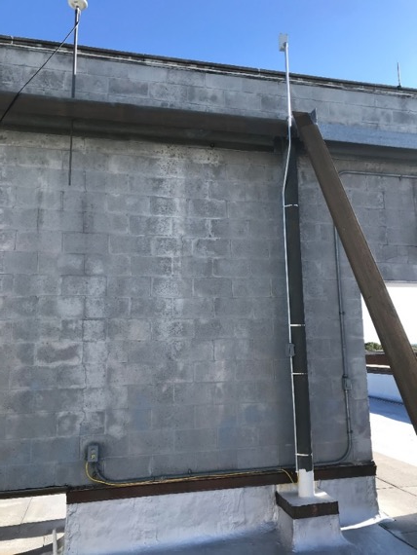
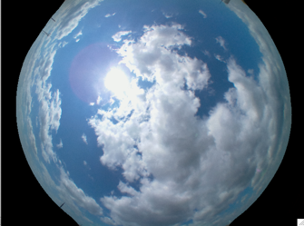
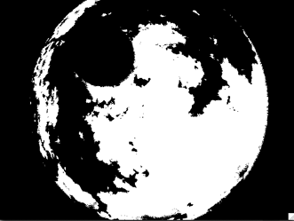
SkyCam system @ NASA/GSFC

Slide 46
WAY FORWARD

Slide 47
WAY FORWARD

Slide 48
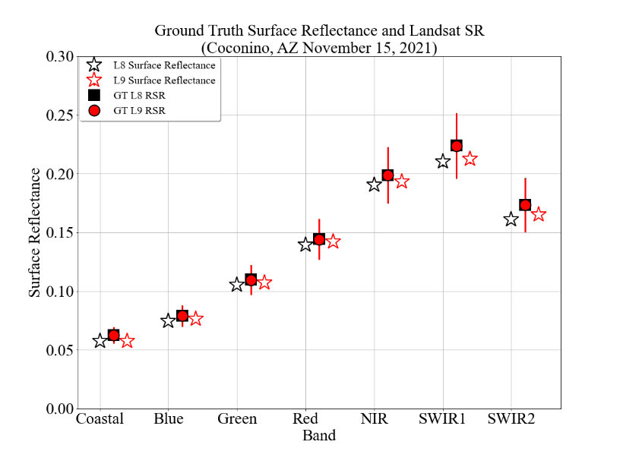
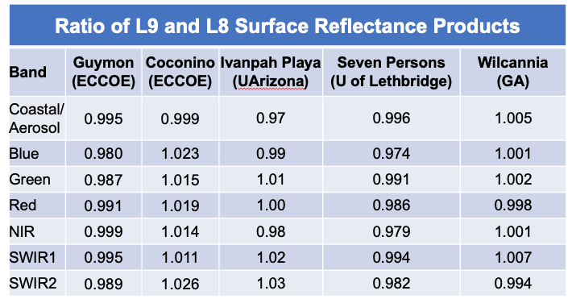
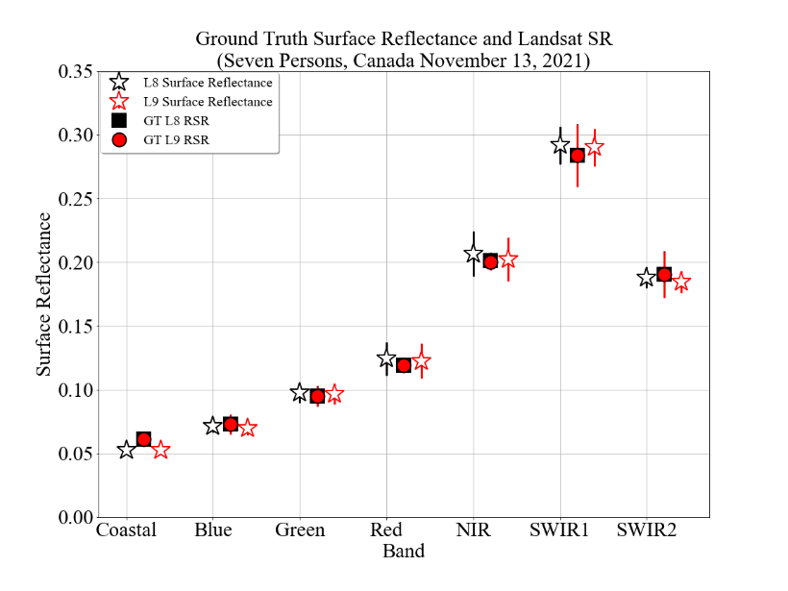
Ground Validation episodic using ground measurements over uniform/stable/arid sites

Slide 49


Ground Validation using CAMSIS
CAMSIS system
CAMSIS is installed at a height of 123m
on a TV tower (WLEF) near Park Falls, WI at the Chequamegon National Forest

Slide 50



CAMSIS Data processing

Slide 51

CAMSIS Data processing

Slide 52

First results from CAMSIS on Sentinel 2

Slide 53

First results from CAMSIS on Sentinel 2

Slide 54

First results from CAMSIS on Sentinel 2

Slide 55

First results from CAMSIS on Sentinel 2

Slide 56


CAMSIS 1 and 2 now operational at WLEF

Slide 57
CONCLUSIONS
Intercomparison exercises are very useful forums to make progress in SR algorithm and validation methodologies.
Efforts should continue as turnaround get shorter as experience is gained (ACIX I compared to ACIX II).
Objectives should be adapted to possible outcome in next phase (e.g. ACIX III focusing on Hyperspectral as ground validation is getting fully developed).
Higher order improvements of Surface reflectance product (Adjacency, BRDF coupling, topographic correction) are within reach as better ground validation data is coming.
Cloud Mask is becoming an integral component of SR validation with an objective validation strategy.
A full validation package, surface, cloud, aerosol integrated measurements network is highly recommended.

