Slide 1
GSICS Annual Meeting 2022
The GSICS Annual Meeting 2022 held virtually, [10 March 2022, 14–18 March 2022].
The Meeting had the following sessions:
UVN Spectrometer Break out Session (10 March)
Mini Conference (14 March)
Plenary: Agency Report (15 March)
IR and GDWG Parallel sessions (16 March)
VIS/NIR and MW parallel sessions (17 March)
Plenary: Cross Cutting (18 April)
Info and presentations can be found at:
http://gsics.atmos.umd.edu/bin/view/Development/Annualmeeting2022
MoM with actions and recommendations:
MoM with actions and recommendations.

Slide 2
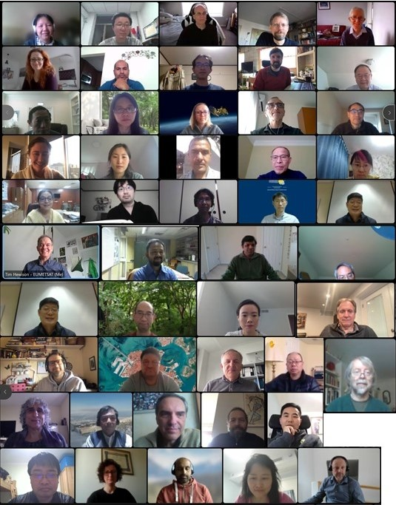
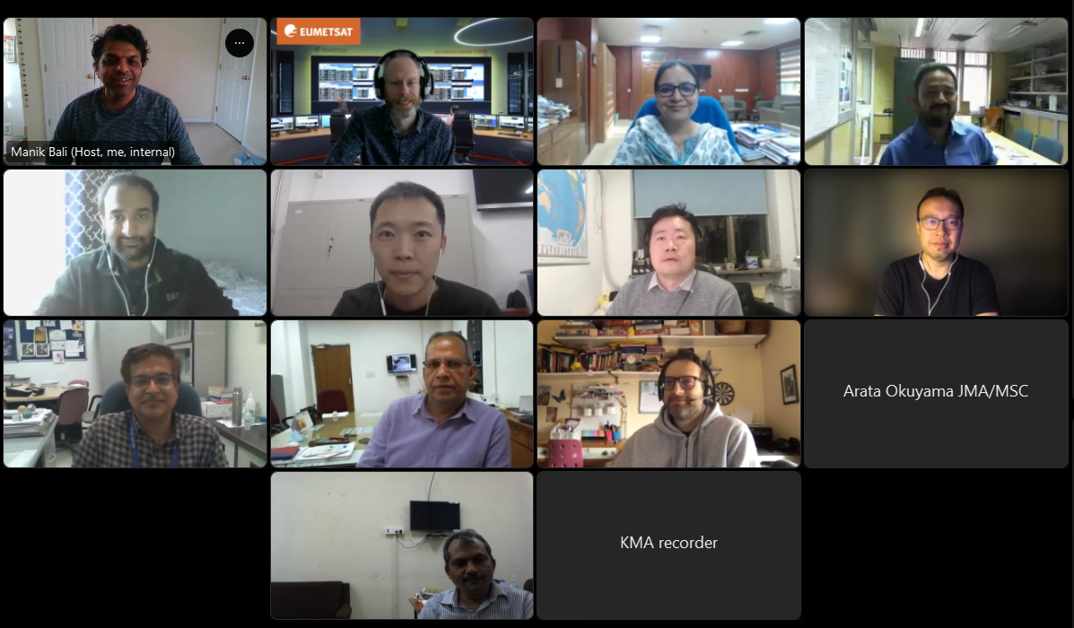
Minute of the Meeting available here:
MoM with actions and recommendations.

Slide 3
GSICS Main activities and
recommendations by subgroups
Notes:
GDWG actively supports all aspects of GSICS activities

Slide 4
GSICS Main activities and recommendations by subgroups

Slide 5
GSICS Main activities and recommendations by subgroups

Slide 6
Summary of links to GSICS tools
Bash script to download GSICS Data http://gsics.atmos.umd.edu/bin/view/Development/DownloadGSICSProducts
Series of notebooks to read, view and process GSICS Data and Deliverables from the browser in a collaborative ecosystem
  DCC Product notebook
    This notebook reads DCC products and plots and lists them
  GIRO SRF notebook
  GSICS Product RAC notebook and NRT notebook
3. Plotting Tool http://gsics.tools.eumetsat.int/plotter
4. GSICS Product Catalog: https://www.star.nesdis.noaa.gov/smcd/GCC/ProductCatalog.php
5. GSICS Product Status registration: Register here

