Slide 1
Report of
The Microwave Sensors Subgroup
Xiaolong DONG
(National Space Science Center, Chinese Academy of Sciences)
Representing the National Remote Sensing Center of China
CEOS Working Group on Calibration and Validation
50th Plenary
March 22-25, 2022 (Virtual)

Slide 2
MSSG Introduction
MSSG: Microwave Sensors Subgroup
The Microwave Sensors Subgroup Mission is to foster high quality calibration and validation of microwave sensors for remote sensing purposes. These include both active and passive types, airborne and space-borne sensors operating in the microwave spectral range, except SAR.
The objectives of the Microwave Sensors Subgroup, beyond those of the WGCV, are to:
Facilitate international cooperation and coordination in microwave sensor calibration/validation activities by sharing information on sensor development and field campaigns
Promote accurate calibration and validation of microwave sensors through the standardization of terminology and measurement practices
Provide a forum for the discussion of current issues and for the exchange of technical information on evolving technologies related to microwave sensor calibration/validation

Slide 3
Recent Focuses and Tasks of MSSG
MSSG covers EO sensors operated in microwave spectrum, except SAR
MWR, SCAT, ALT
  Microwave Radiometers (sounders, imagers) (MWR)
  Radar Scatterometers (surface and volume) (SCAT)
  Radar Altimeters (ALT)
  GNSS-RO and reflectrometry
With current emphasis on
  Radar Scatterometers (Active Microwave)
  CEOS task CV-20-05: Standards and Metrics for Scatterometers and Wind Retrievals
  Microwave Radiometers (Passive Microwave)
  ISO TC211 project:
  Geographic information – Calibration and validation of remote sensing imagery sensors and data– Part 4: Space-borne Microwave Radiometers (ISO TS 19159-4:202X)

Slide 4










CEOS Task CV-20-05:
Standards and Metrics for Scatterometers and Wind Retrievals
Xiaolong Dong (NSSC, CAS), Paul S. Chang (NOAA NESDIS), Ad Stoffelen (KNMI), Marcos Portabella( ICM-CSIC), Raj Kumar (ISRO), Stefanie Linow (EUMETSAT), Juhong Zou (NSOAS), Wenming Lin (NUIST)
Created in 2020
Target completion: 2021 Q4, extended to 2022 Q2 due to COVID-19

Slide 5
Introduction
IGARSS-2021
Spaceborne scatterometers are well-established instruments that provide ocean surface wind products efficiently with high and stable accuracy, as well as large swath coverage.
Scatterometers operated by different space agencies form the virtual constellation. The instruments provide near real-time observations with spatial and temporal continuity and internal physical consistency in time and space.
Scatterometer observations have been available for decades, and many more missions are prepared to be launched in the future.
Inter-calibration/comparison can offer spatial and temporal characteristics of the observing systems to enable the consistency.
-01-

Slide 6
Objective
Main objective:
To develop the standard and guideline for the requirement, procedure, processing and assessment for the spaceborne radar scatterometer measurement calibration, wind retrieval approaches, wind data validation and assessment for OSVW, which will be used to assure the consistency of the data quality of these satellites and instruments are the prerequisite for related scientific researches and applications.

Slide 7
Main Tasks
Task Content
To develop the standard and metrics of spaceborne radar scatterometer backscattering measurement calibration, wind retrieval approaches, wind data validation and assessment for ocean surface vector winds.
The main scope of the standard and metrics cover:
    Calibration, including cross-calibration of L1 and L2 data;
    Validation of scatterometer wind data;
    Quality indices of L1 and L2 data.
Identifying and organizing collocation data
Demonstration of applications and establishment of portal

Slide 8
Development Plan
Created in 2020
Target completion: 2021 Q4, extended to 2022 Q2 due to COVID-19
Progresses
  2019.7 propose WP on WGCV-45
  2020.4.21 teleconference to confirm the task
  2020.5.6 confirmation of leading members
  2020.5.11 WGCV-46 preliminary work plan
  2020.6.16 1st project meeting
  2020.6.18 Specific work plan
  2020.8-2020.9 Data sets contribution confirmation
  2020.9-2020.10 Data sets sharing
  2021.1 Plan implementation plan
  2021. 7 Invited session in IGARSS 2021
  2021.8-11 Test campaign and applications
  2121.12 Demonstration of applications and deliverable release
  2022.01-06 Summary and wrap-up

Slide 9
The Scatterometer Virtual Constellation for
Ocean Surface Vector Wind
 | Instrument | Satellite | System | Orbit | 2018 | 2019 | 2020 | 2021 | 2022 | 2023 | 2024 | 2025 | 2026 | 2027 | 2028 | 2029 | 2030 | 2031 | 2032 | 2033 | 2034 | 2035 | 2036 | 2037 | 2038
C-band | ASCAT | Metop-A | fixed fan beam | 08:46 desc | launch 19 Oct 2006
 | ASCAT | Metop-B |  | 09:30 desc | launch 17 Sep 2012
 | ASCAT | Metop-C |  | 09:30 desc
 | SCA | Metop-SG-B1 |  | 09:30 desc
 | SCA | Metop-SG-B2 |  | 09:30 desc
 | SCA | Metop-SG-B3 |  | 09:30 desc
C-/Ku-band | WindRAD | FY-3E | conical scanning | 05:30 desc
 | WindRAD | FY-3I |  | 05:30 desc
Ku-band | SCAT (CFOSAT) | CFOSAT | rotating fan beam | 07:00 desc
 | SCAT (CFOSAT) | CFOSAT follow-on |  | 07:00 desc
 | SCAT (HY-2) | HY-2A | conical scanning | 06:00 desc | launch 15 Aug 2011
 | SCAT (HY-2) | HY-2B |  | 06:00 desc
 | SCAT (HY-2) | HY-2C |  | 66 °
 | SCAT (HY-2) | HY-2D |  | 66 °
 | SCAT (HY-2) | HY-2E |  | 06:00 desc
 | SCAT (HY-2) | HY-2F |  | 66 °
 | OSCAT | OceanSat-3 |  | 12:00 desc
 | OSCAT | ScatSat-1 |  | 08:45 desc | launch 26 Sep 2016
 | operational
 | commissioning
 | planned
 | considered
(Revised from Paul Chang etal, IGARSS 2021)

Slide 10

Characterization of the Instruments
Data sets contributed by the member groups for implementation of the task:
  Type:
    - Long term L2 wind products;
    - L1 NRCS data products;
    - Buoy data.
  Data Contribution:
  - Global climate data record of L2 winds：
    ESCAT (ERS), QSCAT(Seawinds), ASCAT(Metop-A), OSCAT-2(Oceansat-2);
    - Global Near Real Time L2 winds;
    OSCAT (Scatsat-1), HSCAT(HY-2B), CSCAT(CFOSAT);
    Global in situ buoy winds;
    Global L1 data for specified period:
    CSCAT L1B data; HY-2B/HSCAT-2 L1A

Slide 11
Expected Outcomes
Expected Outcomes :
    - The CEOS guidelines/international standards for calibration (L1)
    - Validation retrieval guidelines (L1 and L2);
    - Best practices of calibration and validation data sharing and collaborations.

Slide 12
Main tasks and Assignments
Sub-task 1:
Development and validation of algorithms and methods for calibration of Sigma 0 using different reference or metrics
  (1) Documentation of the calibration process and the data properties;
  (2) Evaluation and assessment:
    Active calibrator (EUMETSAT):
  -calibration requirements, methodology and procedure;
    Global ocean data methodology and procedure, quality control
-Cone metrics: fixed fan-beam and rotating beam (KNMI);
-NWP (KNMI, NUIST);
    Natural terrestrial targets (ISRO, NOAA, NUIST, NSOAS, KNMI)
-methodology and procedure;
-C and Ku band standard data and standard variation curves;
-Data quality control.

Slide 13
Main tasks and Assignments
Sub-task 2:
Standardization/best practices of retrieval approaches of ocean surface winds (L2b data) by radar scatterometer data and guidelines to users (leading: KNMI, NSOAS, ISRO, ICM, NOAA)
  -GMF;
  -Auxiliary data;
  -Retrieval and direction ambiguity-removal algorithms;
  -Quality control.

Slide 14
Main tasks and Assignments
Sub-task 3:
Development of guidelines/standards of validation of ocean surface winds (L2b data) by radar scatterometer data
(leading: NOAA, ICM, KNMI, ISRO)
  -Reference, auxiliary data and data quality control;
  -Methodology and procedure;
  -Evaluation criteria;
  -Evaluation and error assessment.

Slide 15
Summary of the Task
The project of CEOS WGCV and OSVW-VC by contributions and cooperation from teams of 8 agencies (NSSC, NOAA, KNMI, ICM, ISRO, EUMETSAT, NSOAS, NUIST) to implement.
The requirements for realizing the objectives proposed are data processing, reprocessing and calibration methods.
The outcomes can assure the consistency of the data quality of these satellites and instruments are the prerequisite for related research and operational applications.

Slide 16

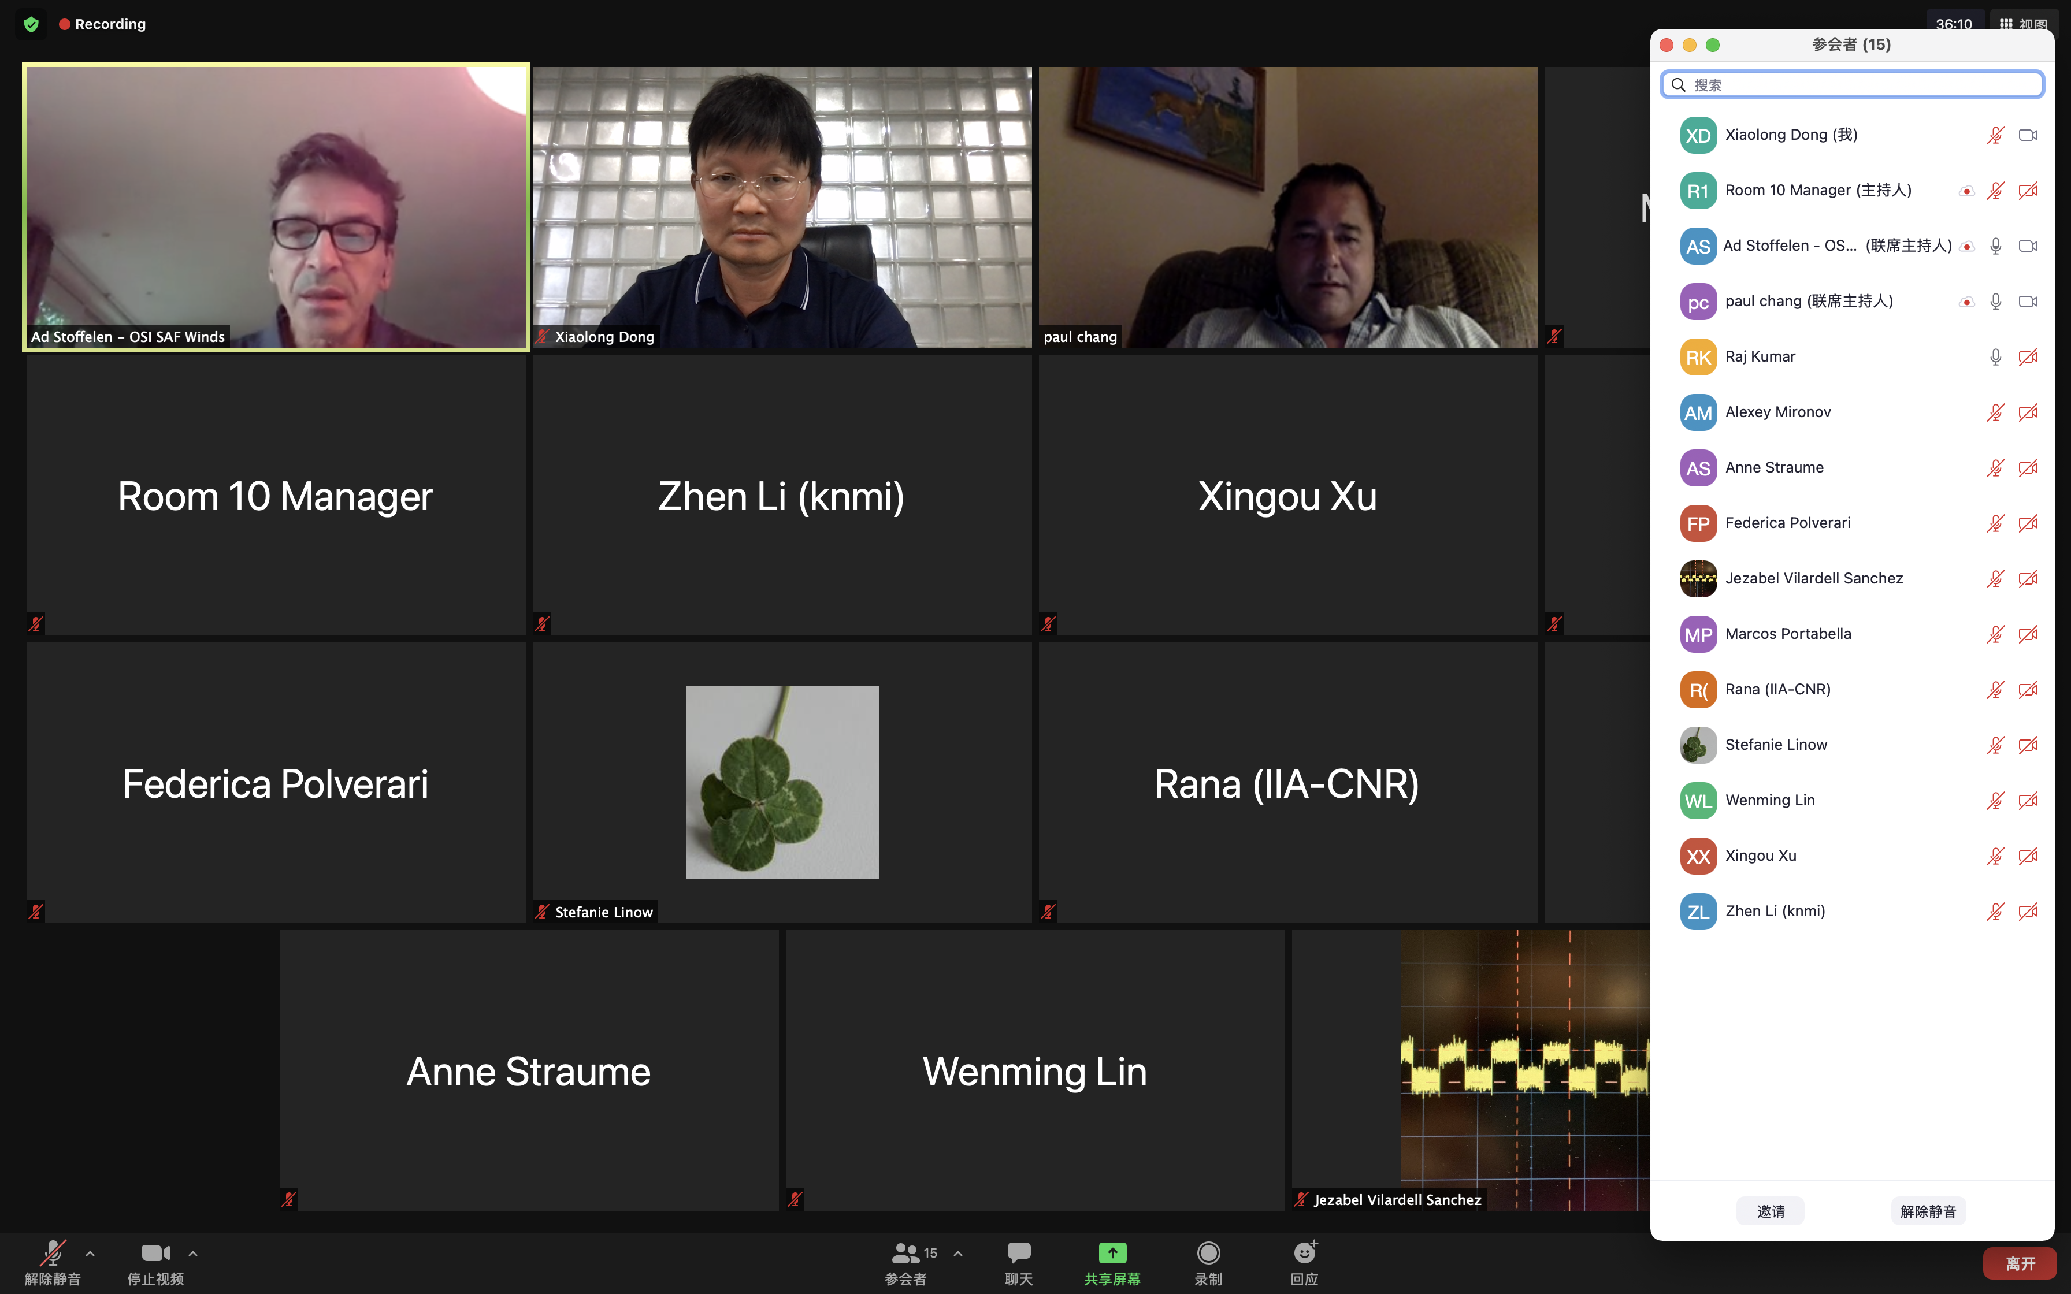
IGARSS 2021 invited technical session proposal
Update and Achievements:
Meeting: Invited Session on IGARSS 2021
2 Invited Session on IGARSS 2021, held on 15th and 16th July 2021

Slide 17
IGARSS 2021 invited technical session proposal
Session briefs:
Improve coordination, consolidation, and development of the collective OSVW capability;
Achieve a more active engagement by nations operating or preparing satellite ocean surface vector winds sensors with the international wind vector community;
Maintain a strong and mutually supportive relationship with the International Ocean Vector Winds Science Team (IOVWST); provide an interface to CEOS for the IOVWST;
Develop recommendations on the driving requirements to create, validate, and sustain the development of an international ensemble of Essential Climate Variable (ECV) measurements;
Provide advice on and advocate to the international community for the importance of OSVW measurements;
Develop and consolidate training on the use of scatterometer winds for different applications, as well as outreach to the general public to demonstrate the societal benefit of these data.

Slide 18
Update and Achievements:
Data sets contribution implemented
Objective
Share within the project groups;
Campaign preparation;
Example application cases;
Data Type
Long term L2 wind products;
A month of L1 NRCS data products;
Buoy data;
KNMI:
  Global climate data record of L2 winds:
  ESCAT (ERS), QSCAT(Seawinds), ASCAT(Metop-A), OSCAT-2(Oceansat-2)
  Global Near Real Time L2 winds:
  OSCAT (Scatsat-1), HSCAT(HY-2B), RFSCAT(CFOSAT)
  Global in situ buoy winds.
NSOAS:
  Three months of HY-2B/HSCAT and CFOSAT/CSCAT L2B data：
  --From June 1, 2020 to August 31, 2020, more data are available upon request.
  CFOSAT/CSCAT L1B data:
  --June, July and August of 2020.
  7 days of HY-2B/HSCAT L1A.

Slide 19
Project progresses
Update and Achievements:
Calibration of Sigma 0
Progresses 1:
Development and validation of algorithms and methods for calibration of Sigma 0 using different reference or metrics
Documentation of the calibration process and the data properties;
a) Data description and processing documentation of CSCAT onboard CFOSAT
b) Data description and processing documentation of HSCAT onboard HY-2B.

Slide 20
Project progresses
Update: Evaluation and Assessment
a) Active calibrator:
A question is forwarded for further discussion: difference application procedure for the same mission of both active and natural target calibrations.
b) Global ocean data:
Cone metrics and NOC are compared considering GMF errors for C-band scats, and are applying to development of CMOD-8, as well as to Ku-band scats.
--Development of cone metrics for C- and Ku-band scatterometers (KNMI)
--CSCAT calibration features in different azimuthal angles (KNMI)
c) Natural terrestrial targets:
Rain forest calibration for HSCAT-B applied.

Slide 21
Update and Achievements:
Retrieval of OSVW
Progresses 2 :
Standardization/best practices of retrieval approaches of ocean surface winds (L2b data) by scatterometer data and guidelines to users
a) Geophysical Model Function (GMF): CMOD8 and NSCAT-5 underdevelopment; (KNMI, NUIST, NSOAS)
b) Wind Retrieval: Maximum Likelihood Estimator, up to 4 ambiguities for C-band ASCATs/up to 144 ambiguous solutions for Ku-band rotating beam scatterometers.
c) Ambiguity Removal: Two-dimensional Variational analysis (2DVAR), taking the flow-dependent errors and the empirical background error correlation into account.
d) Quality Control: Separate good-quality winds from the poor-quality ones using QC indicators, e.g., MLE, singularity exponent, and the newly developed Joss. Rain impact assessment.
e) New wind product: CSCAT coastal product (12.5km) (NSOAS, NUIST); ASCAT coastal product (considering land-contamination); wind variability product.

Slide 22
Project progresses
Update and Achievements:
Validation of OSVW
Progresses 3:
Development of guidelines/standards of validation of ocean surface winds (L2b data) by radar scatterometer data
--Buoy, ECMWF and ASCAT winds are used to validate HSCAT and CSCAT winds. (NSOAS)
--Besides, these comparisons are operationally performed once a week to monitor the stability of HSCAT and CSCAT. (NSOAS, KNMI)
-- Triple and/or quadruple collocation analysis is proposed to reveal the inherent wind errors and the wind calibration factors. (KNMI)

Slide 23
Project progresses
Update and Achievements:
OSVW Product Assessment
Progresses 4:
Identifying and organizing collocation data
a) Meeting to respond to call from the Coordination Group of Meteorological Satellites (CGMS) of the World Meteorological Organization (WMO) to improved coordination of scatterometer missions, a meeting is planned by KNMI;
CGMS meeting held in May 2021, online,
--Constellation of scatterometers addressed (KNMI).
--Consider expanding the scope of the report and include other nonconventional instruments such as scatterometer for precipitation retrieval and cooperation with other rain measurements from satellites (KNMI, ISRO).

Slide 24
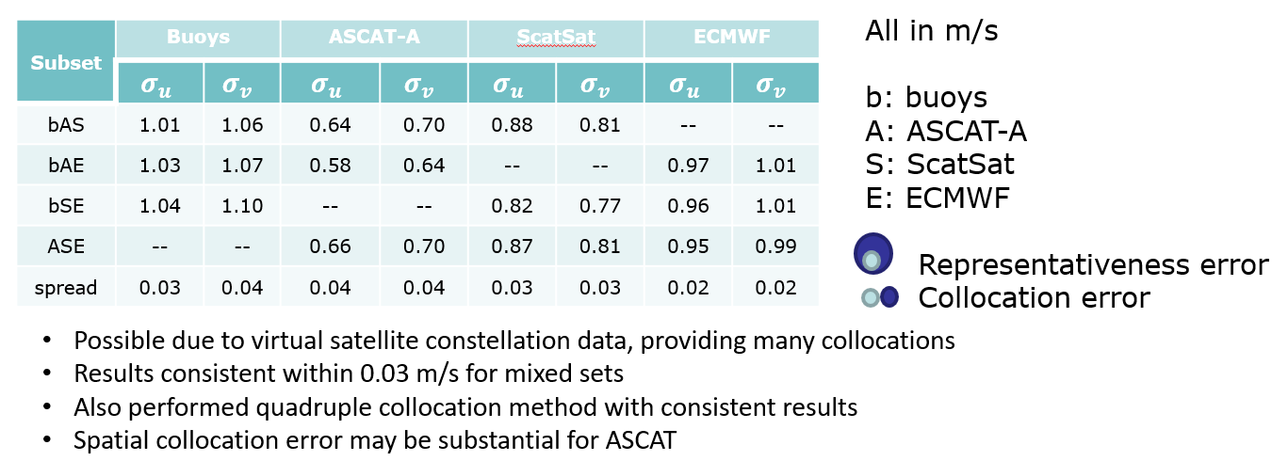
Progress in specific aspects
Intercalibration
Many satellites allow calibration evaluation for almost identical weather sample
Remaining effects are typically 0.1 dB which corresponds to about 0.1 m/s retrieval bias for nominal winds
At 40 m/s, 0.1 dB corresponds to about a 4 m/s error, due to the lower sensitivity of ASCAT σº
^{(A. Stoffelen, 2021)}
J. Vogelzang and
A. Stoffelen, 2021

Slide 25
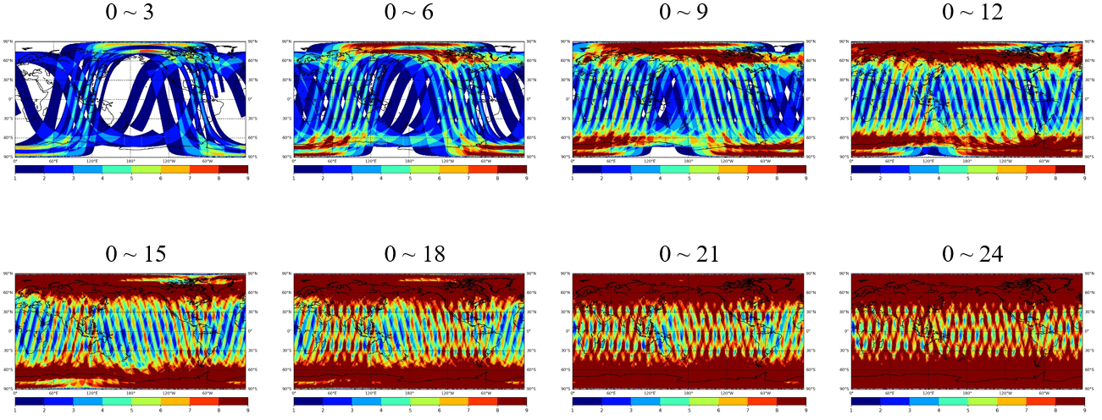
:
Progress in specific aspects
HY2+ MetOp coverage (color as observations)
Intercalibration
Consistency in medium winds（-10~-30 dB）
HY-2C and HY-2D are with better consistency
Larger differences in lower winds
HY2 Series network in operation
(Z. Wang, J. Zou, W. Lin et al. 2022)

Slide 26
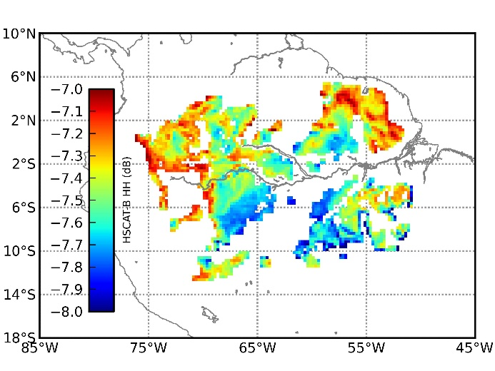
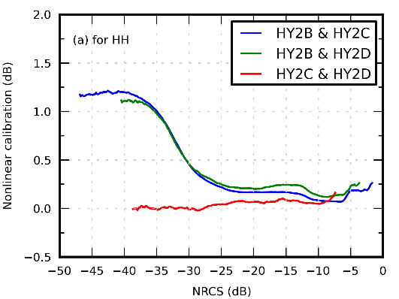
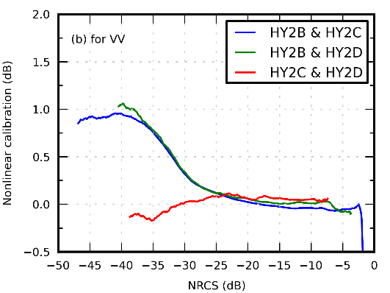
Progress in specific aspects
Intercalibration
CDF matching results for HY-2
--The standard deviation (STD) of HSCAT-B and HSCAT-C for both HH and VV polarization is less than 0.1 dB, indicating that HSCAT-B and HSCAT-C are highly stable (NSOAS).
Spatial mask defining the Amazon rainforest selected grid points. The color scale (in dB) depicts the average of the HSCAT-B HH measurements over 2019.
(Z. Wang, J. Zou, W. Lin et al. 2022)

Slide 27
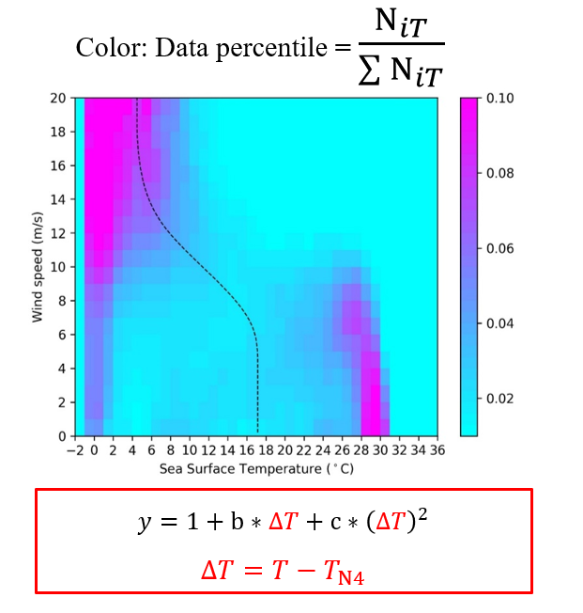
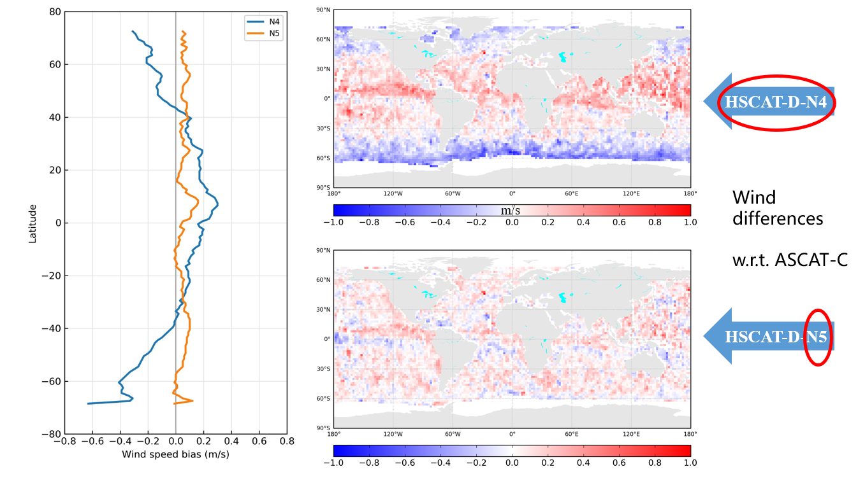
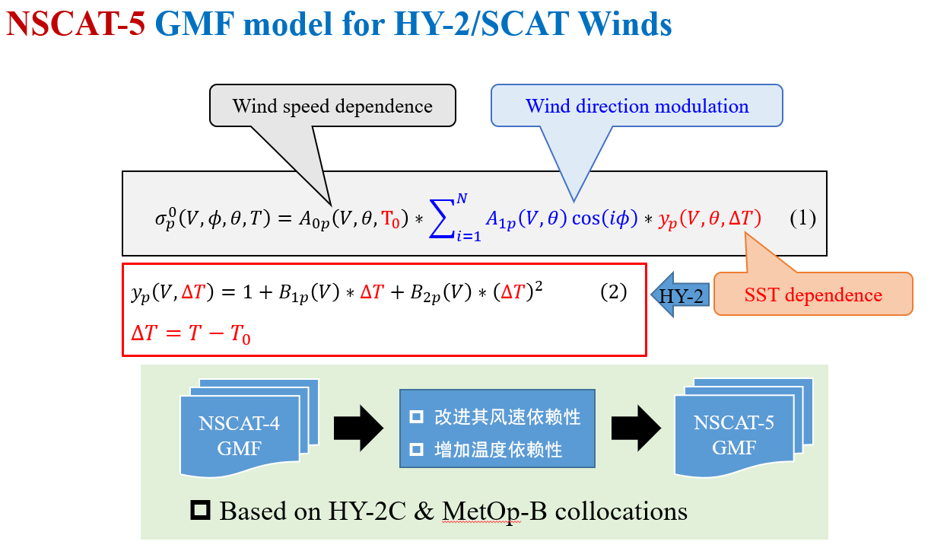
Progress in specific aspects
SST effects & development of NSCAT-5 GMF
(Z. Wang, J. Zou, W. Lin et al. 2021)

Slide 28
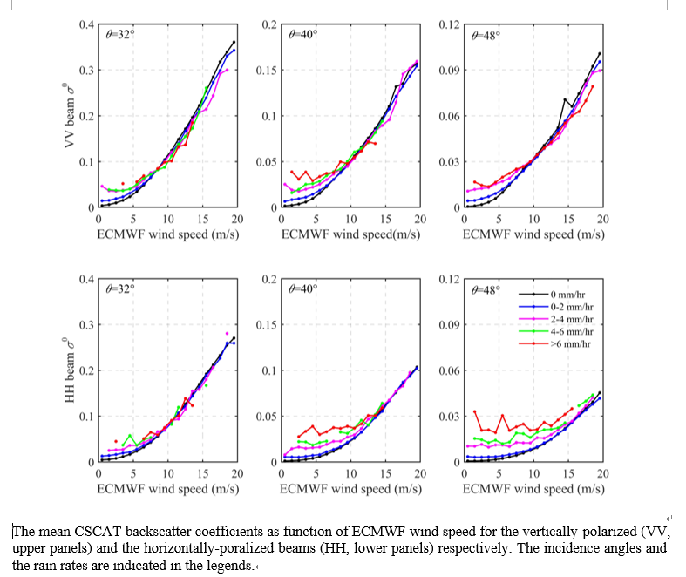
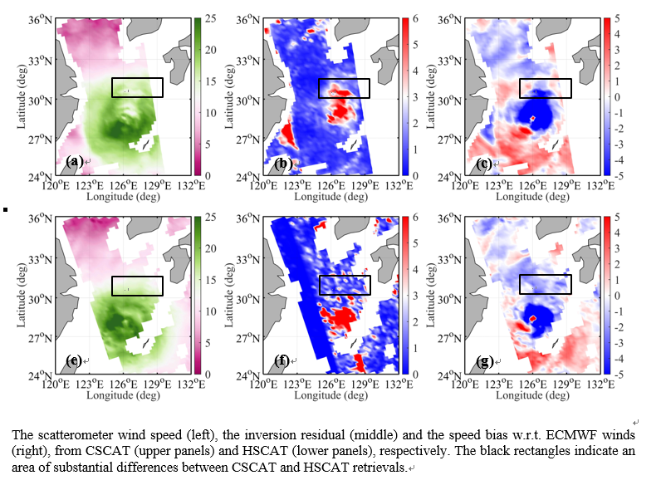
Progress in specific aspects
Rain effects in retrieval
(X. Zhao, W. Lin, M. Portabella et al. 2022)
CSCAT high wind speed retrievals are generally unbiased for low and moderate rain conditions (up to 6 mm/h), due to the compensated rain effects between low and high incidence angle measurements for the inner-swath WVCs.
At high rain rates, significant underestimation of CSCAT wind speed is due to underestimated sigma0 at low incidence angles.

Slide 29
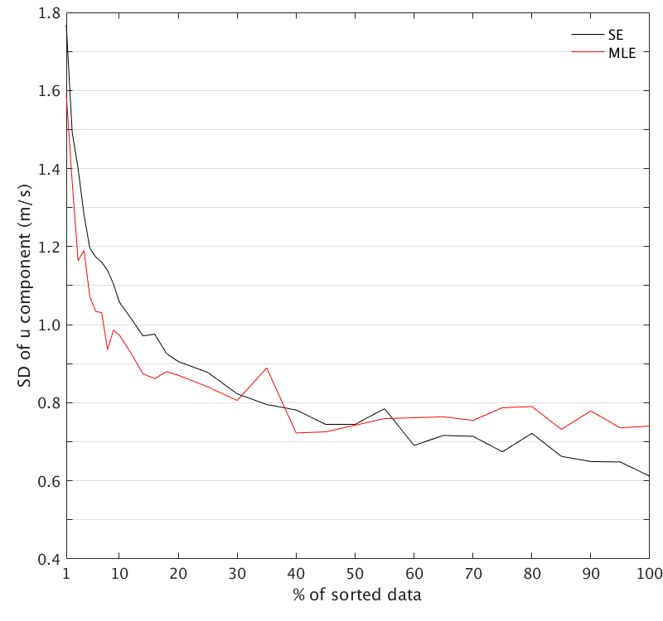
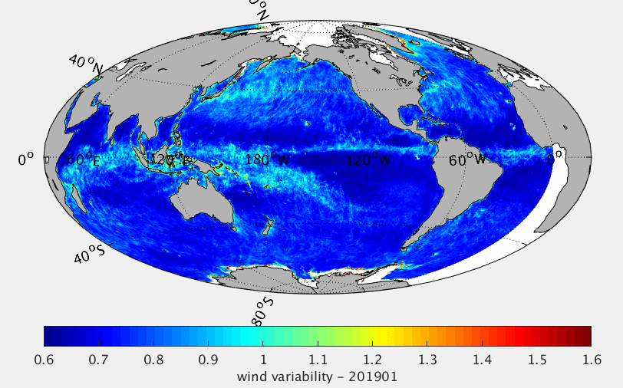
Progress in specific aspects
Wind variability product
Scatterometer QC indicators are sensitive to sea surface wind variability
Using the ASCAT-derived MLE and SE to estimate local wind variability in near-real-time.

Slide 30
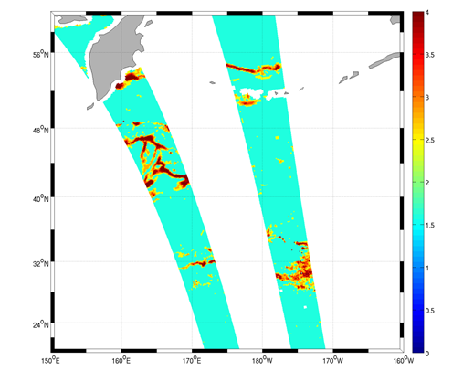
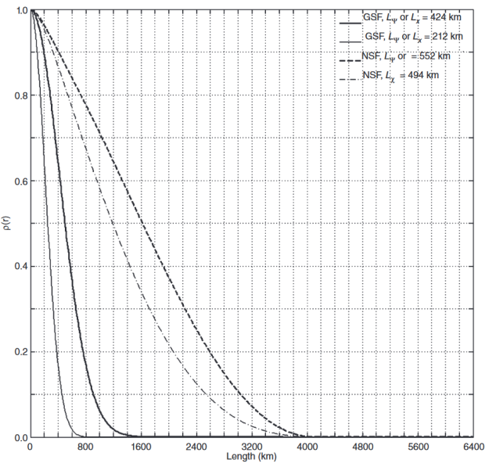
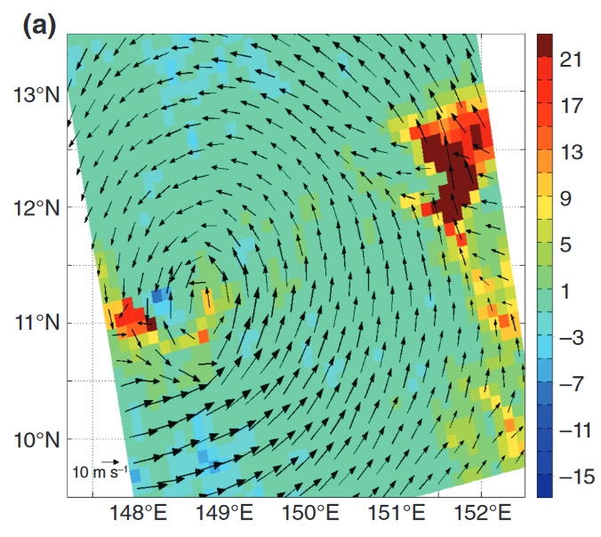
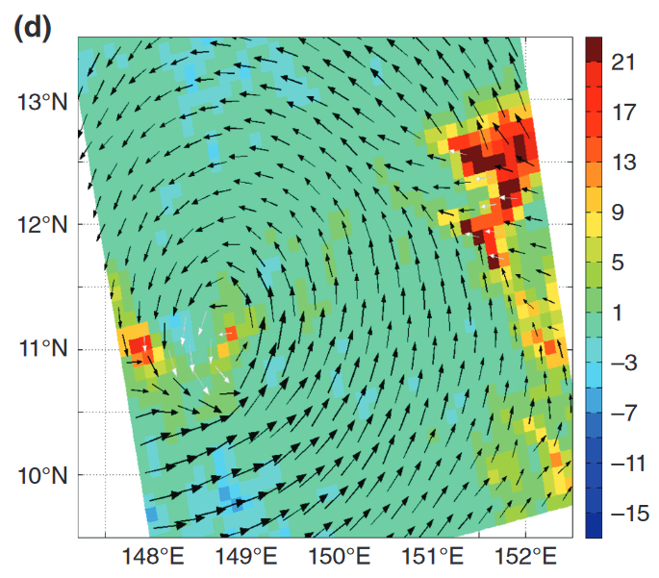
Progress in specific aspects
Improved ambiguity
removal
Flow-dependent wind errors
Empirical background error correlation
Left - tradition 2DVAR result
Right- improved 2DVAR results

Slide 31
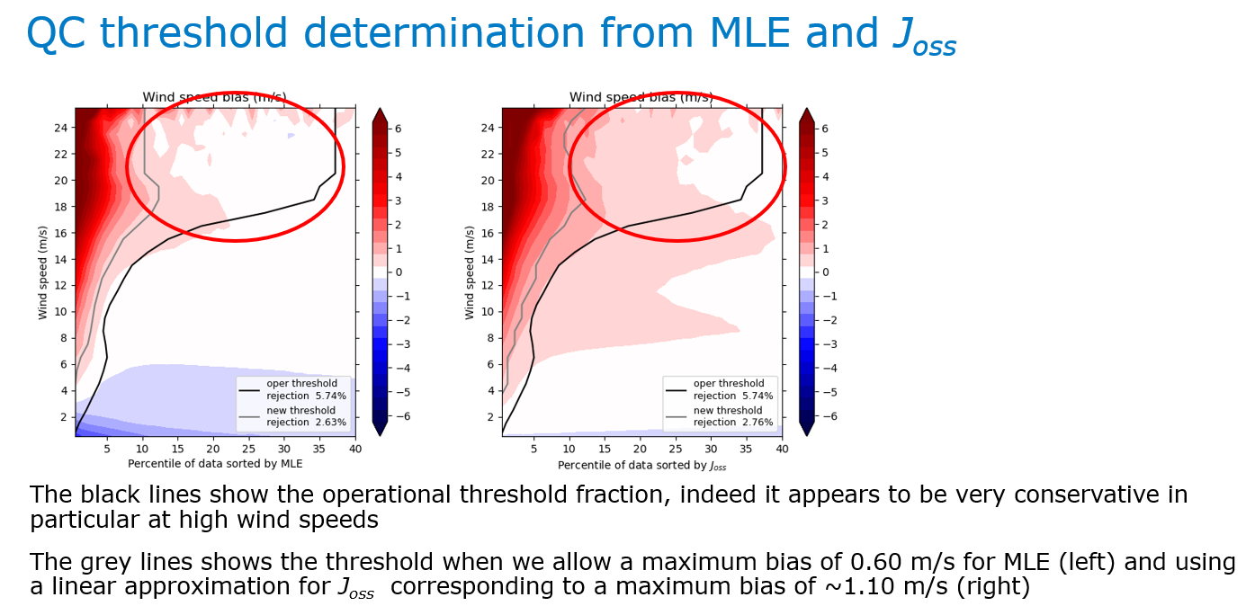
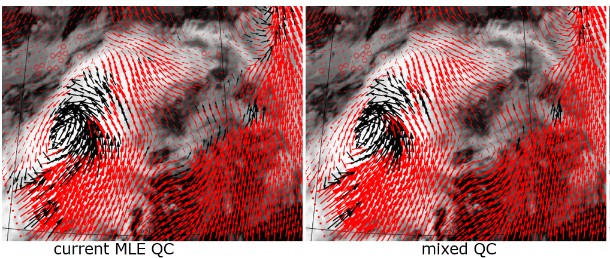
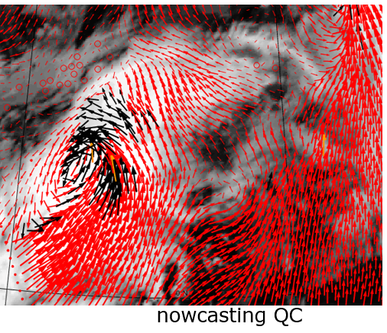
Progress in specific aspects
Rain effects in Ku-QC and retrieval
The current Quality Control algorithm that we use in our Ku-band wind products was determined almost 20 years ago.
The new Quality Control algorithm is used in new wind Climate Data Records based on Ku-band scatterometer(QuikSCAT/SeaWinds, Oceansat-2/OSCAT and ISS/RapidScat).
These datasets will be released in the Ocean and Sea Ice Satellite Application Facility (OSI SAF) in 2022.
The algorithm will also be implemented in future near-real time OSI SAF wind products based on Ku-band instruments.
Mixed QC rejects less scattered winds and less winds near the front in the middle right
Nowcasting QC rejects even less winds, the region north-east of the cyclonic structure is still rejected and apparently heavily contaminated with rain
Verhoef, A. Stoffelen, X. Xu, et al. 2021~2022

Slide 32
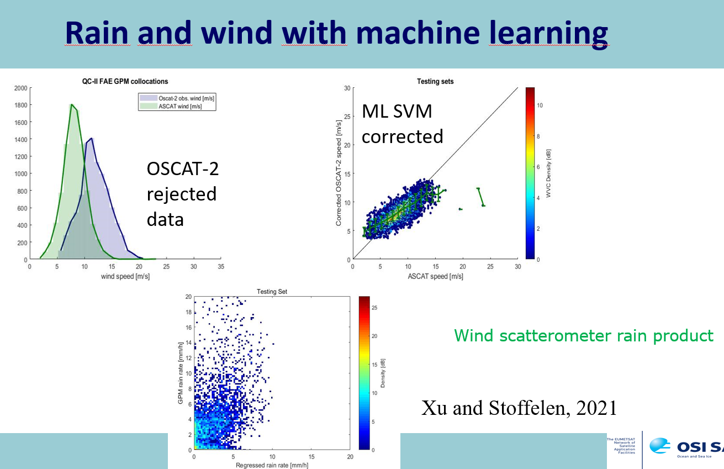

Progress in specific aspects
Rain effects in Ku-QC and retrieval: Machine Learning Approach for effective correction, indicating effectiveness of the joint application of MLE and Joss

Slide 33
Summary of the Progresses
Data sharing for the Task, including L1 and L2 provision confirmed and used in the test
Development of calibration of Sigma 0 (L1) data, retrieval of OSVW (L2) data and quality control;
Test campaign for validation of the development.

Slide 34
Further Steps
Task meeting in May is being planned, to review the draft;
Documentation of the data sharing.
Expected Deliverables in 2022 Q2:
  Draft of a standard for definition and requirement of calibration of spaceborne radar scatterometer for ocean surface vector wind;
  Draft of a technical specification for processing of post-launch calibration data of spaceborne radar scatterometer for ocean surface vector wind;
  Draft of a best practice recommendation for retrieval algorithms of ocean surface vector wind from spaceborne radar scatterometer;
  Draft of a best practice recommendation for quality control and assessment of spaceborne radar scatterometer data;
  L1 and L2 data for CAL/VAL purposes.

Slide 35
Issues to be confirmed
Website for the deliverables;
Further development to a ISO standard or technical specification.

Slide 36
  ISO TC211 Project:
  Geographic information – Calibration and validation of remote sensing imagery sensors and data– Part 4: Space-borne Microwave Radiometers (ISO TS 19159-4:202X)
Project proposal accepted: 2019Q2
Target completion: 2022 Q3

Slide 37
ISO 19159 Series
Developed by ISO TC211 WG6
Defines the calibration and validation of airborne and spaceborne remote sensing imagery sensors.
The term “calibration” refers to geometry, radiometry, and spectral, and includes the instrument calibration in a laboratory as well as in situ calibration methods.
The validation methods address validation of the calibration information (which is different from the CEOS definitions)
ISO/TS 19159-1:2014 “Calibration and validation of remote sensing imagery sensors – Part 1: Optical sensors”
ISO/TS 19159-2:2016 “Calibration and validation of remote sensing imagery sensors –Part 2: Lidar”
ISO/TS 19159-3:2018 “Calibration and validation of remote sensing imagery sensors –Part 3: SAR/InSAR”
ISO/TS 19159-4 “Calibration and validation of remote sensing imagery sensors –Part 4: Space-borne passive microwave radiometers” (under development)
…

Slide 38
ISO TS 19159-4
Development time line
Date | Stage | Activity
2019-03-05 | 10.00 | Proposal for new project registered
2019-03-06 | 10.20 | New project ballot initiated
2019-07-08 | 10.99 | New project approved
2019-07-08 | 30.00 | CD study/ballot initiated
2019-10-31 | 30.20 | WD1
2020-4-15 | 30.20 | WD2
2020-11-03 | 40.00 | DTS approved
2021-12 | 50.00 | FDTS
2022-07-04 ~ 2023-01-05 | 60.60 | International Standard published limit date

Slide 39
ISO TS 19159-4
Scope:
This Technical Specification defines the calibration of space-borne microwave radiometers and validation of the calibrated information.
  Define the calibration of space-borne microwave radiometers and validation of space-borne microwave radiometers calibration information.
  Address in-orbit calibration, rather than prelaunch calibration.
  Specify the terms used in the microwave radiometers calibration procedures.
  Address also the metadata related to calibration and validation.

Slide 40
Procedures in developing 19159-4
The flow chart of radiometer calibration is drawn and the generic technologies are extracted.
Seven classes are abstracted, addressing the key stages or elements in the calibration procedure.
Every class is descried by class diagrams using UML tools.
Every attribute in the classes are described in some detail data in the dictionary.
An abstract test suite which shall be passed by any implementation claiming conformance with 19159-4 is designed. The attached xml schema definition files are consistent with the UML diagram and data dictionary.

Slide 41
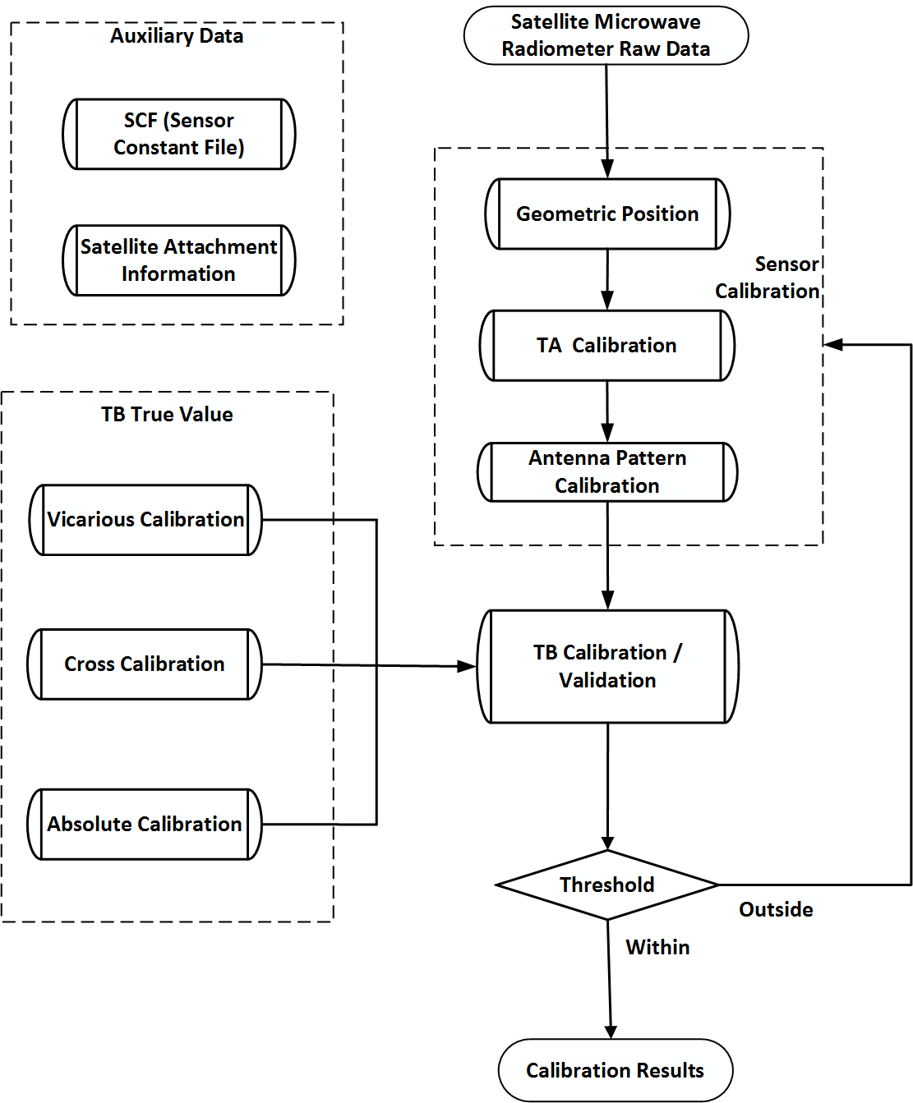
Flow chart of microwave radiometer calibration
Calibration begins with “sensor calibration” using “Satellite Microwave Radiometer Raw Data”；Sensor calibration is implemented for producing the TB products
  Geometric Position
  TA calibration
  Antenna Pattern Calibration
Afterwards, “TB True Value” serves as input for module “TB Calibration / Validation” to calibrate TB, and the results will be assessed
  If the assessments are within the “Threshold”, the calibrated TB will be outputted as “TB Product”
  Otherwise (outside), three main processing in the “Sensor Calibration” will be followed for correcting the errors

Slide 42
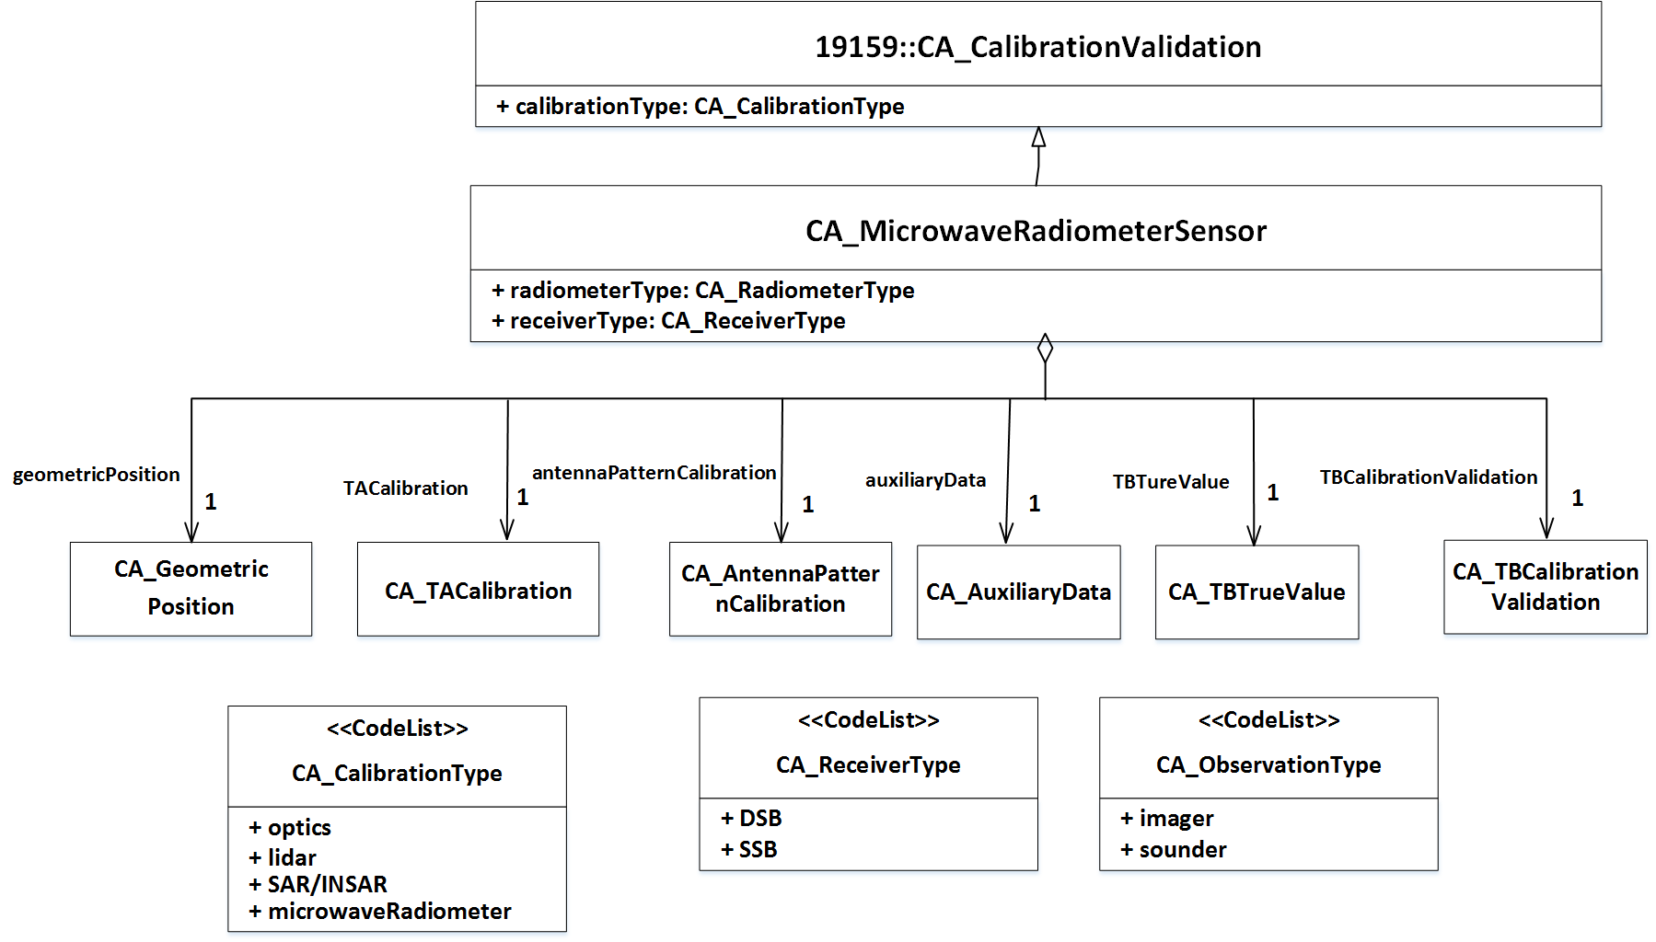
19159-4 top level UML class diagram
Class CA_MicrowaveRadiometerSensor is the top-level class in 19159-4.
It aggregates five classes including sensor calibration, TB cal/val and auxiliary data.

Slide 43
Three main stages of sensor calibration
The sensor calibration is described by three cascading classes to fulfil the following functions.
Geometric position: position the satellite measurements to the scene on earth, and get the latitude, longitude, elevation angle and azimuth angle of every pixel.
TA calibration: calibration on the receiver to acquire the antenna temperature, features in receiver (e.g., receiver temperature, nonlinearity and spectral response function) are considered.
Antenna pattern calibration: calibration of the antenna pattern, in which antenna pattern side-lobe and cross-polarization should be corrected for deriving more accurate TB of the scene.

Slide 44
Three main methods for TB calibration/ validation
The “true value” class lies in the core of the TB cal/val. Different method gives different TB true value as the reference for TB comparison.
Vicarious calibration: validation using well-characterized, stable Earth targets.
  Cold-end usually relies on measurements over calm oceans under cloud free skies and very low humidity
  Hot-end often makes use of a large isothermal blackbody extending over the scene, such as the rain forest.
Cross calibration: relate the measurements of one instrument to those of a high-quality, well-calibrated instrument. The two instruments operating during the same period requires careful geographic collocation.
Absolute calibration (OMB method): derive the difference between simulated (established from the radiative transfer model, which include the effects of ocean or land surface and atmosphere parameters) and measured TB (from radiometer to be calibrated).

Slide 45
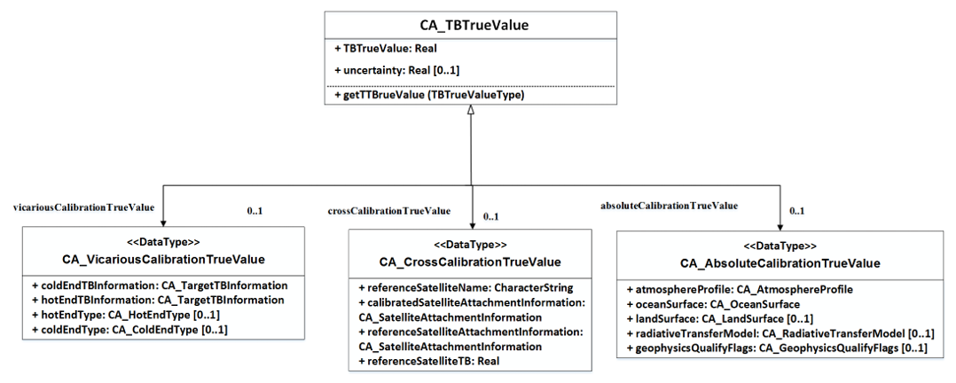

Slide 46
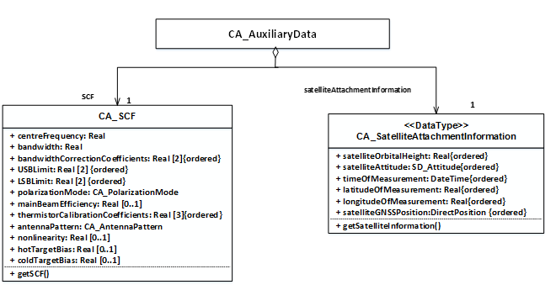
Auxiliary data
Auxiliary data required in the procedure of microwave radiometer calibration/ validation. It has two subclasses:
  SCF: the sensor constants needed in the sensor calibration.
  Satellite attachment information: the information of the platform (satellite) for geometric position and cross calibration.

Slide 47
Other updates
Communications with GSICS Microwave Subgroup
GSICS MWSG workshop on Feb 28- March 1, 2022
GSICS annual meeting- MWSG breakout session on March 17, 2022
GSICS MWSG: focused on recalibration/reanalysis of passive data for CDR

Slide 48
Summary
CEOS WGCV Microwave Sensor Subgroup is working on development and consolidation of standards and metrics for optimized applications, main efforts is toward the best practices;
Two focuses on radar scatterometry for ocean surface vector wind and the calibration of spaceborne microwave radiometers
Thanks for your attention!

