Slide 1
New Space & Future CEOS:
WGCV Role?
Item 1.5
CEOS WGCV-50
Virtual Meeting
22-25 March 2022

Slide 2
Context
CEOS SIT is reflecting on the new geometries in the satellite EO sector, including increasing proportion of commercial missions, and CEOS agency arrangements for commercial data buy and partnerships - hearing agency experiences and examples and strategising how public programmes and CEOS must adapt in the decade ahead with this new context.
Australia and UK have launched joint project ‘Cal-Val Spacebridge’ to explore common interests in the cal-val aspects of these changes and how cal-val can help the public EO programme status, and the sector overall
Slide ‹#›

Slide 3
Context
The share of on-orbit EO satellites belonging to public EO programmes is shrinking rapidly
10 years ago, CEOS agencies launched 14 EO missions during 2012 calendar year (MIM)
5 from China
Some with commercial data aspects
SPOT-6 and Pleaides 1B the only identified commercial sector launches that year
By 2020, more than 50 companies have announced their intention to develop Earth observing missions or constellations, representing roughly 1,800 small satellites, the majority of which are under 50kg
Eg Planet already has ~ 200 active EO satellites in orbit
8 CEOS launches in 2021 (5 from China)
MIM activity shows 80+ commercial EO missions in 2021 (mostly Planet)
These companies raised ~$US 5Bn in each of 2020 and 2021, up from $1Bn in 2019
Slide ‹#›

Slide 4
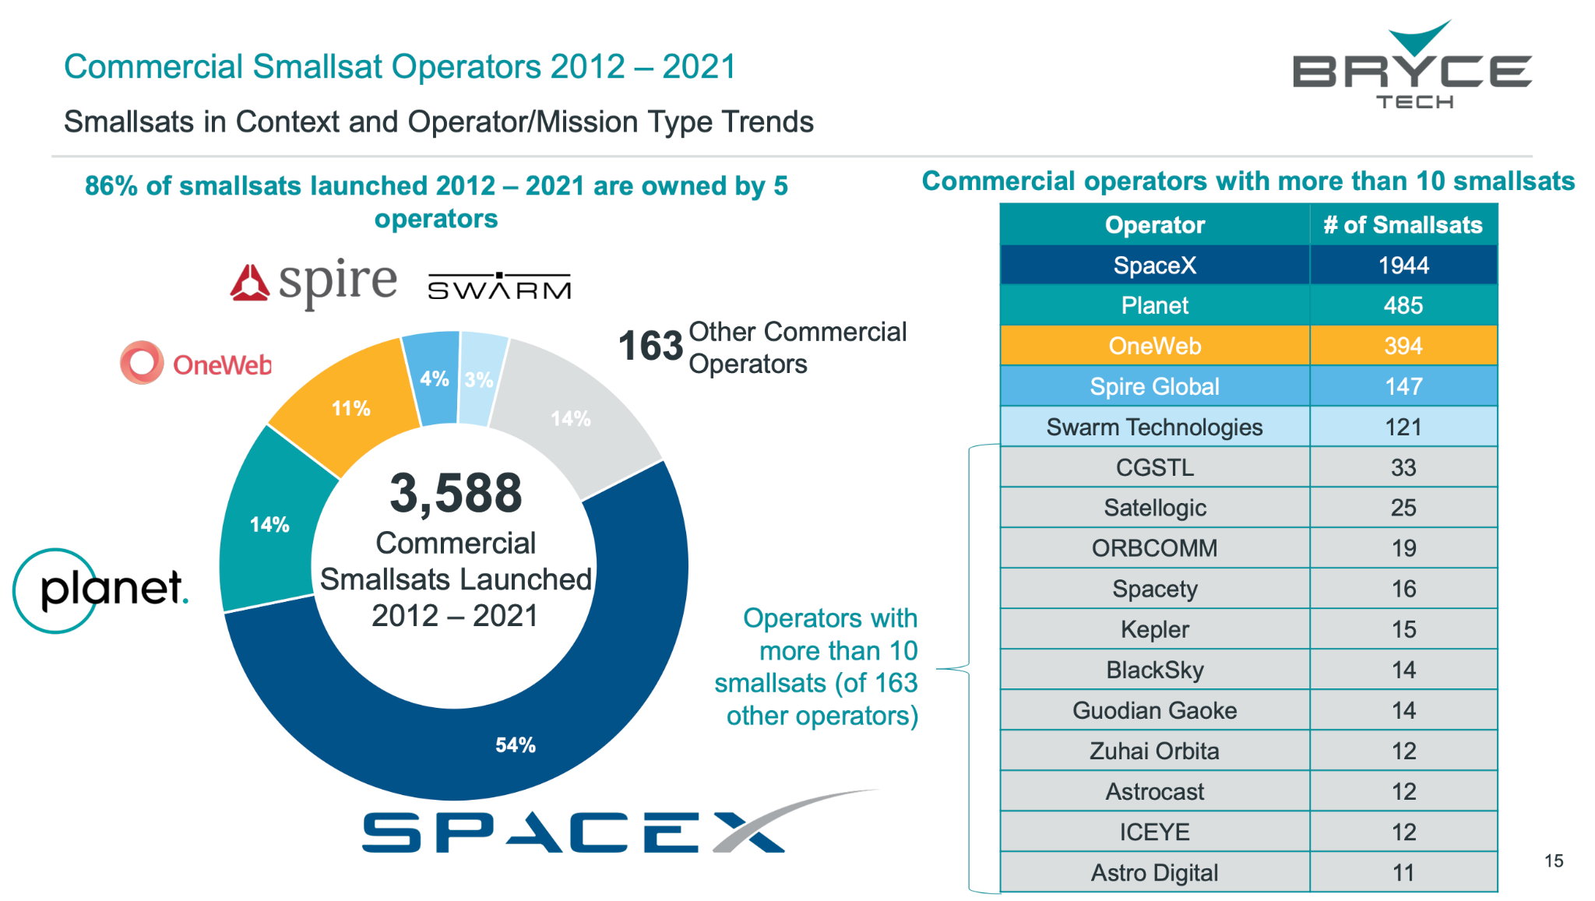
Context
EO missions
Slide ‹#›

Slide 5
Context
The space value chain is evolving, with the traditional upstream driven technology push transitioning into a market demand pull
Space has attracted an important number of actors in the past decades, with New Space and non-space companies entering the different streams of the value chain
Generally EO domain remains geared towards defence and security markets, but an increasing demand from a diversified pool of customers is leading a rapid evolution - with more supply from new entrants, and innovative delivery models for data and analytics to support situational awareness
Cloud computing is bypassing the need for hardware and software ownership, opening up the market to startups and allowing companies to provide ground stations as well as full turnkey solutions as a service (GSaaS concept - allows satellite operators to focus on the core of their business: data)
Machine learning is facilitating the extraction of actionable insights from large amounts of data, automation of repetitive processes, and extending the use of space-based applications to new markets
Slide ‹#›

Slide 6
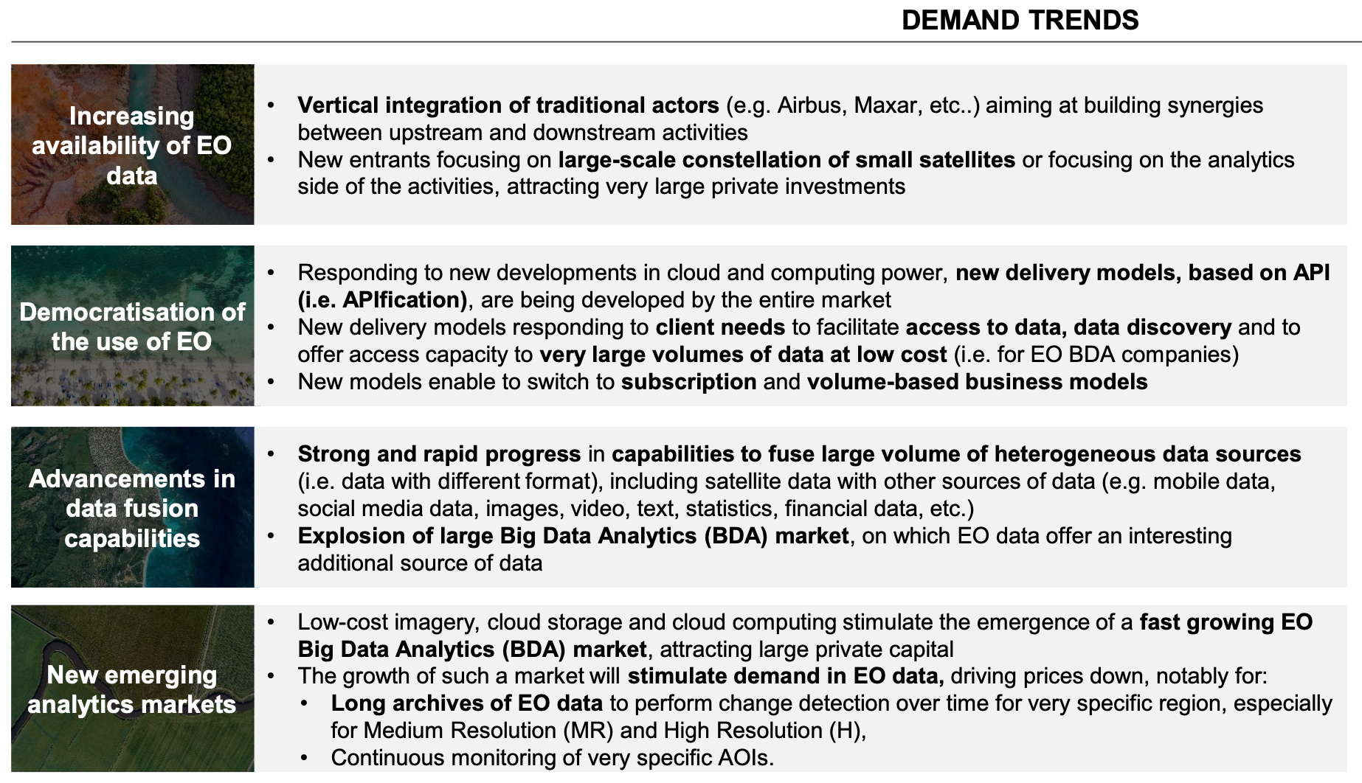
Important trends supporting growth in EO data products & services
Slide ‹#›

Slide 7
Candidate measures in response
Examples to leverage our long technical heritage:
CEOS has spent decades investing in data standards for interoperability, ARD, catalogues etc. If we anticipate an explosion in diversity of datastreams and sources, including through space agency data buys, is NOW not the time to seek uptake of those standards?
For maximum benefit across the whole sector
To allow public EO programmes to be bigger than the sum of their parts
Ensure all our good work is not lost in the noise of a rapidly expanded sector
Likewise we have huge investment by CEOS agencies in legacy infrastructure for cal-val
Supporting easier access and application of the legacy infrastructure for New Space would increase utility and value of the commercial data
SITSAT (SI Traceability Satellites) efforts by ESA/UK (TRUTHS), NASA (CLARREO), GA (SCR)
Slide ‹#›

Slide 8
Candidate measures in response
Open Source Toolkit for Cal-Val
Identified multiple CEOS agencies with expressed interest (NPL-UK, ESA, GA..)
A number of current and planned initiatives
A natural role for WGCV to support this ambition
Supporting New Space, leveraging space agency investment and know-how
Could support schemes aimed at Data Integrity and Accreditation
Simplify access to cal-val and improve utility of New Space missions
Welcome feedback and suggestions from WGCV experts
Relevant experience
Recommendations on approach
Whether a topic for WGCV to follow
Slide ‹#›

