Slide 1
CEOS Priorities & the 2022-2024
CEOS Work Plan
Marie-Claire Greening
CEOS Executive Officer
WGCV-50
22 March 2022

Slide 2
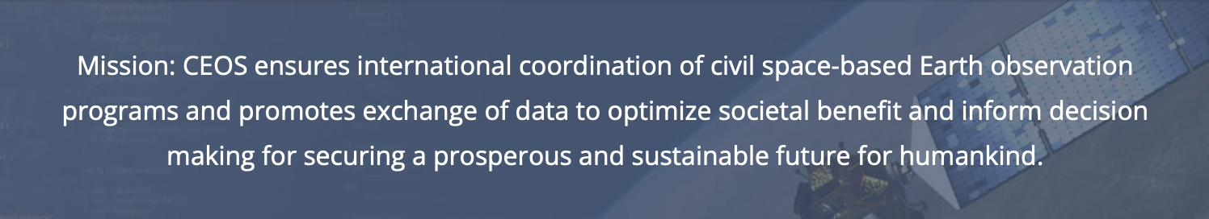
CEOS Mission & Objectives
  Primary Objectives:
To optimise the benefits of space-based Earth observation
To serve as the focal point for international coordination of space-based Earth observation activities
To encourage complementarity and compatibility

Slide 3





CEOS Long-term Priorities
Ensure that climate observation requirements identified by the Global Climate Observing System (GCOS) – and implications of the Paris Climate Agreement – are addressed.
Ensure, in the context of the Sendai Framework for Disaster Risk Reduction 2015-2030, that CEOS Agency data are made available in support of disaster risk reduction and that CEOS continues engagement with UN agencies and authorities.
Ensure that space-based Earth observations support the success of the next decade of the Group on Earth Observations (GEO), and that CEOS engagement in GEO governance and leadership is enhanced.
Proactively engage in global discussions on the critical challenges that face society, in support of the UN 2030 Agenda for Sustainable Development.

Slide 4
CNES CEOS Chair Priorities 2022
Paths to Sustainability: from strategy to practical measures
The 2022 Chair priorities are :
  Priority 1: Disaster Risk Reduction and Response, & Capacity Building
  to ensure long-term sustainability of CEOS strategies
  Priority 2: CEOS Support to the UNFCCC Global Stocktake
    to ensure a strong and unified CEOS support to the UNFCCC Global Stocktake
  Priority 3: Support to CEOS Cal/Val Initiatives
    to increase CEOS Agency Cal/Val Collaboration

Slide 5

WGCV Mission & Objectives
Mission: To ensure long-term confidence in the accuracy and quality of satellite-based Earth observation data and products and provide a forum for the exchange of information about calibration and validation and associated coordination, and cooperative activities.
Objectives:
To enhance coordination and complementarity, to promote international cooperation and to focus activities in the calibration and validation of Earth observations for the benefit of the CEOS membership, the Group on Earth Observation (GEO), and the international user community.
Specific objectives include:
  Sensor-specific calibration and validation
  to document and establish forums for the assessment, recommendation and implementation of current techniques and standards for pre- and post-launch characterisation, calibration and validation.
  Bio-geophysical validation
  to document and establish forums for the assessment, recommendation and implementation of techniques for validation of bio-geophysical parameters derived from EO satellite systems.

Slide 6

Governance & Work Planning
Four key governing documents primarily guide the work of CEOS:
  CEOS Terms of Reference defines the mission and scope of CEOS activities
  CEOS Strategic Guidance document articulates the overarching long-term (7-10 years) purpose and goals of CEOS
  CEOS Governance and Processes document provides guidelines on the structure, operations, and processes CEOS employs to achieve its goals
  CEOS Work Plan (3-year rolling) sets forth near-term actions to achieve the goals outlined in the CEOS Strategic Guidance document
The CEO is the custodian of all CEOS Governing Documents, including the annual update of the 3-year CEOS Work Plan and the definition and monitoring of the deliverables it informs

Slide 7


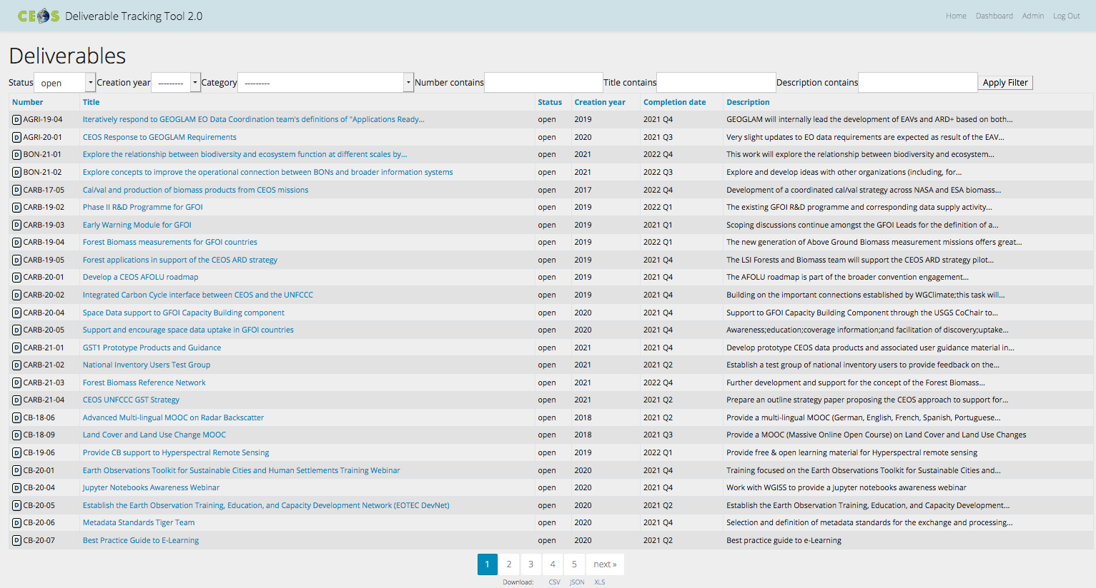
CEOS Work Plan
3-year plan updated by all CEOS entities every year and put forward for formal endorsement at SIT in March. Rigorous work planning, execution and monitoring is critical to CEOS’s credibility.
Plenary
SIT
Jan
Feb
Mar
May
Apr
Jun
Jul
Aug
Dec
Sep
Oct
Nov
SIT TW
Detailed work defined as deliverables: outlined in the WP, reconciled and tracked in CEOS deliverable tracking tool

Slide 8
CEOS Work Plan Structure
 | Chapter in Work Plan | Responsible
1 | Climate Monitoring, Research, and Services | WGClimate
2 | Carbon Observations in Support of Climate Science and Policy
3 | Observations in Support of the Global Stocktake of the UNFCCC
4 | Observations for Agriculture
5 | Observations for Disasters | WGDisasters
6 | Observations for Water
7 | Data Quality | WGCV
8 | Capacity Building and Data Democracy | WGCapD
9 | Data Discovery, Access, Preservation, Usability and Exploitation: approaches, systems, tools and technologies | WGISS
10 | Advancement of the CEOS Virtual Constellations | VCs (includes ARD Oversight Group)
11 | Support to Other Key Stakeholder Initiatives | SDG Coordination Group, Biodiversity experts, COVERAGE, COAST AHT
12 | CEOS Services

Slide 9
2021-23 vs 2022-24
 | Closed from 2021-23 WP | Carried over from 2021-23 WP | New for 2022-24 WP
Climate Monitoring, Research, and Services | 2 | 3 | 4
Carbon Observations in Support of Climate Science and Policy | 3 | 10 | 1
Observations in Support of the Global Stocktake of the UNFCCC | - | - | 10
Observations for Agriculture | 1 | 1 | 3
Observations for Disasters | 3 | 9 | 4
Observations for Water | 0 | 0 | 0
Data Quality | 5 | 6 | 2
Capacity Building and Data Democracy | 17 | 13 | 14
Data Discovery, Access, Preservation, Usability and Exploitation: approaches, systems, tools and technologies | 5 | 1 | 6
Advancement of the CEOS Virtual Constellations | 8 | 23 | 6
Support to Other Key Stakeholder Initiatives | 1 | 12 | 2
Totals | 45 | 78 | 52

Slide 10
Deliverable deadlines
 | 2022 | 2023 | 2024 & beyond
Climate Monitoring, Research, and Services | 4 | 2 | 1
Carbon Observations in Support of Climate Science and Policy | 3 | 8 | 0
Observations in Support of the Global Stocktake of the UNFCCC | 6 | 4 | 0
Observations for Agriculture | 3 | 1 | 0
Observations for Disasters | 5 | 4 | 4
Data Quality | 6 | 1 | 1
Capacity Building and Data Democracy | 18 | 8 | 1
Data Discovery, Access, Preservation, Usability and Exploitation: approaches, systems, tools and technologies | 4 | 3 | 0
Advancement of the CEOS Virtual Constellations | 19 | 5 | 5
Support to Other Key Stakeholder Initiatives | 13 | 1 | 0
Totals | 81 | 37 | 12

Slide 11
WGCV Deliverables

Slide 12
Thank you!
Marie-Claire Greening
CEOS Executive Officer
WGCV-50
22 March 2022

