Slide 1
Welcome and WGCV-Chair Report
Akihiko KUZE and Philippe GORYL
WGCV-50
March 22-25, 2022
(Virtual)

Slide 2
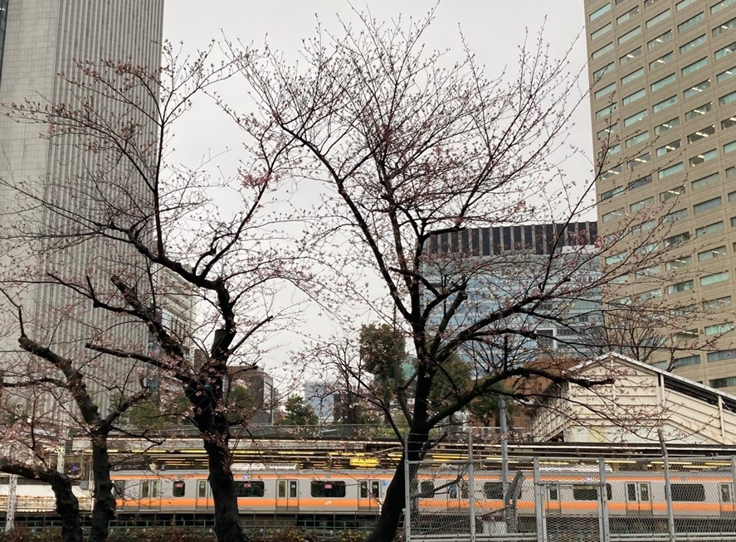
Welcome
4 hours ago
In front of JAXA Tokyo Office.
Too cold and too early to enjoy cherry blossoms.

Slide 3
WGCV-50 (agenda)
WGCV-50 Agenda March 22 (Mon) -25 (Fri)
Day 1: Action Review, CEOS priorities and WP, Vice Chair nomination, Open-source tool kit, subgroup report
Day 2: Subgroup report, ACIX/CMIX, RadCalNet, GHG Cal/Val,
Day 3: Subgroup report, SARCalNet, DEMIX, Terms and Definitions Wiki, ARD
Day 4: CNES SIT chair priority, GSICS feedback, CEOS WGCV WP, ISO, CLARREO, WGCV-51 plan

Slide 4
Topics since WGCV-49
(1) Living Planet Symposium 2022
May 23-27, 2022, Bonn an abstract to (https://lps22.esa.int/)
for a poster dedicated to the CEOS Cal/Val portal for the following session:
(2) Philippe Goryl POC CEOS ARD and Medhavy on the team
CRAD4L Update https://ceos.org/ard/index.html#datasets
(3) DEMIX WEBSITE uploaded (2021 Dec. 16)
https://ceos.org/ourwork/workinggroups/wgcv/current-activites/
(4) CNES Priorities Global Stocktake, CAL-VAL for TIR sensors (CEOS plenary, 2022)
cross-calibration of thermal infrared measurements from future CEOS Agency missions.
(5) ACSG chair position
(6) Journal Publications

Slide 5
WGCV-49 AI
(1) WGCV-49-01
Jean-Christopher to maintain a watch on surface related validation activities emerging in the atmospheric composition world (PICS, (D)(G(E))LER, etc.) To be presented WGCV-50
(2) WGCV-49-02 WGCV Chair and Vice Chair to consider the addition of a CEOS Work Plan 2022-2024 Task regarding "Development of Validation Protocols for Atmospheric Aerosol and Cloud Profiles". COMPLETE Included in latest CEOS Work Plan as task CV-22-01
(3) WGCV-49-03 Medhavy to summerise the proposed changes to the CARD4L peer review process agreed at WGCV-49 in an email for review by WGCV before sending to the LSI-VC Leads. COMPLETE
(4) WGCV-49-04 Odele to provide comparisons of the TSIS-1 HSRS vs other solar references CLOSED
(5) WGCV-49-05 the potential WGCV recommendation of the TSIS-1 HSRS solar spectra
under review
applying TSIS HSRS to GOSAT, OCO, TROPOMI calibrations. It will be completed by June.

Slide 6
TSIS Solar Irradiance dataset for GHG SWIR spectrometers
<TSIS Objective>
The accurate measurement of total and spectral solar irradiance to improve understanding of solar variability and Earth’s climate response to solar variability.
<TSIS-HSRS>
TSIS-1 HSRS high-accuracy (0.3-1.3%), high-resolution (0.01 nm or better), solar reference spectrum
Uncertainty in SWIR irradiance (8-10%) was much reduced
User friendly data base with various spectral resolutions from radiometers to high resolution spectrometers.
Version 2 is under review.
<CEOS WGCV Action>
To recommend TSIS-1 HSRS as the new CEOS solar irradiance reference spectrum (one year).
To assess consistency between GHG sensors; OCO, TROPOMI, GOSAT, extending 2.3 micron for CH₄ and CO. (to be completed in Aug. 2022 (after joint vicarious calibration campaign in June in Railroad Valley, NV, U.S.A.
<Telecon with LASP>
March 2, 2022, Discussion on TSIS high spectral resolution and long-term data using GHG sensors.
September, 2022, in person meeting in Colorado

Slide 7
TSIS-HSRS application
Oct 4 (Oct 5), 2021 TSIS Solar Irradiance Science Team meeting
Dec. 2021, GOSAT-2-L1 V210 with best-estimate radiance using TSIS-HSRS (released)
11-year Solar cycle has not been considered yet.
Systematic difference up to 7% exists between TSIS-HSRS, Toon, and SOLSPEC.

Slide 8
GOSAT re-analysis SCAL data
To be available in September, 2022
SCAL products for SIST-3 | Number of data | Notes
L1B SCAL with backside (Raw data) | 13-year by 12-month files | 3 spectral range by 2 orthogonal linear polarization (P & S) P and S have independent degradation <Assumption> Very short exposure of 30 min per month has no surface degradation of the backside surface
Calibrated radiance (100 % reflectance, Lambertian radiance without the Earth’s atmosphere | 13-year by 12-month by 3 spectra | Analyzed Data from P and S must be the same within uncertainty Radiance conversion using prelaunch calibration data and radiance degradation factor (RDF) <Applied correction > (1)RDF includes TANSO-FTS radiance degradation since its launch (2) Spectralon diffuser reflectance correction using the vendor (Labsphere shipping data) (3) BRDF correction to remove seasonal variation (BRDF model tuned by JAXA) (4) pointing mirror switch correction (primary to secondary in January 2016) (5) Doppler shift correction <Filtering> Remove contaminated spectra transmitted and scattered by Earth’s atmosphere by carefully checking spectra and radiance flattening during the SCAL procedure <Averaging> To minimize random fluctuation (1) average over screened data (2) average over P and S if necessary
Normalized Irradiance at 1AU (represent solar cycle) | 13 year by 12 month by 3 spectra | Radiance to irradiance conversion By multiplying pi, divided by cos(incident angle) Normalized by correcting sun-GOSAT distance

Slide 9
Greenhouse Gas Cal/Val Update
Akihiko KUZE and Philippe GORYL
WGCV-50
March 22-25, 2022
(Virtual)

Slide 10

VCAL portal for GHG sensors
https://ceos.org/gst/
Remaining issue: seamless dataset between multiple instruments: radiance spectra by calibrations and retrieved GHG densities by validation.

Slide 11
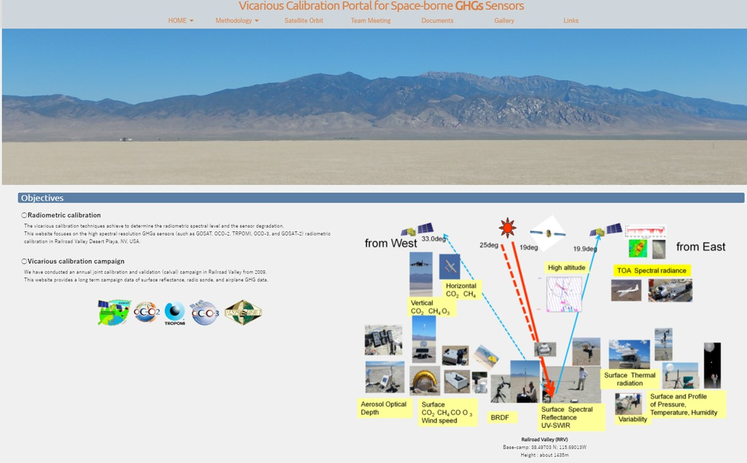
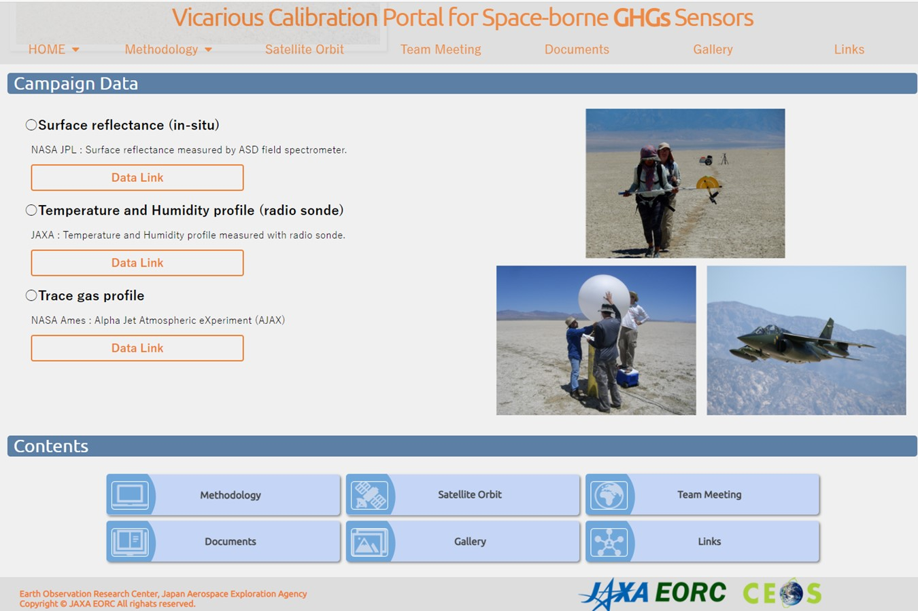
VCAL portal for GHG sensors
GHG sensors have wide swath with larger footprints and SWIR channels at CO₂ and CH₄ bands.
Radiometric calibration is required to estimate the light path modification by aerosol and clouds, which is one of the largest error sources in GHG column density retrieval.
https://www.eorc.jaxa.jp/GOSAT/GHGs_Vical/index.html

Slide 12
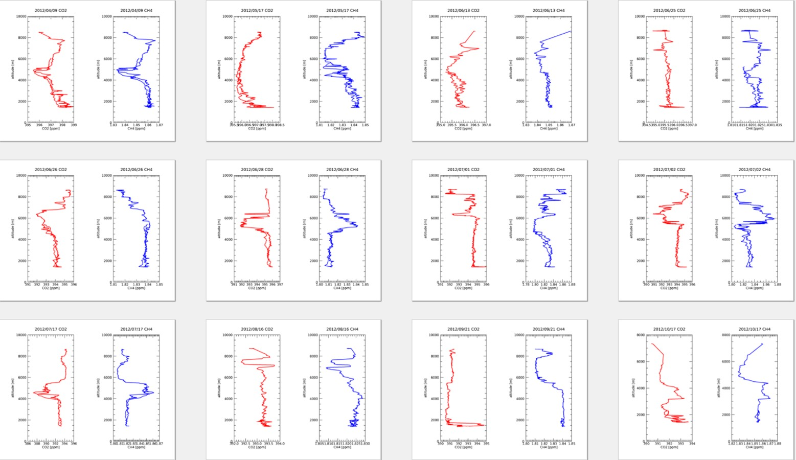
VCAL portal for GHG sensors
The VCAL Portal site provides
Methodology of vicarious calibration for various size footprint and off-nadir data.
13-year annual joint campaign data for CAL-VAL
Dataset for analysis
Analytical results from various type of spectrometers: GOSAT FTS, OCO, S5P TROPOMI
AJAX coincident spiral flight data: CO₂ and CH₄ vertical profile.

Slide 13
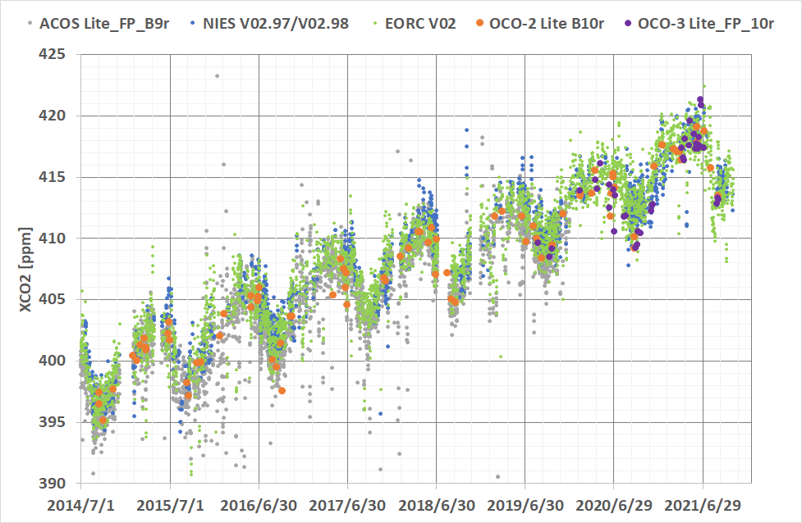
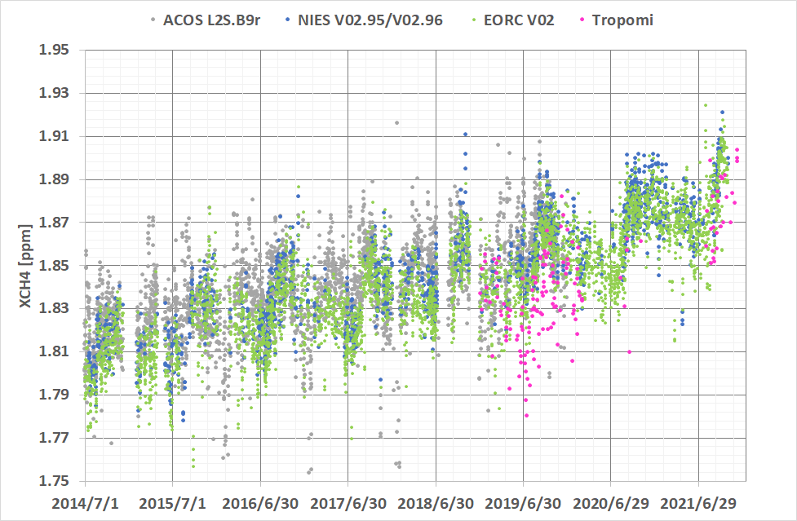
Validation: Intercomparison Long term RRV L2 XCO₂ and XCH₄
ACOS, NIES, EORC (research product) by GOSAT

Slide 14
Multiple senser inter-comparison
Objectives: toward harmonization
Main topics
Seamless dataset for data harmonization: goal bias smaller than 1 ppm for CO₂ and 5 ppb for CH₄ (To be discussed)
Intercomparison of L1 and L2 for 5 instruments
Selection of strict match up data : close geometry and overlapped (if exits) footprint to minimize BRDF correction and IFOV correction (RRV, Sahara site, Lamont ….)

Slide 15
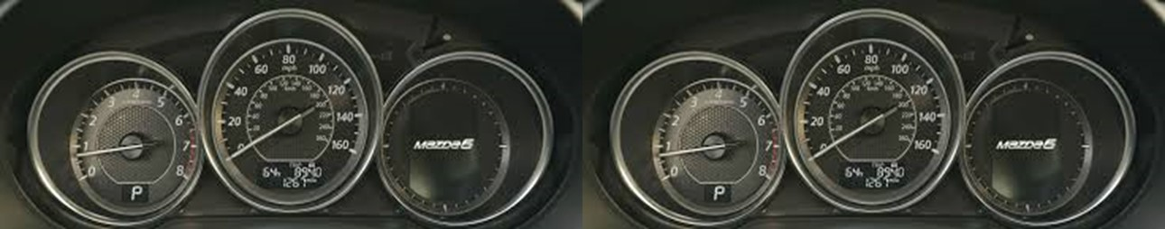
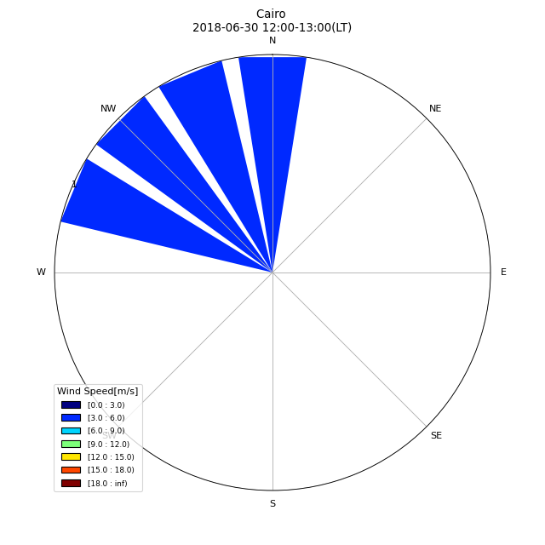
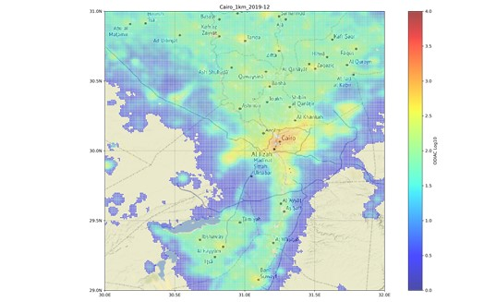
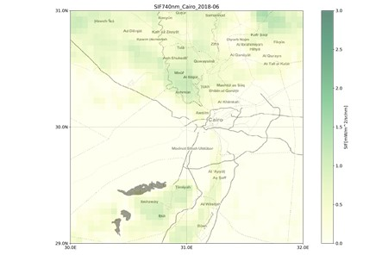
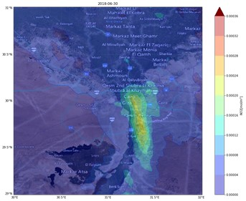
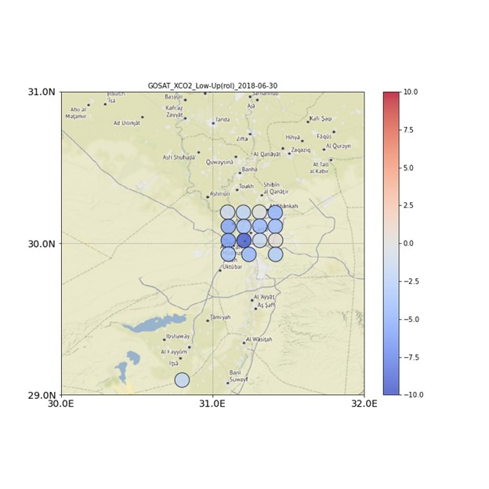
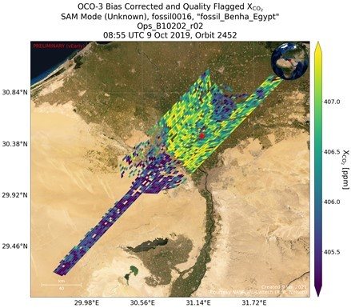
Earth Observation Dashboard - Local Urban Story
ESA-NASA-JAXA collaboration
Provide measured values from multiple instruments
Tell stories to the public
Collaboration between ESA-NASA-JAXA
GOSAT XCO₂^{LT}-XCO₂^{UT}（partial Column) Met (Wind speed & direction), OCO-3 XCO₂
SIF (Solar-Induced chlorophyll fluorescence), ODIAC CO₂ inventory, TROPOM NO₂
Cairo Story (1) COP27 host city (2) Downtown in South (3) Nile delta in North
(4) Double peak SIF (summer and December) (solar-induced chlorophyll fluorescence) Multiple Cropping

Slide 16
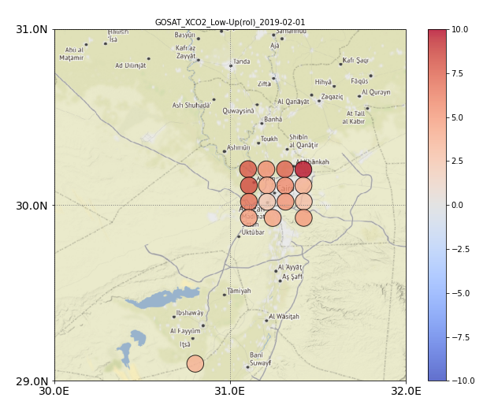
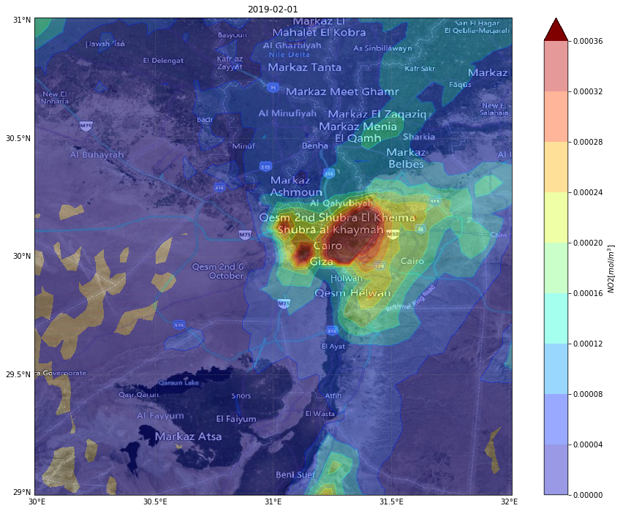
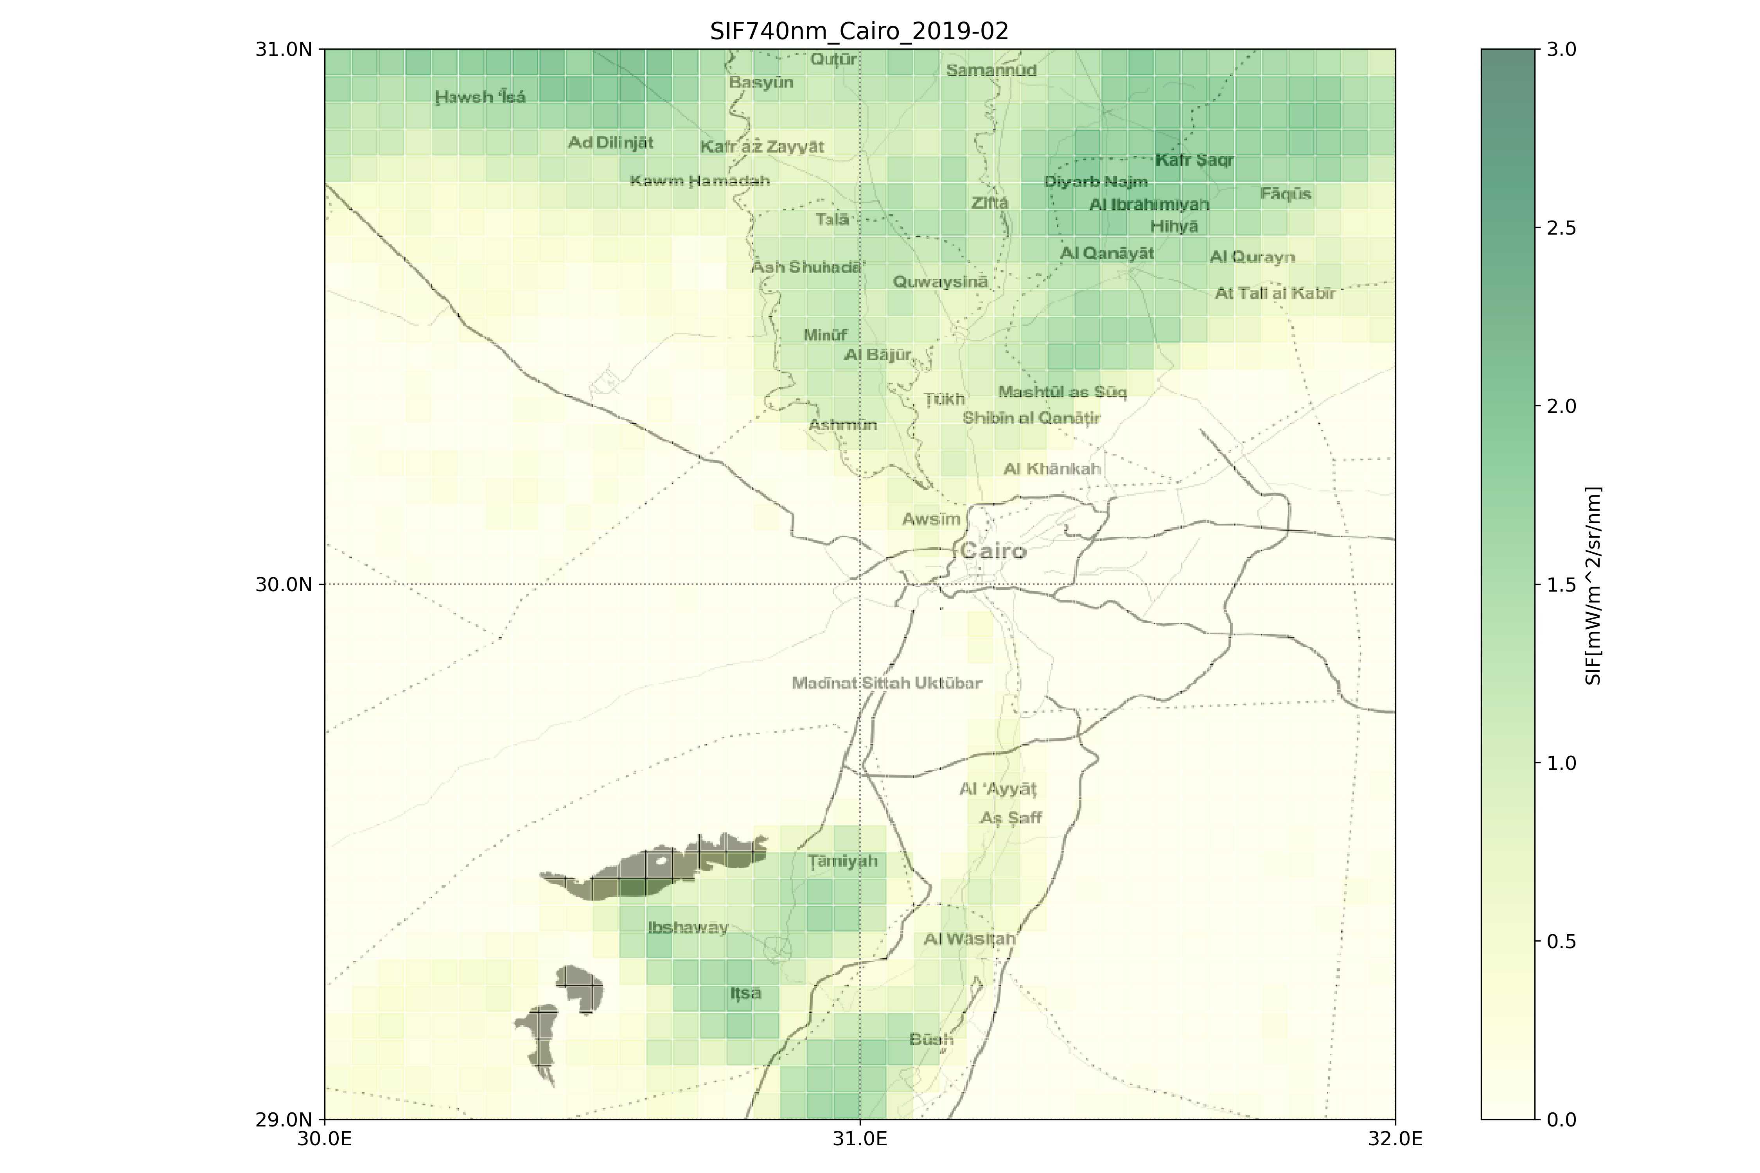
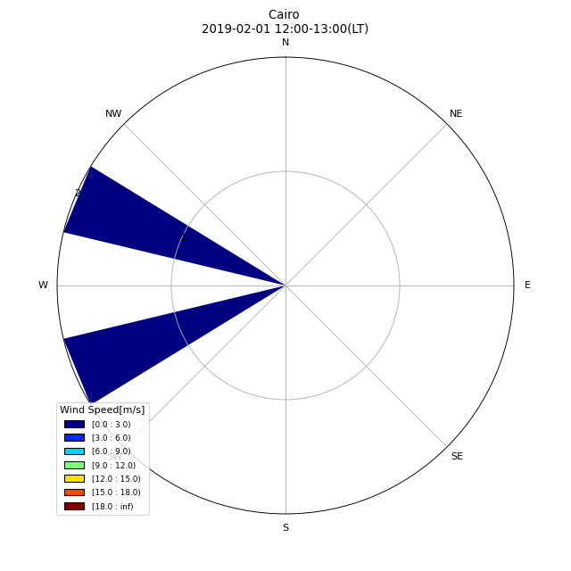
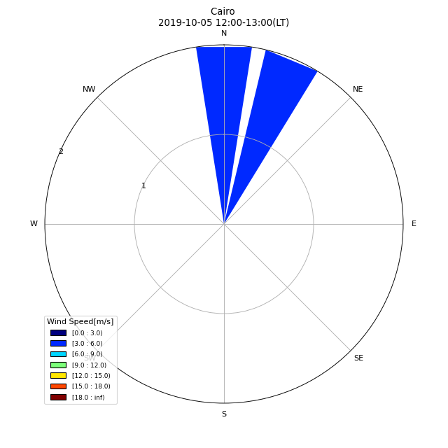
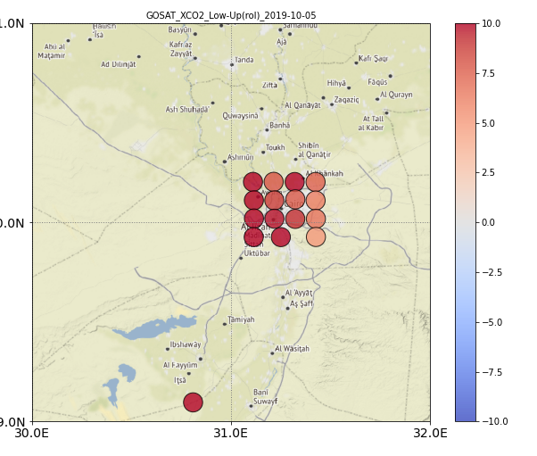
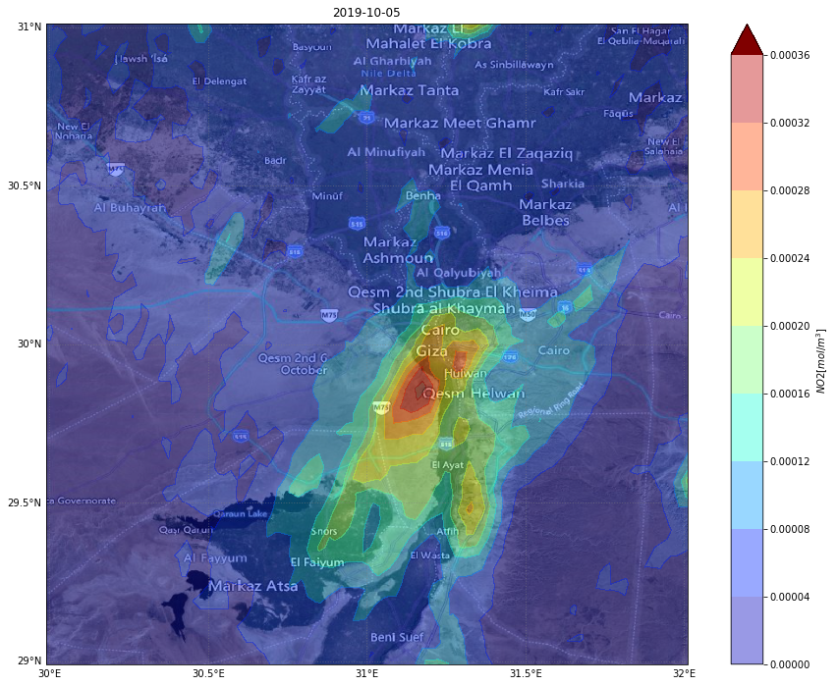
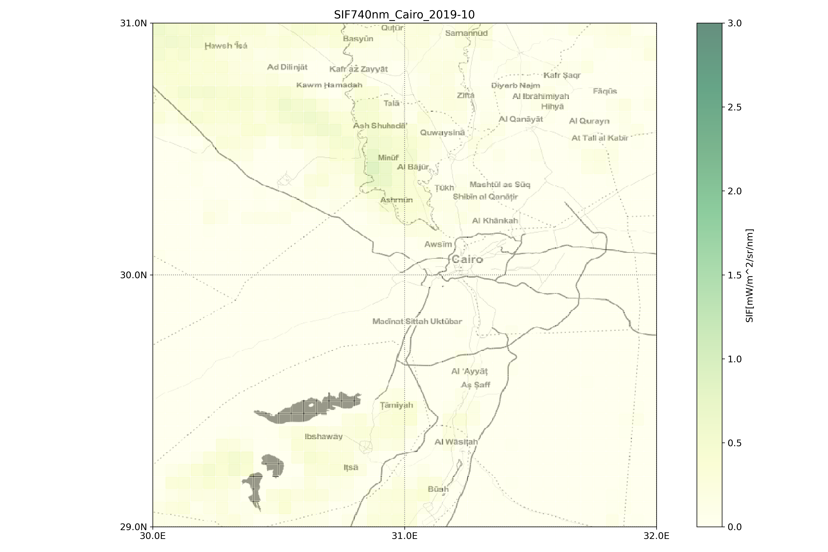
Cairo Story
2018-06-30
negative XCO₂^{LT} enhancement over Cairo
Wind from north
high SIF over Nile Delta
Airport wind at GOSAT overpass
2019-02-01
XCO₂^{LT} enhancement
Wind from east
very high SIF
2019-10-05
XCO₂^{LT} enhancement
Wind from north
weak SIF
GOSAT partial column from SWIR and TIR XCO₂^{LT}-XCO₂^{UT}_{average} Daily TROPOMI NO₂ Monthly TROPOMI SIF

Slide 17
Review Progress on Other WGCV CEOS Work Plan Activities
Akihiko KUZE and Philippe GORYL
WGCV-50
March 25, 2022
(Virtual)

Slide 18
Updated portion
Ensuring that the results of this work are readily available will take place through a significant update to the CEOS Cal/Val portal, the vicarious calibration portal, and the WGCV website within the CEOS interface. From these websites, calibration and validation data are available.
The WGCV will continue to strengthen its cooperation with GSICS in the topic of sensor calibration following the joint effort on a recommendation for a GSICS/CEOS solar spectrum with various spectral resolution and solar cycle that ensures interoperability.

Slide 19
Deliverables
CV-14-03 Workshop on state of the art for pre-flight calibration techniques 2021 Q4 WGCV
It has been postponed (many times) due to COVID.
CV-16-02 Report on application of approaches for cloud masking 2021 Q4 WGCV
close it with the publication of the report. https://calvalportal.ceos.org/cmix Peer review publication is on-going
CV-17-01 L1 top-of-atmosphere interoperability 2021 Q4 WGCV
To be confirmed
CV-20-01 Surface Reflectance measurements Intercomparison exercise for vegetation (SRIX 4Veg).
On-going. good progress.
CV-20-02 Biomass Retrieval Intercomparison eXercise (BRIX-2) WGCV
On-Going - delay due to COVID. The 1st Workshop was held 29-30 April. The results will be submitted in March 22. The report in May22 and the second and final workshop in July 22.
CV-20-03 DEMIX
Three subgroups Publications, Dedicated interface to give users access
CV-20-04 SAR Calibration inventory and joint use assessment SAR subgroup
this action should be transformed in SARCALNET. Chapman close this action but open a new one as I believe SARCALNET
CV-20-05 Standards and metrics for scatterometers and wind retrievals
To be confirmed

Slide 20
New Deliverables, to be discussed
(1) validation protocols for atmospheric aerosol and cloud profiles
Q1 2023 (Before EarthCARE launch)
development of validation protocols for atmospheric aerosol and cloud profiles
(2) CEOS Terms and Definitions Wiki
Q4 2024
Compilation of an agreed list of terms to ensure consistent use across CEOS. Covering words on: Earth observation systems, measurement and metrology, observation properties, and data stewardship.

Slide 21
WGCV-51 Meeting (Tokyo)
Akihiko KUZE and Philippe GORYL
WGCV-50
March 25, 2022
(Virtual)

Slide 22

Venue
Premeeting (Confirmation of Final Agenda, Logistics), Oct. 3 (Mon.), 2022
Meeting (Including joint symposium with WGCV), Oct. 4 (Tue.)-6 (Thu.), 2022
The International House of Japan, Roppongi, Minato-ku, Tokyo
https://www.i-house.or.jp/eng/facilities/

Slide 23
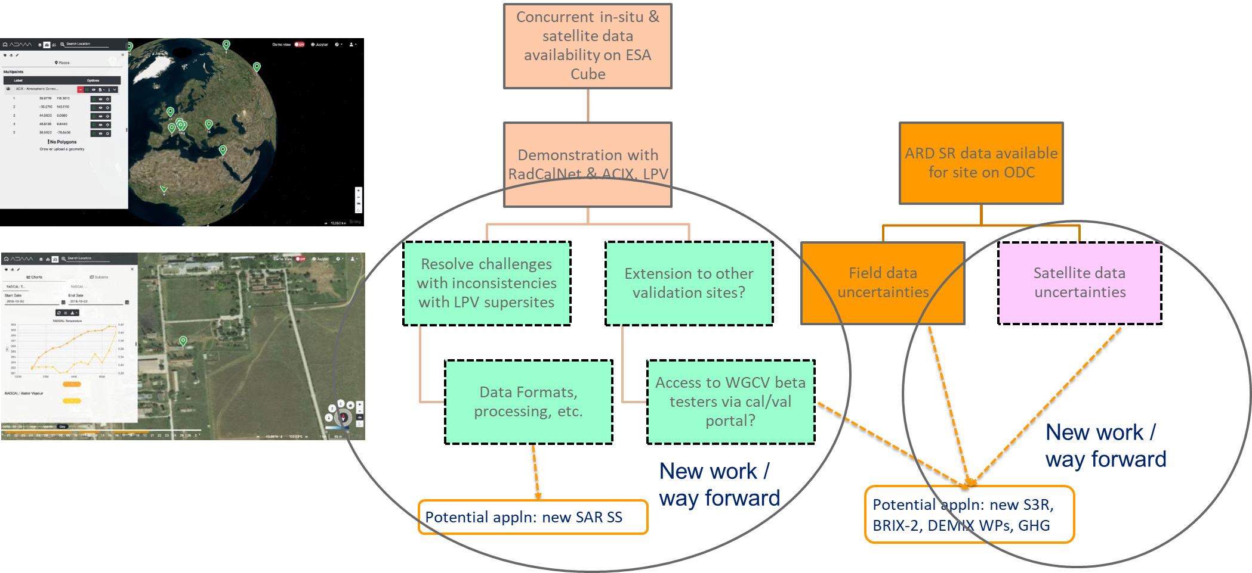
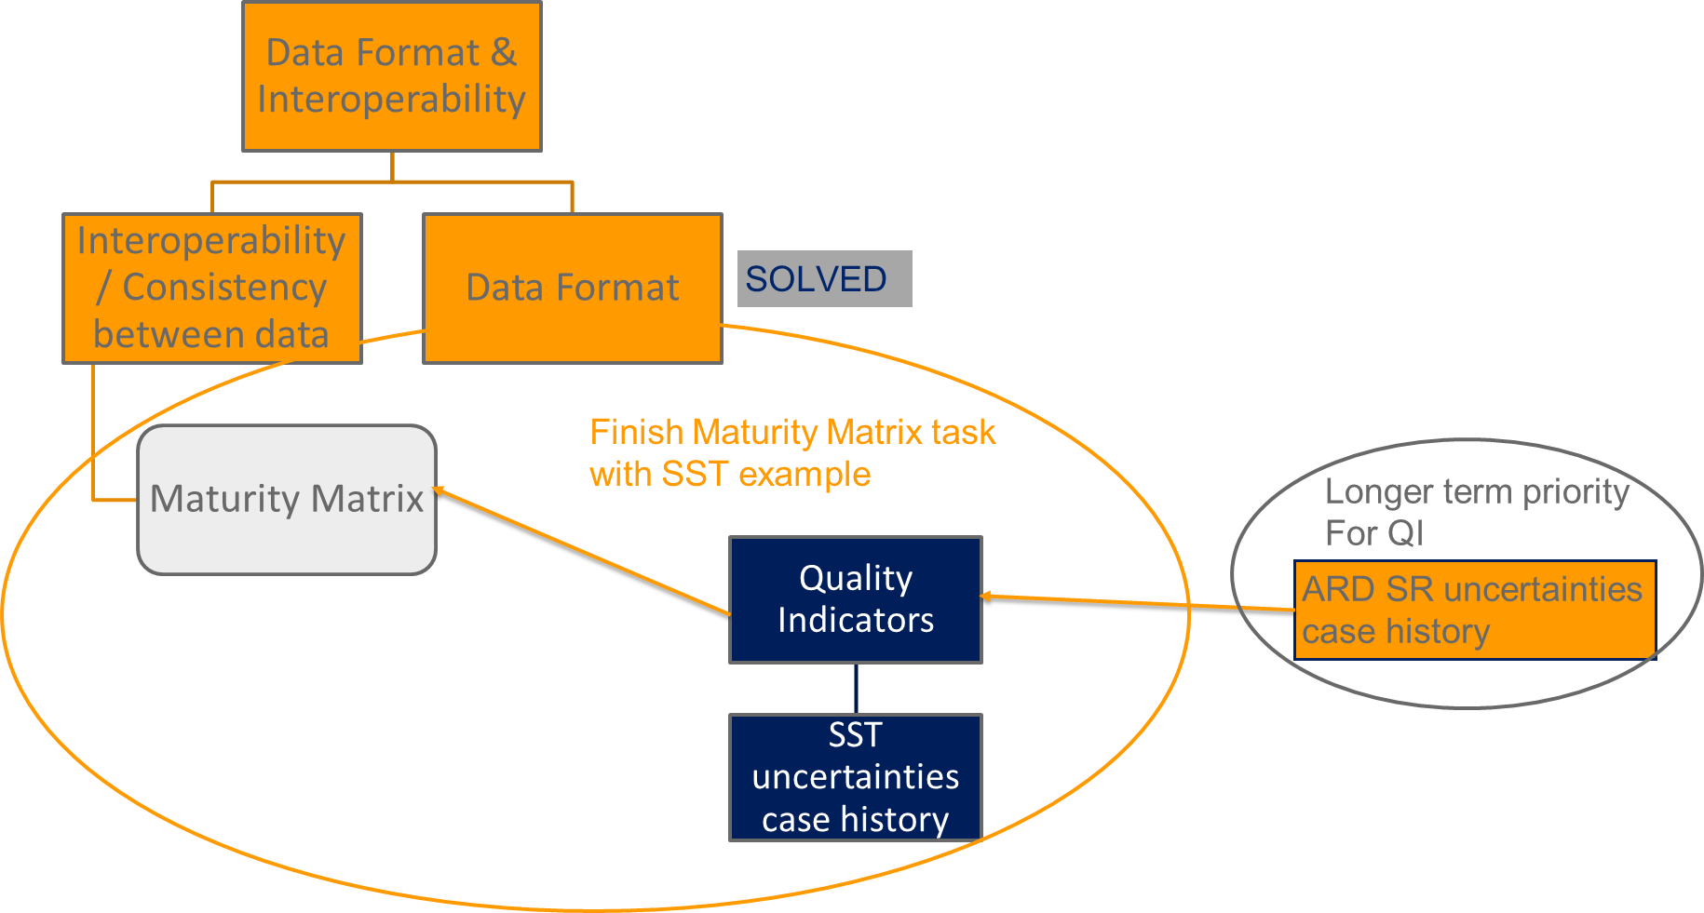
WGCV-51 and WGISS-54 joint meeting
Objectives: Building on collaboration between WGCV & WGISS
WGCV-48 slide by Cindy Ong

Slide 24
Joint WGISS/WGCV Activities
Four topics discussed in April 2018 with leads identified from WGISS and WGCV (updates at later stage)
Data Formats and Interoperability in the framework of FDA
  Robert Woodcock (WGISS), Medhavy Thankappan (WGCV)
Quality Indicators in Discovery Metadata
  Michael Morahan (WGISS), Nigel Fox (WGCV)
CEOS Data Cubes and CEOS Test Sites Data Access in support of WGCV Activities
  Robert Woodcock, Andrea Della Vecchia (WGISS), Cindy Ong (WGCV)
Standardization and Best Practices (e.g. ISO 19159-3)
  Iolanda Maggio (WGISS), Greg Stensaas, Philippe Goryl (WGCV)

