Slide 1
Streamlining the WGCV CARD4L Peer Review
Committee on Earth Observation Satellites
Medhavy Thankappan
Geoscience Australia
WGCV Plenary 49 (Virtual)
29 June – 2 July 2021

Slide 2
Expected Outcomes
Present the status of CARD4L peer-review submissions / prospects
Share information on effectiveness of the WGCV CARD4L peer-review
Increase the WGCV member pool for the CARD4L review panels
WGCV endorsement for streamlining the CARD4L peer-review process
Discuss ‘CEOS ARD Beyond Land’, and WGCV’s potential role(s)

Slide 3
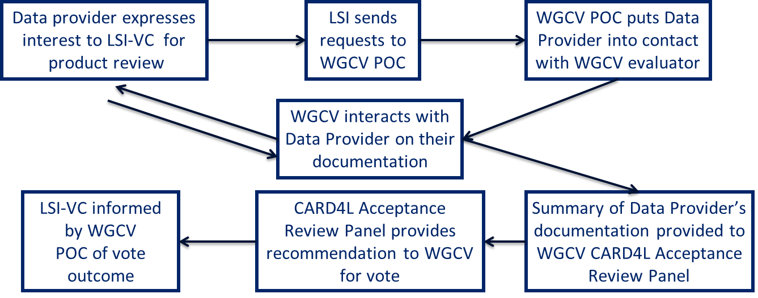
Current CARD4L Assessment Process
Data provider completes self-assessment against CARD4L
Data provider submits request for CARD4L endorsement to LSI-VC
WGCV receives CARD4L peer-review request from LSI-VC
WGCV verifies submitted CARD4L documentation
WGCV Acceptance Review Panel specific to PFS is set up
WGCV PoC interacts with data provider for any clarifications
Review Panel provides recommendation for a vote by WGCV
WGCV membership votes on recommendation
WGCV communicates outcome to LSI-VC
Data provider notified of outcome by LSI-VC

Slide 4
Peer Review Principles
Key principles of the peer review are: (from the CEOS ARD Governance Framework)
independence, including that the data provider is not involved in the review;
expertise-based, ensuring that experts in the data products are used in the peer review;
timeliness and efficiency, ensuring that the work-load is manageable and that data providers receive feedback in a reasonable period of time.
WGCV CARD4L Peer Review Guideline: suggested total of five members on the panel
One WGCV member
Three members who are either WGCV members or sub-group members nominated by the sub-group Chairs
Not more than one member from a given sub-group
Two-year terms for all members (TBR) without service limits

Slide 5
Member Pool for CARD4L Review
Initial member pool identified at WGCV-45
Evaluation Lead (M Thankappan)
WGCV member at large (N Fox)
IVOS subgroup (J Czapla-Meyers, C Anderson, L Ma)
LPV subgroup (F Gascon, F Camacho)
SAR subgroup (B Chapman, D Guedtner, N Miranda, T Tadono)
Land Surface Temperature (D Ghent, F Goettsche)
New members added: (V Boccia, K Thome, C Ong, H Yamamoto)

Slide 6
Current CARD4L Review Status
USGS Landsat Surface Reflectance (Coll.2) PFS ver 4/5 - complete
USGS Landsat Surface Temperature (Coll.2) PFS ver 4/5 - complete
ESA Sentinel-2 Surface Reflectance (self-assessed at ‘Threshold’ only) - review done
Element84 Sentinel-2 Surface Reflectance - in process
DLR EnMAP Surface Reflectance (Hyperspectral) - review panel in place
Queries from INPE and KARI for initiation of assessment
Landsat CARD4L Review Panel
Sentinel-2 CARD4L Review Panel
Hyperspectral CARD4L Review Panel
Nigel Fox (NPL)
Valentina Boccia (ESA)
Darren Ghent (UL)
Jeffrey Czapla-Myers (UoA)
Medhavy Thankappan (GA)
Nigel Fox (NPL)
Cody Anderson (USGS)
Darren Ghent (UL)
Fernando Camacho (EOLAB)
Medhavy Thankappan (GA)
Nigel Fox (NPL)
Kurt Thome (NASA)
Cindy Ong (CSIRO)
Hirokuza Yamamoto (AIST)
Medhavy Thankappan (GA)

Slide 7
Why Streamline the WGCV CARD4L Review Process?
How well are we meeting the key peer-review principles?
independence, including that the data provider is not involved in the review;
 expertise-based, ensuring that experts in the data products are used in the peer review;
❒ timeliness and efficiency, ensuring that the work-load is manageable and that data
providers receive feedback in a reasonable period of time.
12-week process at minimum (~20 weeks in practice)

Slide 8
CARD4L Assessment Issues
Turnaround for CARD4L reviews not optimal/sustainable
review feedback vs data provider product development cycles
review preparation is a front-loaded effort, WGCV PoC availability is critical
interactions with the data provider to complete documentation currently 2-4 weeks
agreed panel assessment turnaround is currently 6 weeks
lead time for vote by WGCV membership is currently 4 weeks
Incomplete submissions for peer-review
wasted effort (non-compliance is known beforehand)
CARD4L Review Panel Member Pool
need more members / specialist panels
a WGCV review member pool in place, but with low redundancy for domain coverage
availability of panel members at the time of assessment

Slide 9
Recommendations for Endorsement (1)
No partial submissions for Threshold (or Target). Gating of submissions at LSI-VC end to
ensure completeness, and avoid delays. Provide examples of complete self-assessments
Rationale: Outcome of review is known before hand through the self-assessment i.e. non-
compliant, a review would be wasted effort
‘Lightweight’ review for “threshold-only” self-assessments submitted for evaluation. No need
for a full blown review panel, have LSI-VC + WGCV PoCs review through 1-on-1 session(s)
with data provider (expected turnaround 4 weeks). Rationale: Fewer requirements to fulfil
at ‘Threshold’ for example: 34 - 43% items with no requirement (16/37 for SR, 10/29 for ST)
Evaluation by a WGCV Review Panel only for (fully) completed self-assessment at “Target”.
Increase the Panel member pool for redundancy and domain coverage, establish panels
in advance. (expected turnaround 8 weeks). Rationale: Higher level of requirement at
Target justifies review, with better availability / use of panel members’ time

Slide 10
Recommendations for Endorsement (2)
Remove requirement for a vote by WGCV membership. Instead share outcome of the peer-
review process via email with the WGCV membership for transparency (saves 4 weeks).
Rationale: Saves 4 weeks, can allocate additional time for expert panel review for Target

Slide 11
CEOS ARD Beyond Land: WGCV Role?
A CEOS ARD governance framework has been proposed:
https://docs.google.com/document/d/15grQ79D-Ge8PN1_4_XDmci5iezs8HAcOpLcM7d2wmAo/edit?usp=sharing
According to the framework, for new PFSs the relevant CEOS entity (normally the VC with carriage of the PFS), provides a review including:
a rapid first pass to confirm all necessary info is present;
confirming the data provider’s self-assessment;
working with the data provider to address any issues.
Would WGCV want (or be able) to conduct peer reviews for other domains (aquatic,
atmospheric, ocean colour etc.)?

