Slide 1
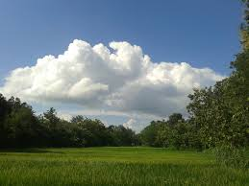
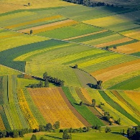

CMIX
ACIX-Land
ACIX-Aqua
>> ACIX-II and CMIX
Status & Main Conclusions

Slide 2
- Status
CMIX
>> Report & Scientific publication
A detailed report has been shared with the participants.
Based on it and the collected feedback a manuscript for publication is being currently prepared.
>> Design & development of CMIX webpage in CEOS Cal/Val portal
The webpage including all the results and documents to be published in Q3/2021
- Main Conclusions
>>
All 5 validation datasets (VD) have different strengths and weaknesses -> results vary depending on the validation dataset
  Subjectivity of detecting/photo-interpreting clouds, especially thin clouds, in VD should be minimized, e.g. use of a network of sky images
No clear superiority of any methodology (Spectral tests vs. AI, mono vs. multitemporal)
Buffer and its size have a strong influence on the validation results --> Bigger buffer = better results
Thin semi-transparent clouds and cloud boundaries are an issue for mostly all algorithms. -> How to define a transparent cloud? boundary of a cloud?
The validation dataset and methods do not allow for detecting systematic errors
>>
>>
>>
>>
>>

Slide 3
- Status
ACIX-Land
>> Report - Scientific publication -
All the re-processed results have been shared with the participants.
A manuscript for publication is being currently prepared with all the updated results.
>> Design & development of ACIX II- Land webpage in CEOS Cal/Val portal
The webpage including all the results and documents to be published in Q3/2021
- Main Conclusions
>>
Simulation reference using 6S and AERONET may biased: Differences between processors and reference (adjacency correction, RTM,…)
No clear superiority - Similar results for most processors in the SR comparison with RadCalNet measurements
Uncertainty is needed to be assigned to ground measurements when involved in the analysis
>>
>>
>>
Some geographical areas were missing (Africa, South America, Australia) & many sites close to big cities, deserts
>>
More in situ SR measurements are needed (CESBIO agricultural site, HyperNet)

Slide 4
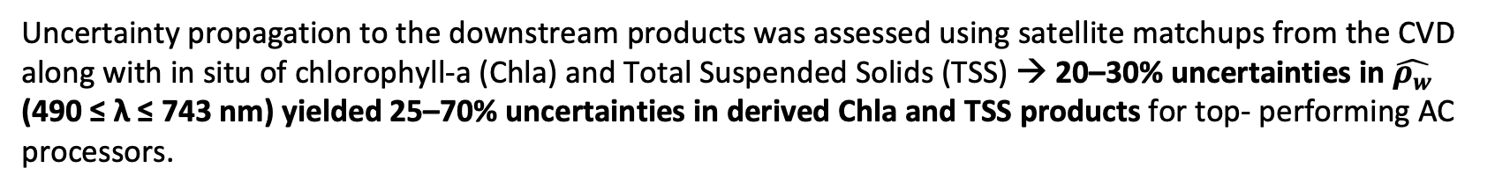
- Status
ACIX-Aqua
>> Report - Scientific publication -
A research paper has been published in Remote Sensing of Environment
Pahlevan, N., Mangin, A., Balasubramanian, S.V., Smith, B., Alikas, K., Arai, K., Barbosa, C., Bélanger, S., Binding, C., Bresciani, M. and Giardino, C., 2021. ACIX-Aqua: A global assessment of atmospheric correction methods for Landsat-8 and Sentinel-2 over lakes, rivers, and coastal waters. Remote Sensing of Environment, 258, p.112366. https://doi.org/10.1016/j.rse.2021.112366
>> Design & development of ACIX-II Aqua in CEOS Cal/Val portal
The webpage including all the results and documents to be published in Q3/2021
- Main Conclusions
>>
AC processors performance differed for Community Validation Database (CVD) and AERONET-OC matchups, likely reflecting inherent variability in aquatic and atmospheric properties between the two datasets.
>>
The largest uncertainties were associated with the blue bands (25 to 60%) for best-performing processors considering both CVD and AERONET-OC assessments.
>>
Uncertainty propagation to the downstream products was assessed using satellite matchups from the CVD along with in situ of chlorophyll-a (Chla) and Total Suspended Solids (TSS) → 20–30% uncertainties in $\hat{ρ_{w}}$ (490 ≤ λ ≤ 743 nm) yielded 25–70% uncertainties in derived Chla and TSS products for top- performing AC processors.

Slide 5
>> ACIX-III and CMIX-II Proposal

Slide 6

ACIX-III and CMIX-II Proposal
With the support of:
WHAT?
International collaborative initiative to inter-compare a set of atmospheric correction (AC) and cloud masking (CM) processors for Hyperspectral imagery (PRISMA) and Multispectral (Sentinel-2 & Landsat-8)
The objective is to point out:
Strengths & Weaknesses
Commonalities & Differences
S
W
C
D
Notes:
.

Slide 7
ACIX-III and CMIX-II Proposal
With the support of:
ACIX-III
CMIX-II
Atmospheric Correction
Inter-comparison
Cloud Masking
Inter-comparison
Processors over
LAND sites
Processors over
AQUATIC sites
Sentinel-2, Landsat-8 & PRISMA*
Sentinel-2, Landsat-8 & PRISMA*
PRISMA*
*PRISMA ad-hoc acquisitions over the selected set of sites for each of the exercises will be provided by ASI
Notes:
.

Slide 8

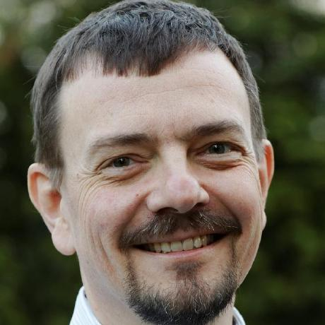


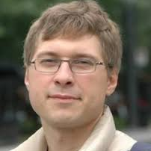
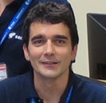

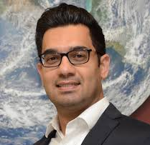
ACIX-III and CMIX-II Proposal
With the support of:
ACIX III
CMIX II
Atmospheric Correction
Inter-comparison
Cloud Masking
Inter-comparison
Task Coordinators
Processors over
LAND sites
Task Coordinators
Processors over
AQUATIC sites
Task Coordinators
Carsten
Brockmann
Jan Wevers
Eric Vermote
Sergii Skakun
Ferran Gascon
Georgia Doxani
Phil Townsend
Claudia Giardino
Nima Pahlevan
8
Notes:
.

Slide 9
ACIX-III and CMIX-II Proposal
With the support of:
WHO?
ACIX and CMIX are open and free exercises and every developer team with an atmospheric correction and/or cloud masking processor is welcome to participate
Potential Participants – Multispectral Data
Processors applicable to Sentinel-2 and Landsat-8 data participated in the previous exercises.
These developer teams will be invited, namely national space agencies, R&D companies, universities, research institutes, etc.
Any new developed processor or interested developer team is welcome to participate

Slide 10
ACIX-III and CMIX-II Proposal
With the support of:
WHO* ? Potential Participants – Hyperspectral Data
* Jennifer Adams, CHIME L2A Processor, Atmospheric Correction and Cloud Masking Algorithms Review

Slide 11
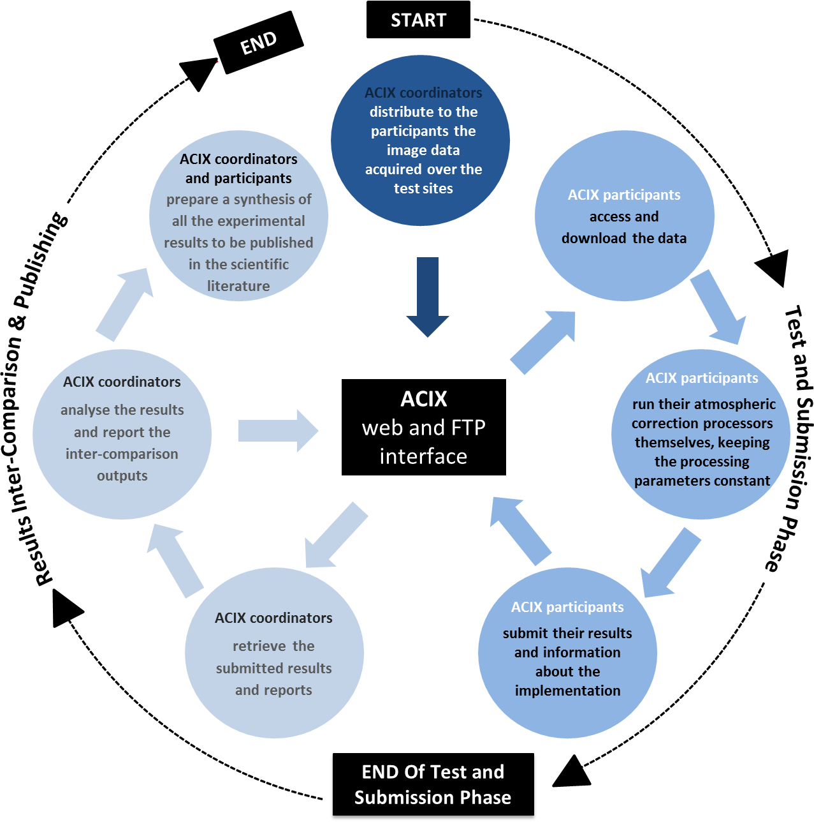
ACIX-III and CMIX-II Proposal
With the support of:
HOW?

Slide 12
ACIX-III Proposal
With the support of:
HOW?
Definition of the inter-comparison protocol:
AC and CM developer teams will be invited to provide their feedback on the suggested protocol for the AC and CM processors inter-comparison respectively. All the proposals will be discussed at the 1st workshop and the final inter-comparison procedure will be agreed by all participants.
Application of the AC processors:
Participants will apply their AC and CM schemes respectively for a set of test sites keeping the processing parameters constant. The results will be submitted for analysis to ACIX/CMIX coordinators.
Analysis of the results:
ACIX/CMIX coordinators will process the results submitted and assess the inter-comparison outputs based on the agreed metrics. All the results will be presented and discussed during the 2nd ACIX and CMIX workshops respectively .

Slide 13
CMIX-II Proposal
With the support of:
HOW?
Definition of the inter-comparison protocol:
AC and CM developer teams will be invited to provide their feedback on the suggested protocol for the AC and CM processors inter-comparison respectively. All the proposals will be discussed at the 1st workshop and the final inter-comparison procedure will be agreed by all participants.
Definition of the validation/test datasets:
CM developer teams will be invited to provide feedback on proposed validation/test dataset(s) and class definitions. Based on the collective decisions the validation/test dataset(s) need to be created.
Creation of the test/validation datasets:
Based on the decided definitions, validation/test dataset(s) will be created.
Application of the AC and Cloud Masking processors:
Participants will apply their AC and CM schemes respectively for a set of test sites keeping the processing parameters constant. The results will be submitted for analysis to ACIX/CMIX coordinators.
Analysis of the results:
ACIX/CMIX coordinators will process the results submitted and assess the inter-comparison outputs based on the agreed metrics. All the results will be presented and discussed during the 2nd ACIX and CMIX workshops respectively.

Slide 14
ACIX-III and CMIX-II Proposal
With the support of:
WHEN*?
Report Release
to the participants
Start
1st workshop
Results Submission
Invitation to developers
?
Autumn
2021
?
?
?
?
?
Input Data Distribution
to Participants
Inter-comparison Results
Presentation
Report
Submission to Scientific Journal
*This is just an indicative timeline. The exercises are anticipated to start together, but they may follow different timelines if needed

Slide 15
VH-RODA 2021
The Very High-resolution Radar & Optical Data Assessment (VH-RODA) 2021 workshop held on-line, 20–23 April 2021.
The 2nd Edition of the Workshop provided an open forum (new space, commercial and institutional) on the status and future developments related to Cal/Val activities of space borne very high-resolution SAR and optical sensors and data products.
Focus on: commercial entities in Cal/Val activities, synergies between optical and SAR communities, presentation of standards and best practices for data quality.

Slide 16
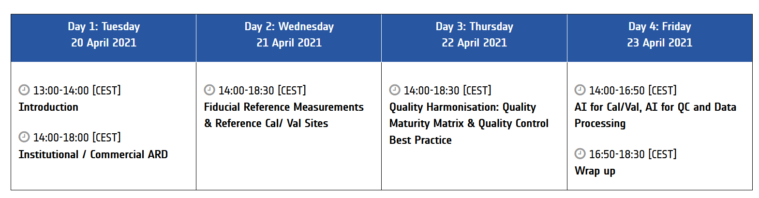
VH-RODA 2021
The workshop has been subdivided by topics along four half-days, with a mean daily audience of 160 participants to the sessions.
Info and presentations can be found on the VH-RODA ESA official web site:
https://earth.esa.int/eogateway/events/vh-roda-workshop-2021

Slide 17
VH-RODA Highlights
The continues growth of EO satellites and sensors implies, for the next future, to provide standardized inputs for sensor fusion and to expand inter-operability to all the processing levels. This growth should stimulate, moreover, “the creation” of a wide multi-sensor community.
The discussion on the ARD definition is still open: institutional and commercial point of views are complementary, and the need to define a working group to bring the different actors, (together commercial and institutional space) is evident and advisable.
The heterogeneity of EO sensors, with different spectral and spatial characteristics, forces to sustain and maintain various sites in order to improve calibration activities (especially for commercial satellites).
  Coordination among institutions/agencies to make Cal/Val data available by the community.
  Joint effort (commercial and agencies) in order to have a collection of sites for geometric Cal/Val.
The availability of larger and distributed GCPs data is becoming fundamental: the accessibility and availability of DBs shall be improved in the frame of CEOS and made available on the Cal/Val portal.
  Interaction with USGS for sharing potential DB for VHR GCPs.
  In-situ and other reference data should be more in the focus of data providers and be considered a substantial part of any 'free & open' data policy

Slide 18
VH-RODA Highlights
Quality Control of EO data needs coordination: a systematic approach by defining and implementing QA standard requires the effort of all in order to keep pace with the development.
  Quality information of each pixel are deemed necessary for interoperability (uncertainty per-pixel important for medium resolution and data assimilation).
  Institutions have to work in order to provide common references and to permit the sensors inter-comparison at different scales.
  Uncertainty associated to measurements and derived quantities should be always included: QA4EO can support commercial entities to improve the provision of uncertainty information through standardization.
  The Maturity Matrix has been recognized as an important instrument for the quality evaluation of data and processes.
  With the growth of VHR missions, an inter-comparison exercise involving commercial companies should be considered.
Artificial Intelligence and Machine Learning methodologies and tools are becoming fundamental instruments in the data processing chains, very promising in terms performances and into supporting the decision making.
  Large training dataset is the key. To make data and resources available arranges the environment for progressing.
  Motivating large number of people and providing benchmark is the way Agencies can help the community about this topic
  Stimulating the interaction between EO and AI communities, still too separated.
  Stimulating initiatives to push forward the re-analysis for past dataset with AI methods;
  Objective for the agencies/institutions: to provide reference/ground truth.

Slide 19
VH_RODA 2021 Actions
ID | Title | Description | Owner
01 | Supporting training dataset | To provide large training datasets and make them available (together with computational resources and environments for progressing) in order to apply AI and ML techniques to different sensors and domains. | ESA
02 | Support the transfer of knowledge from institutional to commercial | To provide reference data (i.e. in situ data, calibration data) with free & open data policy as done for satellite data. | ESA
03
04 | Promote initiatives on ARD | In order to promote CARD4L initiatives and in general ARD, it is essential to instance workshops and support discussion in the existing framework (JACIE, VH-RODA). | ESA/General
05 | ARD: create a link with Commercial Sector | Create Working Group with CEOS and Commercial sector to coordinate this discussion (following the example within LSI-VC). Necessity to integrate commercial inputs in LSI-VC, WGCV, and WGISS. | ESA
06 | Sharing of potential DB for VHR GCPs | Action to get in contact with USGS on sharing available VHR GCPs. | ESA/USGS
07 | AI Challenge | Investigate the opportunity of a challenge on AI methods involving and stimulating collaboration between EO and AI communities. | ESA

