Slide 1
Welcome and WGCV-Chair Report
Akihiko KUZE and Philippe Goryl
CEOS WGCV-49
June 29-July 2, 2021

Slide 2
WGCV-49 (agenda)
(1) WGCV-49 Agenda
2 hour each day
No agency report session
Please show your own screen and send presentation material to Matt and Kuze
On Thursday, LASP at Univ. of Colorado will present TSIS solar database..
(2) WGCV-48 Action Items, Minutes
Uploaded at https://ceos.org/document_management/Working_Groups/WGCV/Meetings/WGCV-48/WGCV-48_Minutes_V1.0.pdf
Please check.
(3) Updates since WGCV-48
Publications and meetings.

Slide 3
WGCV-48 AI
(1) The contact details of the ISO lead for the next standard that is Liping Di.
Liping Di, Ph.D Professor and Director Center for Spatial Information Science and Systems
George Mason University, Liaison via WIGISS, received comments
ISO 19159 series of standards: the pre-launch cal/val of instruments
ISO 19124 series of standards the post-launch cal/val of remote sensing instruments/products
(from low level sensor data to high level thematic products)
* Part 1: Fundamentals * Part 2: Optical sensors * Part 3: Hyperspectral sensors * Part 4: Lidar* Part 5: SAR/InSAR * Part 6: Microwave * Part 7: Thematic Data * Part 8: Cal/Val site
Due to the limited available resources, currently ISO TC 211 is only working on 19124 part 1: Fundamentals.
(2) DEM released from [https://spacedata.copernicus.eu/fr/web/cscda/explore-more/news-archive]
(WGCV-48-03 closed)

Slide 4
Updates since WGCV-48 (Oct. 28, 2020)
<Documents and Publications>
CEOS Work plan 2021-2023 (minor updates)
adding Global stock take
(2) The Soil Moisture Product Validation Good Practices Protocol was endorsed by WGCV (Nov. 30) and uploaded to http://ceos.org/about-ceos/publications-2/.
(3) The Biomass Validation Protocol by the WGCV LPV was reviewed and endorsed SIT.
(4) WGCV report CEOS Newsletter #56

Slide 5
Work Plan 2021-2023 (WGCV updates)
Two topics on in WP2021-2023
(1) Coordinate and contribute to the development of suitable methodologies for the on-ground characterization of satellite-based EO sensors, the on-orbit calibration of EO missions, and the validation of satellite-based Level 1 and Level 2 products.
Interoperability and utility of Analysis Ready Data (ARD) products
ARD beyond Land (CARD4L)
A similar effort to greenhouse gases (GHG) products such as radiance spectra, densities, and flux suitable for inter-comparisons across multiple missions.
(2) Continue cooperation with GEO, Global Space-based Inter-calibration System (GSICS), and WMO and ground-based networks in the provision of high quality EO data products.
The WGCV will continue to strengthen its cooperation with GSICS in the topic of sensor calibration following the joint effort on a recommendation for a GSICS/CEOS solar spectrum that ensures interoperability.
Action Items
CV-14-03 Workshop on state of the art for pre-flight calibration techniques 2021 Q4
CV-16-02 Report on application of approaches for cloud masking 2021 Q4
CV-17-01 L1 top-of-atmosphere interoperability 2021 Q4
CV-18-02 Greenhouse gas reference standards for interoperability (input refinement to the GHG roadmap annex C, July 2020) 2021 Q3
CV-18-03 Biomass validation protocols(submitted, under review, to be approved in March 2021 SIT) 2021 Q1

Slide 6
Updates since WGCV-48 (Oct. 28, 2020)
<Meetings>
SIT-36 meeting
March 24, One topic from WGCV “Biomass and GHG toward Global stocktake”
(2) WGCV team telecon (March 12) by subgroup chairs (Before SIT)
(3) CEOS study team on input to the UNFCC GST
1st Dec. 10, 2020, Jan 20, Feb 23, Apr. 27
(4) CEOS ARD framework review (ARD Beyond Land) (Jan. 21, Ma. 1)
(5) GSICS annual meeting (March 29) report. <Collaboration with GSICS>
Presentation by WGCV (Kuze) March
Recommendation of the TSIS HSRS solar spectra, which the GSICS community has endorsed.

Slide 7
Updates since WGCV-48 (Oct. 28, 2020)
<Subgroup Meetings>
(1) LPV subgroup meeting May 26, 27 (15h-17h UTC)
(2) BRIX-2 workshops
- Second Biomass Retrieval Inter-comparison eXperiment (BRIX-2) Intercomparison of biomass algorithms based on a test dataset, and comparison with ground-truth.
2 workshops (a first one to discuss the protocol with the participants in April), a second one to share and discuss the results of the exercise. Based on the ESA-NASA Multi-Mission Algorithm and Analysis Platform (MAAP).
RadCalNet workshop, June 9
IVOS meeting on a potential new CEOS Solar Spectral Irradiance Spectrum (TSIS HSRS) June 16
Preparation for the WGCV CARD4L Peer Review panel for hyperspectral products.
Preparation of ACIX-3 (intercomparison atmospheric correction)

Slide 8

Day 2 Welcome
Day 1 action review
Summary
Intercomparison exercises are now the main tools to better understand algorithm and the products.
IVOS: CEOS GSICS workshop report on SI traceable space based climate observing system (to be published with CEOS logo)
Action WGCV-49-01
Philippe to connect the team working on the existing WGCV vocabulary (available on the cal-val portal), Peter Strobl, and the WGISS team that is also working on a glossary of terms.
Due WGCV-50

Slide 9
Day 3 Welcome
Day 2 action review
(1) Action WGCV-49-02
Jean-Christopher to maintain a watch on surface related validation activities emerging in the atmospheric composition world (PICS, (D)(G(E))LER, etc.) over the coming months, collect material and contact points, and investigate by WGCV-50 opportunities for a concrete action or activity.
Due, WGCV-50
(2) Action WGCV-49-03
WGCV Chair and Vice Chair to consider the addition of a CEOS Work Plan 2022-2024 Task regarding "Development of Validation Protocols for Atmospheric Aerosol and Cloud Profiles".
Due, In time for the CEOS Work Plan 2022-2024 revision (Q1 2022)

Slide 10
Day 4 Welcome
Day 3 action review
(1) Action WGCV-49-04
Medhavy to summarize the proposed changes to the CARD4L peer review process agreed at WGCV-49 in an email for review by WGCV before sending to the LSI-VC Leads.
Due ASAP
(2) Action WGCV-49-05
Odele to provide a HSRS vs. ‘new curve’ comparison to support the potential WGCV recommendation of the TSIS HSRS solar spectra.
Due: ASAP to support a WGCV revisit of the recommendation in a couple of months on a dedicated call.
(3) Action WGCV-49-06
WGCV Chair and Vice Chair to schedule a follow up teleconference on the potential WGCV recommendation of the TSIS HSRS solar spectra.
Due September

Slide 11
Day 4 Any other business
(1) Nomination of a vice chair candidate (term: Oct. 2022- Oct. 2024)
(2) WGCV mailing list
(3) WGCV-50 and 51
(4) Proposal from commercial sectors

Slide 12

WGCV-50
Natsuisaka-san of WIGISS Vice Chair and Kuze are proposing joint WGCV-50 meeting in March or April in Tokyo (ex. March 21-24, depending on SIT schedule and COVID-19 situations)
Face to face meeting (+ Hybrid if needed)
(2) Three full day + one day (optional)
Joint meetings with WIGISS
2016 March Joint at CSIRO and GA
2018 March-April Joint in INPE
2020 No meeting
2022 March or April (Proposal) Tokyo

Slide 13
Inventory of space data product formats used by CEOS Agencies
Kurt THOME and Akihiko KUZE
CEOS WGCV-49
June 29-July 2, 2021

Slide 14
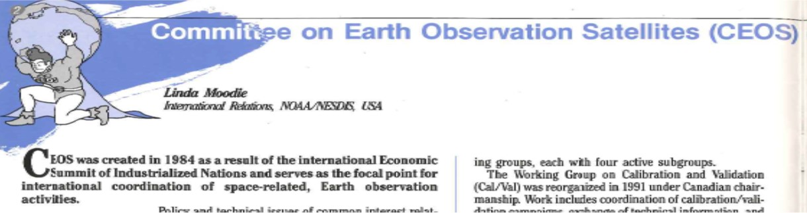
AI (FDA-18-05) Data format
History CEOS Newsletter No1
To develop and support standard data formats for digital user products from all Earth Observations sensors . CEOS-compliant formats have been developed and accepted by WGD, and member agencies have agreed to incorporate them into ongoing data management planning. The further such coordination, a library of
accepted formats is maintained.

Slide 15
WGCV support to the CEOS strategy for the Global Stocktake of the UNFCCC Paris Agreement Report
David CRISP and Akihiko KUZE
CEOS WGCV-49
July 2, 2021

Slide 16
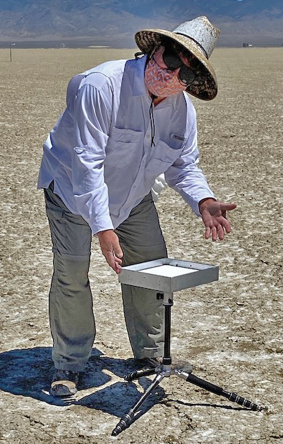
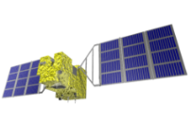
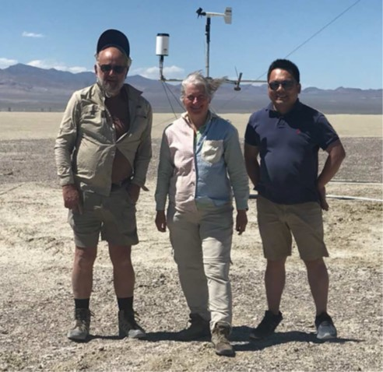
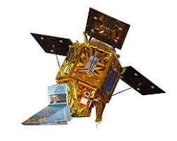
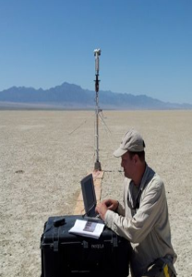
2020 and 2021 Meetings and Campaigns
Intercomparison between GOSAT, -2, OCO-2, -3 and TROPOMI
2020
On June 26, 2020, 5 instruments acquired the radiance spectra over the calibration site of Railroad Velley, NV
2021
(1) Application from NASA to sequester some subset of Railroad Valley (RRV) for use in Vicarious Calibration
(2) 13th annual joint campaign for vicarious calibration campaign
Preparation meeting by GOSAT, -2, OCO-2, -3, TROPOMI team, March 5 and June 4.
April 3 (clear sky),
June 7, 8 (clear sky),
July 8, 9
June 8, 2021 . OCO team
16
RRV2020

Slide 17
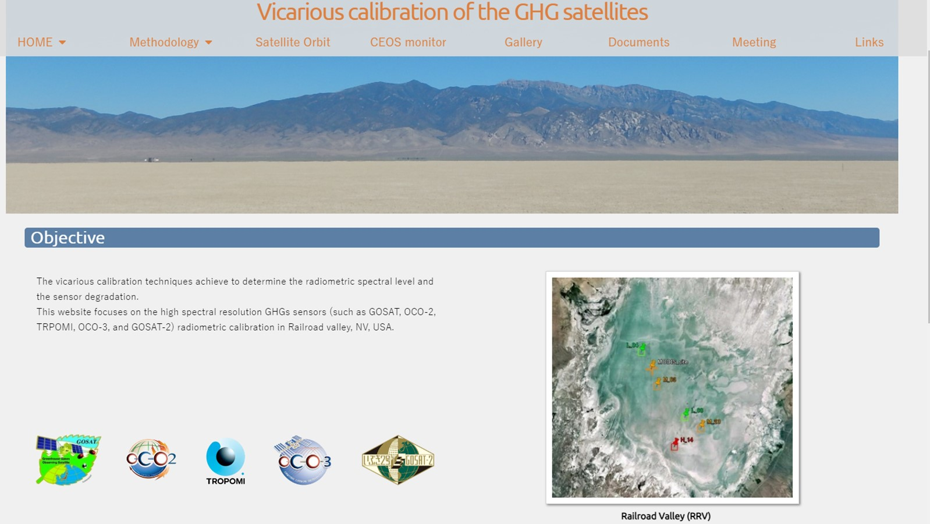
GHG VICAL Portal
To be open to the public after the summer campaign in July.
When the site is ready, CEOS logo on the portal Link to CEOS CAL-VAL portal site.
Test site : https://www.eorc.jaxa.jp/GOSAT/GHGs_Vical/index.html ID: gosat , PW: vicalrrv

Slide 18
Vicarious Calibration Portal
<Methodology>
Large viewing angle GHG sensors
Strong needs for BRDF correction
MODIS new -061 products
(2) Large footprint (GOSAT 10 km, TROPOMI 7km) and unique sampling pattern (GOSAT point others imaging) need inter and extrapolation
(3) Common database: TSIS data, Line Parameters, MET data
(4) Forward calculation to calculate radiance spectra at the top of atmosphere
<Long term data record>
GHG ViCAL Portal will provides：
Ground data (surface albedo, BRF, AOT, XCO₂, XCH₄, XCO) using a portable EM27 FTS
Radio sonde (H₂O, temperature vertical profile)
CO₂, CH₄ vertical profile by NASA Ames AJAX
GOSAT long term radiance degradation estimation

Slide 19
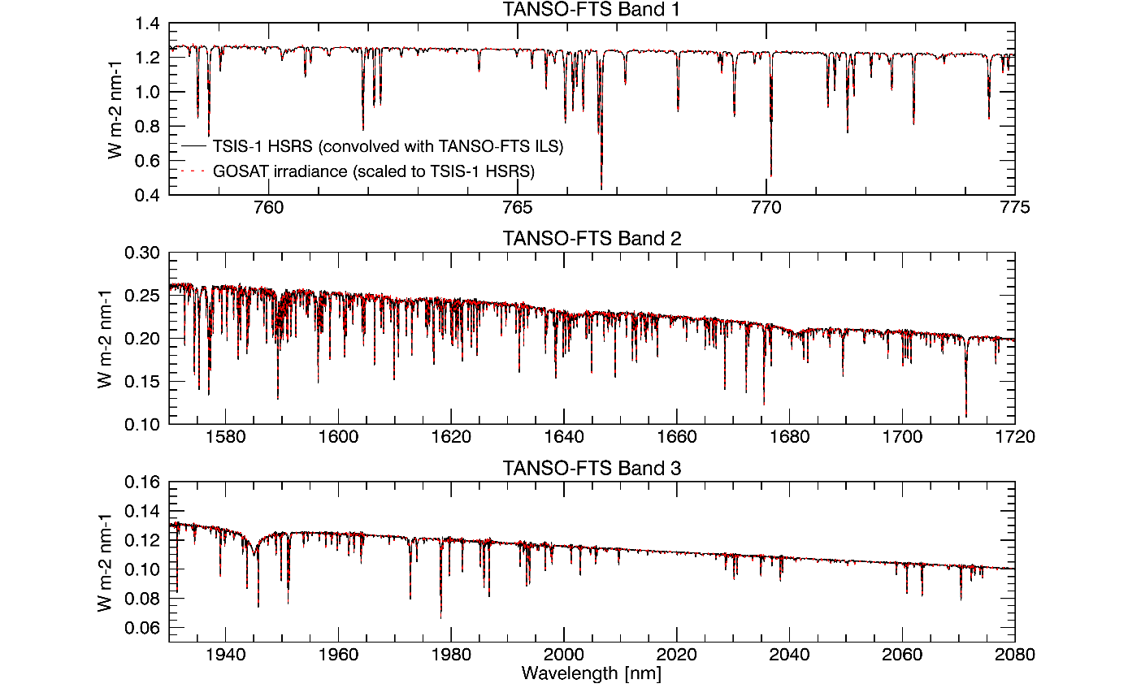
TSIS HSRS Solar model for GHG sensors
<Present Understanding>
(1) (2) TSIS irradiance is lower than the present (JPL Toon data) data at 2 μm.
(3) OCO-2 V9 with Toon and OCO-2 V10 with TSIS has about 5% difference.
<Results>
GOSAT show larger radiance degradation factor (RDF) (less degraded) when TSIS is applied. 0.93 > close to 1
<Use of TSIS>
To be changed
Radiance degradation factor (prelaunch CAL vs VCAL)
Best-estimated radiance in Level 1 products
No direct impact
Surface albedo and XCO₂, XCH₄ retrieval
To be analyzed and reported in next few months
RRV 2020 and 2021 campaign data using TSIS
Check consistency (1)between 5 GHG sensors
(2) Prelaunch CAL vs Vicarious calibration
TSIS HSRS vs GOSAT-2 vs SRON (1.9-2.4 μm)
19
TSIS HYBRID (0.001nm) convoluted with GOSAT ILS vs. GOSAT solar calibration data. Codington et al, JGR 2021

Slide 20
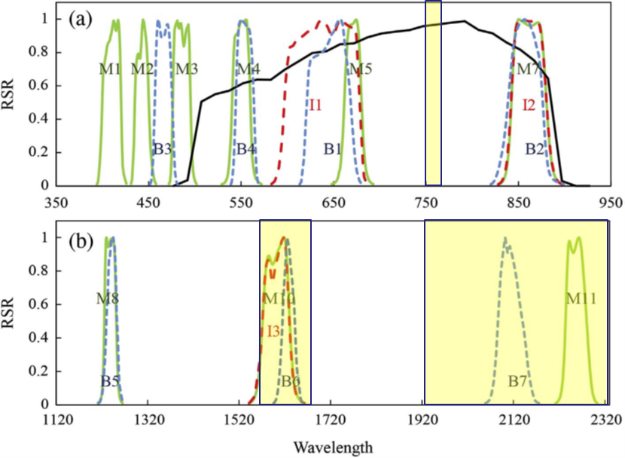
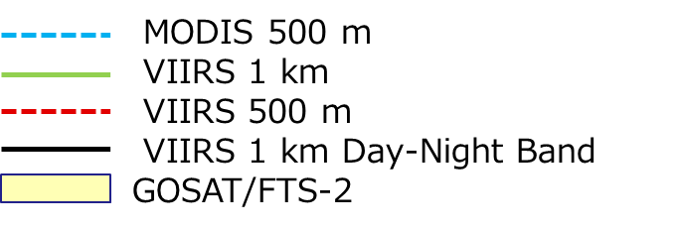
BRDF Correction for GHG sensors with large viewing angles
Existing MODIS BRDF products have large uncertainty in case of bright surface due to aerosol multiple scattering such as over Sahara. However, AOT over RRV is low.
New MODS MCD43A1-061, which is similar to the UMass special product.
(1) University Massachusetts Boston provides a special product for RRV for RRV2020 and RRV2021 April
(2) JAXA-EORC GOSAT forward model (Vector model) uses UMASS BRD UMass Special product
(3) BRDF correction for 2.3 μm without MODIS bands (needs uncertainty estimation)
(4) Use MCD43A1-061 other than RRV2020 and 2021
20

