Slide 1
Incoming WGCV-Chair Report
Akihiko KUZE
CEOS WGCV-48
October 28, 2020

Slide 2
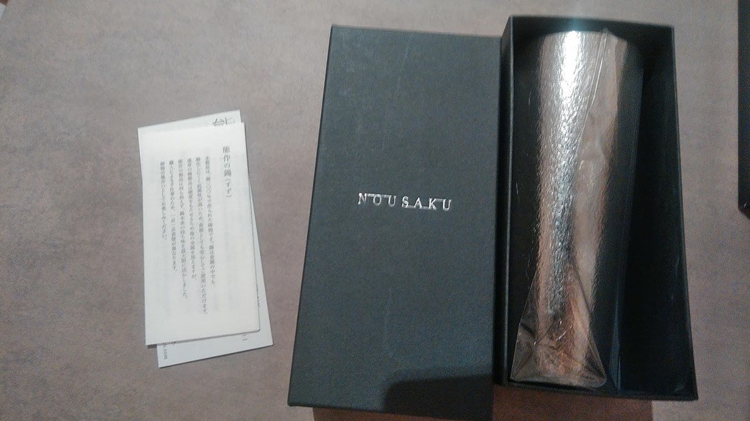
Thank you Cindy-san
From incoming chair to outgoing chair
Air postal service between Australia and Japan has been suspended.

Slide 3
My special interest during the chair term
(1) Carbon and Biomass to contribute Paris Agreement
Validation of retrieved product
Validation of flux (emission and uptake)
(2) ARD
Atmospheric and Ocean missions
Industries
(3) CAL-VAL portal

Slide 4
Upcoming Plenary
WGCV- 48 Today (Oct. 28,2010)
WGCV-49 July 2021 Virtual
WGCV-50 Early 2022 Tokyo
WGCV-51 Joint F to F meeting with WIGISS 2022 (before SIT)
Note All WIGISS meeting will be virtual in 2021.

