Slide 1



RadCalNet: Status
Committee on Earth Observation Satellites
M Bouvet 4 RadCalNet team

Slide 2
Background
Next Meeting
Following previous CEOS workshop at Estec in 2004? Complemented by various
regional/national workshops.
Discussions and recommendations from CEOS WGCV IVOS ~2012 timely for new workshop
Parallel interest from GSICS also WGCV- AC-sub group
Agreed plan and outline strategy to hold optical sensor focussed
workshop to be held in Europe in 2019 – Now revised to Q1 2020
Small task team to initiate process consisting of CEOS and GSICS experts

Slide 3
What is RadCalNet?
RadCalNet is a CEOS WGCV initiative to provide satellite operators with SI-traceable Top-of-Atmosphere (TOA) spectrally-resolved reflectances to aid in the post-launch radiometric calibration and validation of optical imaging sensors from a coordinated network of instrumented land-based test sites.

Slide 4

What is RadCalNet?
Calibration
& QC
& Processing
Surface reflectance and atmosphere products
(RadCalNet specific)
Raw measurements
Site X
Hyperspectral TOA reflectance @ 30 mn interval for nadir view
RadCalNet portal
FTP
RadCalNet
Processing
&
QC
FTP
Calibration
& QC
& Processing
Surface reflectance and atmosphere products
(RadCalNet specific)
Raw measurements
Site Y

Slide 5
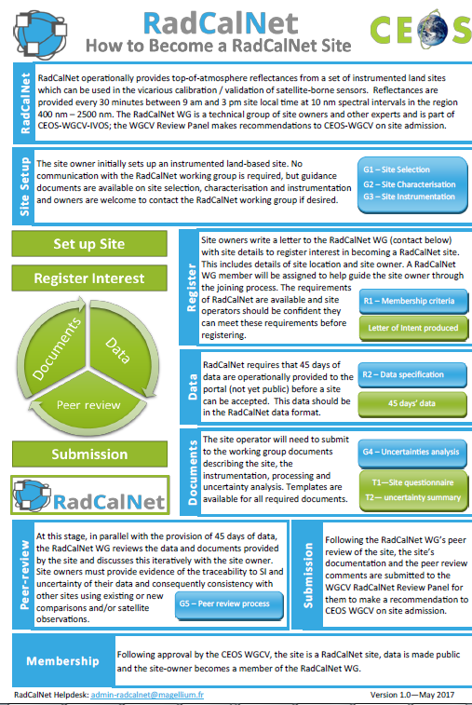
Acceptance process for new sites
RadCalNet members contribute to the review
Process overseen by WGCV
Through an acceptance panel reporting to WGCV

Slide 6
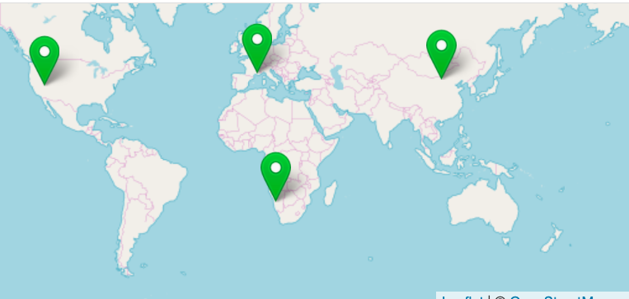
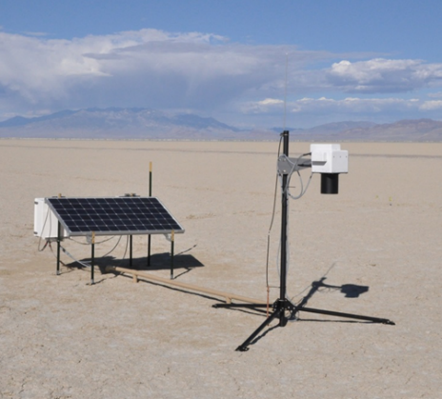
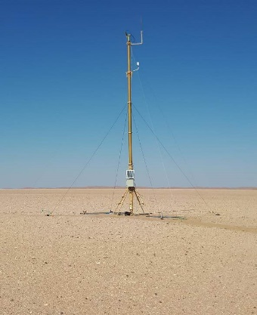
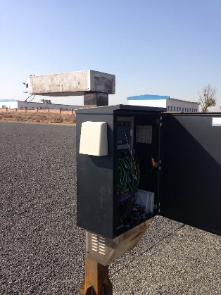
The first RadCalNet sites
LCFR
BTCN
RVUS
GONA

Slide 7
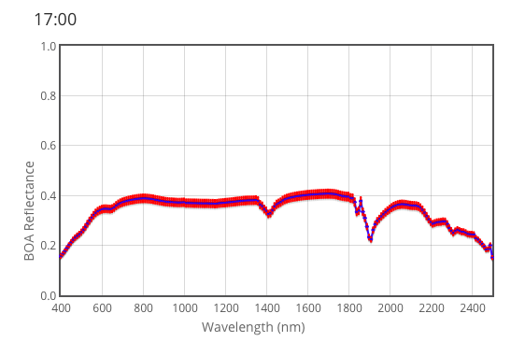
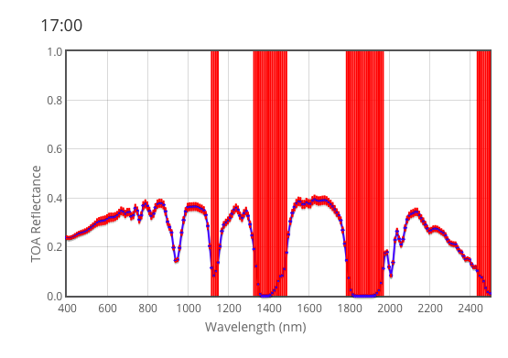
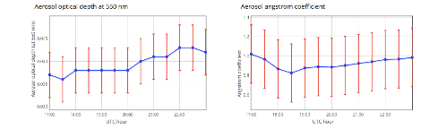
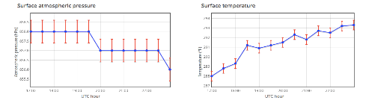
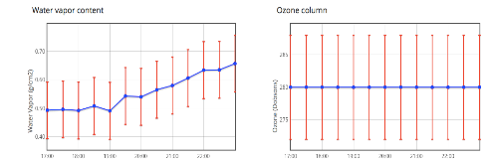
The RadCalNet processing
MODTRAN 5
TOA reflectance reprocessed last summer to include propagation of the surface / atmosphere uncertainties to TOA uncertainties via pre-computed LUT from Montecarlo MODTRAN runs
Surface reflectance
TOA reflectance
RadCalNet
Processing
Atmospheric measurements

Slide 8
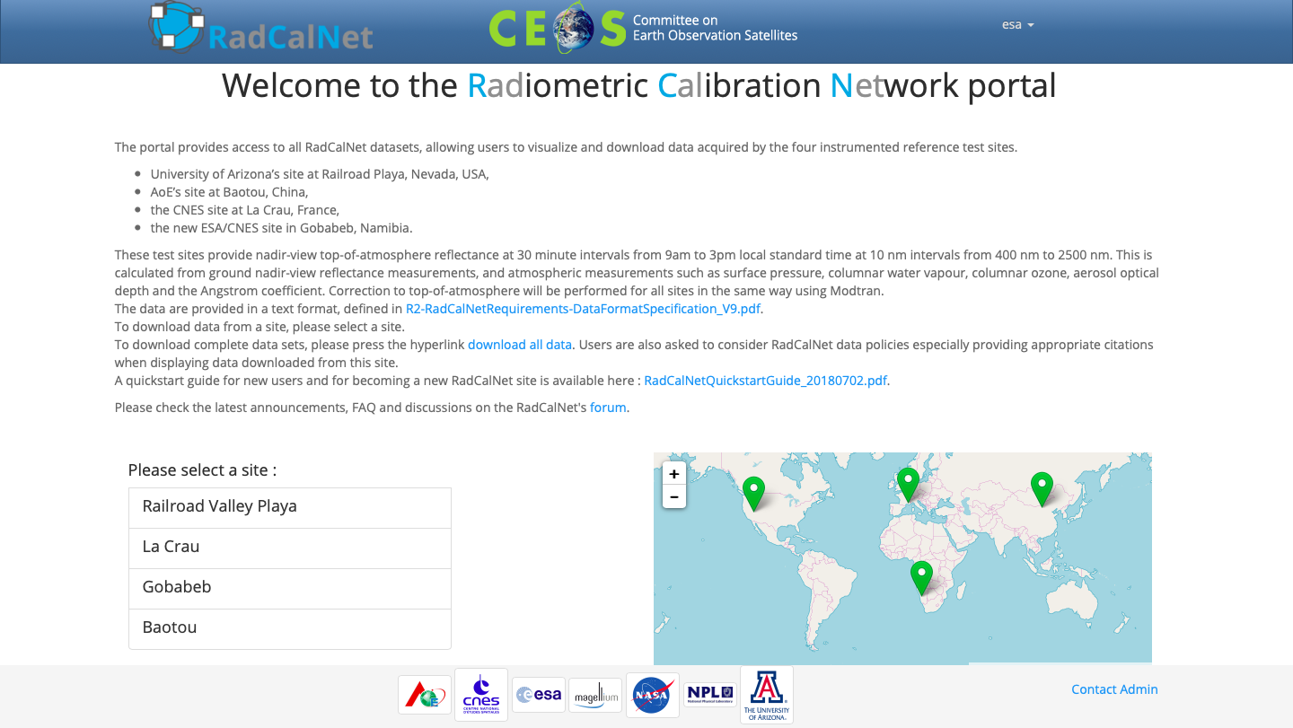
The portal

Slide 9
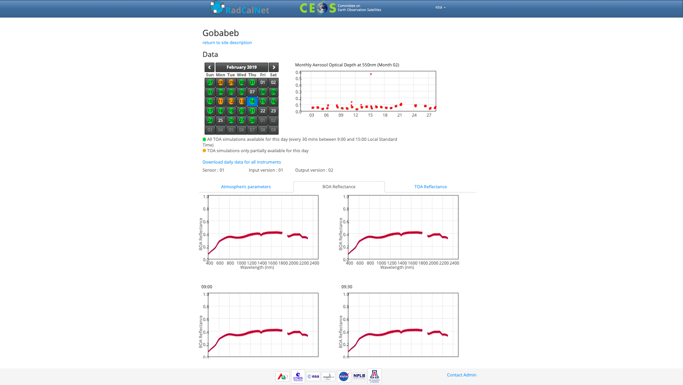
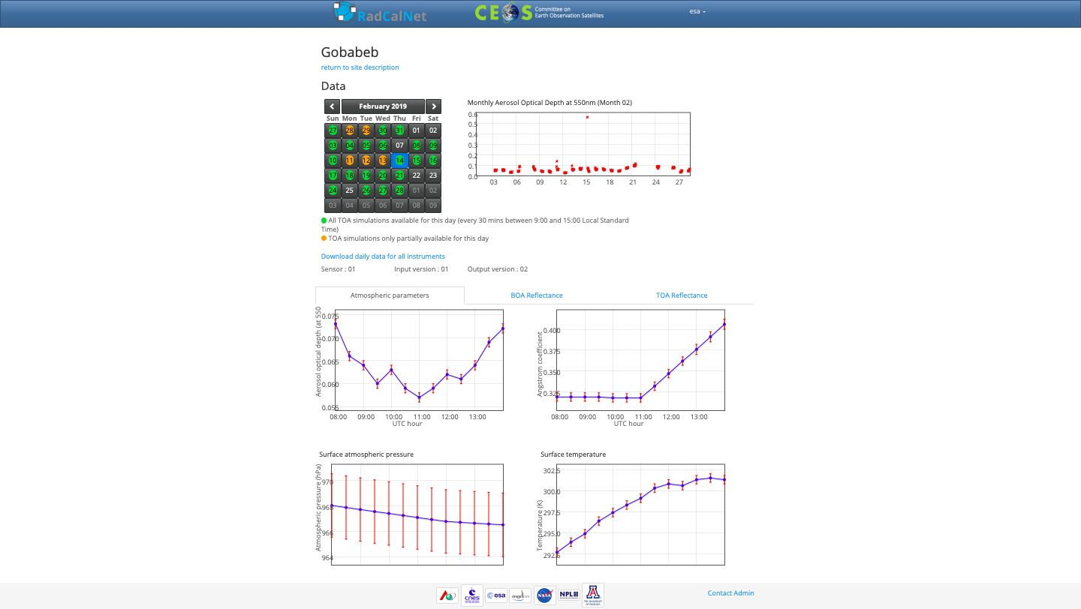
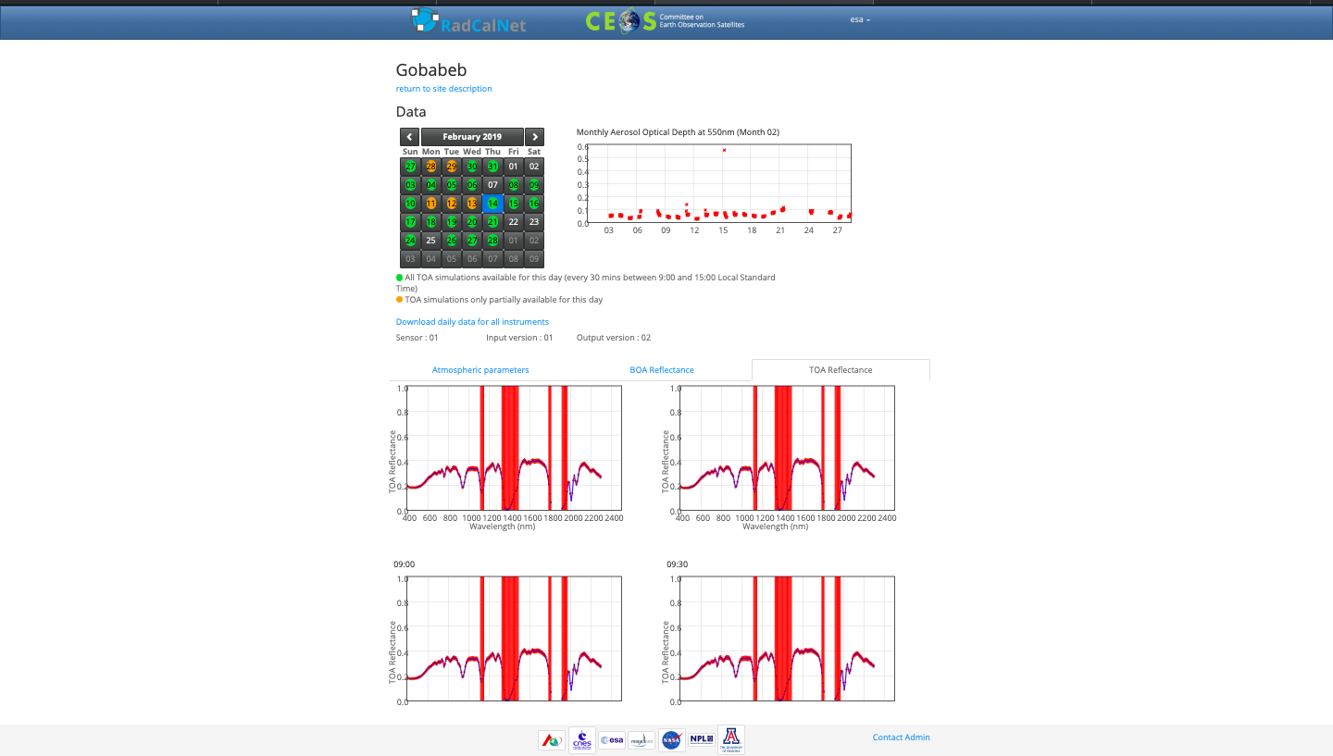
The portal

Slide 10
RadCalNet Documentation
G0-RadCalNet Guidance – Becoming A RadCalNet Site G1-RadCalNet Guidance – Site Selection G2-RadCalNet Guidance – Site Characterisation G3-RadCalNet Guidance - Instrumentation And Data Processing G4-RadCalNet Guidance – Uncertainty Analysis G5-RadCalNet Guidance - Peer-Review And Comparison update R1-RadCalNet Requirements - RadCalNet Membership Criteria R2-RadCalNet Requirements – Data Format Specification RadCalNet Data Policy T1-RadCalNet Templates - Site Questionnaire T2-Uncertainty Summary Report – Template

Slide 11
RadCalNet documentation
RadCalNet Processing
D1-RadCalNet Data Version Description R2-RadCalNet Requirements – Data Format Specification
RadCalNet individual site documentation
Site questionnaires x 4 Site uncertainty summary reports x 4

Slide 12
Introduction of “Collections”
Until the last RadCalNet WG meeting – we operated in a “research” mode
When we saw a problem – we corrected it immediately
At the RadCalNet WG meeting we agreed to move to “Collections”
Data will be updated once a year
The 2020 collection will:
  Include improved uncertainties for sea level sites
  Reduce the bandwidth from 20 nm to 10 nm
  Correct minor problems with uploaded data (improved quality control etc)

Slide 13
Timeline since last WGCV
July 2018: RadCalNet portal and forum open to public
June-Dec 2018: Gobabeb operation degraded
Fall 2018: First known candidate sites formally invited
Xmas 2018: AOE proposed a new sandy site
  Currently being reviewed
  Iterative process has improved questionnaire and uncertainty summary document
  Additional correction has been applied following independent comparison
  Acceptance ready for panel review expected soon
March 2019: RadCalNet WG#8 Perth
April 2019: CMA started preparation for application of Dunhuang site.
Towards reprocessing of full archive by next 2020 IVOS meeting

Slide 14
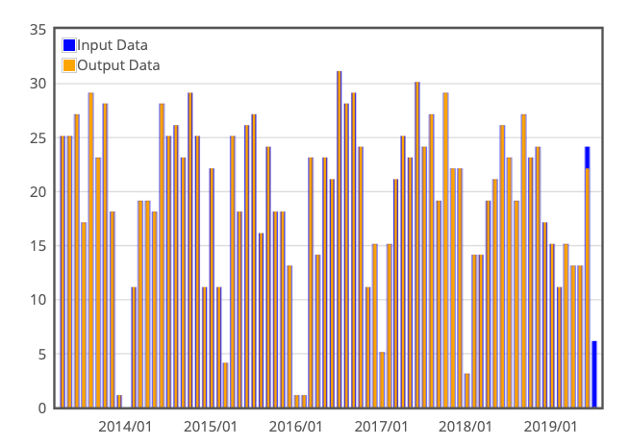
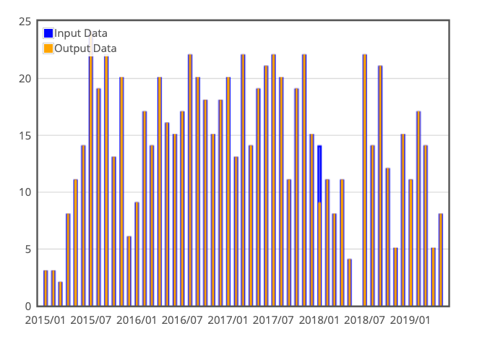
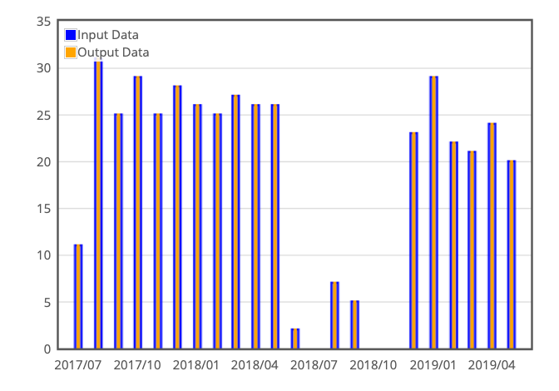
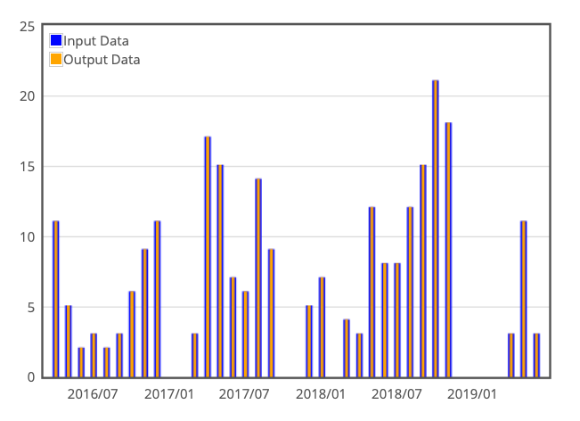
Data availability
RVUS
LCFR
GONA
BTCN
14

Slide 15
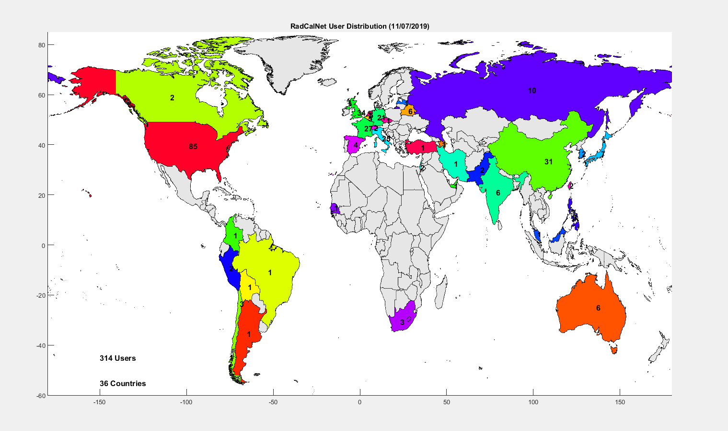
Public users

Slide 16
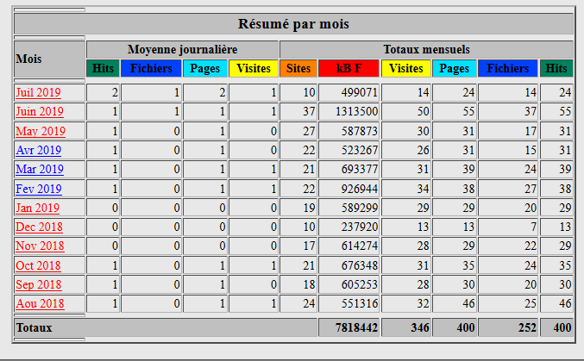
Site traffic
13 to 50 visitors per months
200 to 1300 MB data downloaded per month = 4 to 26 times the full archive volume

Slide 17
Next steps
Continue operation at the sites keeping data latency within 2 weeks
Finish review of the candidacy of AOE Baotou sandy site
Review CMA Dunhuang candidacy site
Reprocess the full RadCalNet BOA/TOA archive mainly in order to increase spectral resolution of TOA reflectance (keeping sampling at 10 nm) and improve the associated uncertainty estimates + improve BOA products quality by fall 2019
Next RadCalNet WG round of telecon mid-Nov. 2019
Provide samples of reprocessed data to beta users 3 months before pushing new data collection on the portal and ask for feedback
Reprocessing complete archive and make it available before IVOS meeting (spring 2020)

