Slide 1

ACSG Subgroup Report &
GHG gas reference standards for interoperability
Committee on Earth Observation Satellites
B. Bojkov (WGCV/ACSG)
Akihiko KUZE
(Earth Observation Research Center, Japan Aerospace Exploration Agency)
CEOS WGCV
CSIRO Perth
July 17, 2019

Slide 2
from report of CEOS Secretariat
Meeting 251 on June 13 2019
The Atmospheric Composition Subgroup (ACSG) held two teleconferences in preparation for the Working Meeting on Defining the Roadmap for Space Agency Coordination on Greenhouse Gas Monitoring – a joint effort between WGClimate, AC-VC, and WGCV. The meeting on June 9 was held as part of the CEOS AC-VC meeting (June 10-12) in Tokyo and was attended by the ACSG Chair and the Vice-Chair of the WGCV. The implementation of a constellation architecture for monitoring carbon dioxide and methane from space and a timeline framework for the roadmap was discussed. The next steps will be presented at the SIT Technical Workshop in September.
The ACSG Chair and the Vice-Chair of WGClimate are now in the process of planning the logistics of the ACSG meeting on Level-2 GHG calibration (October 2019).

Slide 3
Summary of Bojkov’s presentation of WG Clime meeting in Marrakesh
Disclaimer:
“Towards an operational GHG monitoring system” is here within the scope of the satellite systems, specifically addressing the measurement capabilities and performances
CEOS WP CV-18: Greenhouse gas reference standards for interoperability – “Develop list of reference standards for CO₂ and CH₄ products that are suitable for use in intercomparison of multiple missions” with reporting deadline Q4/2019
Release of the CEOS AC-VC GHG Whitepaper in Q3/2018

Slide 4
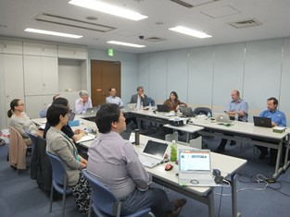
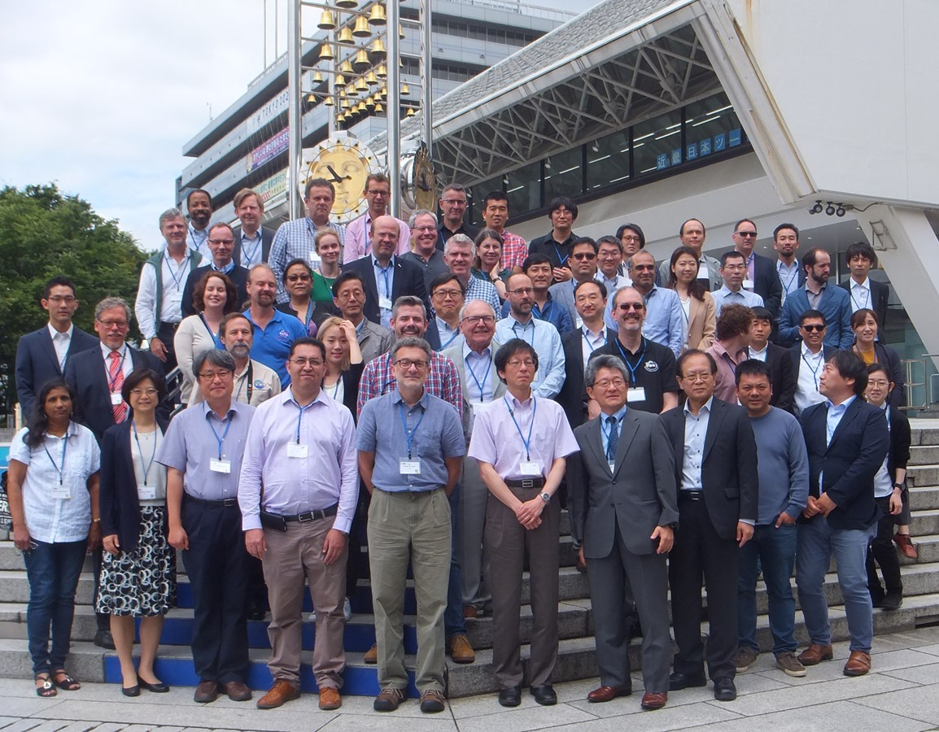
CEOS GHG related events
(- June 2019 )
March 18-21 Marrakesh
Joint meeting of GCOS, CEOS WGClimate, CGMS
(2) April 15 in Darmstadt
European coordination meeting on GHG FRMs (focus on the current status and long-term sustainability of the European component)
(3) May 8-12 in Kyoto
the 49 session of IPCC: use of satellite data for inventory
(4) June 3-5 Sapporo
IWGGMS-15 (International Workshop on Greenhouse Gas Measurements from Space)
(5) June 7 Tokyo
Meeting with CEOS agencies and Ministry of Environment Japan
(6) June 9 Tokyo
Road map by WGClimate, WGCV, AC-VC
(7) June 10-12 Tokyo
AC-VC: Joint session on AQ (such as NO2) and GHG for anthropologic GHG flux estimation
GHG Roadmap discussion by WG-Climate, AC-VC and WGCV
AC-VC in Nakano, Tokyo

Slide 5
CEOS GHG related events
Upcoming events
Upcoming events
September 6
WGClimate GHG
(2) September 11-12
SIT TW: GHG Roadmap Document and Targets
(3) October
Dedicated WGCV/ACSG expert meeting dedicated to the GHG FRMs planned (invitation to be sent out shortly) → to close the action CV-18 by mid-2020

Slide 6
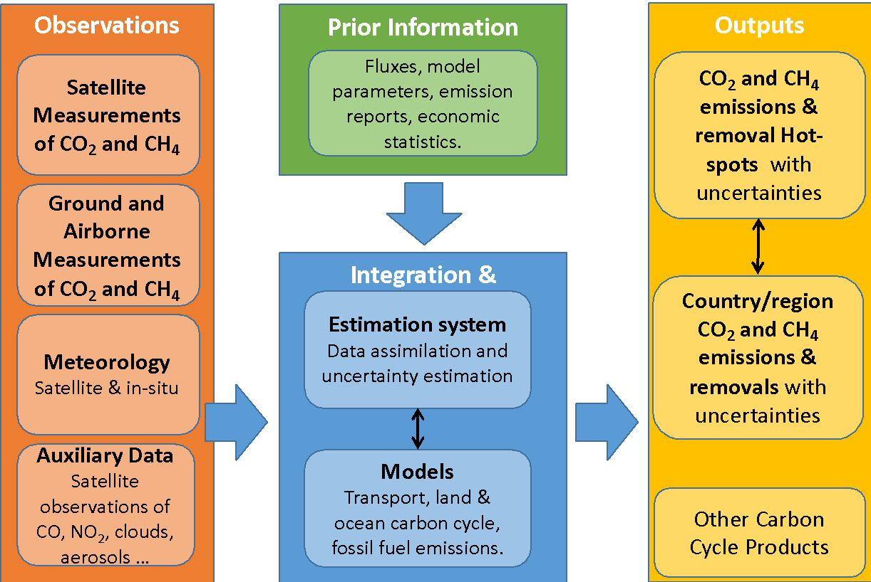
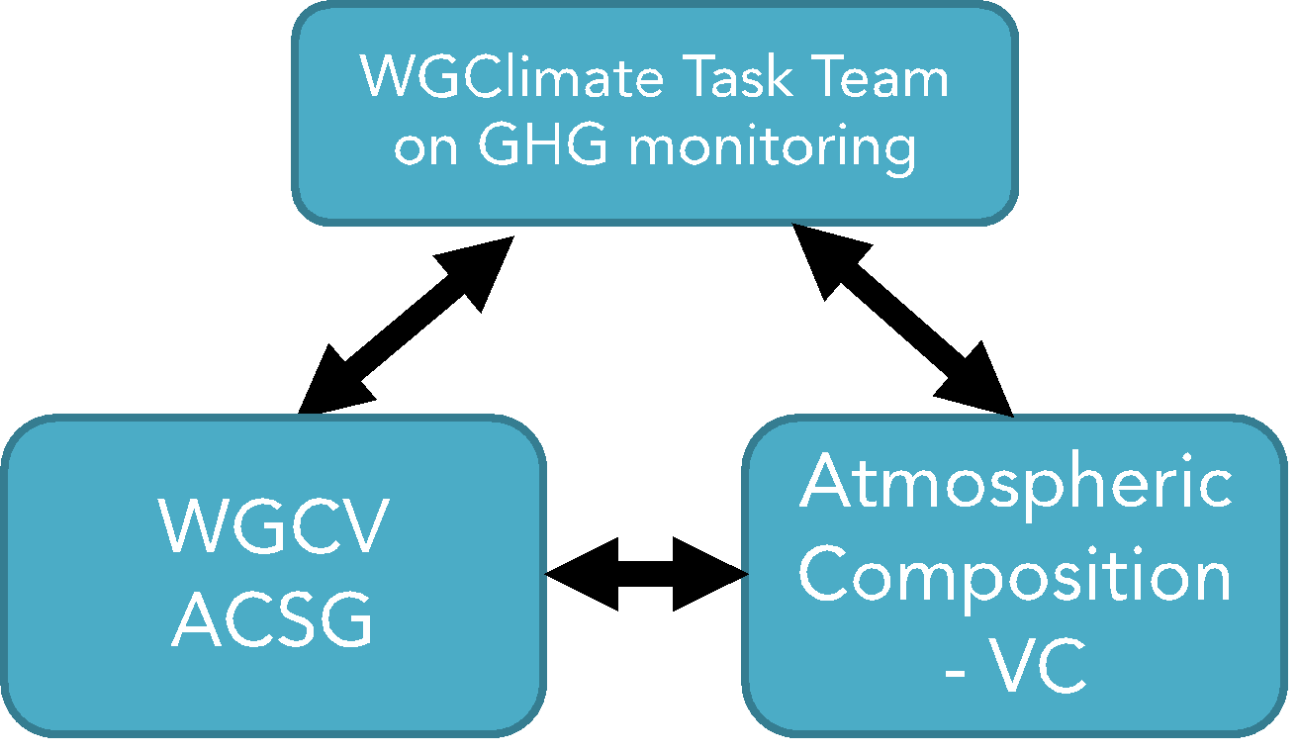
GHG Roadmap
Documents
White paper led by David Crisp
(2) Roadmap For Implementation of A Constellation Architecture for Monitoring Carbon Dioxide and Methane from Space led by Mark Dowell.
Roadmap towards 2023 and 2028 global stocktake
Global flux (2023) + Local flux from different source sectors (2028)

Slide 7
GHG CAL-VAL
Technical Topics
Specific to GHG
Column density of CO₂ (XCO₂) and CH₄ (XCH₄) must be retrieved accurately and precisely (better than 1 ppm for CO₂) (needs validation)
Light path modification by aerosol and thin cloud is the largest error source (needs radiometric calibration)
Larger footprint to achieve SNR with high spectral resolution
Topics
New launches: GOSAT-2 in Oct. 2018 and OCO-3 in May 2019
To contribute the Paris agreement: the goal is not only accurate XCO₂ and XCH₄ measurements but also global and local flux estimation using satellite data
Combination of solar reflected light that passes thorough entire atmosphere and thermal infrared emitted from CO₂ and CH₄

Slide 8
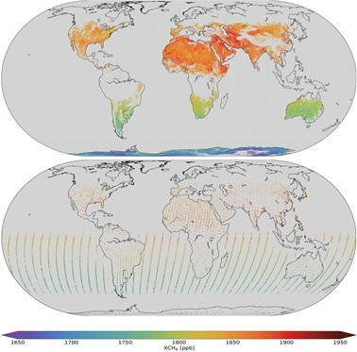
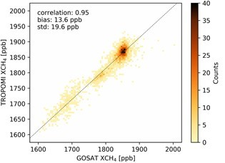
Intercomparison
between Multiple Sensors
Past: GOSAT and GOSAT using the same bands at 0.76, 1.6, and 2 µm
Prelaunch (2008), Radiance Spectra and retrieved XCO₂ over ocean, land, desert (2014-)
2018: Using different bands: GOSAT CH₄ at 1.6 µm and TROPOMI at 2.3 µm
Hu et al. (2018) GRL
8
TROPOMI (upper) GOSAT (lower)

Slide 9
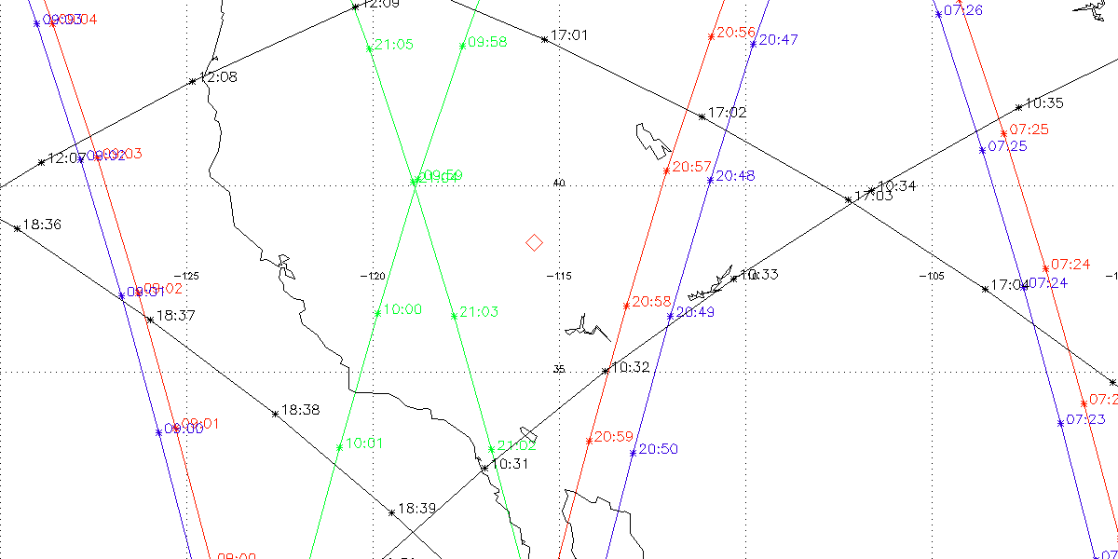
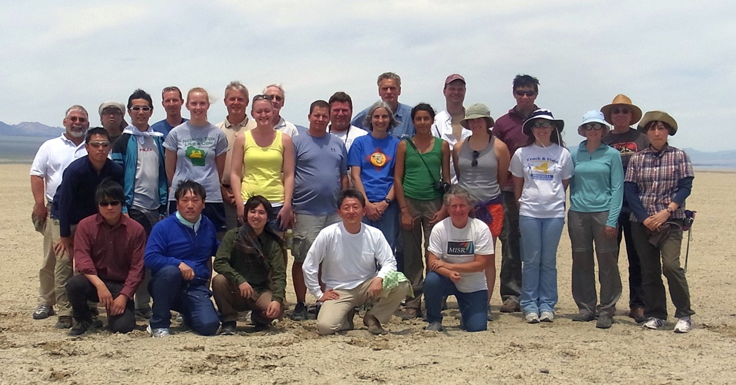
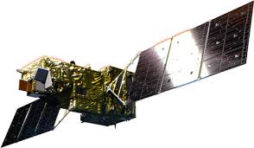

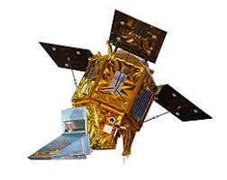
RRV 2019 for OCO-2, OCO-3,
GOSAT, GOSAT-2, TROPOMI
June 30-July 5
11th annual vicarious calibration and X-CAL campaign at Railroad Valley, NV, U.S.A.
(1) Vicarious Calibration
Surface Albedo, AOD
(2) Validation
XCO₂, XCH₄, XCO by EM27 FTS
Vertical profile of CO₂ and CH₄ by SNAAX air plane
(3) Intercomparison
OCO-2 TANSAT,
OCO-3,
GOSAT, GOSAT-2
+ Sentinel 5P (July 1)
OCO-3 (non-sun-synchronous) measured under large Solar Zenith Angle
BRDF is the key for Intercomparison to correct light path modification by aerosol, cloud and surface. (early morning to afternoon)

Slide 10
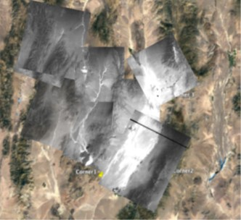
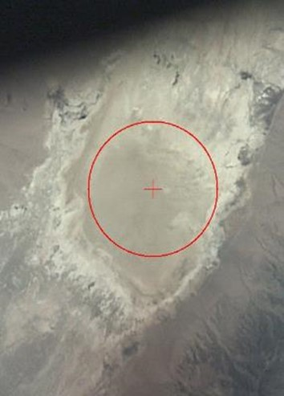
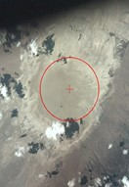
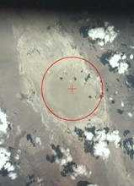
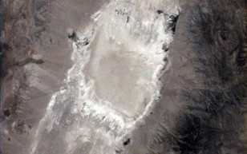

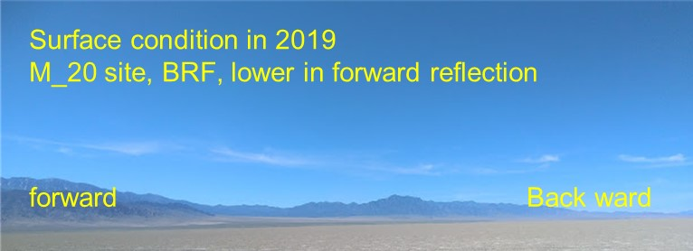
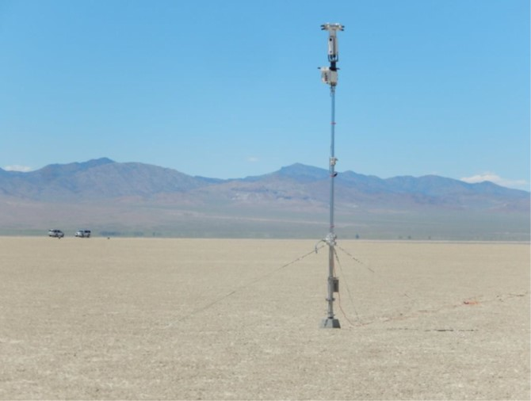
RRV 2019 Campaign Summary
 | July 1 | July 2 | July 3 | July 4 | July 5
GOSAT | ✓ |  |  | ✓ | ✓
GOSAT-2 | ✓ | ✓ | ✓ PM
OCO-2 |  | ✓ |  |  | ✓
OCO-3 on ISS |  |  | ✓AM
TROPOMI | ✓ | ✓ | ✓ | ✓ | ✓
SNAAX aircraft | ✓(test) |  |  | ✓ | ✓
Weather | Clear | Almost clear | Clear in AM | clear | Very small cloud fraction
GOSAT vs GOSAT-2 @ 1.6 µm
10

Slide 11
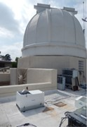
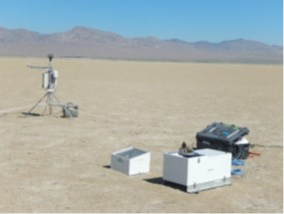
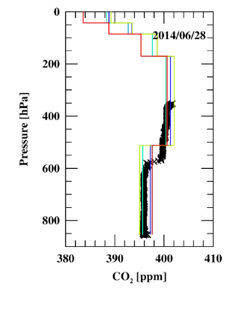
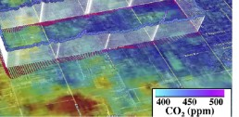
What’s new in 2019 (11th annual campaign)
Calibration and Validation
(1) Validation in addition to XCO₂, XCH₄, XCO by EM27 FTS intercompared with TCCON
Vertical SNAAX spiral flight (GOSAT and GOSAT-2 provides 2 layer partial-column density products)
Automobile Survey to confirm horizontal uniformity within the foot print
(2) Forward Calculation
MODIS BRF products with relaxed aerosol flag (courtesy of Elmes and Schaaf of UMB) (RRV is too bright)
High Spectral resolution Solar model (higher than 0.01nm)
With and without vertical profile of Temperature and H₂O by radiosonde
(3) Maintaining the RRV playa surface
Free from mining
Pasadena >>> RRV, NV
SNAAX by NASA Ames
Leifer et al. (2018)
AMOG

