Slide 1


Concept for a new Australian supersite to support multi-mission SAR calibration
Medhavy Thankappan, Matthew Garthwaite, Guy Royal, Bruce Chapman, Scott Hensley, Yuhsyen Shen, Paul Rosen, Gerald Bawden

Slide 2
Context for a SAR calibration supersite in Australia
AGOS CRs in Surat Basin are currently supporting routine calibration of X and C band SAR missions (1.5m CRs), some CR locations may be affected by deformation in future, and become sub-optimal for long-term calibration
Ongoing discussions with NASA-JPL on support for NISAR calibration involving deployment of additional larger CRs in Australia
Longer wavelength SAR missions are being launched, and would require larger CRs (2.5m) for calibration (SAOCOM, Tandem-L, NISAR, ALOS-4, BIOMASS)
Long-term multi-mission SAR calibration over a high quality supersite will support cross-calibration, and interoperability
Australia is ideal for establishing a SAR calibration supersite (stable continent no significant internal tectonic deformation, large areas, multi-technique colocation)

Slide 3
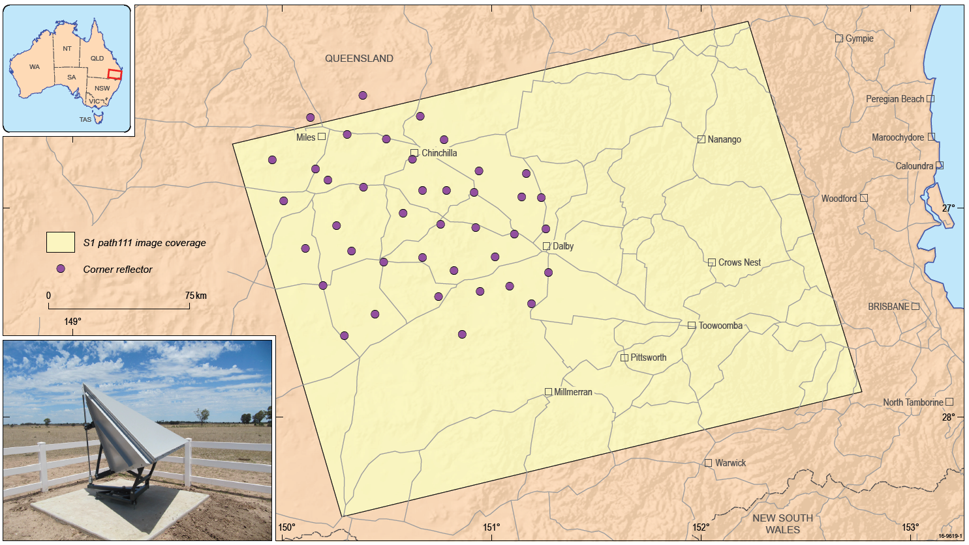
AGOS CR array - Surat Basin, Queensland
65 sites with survey marks, 40 with co-located radar corner reflectors spread over 100km x 100km
34, 1.5m triangular trihedral corner reflectors deployed in the Surat Basin
Three 2.0m and three 2.5m CRs also installed

Slide 4

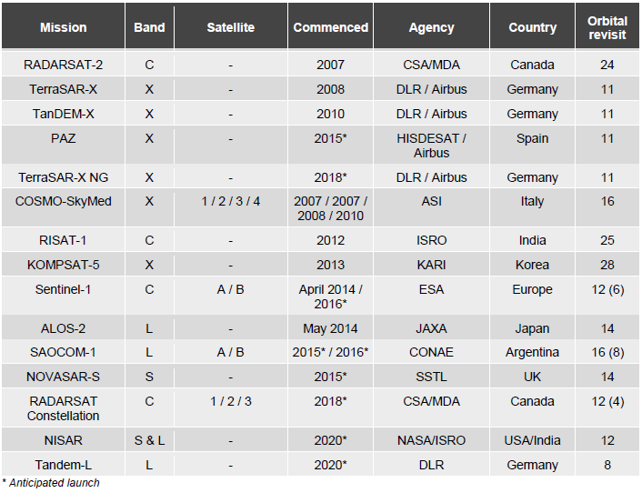
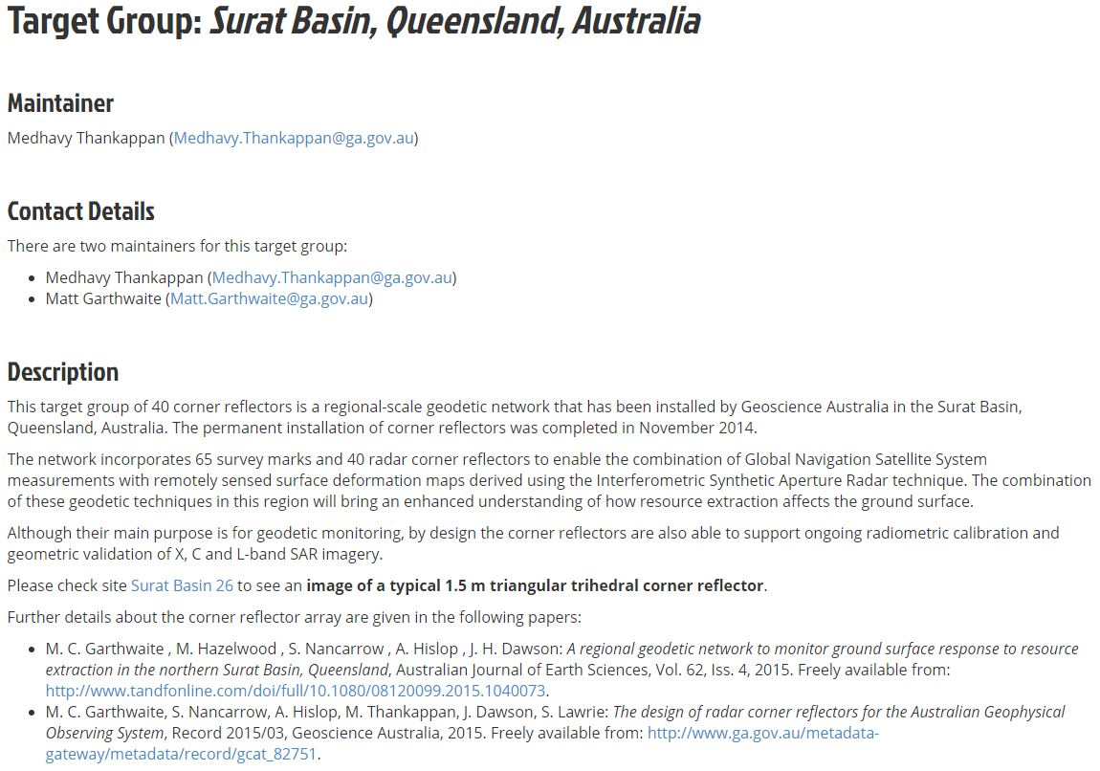
CRs providing multi-mission calibration support
The AGOS CR array is currently used by multiple SAR missions for calibration including the Sentinel-1 constellation under ESA’s FRM4SAR initiative; NISAR cal support being discussed now
CR coordinates can be accessed from the Point and Distributed Targets Database maintained by the CEOS WGCV SAR Subgroup at http://sarcv.ceos.org/targets/target_group/4/
Re-survey of CR locations completed recently, with update to coordinates

Slide 5

Sentinel 1- A / B radiometric performance
Table shows the mean and standard deviation rRCS (no normalisation) for images acquired since the start of 2016 for S1-A and since the start of S1-B routine phase (22nd September 2016). Good rRCS results are obtained including the three 2.5m CRs (#3, #5 & #14).
 | S1-A Relative RCS (dBm²) | S1-B Relative RCS (dBm²)
IW All Corner Reflectors | 0.05±0.55 | 0.09±0.52
IW1 All Corner Reflectors | 0.08±0.50 | 0.15±0.46
IW2 All Corner Reflectors | 0.10±0.62 | 0.00±0.59
IW 2.5m Corner Reflectors | -0.08±0.22 | -0.22±0.30
HH

Slide 6
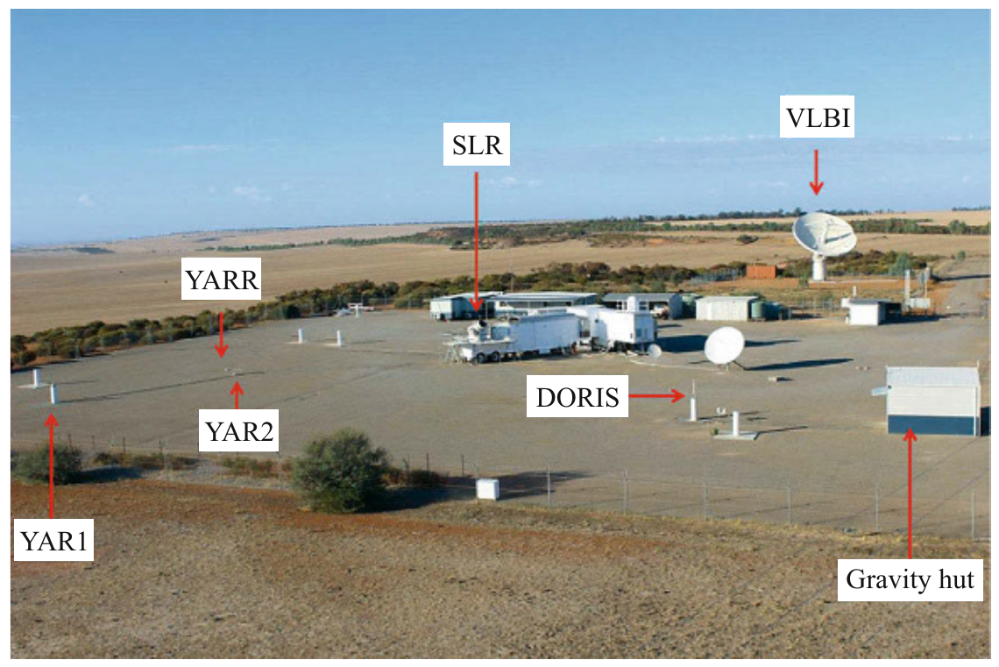

Permanent SAR Corner Reflectors at Yarragadee Geodetic Station
Yarragadee is one of the few fundamental geodetic stations that co-locates all four geodetic techniques (GNSS, VLBI, SLR, DORIS) . In August 2018 station equipped with two trihedral CRs (1.5m), mounted on deep concrete foundations, with one CR facing east and the other CR facing west to support both ascending and descending passes
The CR vertical boresight was aligned for 40° incidence angle to allow measurements from all radar beams between 25° and 55° incidence angle
Local ties have been measured with terrestrial geodetic survey and are now available in GDA2020 & ITRF2014
Both CRs have perfect visibility and the derived SCR values are in line with results obtained for the 1.5m CRs at Wettzell and Metsähovi (45 to 50 dB)
CR_{A}
CR_{D}
Yarragadee
modified from Teunissen & Montenbruck: Springer Handbook of GNSS, 2017

Slide 7
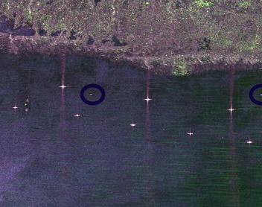
NISAR requires an array of trihedral corner reflectors for calibration
Array characteristics
The array need to span NISAR’s 240 km swath
  Reflectors do not need to lie on a straight line across the swath
A total of 48 reflectors are needed in a cross-track configuration
  Two locations within each of the 12 NISAR sub-beams
  Four pointing directions are needed, asc / desc & left / right looking orbits
Reflectors should be deployed in areas where there is minimal vegetation/agriculture
Reflectors should be deployed in areas where there is minimal deformation/subsidence
Reflectors should either be in protected or remote locations where vandalism is less likely
Reflectors must be in place by mid-2021

Slide 8
Possible Locations of the array
Australia, in partnership with Geoscience Australia
  Surat basin, Queensland
    Current location of C-band corner reflector array, but is deforming
  Near Canberra
    May be easier logistics
  GA has experience managing such an array in the Surat basin.
USA, in partnership with the UAVSAR calibration array
  Western USA
    JPL’s Rosamond array in Southern California maintained for >30 yrs
      > 20 reflectors spanning less than 20km
    This area is an important NISAR science target – need to avoid collection mode changes & signal experiments.
  Texas/Central US
    Non deforming locations can be found, but has vegetation/agriculture
ASF reflector in Alaska – Note topography and ag signal
Notes:
Point out the different in the quality of the reflector signal from this image and the previous image.

Slide 9
Build a consortium - partnerships with other L-band SAR missions
Most SAR missions are right-looking rather than left-looking
  Would need to repoint the reflectors for use by other SAR satellites.
  Would need revised design of reflectors to facilitate repointing
  GA provided such a design
Several planned upcoming L-band SAR missions with large swaths
  Japanese ALOS-4
  European Tandem-L
  Argentina SAOCOM series -- 1A recently launched
Science Goals: This site could become a global geodetic observatory with collocated SAR reflectors, GNSS, and possibly Satellite Laser Ranging (SLR).
  This array could uniquely cross-calibrate the global constellation of radar satellites and aircraft sensors --- a true geodetic supersite.
  Testbed for radar reflectors – i.e. polarimetric active radar calibrators, reflector design, etc.

Slide 10


Notional cooperative arrangement for a SAR supersite in Australia
GA would potentially manage the project, and have oversight over its operations, maintenance and surveying
NASA would contribute funds for the manufacture, deployment, and initial surveying of 48 L-band reflectors extending over 240 km
The consortium would fund GA management of the facility for nominally a decade (2021-2031), management of the facility would include
  site selection and planning (including land right issues)
  regular (annual?) inspection and surveying.
  re-orientation of reflectors as negotiated to support left/right looking missions
Open for other possible arrangements and broader partnership

Slide 11
Summary
The Australian CR array continues to support routine SAR calibration for multiple missions (X/C), including for Sentinel-1 under the FRM4SAR initiative
The Yarragadee geodetic observatory supports SAR calibration with other co-located geodetic measurement techniques; small observation residuals in range and azimuth confirm high accuracy (< 2.5 cm)
Discussions to support specific NISAR (L/S) calibration requirements through additional new CR infrastructure in Australia, presents possibilities for establishing a high quality Australian supersite for calibration of other SAR missions
Long-term multi-mission SAR calibration over a high quality supersite will improve data quality outcomes and interoperability for missions
Discussion on join investment opportunities for SAR supersite

Slide 12
Notes from group discussion - Monday 15 July 2019
Value of global supersites for multi-mission SAR calibration, cross-calibration and interoperability in light of multiple upcoming missions reiterated
SAR supersites need to cater for multiple calibration and observation requirements e.g. CRs, transponders, PARCs, left / right looking, temporal stability etc.
A defined set of criteria / requirements and characteristics would provide shared understanding for setting up SAR supersites (similar to RADCALNET)
Ongoing discussion between NASA, GA for NISAR L-band calibration, ISRO interest for S-band calibration noted with implications for NovaSAR calibration
Sustainability of operations and co-investment would have to be central to SAR supersite discussions
A task plan to define the activity with timelines to be prepared by the SAR subgroup for discussion at the Nov 2019 meeting in Frascati

Slide 13
medhavy.thankappan@ga.gov.au

