Slide 1
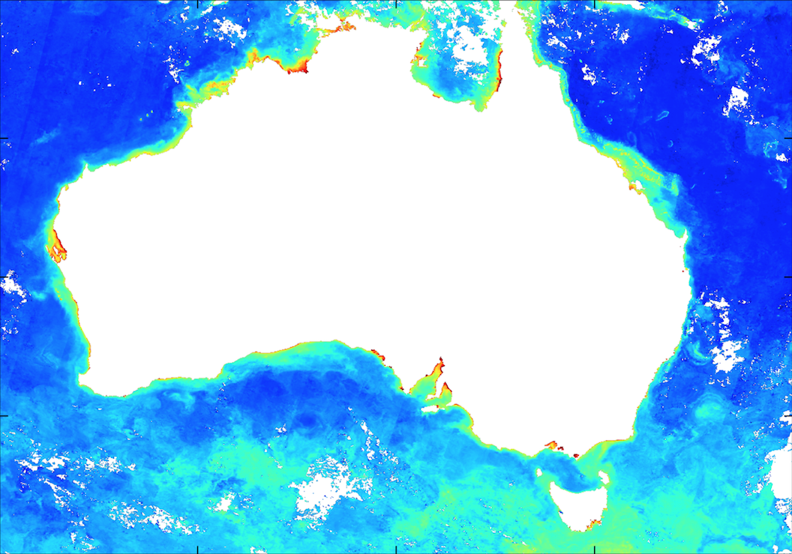

Current Australia’s
cal/val activities
For Ocean Colour Radiometry
David Antoine, Curtin University
Thomas Schroeder, CSIRO O&A
Composite image (March 2017) of the phytoplankton biomass around Australia, from observations of the ESA Sentinel3 “OLCI” sensor. RSSRG algorithms applied on 6 10⁸ pixels using Pawsey computing resources and the Australia “Copernicus data Hub”

Slide 2
Currently two major “spots”
CSIRO O&A, Brisbane, Canberra, Hobart
(Schroeder, Lovell, King, Cherukuru et al.)
Have developed and manage the “Lucinda Jetty Coastal Observatory”
Run underway above-surface radiometry measurements on a vessel from AIMS
Participate to research voyages
Generate matchups from the above data collection efforts
Manage the IMOS satellite ocean colour facility
Participate to international cal/val groups (e.g., S3VT)
Curtin University, Perth, Western Australia
Remote Sensing & Satellite Research Group (RSSRG)
(Antoine, Slivkoff, Robinson, Fearns, Lynch, Chedzey et al.)
Have started deployments off Perth of a profiling mooring (prefiguration of a “blue water” cal/val site?)
Generate matchups from the profiler data
Participate to research voyages (southern ocean, Indian ocean)
Contribute to the IMOS satellite ocean colour facility
Participate to international cal/val groups (e.g., S3VT)

Slide 3
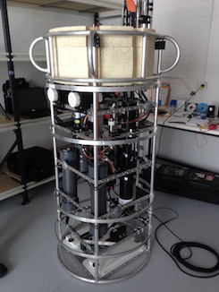
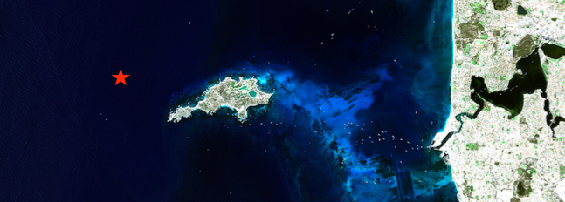
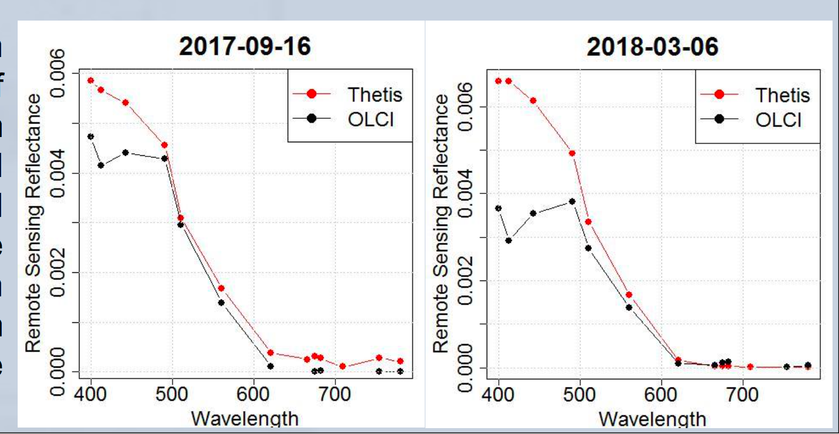


In-situ profiling mooring for ocean colour cal/val
Deployment of the WETLabs Thetis moored profiler near Rottnest Island, off the coast of Perth, Australia.
System provides real-time data of optical properties, environmental parameters and phytoplankton characteristics via a 3G Telemetry system each time it completes a profile of the water column (60 m bottom depth).
Match-ups between Thetis Satlantic OCR Radiometers and Sentinel3–OLCI instrument by Intern student Jorrit Scholze.

Slide 4
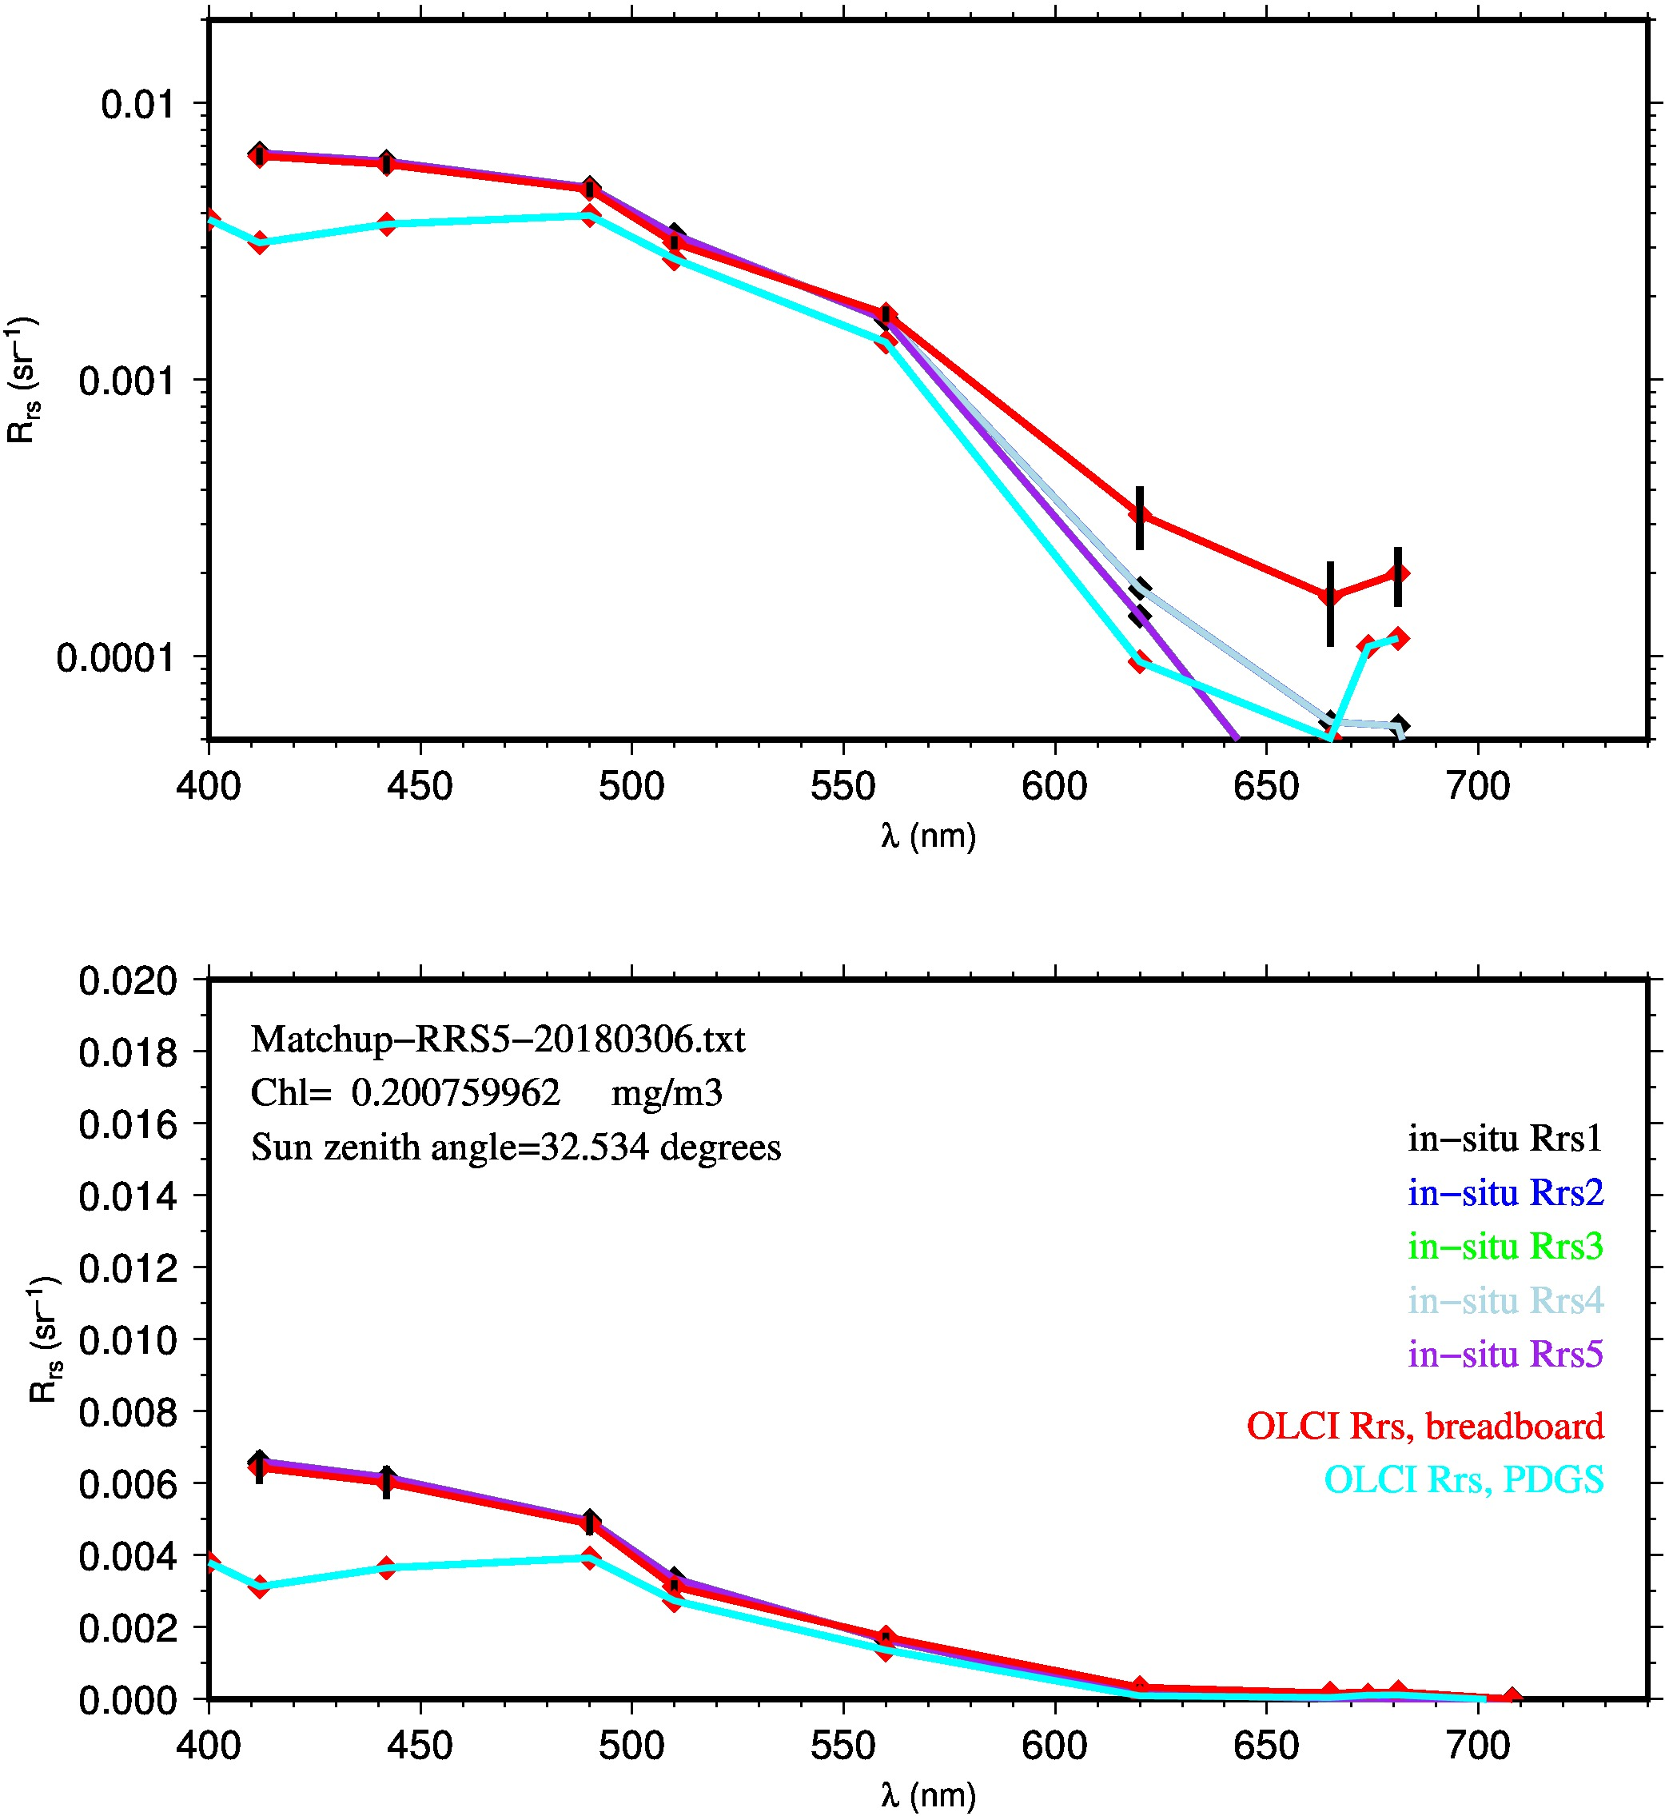
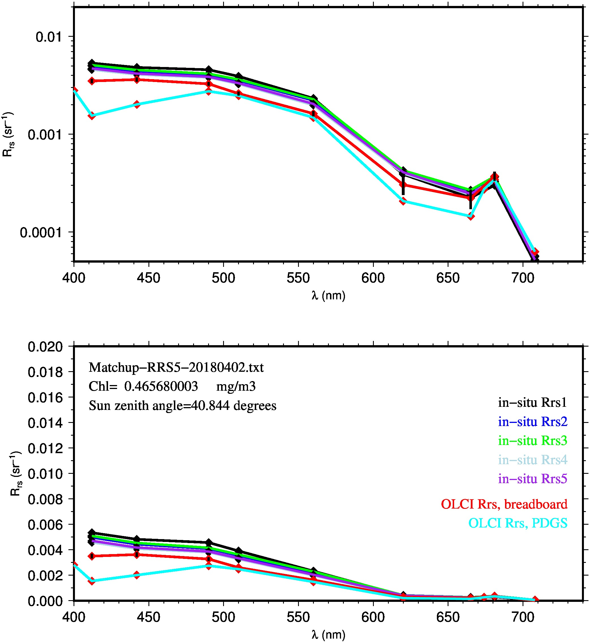
S3A/OLCI matchups
IPF processing vs. in-house “Breadboard prototype”
Something looks wrong with the ground segment processing

Slide 5
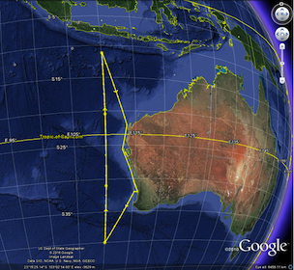
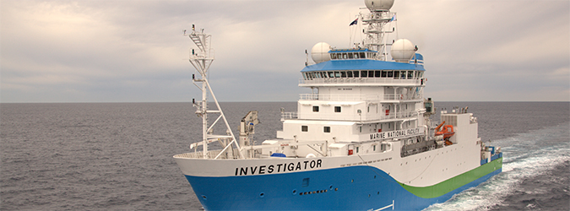




“A coupled bio-physical, ecosystem-scale, examination of Australia’s International Indian Ocean Expedition line”
Lead PI: Lynnath Beckley, Murdoch University, Perth, WA
Co-I David Antoine, Curtin University, Perth, WA, for the bio-optics, ocean color and productivity / export part:
32 days in May-June 2019, 94m R/V Investigator (http://www.mnf.csiro.au)
- 30 Science berths, 10 for the optics /ocean color etc..
- 20 16-hour stations
Conditions: from oligo- to meso-trophic
Part of the “2nd International Indian Ocean Expedition” (IIOE-2)
IOC/UNESCO, IOGOOS, SCOR, SIBER (and many others) joint activity
http://www.iioe-2.incois.gov.in/IIOE-2/EP06.jsp
Supported by:

Slide 6
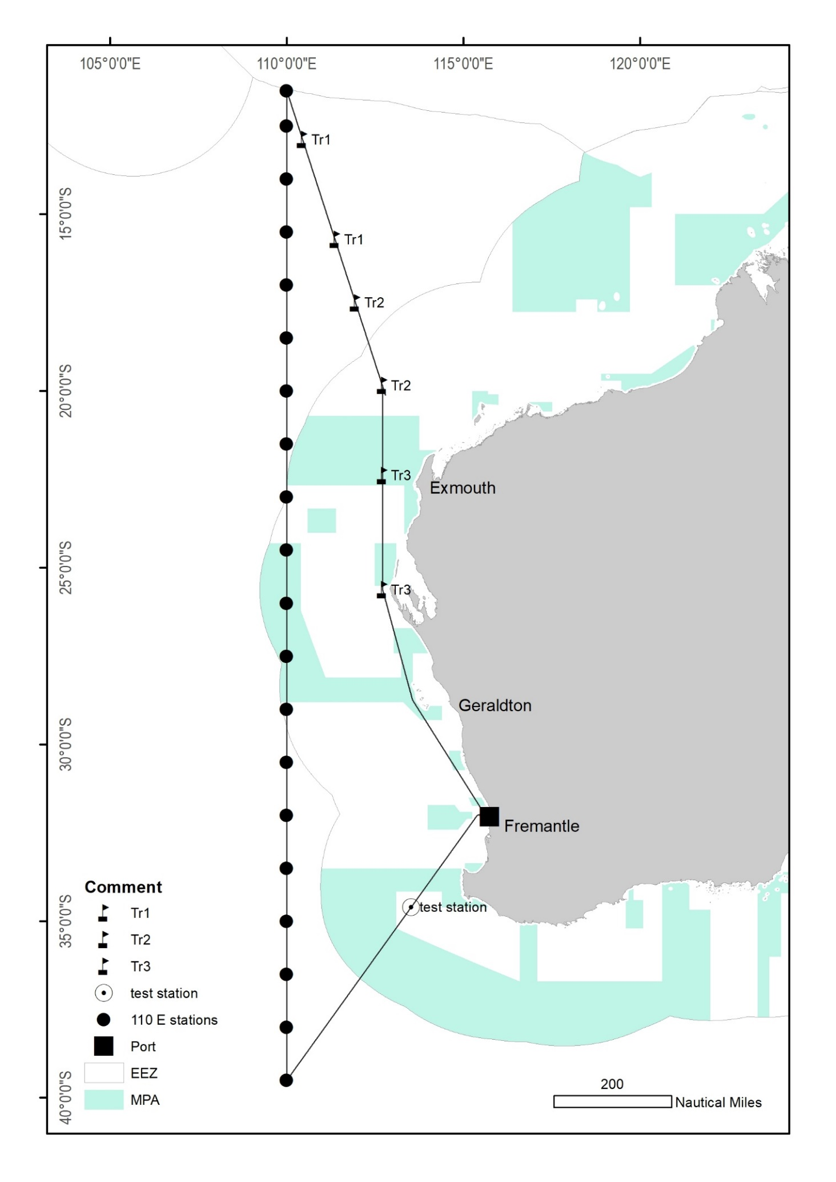
Voyage plan
Instruments to be deployed for radiometry:
In-situ Marine Optics (IMO, Perth) DALEC sensor, 350-800nm, resolution 3nm (above-water radiometry configuration)
Biospherical C-OPS in-water profiling radiometer, 18 wavelengths (320, 340, 380, 395, 412, 443, 465, 490, 510, 532, 555, 565, 589, 625, 665, 683, 710 and 780 nm) in “free-fall” mode in the water column
Satlantic HyperPRO profiling radiometer (350-800nm, resolution 3nm)
Radiance camera (CIMEL/LOV prototype)
Plus:
IOP package (absorption, backscattering)
Phytoplankton pigments
…..

Slide 7
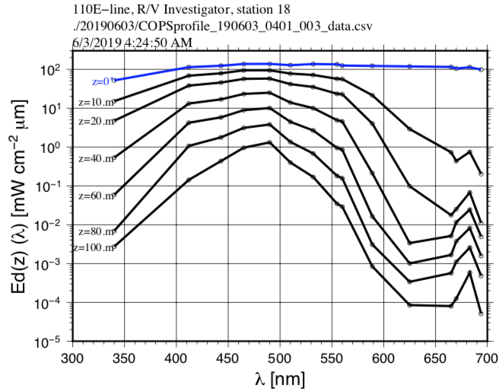
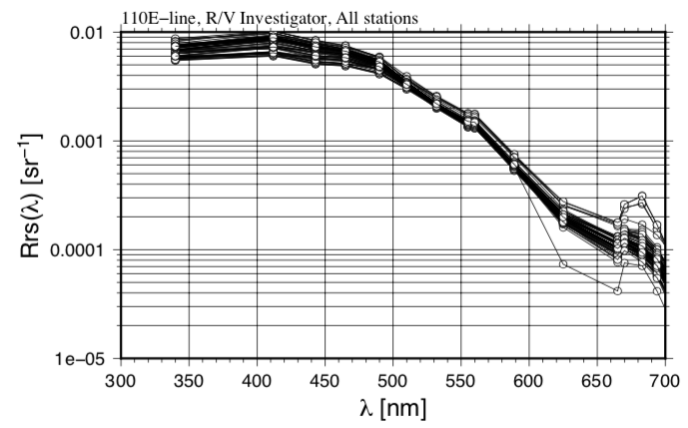
Preliminary outcomes from the IO voyage
 |  | Stations | # profiles
In water | C-OPS | 17 | 68
 | HyperPRO | 17 | 221
Above-water | DALEC | N/A | Continuous since station #1
 | SVC | 6 | 59 sets
Atmosphere | MicroTops | 30 | >300

Slide 8
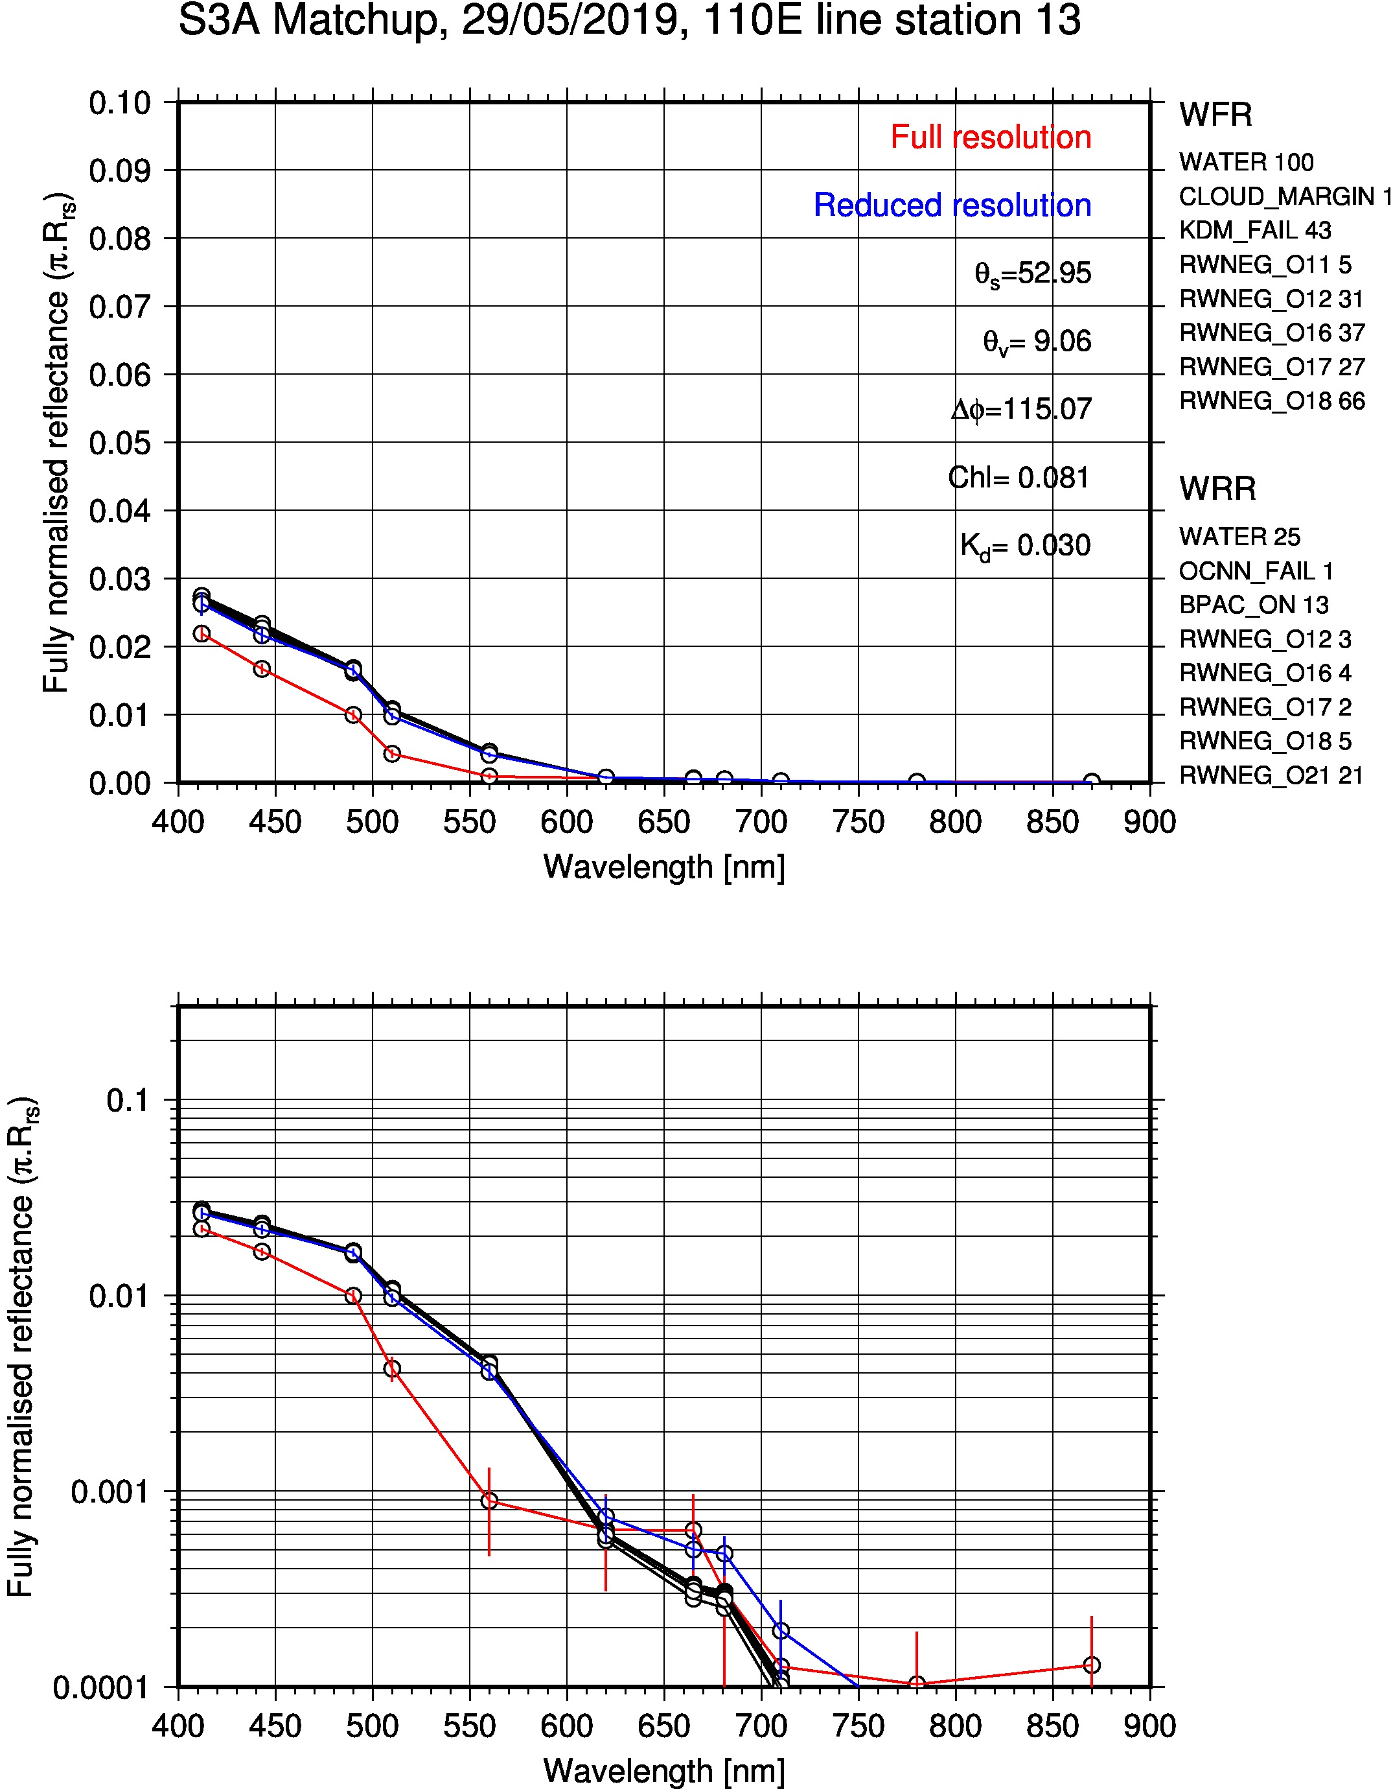
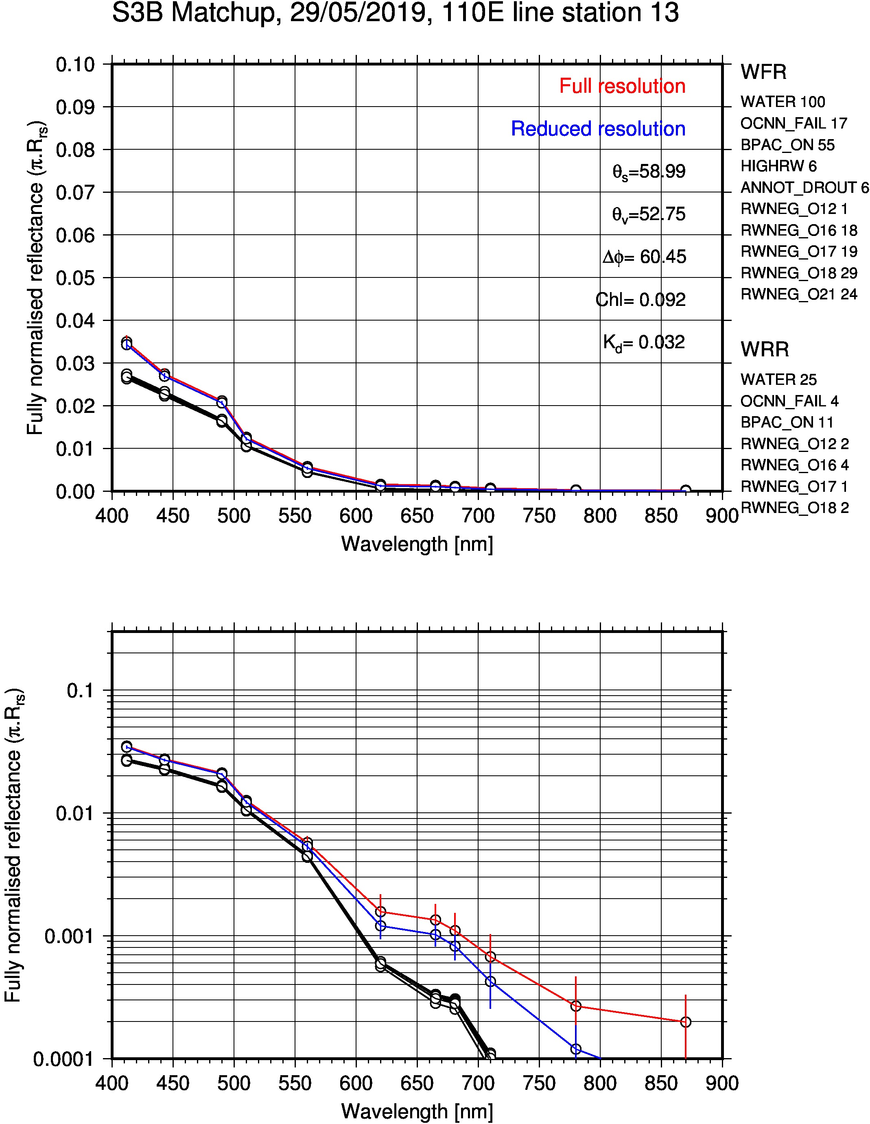
Preliminary outcomes from the IO voyage

Slide 9
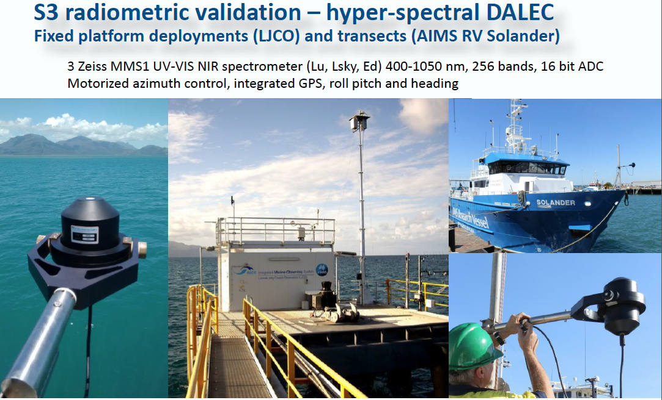
Schroeder et al.

Slide 10
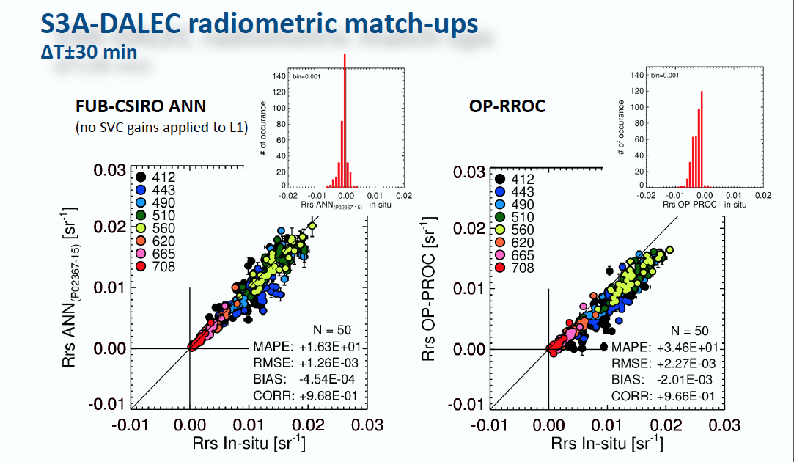
Schroeder et al.

Slide 11
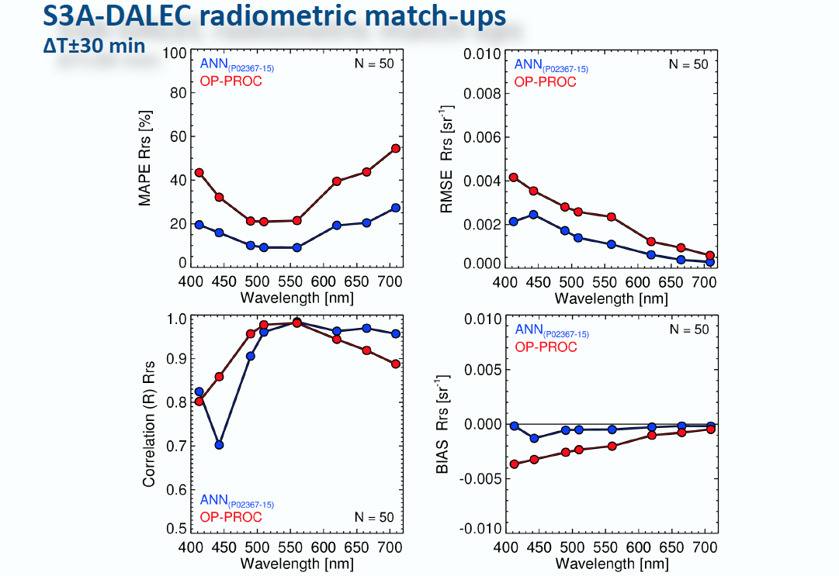
Schroeder et al.

Slide 12
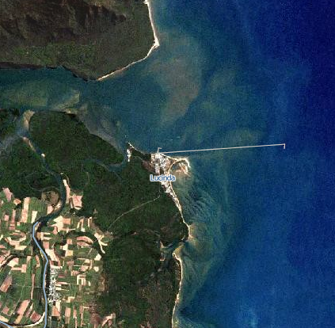
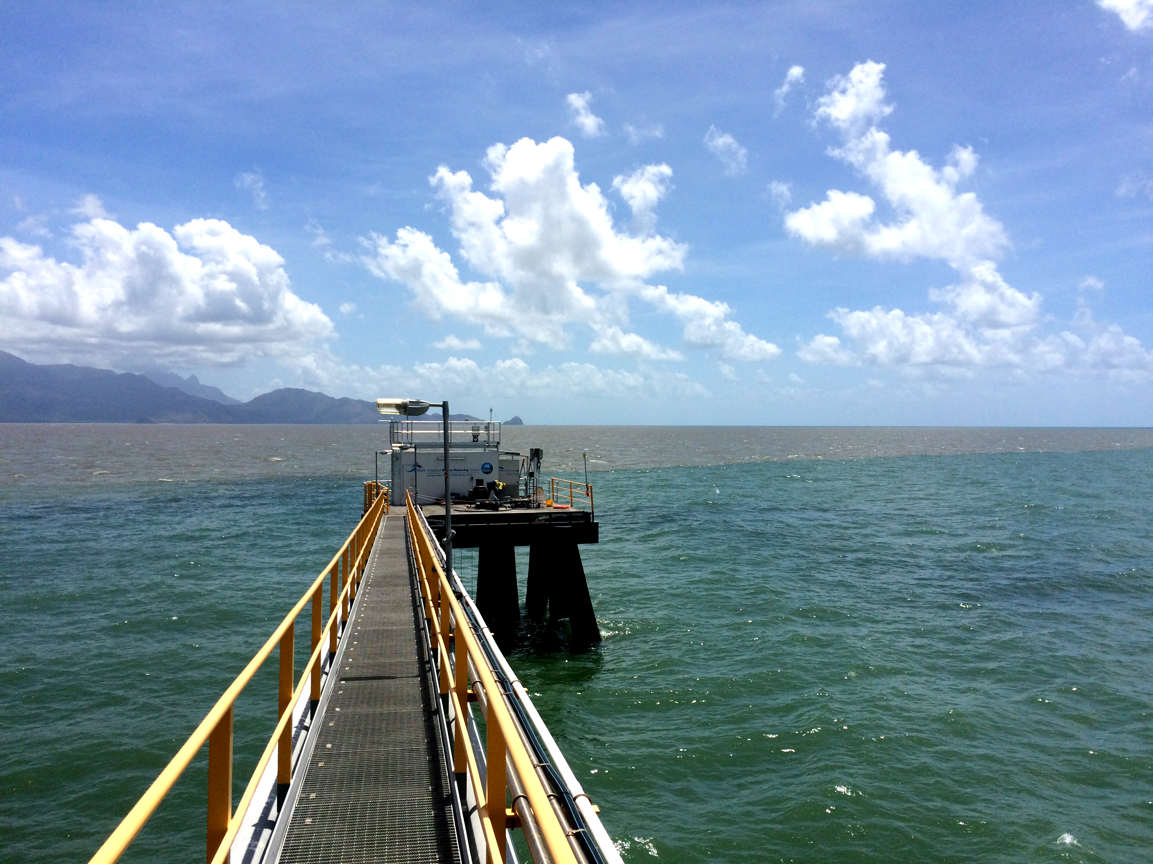
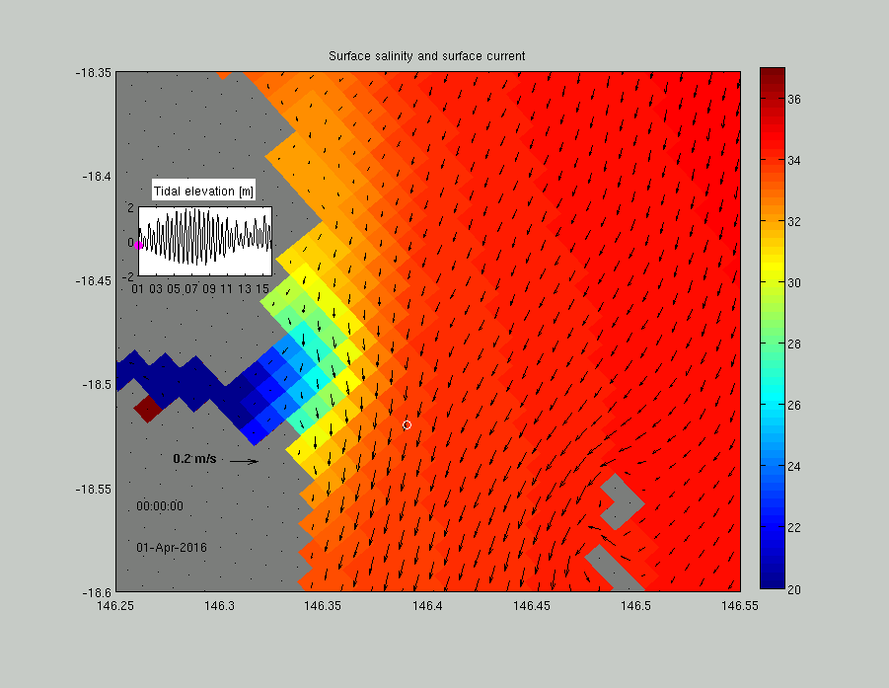
LJCO is variable coastal site
Tidal range 0.2-4 m
Water temperature 22-31°C
Salinity 27-36.5
TSS 1.17-35.7 g m⁻³
CDOM 0.22-6.35 mg m⁻³
Chl-a 0.01-0.49 m⁻¹
(Image credit M. Baird)
(Image credit D. Boadle)

Slide 13
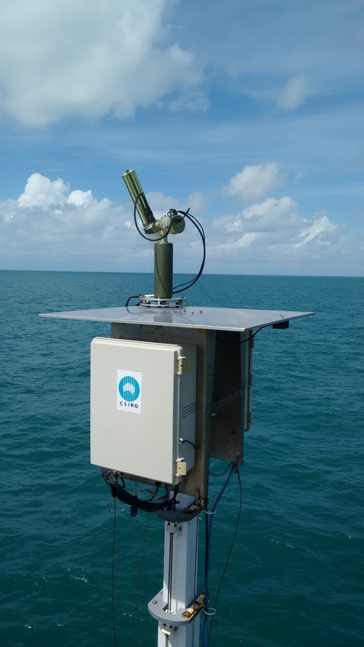
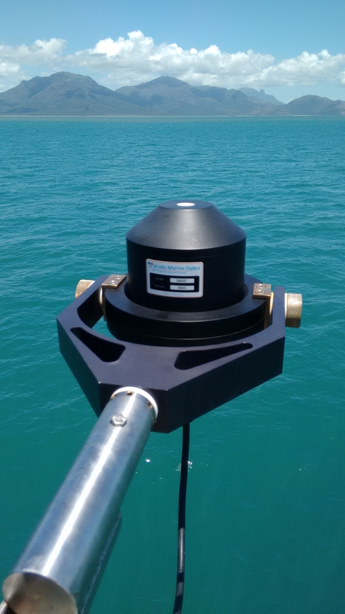
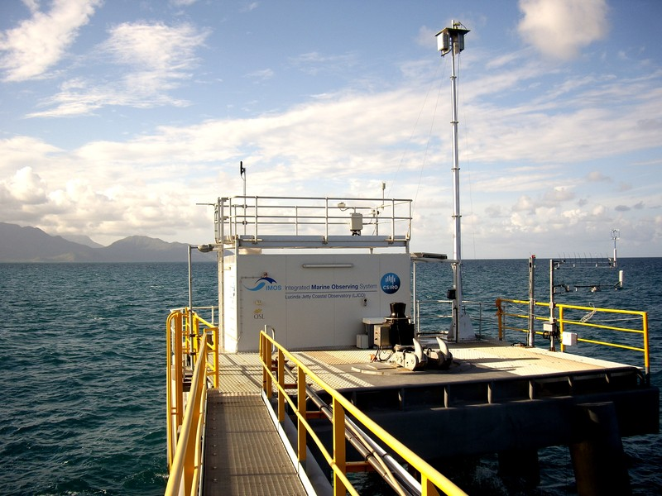

S3VT-OC
Radiometric measurements
Lucinda Jetty & Ship-borne
Contact: Thomas.Schroeder@csiro.au
SeaPRISM AERONET-OC
DALEC
Lucinda Jetty Coastal Observatory
Hyper-spectral measurements (DALEC) added to Lucinda (ad-hoc deployments)
Update on quality assessment of operational and C2RCC processors to be presented at March 2018 S3VT meeting in Darmstadt
IMOS inter-comparison task helped to quantify instrument uncertainties

Slide 14
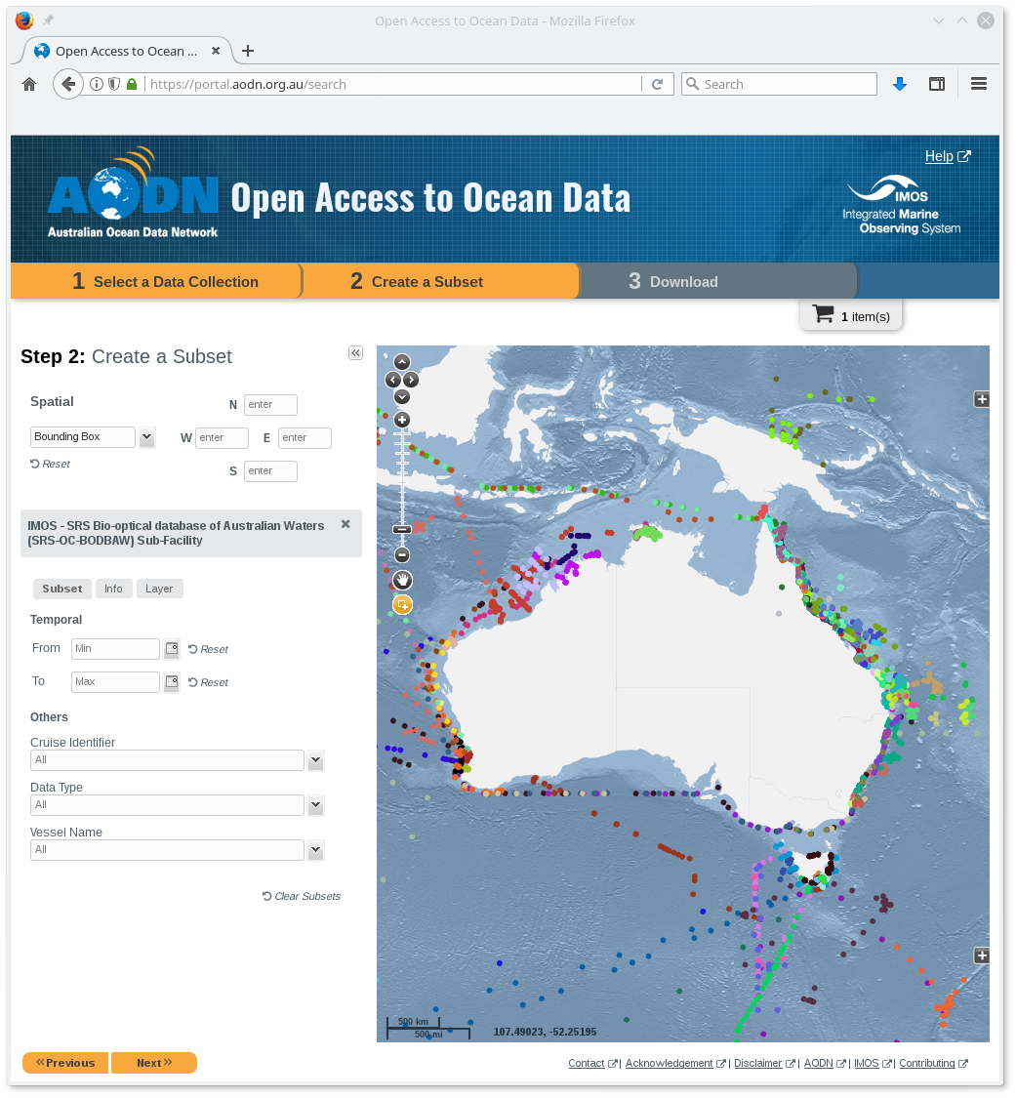
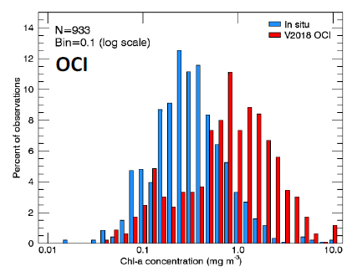
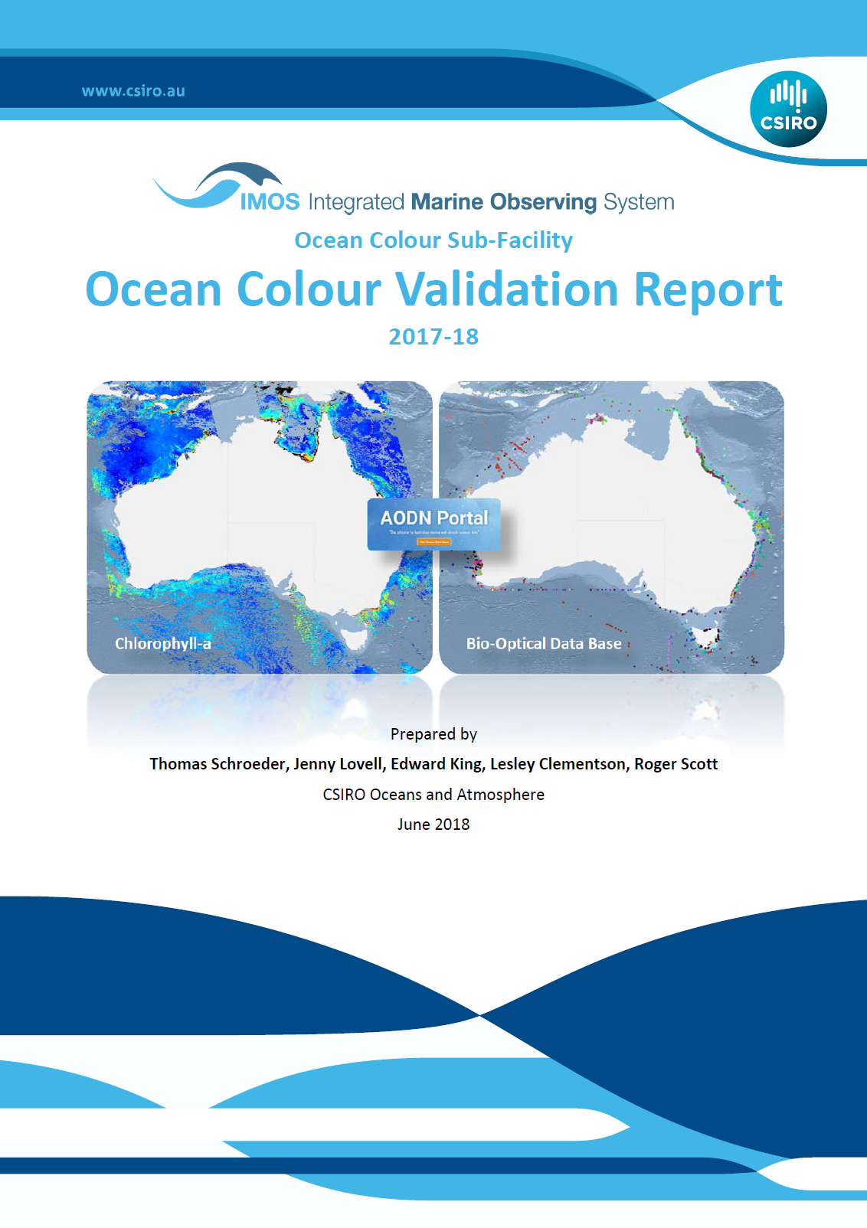
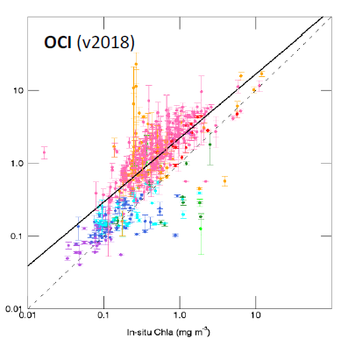

IMOS Ocean Colour Validation
Contact: Thomas.Schroeder@csiro.au
Sub-facility generates daily Level-3 (gridded) ocean colour products from MODIS-Aqua and VIIRS
Product validation using IMOS Bio-optical Database – freely available via AODN
Match-up are separated into Optical Water Types (Moore et al. 2009)
Annual validation reports
Presentation title | Presenter name | Page 14

Slide 15
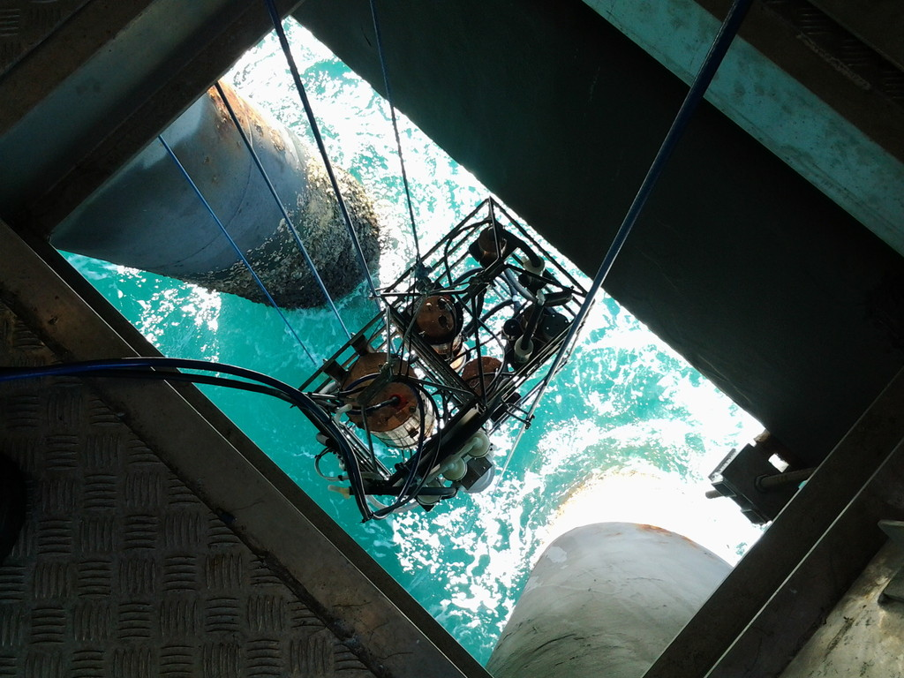
Overview in-water optical measurements
Automatic winch controller keeps cage at a constant depth
WetStar fluorometer
CDOM absorption
Chlorophyll-a
Uranine
Phycoeryhrin
ACs (80 wavelengths)
Total absorption
Total attenuation
WQM
Temperature
Salinity
Depth
Dissolved oxygen
Turbidity
Back scattering
Chlorophyll fluorescence
DAPCS
Network enabled real-time data logger
BB9 (9 wavelengths)
Back-scattering
ACs switching unit
(filtered/unfiltered)
Fortnightly servicing and water sampling
optimized for satellite match-ups
Contact: Thomas.Schroeder@csiro.au

Slide 16
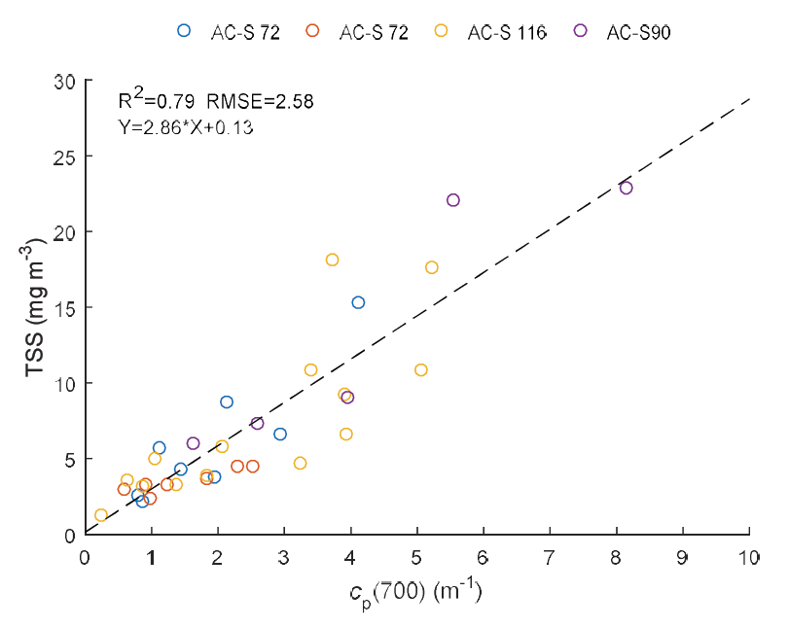
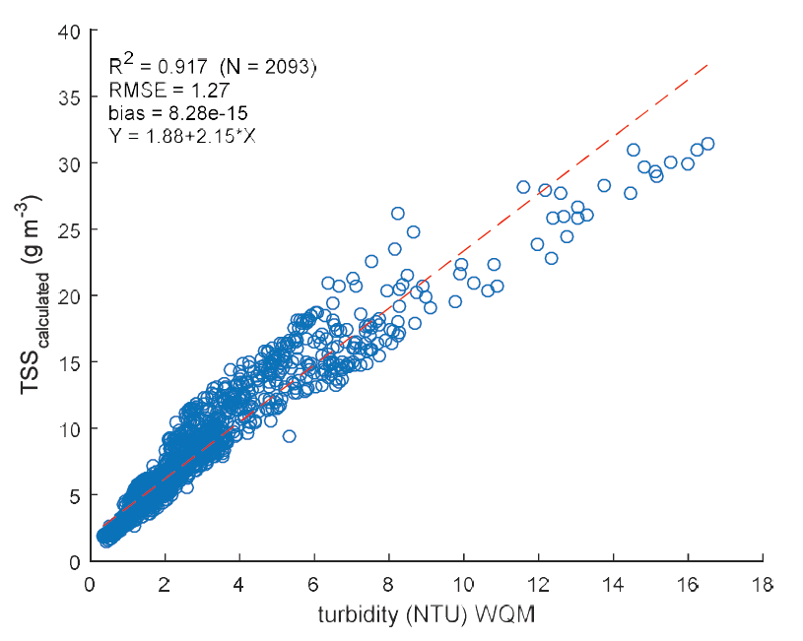
Lucinda Jetty – bio-optical relationships
Proxies to derive continuous concentration time series
(Analysis: Wozniak, M.)
Relationship between attenuation (AC-s) and lab TSS used to calculate TSS from WQM
In addition regression of AC-s absorption at 678 nm vs HPLC chlorophyll.
Relationships will be used to derive a continuous time water quality series of TSS and chlorophyll-a from in-water optical AC-s and WQM measurements.

Slide 17






IMOS “Radiometry Task Team”
David Antoine, Curtin University,
Thomas Schroeder, CSIRO O&A flagship,
and the task team members, by alphabetic order:
Elizabeth Botha (CSIRO), Nagur Cherukuru (CSIRO), Arnold Dekker (CSIRO), Martina Doblin (UTS), Peter Fearns (Curtin),
Nick Hardman-Mountford (CSIRO), Rob Johnson (BoM),
Edward King (CSIRO), Wojciech Klonowski (IMO), Jenny Lovell (CSIRO), Tim Malthus (CSIRO), Ross Mitchell (CSIRO), Matt Slivkoff (Curtin), Peter Thompson (CSIRO), Paul Van Ruth (SARDI)
IMO

Slide 18
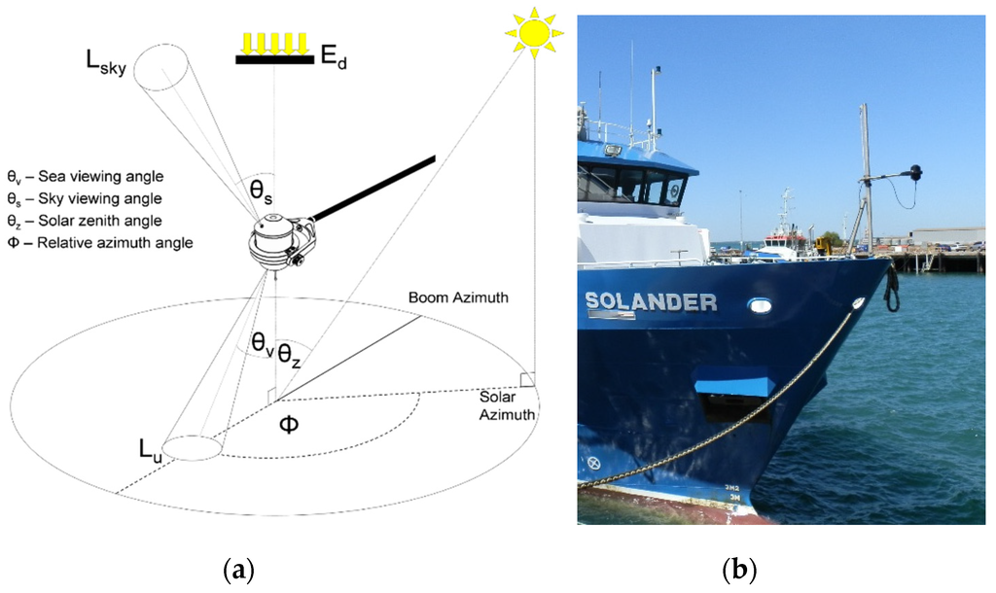
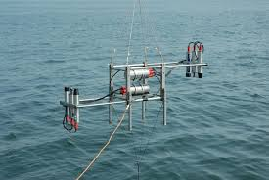
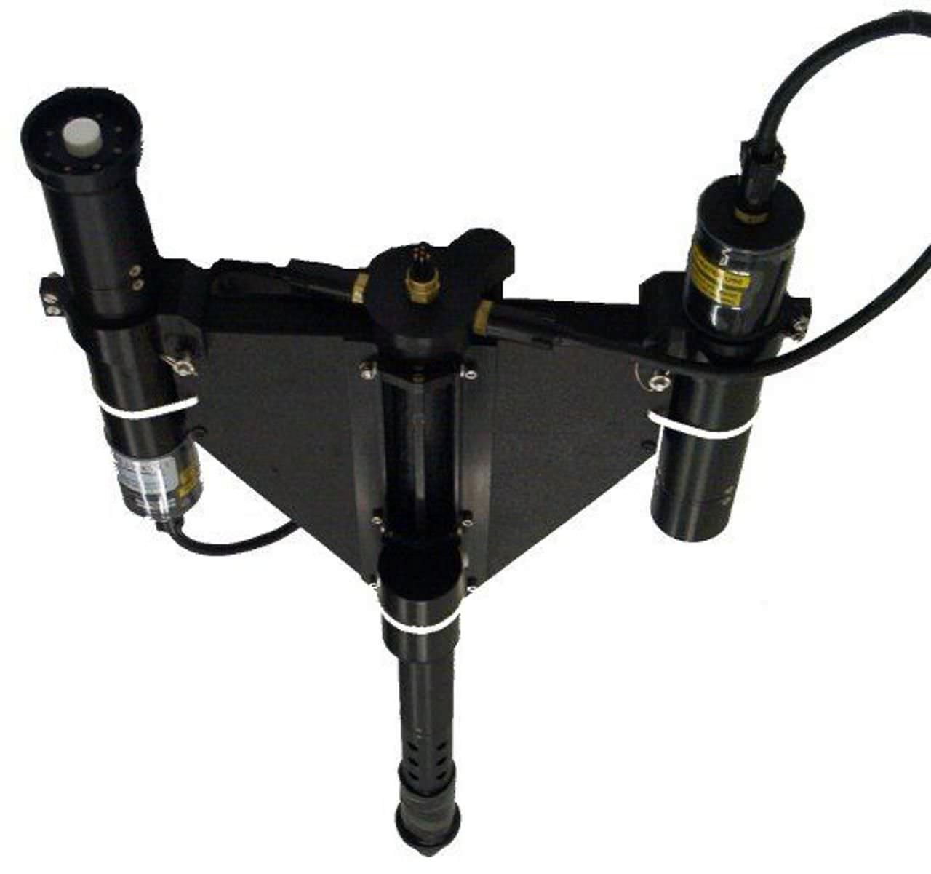
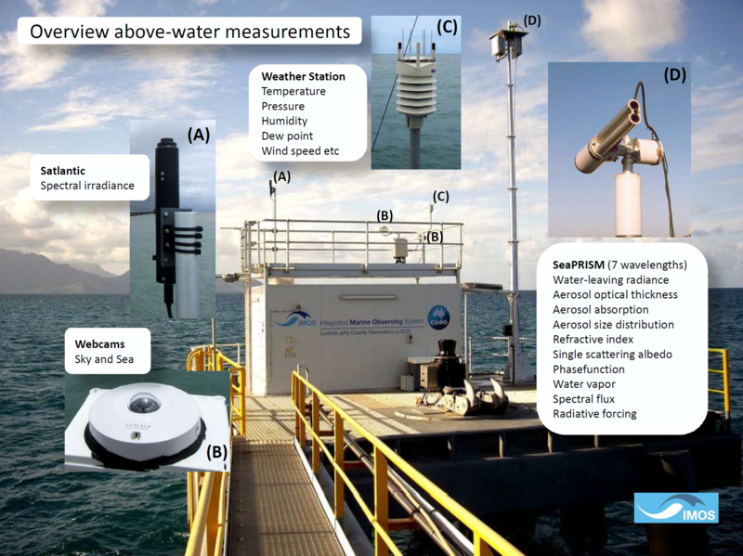
What the Australian community does?
DALEC (IMO)
RAMSES (Trios)
Brando et al., Remote Sens. 2016, 8(2), 150; doi:10.3390/rs8020150
http://www.iopan.gda.pl/RSL/equipment.html
HyperOCR (Satlantic)
SeaPRISM
(CIMEL)

Slide 19
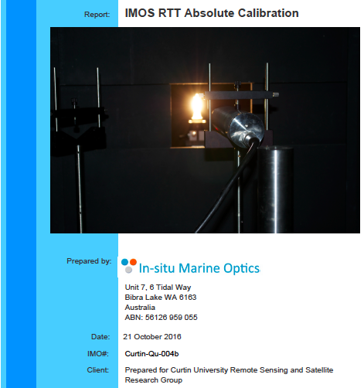
1st activity: lab calibration/characterization
Overall consistency of the calibration lamps
No “out-of-range” instrument
Temperature is to be monitored for spectrometer-based instruments
Calibration must be done at different internal temperatures
Manufacturer cal/charact. work insufficient
Look at counts when using a spectrometer, and don’t try to get measurements for too low/high counts
This will be pursued with the presentation at the ESA’s FRM4SOC workshop (next week), plus lamps will be part of the “LCE1” exercise as well

Slide 20
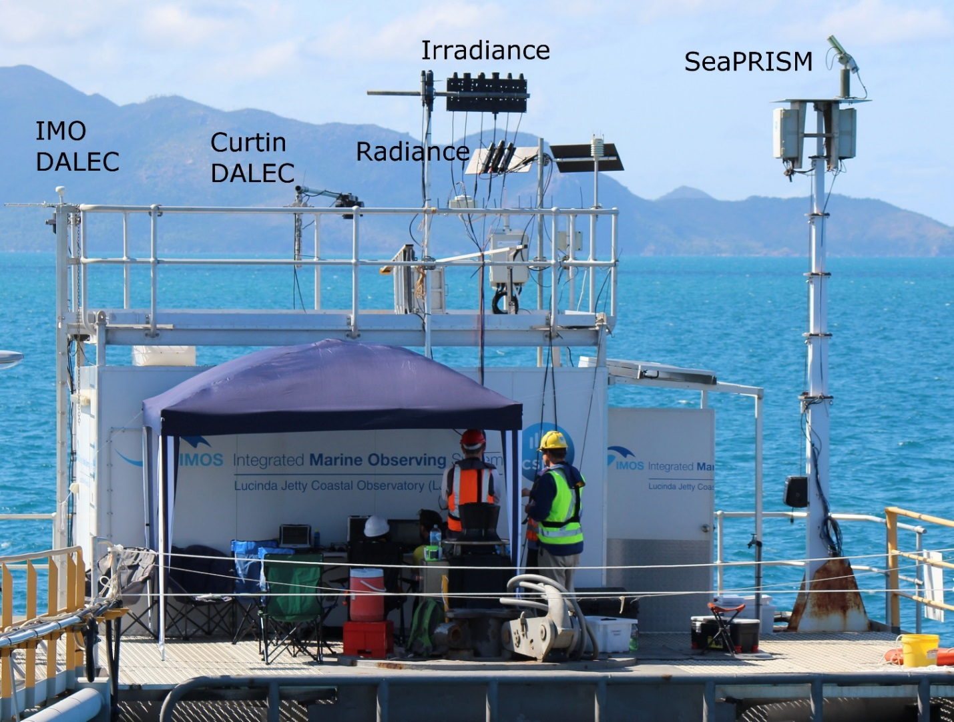
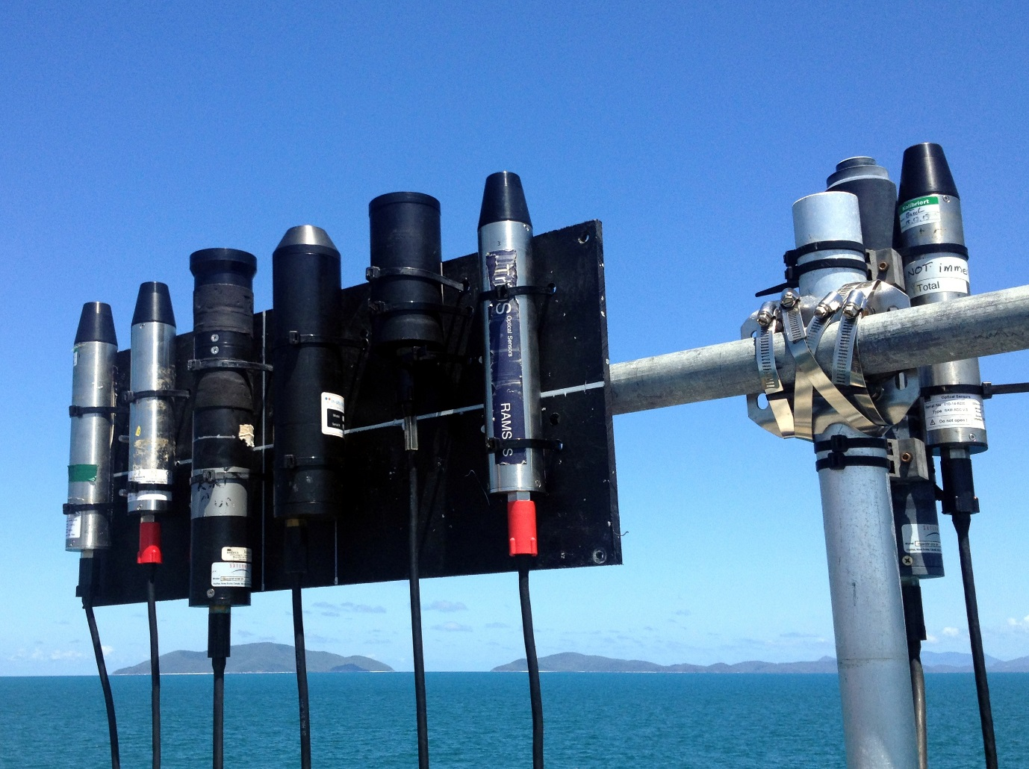
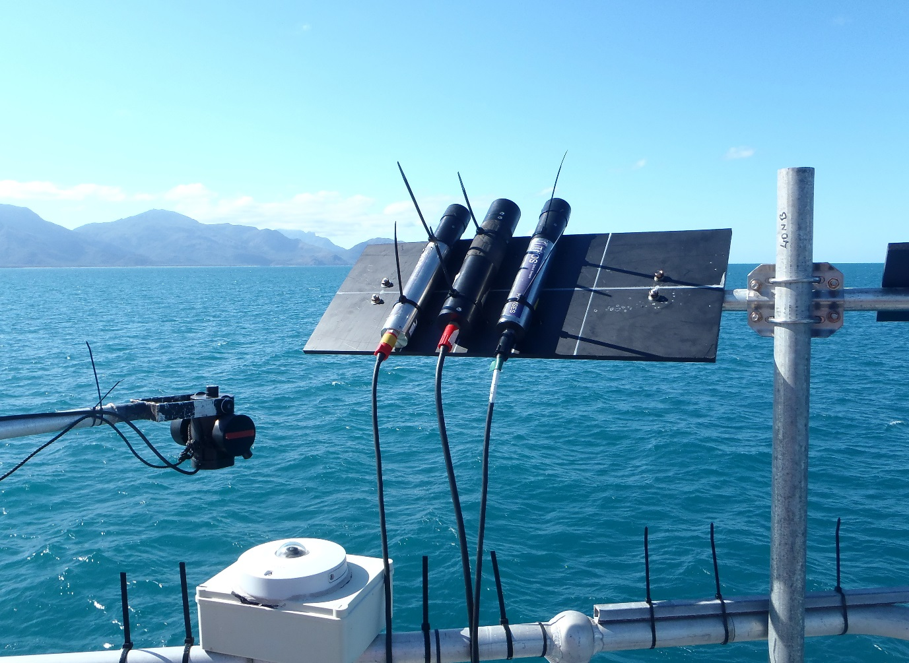
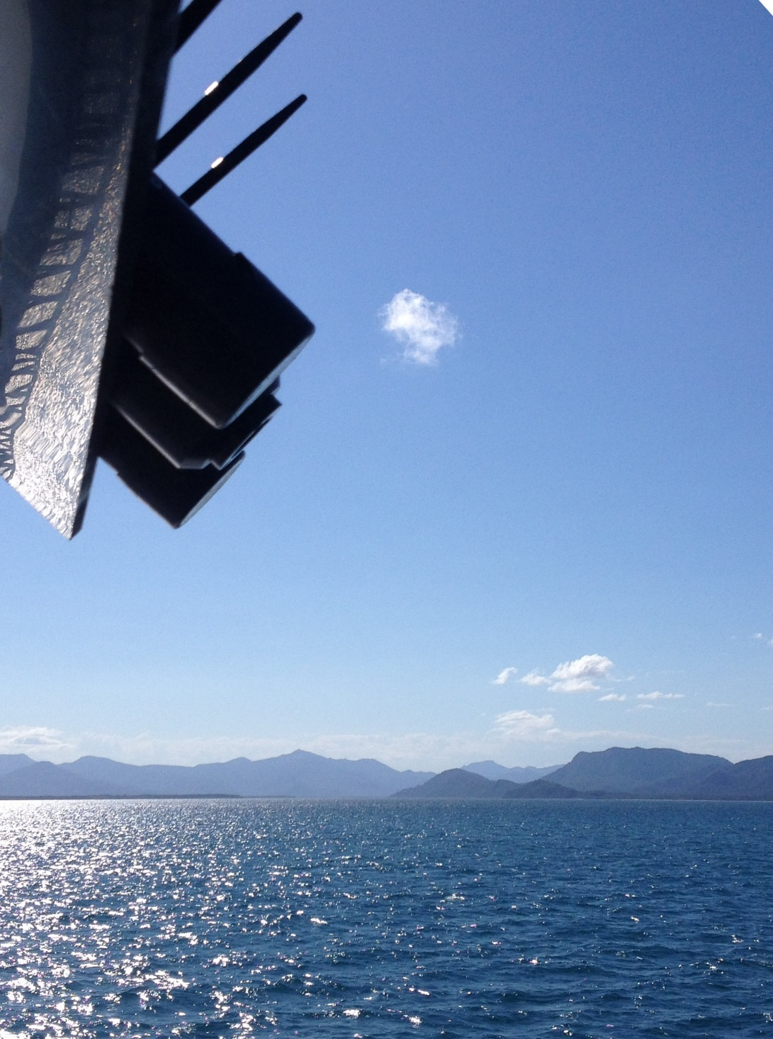
2nd activity: field inter-comparison at LJCO

Slide 21
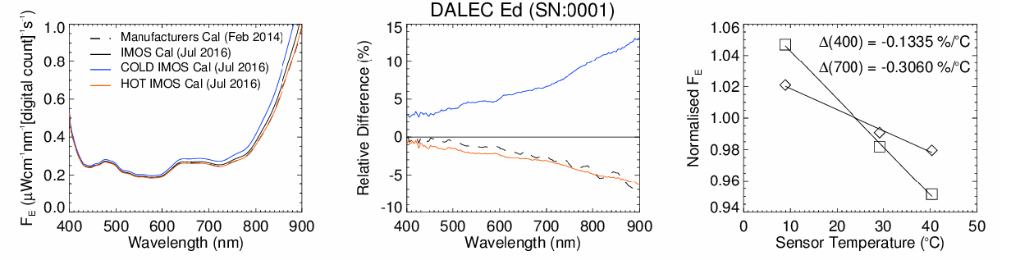
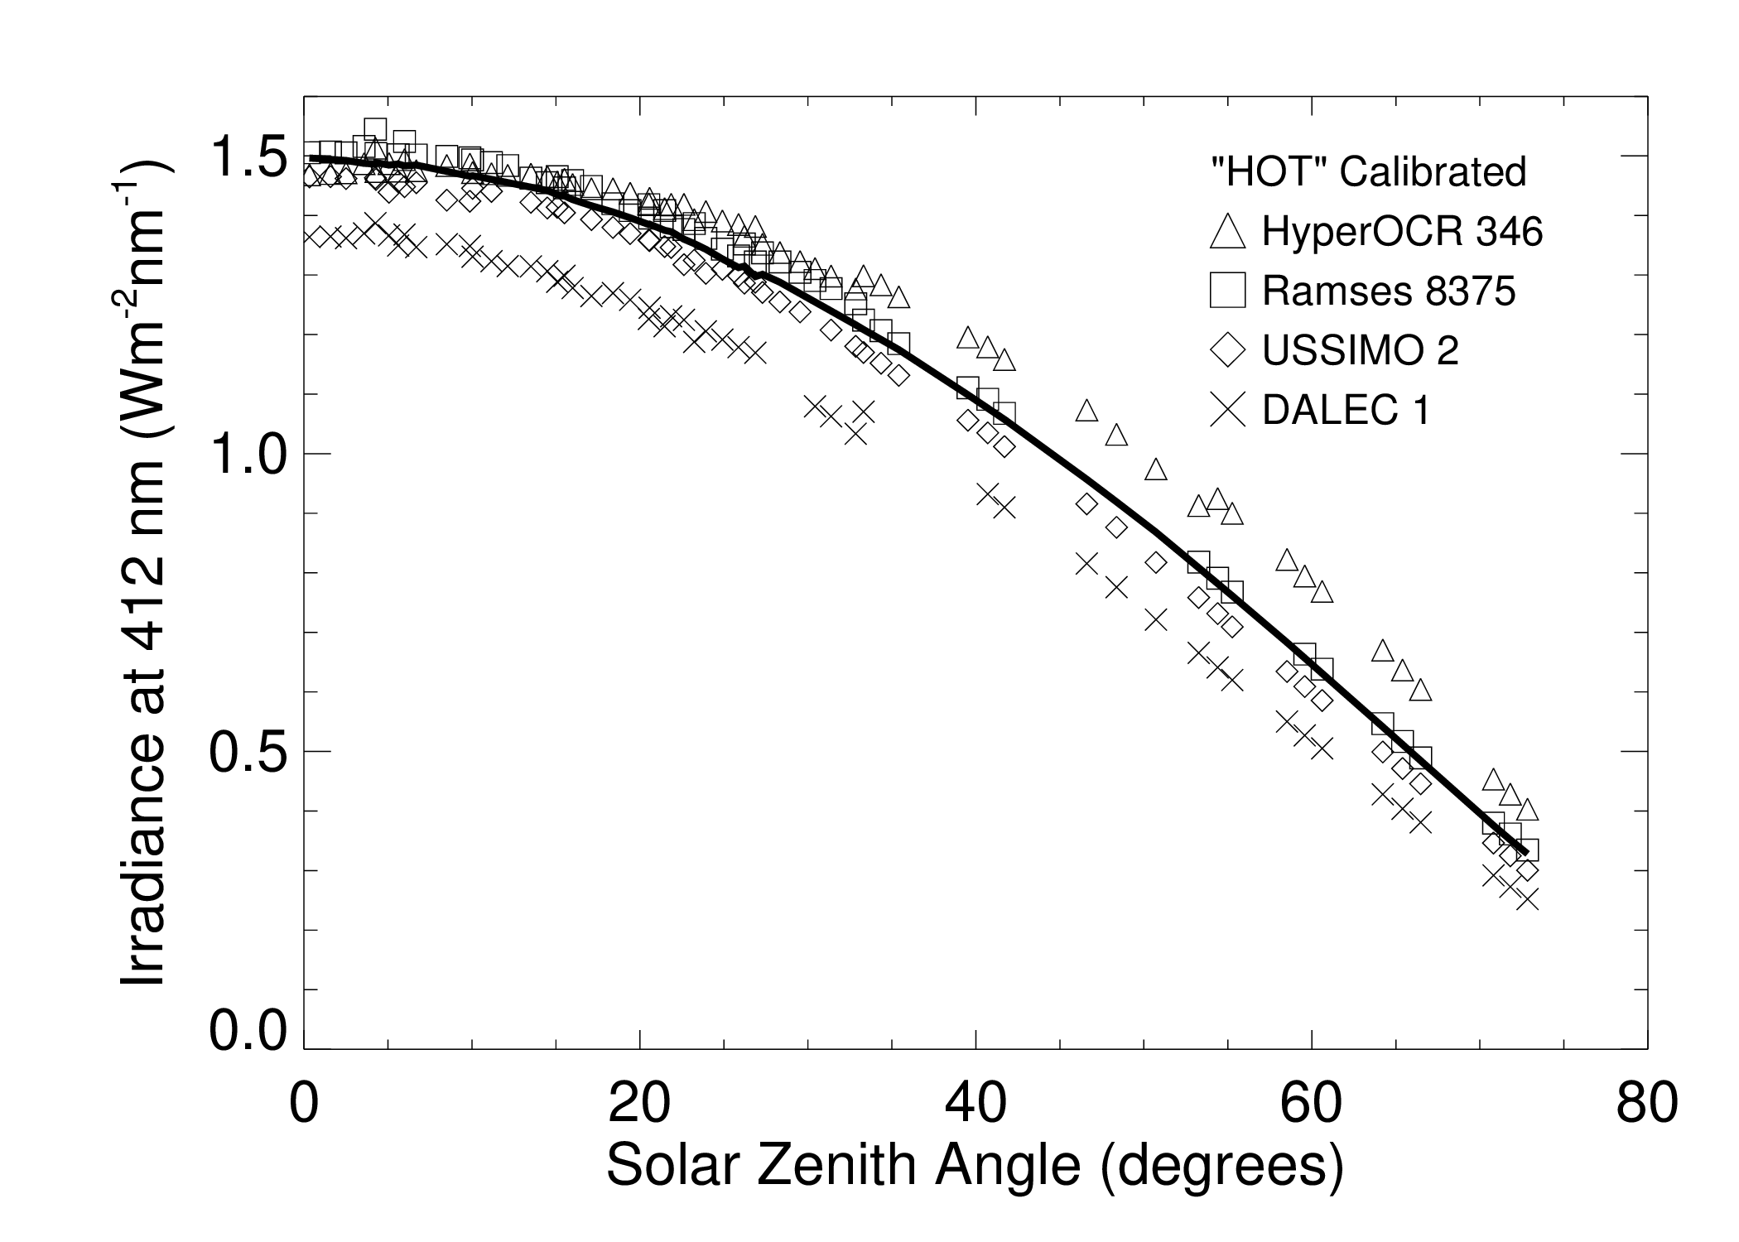
Improving consistency of radiometric measurements
IMOS Radiometry Task Team (Antoine, Schroeder et al.)
Spectral approach for temperature correction of cal. coeff. should be investigated
(Analysis: Slivkoff M., Klonowski W.)

Slide 22
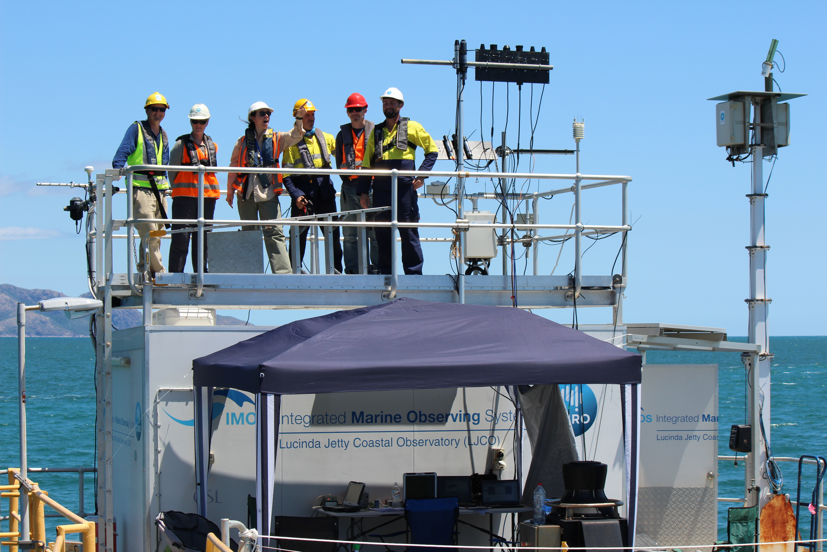
Thanks for your attention

Slide 23
Spares / Old

Slide 24
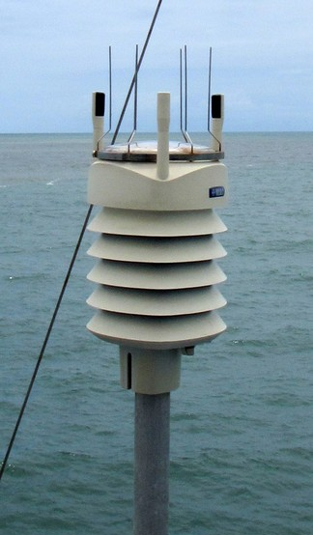
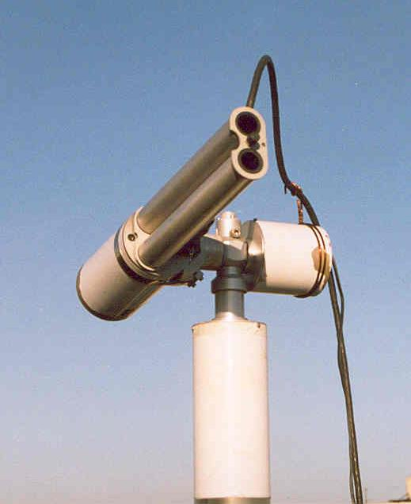
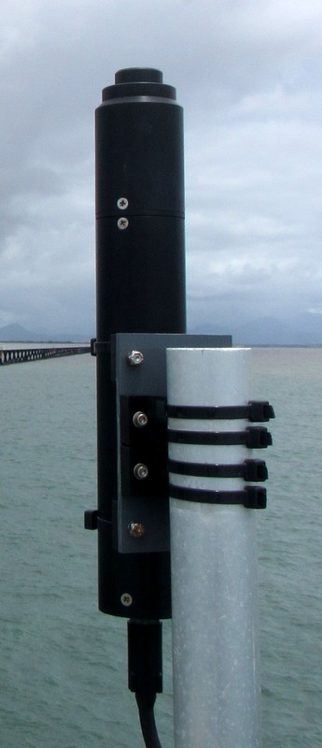
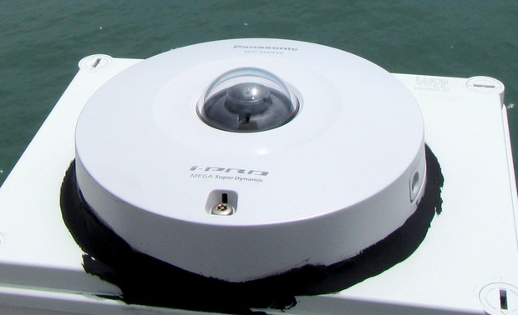
Overview above-water measurements
(C)
(D)
Weather Station
Temperature
Pressure
Humidity
Dew point
Wind speed etc
(D)
(A)
Satlantic
Spectral irradiance
(A)
(C)
(B)
(B)
SeaPRISM (7 wavelengths)
Water-leaving radiance
Aerosol optical thickness
Aerosol absorption
Aerosol size distribution
Refractive index
Single scattering albedo
Phasefunction
Water vapor
Spectral flux
Radiative forcing
Webcams
Sky and Sea
(B)
Contact: Thomas.Schroeder@csiro.au

Slide 25
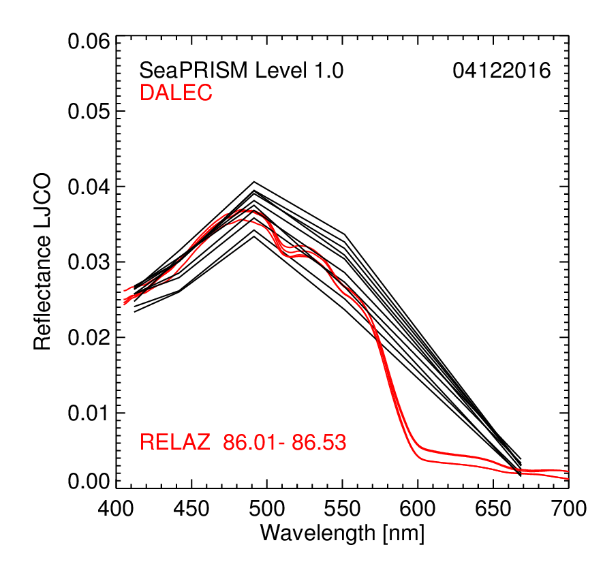
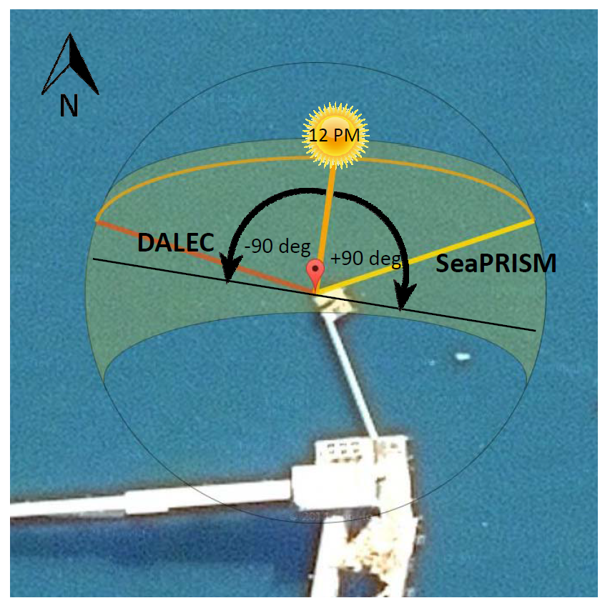
Aligning observing geometries
Data quality improved - DALEC and SeaPRISM now 90° with respect to the Sun
Example 4 Dec 2016
Contact: Thomas.Schroeder@csiro.au
DALEC and SeaPRISM radiometry now in good agreement
More detailed quantitative analysis under RTT based on Level 2 data
Working with In-situ Marine Optics on improving DALEC stability and remote operations
DALEC required to capture AM satellite passes (Sentinel-3A)

Slide 26
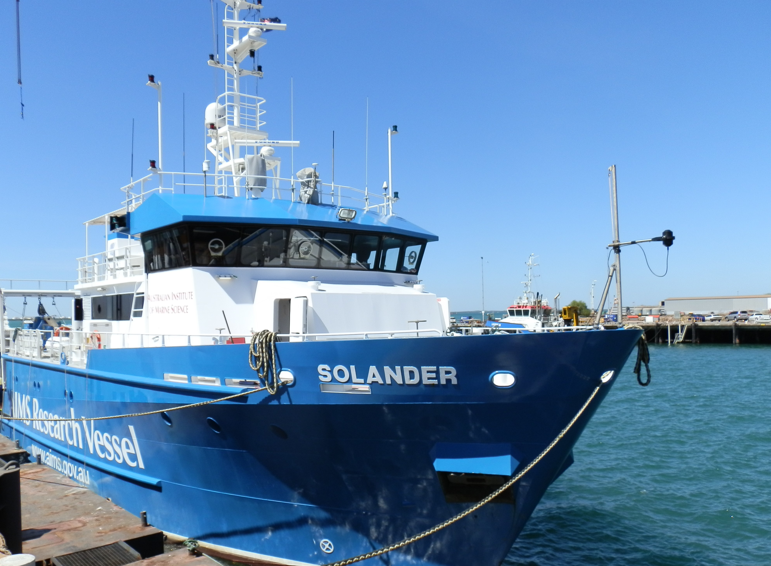
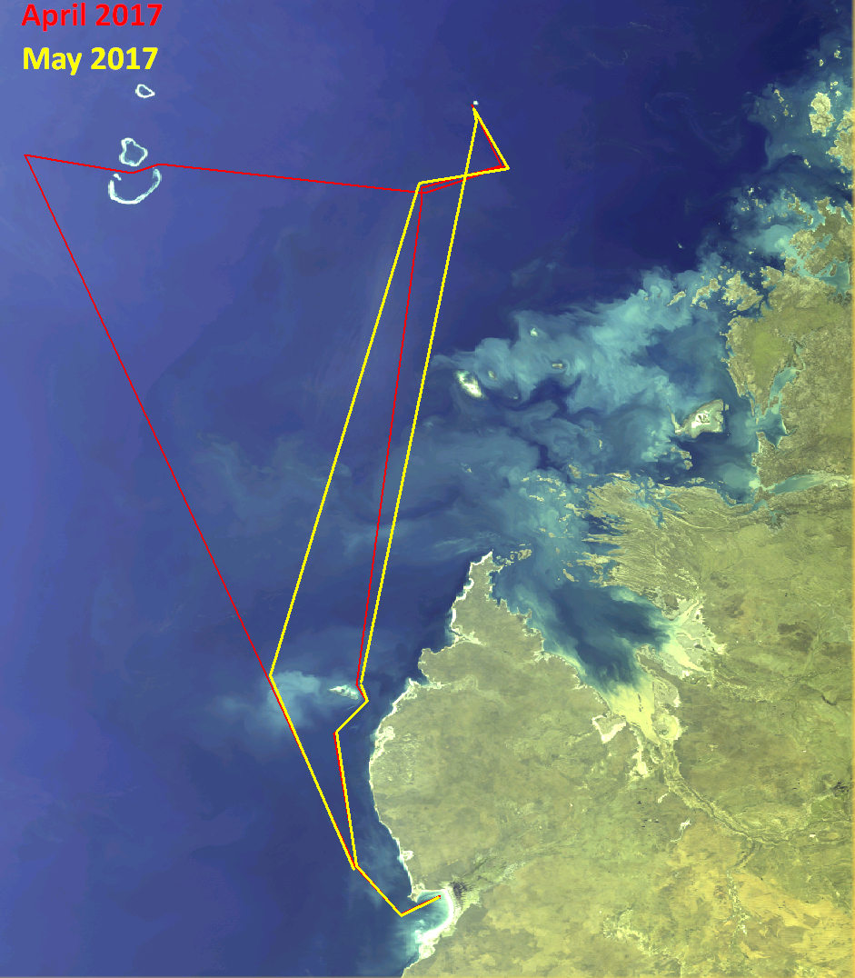
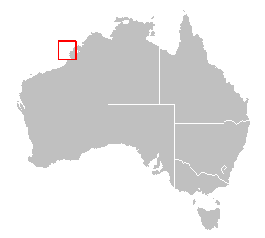
DALEC on RV Solander
Operated by Australian Institute of Marine Science, DALEC deployed ~60 days per year
Continental shelf
5 OLCI scenes, 3x3 median
DALEC R_{rs} 15 min mean
Matchups ±1 hr
Notes:
DALEC operates autonomously, technician starts at beginning of day, stops and downloads at end of day and covers or retrieves during the night.
Agreement to deploy 60 days per year.
Several matchups on approach to Scott reef, some near the NE point (mooring) and a few closer to coast.
DALEC pixel size 100-300m near Scott reef, up to ~4km on transit segments.

Slide 27

OLCI original data release vs DALEC
N=35, 400-665 nm
Notes:
R2 and slope similar or better than LJCO for 400-560. Low signal for wavelengths beyond 620 gives poor relationships. Both DALEC and OLCI have some negative values above 700nm.
DALEC pixel size 100-300m near Scott reef, up to ~4km on transit segments.

Slide 28

OLCI IPF2.23 data vs DALEC
N=31, 400-665 nm
Notes:
Same as LJCO, greater bias in blue.

Slide 29



Spectra and Statistics OLCI vs Ship-based DALEC
(Analysis: Lovell, J.)
Notes:
Statistics behave similarly to LJCO but noisy above 560nm. See spectra for examples, wiggle around 665-680 is sometimes seen in DALEC and reproduced in OLCI but sometimes not.

