Slide 1
CEOS Cal/Val Portal Update
Paolo Castracane¹, Philippe Goryl²
¹ RHEA c/o ESA ESRIN
² ESA/ESRIN
CEOS WGCV #44, Darmstadt, Germany Aug. 28-31, 2018

Slide 2
CEOS Cal/Val Portal Update
Table of Contents:
Cal/Val Portal overview
Current status and Proposed re-shape (Mock-up)
Actions in progress
Conclusion

Slide 3
Outreach of CEOS WGCV
Outreach of CEOS working group CalVal (WGCV) is divided in two websites:
http://calvalportal.ceos.org/
http://ceos.org/ourwork/workinggroups/wgcv/
Hosted by ESA
Include mainly technical content, tools, data access and literature.
Hosted by NASA
Contains mainly current activities, objectives, organizational, and other content-related matter

Slide 4
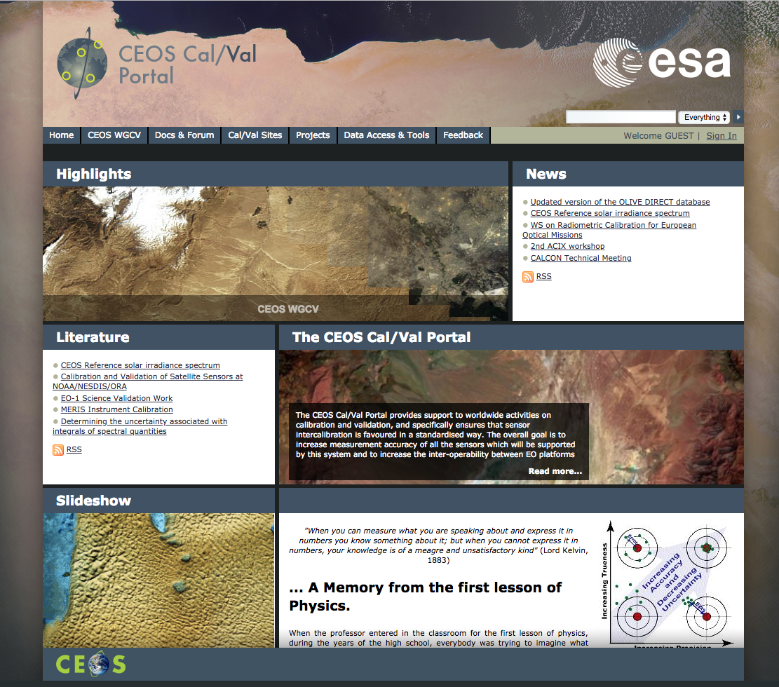
CEOS Cal/Val Portal Overview
The CEOS Cal/Val portal is a web portal funded by ESA and made available to the CEOS WGCV community as a reference point to store/publish Cal/Val related data and information.
The Portal is technically managed by Brockmann Consult GmbH
Two years Contract for Maintenance and Evolution has been signed on April 2018

Slide 5
CalVal portal main contents
Home Page: Main Menu, Mission Statement within the CEOS Cal/Val Portal box,
Highlights, News, Literature and Slideshow.
From main menu:
Home: News & Events, Links
CEOS WGCV: CEOS WGCV – activity, planning, meetings, ACSG (Atmospheric
Composition Sub Group) , IVOS (Infrared and Visible Optical Sensors SubGroup),
LPV (Land Product Validation SubGroup), SAR (Synthetic Aperture Radar SubGroup)
Docs & Forum: Metodology and Guidelines, QA4EO, Literature, Forum and Missions
Cal/Val Sites: CEOS LandNet Sites, Calibration Test Sites, Cryonet Sites,
RadCalNet Prototyping, Radiometric Sites
Projects: MVT,ALTS, G-VAP, SnowPEX, ACIX
Data Access & Tools: Query Products, Metric Data, CalVal SW Tools, CalVal SW Services,
DIMITRI, COVE, 6s Input Configuration, OLIVE, IMPETUS

Slide 6
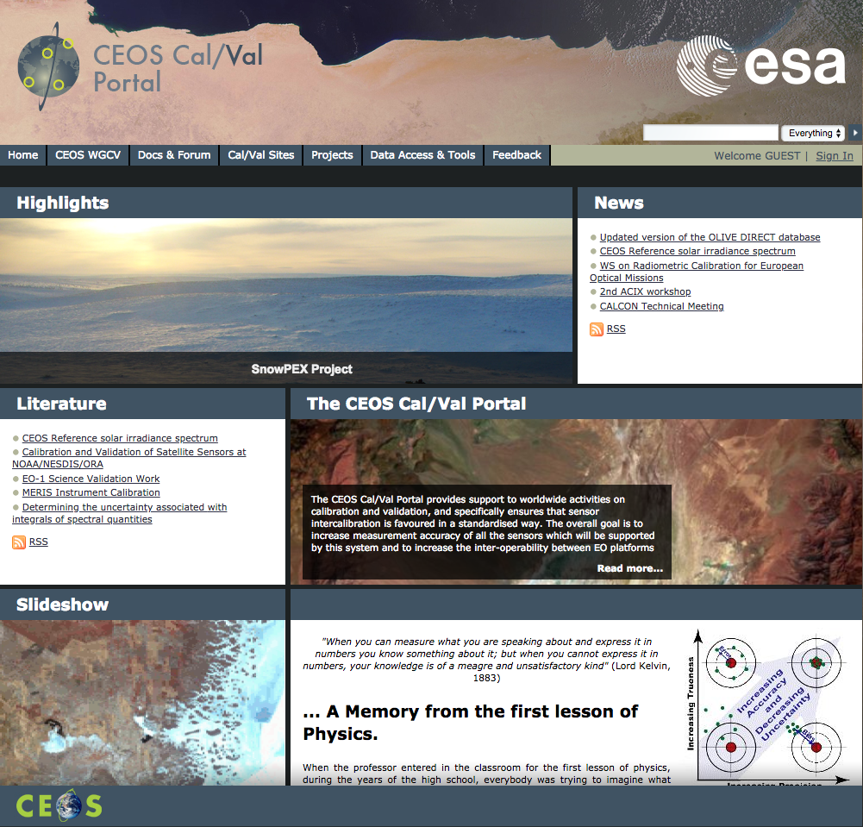
CEOS CalVal Portal –
Current Status
Home Page:
A renewal of the Home page is planned
RSS subscription for “News” and “Literature”.
“News & Events” need a more frequent update
New dedicated pages for: “Workshops & Conferences” “Reference & Standard” and “Contact”. Forum panel will be in the Home page
Home -> Links, a number of links are obsolete, alternative/new links will be proposed

Slide 7
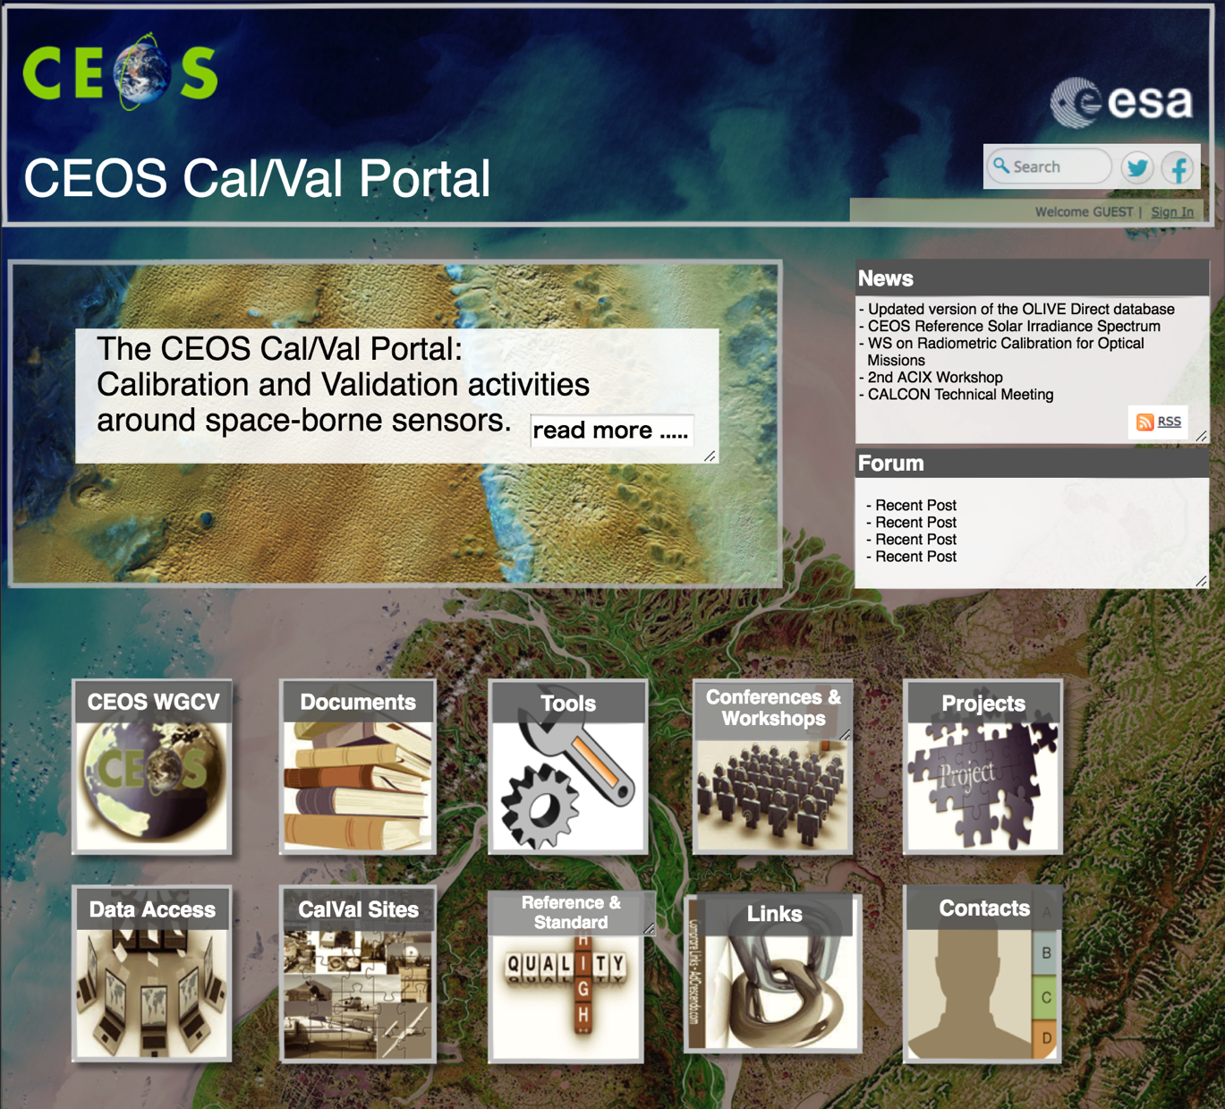
CEOS Cal/Val proposed re-shape
The basic idea for the Home page is to have a short "Mission Statement" extended by the read more option, and some clickable blocks instead of menu.
News and Forum

Slide 8
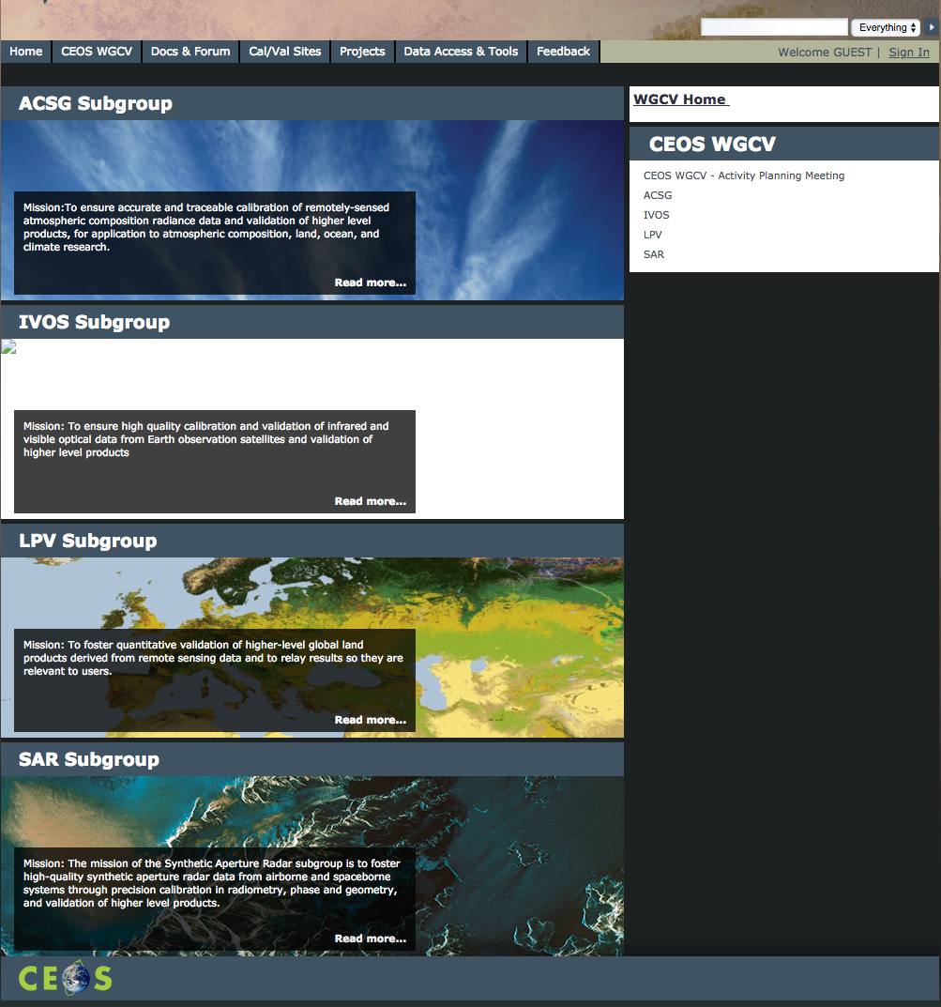
CEOS CalVal Portal – Current Status
CEOS WGCV section:
“Activities planning meeting” to be updated.
Info for Microwave Sensors (MSGS) to be added
The SAR subgroup page, will be replaced with a new internal webpage (TBC)

Slide 9
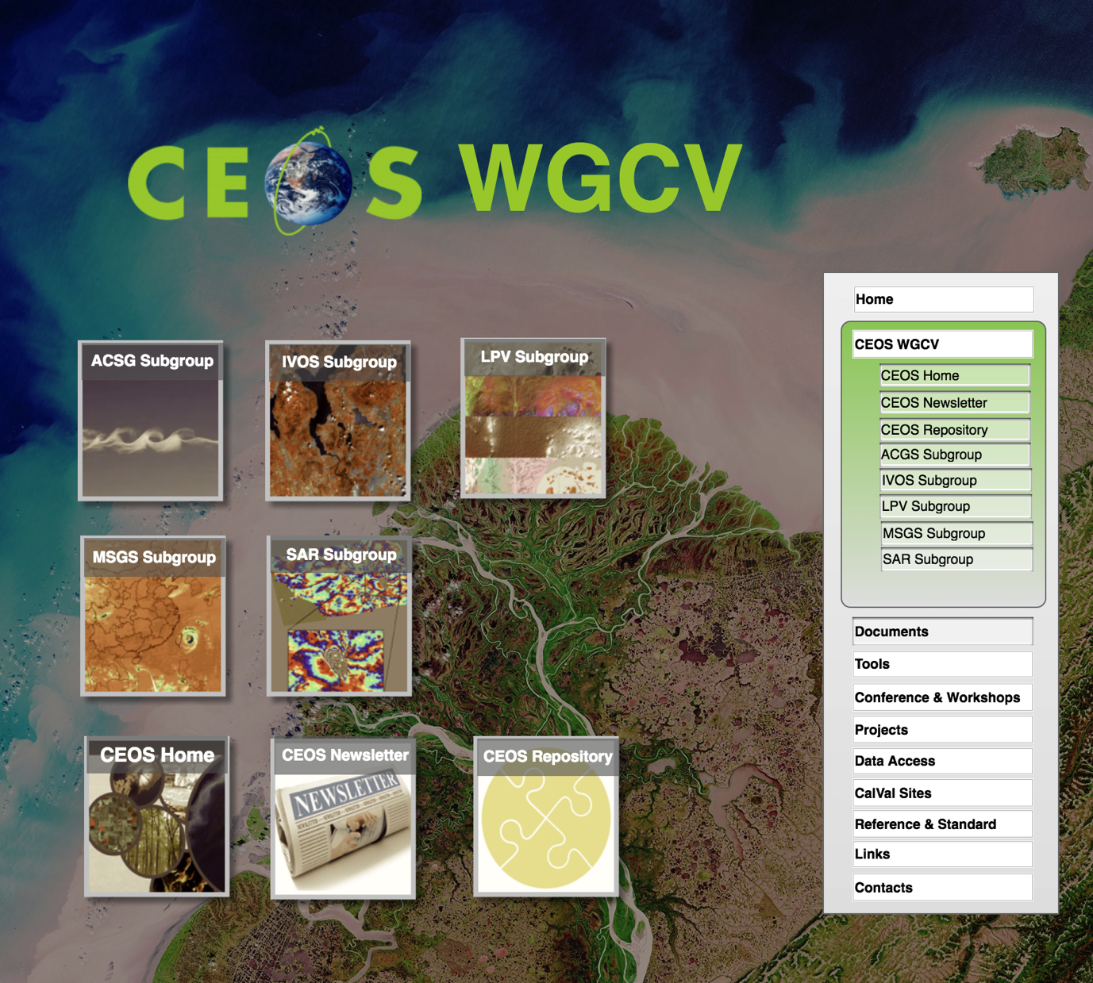
CEOS Cal/Val proposed re-shape
The CEOS WGCV page.
It includes:
All Subgroups: info, relevant materials etc.
CEOS Home and Newsletter links
CEOS Repository: a dedicated and shared space for relevant documents

Slide 10
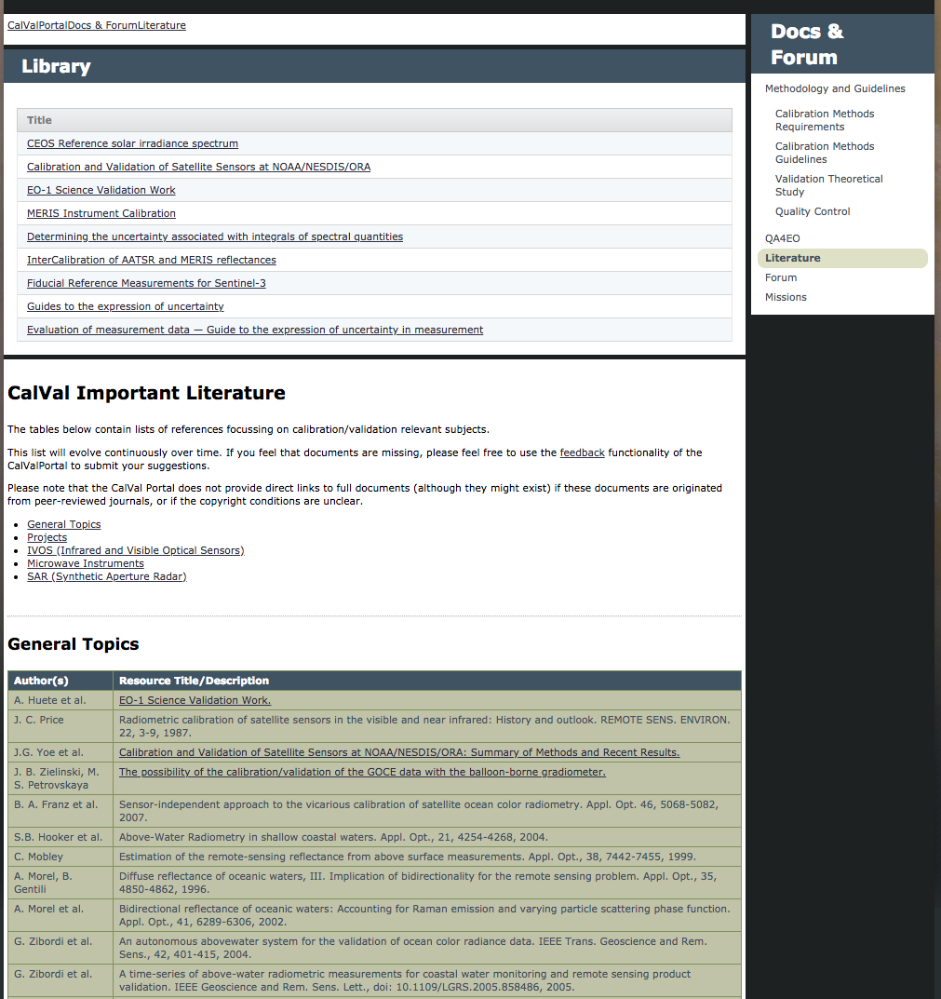
CEOS CalVal Portal – Current Status
Doc & Forum:
The contents need an update for
both “Methodology and Guidelines” and “Literature”
In this section we propose to include/update at least:
Terms and Definitions,
Standard in terminology and methodology
Relevant technical reports for Cal/Val activities.
Updated material concerning LPV Supersites
Cal/Val activities for Ocean Color
Sea Surface Temperature, from the SMOS Mission
“Mission”->Sensor page: it has to be updated

Slide 11
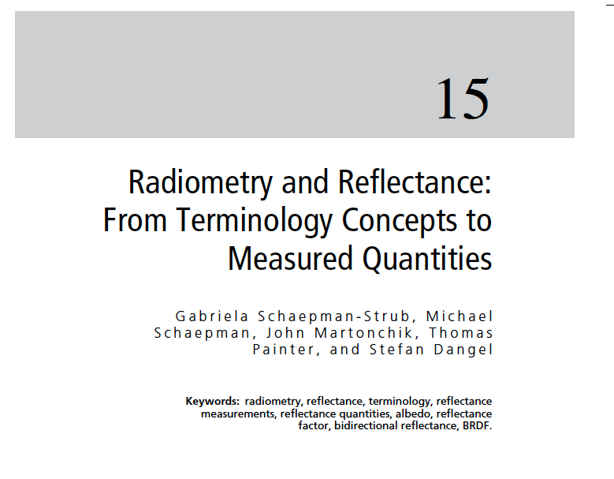
CEOS CalVal Portal: examples of key documents
Three doc.s have been indicated (email exchange J. Nickeson and N. Fox)
CEOSTermsAndDefinitions.pdf Term and definition Pascal Lecomte (ESA)
IASB-BIRA_Standard_Terms_and_Definitions_20170228.docx Terms and definitions
Schaepman_Sage_HB_RS09.pdf Radiometry and Reflectance: From Terminology Concepts to Measured Quantities Gabriela Schaepman – Strub et al. 2009, The SAGE Handbook of Remote Sensing
Regarding Super Sites:
EOLAB_18PPT04_LPVE_SuperSites_Camacho.pdf

Slide 12
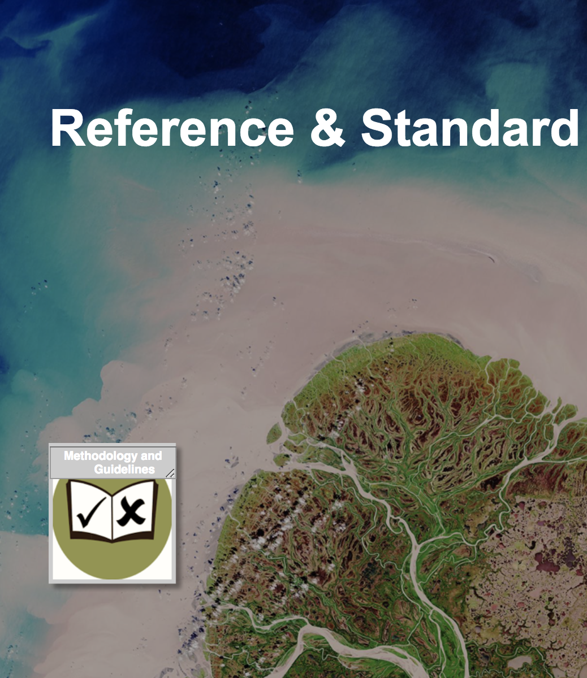
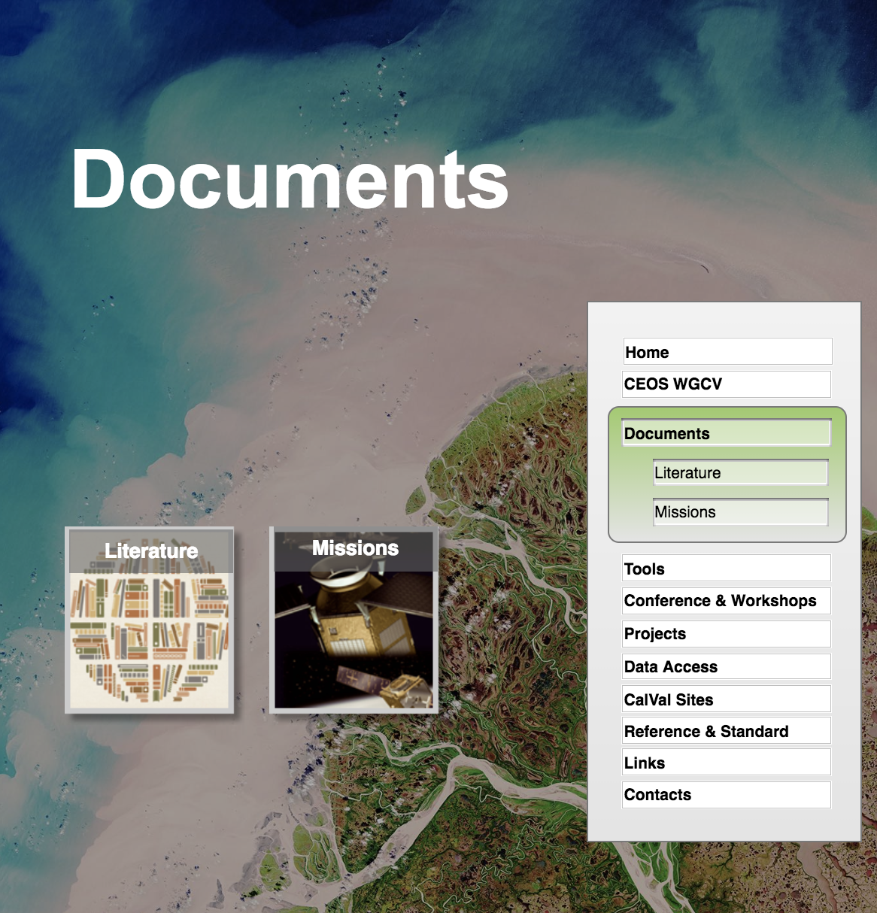
CEOS Cal/Val proposed re-shape
“Documents” and “Reference & Standard” two separated pages
Documents page will include relevant and updated literature as well as information over the current satellite Missions/Sensors
Reference & Standard represents the placeholder for all the materials, methodologies, guidelines and standard references for Cal/Val activities
Feedback very welcome !!!

Slide 13
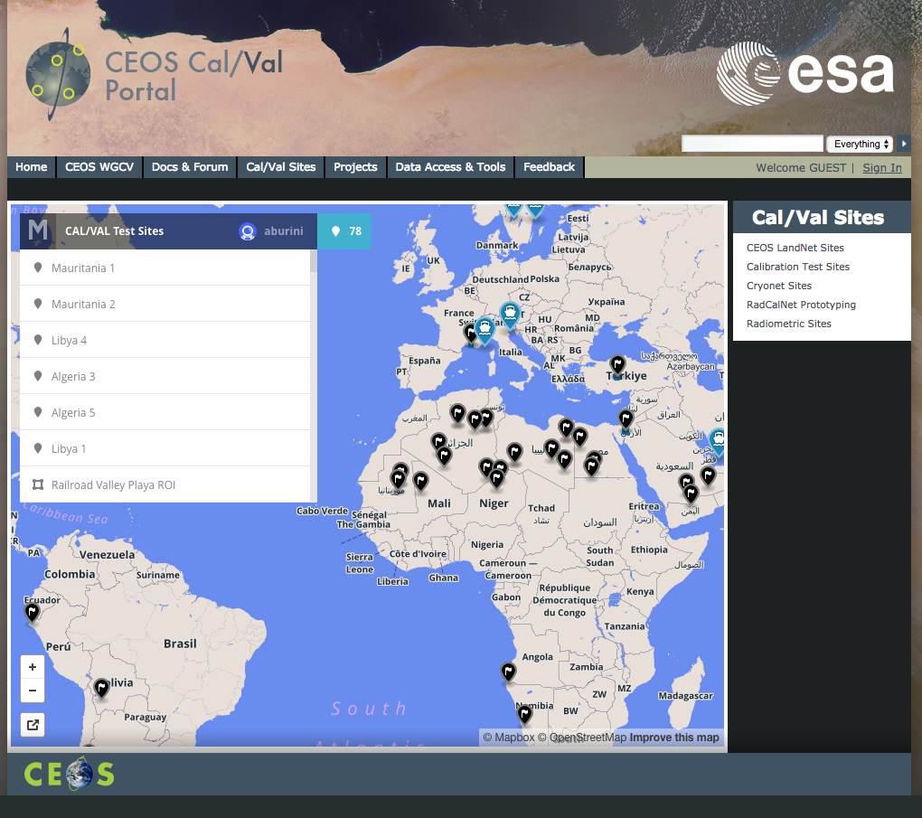
CEOS Cal/Val Portal
Current Status
“CalVal Sites”
“MapBox” tool with several Cal/Val Test Sites: description of the application and of the test sites themselves is missing and need to be provided as an introduction to the tool.
CEOS LandNet Sites: errors due to obsolete links need to be fixed.

Slide 14
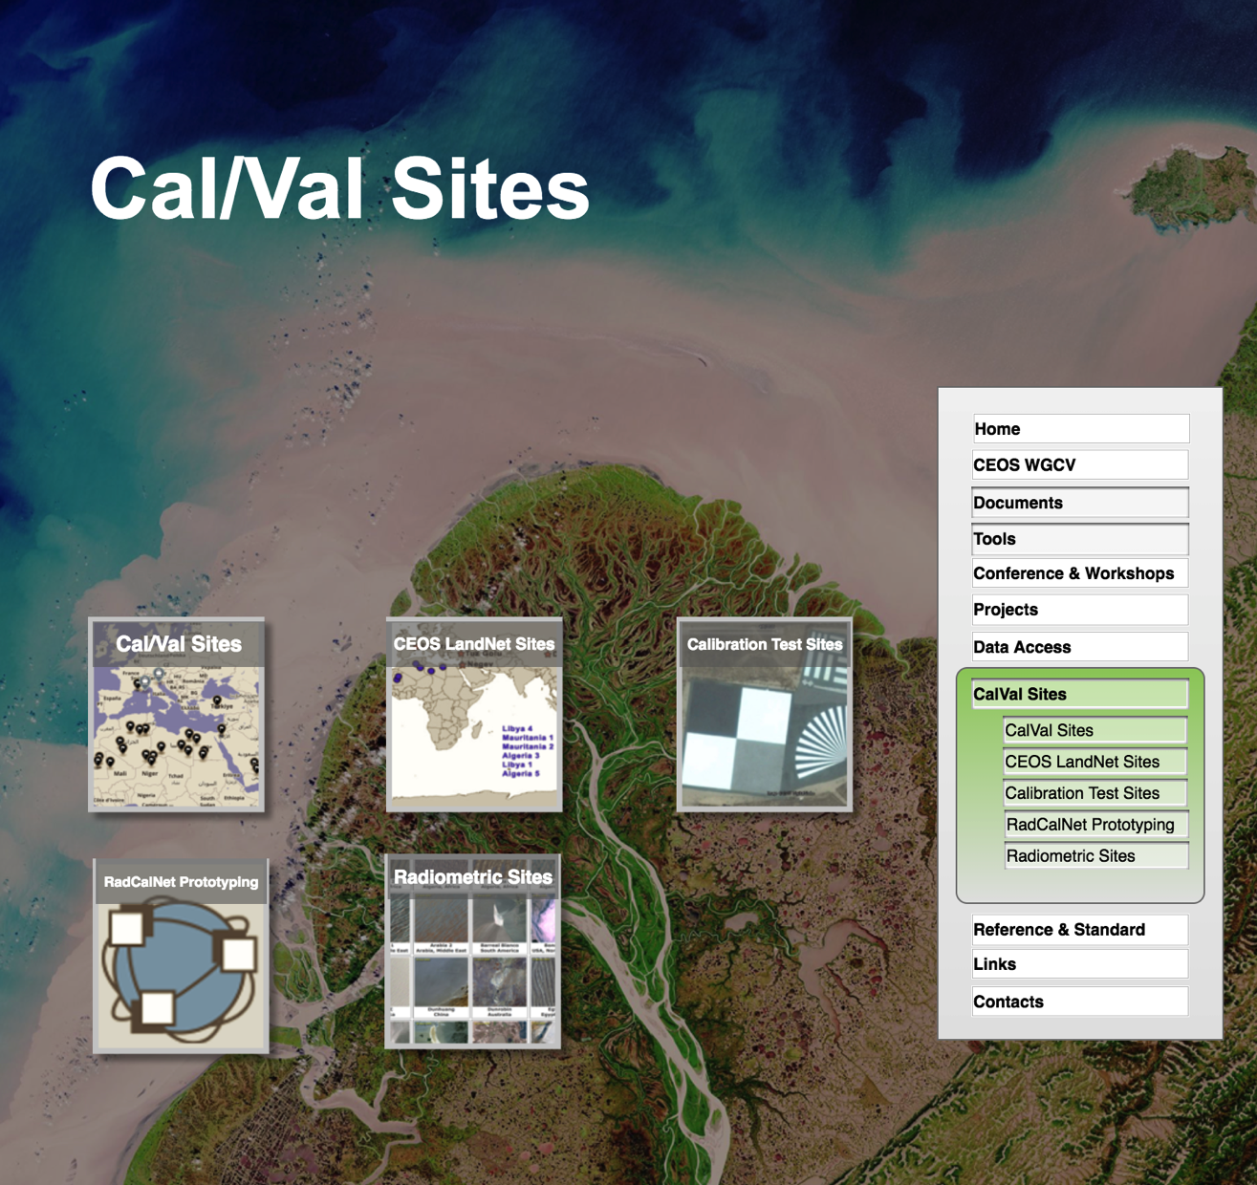
CEOS Cal/Val proposed re-shape
The Cal/Val sites page hosts references and tools to the significant networks of Calibration and Validation sites:
CalVal sites
CEOS landNet Sites
Calibration Test Sites
RadCalNet Prototyping
Radiometric Sites
New Action from WGCV-44!

Slide 15
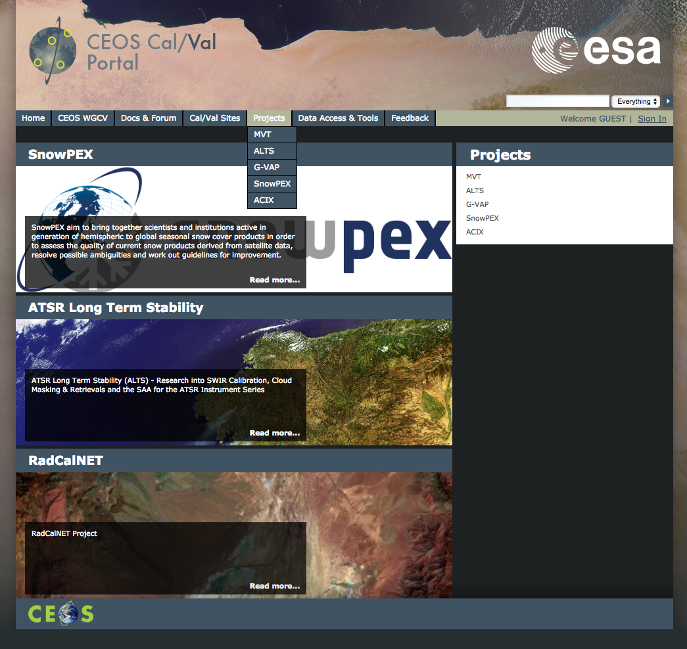
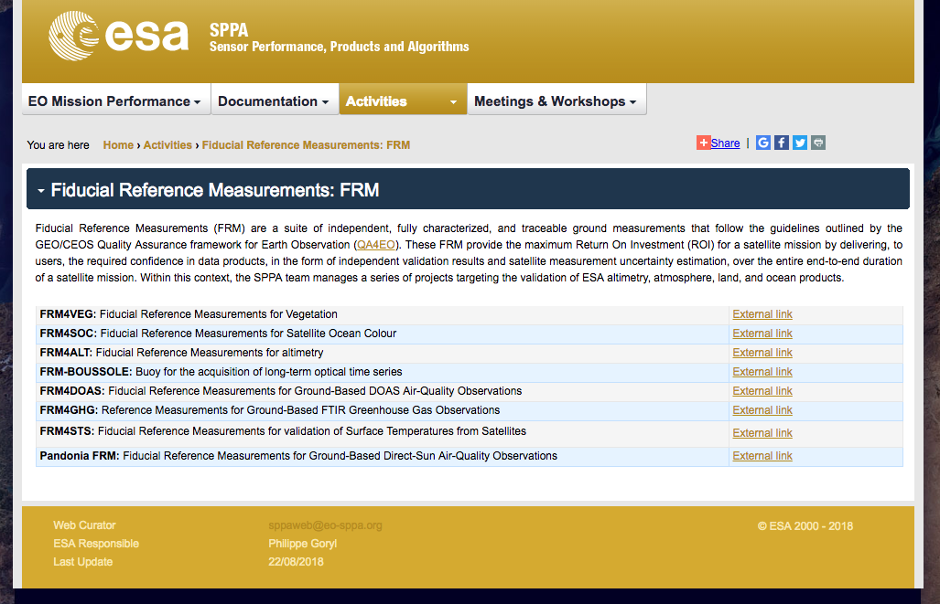
CEOS Cal/Val Portal –
Current Status
The “Projects” section need a frequent update, our plan is to include here all the Fiducial Reference Measurement (FRM) Projects:
https://earth.esa.int/web/sppa/activities/frm

Slide 16
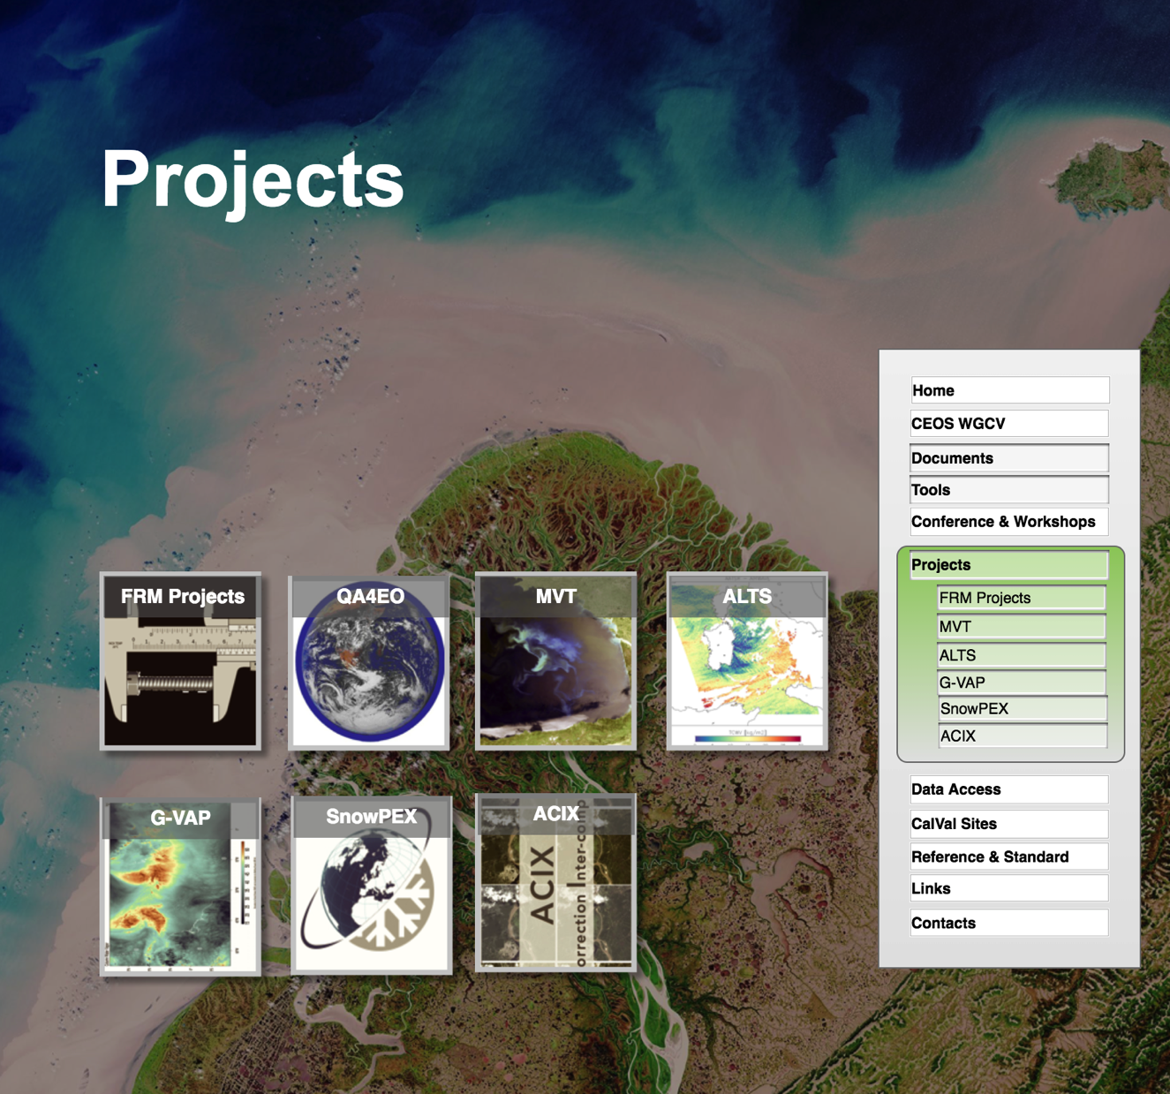
CEOS Cal/Val proposed re-shape
Projects includes relevant activities.
Fiducial Reference Measurement (FRM) projects will be included
QA4EO, MVT, ALTS, G-VAP, SnowPEX and ACIX are maintained
Update for MTF project
F. Viallefont

Slide 17
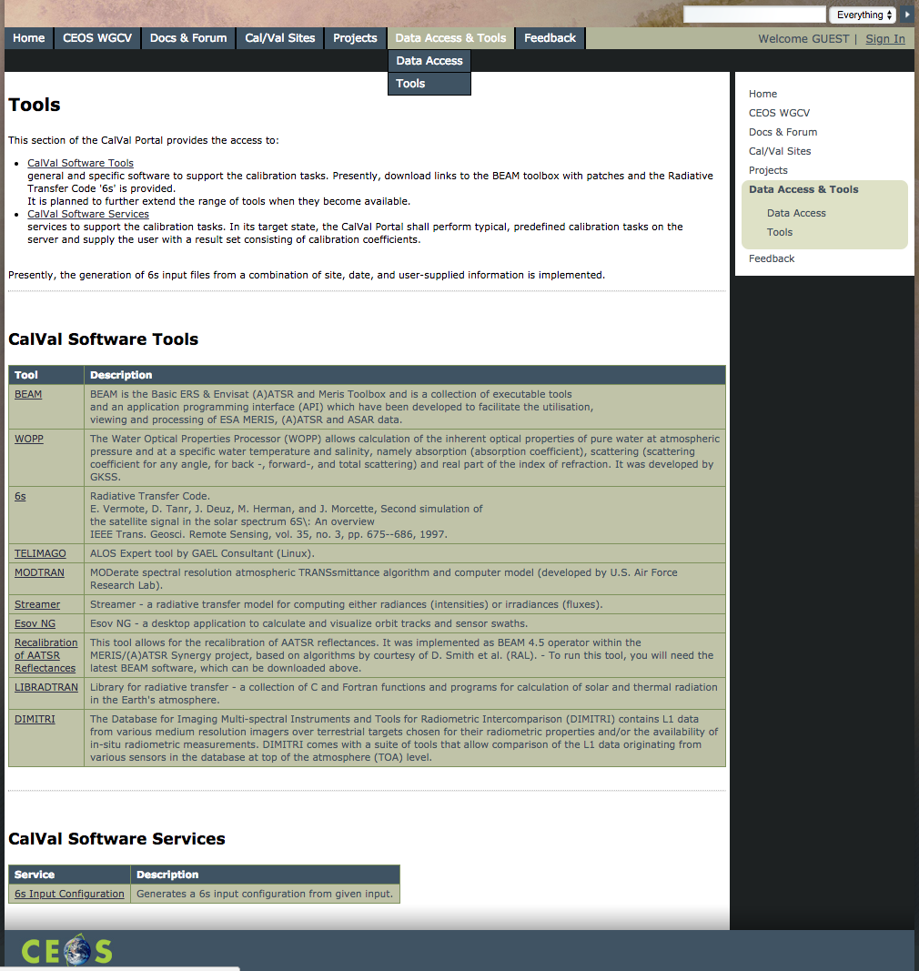
CEOS Cal/Val Portal –
Current Status
“Data Access & Tools”
Several links included in the “CalVal Software Tools” do not work and need an update.
The Products Query Cal/Val Portal offers a query tool for both Satellite Products and In Situ Data. An online description is needed. Update of dataset is needed.

Slide 18
CEOS Cal/Val Portal – Current Status
Clicking on “Tools” five submenu items are available as tools: DIMITRI, COVE, 6s input configuration, OLIVE and IMPETuS. Some links needs an update
Regarding the OLIVE Tool, it would not have to be maintained online. Instead, the OLIVE code will be transitioned into open source format (either in Python and provisioned fully through github or similar interface), so that validation groups running their portals can get access to one single tool, endorsed by WGCV. The code, binaries files, and documentation, will be hosted at the CEOS Cal/Val portal; as well as links to institutions that have integrated the code into their own systems.
The OLIVE DIRECT 2.0 ground database has been recently made available on the portal

Slide 19
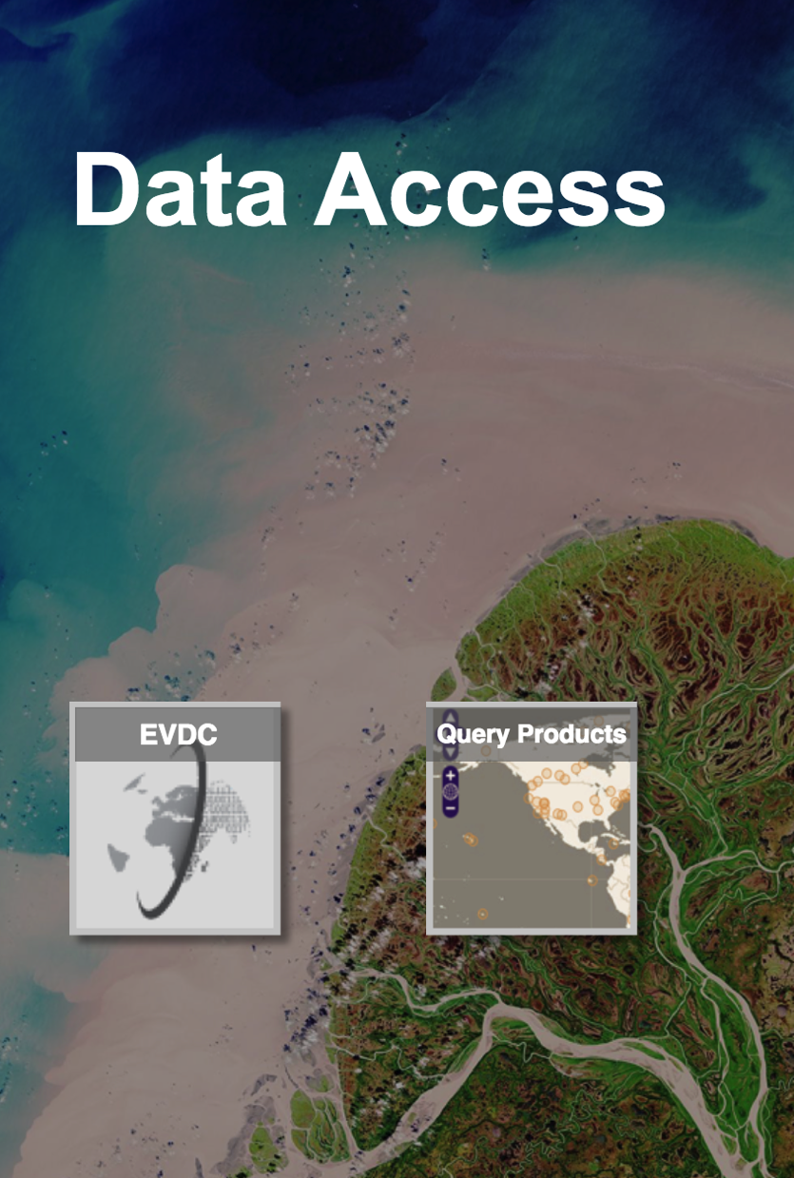
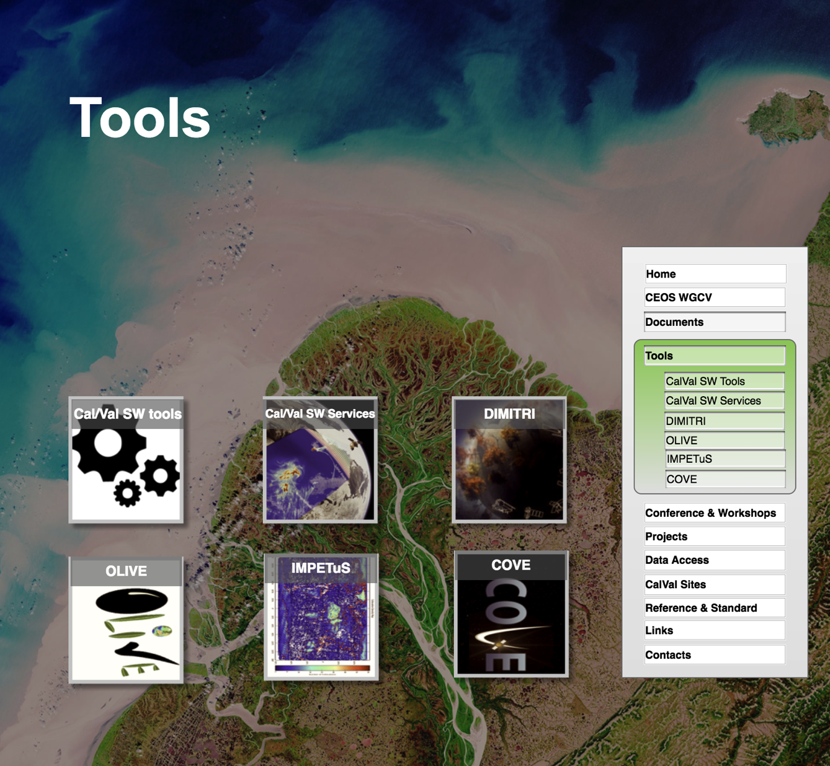
CEOS Cal/Val proposed re-shape
“Data Access” and “Tools” will be two separated pages
Data Access will be dedicated to all the significant CalVal data providers. The plan is to include the Products Query CalVal Portal and the EVDC (ESA Atmospheric Validation Data Centre)
The page “Tools” will host relevant tools: e.g. DIMITRI, OLIVE, IMPETuS and COVE with the possibility to include new ones.

Slide 20
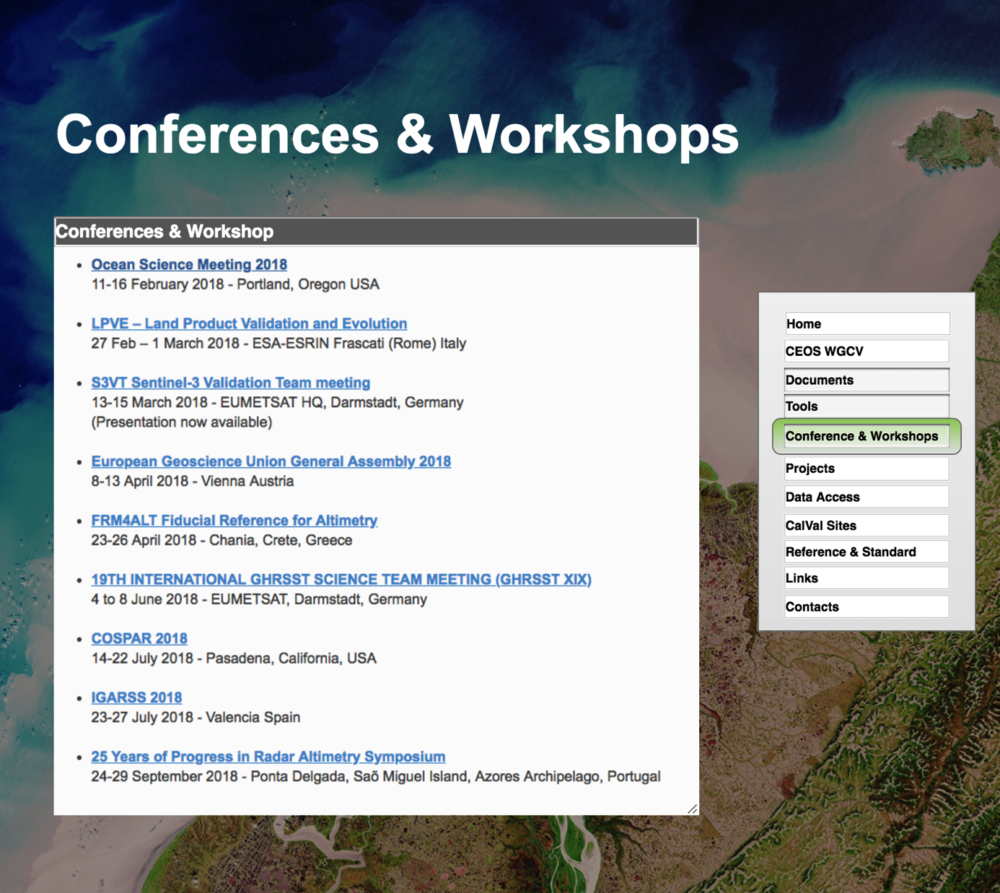
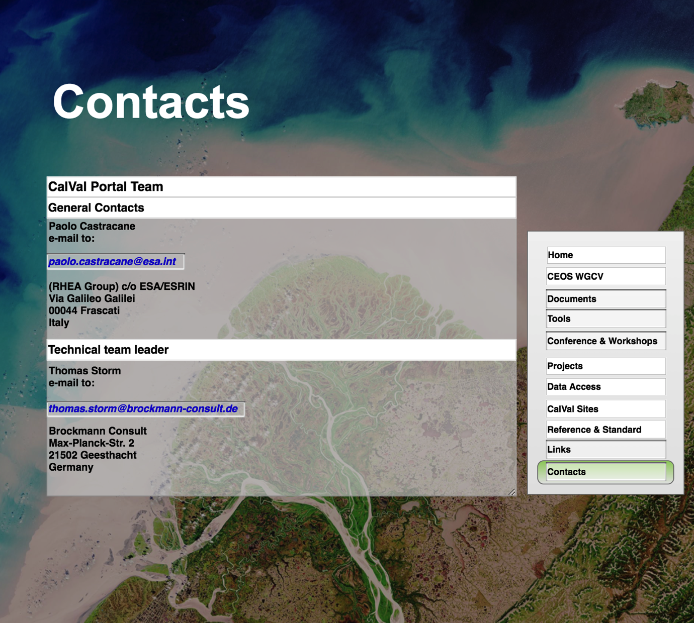
CEOS Cal/Val proposed re-shape
Conferences & Workshops will provide a time ordered list for the relevant events with links to the official websites for conferences and workshops.
The Links page will offers a substantial list of relevant links subdivided by topics.
Contacts will include information on the web administrators for general and technical issues.

Slide 21
Conclusion
For CEOS CalVal Portal two years Contract for Maintenance and Evolution has been signed on April 2018
A detailed review on the Current CEOS CalVal portal has been performed exploring all the items contained in the web portal, this has driven to the definition of a number of Actions
A preliminary Mock-up has been presented to define new site organization and graphic appearance.
Feedback from the CEOS community is welcome

Slide 22
Action in progress
ID | Title | Description | Proposal | Priority
General_1 | Mock-up proposal | A Mock-up for the new CalVal Portal has been prepared. https://t6hpn0.axshare.com Psw: CVP2018 | To share it internally and with the CEOS community to get feedback | High
HomePage_4 | News & Event | More frequent update is needed | PC to iterate with Cal/Val and CEOS teams | Medium
HomeMenu_1 | Obsolete Links | A number of links are resulting obsolete, alternative links are proposed or, alternatively, they will be deleted (see sec. 4.2). | A list of alternative links has to be proposed as well as the list of deletions. A new page “Links” has been added see Mock-up | High
CEOS_WGCV_2 | SAR subgroup page | The SAR subgroup page, which was an external link, will be replaced with an internal webpage (see detail in sec. 6.2) | Full backup requested, Once received it could be passed to TS for integration | High
CEOS_WGCV_3 | Newsletter | Newsletter link: In the CEOS WGCV section a new item called “Newsletter” shall provide a link to CEOS newsletter subscription URL | PC to iterate with CEOS team to get information | Medium
CEOS_WGCV_4 | CEOS Repository | A CEOS Repository: In the CEOS WGCV section a new item “CEOS Repository” shall be included; it allows the access to a new dedicated repository for the CEOS periodic teleconference documentation | TS with PC to implement the repository and define the access mode | Medium
Doc&Forum_2 | Methodology and Guidelines | This section include reports and papers old and probably obsolete | Check the documents and propose a list of updates. In the Mock-up is a box in the Reference & Standard page. | High
Doc&Forum_3 | Literature | This section include reports and papers old and probably obsolete | Check the documents and propose a list of updates. In the Mock-up Literature is a box in the Documents page | High

Slide 23
Action in progress
ID | Title | Description | Proposal | Priority
Doc&Forum_4 | New reference to be included | Three doc.s have been indicated by J. Nicheson CEOSTermsAndDefinitions.pdf Term and definition Pascal Lecomte (ESA) IASB-BIRA_Standard_Terms_and_Definitions_20170228.docx Terms and definitions Schaepman_Sage_HB_RS09.pdf Radiometry and Reflectance: From Terminology Concepts to Measured Quantities Gabriela Schaepman – Strub et al. 2009, The SAGE Handbook of Remote Sensing | Check with Nigel Fox if the three docs can be included | High
Doc&Forum_5 | Additional doc.s to be included | The latest standard in terminology and methodology and the most relevant technical reports concerning CalVal activities have to be included | Propose an updated list of relevant documents | Medium
Doc&Forum_6 | Update or Delete the Missions item | The “Sensor” page is not updates. It has to be updated or deleted | Update or Delete the Mission item. In the Mock-up it is in the Documents page | Medium
Doc&Forum_7 | FORUM item | According to Doc&Forum_1 a new FORUM Item should be included in the Home page | Include FORUM item in the home page (see Mock-up) | Medium
Doc&Forum_8 | Ocean Colour and SST | Ocean Colour and Sea Surface Temparature latest material have to be included in the literature | PC to iterate with CalVal team | High
Doc&Forum_8 | CalVal activity for SMOS | Links relate to the SMOS CalVal activities, e.g. International Soil Mositure Network https://ismn.geo.tuwien.ac.at/ have to be included in the literature section | PC to iterate with the SMOS team | High

Slide 24
Action in progress
ID | Title | Description | Proposal | Priority
Doc&Forum_9 | LPV Supersite | Material related to the SuperSite for validation of land products have to be included, see e.g: https://www.researchgate.net/profile/Fernando_Camacho_de_Coca/publication/323615893_PROPOSITION_OF_CEOS_LPV_SUPER_SITES_FOR_VALIDATION_OF_BIO-GEOPHYSICAL_SATELLITE_PRODUCTS/links/5aa02eec0f7e9badd9a0cc3e/PROPOSITION-OF-CEOS-LPV-SUPER-SITES-FOR-VALIDATION-OF-BIO-GEOPHYSICAL-SATELLITE-PRODUCTS.pdf | PC to iterate with CEOS WGCV | Medium
CalValSites_2 | CEOS LandNet Errors 404 | CEOS LandNet Sites some errors appear at the bottom of the webpage, probably due to obsolete links need to be fixed (Google 404 – The requested URL was not found on this server. That’s all we know) | Check and fix | High
Projects_1 | FRM Projects | FRM project from the SPPA webpage have to be included | Get links from https://earth.esa.int/ web/sppa/activities/frm | High
DataAcc&Tool_1 | CalVal Software Tools LInks | Several links included in the “CalVal Software Tools” do not work and need an update, see details in sec. 10.1 | Update or remove obsolete links | Medium
DataAcc&Tool_2 | Products Query CalValPortal | The use of this query tool is not very clear. It is important to better describe it and know which kind of products and insitu measurements are available. It is important to understand if this tool is related to the EVDC by DCIO interface | PC and TS provide description of the tool and investigate if related to the EVDC | Medium
DataAcc&Tool_3 | Metric Data Links | The links: Desert, Rayleigh and Snow get Internal Errors. They need to be fixed. | Fix the internal errors | Medium
DataAcc&Tool_4 | OLIVE | PC to follow the evolution related to the OLIVE tool and keep TS updated |  | Medium

