Slide 1

WGISS-WGCV Joint Activity
Standardisation and Best Practices
Committee on Earth Observation Satellites
Cindy Ong (CSIRO), Richard Moreno (WGISS)
WGCV#44
EUMETSAT, Darmstadt, Germany
28-31 August 2018

Slide 2
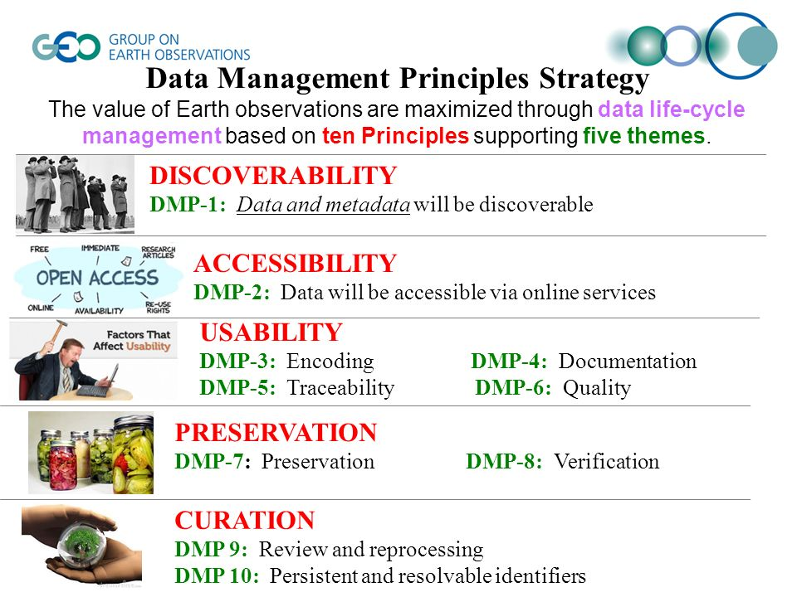
Standardisation and Best Practices
Objective: Contribution on CEOS Best Practice/White Paper
Support evolution of Data Management principles (Quality principles) (WGISS-41)

Slide 3
Standardisation and Best Practices
Objective: Contribution on CEOS Best Practice/White Paper
Support WGISS to provide guidelines for the metadata for ARD to ensure the information needed to describe a measurement is available. (WGISS-41)
Develop Best Practices on Data Reprocessing – including current and future practices (i.e. on-demand ARD Processing) (WGISS-41)

Slide 4
Standardisation and Best Practices - Discussion
Objective: Contribution on CEOS Best Practice/White Paper
Support and collaboration on ISO 19159-3 “Geographic information -- Calibration and validation of remote sensing imagery sensors and data – Part 3: SAR and InSAR.” (WGISS-43)
ISO 19159-3: Geographic information -- Calibration and validation of remote sensing imagery sensors -- Part: 3: SAR/InSAR passed DIS vote in April 2017. It will automatically become ISO Technical Specification in this year.

Slide 5
Standardisation and Best Practices - Discussion
Support evolution of CEOS Best Practices and relevant standards:
  Review of Data Management and Stewardship Maturity Matrix for the Quality area. The result will be provided as input for GEOSS-DMP Implementation Guidelines improvement (Quality principles: DMP-6).
  Support and collaboration on ISO 19159-3 “Geographic information -- Calibration and validation of remote sensing imagery sensors and data – Part 3: SAR and InSAR”.
Support WGISS to provide guidelines for:
  ARD metadata definition for identified areas of interest and/or key sensors.
  Data Reprocessing Best Practices development – including current and future practices (i.e. on-demand ARD Processing).
  Data Quality in Metadata white paper and recommendations definition.

Slide 6
Standardisation and Best Practices
Objective: Contribution on CEOS Best Practice/White Paper
  Discussion from 2016 is still valid today
  Work on actions from 2016 still remains
  Tasks:
Revisit and update WGISS-41/WGCV-40 actions: Define a point of contact within WGCV to work with WGISS to reinvigorate the actions of WGISS-41 in terms of more recent CEOS activities and move towards closure of these items to provide a good practice white paper for inclusion on the CEOS website

Slide 7
4) Standardisation and Best Practices
  Tasks:
Revisit and update WGISS-41/WGCV-40 actions: Define a point of contact within WGCV to work with WGISS to reinvigorate the actions of WGISS-41 in terms of more recent CEOS activities and move towards closure of these items to provide a good practice white paper for inclusion on the CEOS website
  Definition of points of contact
  Reviewing of Data Management and Stewardship Maturity Matrix
    Collection of the RIDs
    Issuing new version of the Data Management and Stewardship Maturity Matrix
  Provision of new input to GEO Data Management Principles Implementation Guidelines (DMP IG)
Telecon Outcomes
  WGISS point of contact: Iolanda. WGCV point of contact: Greg
Next Steps
WGCV (Greg) to provide comments on Maturity Matrix to WGISS (Iolanda) by end of July.
Iolanda and Greg to review actions from 2016 and reformulate as needed by end of July.

Slide 8
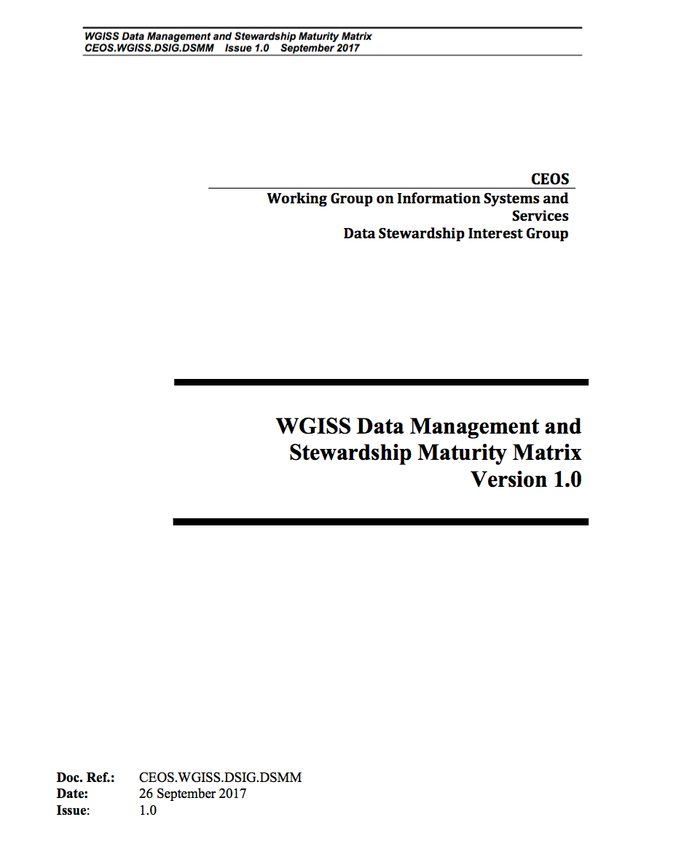
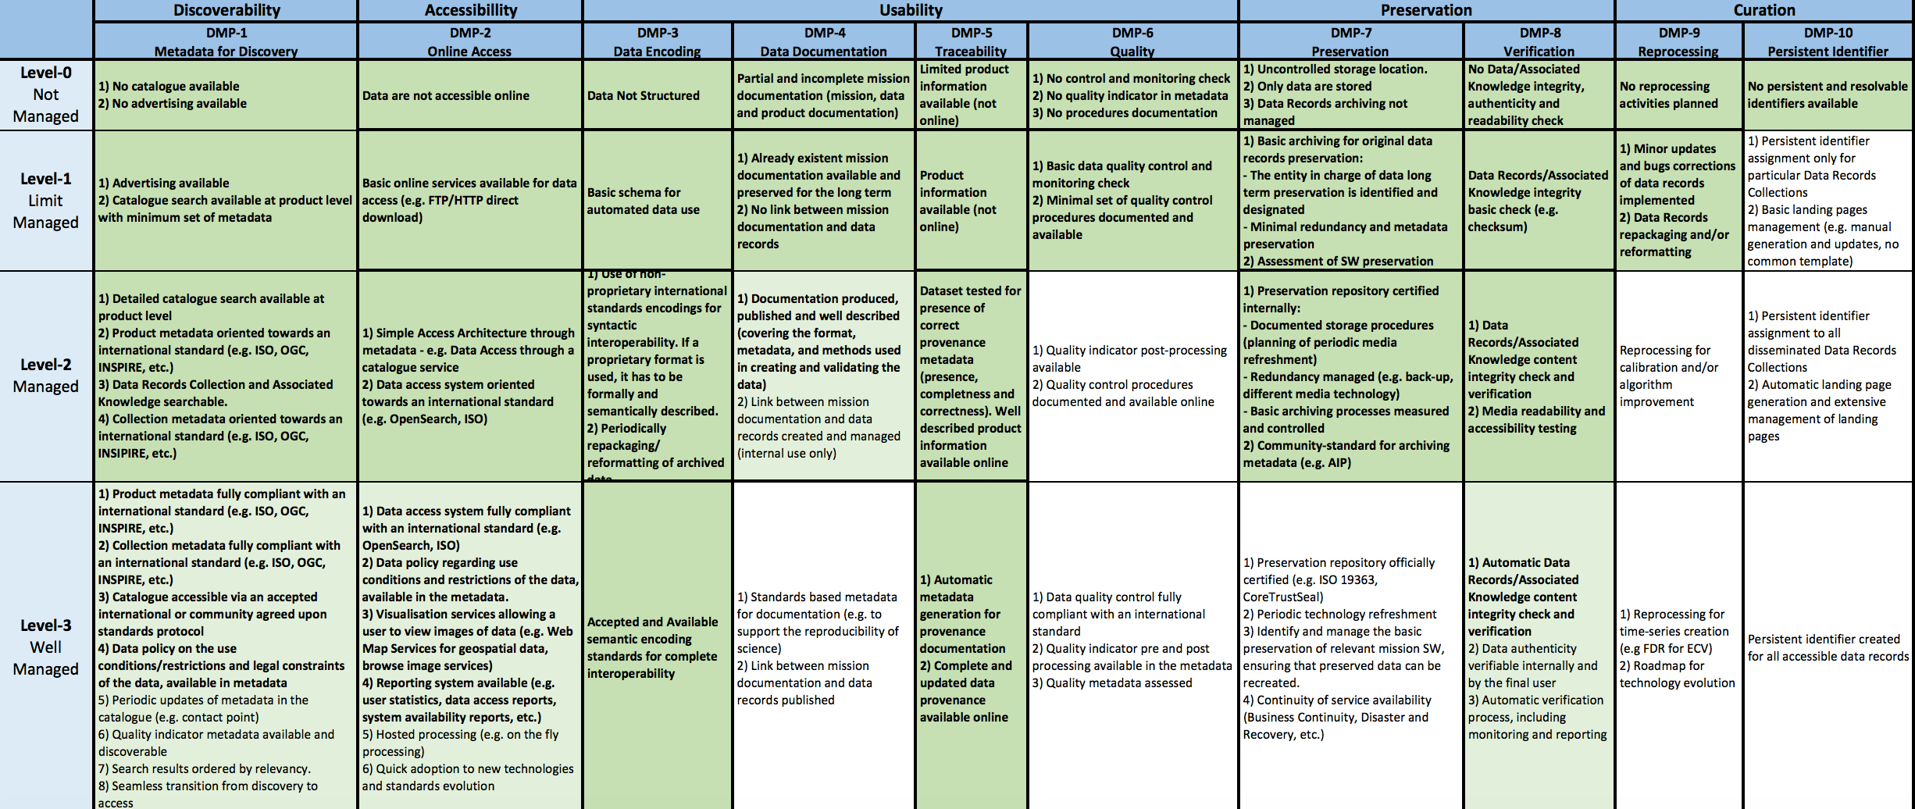
Standardisation and Best Practices
WGISS Data Management and Stewardship Maturity Matrix

Slide 9


