Slide 1
Interoperability in the framework of FDA
Medhavy Thankappan

Slide 2
WGCV-WGISS interactions
Attended WGCV-WGISS teleconference, next is on 6 Sep
Two subsequent meetings with WGISS Rep (Rob Woodcock)
WGISS to investigate how field sites data (e.g. for Surface Reflectance) can be made available through Data Cube technology by end 2018
Workflow for this is in DEA - starts with field data, convolution to match satellite sensor surface reflectance, then comparison report mechanism – this is in dev for LS8 and Sentinel-2
MVP should support alternate algorithms for ARD production and the common ones such as USGS, GA, ESA S-2 could be baked in (interaction with Greg Stensas)
Next steps:
Review USGS land product characterisation website for further use-case insight
Develop base architecture diagram to define MVP
Work with the WGISS Connected Data Assets team for an ARD data cube on demand

Slide 3
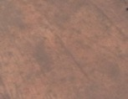
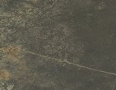
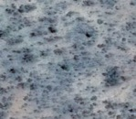
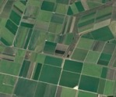
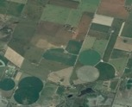
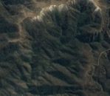
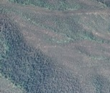
Tools for ARD intercomparison

