Slide 1
CSIRO Agency Report
CSIRO
Ong, C., Lau, I.C., Fearns, P., Malthus, T., Caccetta, M.
CEOS WGCV #44, 28-31 August 2018
EUMETSAT, Darmstadt, Germany

Slide 2
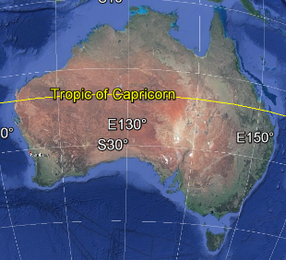
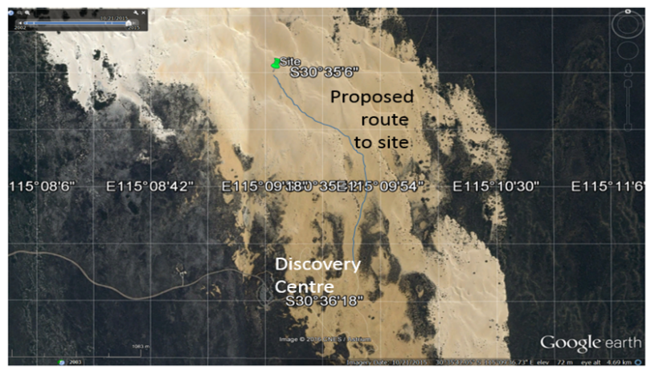
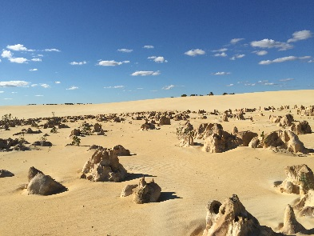
Optical Vicarious Calibration Site at Pinnacles Desert
Traditional owners & heritage consultation completed. Heritage & archeological survey to be conducted Sept/Oct

Slide 3
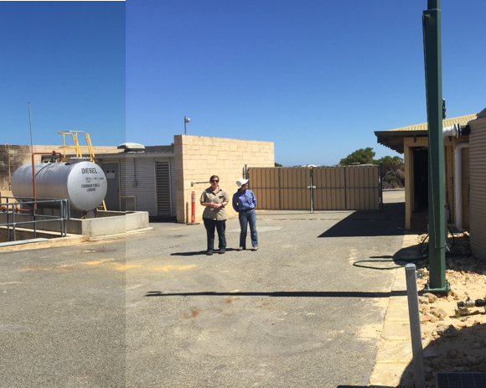
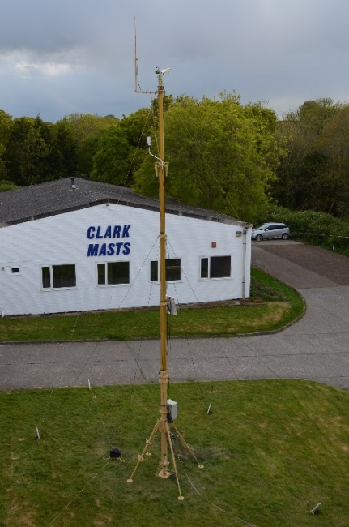
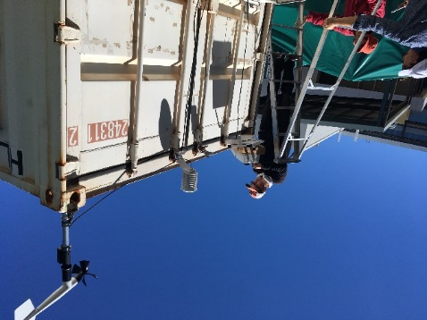
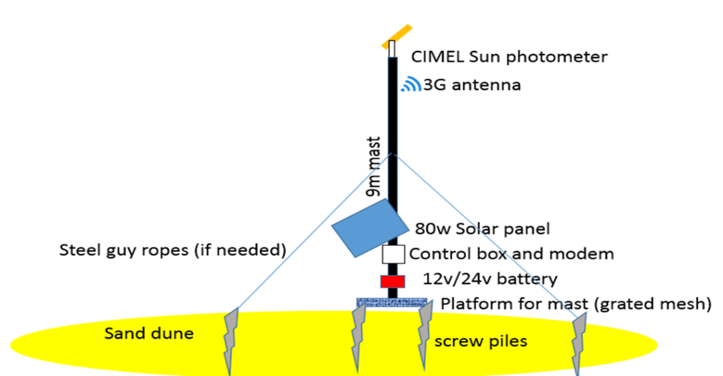
Pinnacles Site Instrumentation
To be augmented in the future to DFOV VNIR-SWIR spectrometer and/or multiple radiometers

Slide 4
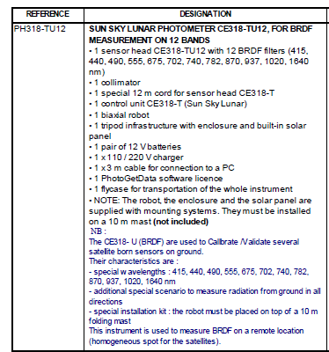
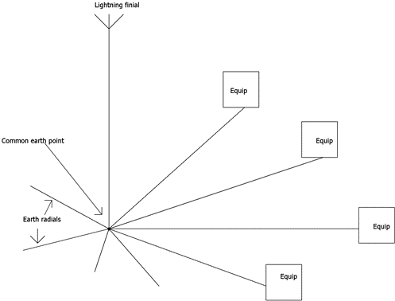
Pinnacles Site Instrumentation
To be augmented in the future to DFOV VNIR-SWIR spectrometer and/or multiple radiometers
Concept sketch of mast, foundations and instrumentation installed on the sand dune
Concept sketch of lightning protection

Slide 5
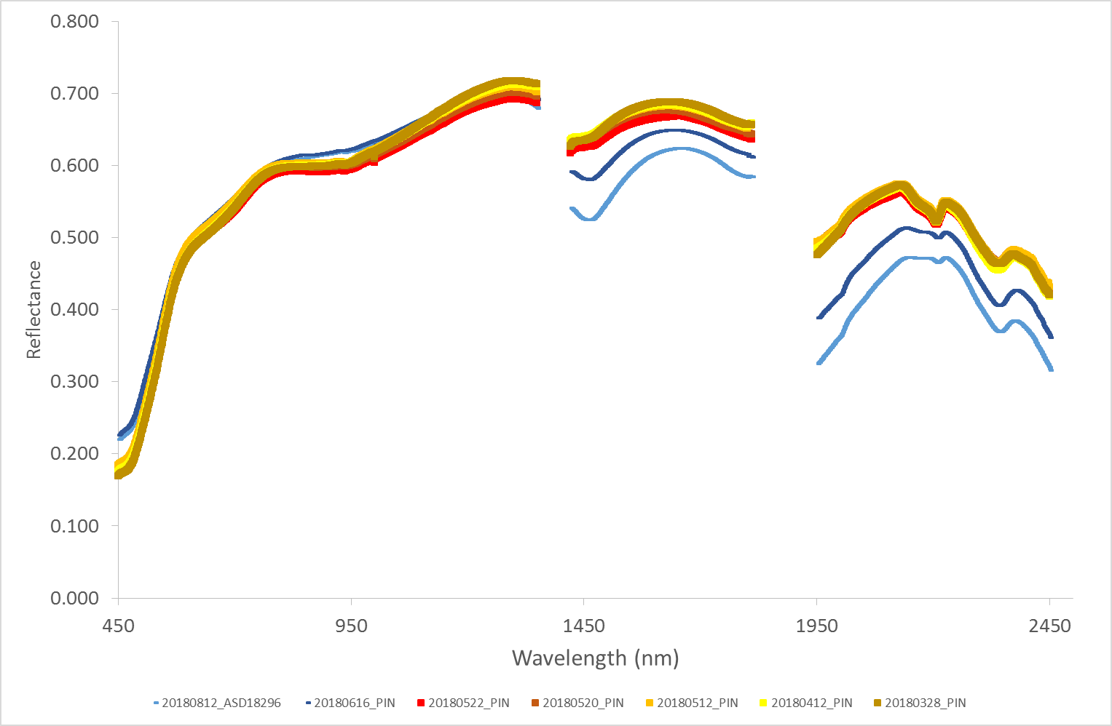
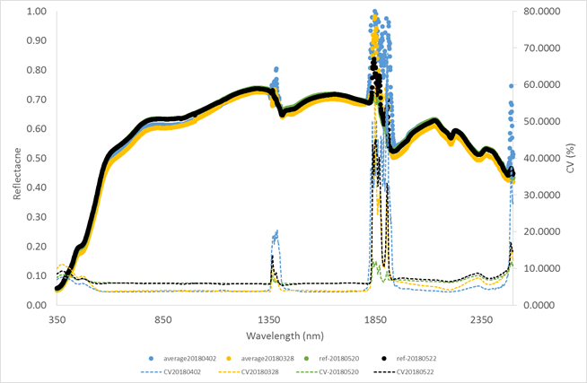
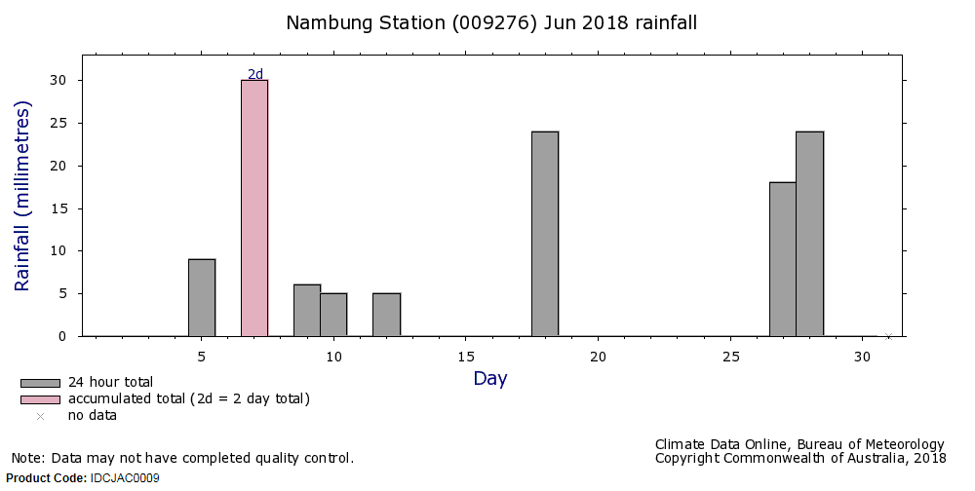
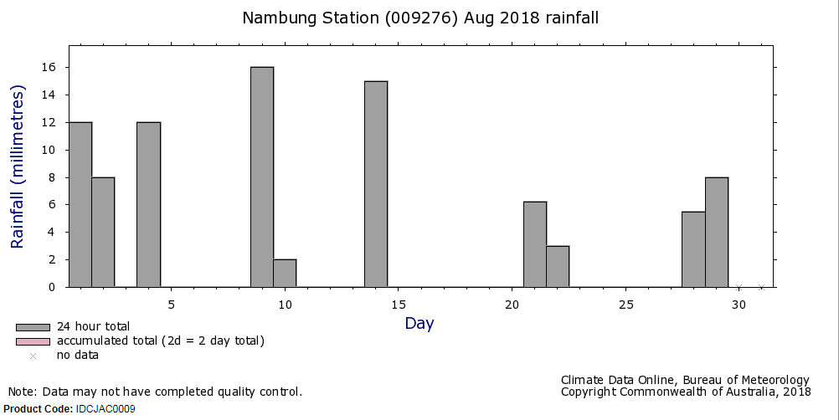
Site Characterisation - Temporal Variability Across 2018 Winter

Slide 6
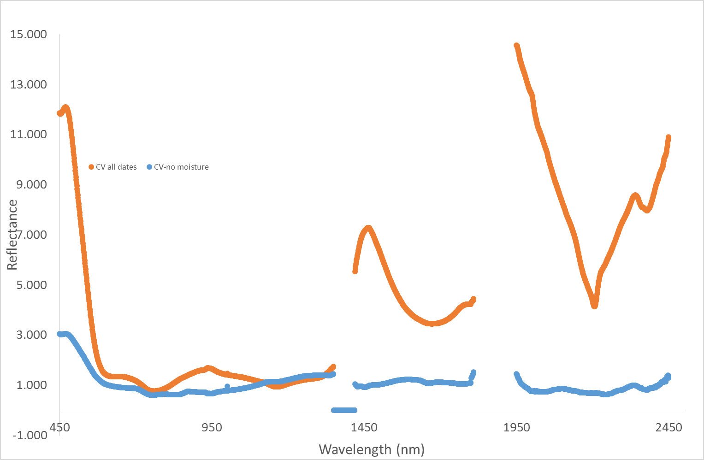
Site Characterisation - Temporal Variability Across 2018 Winter
Coefficient Of Variation Across 2018 Winter
Coefficient Of Variation VNIR-SWIR 10 Years Landsat TM

Slide 7
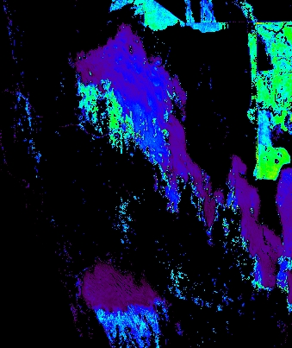
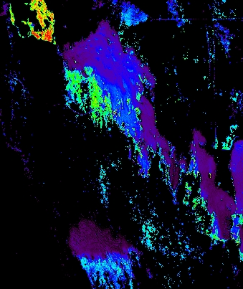
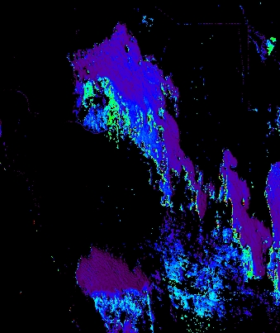
Site Characterisation - Temporal Compositional Variation (FeOx)
X
ASTER
2km
25Nov2000
27Oct2001
12Oct2007
Hyperion
17Oct2016
16Nov2016
8Dec2016

Slide 8
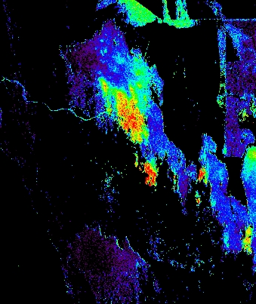
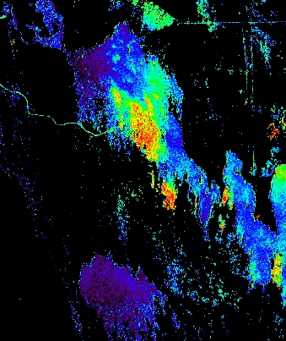
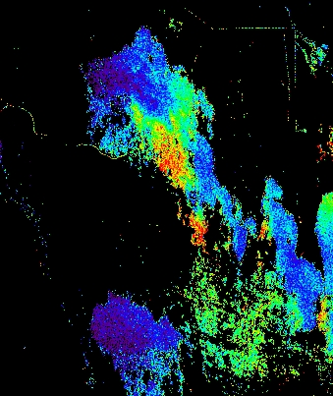
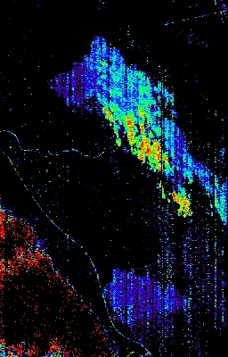
Site Characterisation - Temporal Compositional Variation (AlOH)
X
ASTER
2km
25Nov2000
27Oct2001
12Oct2007
Hyperion
17Oct2016
16Nov2016
8Dec2016

Slide 9
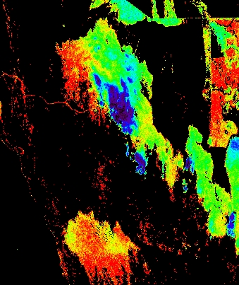
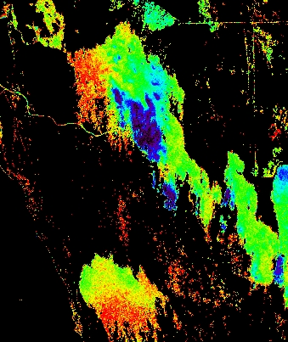
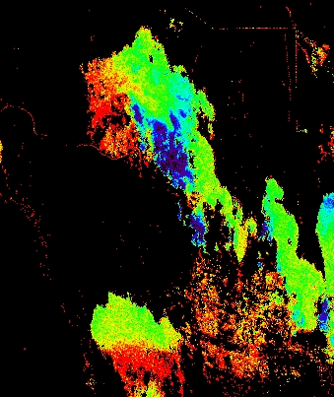
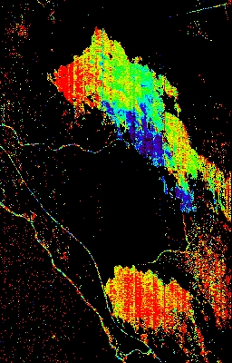
Site Characterisation - Temporal Compositional Variation (MgOH)
X
ASTER
2km
25Nov2000
27Oct2001
12Oct2007
Hyperion
17Oct2016
16Nov2016
8Dec2016

Slide 10
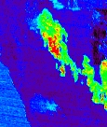
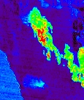
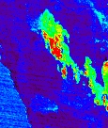
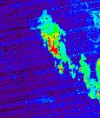
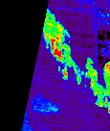
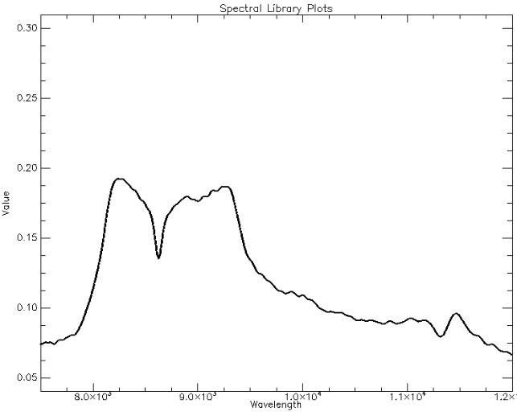
Site Characterisation - Temporal Compositional Variation (Silica)
X
ASTER
2km
25Nov2000
27Oct2001
12Oct2007
ASTER
01Dec2016
16Dec2016

Slide 11
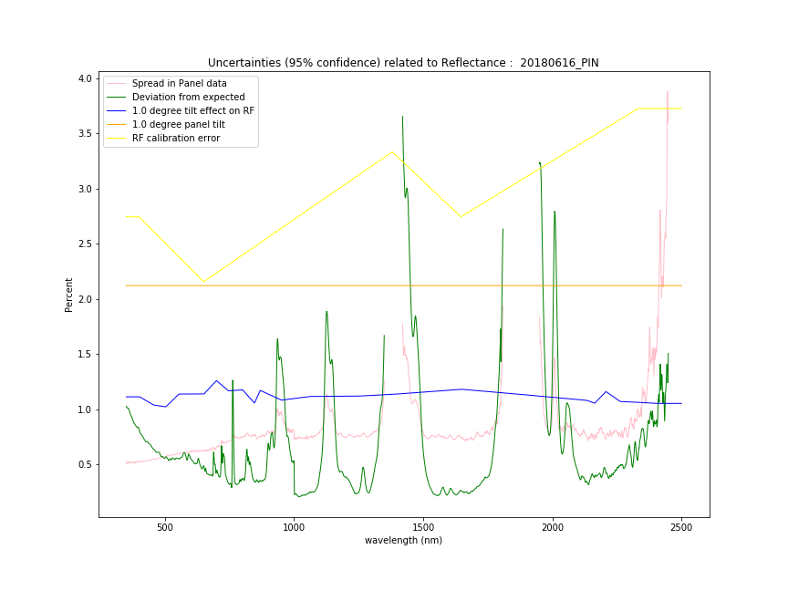
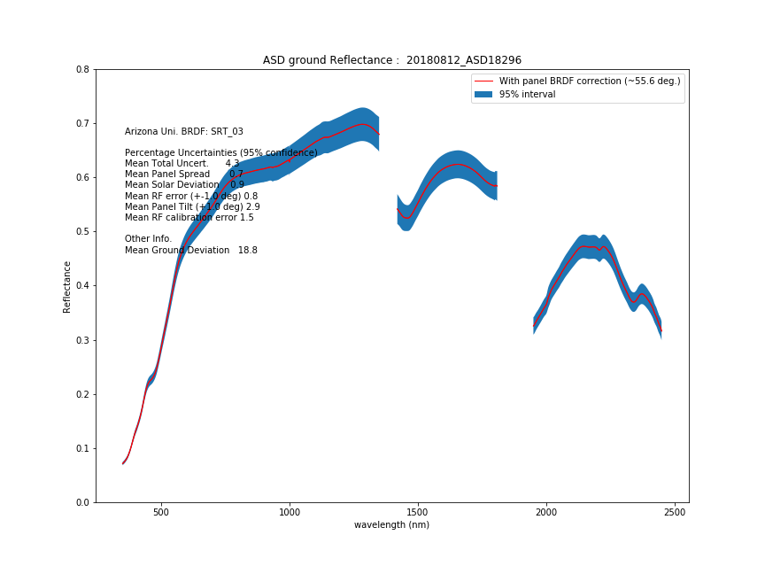
A Start On Uncertainties Budget

Slide 12
Pinnacles Site Schedule
June – CIMEL received at Clark Mast
End Sept/Oct – heritage and archaeological survey
22-23 Oct – mast training
Mid Dec – mast & CIMEL arrival in Australia
Jan – Feb ? (depends on results of heritage survey) – construction of platform for mast

Slide 13
Thank You
CSIRO Energy
Cindy Ong Principal Research Scientist
t +61 8 6436 8677
e cindy.ong@csiro.au
w www.csiro.au
CSIRO Energy

