Slide 1
Day 2 Summary
K. Thome
NASA
WGCV Plenary # 44
EUMETSAT, Darmstadt, Germany
August 28-31, 2018

Slide 2
Key points from Day 2
Overview of EUMETSAT cal/val activities are impressive, comprehensive and quantitative
GSICS/WGCV links are strong at the subgroup levels
Reference solar spectrum activities
Lunar calibration efforts
TIR standards
Microwave collaborations are being formalized
MTF activities on WGCV side need to find a home within GSICS
L1 interoperability efforts
Is a large topic area to address fully
There are long term benefits to the CEOS community from WGCV examining this fully
There are also short term needs of CEOS that WGCV needs to recognize pointing to providing results sooner than later

Slide 3
Key points from Day 2
Virtual constellations
Impressive array of people at EUMETSAT in leadership roles within VCs that took the time to meet with WGCV
Identified several tasks happening with the VCs and WGCV subgroups that have natural connections between the organizations
Agreed that forced collaborations are not as productive as ones occurring using existing efforts on one or both sides
Repeating the exercise of VC presentations would be useful and future interactions can become more focused on details on how each of the groups is benefiting or has benefited directly from the support of the other
NEED a rep POC to LSI VC
Header

Slide 4
Key points from Day 2
CARD4L and LSI-VC
One topic was overlooked in the discussion:
LSI-VC would appreciate WGCV identifying a point of contact within WGCV to identify a POC for CARD4L PFS Product Alignment Assessment process
Presentation of examples of ARD and CARD4L
Still remains concern, confusion, difficulties of what is specifically meant by the term “Analysis Ready Data”
Largest concern is the possible lack of quantitative assessment of and traceability to the at sensor radiance (often called Level 1)
CARD4L product assessment process makes sense at a high level view

Slide 5
Key points from Day 2
CARD4L and LSI-VC
CARD4L product assessment process makes sense at a high level view
Still some issues with the details of the process
Details on who is doing what and with what resources is lacking
It is possible to develop a “peer review” process of a CARD4L product assuming that the current LSI-VC CARD4L is the evaluation criteria
It is imperative that WGCV work with LSI-VC to iterate on the definitions and criteria within their product family specifications
A reasonable first draft of a review process was described and will be forwarded to LSI-VC for discussions

Slide 6
CARD4L evaluation process
WGCV-44-07
An initial draft of a CARD4L peer review process will be provided to LSI-VC that clarifies the term “peer review” and makes clear that the process is for evaluation and approval of CARD4L products and does not carry WGCV’s (or its subgroups’) endorsement of the product or their validation but rather that the products meet the CARD4L PFS
Thome
Sept. 5, 2018

Slide 7
CARD4L evaluation process
WGCV-44-08
A WGCV POC for the CARD4L PFS Product Alignment Assessment process will be identified and provided to LSI-VC
Thome
Sept. 12, 2018

Slide 8
CARD4L evaluation process
WGCV-44-09
WGCV shall provide LSI-VC and the CEOS CEO with a two-page description of WGCV’s willingness to assist in completing CARD4L Product Alignment Assessments, describe what the assistance would entail, how it interact with LSI in the PAA process, and identify any necessary POCs
Thome
Sept. 12, 2018

Slide 9
Revised Agenda items
Work Plan discussion will follow this Day 2 summary
NASA agency report will be at the end of the morning collection of reports
ROSCOSMOS and USGS talks will lead the agency talks in the afternoon
ACSG subgroup report at 15:15
Projected adjournment this evening is now 6 pm unless there are cancellations of an agency report

Slide 10
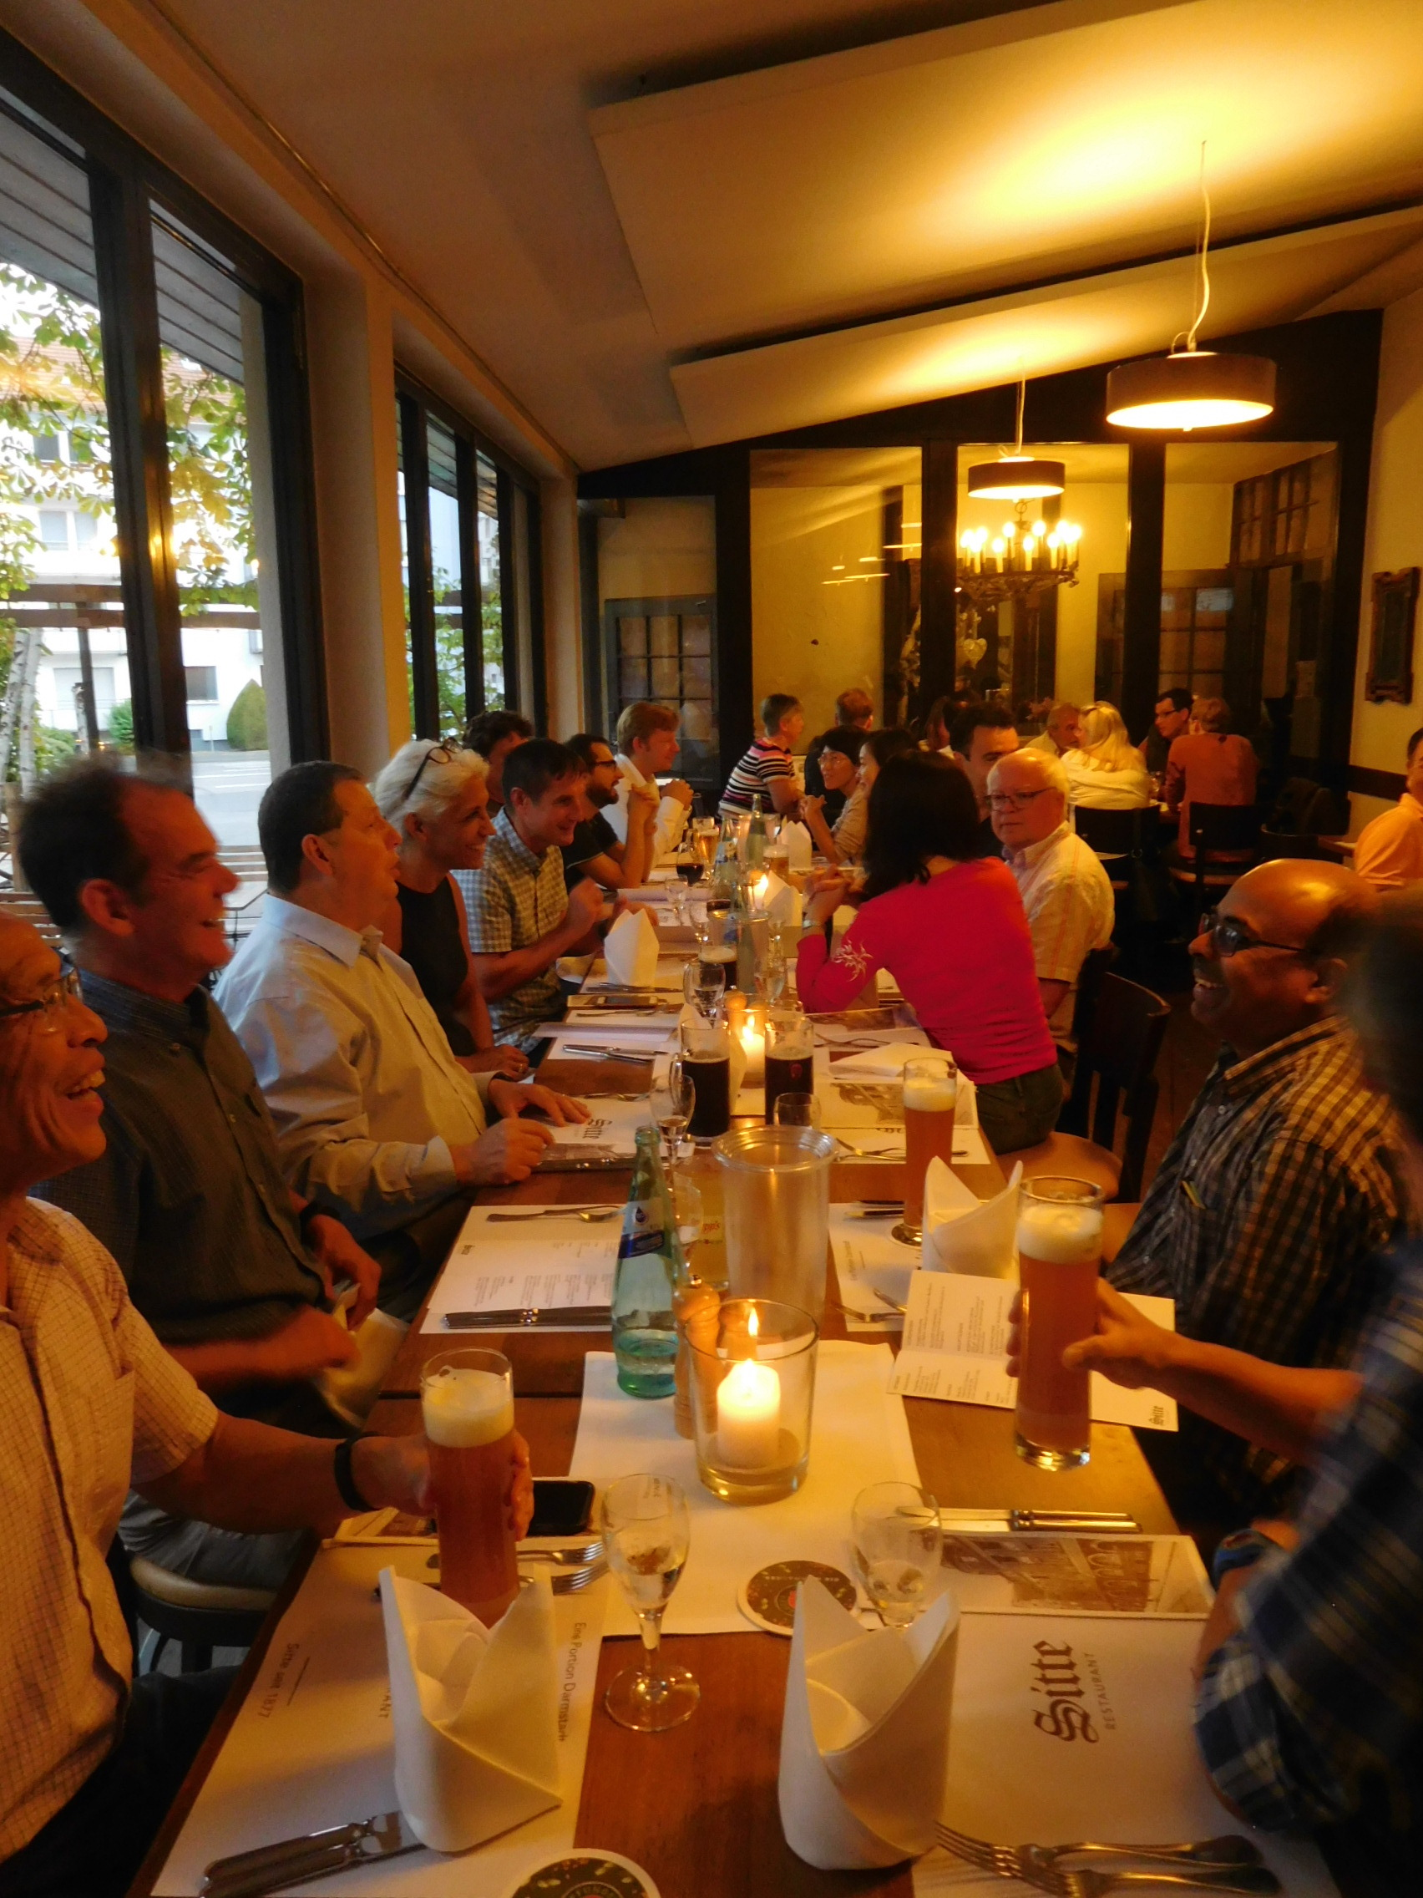
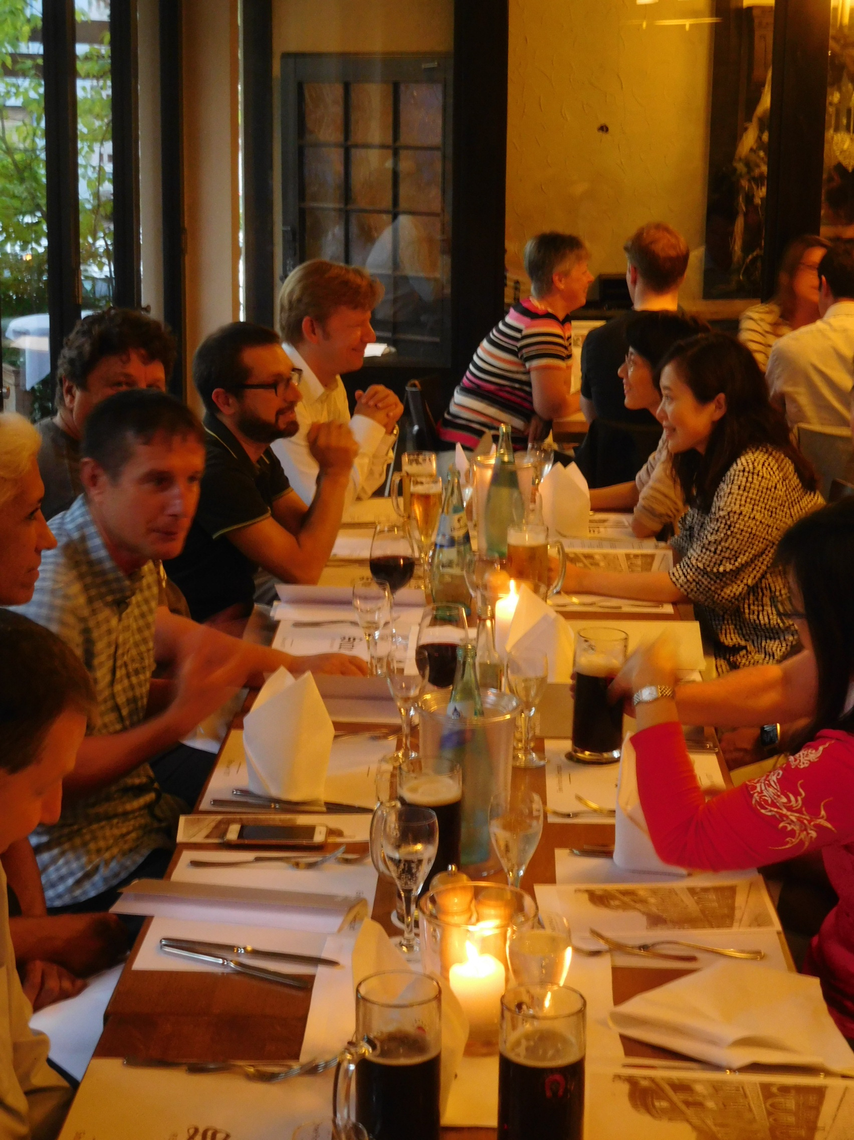
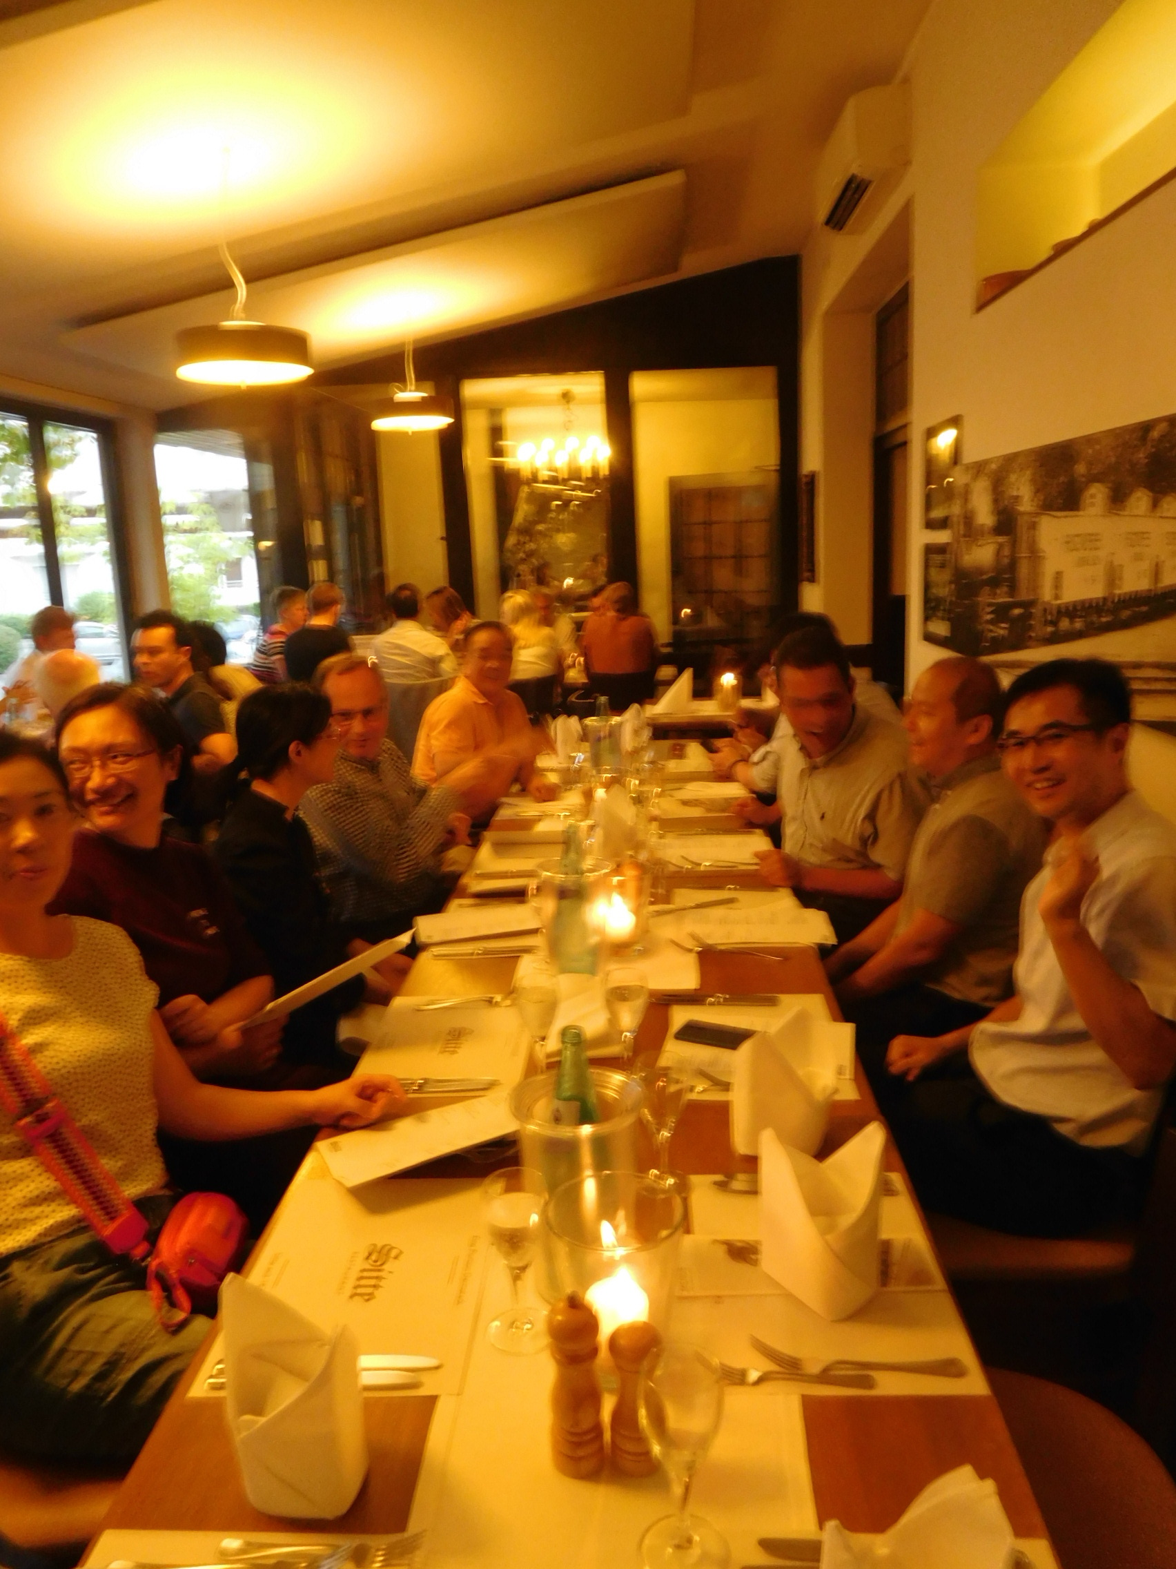
Many thanks to our hosts at EUMETSAT for arranging a spectacular German feast after a long day of WGCVing

