Slide 1
ESA Agency Report
CEOS WGCV 44
28-31 August 2018
EUMETSAT
Philippe Goryl

Slide 2

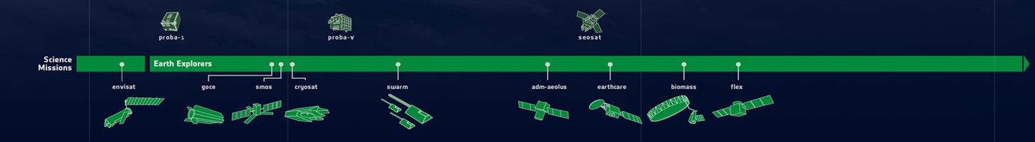
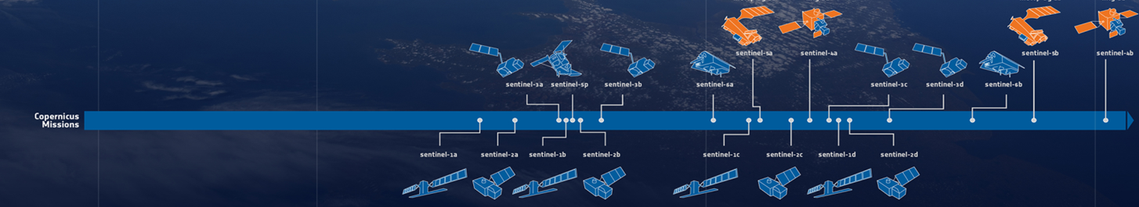
13 ESA satellites (11 missions) in Phase E → 2 new in 2017
Currently
4 ESA heritage missions
30+ third party and contributing missions
ers-1
ers-2
3
ESA Third Party Missions (landsat, spot, e-pop, gosat, alos, terrasar, etc.)
Copernicus Contributing Missions (pleiades, cosmo-skymed, terrasar, deimos, planet, etc.)

Slide 3
13 ESA missions to be launched before 2024
In development
future of third party & contributing missions
altius
ers-1
ers-2
3
ee-9
ESA Third Party Missions (landsat, spot, e-pop, gosat, alos, terrasar, etc.)
Copernicus Contributing Missions (pleiades, cosmo-skymed, terrasar, deimos, planet, etc.)

Slide 4

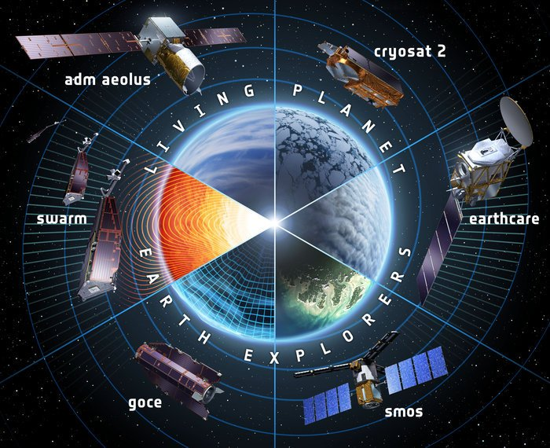
Earth Explorers
GOCE | 2009 – 2013
SMOS | 2009 – Present
Cryosat | 2010 – Present
SWARM | 2013 – Present
Aeolus |  | 2018
EarthCARE |  | 2020
Biomass |  | 2021
FLEX |  | 2022
Notes:
The Earth Explorers allow us to understand the Earth System and its diverse aspects in more and more detail.

Slide 5
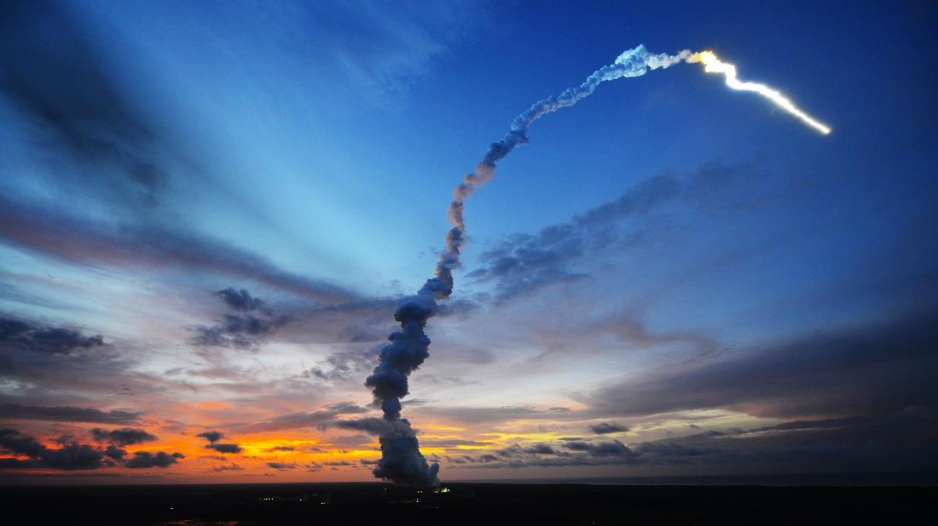
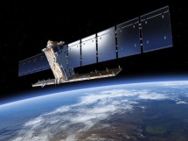
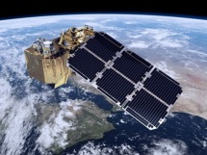
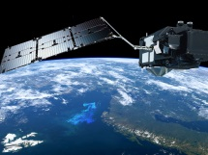
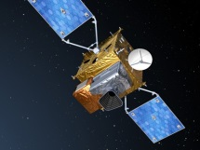
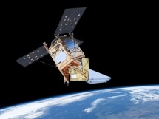
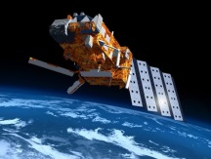
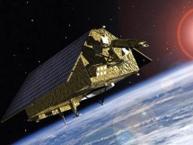

Copernicus – European Leadership in EO
S-1
S-2
S-3
S-4
S-5P
S-5
S-6
Radar
High Resolution Optical
Medium Resolution Optical & Altimetry
Atmospheric Chemistry (GEO)
Atmospheric Chemistry (LEO)
Atmospheric Chemistry (LEO)
Altimetry
A
3 Apr. 2014
A
23 Jun. 2015
A
16 Feb. 2016
A
2021
A
13 Oct. 2017
A
2021
A
2020
B
25 Apr. 2016
B
6 Mar. 2017
B
2018
B
2027
B
2027
B
2025
C
2022/23
C
2022/23
C
2023
C
> 2027
D
> 2022/23
D
> 2022/23
D
> 2023

Slide 6

CSC Expansion (Sentinel 7, 8, 9, …)
High Priority Candidates | Applications
Anthropogenic CO₂ | Greenhouse Gases - Climate Change
High Res. Land Surface Temperature | Agriculture & Urban Management Services
Polar Ice & Snow Topography | Land & Sea Ice Thickness
Passive Microwave Imaging | Sea Ice Concentration
HyperSpectral Imaging | Mining & Waste Management
L-band SAR | Soil, Vegetation, Food Security & Precision Farming
Notes:
In December 2017, all six Copernicus Space Component Phase A/B1 system studies Invitation to Tenders (ITTs) of Copernicus High Priority Candidate Missions (HPCMs) were published. Mission Advisory Groups (MAGs) for each of the HPCMs are being established in line with ESA’s standard advisory group mechanism.
Anthropogenic CO2 Monitoring Mission
This mission aims to analyse through the use of CO₂ satellite imagers the man-made CO₂ emissions and overall CO₂ budget at country and regional (e.g. city) scales and assess the effectiveness of the relevant COP21 decisions. This requires the capability to provide satellite accurate and consistent quantification of anthropogenic CO₂ emission and their trends.
High Spatio-Temporal Resolution Land Surface Temperature (LST) Monitoring Mission
Surface temperature is already being observed from space with thermal-infrared (TIR) sensors, however at spatio-temporal resolutions insufficient for many applications and services including agriculture. This mission shall be able to complement the current visible (VIS) and near-infrared (NIR) Copernicus observations with high spatio-temporal resolution Thermal Infrared observations over land and coastal regions in support of agriculture management services and possibly a range of additional services.
Polar Ice and Snow Topographic Mission
Measurements of land ice elevation and sea ice thickness are essential to monitor critical and direct climate change signals: ice cap melting and sea level. Building on Cryosat experience, this mission shall provide enhanced of land ice elevation and sea ice thickness measurements implementing higher spatial resolution for improved lead detection and additional capability to determine snow loading on sea ice. Improved on-board tracking systems for operation in rough terrain and addition of radiometer for all-round oceanographic use and coastal altimetry may also be considered.
Passive Microwave Imaging Mission
Passive Microwave Imaging Multi-Spectral Radiometers uniquely observe a wide range of parameters, in particular sea ice concentration, and serve operational systems at almost all weather conditions, day and night. This mission shall provide improved continuity of sea ice concentration monitoring missions, in particular in terms of spatial resolution (15 km), temporal resolution (sub-daily) and accuracy (in particular near the ice edges). Additional measurement of Sea Surface Temperature in the polar regions may also be included.
HyperSpectral Imaging Mission
For raw material resources applications, only a hyperspectral imager with contiguous bands can provide the spectral signatures in the Visible, Near Infrared and Short Wave Infrared (VNIR and SWIR), needed to identify and separate observed minerals, rocks and soils and their chemical composition. This is also the case for identifying and monitoring of mining operations and mine-waste management activities.
L band SAR Mission
This mission is responding to the requirements expressed by both the Land Monitoring and the Emergency Management services. Its target applications are: soil moisture, crop type discrimination, forest type/forest cover (in support to biomass estimation), food security and precision farming. In addition the mission will contribute to the monitoring of ice extent in the polar region. Other emerging applications will be possible by the synergetic and complementary observations with C band and X band SAR systems.

Slide 7
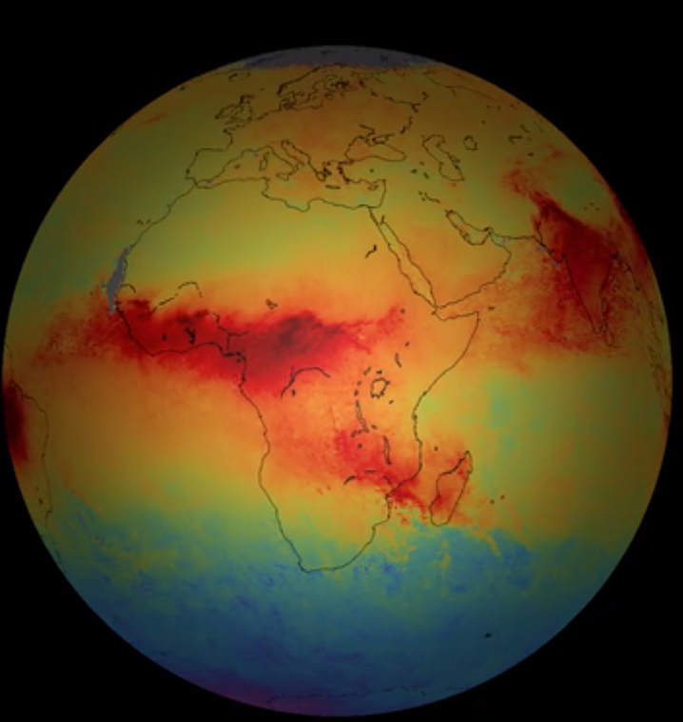
Outline
Sentinel-2 status
Sentinel-3 status
Sentinel-5P status
Aeolus status
L8 / Sentinel-2 harmonized products / ARD
FRM4SOC workshop, eRadiate Workshop
CO (November 2017)
Credits: SRON/ESA

Slide 8
Sentinel-2 Missions status
Sentinel-2A Launch: 23 June 2015
Sentinel-2B launch: 7 March 2017
Core Products:
              - L1C orthorectified TOA
              - Systematic global production (land/coastal areas)
              - L2A orthorectified BOA (ARD)
              - Systematic production over Europe
              - Systematic global production Q4 2018
              - user tool available
              Sentinel-2 Constellation Mission Operations Review was held on 27 June 2018, ESRIN
              All quality parameters are within specifications
              An anomaly was identified and corrected for the spectral response function of S2A (15/01/2018), affecting bands B01, B02, and B08 (https://cophub.Copernicus.eu/news/News00138).
              Information can be found at: https://sentinels.copernicus.eu
              Quality report: https://earth.esa.int/web/sentinel/user-guides/sentinel-2-msi/document-library

Slide 9
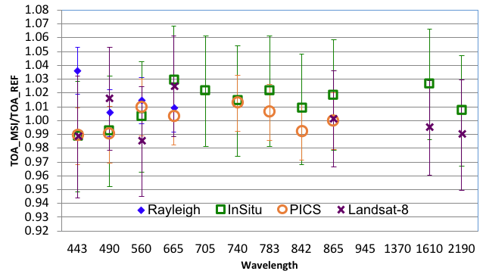
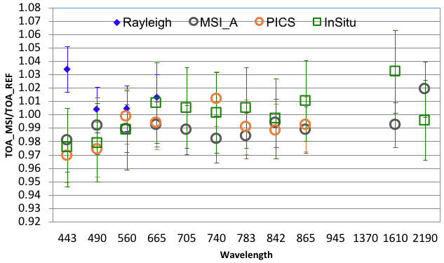
Small systematic difference in radiometry is observed between S2A and S2B: S2A is brighter (measured reflectance is higher) than S2B by about 1%. This difference is currently under study.
L1C - Absolute Radiometric Accuracy
The Absolute Radiometric Accuracy is within the goal level (3%) or within the threshold level (5%). Good consistency over all methods.
S2A
S2B
[nm]
[nm]
Plots show the ratio of MSI measurements over reference values. Error bars indicate the validation method uncertainty.
Notes:
The absolute radiometric calibration relies on the on-board solar diffuser. However, this calibration is validated by using several methods:
Rayleigh method is a so-called vicarious method, that means that the equivalent TOA radiance is computed for a known surface reflectance and atmosphere, in this case over stable oceanic regions, far from land so to ensure a purely maritime aerosol model [Rayleigh scattering can accurately be calculated based on the surface pressure and viewing angles][low concentration of phytoplankton and sediment] [low wind speed, less than 5 m/s] [low aerosol content] [6 Cal/Val sites were selected]
Comparison with in-situ data; that means comparison with the TOA normalized reflectance [reconstructed by the University of Arizona] using ground and atmosphere radiometric measurements provided by NASA (Landsat Cal/Val Team) via ESA as part of the ESA-NASA agreement over the Radiometric Calibration Test Site [Railroad Valley Playa site] [the dataset has been specifically generated for the spectral bands of S2A using hyperspectral reference profiles of the site]
Measurement over well characterized, temporally stable desert areas (Pseudo-Invariant Calibration Sites or PICS) [for this sites we have built a reference BRDF model using TOA measurements from MERIS than propagated to the surface using an inverse Radiative Transfer simulation. Therefore we have a database of BOA measurements with various acquisition geometries, i.e. Sun and viewing zenith angles, and relative azimuth angle. Then, the TOA measurement is simulated by using the BRDF model, the observation geometry, ozone and WV content from the European Centre for Medium-range for Weather Forecasts, and constant AOT is assumed]
Comparison with other sensors (Landsat-8 OLI and S2A for S2B case) [near-simultaneous TOA reflectance measurements made under similar observational geometries, over the same natural target. [The comparison is done over three desert sites: Algeria-3, Libya-4 and Railroad Valley Playa]
A small systematic difference in radiometry is observed between S2A and S2B: S2A is brighter (measured reflectance is higher) than S2B by about 1%. This difference is currently under study.
B9 Water vapour
B10 cirrus
For Band B10 direct validation is not possible

Slide 10
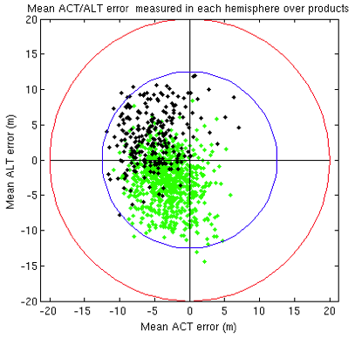
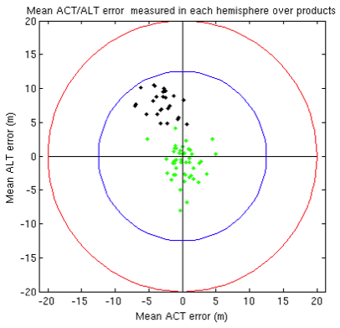
L1C - Geolocation accuracy
S2A
S2B
1079 L1C products
Circular error @95.5% conf. level: 11.16 m
75 L1C products
Circular error @95.5% conf. level: 11.29 m
Notes:
The geolocation performance has a latitude-dependent component. This effect is particularly visible on the along-track component, and more pronounced for S2B than S2A. Images are shifted of about 5 m southward in the Northern latitudes, and about 5 m northward in the southern latitudes. However, this will be corrected with the introduction of the geometric refinement [expected performance of geometrically refined L1C products is better than 12.5 m at 95 percentile of the circular error].
These are the results obtained by using Sentinel-2 products acquired since the last SPAMOD update (S2A: November 2016; S2B: April 2018).

Slide 11
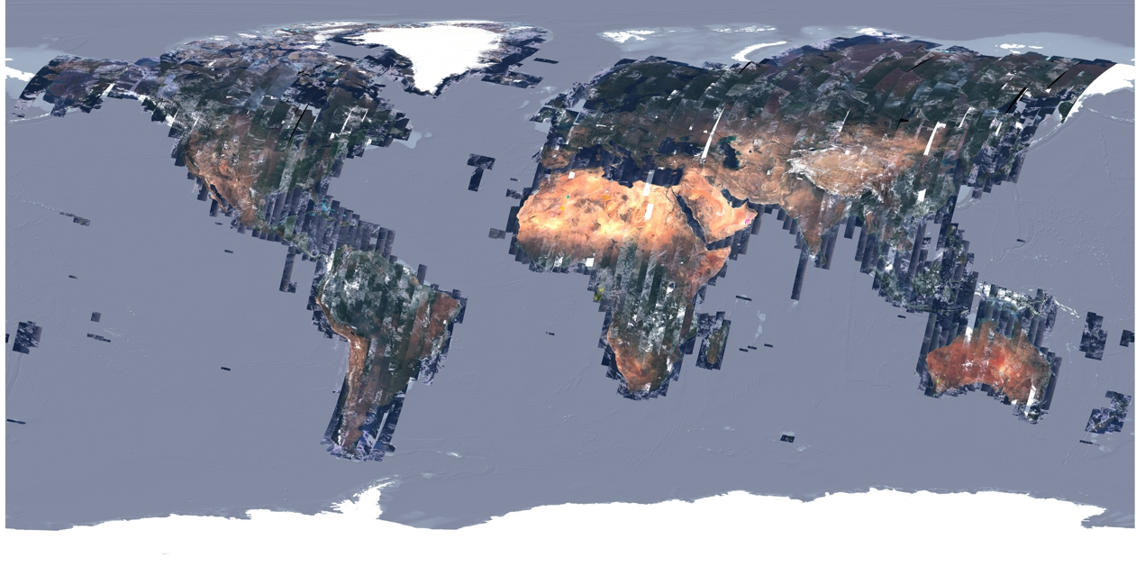
Evolutions - Geometric refinement with GRI
L1 processor is being upgraded to improve geolocation and multi-temporal co-
registration beyond the MRD requirements.
Processing based on the usage of a GRI (Global Reference Image ) as a source of GCPs.
Elaboration and validation of the GRI is on going (completion expected in summer 2018).
A full repeat cycle dataset of well-localized and as cloud-free as possible mono-spectral (band 4) Level-1B products

Slide 12
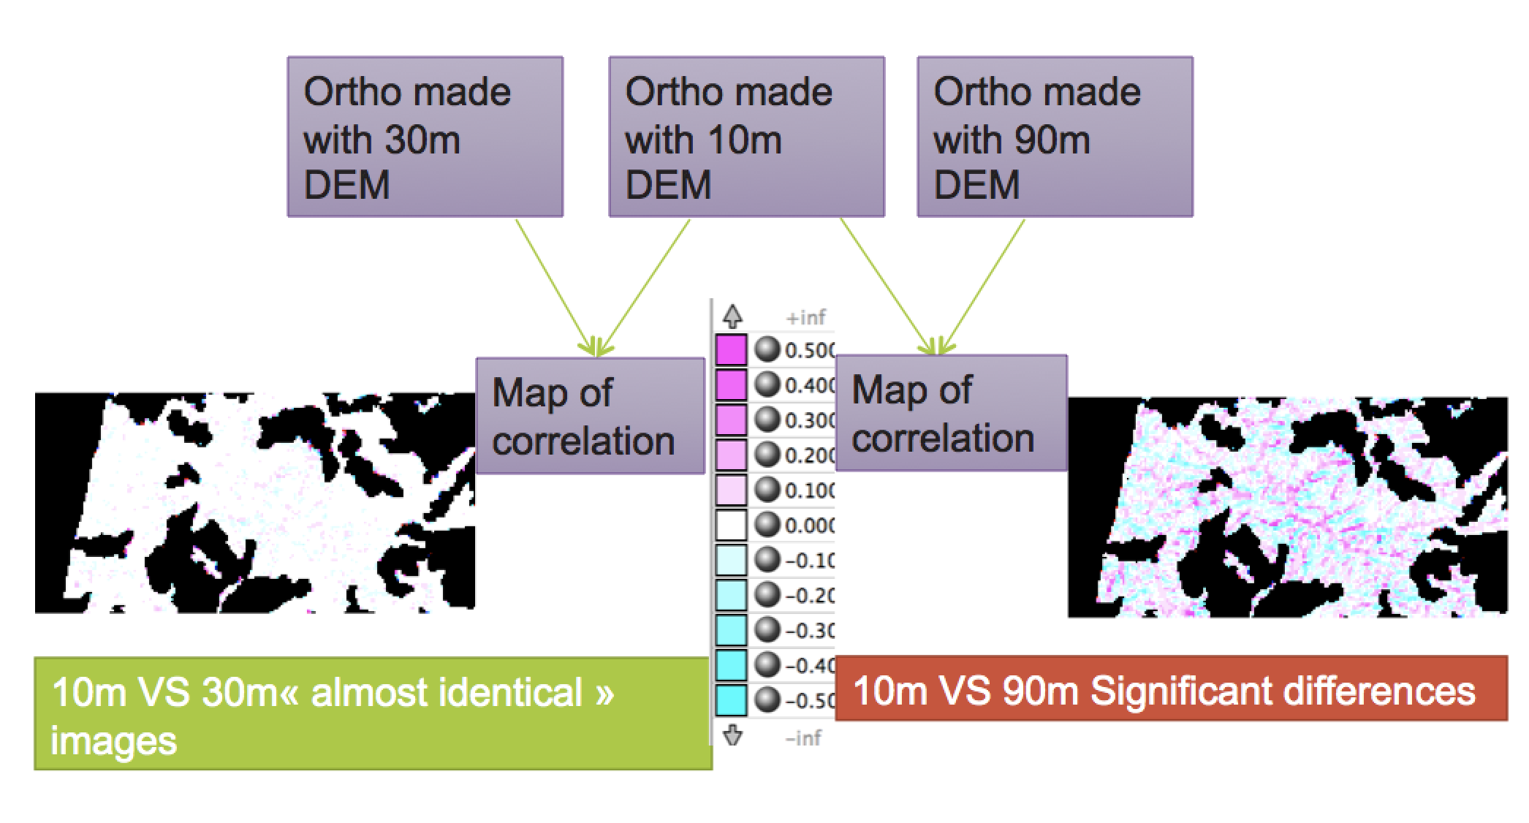
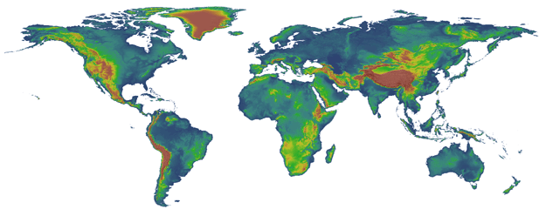
Evolutions – Digital Elevation Model (DEM)
DEM will be upgraded to improve geolocation over mountainous regions
30m DEM currently in procurement process
30 m resolution is sufficient

Slide 13
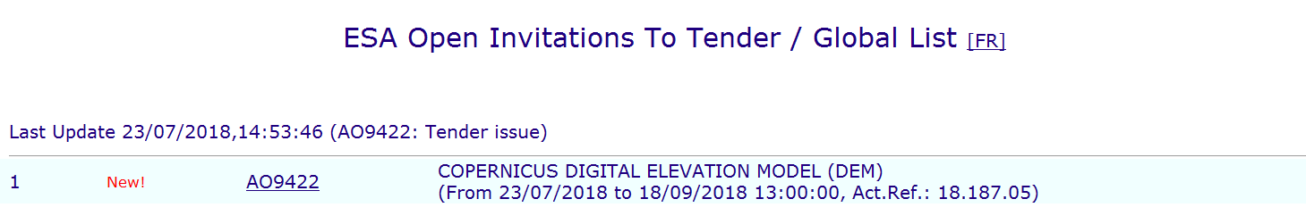
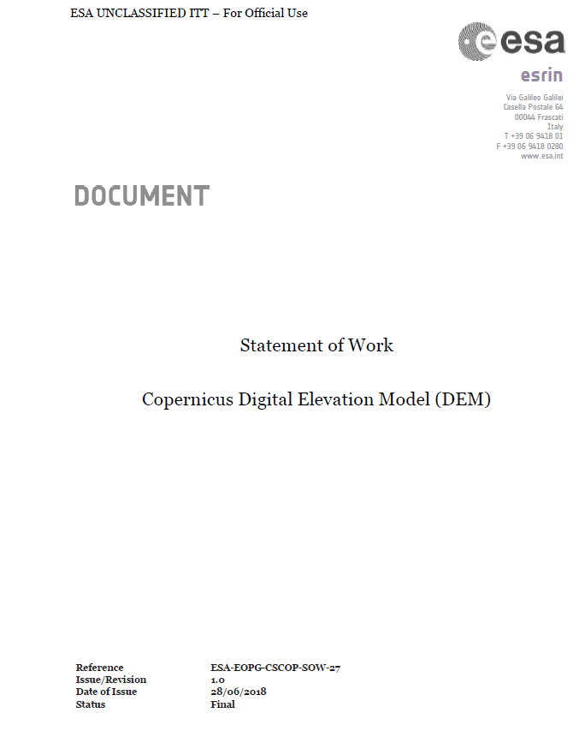
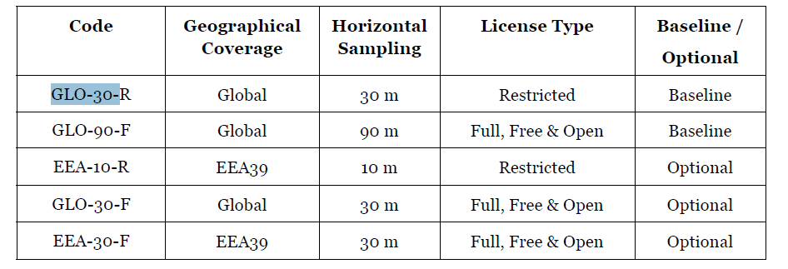
DEM Invitation to Tender
Table 1: Copernicus DEM instances. "Global" DEM instances shall cover all landmasses, while "EEA39" (European Environment Agency 39) shall cover all countries/regions indicated in Annex I. The Horizontal Sampling is understood as defined in Section 1.5.5. License types Restricted and Full, Free & Open are defined in Annex III. The DEM instances marked as "Baseline" will be part of the procured items undertaken at contract signature. For DEM instances marked as "Optional", the bidder shall mandatorily provide an offer but the Agency reserves the right to activate its purchase at any time before the closure of the contract.

Slide 14
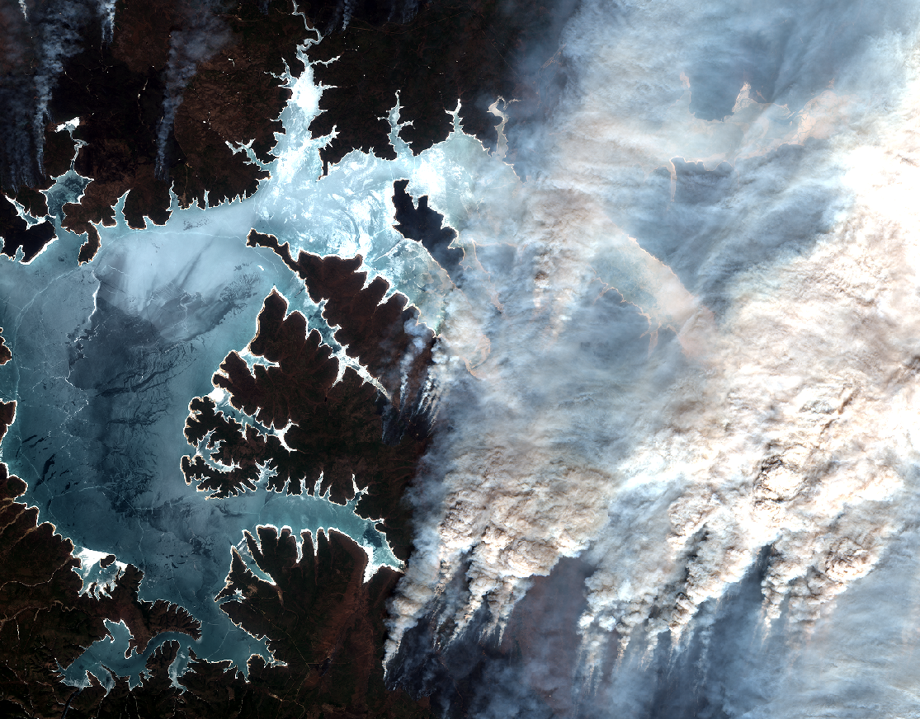
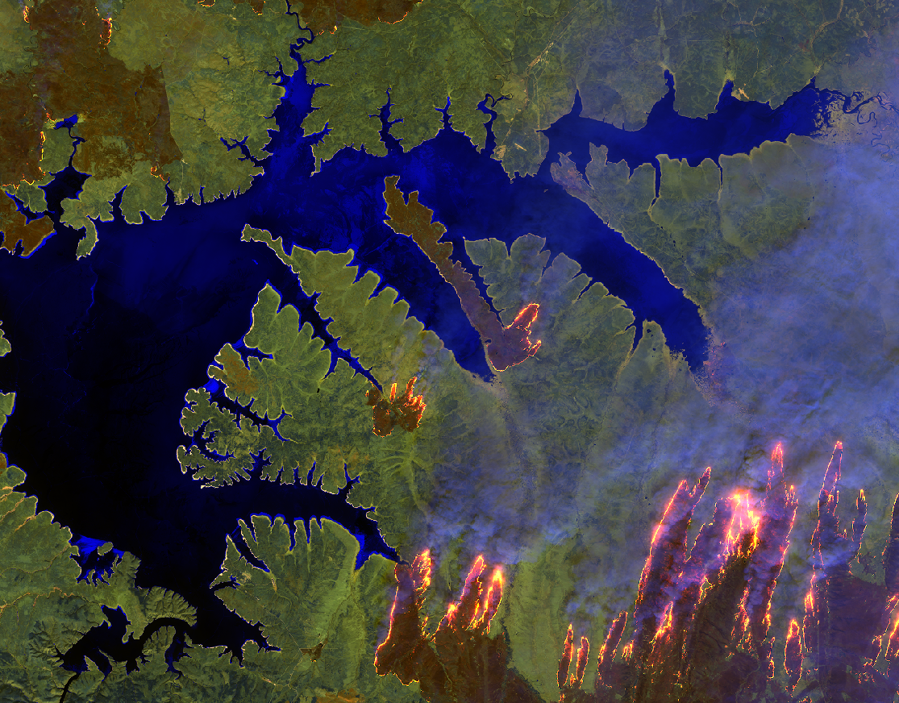
Augustus Island, Australia
Siberia (S2B – 09/05/2018)

Slide 15
Sentinel-3
Sentinel-3A launch 16 February 2016
Sentinel-3B launch 25 April 2018
- in commissioning phase. Tandem mode
- drift to nominal orbit: after summer (140 deg phase wrt S3A)
Products
    L1B (orto-georeferenced TOA) produced at ESA and EUM
    L2 Marine (OC, SST) produced at EUM
    L2 land (vegetation and LST) produced at ESA
    L2 Atmosphere (aerosol, WV) produced at ESA and EUM
    Altimetry (L2 marine at EUM, L2 land at ESA)
CP S3B Satus
Geometry OK
Radiometry OK
OLCI-B radiometry is comparable to MERIS and by about 1.5-3% lower than OLCI-A (OLCI-A has a bright bias). Similarly to OLCI-A the 1020nm band is subject to a bright bias of about 5%. These early results show an excellent results.
SLSTR-B radiometry is comparable to SLSTR-A
    Still issue in SWIR → need vicarious adjustment (coefficient published)
    Moon manoeuvre in July (cal, straylight)
    Altimetry nominal. Good results
OLCI B rad. CNES
SLSTR B rad. CNES

Slide 16
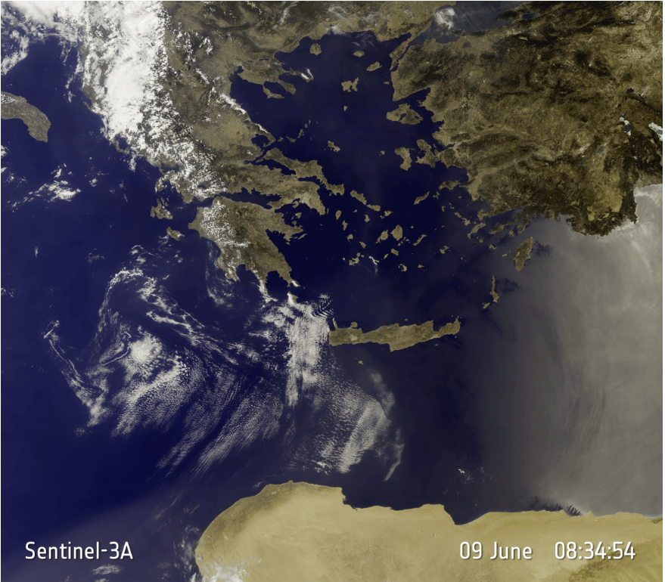
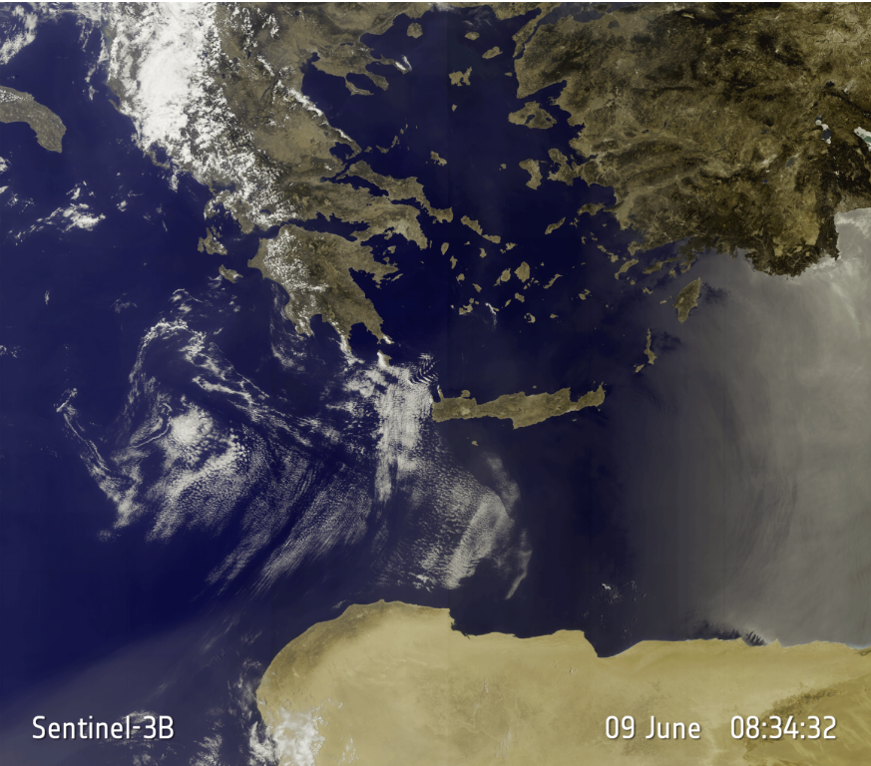
OLCI: Sentinel-3B and Sentinel-3A 22 seconds after
Spot the difference

Slide 17
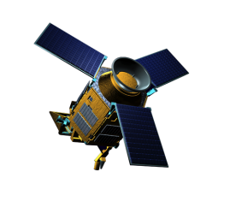
Sentinel-5 Precursor
COPERNICUS ATMOSPHERE MISSION IN POLAR ORBIT
The Sentinel-5 Precursor (S5p) is the first atmospheric Sentinel mission focusing on global observations of the atmospheric composition for air quality and climate.
The TROPOspheric Monitoring Instrument (TROPOMI) is the payload of the S5p mission and was jointly developed by The Netherlands and ESA.
S5p provides enhanced radiometric sensitivity & spatial resolution enabling sampling of small-scale variabilities specifically in the lower troposphere.
Launched on Oct. 13 2017 with a 7 years design lifetime.
Commissioning Phase
finalised successfully on
24 April 2018.
Ramp-up Phase started on
April 25.
First products released to the users on
10 July 2018: NO2, O3-NRT, CLOUD,
Aerosol Index, CO-OFFL and Clouds
TROPOMI
UV-VIS-NIR-SWIR nadir view grating spectrometer.
Spectral range: 270-500,
675-775, 2305-2385 nm
Spectral Resolution: 0.25-1.1 nm
Spatial Resolution: 3.5x7km²
Global daily coverage at 13:30 local solar time.

Slide 18
Sentinel-5 Precursor Level 2 Products
Product | Wavelength | Application
Ozone | UV, UVIS | Ozone layer monitoring, UV-index forecast, Climate monitoring
NO₂ | UVIS | Air quality forecast and monitoring
CO | SWIR | Air quality forecast and monitoring
CH₂O | UVIS | Air quality forecast and monitoring
SO₂ | UVIS | Air quality forecast and monitoring, Climate monitoring, Volcanic plume detection
Aerosol | UVIS, NIR | Air quality forecast and monitoring, Climate monitoring, Volcanic plume detection
CH₄ | SWIR | Climate monitoring
Clouds | UVIS, NIR | Climate monitoring
UV-Index | UVIS | UV index forecast (provided by FMI)
Routine dissemination of global L1B & 2
products over design lifetime
Near real time (NRT & Offline) service for most data products (Offline only: L1B, CH4)

Slide 19
Sentinel-5 Precursor Commissioning Phase Outcome - Ramp-up Phase
Algorithm Investigations for product quality improvement:
Channel 1/2 radiometric inconsistency (impact on O3 profiles)
Verify the NIR stray-light correction based on the dedicated phase E1 (limb) measurements, verify sun diffuser reflectance characterisation
Methane retrieval: test the inclusion of the NIR band in the retrieval, reduce delivery time (within 2 days as requested by the Copernicus Atmospheric Monitoring Service (CAMS) rather than 2 weeks)
TROPOMI Operations: QWG/Experts to investigate possible impact of reduced along-track spatial resolution of 5.5 km on all Level 2 processors
Spacecraft Operations: QWG/Experts to investigate possible off-set S5p operations in order to fill the small gap over the equator on all processors
On-board fuel for additional 13 years of operations (in theory).
First Ramp-up phase Milestones: Workshop on the first S5p product release – 25/26 June 2018 ESRIN - Meeting on the Second S5p product release – 28 September 2018 - Start full qualified operations after the Routine Operations Readiness Review (RORR) Meeting - December 2018.

Slide 20
Sentinel-5 Precursor Mission Status
https://sentinel.esa.int/web/sentinel/missions/sentinel-5p/mission-status
Reports covering a time period of 2 weeks
http://www.tropomi.eu/mission-status - L1 Portal, L2 Data Quality, Routine Validation
The TROPOMI instrument continues measuring in nominal operations baseline with the 360 orbit repeat cycle that started on April 30, 2018.
The Level 1B processor (V1.0) has been activated on 19 April 2018. The Level 1B data from the beginning of the mission has been reprocessed with this processor version (V1.0).
The latest Level 2 processors (V1.x) updates by RAL, KNMI and DLR have been activated in the PDGS on 04 May, 18 July and 08 August. Reprocessing by PDGS of phase E1 data (selected product types) has started (for validation purposes).
E2 Anomalies/Data Gaps:
24 May 2018: 2 Collision Avoidance Manoeuvres – 9 hours data loss
13-14 June 2018: TROPOMI L3 reconfiguration – 16 hours data loss
11-12 August 2018: 2 Collision Avoidance Manoeuvres – 20 hours data loss
Notes:
Upd – statistics (Jolyon or use scihub.copernicus.eu)

Slide 21
Sentinel-5 Precursor Product Releases
Product | Main Parameter
UV Aerosol Index | Aerosol index
Cloud Properties | Fraction, optical depth, top height
Nitrogen Dioxide (NO₂) | Total and tropospheric columns
Total Ozone (O₃) | NRT total column
Carbon Monoxide (CO) | Offline total column
NPP_CLOUD | Cloud mask from VIIRS
Sulphur Dioxide (SO2) | Total column
Formaldehyde (HCHO) | Total column
Tropospheric Ozone | Tropospheric column
Total Ozone (O₃) | OFFL Total column
Carbon Monoxide (CO) | NRT total column
Methane (CH4) | Offline total column
Aerosol Layer Height | Mid-level pressure
Ozone Profiles | Total and tropospheric profiles
UV (FMI – co-laborative GS) | UV dose
Staggered Product Releases to the Public
July 2018
September 2018
December 2018

Slide 22
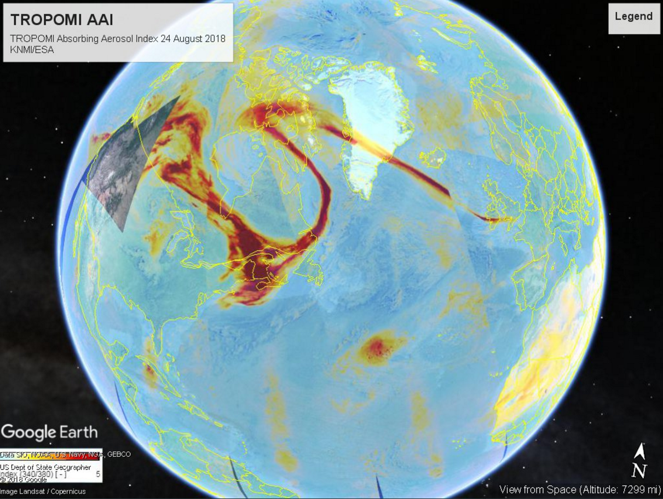
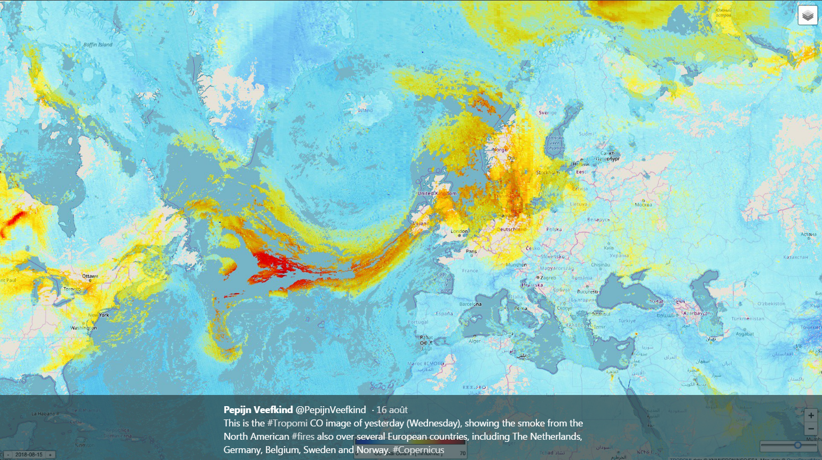
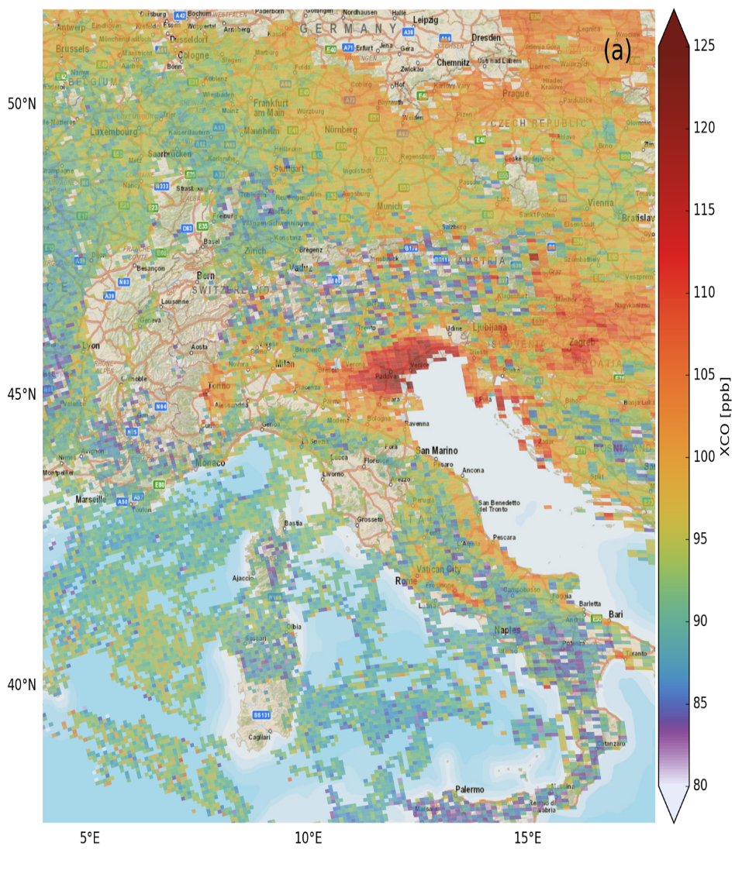

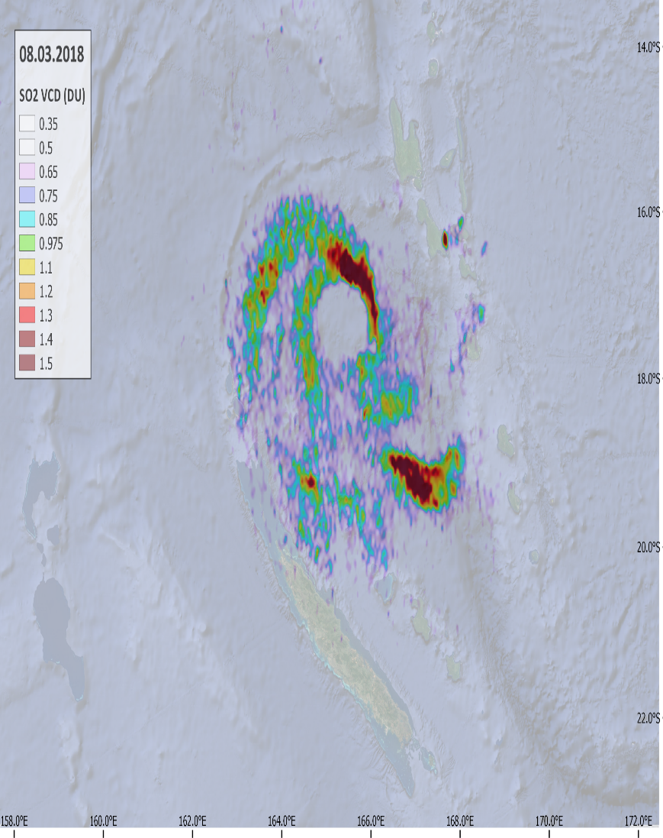
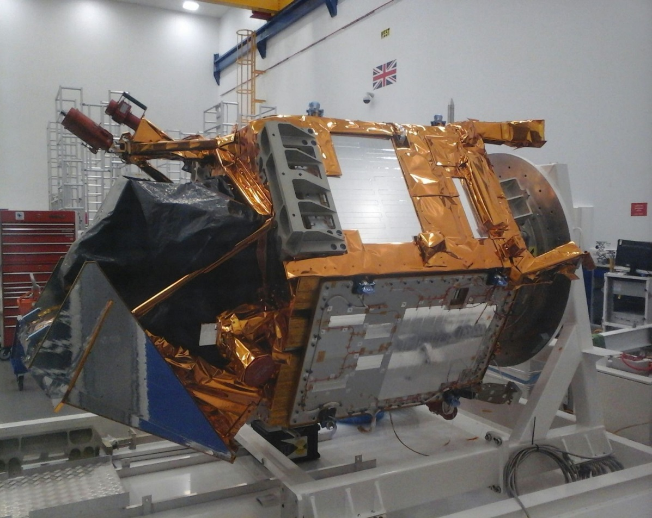


Sentinel-5 Precursor
https://twitter.com/PepijnVeefkind
Carbon Monoxide Sulphur Dioxidde
https://twitter.com/weerrecords
Jos de Laat

Slide 23
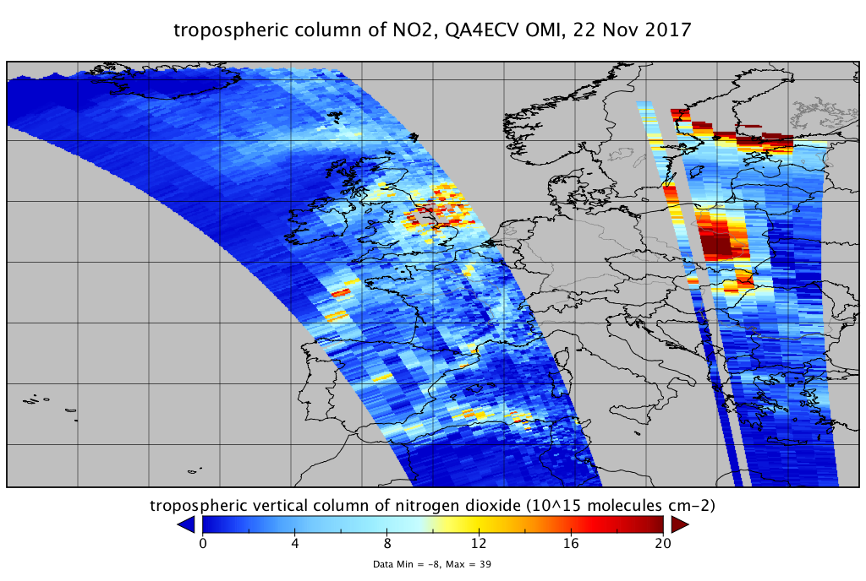
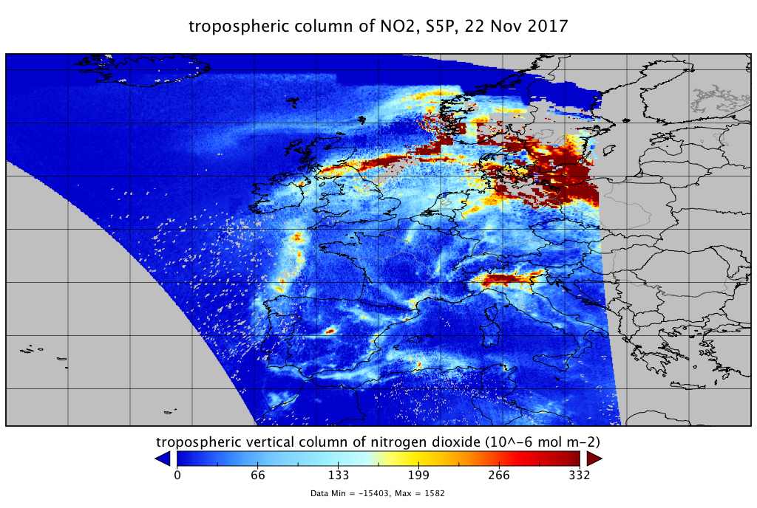
Improved Spatial Resolution
Comparison with the new QA4ECV NO₂ product of OMI, 22 Nov 2017
(Courtesy: KNMI)

Slide 24
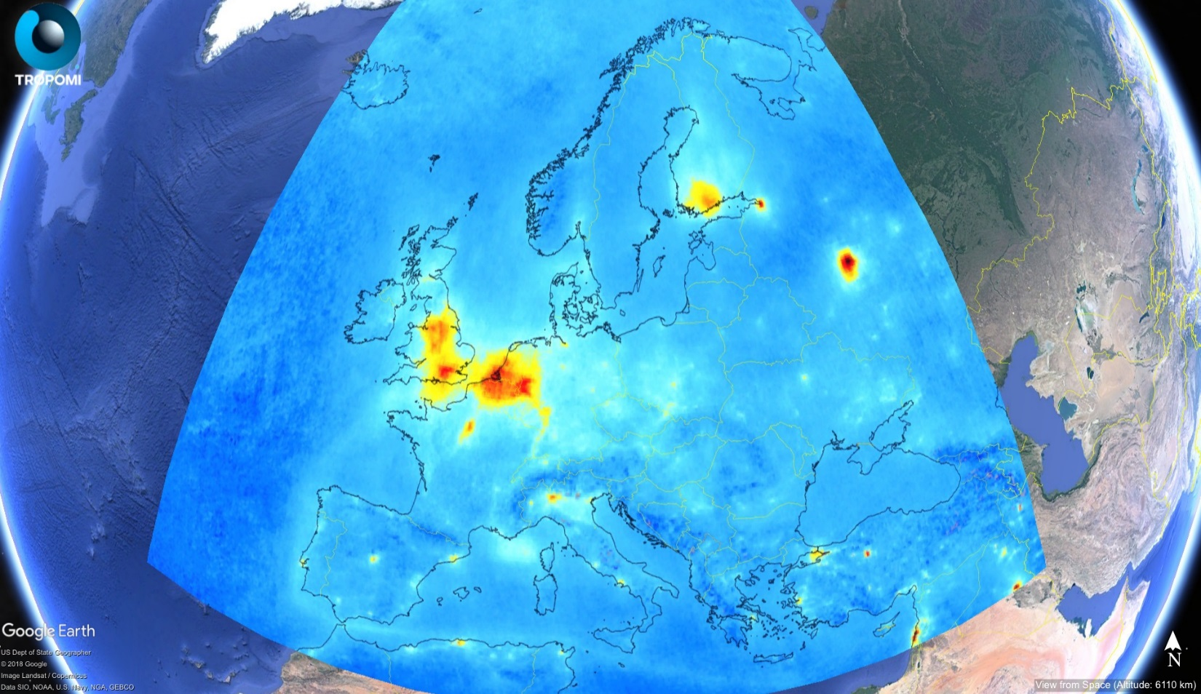
TROPOMI NO2 vertical column densities (average May 2018)

Slide 25
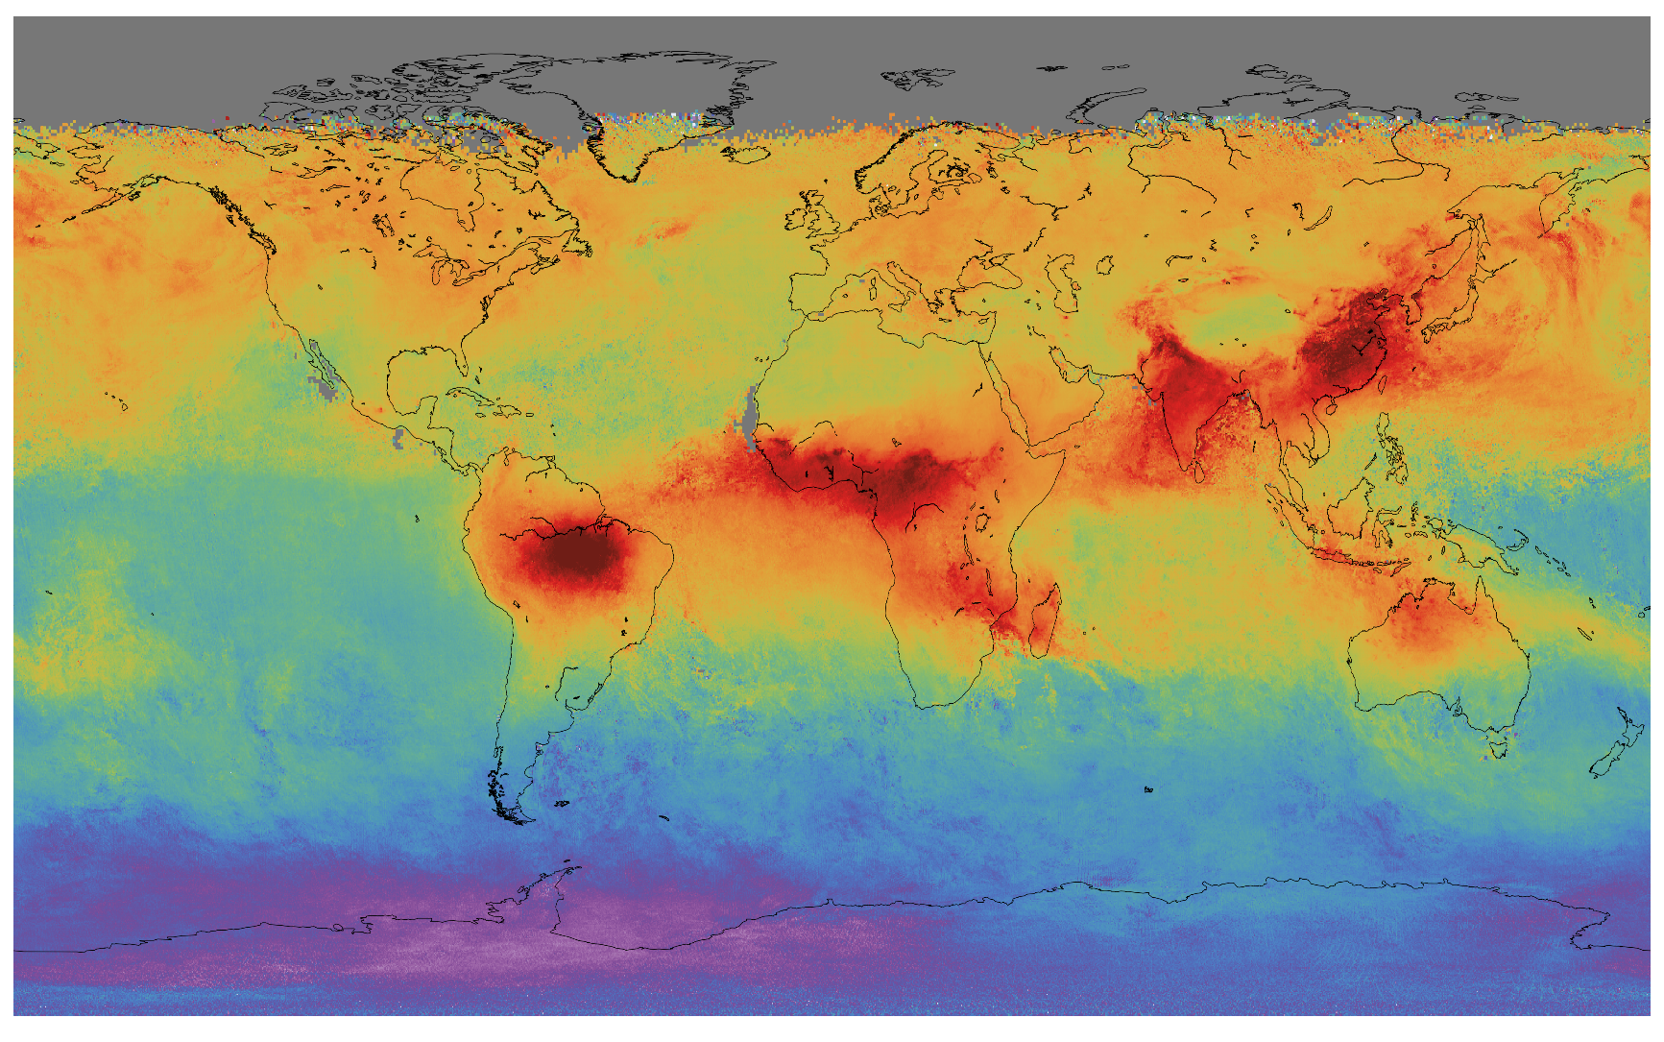

TROPOMI CO vertical column densities (averaged from 9.11 - 22.11.2017)
Low
High

Slide 26
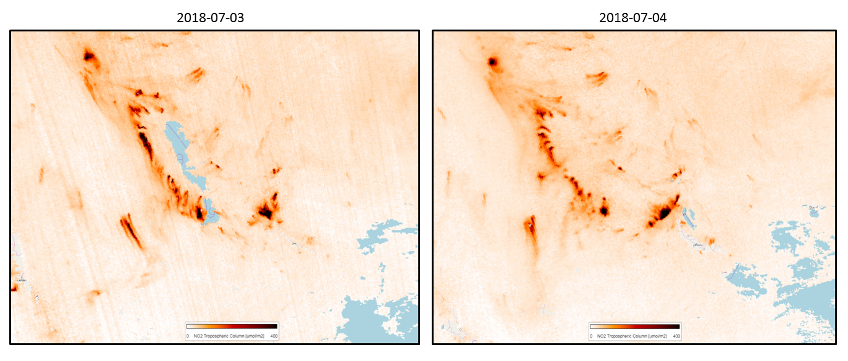
Latest Level 2 algorithm Update – July 04
Impact of using the sun-irradiance measurements
closest in time to the radiance measurements

Slide 27
Sentinel-3
Sentinel-3A launch 16 February 2016
Sentinel-3B launch 25 April 2018
- in commissioning phase. Tandem mode
- drift to nominal orbit: after summer (140 deg phase wrt S3A)
Products
    L1B (orto-georeferenced TOA) produced at ESA and EUM
    L2 Marine (OC, SST) produced at EUM
    L2 land (vegetation and LST) produced at ESA
    L2 Atmosphere (aerosol, WV) produced at ESA and EUM
    Altimetry (L2 marine at EUM, L2 land at ESA)
CP S3B Satus
Geometry OK
Radiometry OK
OLCI-B radiometry is comparable to MERIS and by about 1.5- 3% lower than OLCI-A (OLCI-A has a bright bias). Similarly to OLCI-A the 1020nm band is subject to a bright bias of about 5%. These early results show an excellent results.
SLSTR-B radiometry is comparable to SLSTR-A
    Still issue in SWIR → need vicarious adjustment (coefficient published)
    Moon manoeuvre in July (cal, straylight)
    Altimetry nominal. Good results
OLCI B rad. CNES
SLSTR B rad. CNES

Slide 28
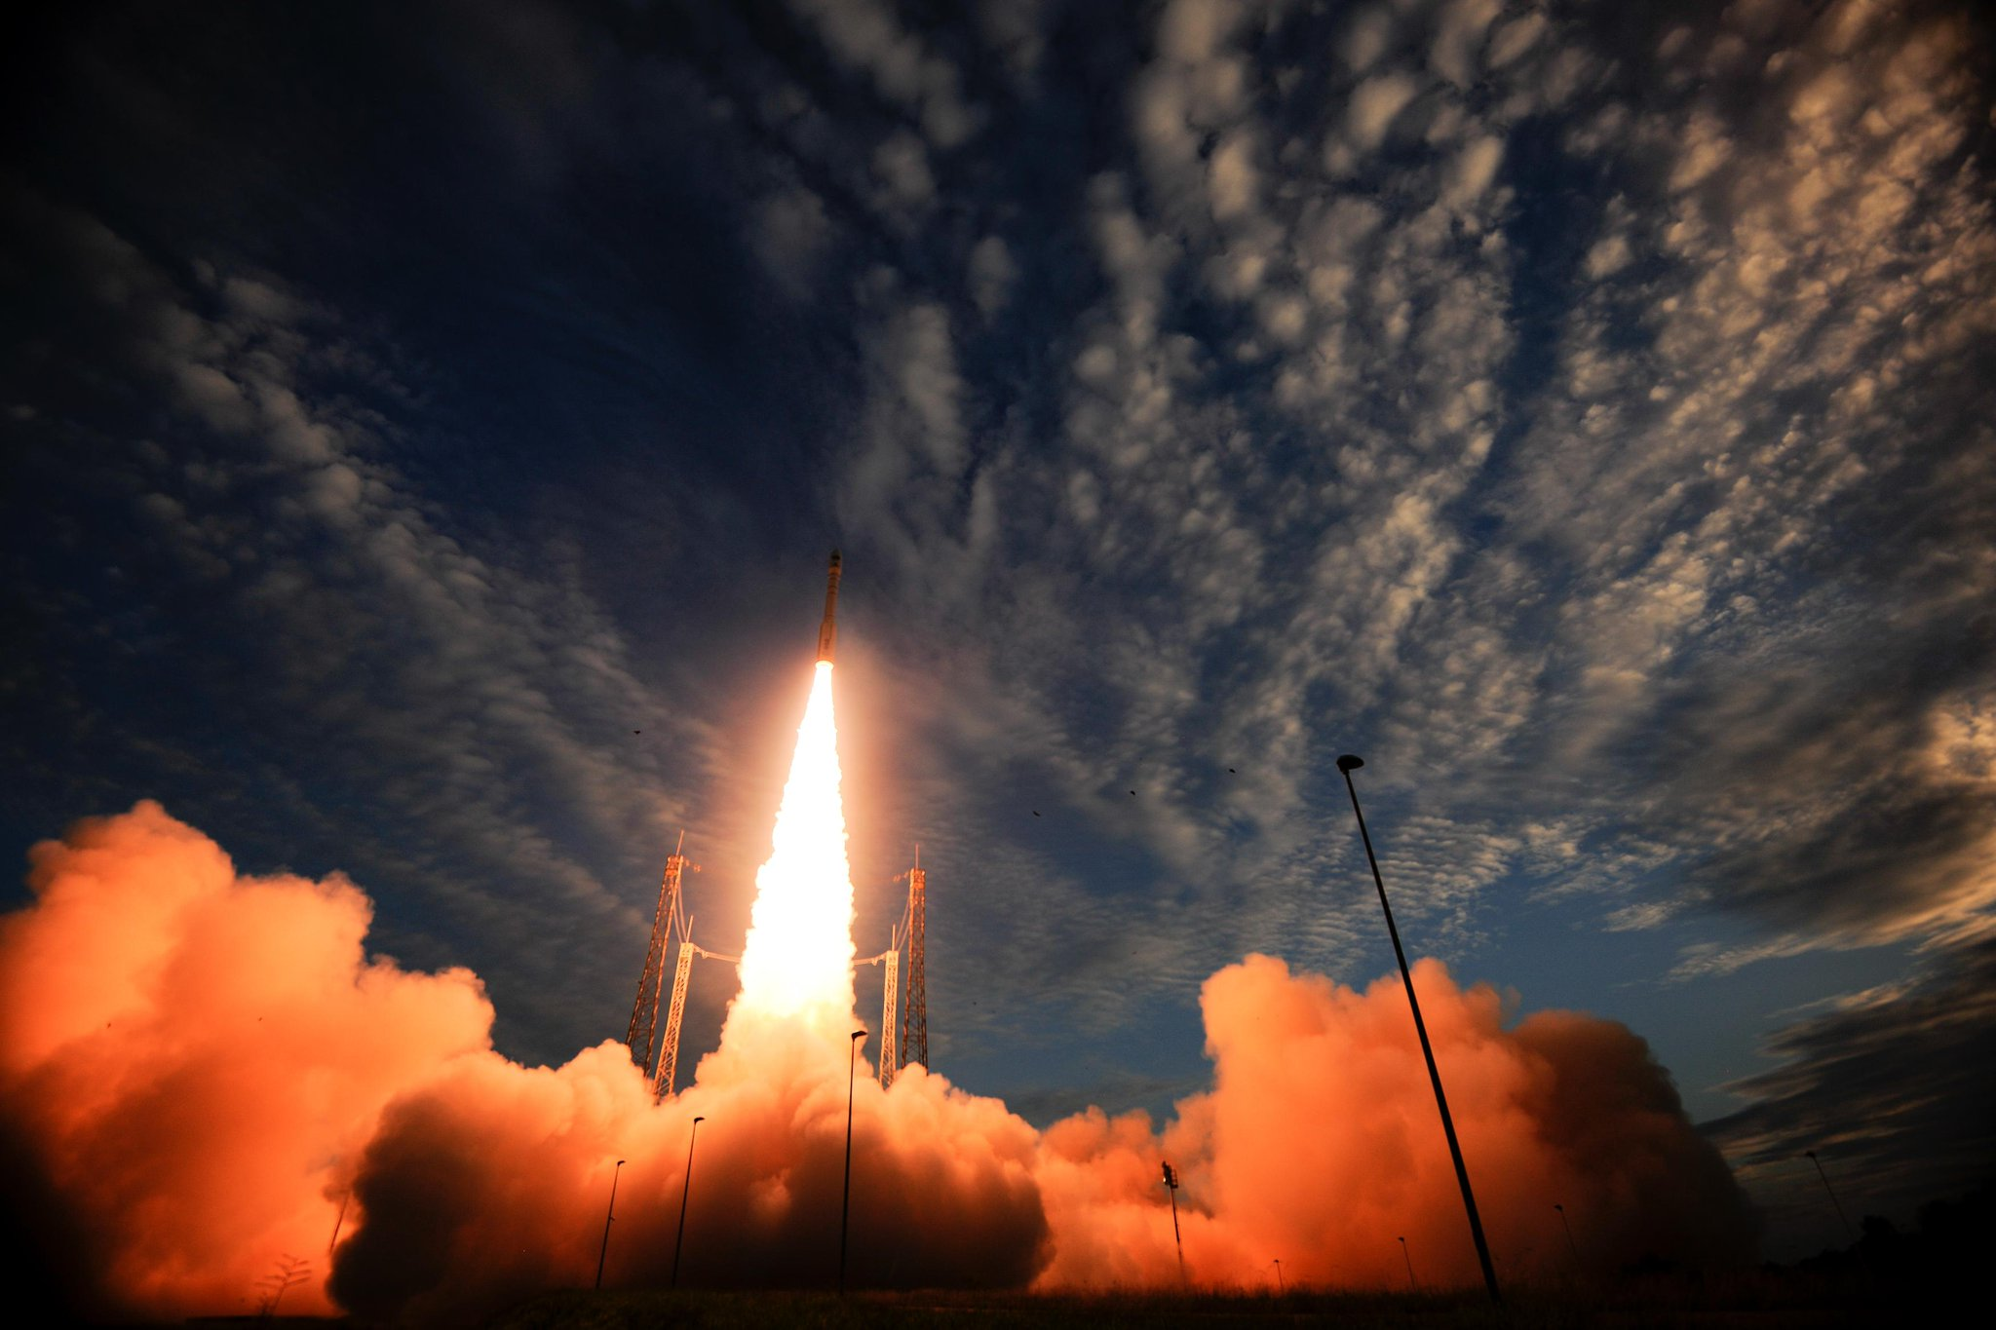
AEOLUS
Successful Launch from Kourou with VEGA on 22 August 2018
LEOP nominal
Notes:
Start laser in leop at low level then increase increase the power slowly (and always go back) and check the laser condition (pressure) – LASER aladin (airbus fr), airbus UK satellite, LASER (Leonardo Italy), DLR

Slide 29

Aeolus Mission Objectives
Scientific objectives
To improve the quality of weather forecasts;
To advance our understanding of atmospheric dynamics and climate processes;
Explorer objectives
Demonstrate space-based Doppler Wind LIDARs potential for operational use.
Observation means:
Provide global measurements of horizontal wind profiles in the troposphere and lower stratosphere
Payload
ALADIN: Atmospheric LAser Doppler INstrument

Slide 30
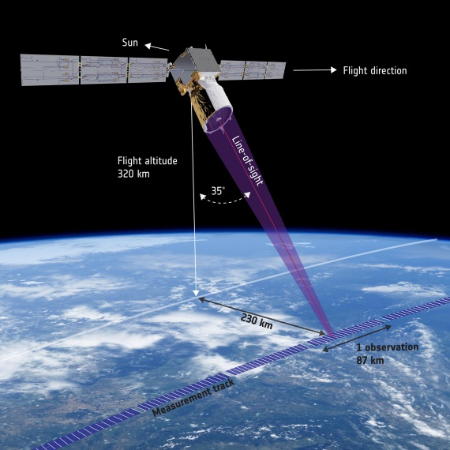
Aeolus: Measurement Principle
Direct detection UV Doppler wind Lidar operating at 355 nm and 50 Hz PRF in continuous mode, with 2 receiver channels.
Mie receiver to determine winds from aerosol & cloud backscatter.
Rayleigh receiver to determine winds from molecular backscatter.
The line-of-sight is pointing 35º from Nadir to obtain horizontal backscatter component
The line-of-sight is pointing orthogonal to the ground track velocity vector to remove contribution from the satellite velocity.

Slide 31
AEOLUS
Aeolus Phase E2 challenging → very short product life-cycles in order to have a stable mission by 2019. This allows Aeolus to be considered for the ECMWF data assimilation, hence enabling to demonstrate impact. WIGOS 2020 (WMO Integrated Global Observing Systems ) will be the “show-down” on impact.
Phase E2 mission is set-up to identify and fix quickly problems → very high emphasis on product improvements (not evolution) and impact.
Cal/Val
Cal/Val AO call re-opened permanently in March 2018. 2 new proposals submitted and several more in preparation or expected.
ESA and EUMETSAT joint workshop on Aeolus exploitation for NWP and future needs for satellite wind observations. Proved as a very effective forum for the alignment of NWP centers that plan to carry out Aeolus product impact assessments.
Dissemination of 1st data to Cal/Val experts expected at ~ L+2M
First post-launch Campaigns: A2D Airborne Demonstrator under-flights in central Europe, November 2018 Strateole/TAPAPA Stratospheric Balloon flights circumventing the globe at tropical latitudes, December 2018-February 2019
First post-launch Cal/Val workshop in ESRIN March 25-29, 2019
Aeolus DISC in preparation to commence data quality activities in Phase E2
Notes:
DLR/Dorit (D) 30%
ECMWF (UK) 15%
KNMI (NL) 20%
MeteoFrance/CNRS 20%
ABB (CA) 5%
S&T (NL) 5%
ADS/Selex 5%

Slide 32
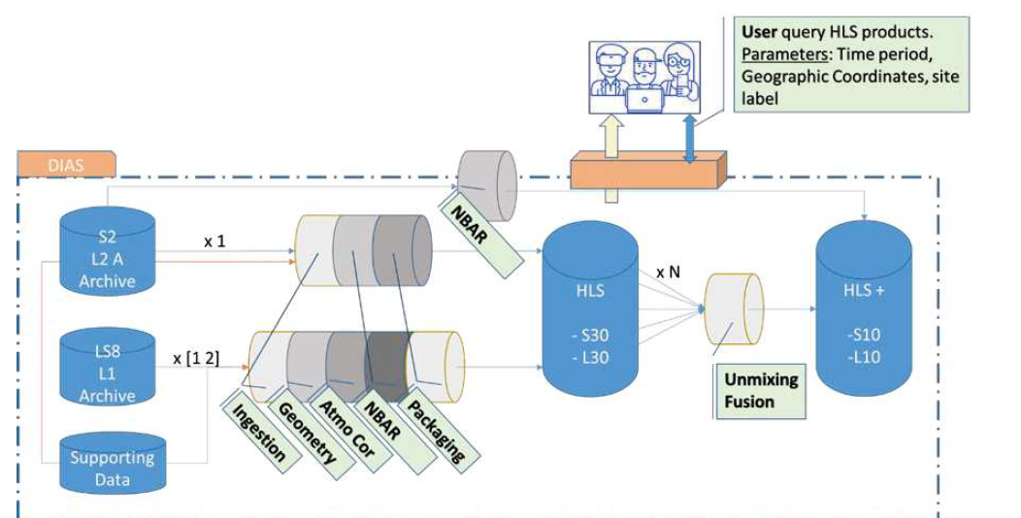


“Sen2Like” Initiatives
The “Sen2Like” processor aims at combining the Sentinel 2 MSI and Landsat 8 OLI data in view of providing large multi temporal dataset to the user (ARD) directly available as a service in one ESA / Copernicus DIAS infrastructure,
Also, the “Sen2Like” project goals and objectives are :
  The development of an operational software following harmonization guidelines defined, notably by CEOS LSI VC sub group
  The integration and development (if needed) of “cross domain” building blocks, in charge of Geometric Evaluation & Correction, Level 2 processing, Spectral Adjustment, BRDF Correction and Data Fusion.
  The development of a “flexible” software solution, allowing to change / configure building blocks and validate the proposed configuration.
For the creation of harmonized dataset, the following strategies have been proposed
  Production of a baseline dataset at Landsat OLI Multi spectral band spatial resolution => ‘HLS’
  Production of a second dataset at Sentinel MSI 10.0 m spatial resolution => ‘HLS+’

Slide 33
“Sen2Like” Processing & status
  Geometric Processing
    Image matching between S2 and LS8 NIR Images will be systematically applied for monitoring of geolocation performance and reporting to the user. The matching tool is MEDICIS (CNES) Open Source Tool.
    In case, geometric discrepancies exist, an affine geometric correction will be applied.
  Atmospheric corrections (Two steps)
    S2 / LS8 Atmospheric Correction by using SMAC, (‘LUT shared by CESBIO’) with climatology from CAMS. Inter calibration results are within expectations – This method allows to quickly apply corrections.
    Development of “Lan2Cor”, a “landsat” plug for the “Sen2Cor” s/w already running in the PDGS and involved in the S2 Level 2 product generation.
  Processing of Quality Band and Harmonization:
    The design of an harmonized Level2 Pixel QA band is on going
  Nadir BRDF - Adjusted Reflectance:
    Validation of global 12 month fixed BRDF technique (Roy and Al. 2016) is on going
  Band Pass Adjustment:
    Validation of Coefficients proposed by NASA / USGS is on going
  Implementation / integration of “STAR FM” (HLS+)
    The algorithm has been prototyped and results are correct
    An analysis on going to find the best implementation, tune parameter and optimize performance.

Slide 34
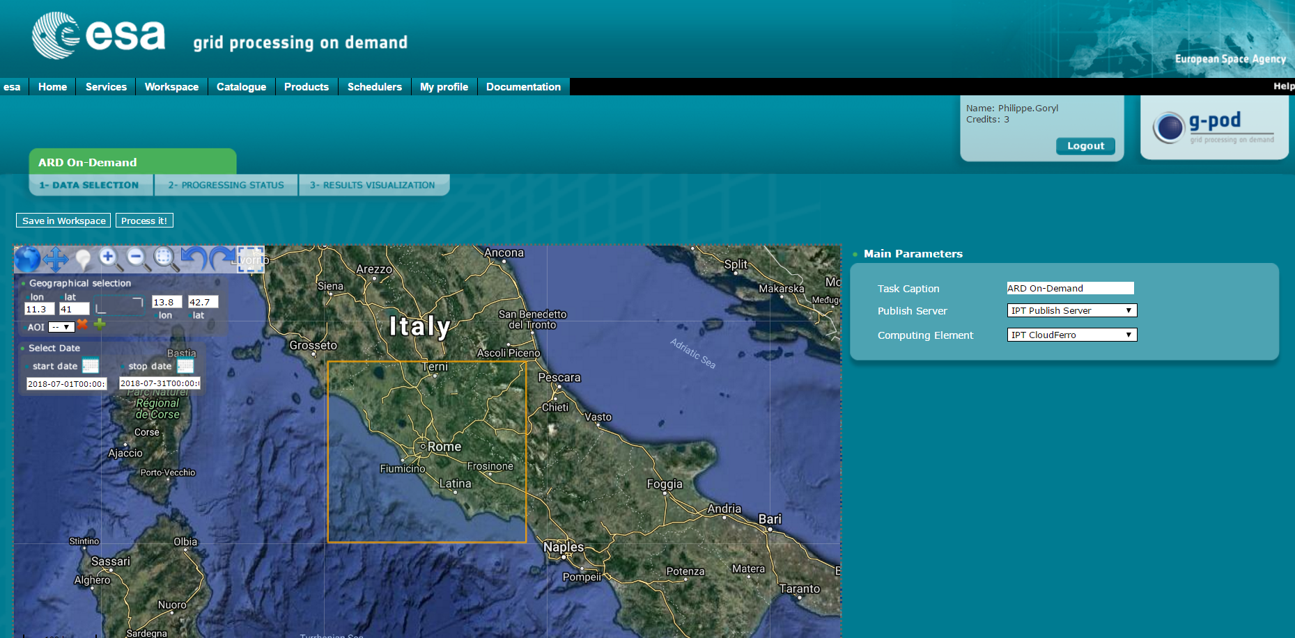
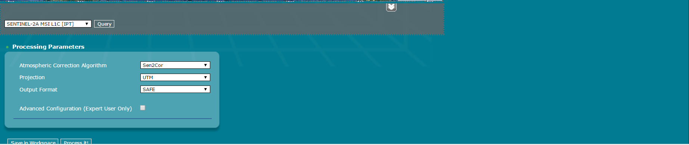
Future : ARD on Demand ?
Select:
- Area of interest
- dates
- Sensor (L8, S2)
- Atmospheric correction
- Projection
- Format
- BRDF correction

Slide 35
eRadiate
Single RTM for all communities: Most appropriate identified method: 3D Monte Carlo ray tracing (MCRT)
  Should feature:
  Account for multiple radiative processes (reflection, emission, polarization, …)
    Multi-scale to model both satellite & ground radiometric measurements
    Availability of spectral databases and standard scenes to support Cal/Val activities
3D RT Community Model User Workshop
was held 23 – 24 April 2018, JRC, Ispra, Italy
Communicate towards user community
on the new 3D RTM based on the Monte Carlo Ray Tracing method;
• Gather user requirements from various scientific communities;

Slide 36
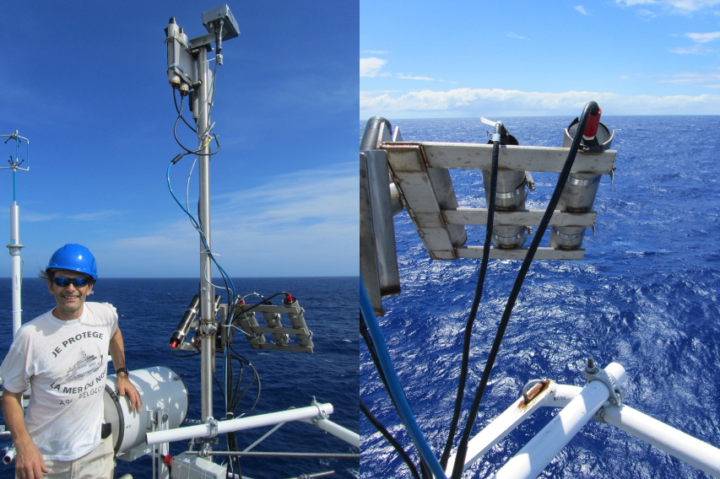
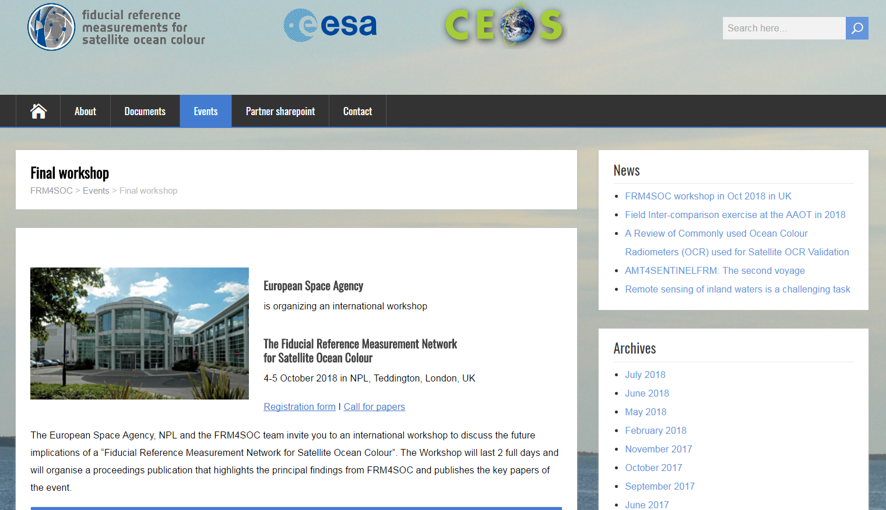

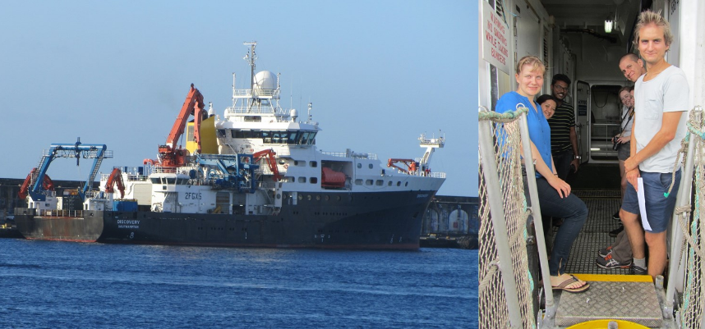
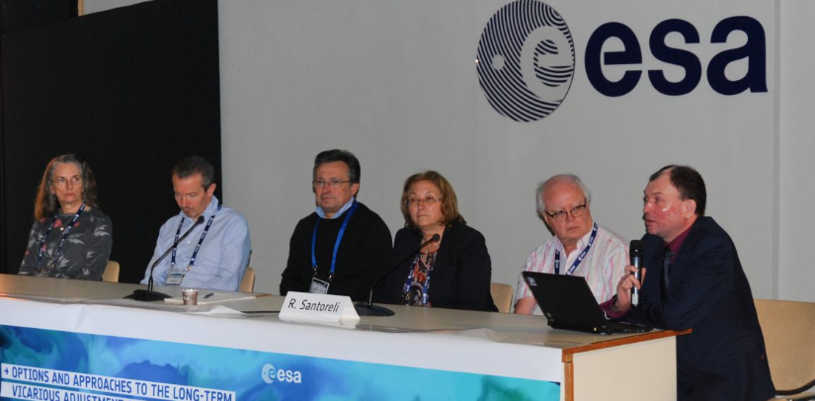

Slide 37
Thank you for your attention!
www.esa.int

Slide 38
SPARE SLIDES
1. Lunar irradiance measurement and modelling for absolute radiometric calibration of EO sensors
2. Principles for a 3D Radiative Transfer Model to support Cal/Val activities : eRadiate

Slide 39



Lunar irradiance measurement and modelling for absolute radiometric calibration of EO sensors
M. Bouvet (ESA), Emma Woolliams (NPL), Claire Greenwell (NPL), Maria Garcia Miranda(NPL), Carlos Toledano (Univ. Valladolid), Alberto Berjón (Univ. Valladolid), África Baretto (Univ. Valladolid), Stefan Adriaensen (VITO)

Slide 40
Objective of the study
Define a strategy for the measurement of the lunar spectral irradiance variation from the ground
Demonstrate the feasibility of such measurements
Compile a database of such measurements and on that basis improve the modelling of the lunar disk irradiance variations through its cycles (targeting sub-2 % absolute radiometric accuracy)
Compare the improved lunar disk irradiance model to various independent sources of lunar observations from space

Slide 41
Planning
KO of activity in Sept. 2017
KO+2 months: definition and procurement of lunar photometer
KO+6 months (19th of March 2018): Review of instrument characterisation (spectral, geometric and radiometric), calibration and derivation of measurement uncertainties.
KO+6 months (19th of March 2018) to end:
  Lunar data collection at Pico Teide / Izana (Spain)
  Development of a model of lunar irradiance
KO+12 month to end: comparison of the model of lunar irradiance to:
  lunar observations: from Proba-V, PLEIADES and a subset of the GLOD
  Other lunar model(s): GIRO
Duration: 21 months
Notes:
Depuis l’instrument a ete calibre au NPl et a l’university de valladoide.
Result of instrument cal. Now.
Entre now et la fin on fait des mesures et on fait un modele base sur rolo (usgs).
Glod: ensemble des donnees mise en commun du gsics (modis, pleiades, proba).
Peut etre pas utiles de demander des donnees glod. Mais on s engage a contribuer a glod (a la fin).

Slide 42
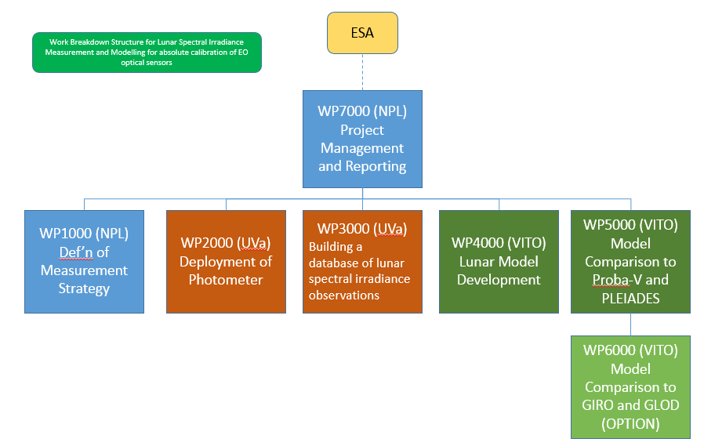
Project team

Slide 43
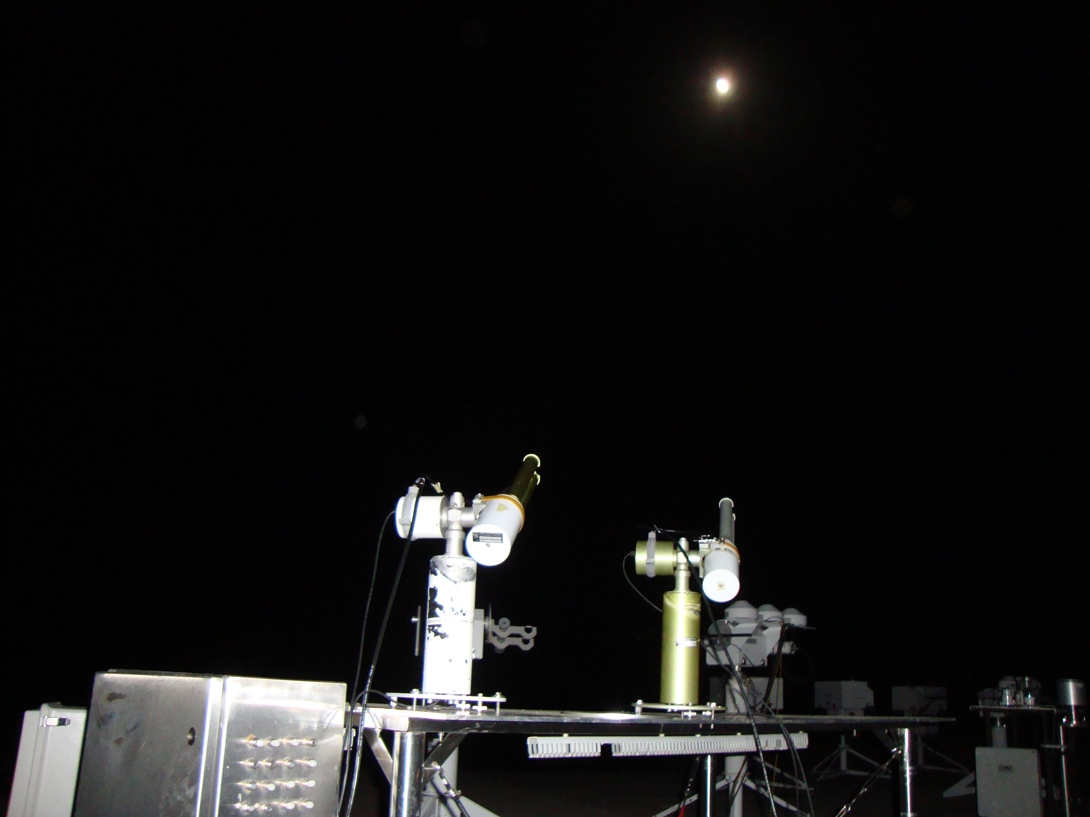
WP 1000: Instrument specification, characterisation, calibration and uncertainty budget
Instrument selected is the Sun-Sky-Lunar photometer CE318 from CIMEL:
Spectral channels: 340, 380, 44, 500, 670 870, 936, 1020, 1640 nm
Double filter wheel for polarimetric measurements
Modification of firmware for polarimetric capabilities in direct lunar observation configuration
Notes:
Wp finalised waiting for report.
Rapport available at the end.

Slide 44
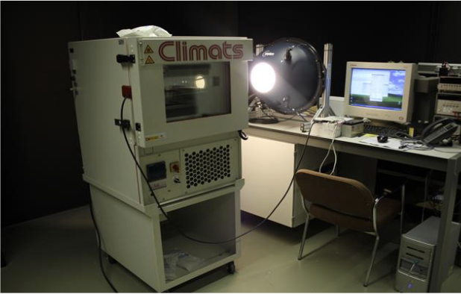
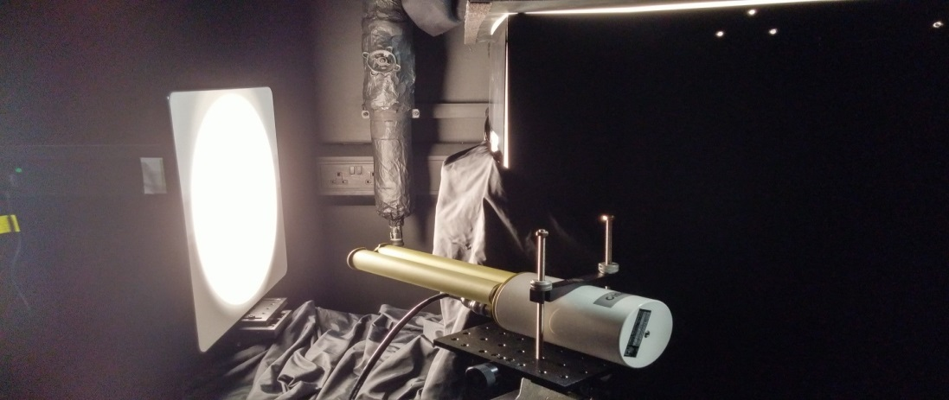
WP 1000: Instrument specification, characterisation, calibration and uncertainty budget
Temperature characterization (UVa)
Irradiance responsivity (NPL)
Linearity of the instrument (NPL)
Effective Wavelength of the instrument (NPL)
Polarisation (NPL)
Final tests at Izana Observatory
Notes:
Test at izana just done.

Slide 45





WP 2000: Deployment
Notes:
Wp 2000 start now. Monday 19 march.

Slide 46
WP 2000: Deployment
Measurement principle
Langley plots for AOD and TOA lunar irradiance measurements
Might require iterative use of lunar irradiance model
Notes:
Might require iterative use of lunar irradiance model
→ Tu suis la lune pendant la nuit

Slide 47

WP 2000: Deployment

Slide 48

WP 2000: Deployment
Additional instrument (already previously) deployed will include:
Standard lunar photometer CIMEL (no polarimeteric capabilities)
ASD spectrometer
Pandora-2S
Notes:
ASD / Pandora-2S : Utilise pour l hyperspectral.
New vs previous = capacity polarimetric

Slide 49
WP 3000: Building a database of quality controled measurements
Develop an automated processing scheme for the derivation of lunar spectral irradiance measurements
Archive the raw data
Process the raw data into lunar spectral irradiance measurements
Build a database of lunar spectral irradiance measurements

Slide 50

WP 3000: Building a database of quality controlled measurements
Notes:
Part of aeronet
Ils ont l habitude de faire du qc et controle de donnees

Slide 51
WP 4000: Lunar spectral irradiance model development
Define a strategy to derive the model regression coefficients (ROLO based) from the lunar measurements
Derive regression coefficients from database of measurements
Measurements uncertainty propagation in to the model parameters / regression coefficients

Slide 52
WP 5000/6000: Comparison of the lunar spectral irradiance model to space borne observation and other models
Lunar observations:
  Proba-V (ESA mission operated by VITO)
  PLEIADES (through an agreement with CNES)
  GLOD: access requested via EUMETSAT
Other lunar model(s):
  GIRO: access requested via EUMETSAT
Notes:
On contribue a glod.
Name of the model to come.
Giro used for intercomparison.

Slide 53
Thank you for you attention

Slide 54
Principles for a 3D Radiative Transfer Model to support Cal/Val activities

Slide 55
Background
Current situation: many RTM for EO applications, but
  Fragmented user & developer communities (Atmosphere, Water, Lands, Snow+Ice)
    ➙ Difficult to simulate realistic scenes as observed from space accounting for ground observations
  Lack of community-based development efforts due to
    Insufficient user base (narrow target, community fragmentation)
    Insufficient contribution potential (closed/complex code base, no contribution mechanism)
Discussions @ JRC (Jan 2017): need for a single RTM for all communities
  Most appropriate identified method: 3D Monte Carlo ray tracing (MCRT)
  Should feature:
    Account for multiple radiative processes (reflection, emission, polarization, …)
    Multi-scale to model both satellite & ground radiometric measurements
    Availability of spectral databases and standard scenes to support Cal/Val activities
Notes:
Difficult to simulate realistic scenes: impossible to have atmosphere + land + water surfaces + etc. with complex geometry + detailed spectral model + polarization + etc.
Lack of community-based effort: the EO community has not yet started to build a unified tool for radiation transfer simulation. Each team or small consortium has their own thing, there is no reference community code (as opposed to the CFD community, which has OpenFOAM and many other well-engineered pieces of software)
Narrow target + community fragmentation: communities are small so they have trouble allocating sufficient resources for that
Insufficient contribution potential: even when code is open source (and it often isn’t), contributing is difficult because the code is not designed for it: potential contributors are discouraged

Slide 56







Current and future actions
Development phases
  User requirement definition & analysis ☚ we are here
  Kickstart development
    Implement fundamental feature set
    Set ground for collaborative development
  Community-based development
Current actions [MetEOC-3 project]
  User requirement assessment [Spring 2018]
  ➙ User Requirement Workshop @ JRC [Ispra, 23-24th April 2018]
  Guidelines for implementation [Fall 2018]
Beta release with partial functionality planned for early 2020
Setup standard protocols for validation (e.g., RAMI, I3RC, …)
Notes:
Kickstart development: no community contribution expected
Community-based development: community contributions are expected for the project to grow and mature

Slide 57
Applications & Benefits
Generation of reference data for
  Calibration (e.g., RadCalNet)
  Geophysical product validation vs synthetic data sets (e.g., QA4ECV, MetEOC-2)
Sensitivity analysis, e.g.
  Cloud-aerosol interactions over different type of terrains
  Effects of canopy 3D structure on reflectance seasonality
Preparation of space missions requiring realistic simulation of observations
Optimization of in situ observation sampling strategy and upscaling
Radiative transfer research and teaching (virtual laboratory)

Slide 58

Notes:
Voici une illustration. Il s’agit d’une comparaison entre données simulées (SIM) et observations MERIS (OBS) sur Libya-4. Les simulations (voir article ci-joint pour le détail des simulations) sont effectuées avec 3 modèles 1D différents, dont l’input est rigoureusement le même à l’exception des absorptions gazeuses qui diffèrent d’un modèle à l’autre.
- SIXS-V inclut en plus la polarisation, liquation du transfer est résolue avec la méthode des Successive Order. Le couplage surface-atmosphere et diffusion-absorption gazeuse sont paramètres;
- LibRadtran résout l’equation du transfer avec DISORD sans polarisation;
- RTMOM résout l’equation du transfer avec les Matrix Operator (bon couplage surface-atmosphere) sans polarisation;
Comme tu peux le voir, le désaccord entre les modèles est assez important. Pour pouvoir vérifier l’étalonnage de S2/MSI avec une précision inférieure à 3%, il faut donc un modèle qui soit capable d’atteindre cette précision.

Slide 59


simulations on Libya4 with 3 RTM vs S2A.
Notes:
Voici les résultats de comparaison entre nos simulations sur Libya4 avec 3 modèles différents de transfer comparés aux acqusition S2A_MSI.
J’ai produit une figure pour SZA [0,30] et une pour SZA [30,70].
Pour descendre avec une précision inférieure à 3%, il est nécessaire de faire un travail d’améliorations sur les modèles de transfert.
De même, pour comparer des instruments avec des temps d’acquisition différent, ie, différents angles SZA, ou différents angles de vue, il est également nécessaire de mettre les modèles d’accord.
Finalement, on observe un grande variabilité spectrale des différence, résultant principalement du traitement du couplage entre absorption gazeuse et diffusion.

Slide 60

Fundamentals [extra slide]
Notes:
Extra slide (but contains interesting details in case people would like to learn a bit more)
MCRT: Monte Carlo ray tracing. Allows realistic simulation of physical processes and radiometric measurements, with good efficiency. Arbitrary complex 3D geometry and media (e.g. complete forest patch, realistic dunes, heterogeneous clouds, water surfaces, urban canopies) can be supported with a sufficient amount of modeling and work. Additional radiative processes (e.g., spectral correlation, polarization, etc.) can be taken into account.
Wide application range: See previous point. Realistic detectors can be simulated (advanced topic), but also unmeasurable quantities such as BRDF. Any scene can be modeled with the appropriate geometrical description and interaction model (e.g., reflectance or phase function).
Contribution mechanism: A key point of the development is that it should be easy to add contributed data (e.g. scenes, spectra, reflectances, phase functions) and rather easy to extend the code (e.g. add new interaction model or integration method). Detailed contribution guidelines will also be edited to encourage contribution.
Rigorous development practices: If we want the code to be testable, maintainable and improvable, we need rigorous development practices. Hence the 3-phase development model, with the highly critical phase 1 (requirement assessment and analysis).

