Slide 1

CARD4L Product Alignment Assessment
Committee on Earth Observation Satellites
Steven Hosford, Andreia Siqueira,
On behalf of LSI-VC co-leads (GA, USGS, ESA)
WGCV-44
29th August 2018

Slide 2
Overview
Context/Overview of CARD4L
CARD4L Product Alignment Assessment
  Discussion on main steps
Role of WGCalVal
  Carrying out a “peer review”
  What does a peer review process entail?
  How could WGCalVal operationalise this process?
Summary/Conclusions

Slide 3
CARD4L context
LSI-VC served as the forum for developing the CEOS Analysis-Ready Data definition (now known as CARD4L – CEOS Analysis-Ready Data for Land)
The CARD4L definition and the overall framework were endorsed by the CEOS Plenary in 2016
Implementation of CARD4L necessitates a strong contribution from WGCalVal with
  support to LSI-VC/CARD4L on Product Family Specifications definitions
  assistance in completing CARD4L Product Alignment Assessments

Slide 4
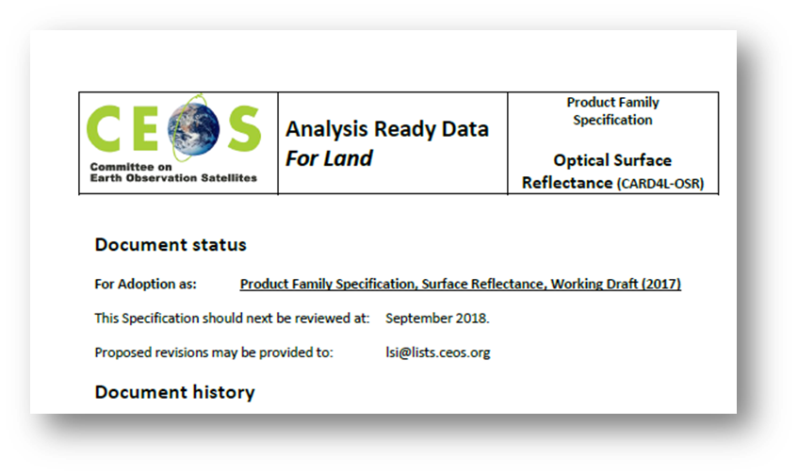
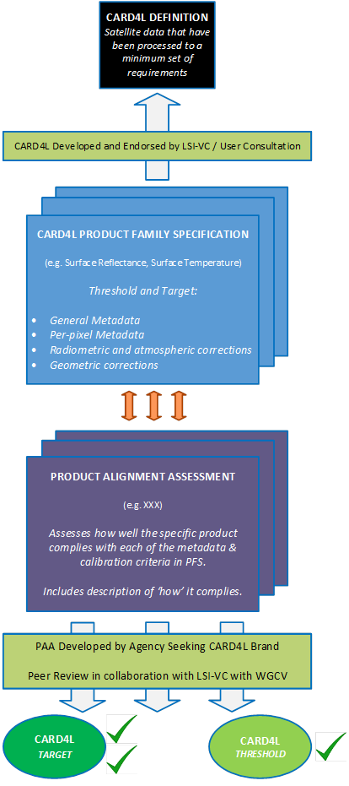
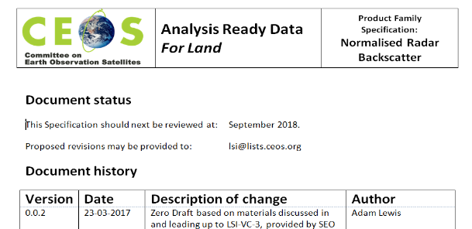
CARD4L Framework
Definition of
CARD4L
Current (Surface Reflectance, Land Surface Temperature and Radar Backscatter)
Under development (Polarimetric covariance, Polarimetric decomposition, INSAR LOS, INSAR Coherence, Geocoded SLC)
Product
Family
Specs

Slide 5
PFS Document content
PFS Description (ST, SR, Backscatter)
Definitions / Terminology
Requirements
  General Metadata – lineage, coverage “what is it and where did it come from?”
  Per-pixel Metadata – “is this observation (pixel) suitable to use?”
  What is this pixel? (e.g. Radiometric and atmospheric corrections – “a measurement of the land surface”)
  Where is this pixel? (Geometric corrections – “accurately located on the land surface”)
Each PFS document has a guidance section:
  Discussion on the difference between ‘threshold’ and ‘target’ levels of processing
  References to example processes that could be used to produce analysis ready data
  Specific examples of data and processing that produces CARD4L

Slide 6
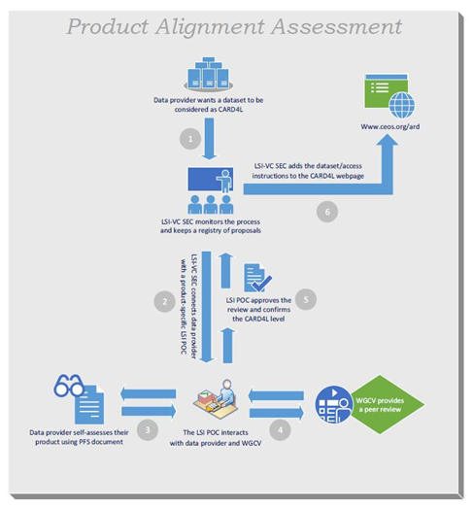
CARD4L Framework
Definition of
CARD4L
Current (Surface Reflectance, Land Surface Temperature and Radar Backscatter)
Under development (Polarimetric covariance, Polarimetric decomposition, INSAR LOS, INSAR Coherence, Geocoded SLC)
Product
Family
Specs
Product
Alignment
Assessment

Slide 7
CARD4L Framework

Slide 8
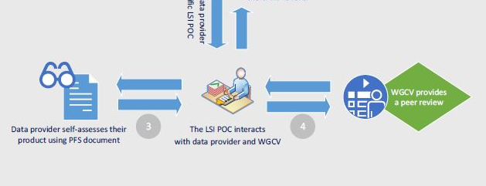
CARD4L Product Alignment Assessment
PAA burden is borne by LSI-VC
LSI-VC POC identified for each Product Family Specification
PFS POC interacts with Data Provider and WGCalVal to
  Verify Data Provider’s Product Self-Assessment
  Obtain the feedback of WGCalVal on the Product’s Cal/Val process

Slide 9
WGCalVal CARD4L PAA role
Confirmation of WGCalVal’s role in CARD4L PAA
Question: Is WGCalVal ready to provide a “peer review” of a candidate CARD4L product’s CalVal process?
Q1. What does “a peer review” entail?
Need for WGCalVal to define what the right level of detail is in such a review – a large range would be possible
LSI-VC anticipated this “peer review” as ensuring that
  a recognised CalVal process was being employed
  CalVal “good practice” was being applied
  However, this needs to be specified.

Slide 10
WGCalVal CARD4L PAA role
Q2. How would WGCalVal operationalise this peer review?
  Identify a POC for candidate products from each Product Family?
  POC associated with current WGCalVal subgroups?
Q3. Other questions?

Slide 11
Summary/Conclusions
LSI-VC is soliciting WGCalVal to assist in completing CARD4L Product Alignment Assessments
WGCalVal should
  Confirm their willingness to contribute
  Establish what this contribution is
  Describe how their interaction with the PAA process will function
  Identify any necessary POCs
  Feasible to have a 2-pager covering these bullets by end sept?
WGCalVal should continue to support LSI-VC/CARD4L on Product Family Specifications to ensure improved product interoperability (e.g. detailing product uncertainties)

